Slide 1
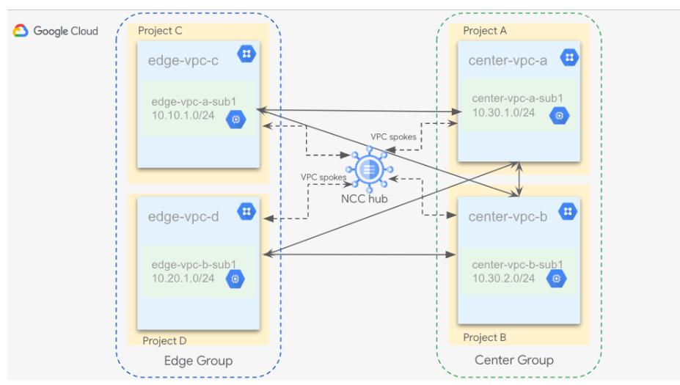
Star topology
Star topology is only supported with VPC spokes.
When you use star topology for connectivity, the edge spokes and their associated subnets reach only the designated center spokes, while the center spokes can reach all other spokes.
This helps ensure segmentation and connectivity separation across edge VPC networks..

Slide 2
When to Choose Star
Workloads running in different VPC networks that don't require connectivity with each other but do require access only to the VPC networks through the central shared services VPC network.
Security control over communication across multiple VPC networks that requires the traffic to pass through a set of centralized network virtual appliances (NVAs).
A center group of spokes, which communicate with every other spoke connected to the hub
An edge group of spokes, which communicate only with spokes that belong to the center group
A VPC spoke can belong to only one group at a time. Groups are automatically created when you create a hub.

Slide 3
Limitations
VPC networks can connect with each other in an exclusive manner through either the Network Connectivity Center hub or through VPC Network Peering.
VPCs connected together by using Network Connectivity Center and VPC Network Peering in any combination are not transitive.
Static routes exchange across VPC spokes isn't supported.
Overlapping subnets must be masked by exclude export filters.
IPv6 dynamic route exchange isn't supported.
Auto mode VPC networks are not supported as VPC spokes.
Star topology connectivity doesn't support hybrid spokes or dynamic route exchange.

