Slide 1
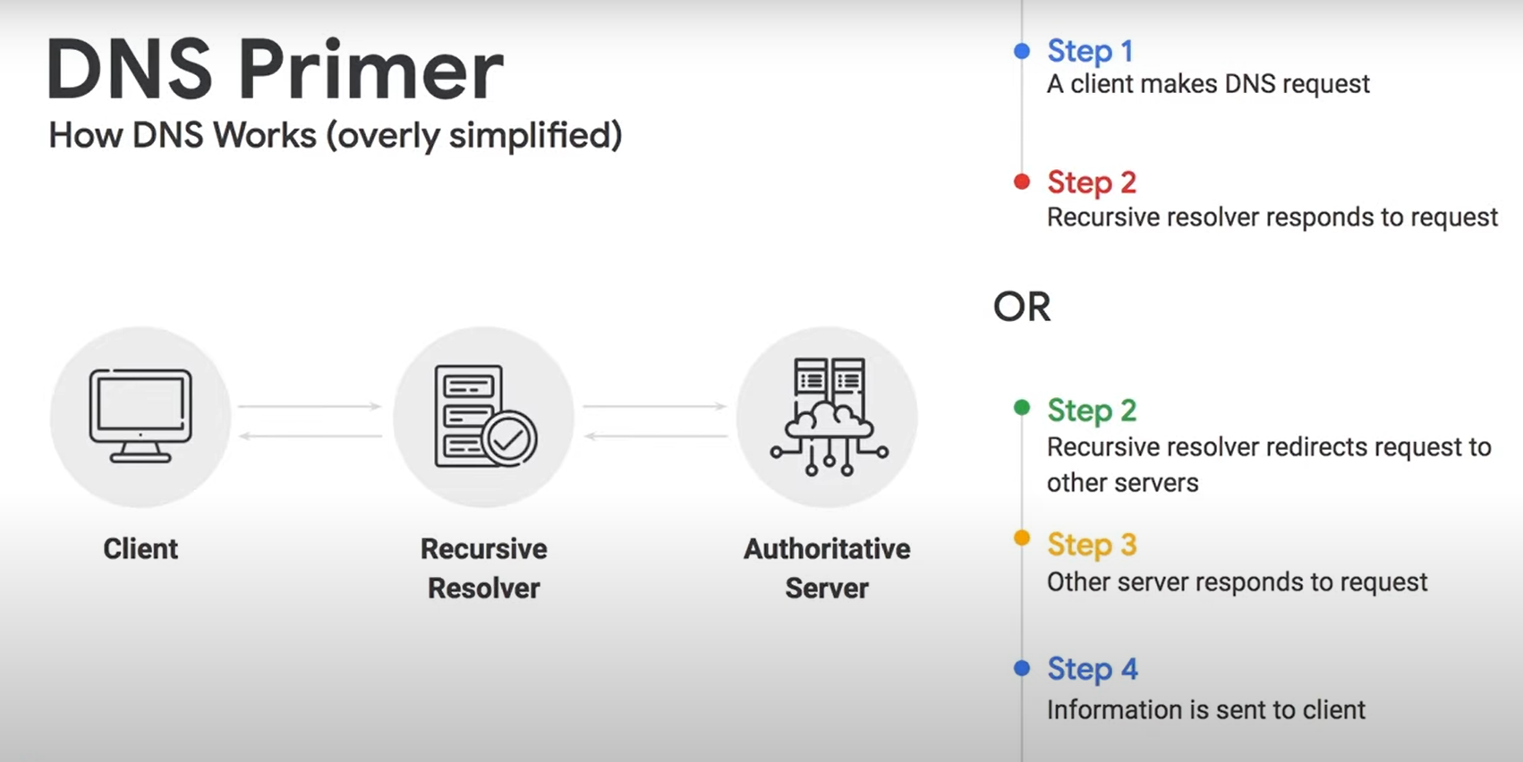
Cloud DNS
Cloud DNS is a high-performance, resilient, global Domain Name System (DNS) service that publishes your domain names to the global DNS.
Cloud DNS lets you publish your zones and records in DNS without the burden of managing your own DNS servers and software.
Cloud DNS offers both public zones and private managed DNS zones. A public zone is visible to the public internet, while a private zone is visible only from one or more Virtual Private Cloud (VPC) networks that you specify.

Slide 2
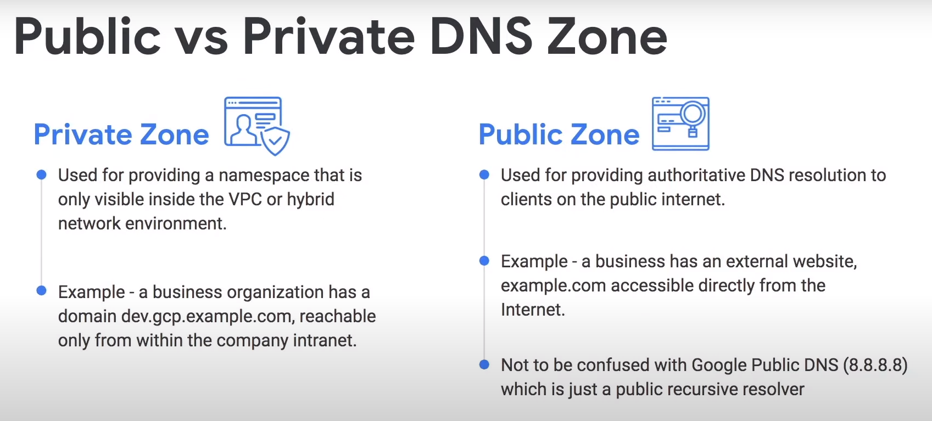

Slide 3
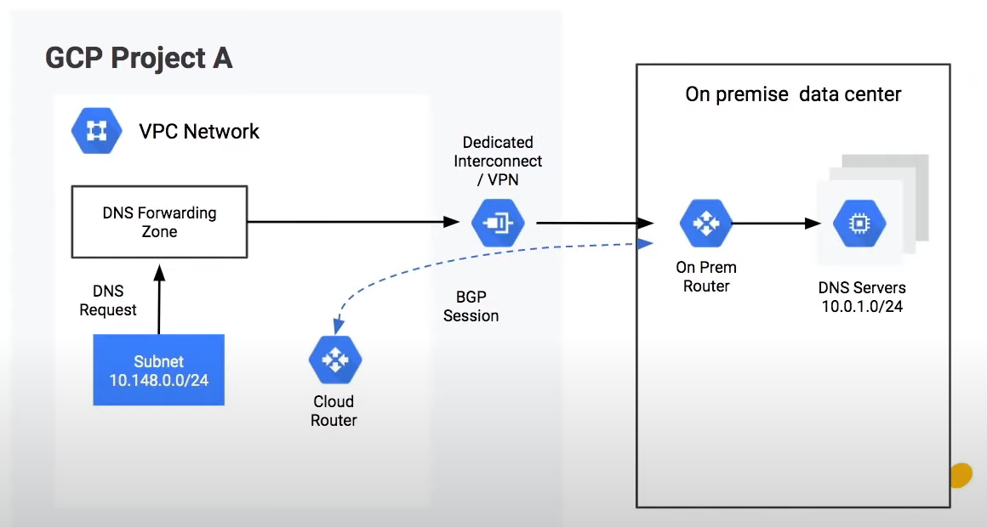
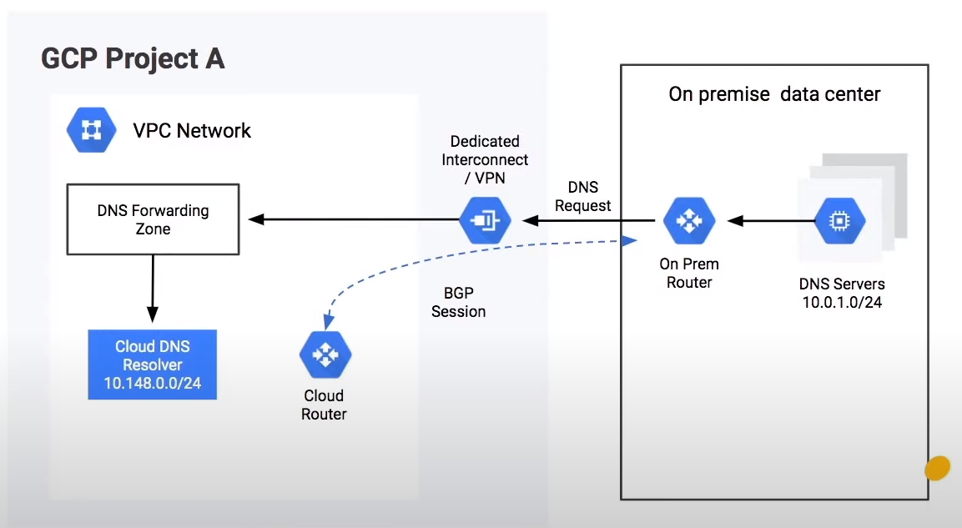
DNS Forwarding
It is the process by which a particular set of DNS queries are handled by a designated server, rather than being handled by the initial server contacted by the client.
Outbound Zone – From GCP to on-prem
Inbound Policy – From on-prem to GCP
Outbound Zone
Inbound Policy

Slide 4
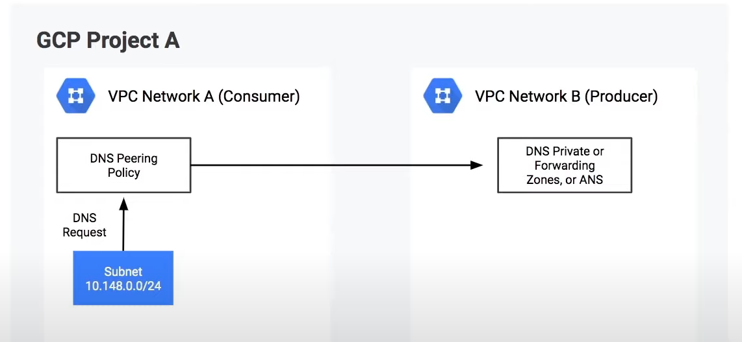
DNS Peering
DNS Peering allows DNS queries to be sent to another VPC for resolution.
To provide DNS peering, you must create a Cloud DNS peering zone and configure it to perform DNS lookups in a VPC network where the records for that zone's namespace are available.
Once the DNS request is received, a final resolution is done via a private zone, forwarding zone, or Alternate Name Server attached to the targeted network.
DNS peering is a one-way relationship.
DNS peering and VPC network Peering are different services. DNS peering can be used with VPC Network Peering, but VPC Network Peering is not required for DNS peering.

Slide 5
