Slide 1
Producer VPC spokes (Preview)
If you have a VPC network that consumes a service from a producer network in another project through VPC Network Peering, you can use a Network Connectivity Center producer VPC spoke to make the service reachable by other networks.
When you create a producer VPC spoke, you provide the following:
The existing VPC spoke of your consumer network that is peered with the producer network.
The name of the peering connection.
Then, Network Connectivity Center uses that information to identify the VPC network of the service producer and add a corresponding producer VPC spoke to a hub in your project.
After the producer VPC spoke is part of the hub, its subnet routes are exported and the other spokes on that hub can access its services.
Google services that rely on dynamic routes are not supported because producer VPC spokes export only subnet routes.

Slide 2
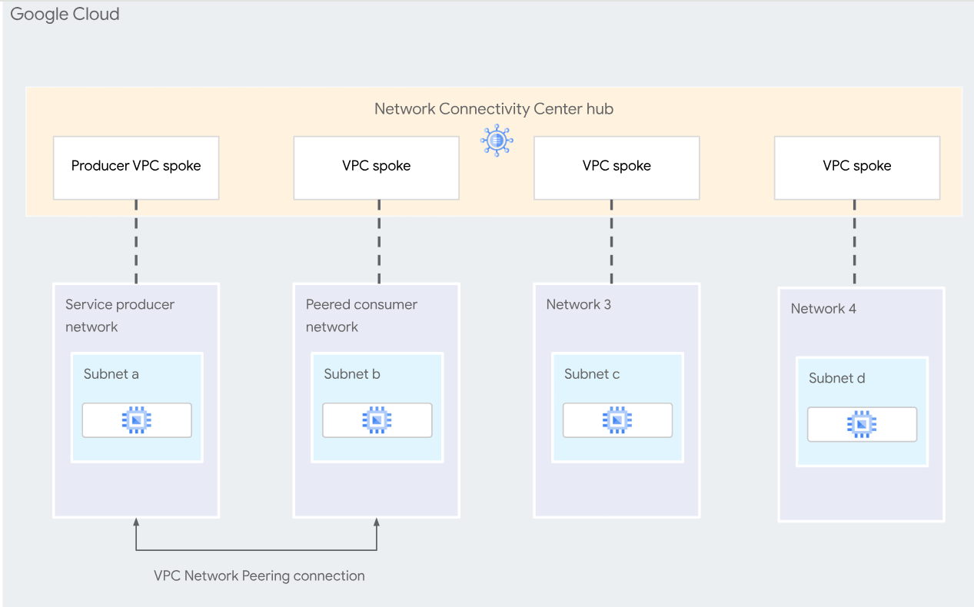
Example

Slide 3
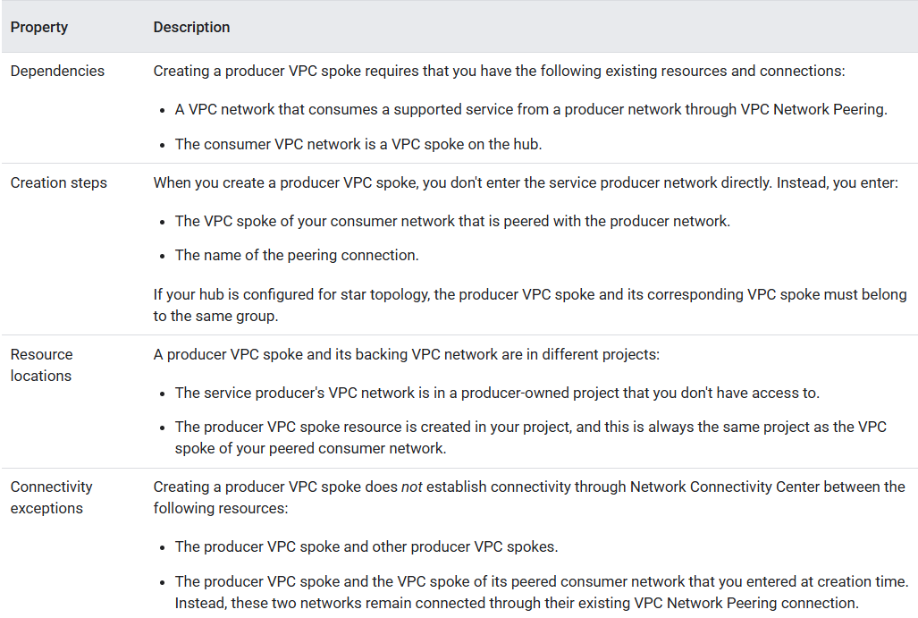
Properties unique to producer VPC spokes

Slide 4
Avoid overlap with allocated IP ranges
Network Connectivity Center does not check for overlaps with allocated IP ranges. Ensure that the IP address ranges of the VPC spokes on your hub don't overlap with an allocated IP range configured for private services access. When you create a producer VPC spoke, you provide the following:
If your VPC spokes overlap with allocated IP ranges, private services access might not be able to create new resources when needed and you'll get an error. To resolve this, expand or modify the allocated IP range.

