Slide 1
Privileged Access Manager (PAM)
You can use Privileged Access Manager (PAM) to control just-in-time temporary privilege elevation for select principals.
To allow temporary elevation, you create an entitlement in PAM.
A set of principals who are allowed to request a grant against the entitlement.
Whether a justification is required for that grant.
A set of roles to temporarily grant. IAM conditions can be set on the roles.
The maximum duration a grant can last.
Optional: Whether requests need approval from a select set of principals, and whether those principals need to justify their approval.
Optional: Additional stakeholders to be notified about important events, such as grants and pending approvals.

Slide 2
Entitlements in PAM
Entitlements can be created at the organization, folder, or project level. Roles granted by an entitlement at each level follow the Google Cloud resource hierarchy.
If you add a group as a requester to an entitlement, all individual accounts in that group can request a grant of that entitlement. However, only the individual account requesting the grant can receive elevated privileges.
If you add a group as an approver to an entitlement, all individual accounts in that group can approve or deny a grant request.
Basic roles aren't supported.
All principal types are supported except allUsers and allAuthenticatedUsers.

Slide 3
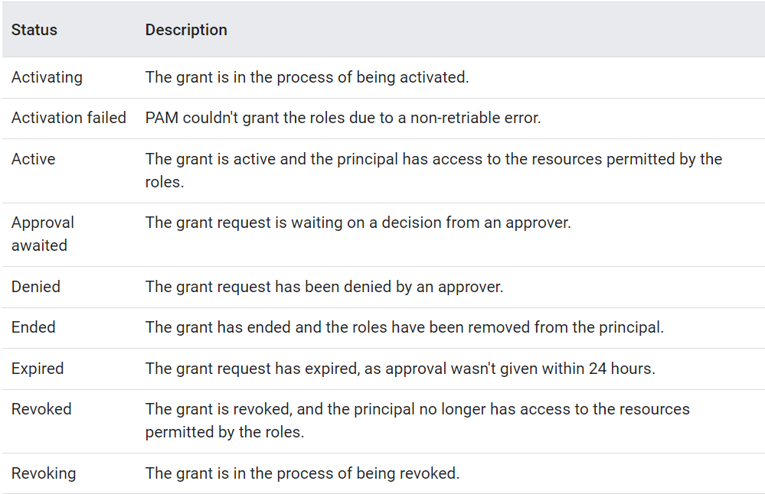
Grant Status

Slide 4
PAM permissions and setup
Principals requesting grants and approving or denying the grants don't require any PAM-specific permissions.
To create, update, and delete entitlements: Privileged Access Manager Admin (roles/privilegedaccessmanager.admin). Additionally, either Folder IAM Admin (roles/resourcemanager.folderIamAdmin), Project IAM Admin (roles/resourcemanager.projectIamAdmin), or Security Admin (roles/iam.securityAdmin)
To view entitlements and grants: Privileged Access Manager Viewer (roles/privilegedaccessmanager.viewer

