Slide 1
VPC Service Controls
VPC Service Controls helps protect against accidental or targeted action by external entities or insider entities, which helps to minimize unwarranted data exfiltration risks from Google Cloud services such as Cloud Storage and BigQuery.
You can use VPC Service Controls to create perimeters that protect the resources and data of services that you explicitly specify.
VPC Service Controls provides an extra layer of security defense for Google Cloud services that is independent of Identity and Access Management (IAM).
To protect your highly sensitive data, you might want to ensure that your resources can only be accessed from trusted networks.
To mitigate data exfiltration risks, your organization might also want to ensure secure data exchange across organizational boundaries with fine-grained controls.

Slide 2
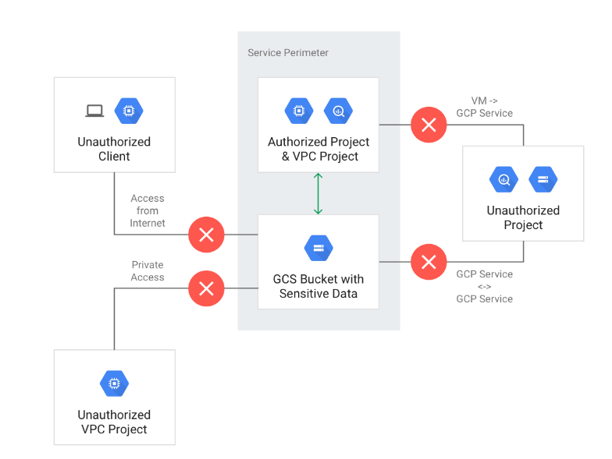
Security benefits of VPC Service Controls
VPC Service Controls helps mitigate the following security risks without sacrificing the performance advantages of direct private access to Google Cloud resources:
Access from unauthorized networks using stolen credentials
Data exfiltration by malicious insiders or compromised code
Public exposure of private data caused by misconfigured IAM policies
Monitoring access to services

Slide 3
Service perimeter
To protect Google Cloud services in your projects and mitigate the risk of data exfiltration, you can specify service perimeters at the project or VPC network level.
Also, the services that are accessible inside a perimeter, such as from VMs in a VPC network that is hosted inside a perimeter, can be restricted using the VPC accessible services feature.
You can configure VPC Service Controls perimeters in enforced or dry run mode. The same configuration steps apply to both enforced and dry run perimeters. The difference is that dry run perimeters log violations as though the perimeters are enforced but don't prevent access to restricted services.

Slide 4
Enforced mode
Enforced mode is the default mode for service perimeters. When a service perimeter is enforced, requests that violate the perimeter policy, such as requests to restricted services from outside a perimeter, are denied.
A perimeter in enforced mode protects Google Cloud resources by enforcing the perimeter boundary for the services restricted in the perimeter configuration. API requests to restricted services do not cross the perimeter boundary unless the conditions of the necessary ingress and egress rules of the perimeter are satisfied.
An enforced perimeter protects against data exfiltration risks, such as stolen credentials, misconfigured permissions, or malicious insiders that have access to the projects.

Slide 5
Dry run mode
In dry run mode, requests that violate the perimeter policy are not denied but only logged. Dry run service perimeters are used to test perimeter configuration and to monitor usage of services without preventing access to resources.
Determining the impact when you change existing service perimeters.
Previewing the impact when you add new service perimeters.
Monitoring requests to restricted services that originate from outside a service perimeter. For example, to identify from where requests to a given service are coming from or to identify unexpected service usage in your organization.
Creating a perimeter architecture in your development environment that is analogous to your production environment. You can identify and mitigate any issues caused by your service perimeters before submitting changes to your production environment.

