Slide 1
Scoped Policies
Scoped policies are access policies that are scoped to specific folders or projects alongside an access policy that you can apply to the entire organization.
We can use scoped policies to delegate administration of VPC Service Controls perimeters and access levels to folder-level and project-level administrators.
Organizations can only have one access policy at the organizational level, and you can apply the organizational-level access policy to any folder or project in your organization.
Warning: If an organization-level access policy doesn't exist for your organization, scoped policies that you create at the folder or project-level will not operate.

Slide 2
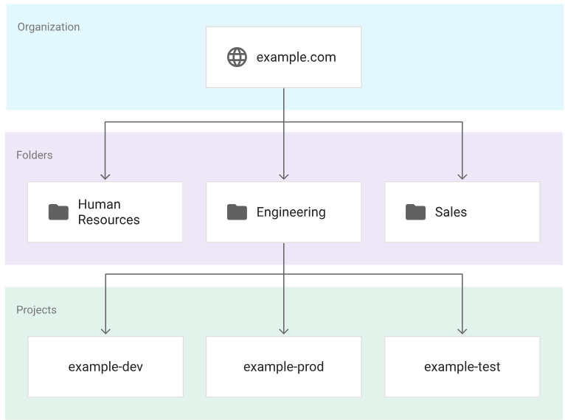
Scoped Policies hierarchy
Service perimeters in a scoped policy can only restrict resources that exist in the scope of that policy.
Access levels in a scoped policy are only visible within the scope of the policy. If you create an access level in the policy scoped to the engineering folder, then only service perimeters and access levels in the engineering folder can use it.
A policy can contain only one scope, such as a folder, but you can create a policy for each level of an organization.
A project can be a member of only one service perimeter across all policies.

