Slide 1
Private Service Connect connection propagation (Preview)
With propagated connections, services that are accessible in one consumer VPC spoke through Private Service Connect endpoints can be privately accessed by other consumer VPC spokes that are connected to the same Network Connectivity Center hub.
You can use a common services VPC network to simplify the deployment of Private Service Connect endpoints.
You can manage which services are accessible to individual VPC spokes through the Network Connectivity Center hub.
Propagated connections are managed by Network Connectivity Center. You can't directly manage propagated connections by using Private Service Connect.

Slide 2
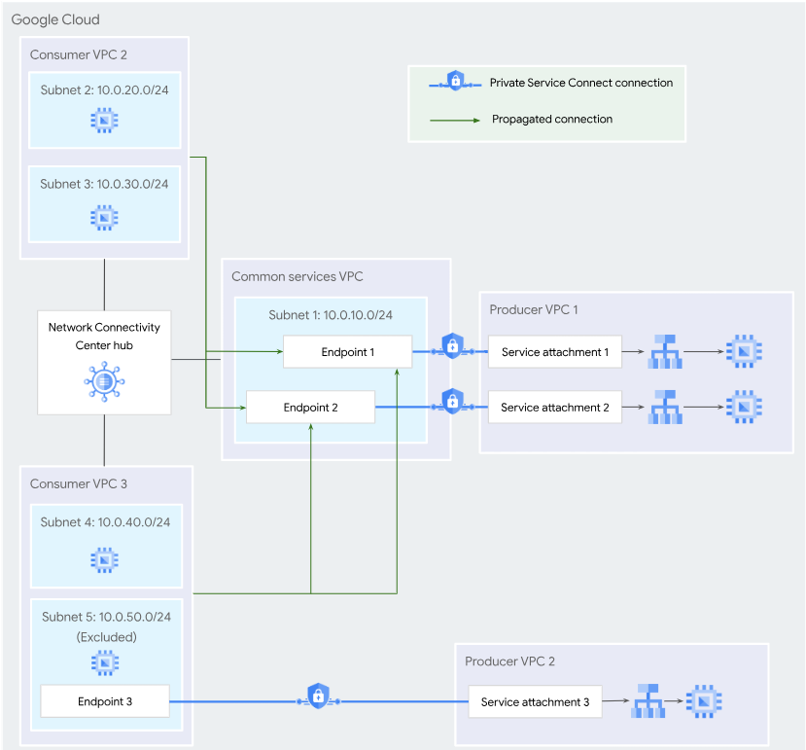
Example

Slide 3
Triggering connection propagation
When a hub administrator enables connection propagation for a hub, Network Connectivity Center creates propagated connections for existing endpoints in the VPC spokes that are connected to the hub.
When a hub administrator adds a VPC spoke to a hub that has connection propagation enabled, Network Connectivity Center creates propagated connections in the new spoke for existing endpoints in other VPC spokes that are connected to the same Network Connectivity Center hub. If the new spoke has existing endpoints, propagated connections are created for those endpoints in each connected spoke.
When a consumer service administrator creates an endpoint in a VPC spoke that is attached to a Network Connectivity Center hub with connection propagation enabled, Network Connectivity Center creates propagated connections for that endpoint in other connected VPC spokes.

Slide 4
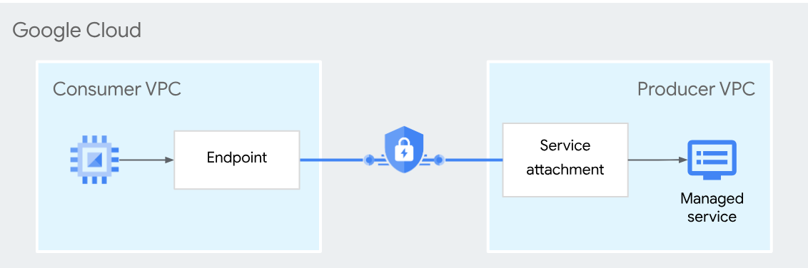
Private Service Connect

