Slide 1
ACL&RBAC

Slide 2
Access Control List (ACL)
An ACL is a list of permissions attached to an object (like a file, database row, S3 bucket, or API). It specifies which users or system processes can access the object and what operations they can perform.
Structure: Object → List of (User/Group + Permission).
Granularity: Very fine-grained (per resource, per user).
Use Cases: File systems, network firewalls, cloud object storage (e.g., AWS S3 bucket ACLs).
EX
ACL:
Alice → Read, Write
Bob → Read only
Guest → No Access

Slide 3
Role-Based Access Control (RBAC)
RBAC assigns permissions to roles, and users are assigned to those roles. Instead of directly giving permissions to users, you group them into roles (like Admin, Analyst, Developer).
Structure: User → Role → Permission.
Granularity: Coarser (role-level, not per object).
Use Cases: Databases, applications, Kubernetes, AWS IAM, Azure AD.
Example:
Roles:
Admin → Read, Write, Delete
Analyst → Read
Assignments:
Alice → Admin
Bob → Analyst

Slide 4
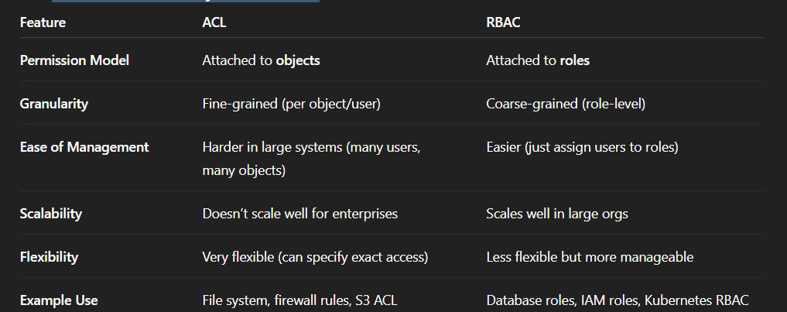
ACL vs RBAC – Key Differences

Slide 5
ACL → “Who can access this object and how?”
RBAC → “What role does this user have, and what can that role do?”

