Slide 1
DAY 2 · MASTER PRESENTATION
Functions, College OOP Architecture, Error Resilience & Git
Building Reusable Functions, Simulating KIT College with Advanced OOP (USN, MRO, Polymorphism, Abstraction) & Version Control
Welcome to Day 2! Here is What You and I Will Master Today:
• Section 3: Functions as reusable machines, *args/**kwargs, execution time decorators, and lambdas.
• Section 4: Advanced OOP simulated around KIT College: USN standard, Abstraction (ABC), Encapsulation (@property), and Name Mangling.
• Section 4: 5 Types of Inheritance, MRO (C3 Linearization), Campus Hierarchy (Management, Support, Faculty), Polymorphism & Operator Overloading.
• Section 4 & 6: Defensive Error Handling (try/except/else/finally), leak-proof file streams, and Git/GitHub collaboration.
• Interactive Lab: 4 comprehensive Day-2 Jupyter Notebooks (.ipynb) with live runnable code!
Python for AI Developers · Day 2: Functions, KIT College OOP, Errors & Git
Slide 1 of 30
Notes:
Welcome to Day 2! Today we take your programming skills to production grade. We cover functions, complete Object-Oriented design modeled around our own KIT College campus using USN numbers, Method Resolution Order, Polymorphism, and crash-proof error handling.

Slide 2
DAY 2 FLIGHT PLAN
The 4 Power Pillars of Today's Journey
From writing modular functions to simulating our college campus and sharing code on GitHub
PILLAR 1
Modular Functions
• Anatomy: Inputs, body, return
• Dynamic *args & **kwargs
• Stopwatch @decorators
• Fast anonymous lambdas
• Built-in Python modules
PILLAR 2
KIT College OOP
• Class (blueprint) vs Object (heap)
• Abstraction with abc.ABC
• Encapsulation & private __cgpa
• @property getter & setter
• USN collegiate standard
PILLAR 3
Advanced OOP & MRO
• 5 Types of Inheritance
• MRO & C3 Linearization
• Management & Support staff
• Dynamic Polymorphism
• Operator Overloading (+, >, ==)
PILLAR 4
Errors & Git Highway
• 4-stage try/except/else/finally
• Safe with open() file streams
• Reading & writing CSV rosters
• Git 4 zones: Add, Commit, Push
• AI .gitignore & Pull Requests
Python for AI Developers · Day 2: Functions, KIT College OOP, Errors & Git
Slide 2 of 30
Notes:
Outline today's roadmap: we start with functions, dive deep into campus OOP with real KIT roles, tackle exceptions and file persistence, and finish with Git collaboration.

Slide 3
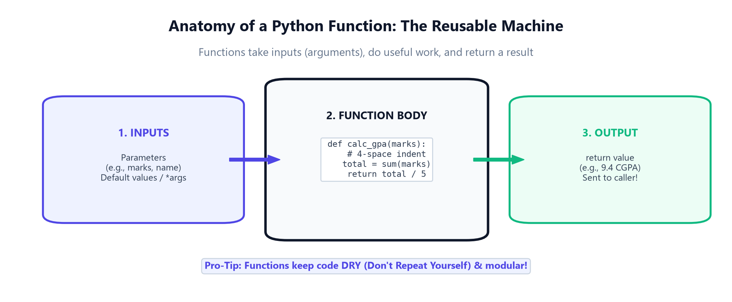
3.1A · MODULAR PYTHON
Anatomy of a Function: The Reusable Machine
Functions take inputs, perform operations, and return outputs — keeping your code DRY
Key Function Concepts:
1. def keyword: Signals to Python that you are defining a reusable function.
2. Parameters: Variables listed inside parentheses that receive values from caller.
3. Indented Body: 4 spaces define the scope of what the function executes.
4. return statement: Sends computed results back; without return, Python gives back None!
5. Docstrings: Triple quotes """ explain what your function does for team documentation.
Default Arguments Rule:
You can provide sensible default values (e.g., def calc_fee(amount, college='KIT'):). If callers don't pass the college, it automatically uses 'KIT'!
Python for AI Developers · Day 2: Functions, KIT College OOP, Errors & Git
Slide 3 of 30
Notes:
Explain that functions are the basic building blocks of all software. In AI, functions represent prompt builders, token cost calculators, and tool callbacks.

Slide 4
3.1A · ADVANCED PARAMETERS
Dynamic Arguments (*args, **kwargs) & Decorators
Handling arbitrary electives and wrapping functions with timing stopwatches
1. Positional *args
Packs into a Tuple: *args gathers extra unnamed parameters.
Variable Electives: enroll_student('Sundeep', 'AI', 'NLP', 'Robotics')
Unpacking: *my_list expands items into function arguments effortlessly.
2. Keyword **kwargs
Packs into a Dict: **kwargs gathers named keyword parameters.
Flexible Profiles: register(hostel='Block A', scholarship=50)
Forwarding: Passes unknown hyperparameters directly to underlying AI models.
3. The @ Decorator
The Campus Guard: Wraps around your function to add logging or timing.
@track_time: Starts a stopwatch before the function runs and reports milliseconds after it finishes!
@wraps: Preserves original function name and docstrings.
Python for AI Developers · Day 2: Functions, KIT College OOP, Errors & Git
Slide 4 of 30
Notes:
Demonstrate *args and **kwargs. Explain how decorators allow adding production concerns like execution timing or rate limiting without changing the function's internal logic.

Slide 5
HANDS-ON PRACTICE
Let's Open Notebook 01: Functions & Modules
Time to run campus GPA calculations, decorators, and leaderboard sorting live!
📓 Open: notebooks/day_02/01_day2_functions_and_modules.ipynb
1. Open Notebook 01 and run the calculate_gpa() semester grade function.
2. Test register_kit_student() using *electives and **extra_details with USN 1KT23AI042.
3. Run the @track_execution_time stopwatch decorator on an AI training simulation.
4. Use a 1-line lambda function to rank KIT student exam scores descending.
5. Complete the attendance eligibility challenge and verify your result!
Python for AI Developers · Day 2: Functions, KIT College OOP, Errors & Git
Slide 5 of 30
Notes:
Pause presentation and switch to Jupyter Notebook 01. Guide students through running the GPA calculator and testing their attendance checker.

Slide 6
4.3A · CORE FOUNDATIONS
What is a Class & Object? The Memory Model
Understanding the blueprint vs the living instance allocated in heap memory
1. Class vs Object
The Blueprint (Class): Code defining attributes and methods. Cost = 0 bytes in heap until instantiated.
The Instance (Object): Real entity loaded in RAM: s1 = Student('Sundeep', '1KT23AI001').
Analogy: Class is the blank KIT admission form. Object is YOU enrolled!
2. Memory Inspection
id(obj): Unique RAM address in heap (e.g. 0x0000021A5).
type(obj): Points to the blueprint class definition.
obj.__dict__: Python stores every object's instance state in a native hashmap dictionary!
3. Class vs Instance Scope
Class Attributes: institute_name = 'KIT College Institute'. Shared across all 2,000 students!
Instance Attributes: self.name and self.usn are unique to each student.
Memory Efficiency: Shared methods and class variables save megabytes of RAM.
Python for AI Developers · Day 2: Functions, KIT College OOP, Errors & Git
Slide 6 of 30
Notes:
Clarify the distinction between class and object. Show that id() gives the heap memory location and __dict__ holds the instance variables.

Slide 7
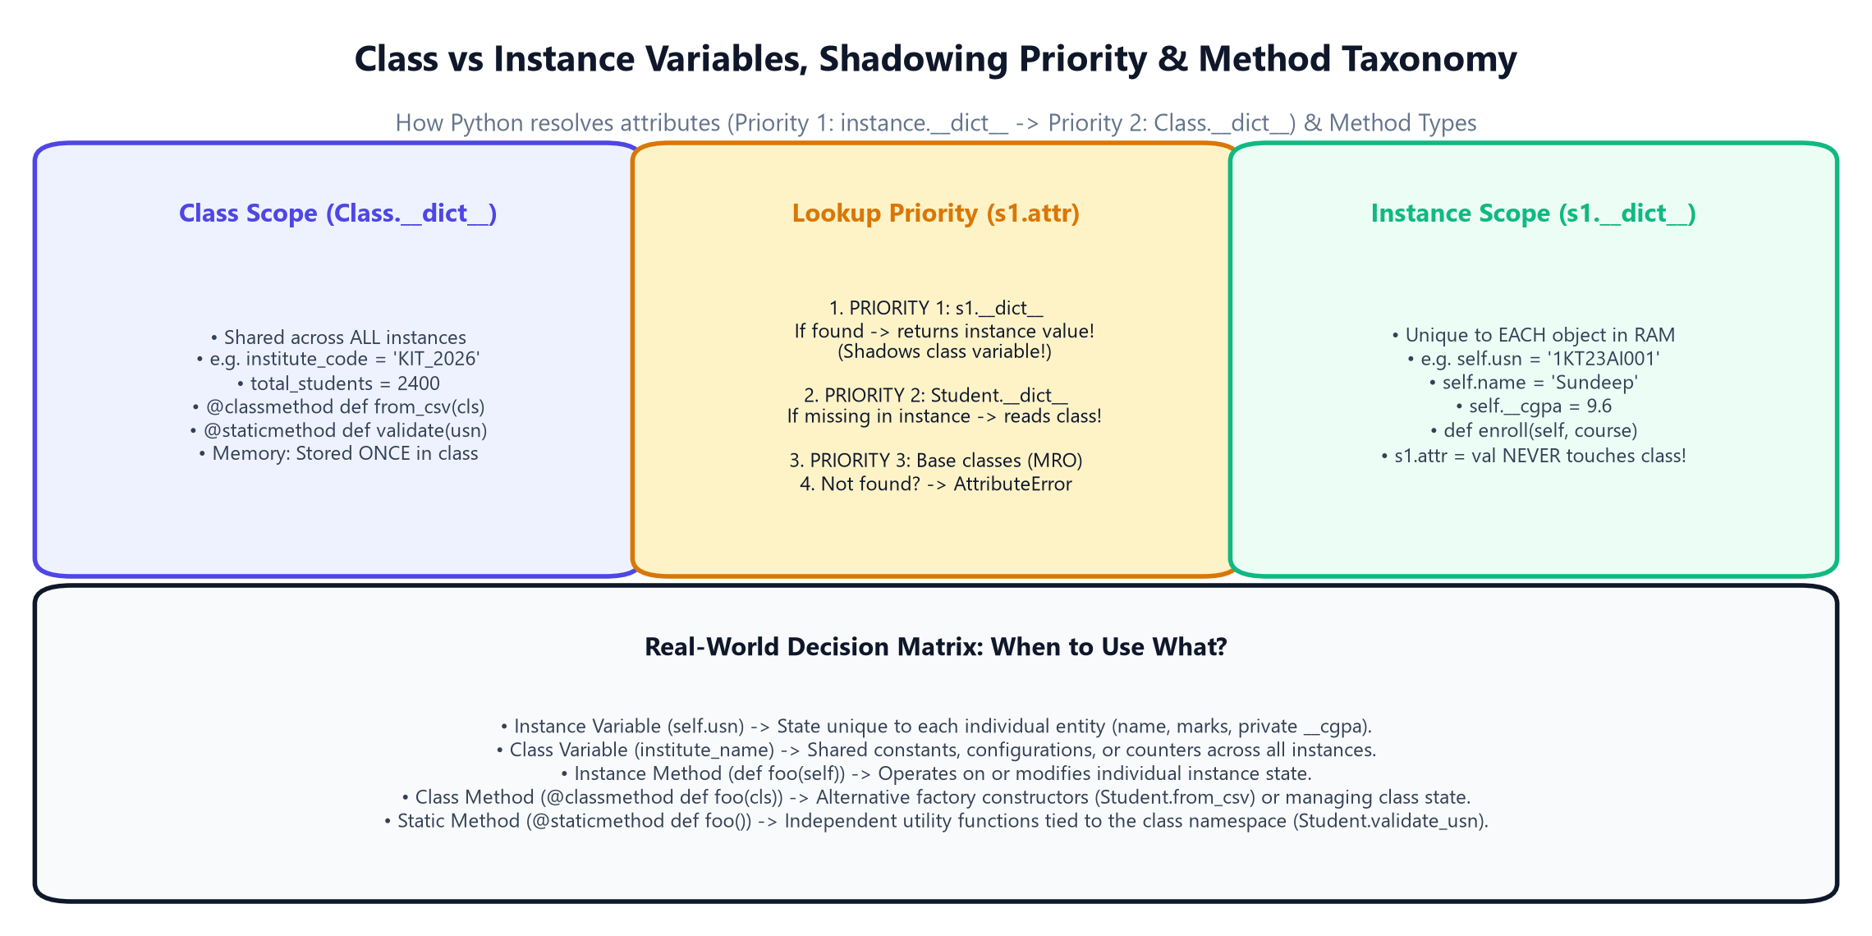
4.3A · DEEP OOP MECHANICS
Class vs Instance Scope: Lookup Priority & Methods
Understanding attribute shadowing in __dict__, the mutable trap, and self vs cls vs @staticmethod
Attribute Priority & Taxonomy:
• Priority 1 (Instance): Python checks instance.__dict__ first. If present, it returns immediately!
• Priority 2 (Class): If not in instance, Python checks Class.__dict__, then MRO parent classes.
• Shadowing Trap: s1.campus = 'North' writes to s1.__dict__. It NEVER modifies KITStudent.campus!
• Mutable Class Trap: clubs = [] at class level is shared by ALL students! Always initialize inside __init__.
• Instance Method: Takes self. Accesses unique instance state (e.g. s1.record_exam_score()).
• Class Method: Takes cls. Modifies class state or acts as factory constructor (from_csv).
• Static Method: Takes no self/cls. Pure isolated utility function (validate_usn).
IITian Rule of Thumb — Where to Use What:
If state belongs to one entity -> Instance. If state belongs to the blueprint -> Class. If logic needs no state -> Static utility.
Python for AI Developers · Day 2: Functions, KIT College OOP, Errors & Git
Slide 7 of 30
Notes:
Explain lookup priority: Python checks instance.__dict__ before Class.__dict__. Demonstrate shadowing: s1.campus = 'North' does not change the class attribute. Warn against mutable class variables like clubs = []. Then break down self vs cls vs @staticmethod with the decision matrix.

Slide 8
4.3A · ARCHITECTURAL CONTRACTS
Abstraction: Enforcing Mandatory Campus Interfaces
Using abc.ABC and @abstractmethod to guarantee that incomplete entities cannot exist
1. What is Abstraction?
Hiding Complexity: Users only see WHAT an object does, not HOW it works internally.
Campus Contract: The governing board declares: every campus member MUST have a role summary and payout formula!
Design First: Architects define blueprints before engineers build concrete subclasses.
2. abc.ABC & @abstractmethod
from abc import ABC: Inherit from ABC to mark class as an abstract base.
@abstractmethod: Decorate methods that subclasses are legally REQUIRED to implement.
Contract Enforcement: If a subclass forgets to implement an abstract method, Python blocks it!
3. Direct Instantiation Shield
Can't Instantiate Ghost: CollegeMember('Ghost') raises TypeError immediately.
Error Message: "Can't instantiate abstract class with abstract methods get_role_summary"
Bug Elimination: Eliminates half-baked objects before your app ever reaches production.
Python for AI Developers · Day 2: Functions, KIT College OOP, Errors & Git
Slide 8 of 30
Notes:
Demonstrate abstraction. Explain that CollegeMember is an abstract idea; you cannot have a generic human who is neither student, professor, nor staff.

Slide 9
4.3A · DATA PROTECTION
Encapsulation & Access Modifiers: Public, Protected & Private
How Python protects sensitive grades and why 'We are all consenting adults'
1. Public & Protected (_)
Public (self.usn): Freely accessible anywhere across campus programs.
Protected (self._conduct): Single underscore prefix. Developer convention: 'Internal use only; do not tamper!'
Subclass Friendly: Protected variables are easily inherited by child classes.
2. Private (__) & Name Mangling
Double Underscore: __cgpa and __salary trigger Name Mangling.
Accidental Block: student.__cgpa from outside raises AttributeError.
Behind the Scenes: Python renames it to _Student__cgpa in RAM to prevent accidental overrides!
3. 'Consenting Adults' Rule
Guido's Philosophy: Python does not build impenetrable C++ walls.
Trust the Developer: You CAN access student._Student__cgpa, but it violates the API contract!
Standard Practice: Use @property getters and setters for all controlled data.
Python for AI Developers · Day 2: Functions, KIT College OOP, Errors & Git
Slide 9 of 30
Notes:
Explain encapsulation. Point out name mangling: Python renames __cgpa to _Student__cgpa. Explain the famous Python quote: 'We are all consenting adults here'.

Slide 10
4.3A · PYTHONIC ATTRIBUTES
The Gatekeeper: @property Getter, Setter & Deleter
Writing clean attribute access while strictly validating grades and sensitive records
1. @property Getter
Clean Syntax: Write print(student.cgpa) without ugly parentheses .get_cgpa()!
Read-Only Shield: Omit the setter to make any attribute permanently immutable.
Computed Fields: Can compute student standing or honors status dynamically on read.
2. @cgpa.setter Guardrail
Strict Validation: if 0.0 <= new_grade <= 10.0: save it!
Crash Prevention: Raises ValueError if someone inputs negative or impossible marks (e.g. 15.0).
Enterprise Standard: Identical to how Pydantic and PyTorch validate inputs.
3. @cgpa.deleter Action
del student.cgpa: Controls what happens when an attribute deletion is attempted.
Safe Reset: Instead of deleting records, resets grade to 0.0 with a security log!
Audit Trail: Logs who triggered the deletion and when.
Python for AI Developers · Day 2: Functions, KIT College OOP, Errors & Git
Slide 10 of 30
Notes:
Demonstrate how @property transforms methods into clean attribute lookups. Show how the setter blocks corrupted data before it touches storage.

Slide 11
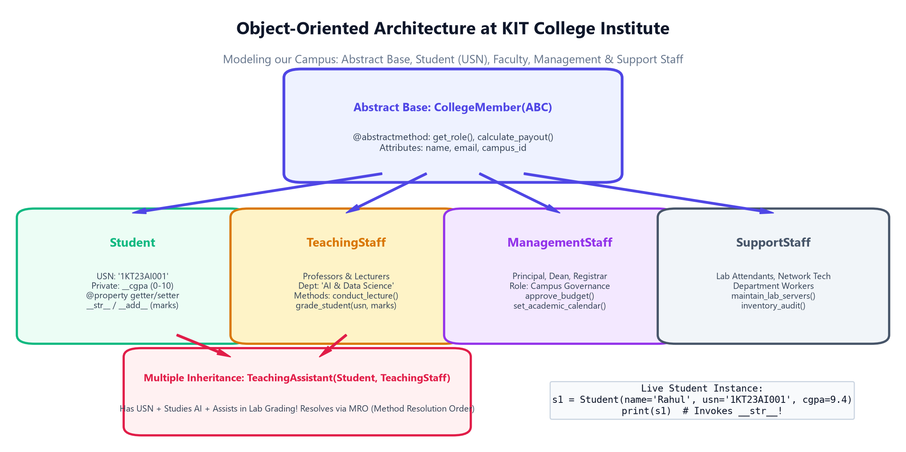
4.3A · CAMPUS ARCHITECTURE
The KIT College Model: Complete Entity Hierarchy
Modeling our campus: Abstract Base, Student (USN), Faculty, Management & Support Staff
Campus Hierarchy Overview:
• CollegeMember(ABC): Abstract base class requiring get_role_summary() & calculate_payout().
• Student: Has USN (e.g. '1KT23AI001'), branch, private __cgpa, and merit payouts.
• TeachingStaff: Professors conducting lectures and research.
• ManagementStaff: Principal & Deans approving departmental budgets.
• SupportStaff: AI Lab Attendants servicing GPU racks.
• TeachingAssistant: Multiple inheritance: Student + TeachingStaff!
The USN Standard at KIT:
In college, roll numbers are replaced by official University Seat Numbers (USN: 1KT23AI001). Every student record is uniquely mapped to their USN!
Python for AI Developers · Day 2: Functions, KIT College OOP, Errors & Git
Slide 11 of 30
Notes:
Walk through the complete KIT College OOP architecture diagram. Point out how real campus roles map cleanly into classes and inheritance.

Slide 12
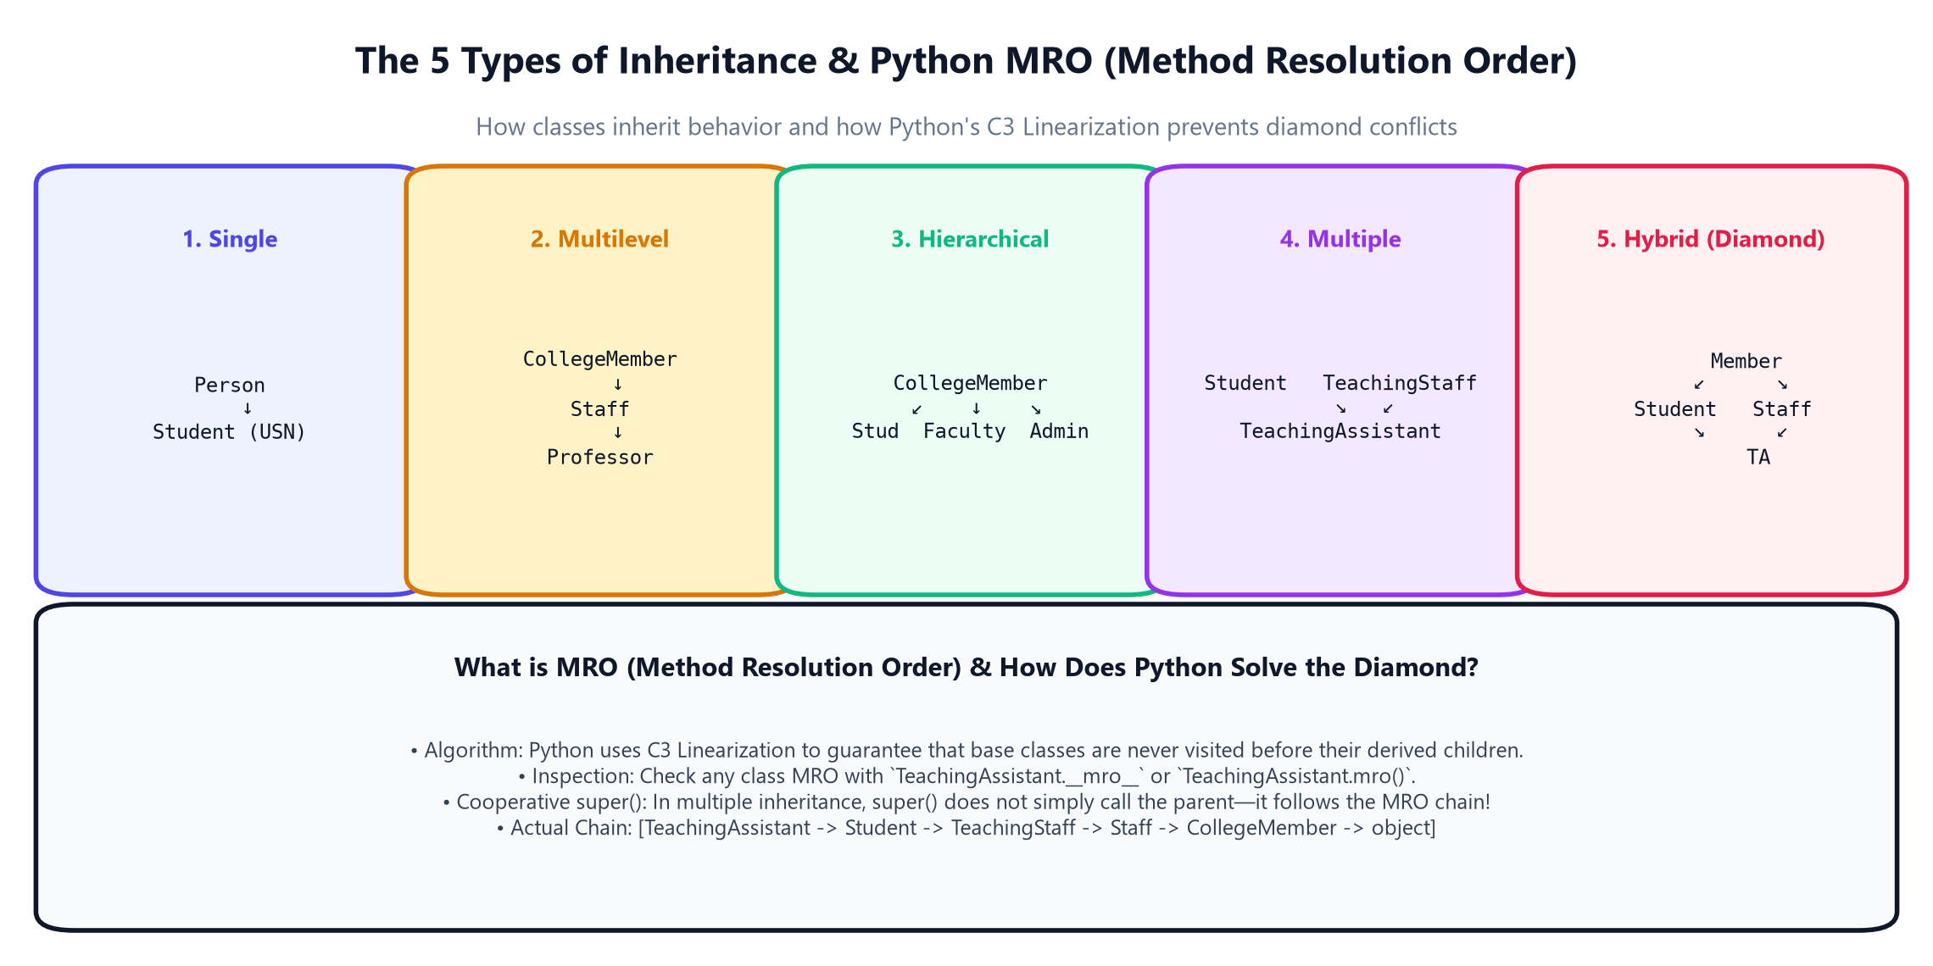
4.3A · OBJECT-ORIENTED POWER
The 5 Types of Inheritance in Python
Single, Multilevel, Hierarchical, Multiple, and Hybrid (Diamond) Architectures
Real Campus Examples:
1. Single: Person -> Student (One parent to one child).
2. Multilevel: CollegeMember -> Staff -> TeachingStaff (A chain of inheritance).
3. Hierarchical: CollegeMember -> Student, Staff, Management (One parent, many siblings).
4. Multiple: TeachingAssistant(Student, TeachingStaff) (Two parents!).
5. Hybrid / Diamond: TA connects back to CollegeMember via two separate branches!
Why Multiple Inheritance Matters:
In Python, a Teaching Assistant is genuinely both a Student (takes exams) and an Employee (grades lab sessions). Multiple inheritance captures this duality!
Python for AI Developers · Day 2: Functions, KIT College OOP, Errors & Git
Slide 12 of 30
Notes:
Explain each of the 5 types of inheritance. Emphasize that while Java bans multiple inheritance of classes, Python supports it fully through MRO.

Slide 13
4.3A · DIAMOND RESOLUTION
MRO (Method Resolution Order) & C3 Linearization
How Python resolves diamond inheritance without duplicate method calls or ambiguities
1. The Diamond Problem
Two Parent Paths: Both Student and Staff inherit from CollegeMember.
Ambiguity Hazard: If both override get_role(), which one should TA execute?
C++ Flaw: In naive languages, the base constructor runs twice! Python solves this.
2. C3 Linearization Algorithm
Strict Ordering: Children appear before parents; parent order in class def is preserved.
No Duplicates: Guarantees every base class in the tree is visited exactly once!
Inspection: Check any class with TeachingAssistant.__mro__ or .mro().
3. Cooperative super()
Not Just Parent: super() doesn't call the immediate parent—it follows the MRO chain!
Chain Order: [TA -> Student -> TeachingStaff -> Staff -> CollegeMember -> object]
Seamless Coordination: Ensures all initializers and methods coordinate harmoniously.
Python for AI Developers · Day 2: Functions, KIT College OOP, Errors & Git
Slide 13 of 30
Notes:
Deep dive into MRO. Emphasize that super() in Python is dynamic and cooperative, following the C3 linearized list rather than hardcoded parent links.

Slide 14
4.3A · CAMPUS OPERATIONS
Campus Roles: Management Staff & Support Staff
Empowering the entire institution: Leadership, Professors, Lab Technicians & Attendants
1. Management Staff
Campus Leadership: Principal, Deans, Registrar running administration.
Specific Methods: approve_budget('AI Lab', 850000.0) and set_academic_calendar().
Governance: Ensures college accreditation and institutional operations run smoothly.
2. Support Staff & Workers
Department Backbone: AI Lab Attendants, GPU Engineers, Network Techs.
Specific Methods: perform_maintenance('NVIDIA RTX 4090 Rack') and lab_inventory_audit().
Operational Health: Keeps high-performance AI compute clusters running 24/7.
3. Teaching Assistant (TA)
Hybrid Scholar: Senior student who studies and instructs lab sections.
Dual Role: Enjoys student merit scholarships + employee monthly stipend.
Lab Leadership: ta_meera.conduct_lecture('YOLOv8 Computer Vision Lab')!
Python for AI Developers · Day 2: Functions, KIT College OOP, Errors & Git
Slide 14 of 30
Notes:
Showcase the expanded campus hierarchy. Students appreciate seeing that software models real humans in their institute with tailored responsibilities.

Slide 15
4.3A · POLYMORPHISM
Polymorphism: Dynamic Duck Typing vs Static Overloading
Why Python has no method signature overloading and how we solve it with modern patterns
1. Dynamic Polymorphism
Duck Typing: 'If it walks like a duck and quacks like a duck, it's a duck!'
Unified Loop: for m in campus: print(m.get_role_summary())
No Type Checks: Zero need for ugly if isinstance(...) checks; Python dispatches at runtime automatically!
2. Static Overloading Truth
No Signature Overloading: In Java, you can have 2 methods with different parameter types.
Python Overwrite: In Python, defining def foo() a second time completely REPLACES the first!
Why?: Python is dynamically typed; signatures are checked at call time, not compile time.
3. Python's Overloading Solutions
Default Arguments: def register(usn, hostel=None, scholarship=0)
Arbitrary Arguments: Use *args and **kwargs to handle variable parameters.
@singledispatch: Built-in functools module dispatches based on the type of the first argument!
Python for AI Developers · Day 2: Functions, KIT College OOP, Errors & Git
Slide 15 of 30
Notes:
Demystify polymorphism. Be clear: Python does NOT have compile-time method overloading by signature like Java. Instead, default arguments, *args, and singledispatch provide idiomatic flexibility.

Slide 16
4.3A · OPERATOR MAGIC
Operator Overloading: Custom Math & Logic Operators
Teaching +, >, <, and == to interact seamlessly with our custom campus objects
1. Arithmetic: __add__ (+)
Math on Objects: Enables writing student1 + student2!
Summing Credits: Combines exam marks or team project credit scores.
Fallback: Return NotImplemented if the other operand type is unsupported.
2. Comparisons: __gt__ & __lt__
Direct Ranking: Enables s1 > s2 based on academic CGPA.
sorted() Integration: Implementing __lt__ allows Python's sorted(students) to work automatically!
Clean Analytics: Sort thousands of student records in 1 line of code.
3. Equality: __eq__ (==)
By Value, Not Pointer: Default == checks if memory addresses match. That's usually not what we want!
USN Matching: __eq__ checks if self.usn == other.usn.
Duplicate Detection: Identifies duplicate student entries across campus databases instantly.
Python for AI Developers · Day 2: Functions, KIT College OOP, Errors & Git
Slide 16 of 30
Notes:
Explain operator overloading. In Python, operators like +, >, and == map directly to dunder methods. This makes custom classes feel like built-in Python types.

Slide 17
4.3A · MAGIC PYTHON
Dunder Methods: __str__ vs __repr__ & Container Protocols
Making custom classes native: Human report cards, developer debugging, and department containers
1. __str__ vs __repr__
__str__ (Human): Clean, friendly view for students & parents: '🎓 KIT Student: Sundeep | USN: 1KT23AI001'.
__repr__ (Dev Debug): Unambiguous developer view: Student(name='Sundeep', usn='1KT23AI001', cgpa=9.6).
Golden Rule: __repr__ should ideally produce a string that can recreate the object in code!
2. __len__ & __getitem__
len(department): Returns enrolled student count without writing dept.get_count().
department[0]: Accesses first student by integer index.
department['1KT23AI001']: Accesses student directly by USN string through bracket syntax!
3. __contains__ & __iter__
'1KT23AI001' in dept: Enables lightning-fast membership checking using the 'in' keyword!
for student in dept: __iter__ makes the department iterable in standard for loops.
PyTorch Connection: This exact container protocol powers PyTorch Dataset and DataLoader!
Python for AI Developers · Day 2: Functions, KIT College OOP, Errors & Git
Slide 17 of 30
Notes:
Compare __str__ and __repr__. Emphasize __str__ for users and UI, and __repr__ for logs and developers. Show how implementing container dunders makes custom classes integrate with Python's syntax.

Slide 18
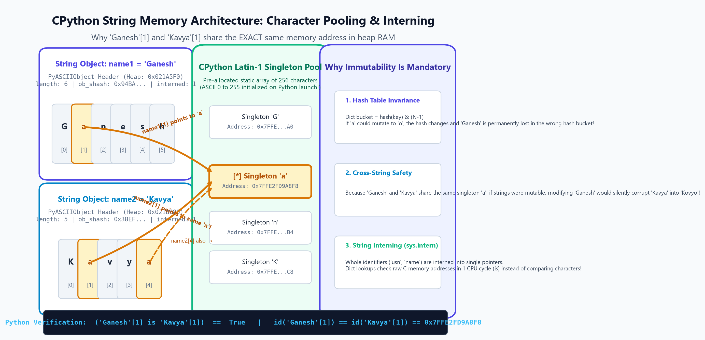
4.3A · DEEP MEMORY MECHANICS
String Internals, Immutability & The Hash Contract
Why strings are immutable, how hash tables achieve O(1) speed, and CPython string interning
Character Pooling & Hash Invariance:
• Singleton Pooling: 'Ganesh'[1] and 'Kavya'[1] share the EXACT same heap pointer (0x7FFE2FD9A8F8) in the 256 Latin-1 singleton pool!
• Hash Contract: a == b => hash(a) == hash(b). Overriding __eq__ disables __hash__. Explicitly implement __hash__ on classes to enable set() and dict keys.
• String Interning: sys.intern() ensures identical identifiers share 1 RAM address. Dictionary lookups become 1-cycle pointer equality checks!
• Why Immutability?: If 'a' could mutate to 'o', 'Ganesh' would mutate to 'Gonesh' AND 'Kavya' would mutate to 'Kovyo'! Plus, hash changes break dict buckets permanently.
• SipHash-2-4 Defense: Random PYTHONHASHSEED salting eliminates HashDoS algorithmic complexity attacks on web servers.
Python Live Memory Verification:
('Ganesh'[1] is 'Kavya'[1]) == True | id('Ganesh'[1]) == id('Kavya'[1]) == 0x7FFE2FD9A8F8 | Singletons shared across RAM!
Python for AI Developers · Day 2: Functions, KIT College OOP, Errors & Git
Slide 18 of 30
Notes:
Walk students through the memory pooling diagram. Point out that 'a' in 'Ganesh' and 'a' in 'Kavya' point to the exact same pre-allocated singleton in CPython's 256-character pool. Explain that without immutability, modifying 'Ganesh' would corrupt 'Kavya'! Then tie this to hash invariance for O(1) dictionary lookups.

Slide 19
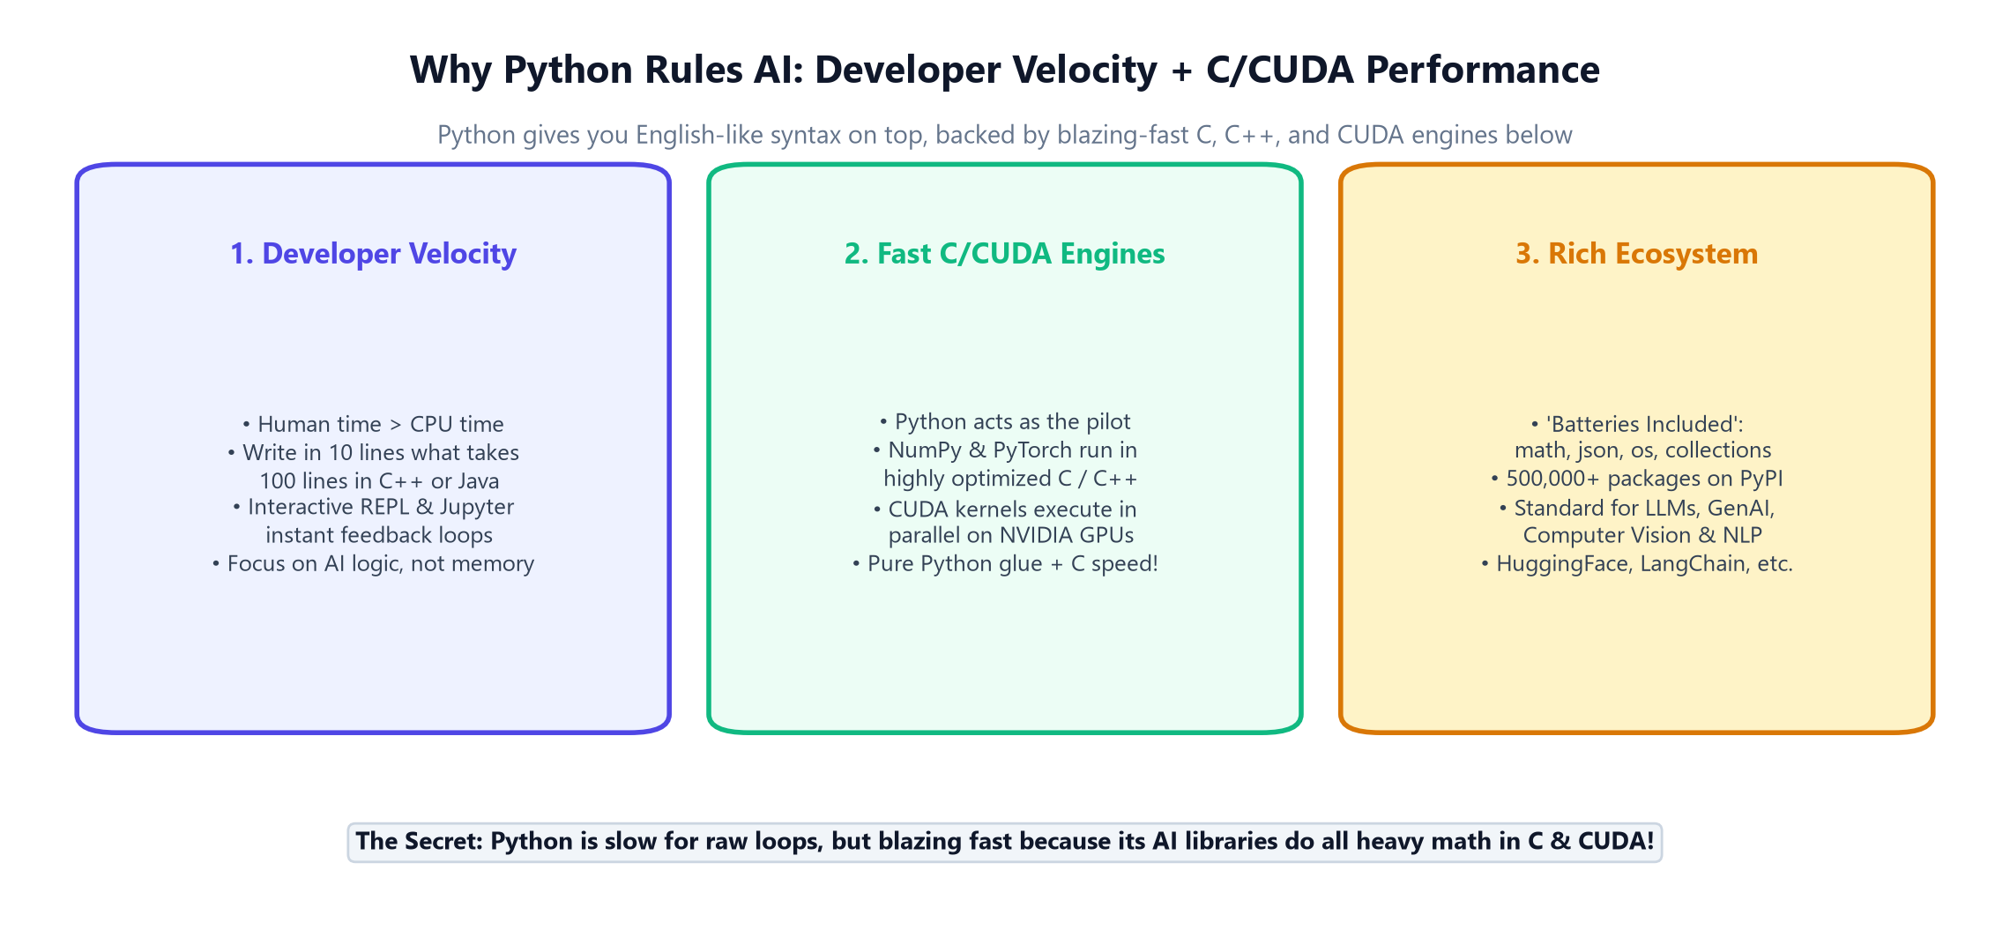
INDUSTRY INSIGHTS
Why Python Rules AI: Developer Velocity + C/CUDA Engines
High-level English readability on top, powered by blistering C and NVIDIA CUDA kernels below
The AI Developer Advantage:
• Developer Velocity: Human engineering time is expensive; cloud GPU time is cheap. Python writes in 10 lines what takes 100 in Java.
• C Engine Secret: PyTorch, NumPy, and TensorFlow execute in compiled C/C++ and CUDA.
• Best of Both Worlds: Python serves as the steering wheel for high-performance C++ Formula 1 engines!
• Batteries Included: Built-in math, json, os, datetime, and collections.
• PyPI Ecosystem: 500,000+ packages: HuggingFace, LangChain, Transformers, OpenCV.
Vectorization Speedup Benchmark:
In Notebook 02, we benchmark 1,000,000 score calculations: Pure Python takes ~85 ms, while NumPy takes ~0.8 ms (100x speedup!) due to underlying C vectorization.
Python for AI Developers · Day 2: Functions, KIT College OOP, Errors & Git
Slide 19 of 30
Notes:
Answer the big question: 'Why is Python the king of AI if it is an interpreted language?' Reveal the architecture: Python is the high-level orchestrator, but C/CUDA do the heavy lifting.

Slide 20
HANDS-ON PRACTICE
Let's Open Notebook 02: KIT College OOP Master Simulation
Instantiate yourself with a USN, test MRO, override operators, and manage your department!
📓 Open: notebooks/day_02/02_day2_college_oops_kit_institute.ipynb
1. Open Notebook 02 and verify that instantiating CollegeMember(ABC) directly raises TypeError.
2. Create Student Sundeep with USN '1KT23AI001' and test private __cgpa guardrails.
3. Inspect TeachingAssistant.__mro__ and watch C3 Linearization resolve diamond inheritance.
4. Test operator overloading: Add marks with +, sort students with >, and check USN equality with ==.
5. Populate KITDepartment and access students via index and USN string (ai_dept['1KT23AI001'])!
6. Run the live NumPy vs Pure Python benchmark to witness the 100x C-vectorization speedup!
Python for AI Developers · Day 2: Functions, KIT College OOP, Errors & Git
Slide 20 of 30
Notes:
Pause presentation and switch to Notebook 02. Guide students through running all 12 concepts live in Jupyter.

Slide 21
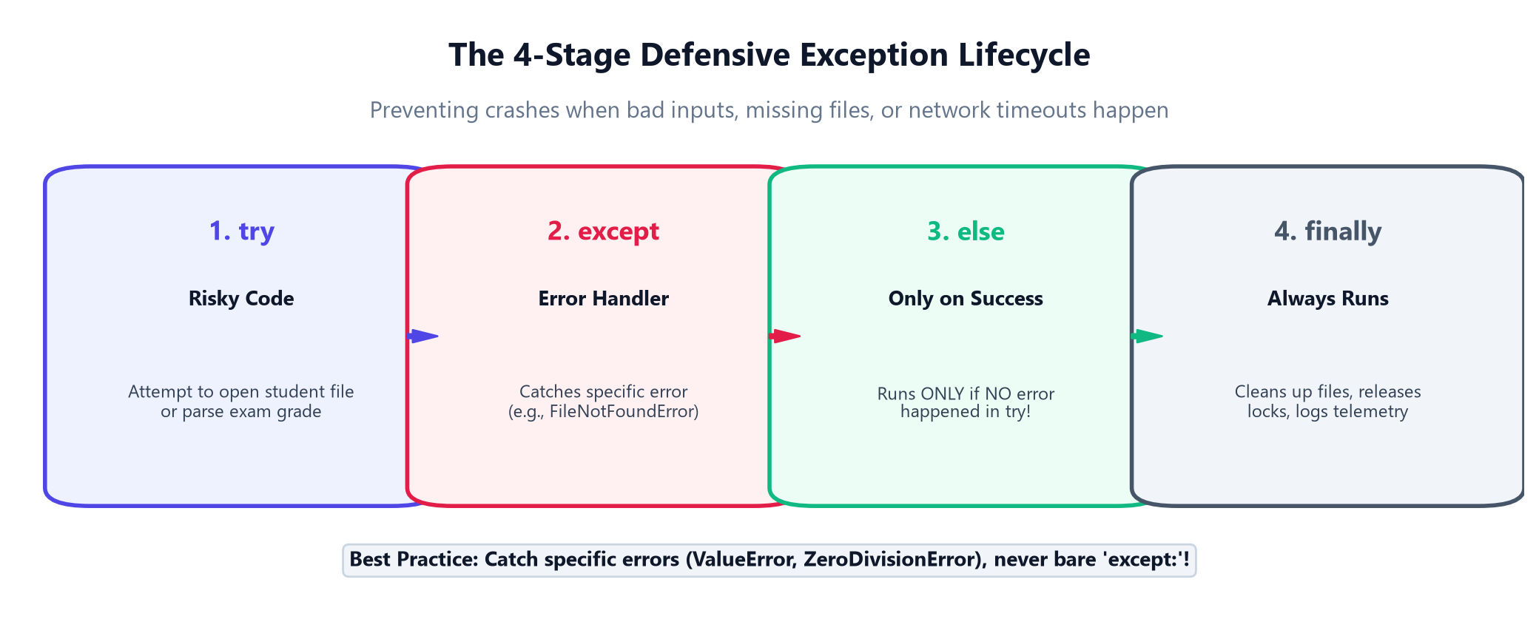
4.1A · CRASH-PROOF CODE
The 4-Stage Defensive Exception Lifecycle
How we ensure our software never crashes when bad inputs, missing files, or network timeouts happen
The 4 Golden Stages:
1. try: Place only the risky code here (opening files, network requests, math division).
2. except ErrorType: Catches specific problems gracefully. Never use bare except:!
3. else: Runs ONLY if the try block completed with zero errors. Keeps success logic clean.
4. finally: Runs ALWAYS, whether an error occurred or not! Perfect for closing database connections.
Production Exception Rule:
Never silence errors with 'except: pass'. That creates invisible bugs that corrupt databases and AI pipelines. Always log the error or re-raise with context!
Python for AI Developers · Day 2: Functions, KIT College OOP, Errors & Git
Slide 21 of 30
Notes:
Walk through the 4 stages of try/except/else/finally. Explain why else and finally are critical for production software.

Slide 22
4.1A · ERROR TAXONOMY
Built-In vs Custom Domain Exceptions
Catching specific errors and defining college business rule exceptions like AttendanceShortageError
1. Common Built-In Errors
ValueError: Right data type, but illegal value (e.g., CGPA = 15.0).
FileNotFoundError: Trying to read a dataset that doesn't exist on disk.
ZeroDivisionError: Dividing by zero in average calculation.
KeyError: Searching for a student USN missing from dictionary.
2. Custom Domain Exceptions
class AttendanceShortageError(Exception): Subclass from Python's base Exception.
Domain Clarity: Signals domain-specific business rules to callers.
raise keyword: raise AttendanceShortageError(f'{usn} has only {pct}% attendance!')
3. Defensive AI Engineering
API Rate Limits: Catch 429 TooManyRequests and retry with exponential backoff.
Context Length: Catch TokenLimitExceeded and automatically truncate prompt history.
Model Failovers: Fall back to a local model if the cloud API times out.
Python for AI Developers · Day 2: Functions, KIT College OOP, Errors & Git
Slide 22 of 30
Notes:
Contrast built-in exceptions with custom domain exceptions. Emphasize that custom exceptions make AI systems self-documenting and easier to debug.

Slide 23
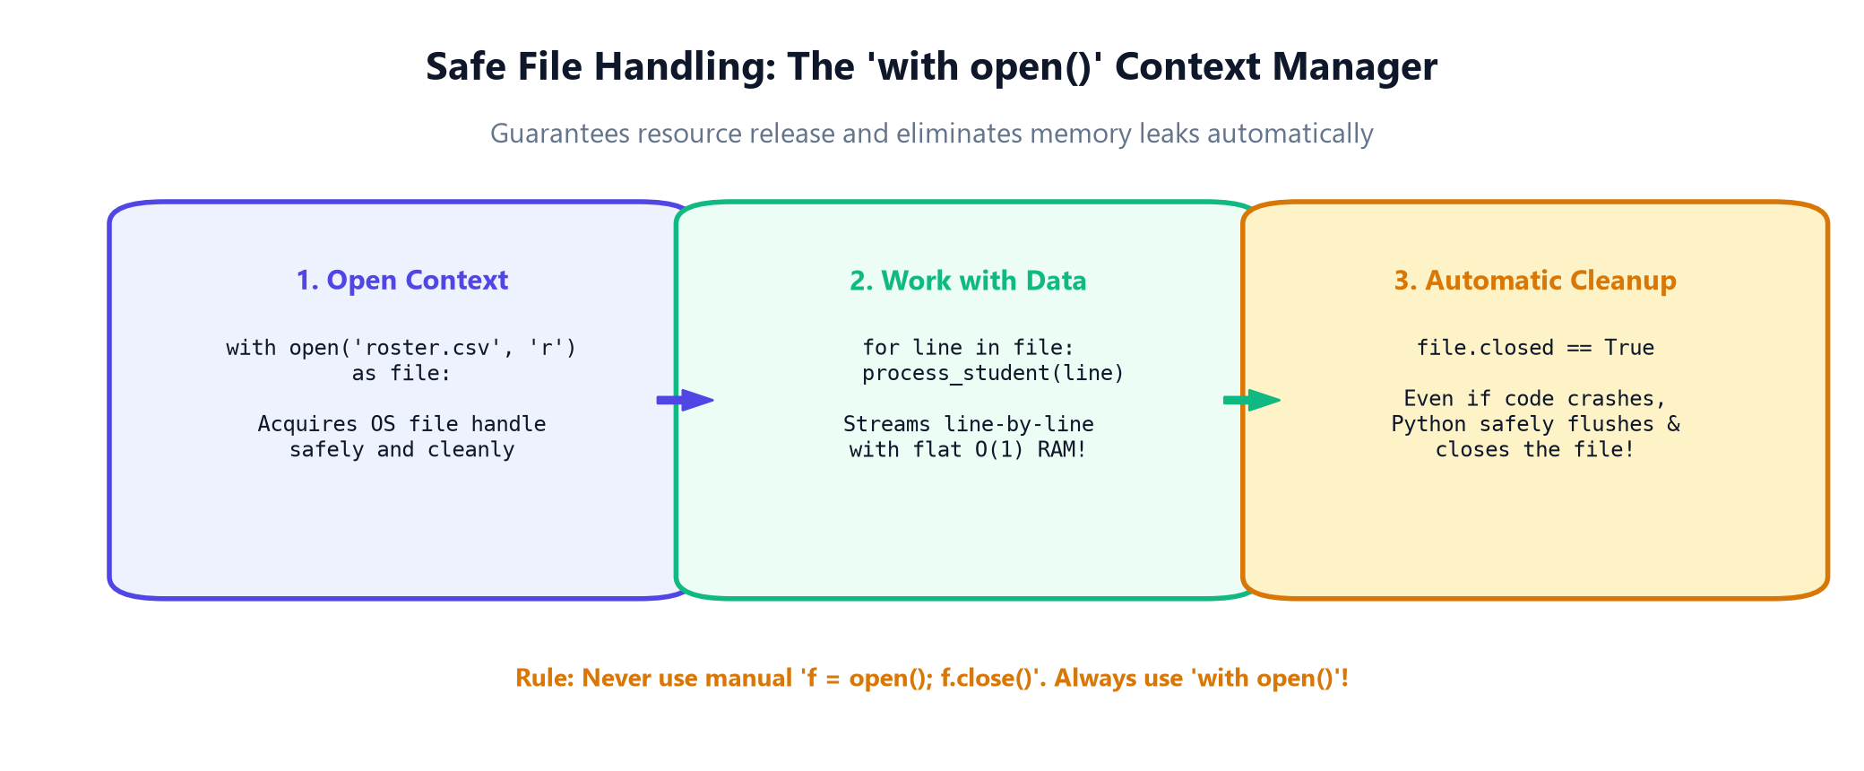
4.2A · DATA PERSISTENCE
Safe File Handling: The 'with open()' Context Manager
Automatic resource acquisition and cleanup that eliminates file handle leaks permanently
File Modes Guide:
'r' (Read): Default mode. Raises FileNotFoundError if file is missing.
'w' (Write): Overwrites existing file completely or creates a new one.
'a' (Append): Adds new lines at the end without erasing previous data.
encoding='utf-8': Always specify utf-8 to avoid international encoding bugs!
line streaming: for line in file: streams massive gigabyte files with O(1) RAM!
The Golden Rule of File I/O:
Never write manual 'f = open(...)' and 'f.close()'. If an error happens before close(), the OS file lock leaks. 'with open()' guarantees cleanup 100% of the time!
Python for AI Developers · Day 2: Functions, KIT College OOP, Errors & Git
Slide 23 of 30
Notes:
Explain context managers. Mention that under the hood, with triggers __enter__ and __exit__, which guarantees f.close() runs even on unexpected exceptions.

Slide 24
4.2B · REAL-WORLD DATA
Processing Tabular Data: CSV & JSON Streams
Reading student records, serializing model configurations, and managing AI datasets
1. Writing CSVs with csv.writer
import csv: Python's standard library module for tabular spreadsheets.
writer.writerow([headers]): Writes USN, Name, Branch, CGPA.
writer.writerows(rows): Dumps complete student batches in one shot with automatic escaping.
2. Reading with csv.DictReader
Dict Mapping: Turns every CSV row into a clean dictionary {'USN': '1KT23AI001'}!
Header Resilient: Code doesn't break if column order in the CSV changes.
Flat Memory Usage: Streams row-by-row without loading the whole file into RAM.
3. JSON Configurations
json.dump(data, file): Saves Python dicts directly as structured JSON files.
json.load(file): Loads hyperparameters and student profiles back into Python.
Universal Standard: The universal format for REST APIs, LLM prompts, and tool calling.
Python for AI Developers · Day 2: Functions, KIT College OOP, Errors & Git
Slide 24 of 30
Notes:
Cover CSV and JSON. Emphasize that csv.DictReader is preferred over raw string splitting because it handles commas inside quoted fields automatically.

Slide 25
HANDS-ON PRACTICE
Let's Open Notebook 03: Errors & Safe File Handling
Test defensive error recovery and generate student CSV rosters on disk!
📓 Open: notebooks/day_02/03_day2_errors_and_file_handling.ipynb
1. Open Notebook 03 and run the exam score parser with valid, invalid, and string inputs.
2. Observe how the finally block executes every single time for audit telemetry.
3. Write a batch of KIT student records to 'kit_students_roster.csv' using USN.
4. Stream the CSV records back using csv.DictReader and filter for honors students (CGPA >= 9.0).
5. Complete the missing file error recovery challenge and verify that your script doesn't crash!
Python for AI Developers · Day 2: Functions, KIT College OOP, Errors & Git
Slide 25 of 30
Notes:
Pause presentation and switch to Notebook 03. Walk students through executing file I/O safely and catching missing file exceptions.

Slide 26
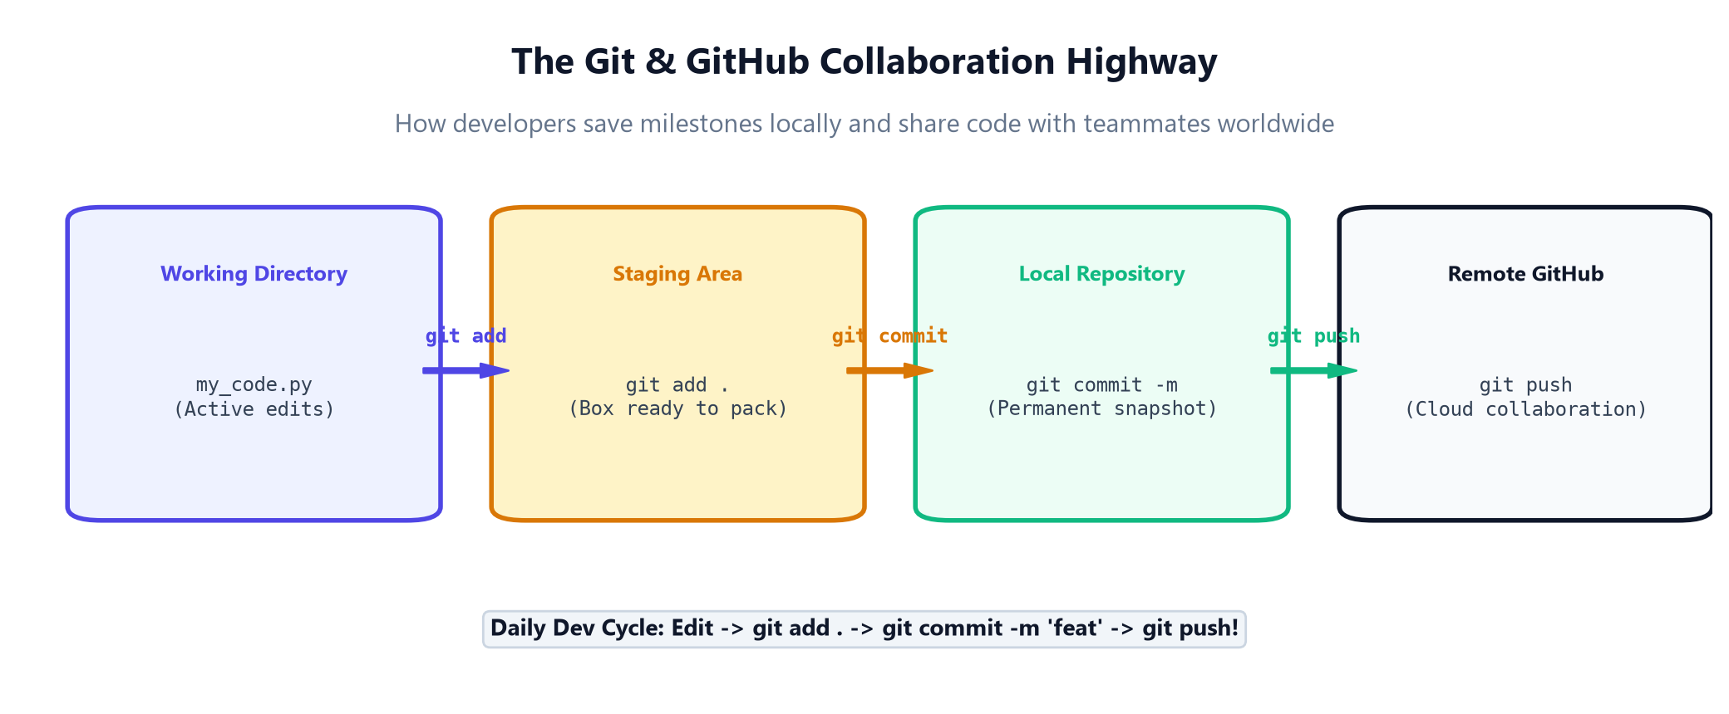
6.1A · COLLABORATION HIGHWAY
The Git & GitHub Workflow Highway
How modern developers track milestones locally and collaborate across teams globally
The 4 Git Zones:
1. Working Directory: Your active folder where you edit Python code.
2. Staging Area: The packaging zone (git add .). Choose exactly what to include.
3. Local Repository: Permanent snapshot with author & message (git commit -m).
4. Remote GitHub: Cloud repository for team collaboration and backup (git push).
Git Mental Model:
Git is not just backup; it is a time machine! Every commit is a checkpoint you can return to if a new experiment breaks your model.
Python for AI Developers · Day 2: Functions, KIT College OOP, Errors & Git
Slide 26 of 30
Notes:
Explain the 4 Git zones. Emphasize the difference between git add (staging changes) and git commit (recording a permanent milestone).

Slide 27
6.1A · PROFESSIONAL WORKFLOW
The Daily Git Cycle & Feature Branching
Writing clean commit messages, inspecting changes, and creating safe development branches
1. Daily Command Cycle
git status: Checks modified files in your working directory.
git add .: Stages all modified files for the next commit.
git commit -m 'feat': Creates permanent snapshot with a descriptive message.
git push origin main: Uploads local commits to GitHub cloud.
2. Safe Feature Branching
Never code on main: Production code lives on main; new features get their own branch.
git checkout -b feat/ai: Creates and switches to a new feature branch.
git branch -a: Lists all local and remote branches.
git merge feat/ai: Merges tested feature into main.
3. Inspection & History
git log --oneline: Compact visual view of commit history.
git diff: Shows exact line-by-line additions and deletions.
git restore file.py: Discards unwanted uncommitted local changes instantly.
Python for AI Developers · Day 2: Functions, KIT College OOP, Errors & Git
Slide 27 of 30
Notes:
Demonstrate branching. Explain that branches allow team members to develop experimental AI models simultaneously without conflicting with stable production code.

Slide 28
6.1B · OPEN SOURCE STANDARDS
Production .gitignore & The Pull Request (PR) Highway
Protecting API secrets, preventing multi-gigabyte model commits, and collaborating on GitHub
1. Essential AI .gitignore
.env (CRITICAL): Never commit API keys or database passwords!
*.pt / *.onnx / *.safetensors: Large model weights belong on HuggingFace or S3, not in Git!
__pycache__/ & *.pyc: Compiled Python bytecodes.
.venv/ & env/: Virtual environments.
2. The Pull Request (PR)
Propose Changes: Push feature branch to GitHub and open a Pull Request.
Peer Review: Teammates review code diffs, comment on lines, and request tweaks.
CI/CD Automation: Automated GitHub Actions run pytest test suites on every PR.
3. Open Source Collaboration
Forking: Create your personal copy of an open source repo on GitHub.
Upstream Sync: Keep your fork updated with the main project.
Merge & Deploy: Once approved, PR merges into main and triggers automatic deployment!
Python for AI Developers · Day 2: Functions, KIT College OOP, Errors & Git
Slide 28 of 30
Notes:
Emphasize security with .gitignore. Warn students about API key leaks on GitHub. Explain that Pull Requests are how all enterprise software is built.

Slide 29
HANDS-ON PRACTICE
Let's Open Notebook 04: Git & GitHub Live Repo
Initialize a Git repository, write an AI .gitignore, make commits, and simulate branches!
📓 Open: notebooks/day_02/04_day2_git_and_github_essentials.ipynb
1. Open Notebook 04 and initialize a test Git repository using Python's subprocess.
2. Create a production .gitignore file blocking .env, large model weights, and __pycache__.
3. Stage student scripts and make a clean semantic commit: 'feat: add kit college student model'.
4. Create a feature branch 'feat/rag-pipeline' and verify its isolation from main.
5. Inspect git log --oneline to view your permanent repository timeline!
Python for AI Developers · Day 2: Functions, KIT College OOP, Errors & Git
Slide 29 of 30
Notes:
Pause presentation and switch to Notebook 04. Guide students through running Git commands in the terminal and understanding repository states.

Slide 30
DAY 2 GRADUATION
Master Summary: You are Now an Object-Oriented AI Developer!
Congratulations on mastering functions, campus architecture, MRO, errors, and Git collaboration
Functions & Modules
• Modular reusable logic
• *args & **kwargs flexibility
• Stopwatch @decorators
• 1-line lambda functions
KIT College OOP
• Classes vs Objects in RAM
• Abstraction (abc.ABC)
• Encapsulation & private __cgpa
• USN: 1KT23AI001 standard
Advanced OOP & MRO
• 5 Types of Inheritance
• MRO C3 Linearization
• Campus Hierarchy (Management)
• Dynamic Polymorphism & + > ==
Errors & Git Highway
• 4-stage try/except/else/finally
• with open() context manager
• Git add, commit, push
• PRs & AI .gitignore
🎉 What Comes Next in Day 3:
Tomorrow we enter Data Analysis & Numerical Computing with NumPy and Pandas! You will leverage your OOP, error handling, and Git skills to build production data pipelines for Generative AI models.
Python for AI Developers · Day 2: Functions, KIT College OOP, Errors & Git
Slide 30 of 30
Notes:
Congratulate the students on completing Day 2. They now have professional Object-Oriented design, defensive error handling, and Git collaboration skills. Preview Day 3: NumPy and Pandas.

