Slide 1



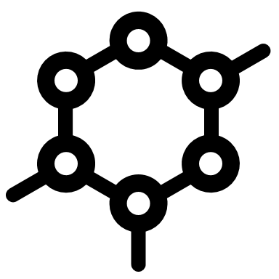
Discovery Service
Schema Registry
Subscription Manager
Publish Endpoint
Tenant Bridge

Slide 2
CloudEvents Integration Patterns
Direct
Publisher delivers directly into preconfigured app endpoint
Intermediated
Publisher delivers into an intermediary which delivers into a preconfigured app endpoint
Decouples delivery concerns (retries, error handling) from publishing
App
Publisher
App
Publisher

Slide 3
CloudEvents Integration Patterns
Intermediated multicast
Publisher delivers into an intermediary which delivers into one or more preconfigured app endpoints
Publisher decoupled from management of app endpoints
Intermediated, dynamic multicast
Publisher delivers into an intermediary which delivers into one or more app endpoints that can be configured at runtime
App
Publisher
App
Publisher
App
App
Subscription Manager

Slide 4


CloudEvents Integration Patterns
Schema sharing
Any of the above with publishers sharing serialization and/or validation schemas with subscribers
Dynamic + Discovery
Any dynamic scenario, but with apps discovering subscription managers and schema registries at runtime
Publisher
App
Publisher
App
Publisher
App
App
Publisher

Slide 5
Federation Scenarios
Multi-hop, intermediated multicast
Publisher endpoints might be chained: Routing and partitioning, crossing trust domains, crossing network isolation boundaries, etc.
App
Publisher
App
App
App

Slide 6
Federation Scenarios: Subscriptions
Subscriptions may be propagated
Chaining of flow paths might be the result of subscription managers propagating subscriptions "upstream" towards a publisher via intermediary subscription managers
Publisher
App

Slide 7
Federation Scenarios: Discovery
Discovery: Central discovery
Publishers and apps refer to the same instance of a discovery service.
Publishers announce what events they can/will deliver.
Potential subscribers are pointed to (a) subscription manager endpoint(s) where those events are available for subscription.
The same set of events might be available from different, chained subscription manager endpoints.
App
Publisher
App
App
App

Slide 8

Federation Scenarios: Discovery
Discovery: Central registry, central governance
Like before, but the discovery service is centrally managed.
Publishers might self-register, but entries are generally subject to review and approval.
App
Publisher
App
App
App

Slide 9
Federation Scenarios: Discovery
Discovery: Federated registries
Publishers and apps refer to local discovery services whose contents are actively replicated along the event flow path.
Subscribers might not be able to access a central service in public IP space or have no access permissions to external resources.
Addresses of subscription managers and schema registries are overwritten with local proxies that are reachable in the same network scope.
App
Publisher
App
App
App

Slide 10
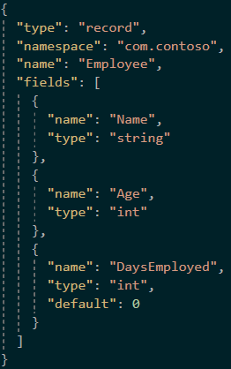
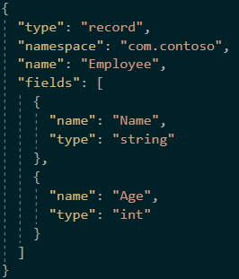
CloudEvents Schema Registry
Why use a schema registry?
Validation
Efficiency
Evolution

Slide 11
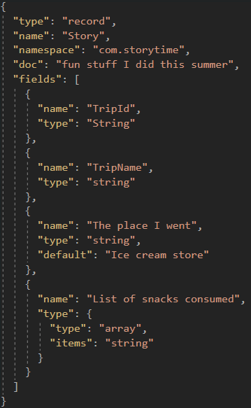
CloudEvents Schema Registry
Why use a schema registry?
Validation
Efficiency
Evolution
Governance

Slide 12
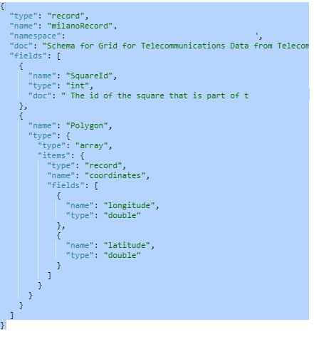
Schema Registry concepts
Namespace
Host Schema Groups and topics/event hubs
Provides a unique FQDN
Multiple Schema Groups
Schema Group
A logical container/repository for schemas
Groups multiple schemas
Type and Compatibility applicable to all schemas in the group
Schema Metadata
Schema name
Schema Type
Format
Version
Authority
Event Hubs Namespace
Schema Group
Schema
Name
Type
Format
Authority
SchemaVersion3
SchemaVersion2
SchemaVersion1

Slide 13


Schema Registry in Practice: Azure Event Hubs
JAVA
C#
Kafka Producer
Kafka
Azure Event Hubs
AMQP
AMQP Consumer
KafkaAvroSerializer
SchemaRegistryAvroObjectSerializer
schema cache
schema cache
Azure Schema Registry

Slide 14
Federation Scenarios: Schema Registry
Schema sharing: Central registry
Publishers and apps refer to the same instance of a central schema registry.
App
Publisher
App
App
App

Slide 15
Federation Scenarios: Schema Registry
Schema sharing: Central registry, central governance
The schema registry is centrally managed.
Publishers might accounce new schemas, but all schemas are subject to review and approval.
Commonly integrated with an enterprise schema catalog that also help govern rules for databases.
App
Publisher
App
App
App

Slide 16
Federation Scenarios: Schema Registry
Schema sharing: Federated registries
Publishers and apps refer to local schema registries that are replicated along the event flow path.
Subscribers might not have be able to access a central registry in public IP space or have no access permissions to external resources.
See Discovery: Federated discovery services may point apps to different registry endpoints that function as proxies.
App
Publisher
App
App
App

Slide 17



Federation: Tenant Bridges 1/3
Tenant bridges allow for mapping (proxying) of metadata and events flows across tenancy boundaries in multitenant platforms.
App tenants might be isolated in their own virtual network environments and/or unable to communicate with the publisher's endpoints.
App tenants might use a different identity realm and access control rule space
Platform Tenant
App Tenant
App
Publisher
App Tenant
App

Slide 18
Federation: Tenant Bridges 2/3
App tenant accepts the bridge allowing the platform to mediate across boundaries, bypassing certain tenant isolation rules.
The trust model lets a publisher (platform tenant) offer a bridge to an app and for the app to accept the bridge.
The platform allows flow across the tenant boundary based on that handshake.
Access control to the "in-app" subscription manager, schema registry, and discovery service endpoints is governed within the app's scope.
Publisher offers to create a bridge to the app
Platform Tenant
App Tenant
App
Publisher
App Tenant
App
Publisher announces available events, registers schemas, and publishes events into endpoints of a tenant under its control

Slide 19
Federation: Tenant Bridges 3/3
Platform A
Platform B
Apps in two platforms may belong to the same party who wants to connect them, but the tenant concepts may differ.
Neutral "channel ID" that can map to the tenancy concept on either side
Routing between platforms with dispatch to the app tenant based on the neutral "channel ID".
App
App Tenant
Channel ID
App
App
App
App Tenant
App
App

