Slide 1
Deep Convolutional Neural Networks for Anomaly Event Classification on Distributed Systems
Jiechao Cheng, Rui Ren
jetrobert19@gmail.com

Slide 2
Outline
Background:
Anomaly classification facilitates the anomaly detection of system operations and states, which including system events like unauthorized access or unexpected data wrote in the system.
Motivative:
Effectively categorize the records of abnormal operations, which can indicate problems of an application or server.
Method:
We employ deep CNN architectures to build data-driven models for automated classification and predictions of the anomaly events detected from distributed system.

Slide 3
Outline
Dataset:
Hundreds of thousands of event-wise text logs spanning a period of a couple of months with consecutive days, preprocess, convert to numerical event-wise features, then normalize, as the input fed to the neural network.
Totally 14 different classes of anomaly events (e.g., network, database, memory, driver, security, disk).
Model Implementation:
conv-layer + fully-conn layer (e.g., 2+1, 3+2, 5+3), inspired by LeNet, AlexNet and VGG-16
Hyper-parameter
learning rate: 0.1~0.0001 | hidden layer size: 16~128 | dropout: 0.25~1.0
Evaluation Metrics:
Best accuracy, recall, precision, f1-score

Slide 4
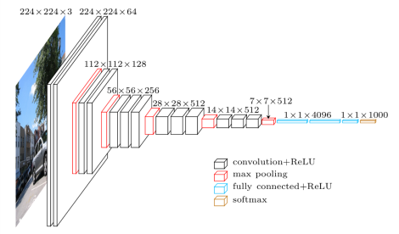
Outline
Macroarchitecture of VGG-16 (Fig. from Davi Frossard)

