Slide 1
RETON
Payments you can take back.
Africa’s trust-first digital banking platform — built so a mistake or a scam doesn’t have to be final.
RETON PTE LTD · retonpay.com · Licensed rails via ALAT by Wema

Slide 2
THE PROBLEM
Sending money is easy.
Taking it back is not.
One wrong digit and the money is gone.
Scams move faster than bank disputes.
Most wallets optimise for “send and forget.”
People don’t need another clone — they need a second chance.

Slide 3
WHY THIS IS REAL
When money leaves…
getting it back is a war.
In 2024, about ₦95 million was pulled from a company’s account without permission. Banks rushed “block and recall.” Freezes often last only 72 hours. A court later ordered the money returned — and reversing it still became a legal fight.
How it works today
What a baby can understand
Money flies out → hope a freeze works → race the clock → maybe a court → maybe nothing comes back.
If you give away a toy and it leaves the room, chasing it is hard. Reton keeps a string on the toy until you say “okay.”

Slide 4
RETON’S ANSWER
Don’t wait for a chase.
Build the undo first.
Callback Protection — hold the payment before it becomes final.
Wrong-transfer recovery — freeze eligible funds and open a case.
Fraud signals — watch risky moves while money is still in motion.
A clear timeline — so everyone can see what happened, step by step.
Courts and bank recalls still matter. Reton adds something they can’t: protection inside the payment itself.

Slide 5
THE INSIGHT
Trust isn’t a badge on the login screen.
It’s what happens after the money moves.
Reton is built for the moment something goes wrong — not just the moment you hit send.

Slide 6
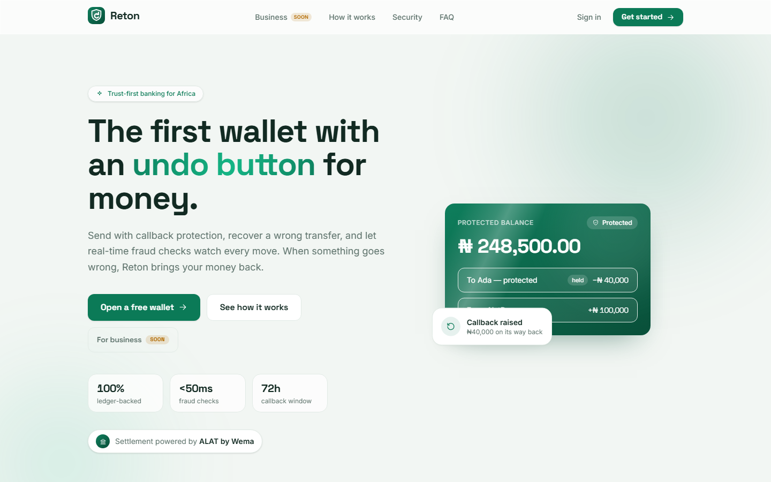
PRODUCT · LIVE
The first wallet with an undo button for money.

Slide 7
FLAGSHIP
Callback Protection
Hold a payment until you’re ready. Release it when it feels right — or pull it back if something’s off.
Send
→
Protected / Pending
→
Release
or Callback
Receiver sees “Payment Protected.”
Every step is logged on a visible timeline.
Sender, receiver, and admin can act with clarity.

Slide 8
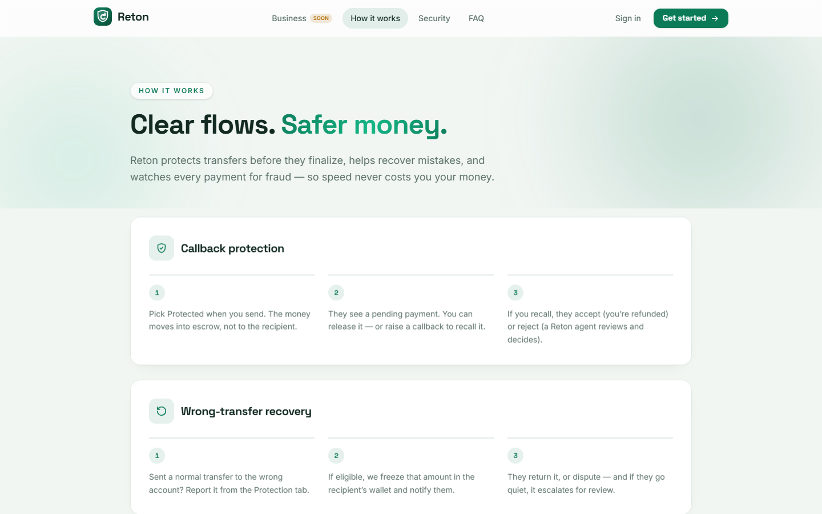
HOW IT WORKS
Clear flows. Safer money.

Slide 9
WHAT WE BUILT
A full trust stack — not slideware.
Wrong-transfer recovery
Fraud signals
Double-entry wallet
Report a mistake. Hold eligible funds. Track the case.
Rule-based scoring with admin visibility.
Every naira ledgered — no silent tweaks.
KYC tiers
Protected marketplace
Money-aware support
CBN-aligned limits. BVN unlock for funding.
Escrow-style protection until delivery confirmed.
Find a tx, explain protection, escalate.

Slide 10
SHOP & LISTINGS
Sell something.
Get paid — safely.
List an item. Share the link on WhatsApp. The buyer’s money stays protected until you deliver and they confirm.
Create a listing & share your link
Buyer pays with Callback Protection
You deliver · they confirm · money releases
Same undo button for money — now for real sales. No public mall browse.

Slide 11
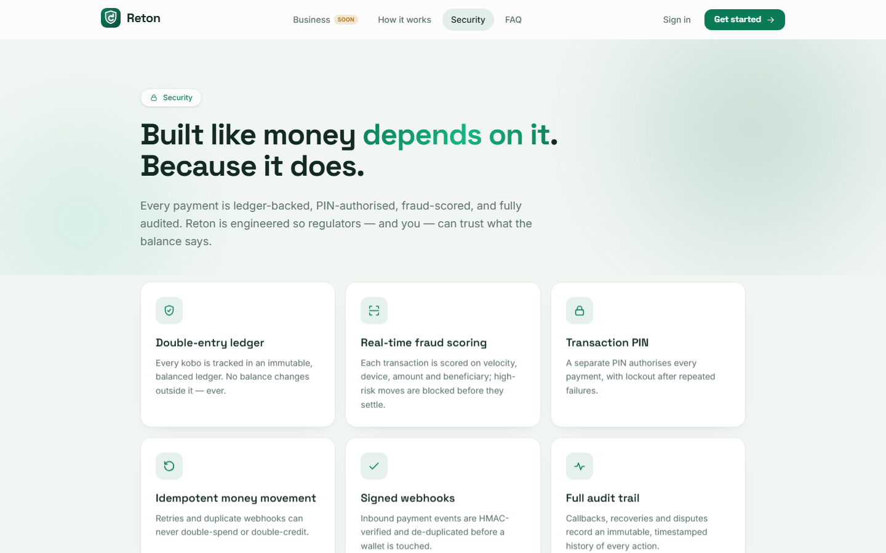
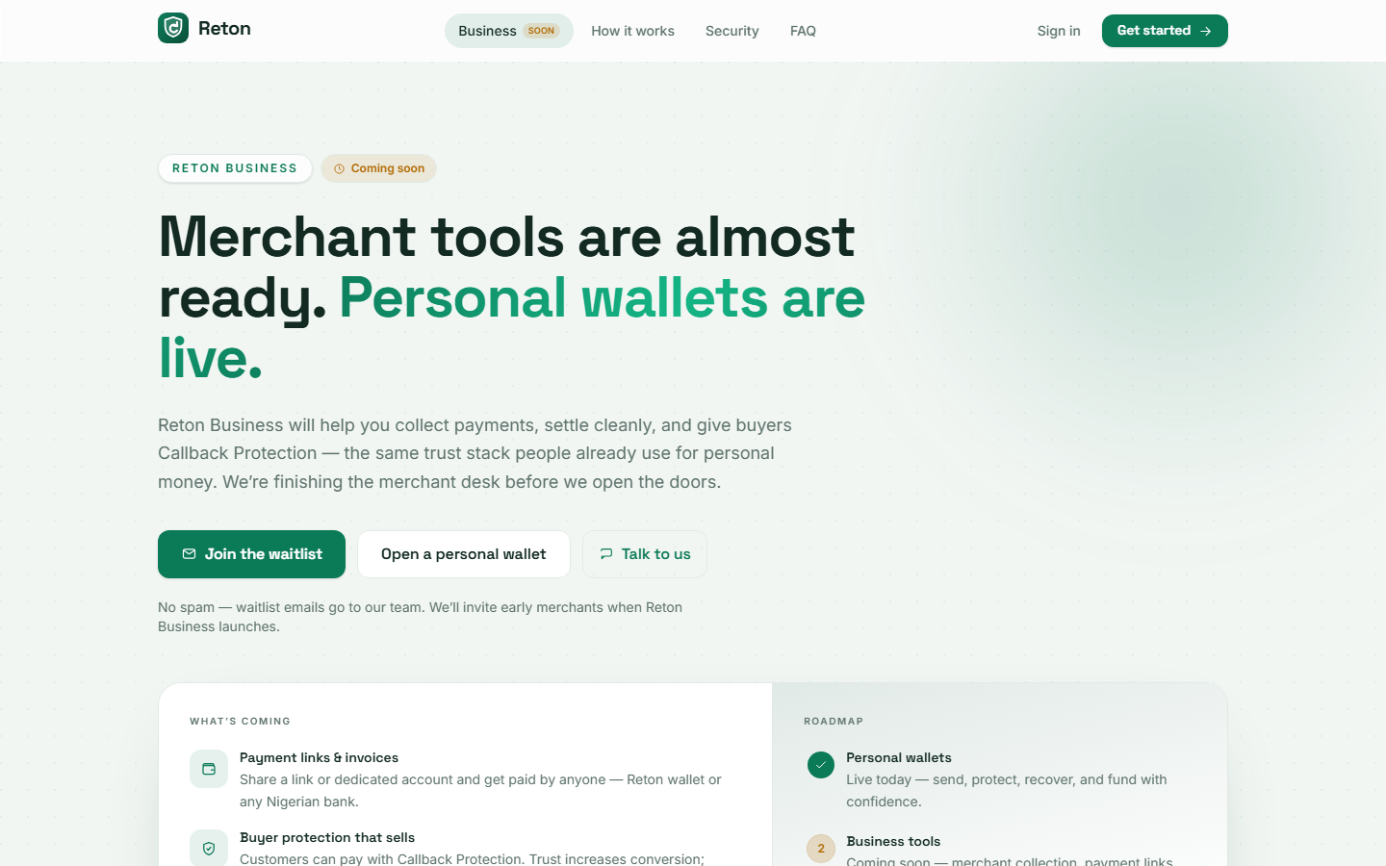
PRODUCT · LIVE
Security posture. Business on the way.

Slide 12
ALATPAY INTEGRATION
Real rails. Not a mock bank.
What we use
Where money enters
Collections & payment links · Static virtual accounts · BVN OTP · Signed webhooks · Transaction verification
Users fund Reton wallets on ALATPay. We credit our ledger only after verified settlement.
ALAT by Wema gives us a licensed Nigerian bank rail — so Callback Protection sits on infrastructure people can trust.

Slide 13
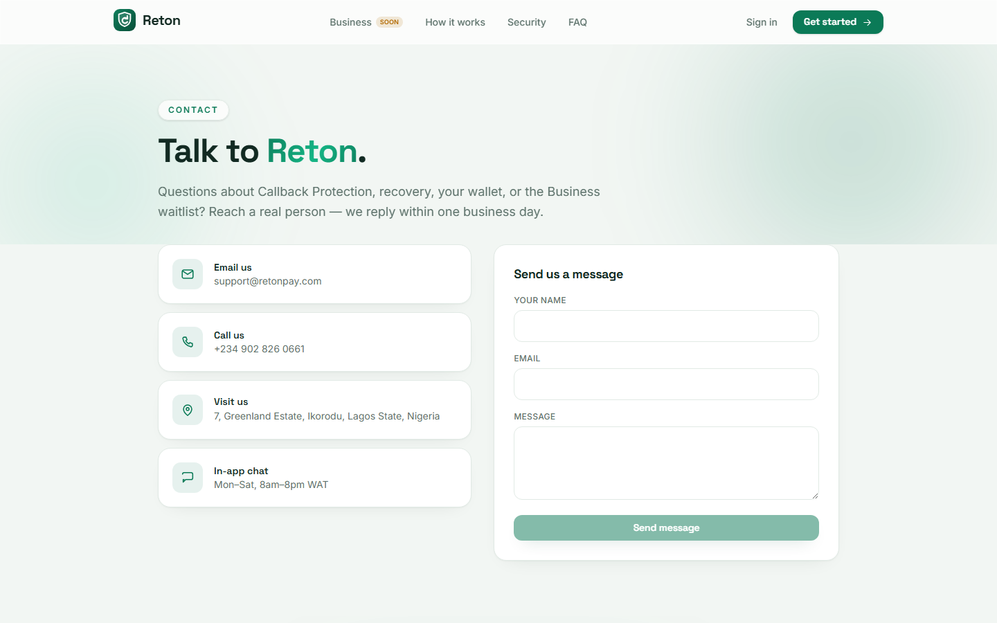
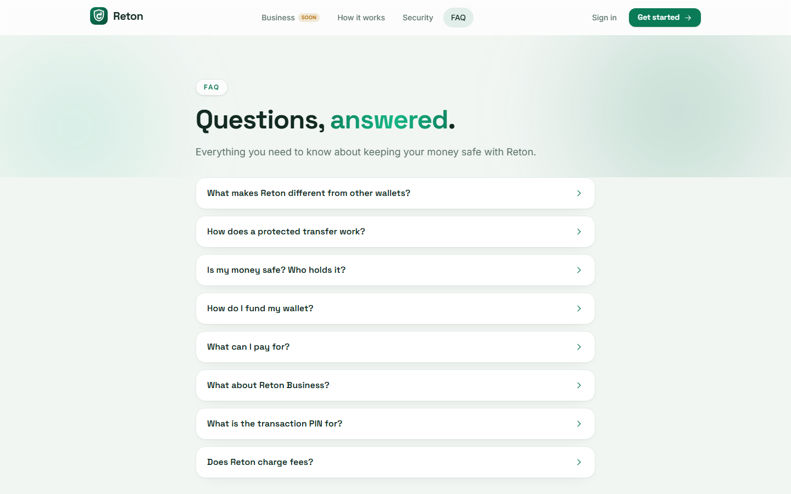
PRODUCT · LIVE
Reachable. Self-explanatory.

Slide 14
WHY RETON
We’re not another wallet.
Trust layer — protection and recovery are the product.
Visible timeline — every money event is explainable.
Licensed settlement — ALATPay / Wema.
Production mindset — signed webhooks, PINs, encrypted secrets, audited admin.

Slide 15
DEMO IN 90 SECONDS
Show, don’t tell.
Open a wallet — balance & KYC tier
Send a protected transfer
Receiver sees Payment Protected
Request callback — timeline updates live
Optional: recovery case or admin fraud view
The story: money moved — and I still had control.

Slide 16
TEAM
RETON PTE LTD
Gabriel Rotimi Mogaji
Aina Christana Olajumoke
Founder & CEO
Co-Founder
Building Africa’s trust-first payment platform — one protected transfer at a time.

Slide 17
RETON
Money you can take back.
Thank you. We’re ready to demo, walk the product, and answer anything.
retonpay.com · support@retonpay.com
7, Greenland Estate, Ikorodu, Lagos · © 2026 RETON PTE LTD

