Slide 1
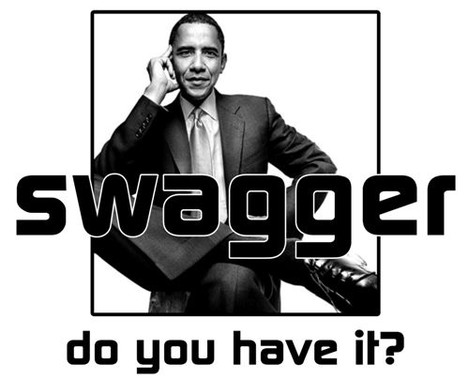
http://actingwhite.blogspot.com/2010/05/12-blacks-and-swagger-obama-too.html

Slide 2


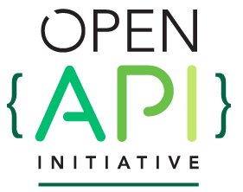
CF-Swagger
giving Cloud Foundry APIs their swagger back
Michael Maximilien (aka dr.max) @maximilien, IBM
Tony Tam @fehguy, SmartBear

Slide 3

agenda
what is swagger? what is CloudFoundry?
what part of CF could use swagger?
CF Service Broker APIs
docs,
server, clients,
tests and TCK
value of TCK survey results
what next?
‹#›

Slide 4
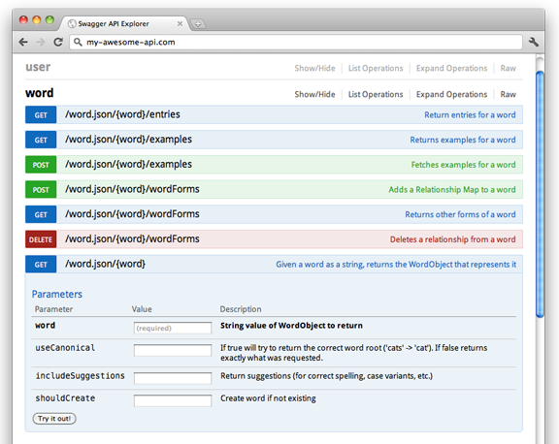
What is Swagger?
Not just a Pretty UI
A contract for APIs
A complete prescription to produce or consume an API
Rich tooling support across lifecycle
An Open Spec under the Linux Foundation

Slide 5
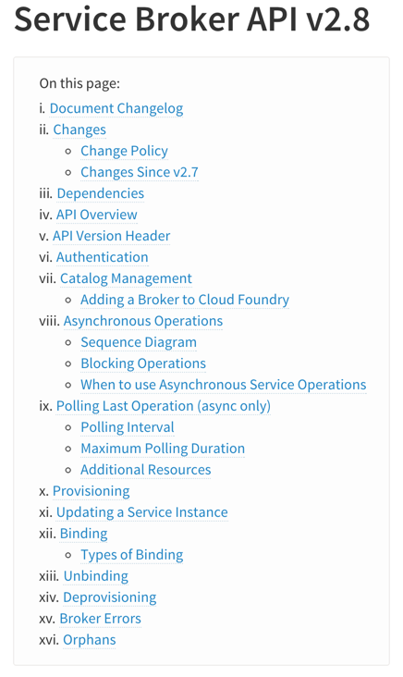
So you want to API?
As a consumer
What do you call? Read the docs?
Hope for a (decent SDK)?
What are the parameters? What is the payload?
As a provider
Accurate documentation is hard
Making SDKs is hard
Supporting users is really, really hard
And in general…
Writing boilerplate code blows

Slide 6
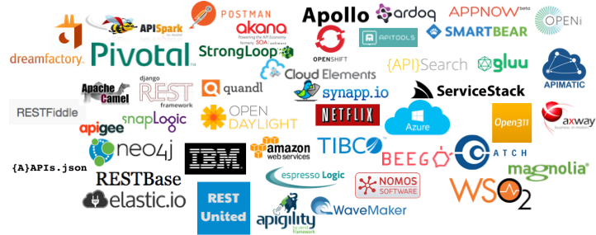
How can Swagger Help?
Design + Document your API interface
Generate client & server code
Let you write your business logic
Iterate and repeat
‹#›

Slide 7
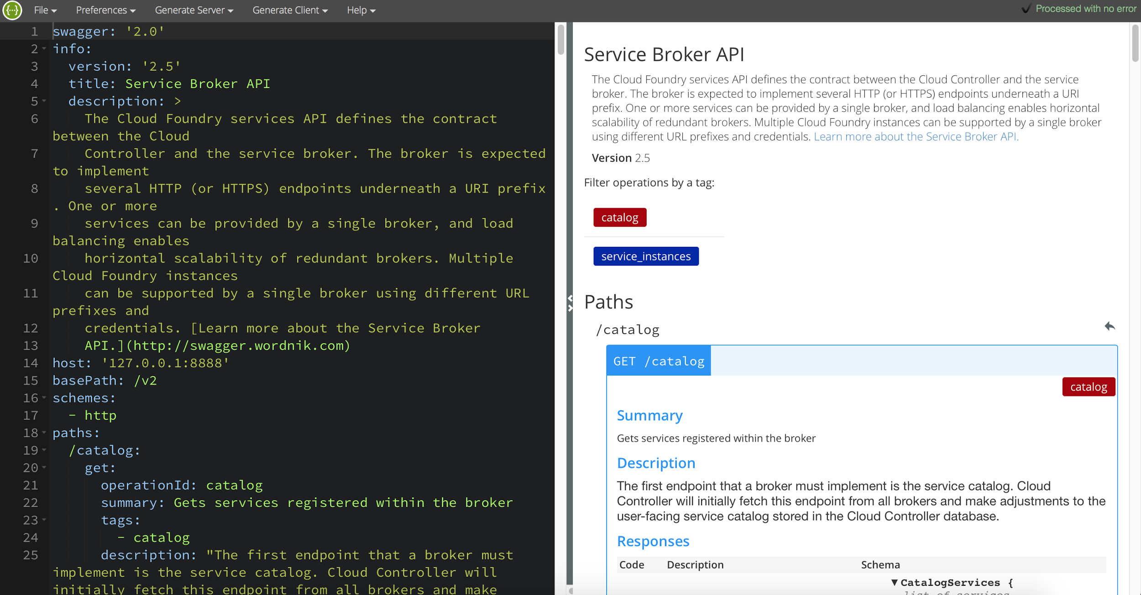
what is swagger? interactive editor
‹#›

Slide 8
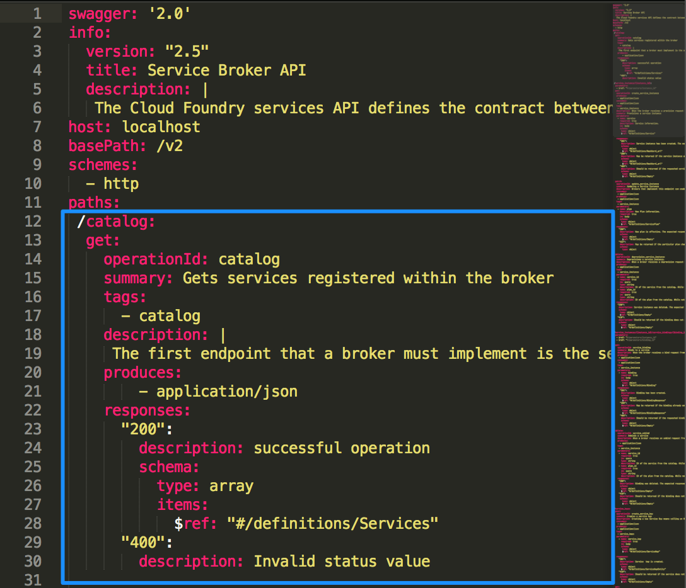
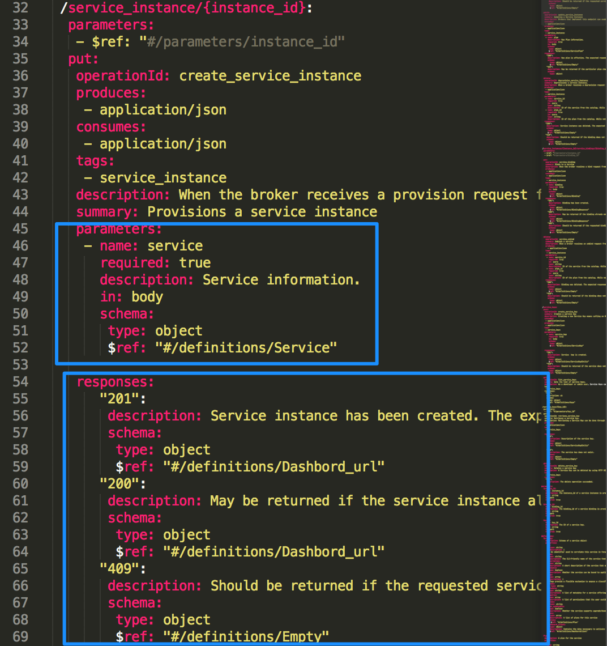
what is swagger? spec details
‹#›

Slide 9
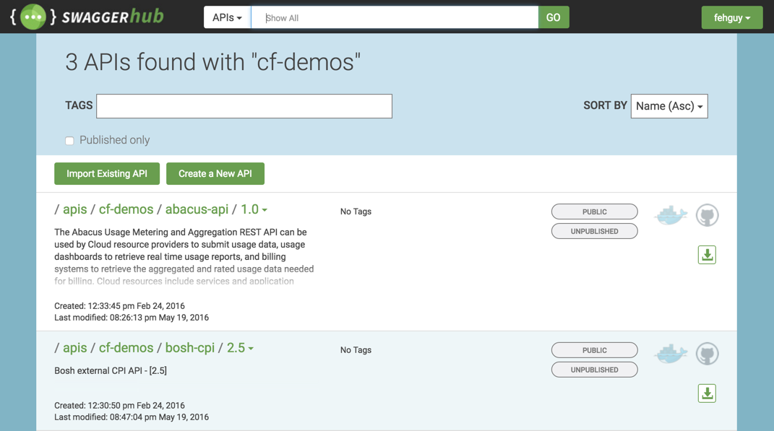
An ecosystem of tooling
‹#›

Slide 10
Why does this matter to CF?
New services need…
Implement the CF broker API
Service implementation
A client SDK or docs for calling the service

Slide 11
what is swagger? demo
Demo
‹#›

Slide 12
what is CloudFoundry?
the basis of Bluemix
a complete PaaS… it’s also OSS
agnostic to lang. framework, cloud, and services
high-density container-based runtime with Diego
extensible via service broker model
managed by foundation
50+ member companies and growing
interactive set of components via APIs
‹#›

Slide 13
cf-swagger
describe all CF APIs (eventually)
CF services: broker APIs
CF Cloud Controller: v3
UAA APIs
generate API docs
generate API client and servers (stubs)
generate test suites for API servers
generate Test Compatibility Kits
‹#›

Slide 14
cf-swagger: service broker APIs
API docs
server generation
extending the swagger spec
prototypes for
unit and integration tests generation
Test Compliance Kit (TCK) generation
‹#›

Slide 15
cf-swagger: why a TCK?
some CF APIs are “plugins” or “extensions”
designed to allow many (1K+) providers
heterogeneous supporting lots of versions
tests are templatized-able and tedious
TCK is meant for
verifying compliance level of broker
tell you what part of spec is not supported
‹#›

Slide 16
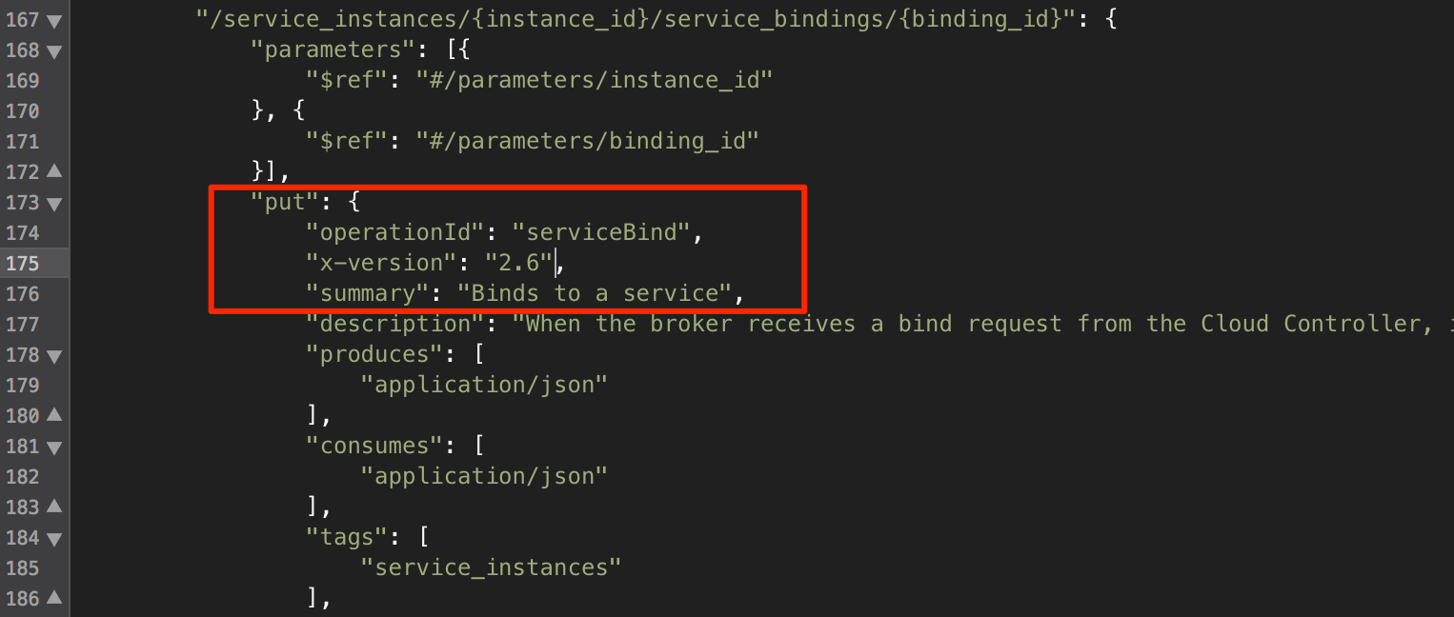
cf-swagger: spec extensions
‹#›

Slide 17
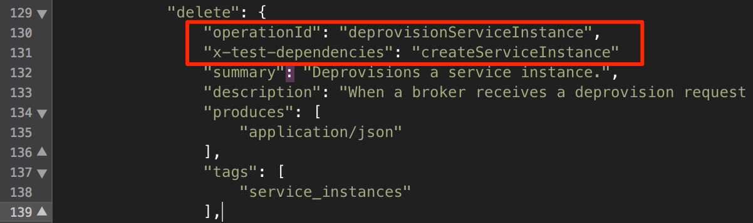
cf-swagger: spec extensions (cont.)
‹#›

Slide 18
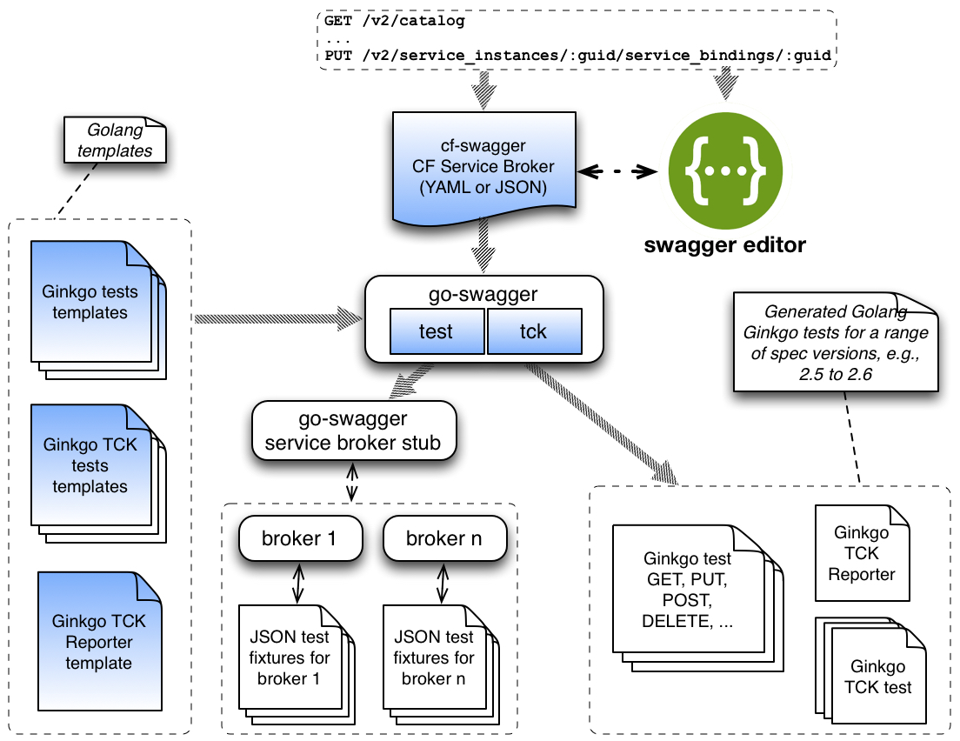
cf-swagger: TCK generation high-level overview
‹#›

Slide 19
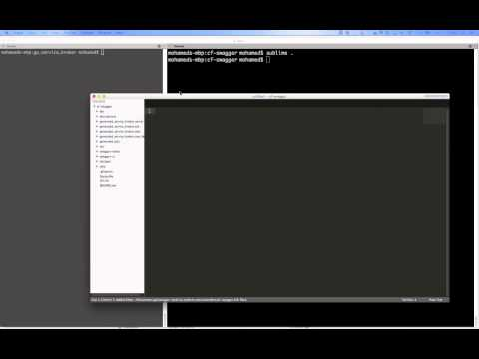
cf-swagger: demo 2
Demo 2
swagger spec extension for test and TCK
go-swagger test command
go-swagger tck command
running tests with real broker
Youtube Video: goo.gl/C8Nz5p
‹#›

Slide 20
existing solutions for CF service broker TCK
Bluemix: servicebrokertest
manually created
stuck at v2.3 of spec
Others?
CATs services tests
manual, indirectly with CF CLI
‹#›

Slide 21
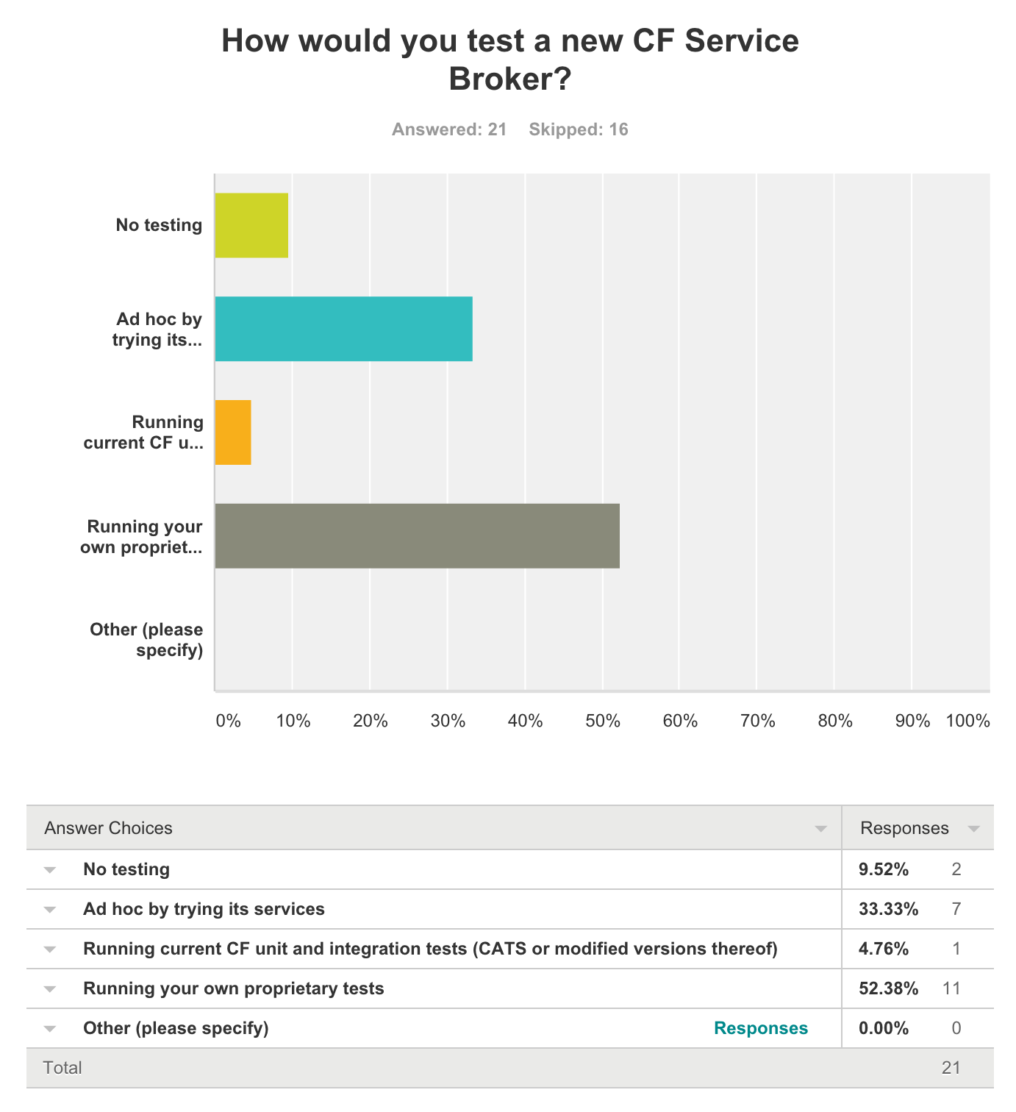
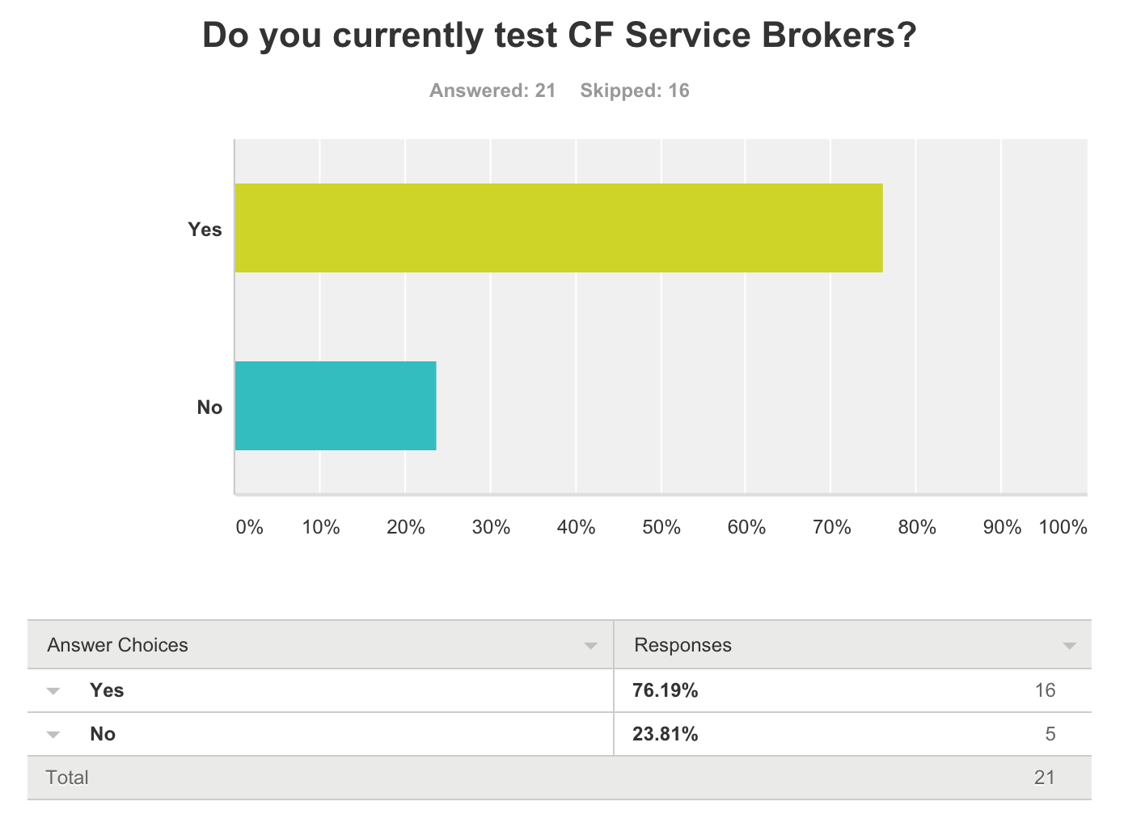
TCK utility: survey results
‹#›

Slide 22
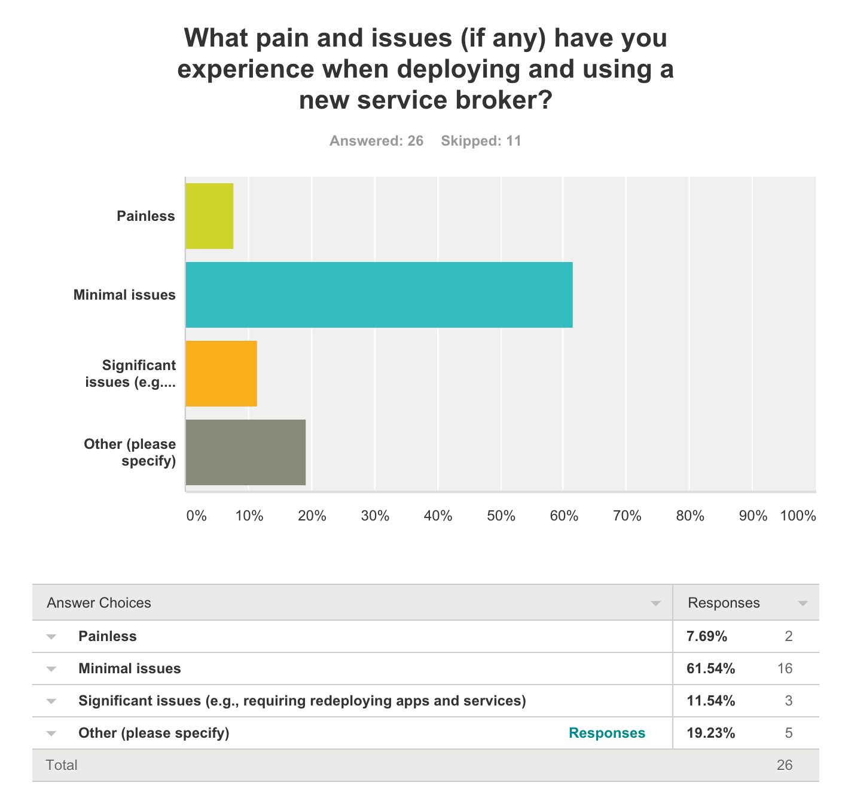
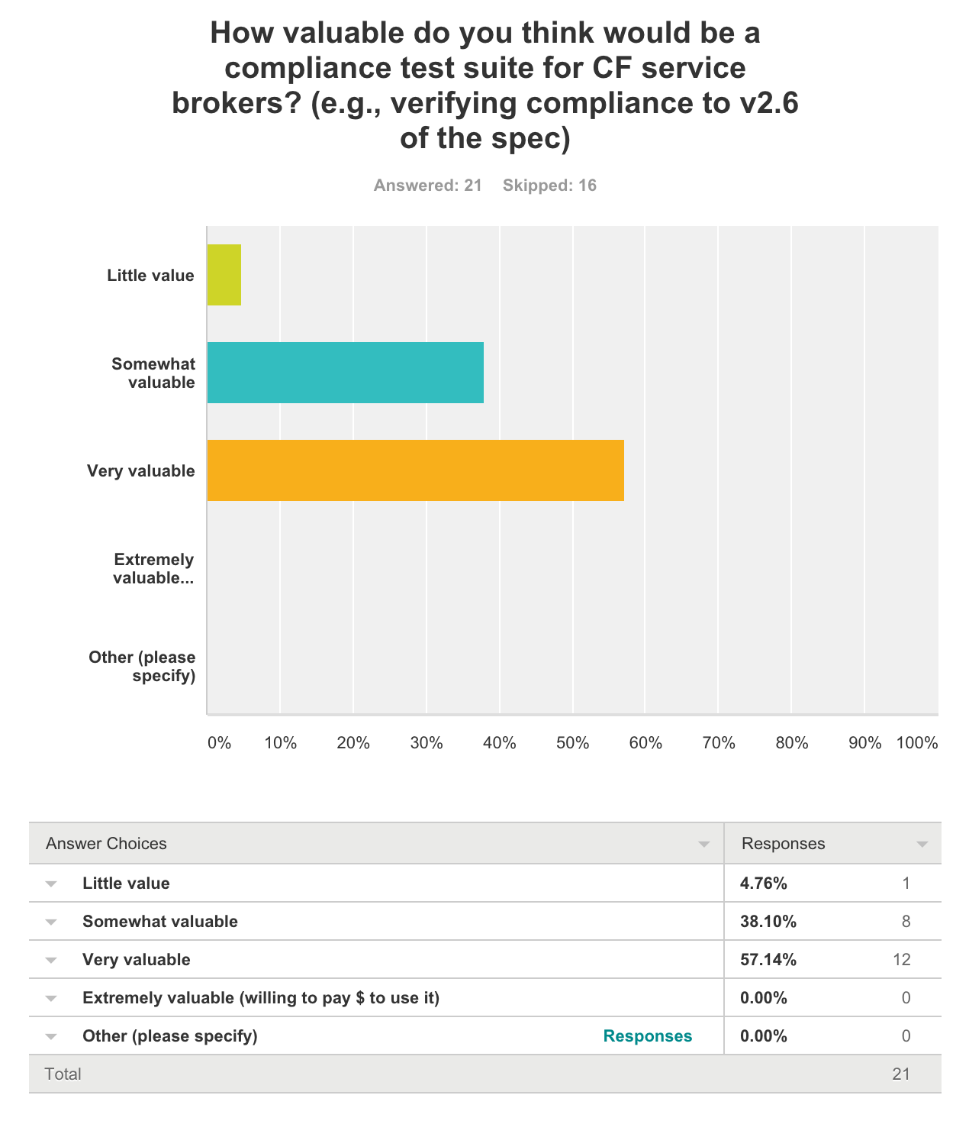
TCK utility: survey results (cont.)
‹#›

Slide 23
what next?
TCK
complete and harden the code generation
submit code-generation changes to go-swagger
explore describing other CF APIs
CC v3 (?)
UAA, CF-Abacus, BOSH
socialize with CF community
‹#›

Slide 24

thank you and QAs
credit: http://knowyourmeme.com/photos/522333-language
‹#›

Slide 25
references
https://github.com/maximilien/cf-swagger
‹#›

Slide 26
backup
backup
‹#›

Slide 27
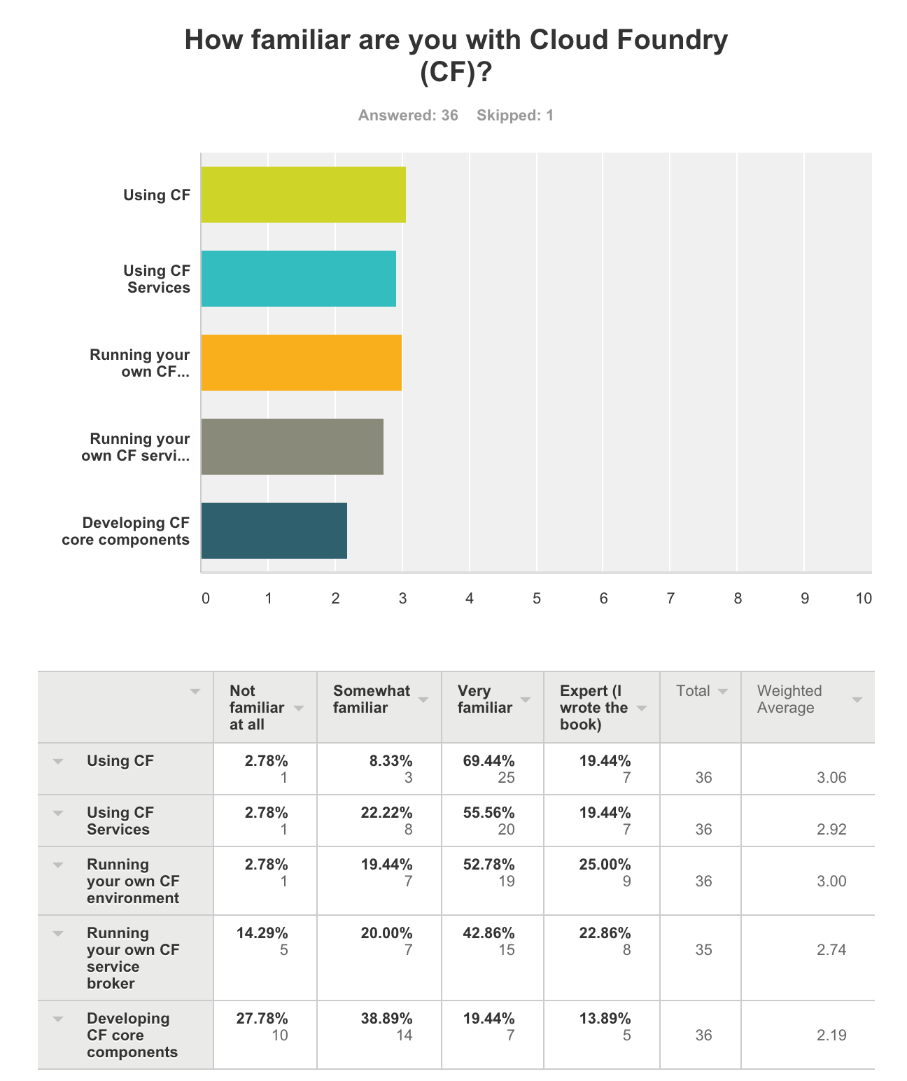
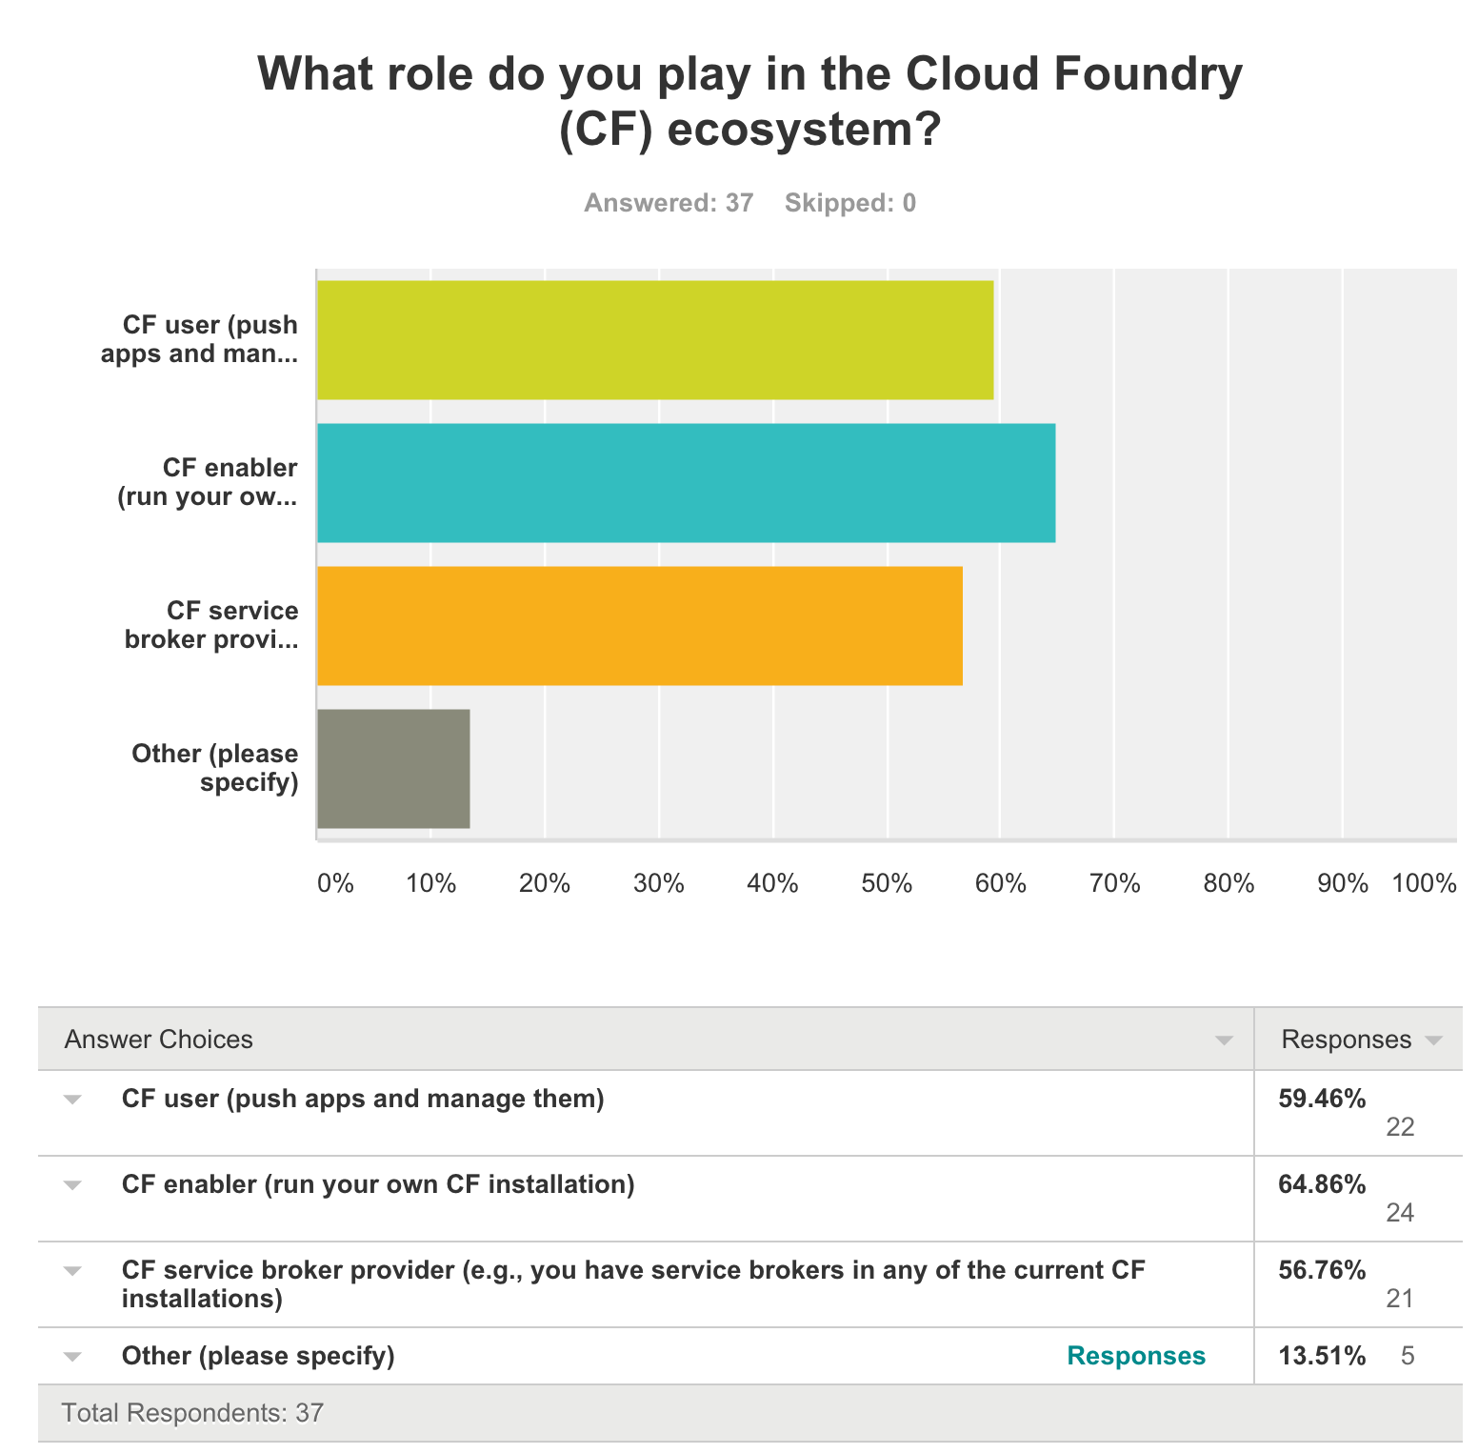
TCK utility: survey results
‹#›

Slide 28
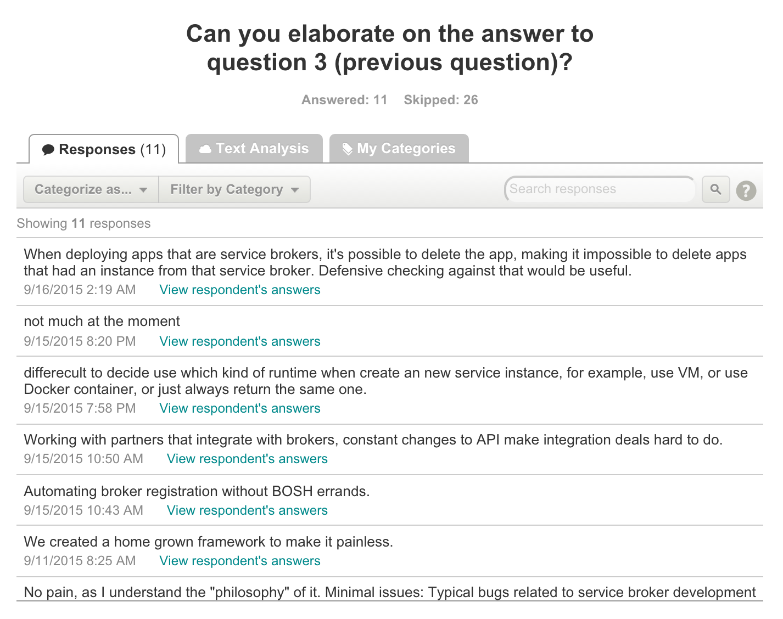
TCK utility: survey results
‹#›

Slide 29
Please Note:
IBM’s statements regarding its plans, directions, and intent are subject to change or withdrawal without notice at IBM’s sole discretion.
Information regarding potential future products is intended to outline our general product direction and it should not be relied on in making a purchasing decision.
The information mentioned regarding potential future products is not a commitment, promise, or legal obligation to deliver any material, code or functionality. Information about potential future products may not be incorporated into any contract.
The development, release, and timing of any future features or functionality described for our products remains at our sole discretion.
Performance is based on measurements and projections using standard IBM benchmarks in a controlled environment. The actual throughput or performance that any user will experience will vary depending upon many factors, including considerations such as the amount of multiprogramming in the user’s job stream, the I/O configuration, the storage configuration, and the workload processed. Therefore, no assurance can be given that an individual user will achieve results similar to those stated here.
‹#›

Slide 30
Notices and Disclaimers Con’t.
Information concerning non-IBM products was obtained from the suppliers of those products, their published announcements or other publicly available sources. IBM has not tested those products in connection with this publication and cannot confirm the accuracy of performance, compatibility or any other claims related to non-IBM products. Questions on the capabilities of non-IBM products should be addressed to the suppliers of those products. IBM does not warrant the quality of any third-party products, or the ability of any such third-party products to interoperate with IBM’s products. IBM EXPRESSLY DISCLAIMS ALL WARRANTIES, EXPRESSED OR IMPLIED, INCLUDING BUT NOT LIMITED TO, THE IMPLIED WARRANTIES OF MERCHANTABILITY AND FITNESS FOR A PARTICULAR PURPOSE.
The provision of the information contained h erein is not intended to, and does not, grant any right or license under any IBM patents, copyrights, trademarks or other intellectual property right.
IBM, the IBM logo, ibm.com, Aspera®, Bluemix, Blueworks Live, CICS, Clearcase, Cognos®, DOORS®, Emptoris®, Enterprise Document Management System™, FASP®, FileNet®, Global Business Services ®, Global Technology Services ®, IBM ExperienceOne™, IBM SmartCloud®, IBM Social Business®, Information on Demand, ILOG, Maximo®, MQIntegrator®, MQSeries®, Netcool®, OMEGAMON, OpenPower, PureAnalytics™, PureApplication®, pureCluster™, PureCoverage®, PureData®, PureExperience®, PureFlex®, pureQuery®, pureScale®, PureSystems®, QRadar®, Rational®, Rhapsody®, Smarter Commerce®, SoDA, SPSS, Sterling Commerce®, StoredIQ, Tealeaf®, Tivoli®, Trusteer®, Unica®, urban{code}®, Watson, WebSphere®, Worklight®, X-Force® and System z® Z/OS, are trademarks of International Business Machines Corporation, registered in many jurisdictions worldwide. Other product and service names might be trademarks of IBM or other companies. A current list of IBM trademarks is available on the Web at "Copyright and trademark information" at: www.ibm.com/legal/copytrade.shtml.
‹#›

Slide 31
Notices and Disclaimers
Copyright © 2016 by International Business Machines Corporation (IBM). No part of this document may be reproduced or transmitted in any form without written permission from IBM.
U.S. Government Users Restricted Rights - Use, duplication or disclosure restricted by GSA ADP Schedule Contract with IBM.
Information in these presentations (including information relating to products that have not yet been announced by IBM) has been reviewed for accuracy as of the date of initial publication and could include unintentional technical or typographical errors. IBM shall have no responsibility to update this information. THIS DOCUMENT IS DISTRIBUTED "AS IS" WITHOUT ANY WARRANTY, EITHER EXPRESS OR IMPLIED. IN NO EVENT SHALL IBM BE LIABLE FOR ANY DAMAGE ARISING FROM THE USE OF THIS INFORMATION, INCLUDING BUT NOT LIMITED TO, LOSS OF DATA, BUSINESS INTERRUPTION, LOSS OF PROFIT OR LOSS OF OPPORTUNITY. IBM products and services are warranted according to the terms and conditions of the agreements under which they are provided.
Any statements regarding IBM's future direction, intent or product plans are subject to change or withdrawal without notice.
Performance data contained herein was generally obtained in a controlled, isolated environments. Customer examples are presented as illustrations of how those customers have used IBM products and the results they may have achieved. Actual performance, cost, savings or other results in other operating environments may vary.
References in this document to IBM products, programs, or services does not imply that IBM intends to make such products, programs or services available in all countries in which IBM operates or does business.
Workshops, sessions and associated materials may have been prepared by independent session speakers, and do not necessarily reflect the views of IBM. All materials and discussions are provided for informational purposes only, and are neither intended to, nor shall constitute legal or other guidance or advice to any individual participant or their specific situation.
It is the customer’s responsibility to insure its own compliance with legal requirements and to obtain advice of competent legal counsel as to the identification and interpretation of any relevant laws and regulatory requirements that may affect the customer’s business and any actions the customer may need to take to comply with such laws. IBM does not provide legal advice or represent or warrant that its services or products will ensure that the customer is in compliance with any law
‹#›

