Slide 1
UAA Concepts and Overview
25 Feb 2013

Slide 2
introduction
too many passwords are making us crazy: http://www.youtube.com/watch?v=2tJ-NSPES9Y
how many passwords vs bank/credit accounts do you have and why?
password managers are single point of failure: http://www.miamiherald.com/2012/09/13/3000801/miami-federal-jury-convicts-man.html
more importantly, we need to control authorization not just reduce passwords: http://www.schneier.com/blog/archives/2008/07/disgruntled_emp.html
the uaa aims to conveniently manage proof of authorization: http://xkcd.com/149/

Slide 3
illustration: selling a car
Bank
Joe,
used car
broker
Me, selling
a rusty 2000
nissan pathfinder*
3. Sam gives the check to Joe, but it's
signed by the bank.
4. Joe gives the check to me in
exchange for the car. I don't really care who Joe and Sam are, the check authorizes the transaction
and it's guaranteed by the bank.
2. Sam authenticates and gets a cashier's check.
Sam
1. Sam tells Joe he'll
take the pathfinder.
Joe replies that he'll
need a cashiers check
for the purchase price.
* the pathfinder is actually for sale.

Slide 4
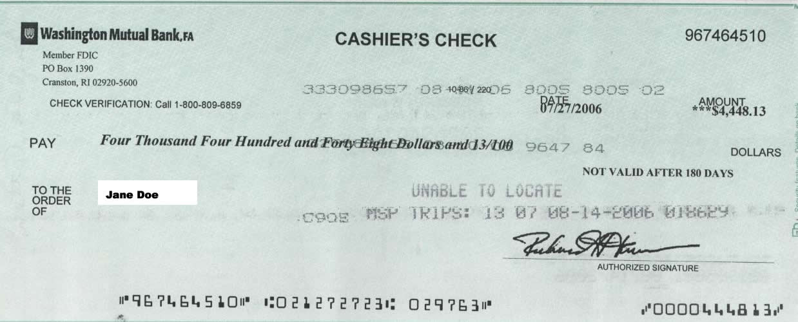
cashier's check
issuing bank
check number
account and name
authorized amount
issued at date
expiration date
recipient
authorized signature

Slide 5
illustration in oauth2 terms
authorization
server
(bank)
client
application
(joe broker)
resource server
(me with pathfinder)
3. user is redirected
back to the client app
which gets the token.
4. client app presents token to resource server to authorize access.
2. user authenticates and approves release of token containing proof of authorization.
resource
owner
(user)
1. user accesses application
but is not authorized. Application
redirects user to the authorization
server with instructions of
what authorization to request

Slide 6
json web token – jwt (uaa cashier's check)
jwt is an ietf standard, pronounced jot
base64 encoded parts separated by periods
header.content.signature
header indicates signature algorithm
contents:
iss: issuer
jti: token id
sub: user id
scope: authorization
iat: issued at
exp: expiration
aud: audience
others: user name, email, client id

Slide 7
illustration in cloud foundry terms
authorization
server
(uaa)
client
application
(portal, vmc,
cloudbees,
etc)
resource server
(cloud controller)
3. user is redirected
back to the client app
which gets the token.
4. client app presents token to resource server to authorize access.
2. user authenticates and approves (explicitly or automatically) release of token containing proof of
authorization.
resource
owner
(user)
1. user accesses application
but is not authorized. application
redirects user to the authorization
server to request authorization.

Slide 8
implicit grant
authorization
server
(uaa)
client
application
resource server
(cloud controller)
3. user is redirected
back to the client app
with an access token
in location fragment
5. client app presents access token to resource server to authorize access. client app can use access token until it expires.
2. user authenticates and approves release of token containing proof of authorization.
access token is exposed to user's agent.
access token lifetime is longest interval user cannot revoke access.
client id, redirect urls must be registered – no secret
generally a less secure and less convenient grant – avoid if possible
resource
owner
via user
agent
(browser)
1. user accesses application
but is not authorized.
application redirects user to
the authorization server to
request authorization.

Slide 9
authorization code grant (and refresh token grant)
4. client redeems auth code for access and refresh tokens.
authorization
server
(uaa)
client
application
(portal,
cloudbees,
etc)
resource server
(cloud controller)
3. user is redirected
back to the client app
with an authorization code.
5. client app presents access token to resource server to authorize access. client app can use refresh token to request new access token on expiration.
2. user authenticates and approves release of token containing proof of authorization.
access and refresh tokens aren't exposed to user's agent.
access token lifetime is longest interval user cannot revoke access.
refresh token lifetime is interval before user has to re-authenticate.
client id, secret, redirect urls must be registered
resource
owner
via user
agent
(browser)
1. user accesses application
but is not authorized.
application redirects user to
the authorization server to
request authorization.

Slide 10
implicit grant with credentials (deprecated)
authorization
server
(uaa)
resource server
(cloud controller)
3. authorization server returns a redirect with access token in the location fragment
4. app presents access token to resource server to authorize access. client app can use access token until it expires.
2. app posts user credentials to authenticate user and autoapprove release
of token containing proof of authorization,
requests implicit
grant.
access token is exposed to the user's machine.
access token lifetime is longest interval user cannot revoke access.
client registration and hardcoded, unnecessary redirect urls were problem
our extension to oauth that is now deprecated.
resource
owner
via native
app (vmc)
1. user accesses cloud
controller but is not authorized.
application gets prompts for
required credentials from
authorization server and
collects credentials

Slide 11
resource owner password grant (& refresh token grant)
authorization
server
(uaa)
resource server
(cloud controller)
3. returns to the app with an access token and a refresh token
4. app presents access token to resource server to authorize access. app can use access token until it expires, but can get a new access token with the refresh token
2. app posts user credentials to authenticate user and autoapprove release
of token containing proof of authorization,
requests password
grant.
access and refresh tokens are exposed to the user's machine.
access token lifetime is longest interval user cannot revoke access.
limited to user name and password.
for vmc, requires public client (no client secret).
resource
owner
via native
app (vmc)
1. user accesses cloud
controller but is not authorized.
application gets username
and password

Slide 12
client credentials grant
authorization
server
(uaa)
client
application
(portal,
cloudbees,
etc)
resource server
(cloud controller)
1. client authenticates and gets an access token with all its registered authorizations.
2. client app presents access token to resource server to authorize access.
access token lifetime is longest interval uaa cannot revoke access.
client id, secret must be registered

Slide 13
client registration contents
client id: name, e.g. vmc or portal
client secret: can be empty for a public client
authorized grant types
authorities: authority as the client, token scope for client credentials grant – think 'client scope'
scope: authority that can be requested for a user via all other grant types – think 'maximum user scope'
redirect uris
access token validity
refresh token validity
autoapprove scope

Slide 14
calculating client token scope
authenticate client id and secret via basic auth
validate request is client credentials grant
read client authorities
put it in the scope field of the token

Slide 15
calculating user token scope
if no scope is requested, the default is the scope registered for the requesting client
for each scope: if the user is in the group and the scope is either autoapprove or the user explicitly approves it, put it in the token.

Slide 16
calculating user token scope: details
given a list of scopes, a user, and a client
return error if the list of scopes includes a scope not in the client registration
if the list is empty, fill it with the scopes from the client registration
remove all scopes for which the user is not a member of the corresponding group – this is the possiblescopes list.
make a list of all remaining scopes that are not autoapproved (approvable)
get the stored approved and denied lists for this user and client
make a list of all scopes from the approvable list that are not on the approved or denied lists (unapproved)
if it's a refresh token and unapproved list is not empty, return error (the client must send the user through a new grant).
ask the user for approvals for all approved or denied scopes (with appropriate defaults), AND the unapproved scopes (as "new").
make a list of the possiblescopes that are now approved or autoapproved -- that's what goes in the token.

Slide 17
extensible authentication with a login server
4. client redeems auth code for access and refresh tokens.
allows authentication to be other than user name and password in uaa db.
supports graphics and branding for cloudfoundry rather than generic interface in uaa
login server may support saml, ldap, openid2 (google), oauth 1.1a (twitter), facebook, etc.
some login servers proxy the oauth2 token endpoint to the uaa.
we are working on making endpoints available from the /info endpoint on the login server: oauth2 token & authorize, scim users & groups, openid connect userinfo, etc.
login
server
uaa
client
application
(portal,
cloudbees,
etc)
3. user is redirected
back to the client app
with an authorization code.
2. user authenticates and approves release of token containing proof of authorization.
resource
owner
via user
agent
(browser)
1. user accesses application
but is not authorized.
application redirects user to
the authorization server to
request authorization.

Slide 18
openid connect
authorization
server
(uaa)
client
application
(portal,
cloudbees,
etc)
client can use access token to authorize access to a resource server, including the uaa's /userinfo endpoint.
/userinfo endpoint requires access token with openid scope
resource
owner
via user
agent
(browser)
openid connect also specifies another token type called an id_token which is not yet implemented.
the id_token represents the authentication event and its audience is the client, not the resource server.
it essentially contains information about the user's session with the uaa

Slide 19
simple cloud identity management - scim
ietf draft changed name to system for cross-domain identity management.
rest apis for managing user accounts, groups, and client registrations
supports read, create, delete, full update, query
partial update not yet implemented
primarily designed for provisioning, but provides enough directory-like capabilities for what we need.

Slide 20
using uaac
based on cf-uaa-lib, which is available from rubygems with damn fine documentation
targets a uaa or login server similar to how vmc targets a cloud controller
saves state in ~/.uaac.yml
a context is relative to a target and contains an access token (and possibly a refresh token) for a specific user or client
supports multiple targets, each with multiple contexts

Slide 21
demo uaac

