Slide 1
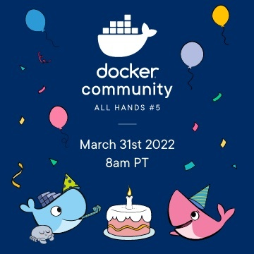
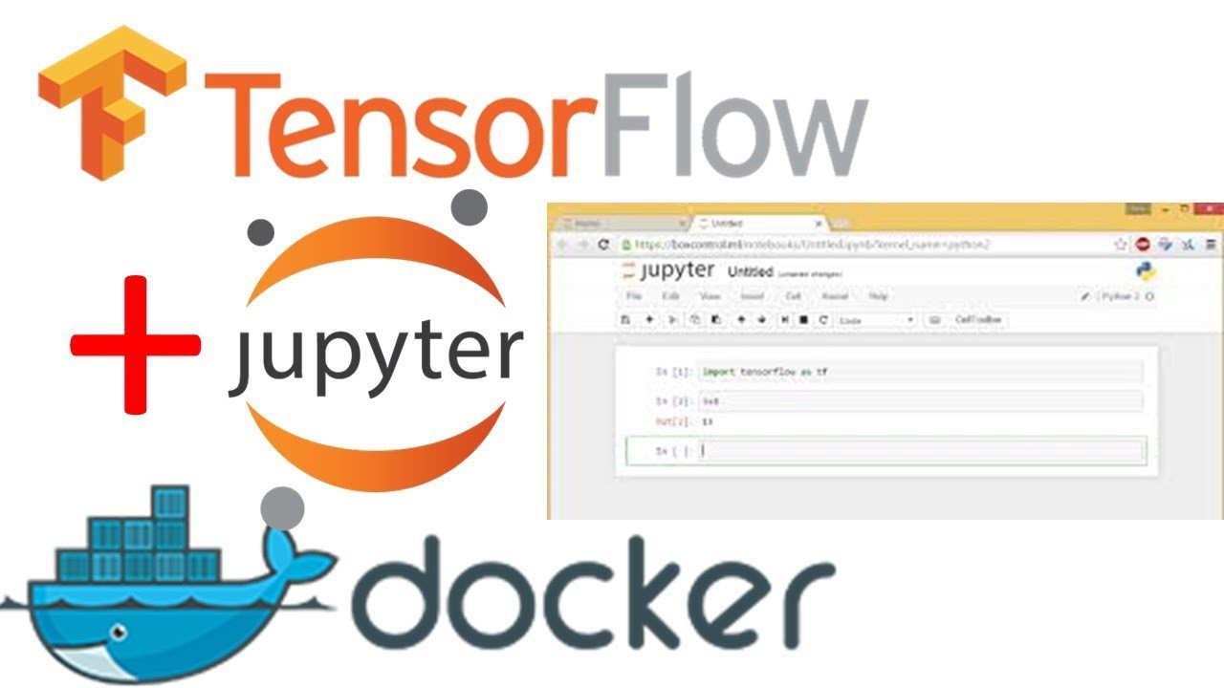
Machine Learning with TensorFLow Object Detection running on Docker

Slide 2


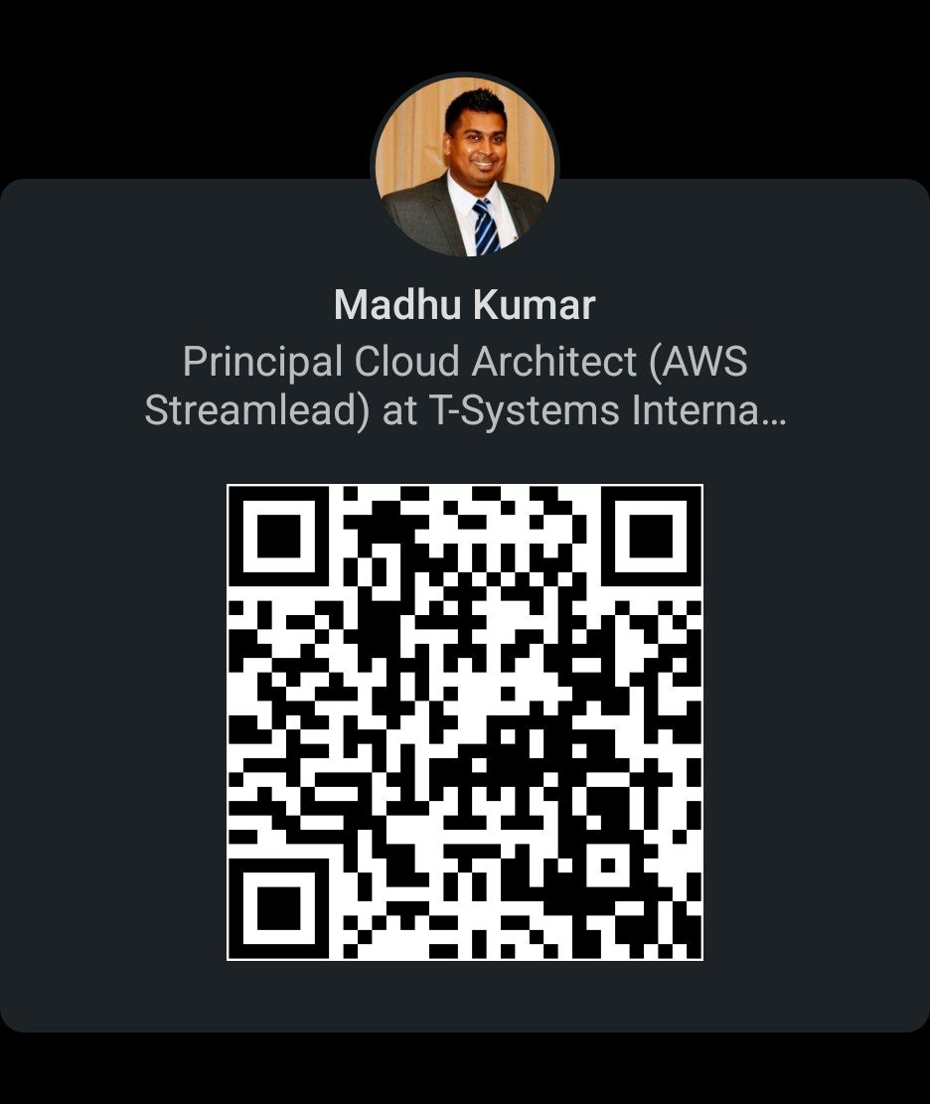
54455816
About the Speaker
Yeluri, Madhu Kumar
Madhu is a qualified Principal Cloud Architect and Senior DevSecOps Consultant with over 21 years of IT experience working across multiple regions including Asia, Middle East, the US, Europe and the UK. He is helping many customers transform their business using the cloud. He is leading diverse teams to driving change and deliver business value at scale.
A certified Amazon Web Services (AWS) Solution Architect and Security Specialist. Product Owner for Container services (Docker, K8s, AWS ECS and EKS). He has worked with many Cloud Partners/Providers (AWS, Rackspace, Wipro, Google, Oracle, Azure, IBM and Vodafone) and successfully managed and implemented multiple Cloud migration projects replacing business-critical core legacy systems across the Telecom, Financial, Banking, Insurance, Retail, and Government sectors.
Yeluri, Madhu Kumar
Principal Cloud Architect @ T-Systems International
Budapest, Hungary

Slide 3
54455816
Agenda
Surprising Facts about Docker Adoption
TensorFlow
Create the Dockerfile
Build the Dockerfile (Demo)
Run the Docker Image (Demo)
Object Detection API (Demo)
Conclusion
Questions

Slide 4
54455816
Surprising Facts about Docker Adoption
Nearly One Quarter of Companies Have Adopted Docker
Docker Now Runs on More Than 20% of Hosts
Docker Usage Rates Increase with Infrastructure Size
Half of Docker Environments Are Orchestrated
The Average Size of a Docker Deployment Has Grown 75% in One Year
The Most Widely Used Images Are NGINX, Redis, and Postgres
The Median Docker Organization Runs Eight Containers per Host
Orchestrated Containers Churn 12x Faster
Source: https://www.datadoghq.com/docker-adoption

Slide 5
54455816
TensorFlow
TensorFlow is a free and open-source software library for machine learning and artificial intelligence. It can be used across a range of tasks but has a particular focus on training and inference of deep neural networks.
TensorFlow was developed by the Google Brain team for internal Google use in research and production. The initial version was released under the Apache License 2.0 in 2015. Google released the updated version of TensorFlow, named TensorFlow 2.0, in September 2019.

Slide 6
54455816
FROM "ubuntu:bionic"
RUN apt-get update && yes | apt-get upgrade
RUN mkdir -p /tensorflow/models
RUN apt-get install -y git python-pip
RUN pip install --upgrade pip
RUN pip install tensorflow
RUN apt-get install -y protobuf-compiler python-pil python-lxml
RUN pip install jupyter
RUN pip install matplotlib
RUN git clone https://github.com/tensorflow/models.git /tensorflow/models
WORKDIR /tensorflow/models/research
RUN protoc object_detection/protos/*.proto --python_out=. RUN export PYTHONPATH=$PYTHONPATH:`pwd`:`pwd`/slim
RUN jupyter notebook --generate-config --allow-root
RUN echo "c.NotebookApp.password = u'sha1:6a3f528eec40:6e896b6e4828f525a6e20e5411cd1c8075d68619'" >> /root/.jupyter/jupyter_notebook_config.py
EXPOSE 8888
CMD ["jupyter", "notebook", "--allow-root", "--notebook-dir=/tensorflow/models/research/object_detection", "--ip=0.0.0.0", "--port=8888", "--no-browser"]
Create the Dockerfile

Slide 7
54455816
Demo

Slide 8
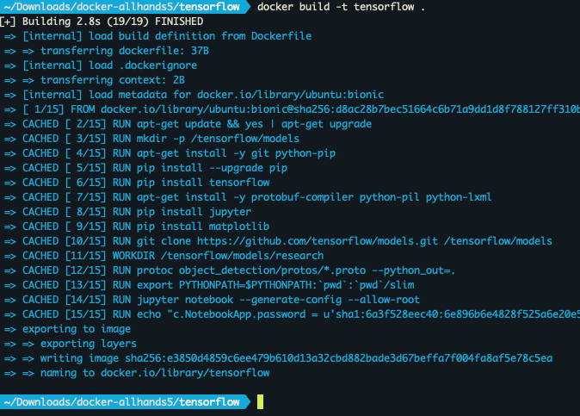
54455816
Build the Docker image
Build the Docker image
docker build -t tensorflow .

Slide 9
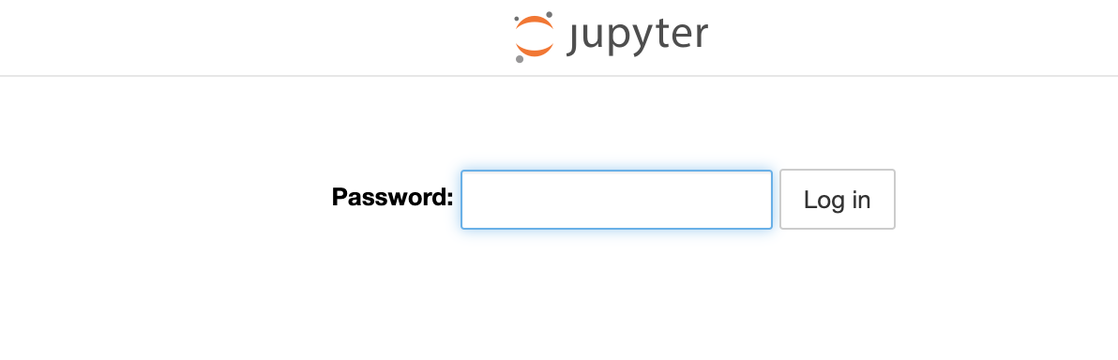
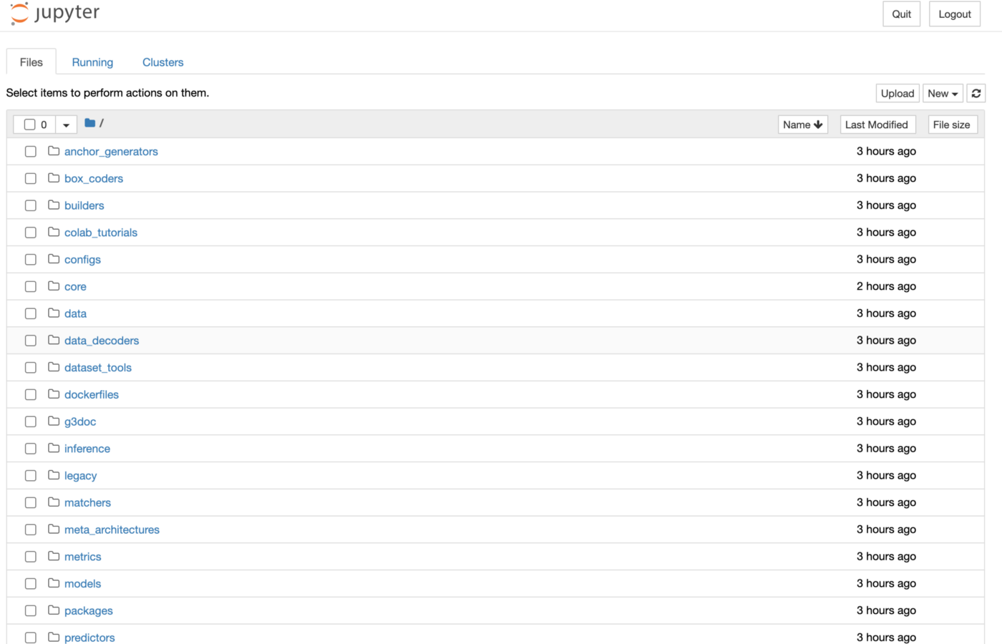
54455816
Run the Docker Image
Run the Docker container
docker run --rm --name tensorflow -p 8888:8888 -d tensorflow
Run the Docker container
Open http://localhost:8888

Slide 10
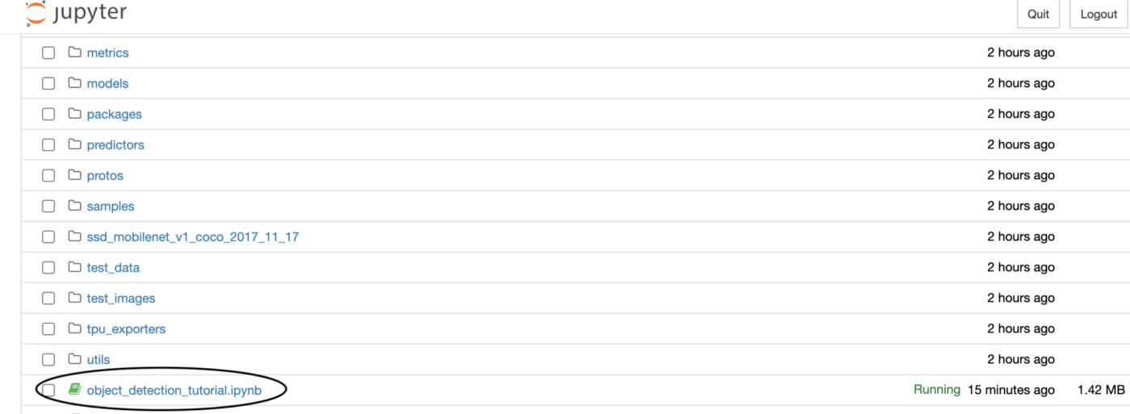
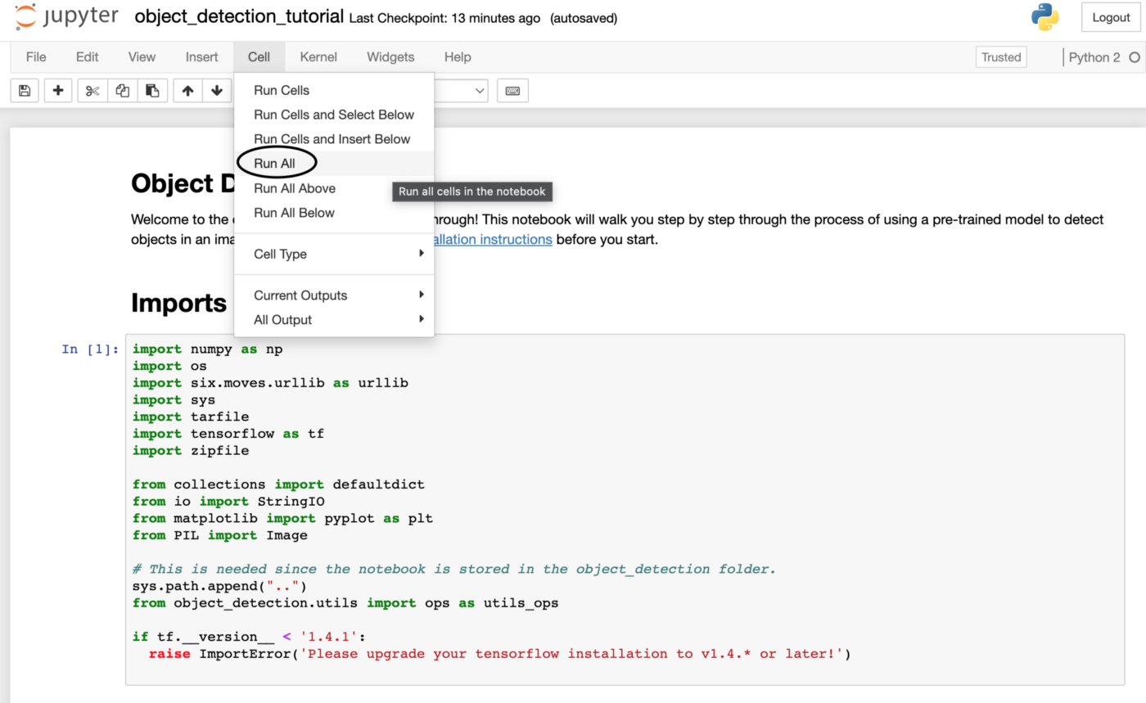
54455816
Object Detection API Demo
Run the object detection from the menu “Cell → Run all”

Slide 11
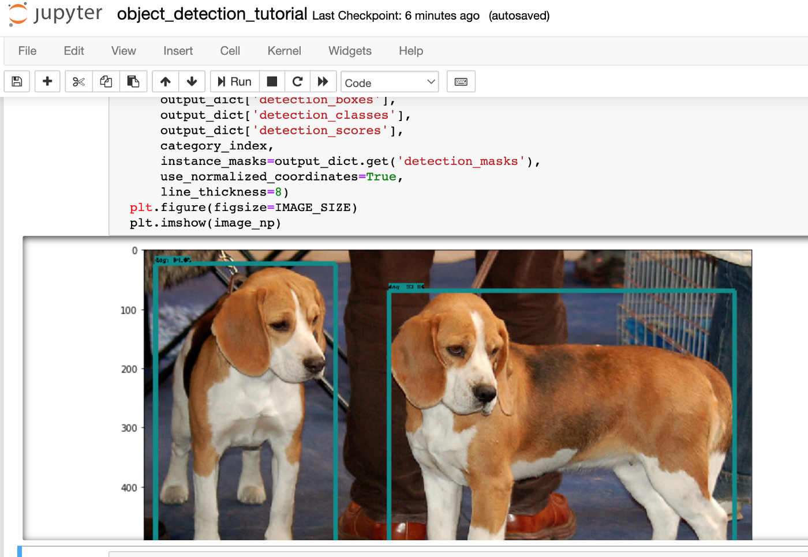
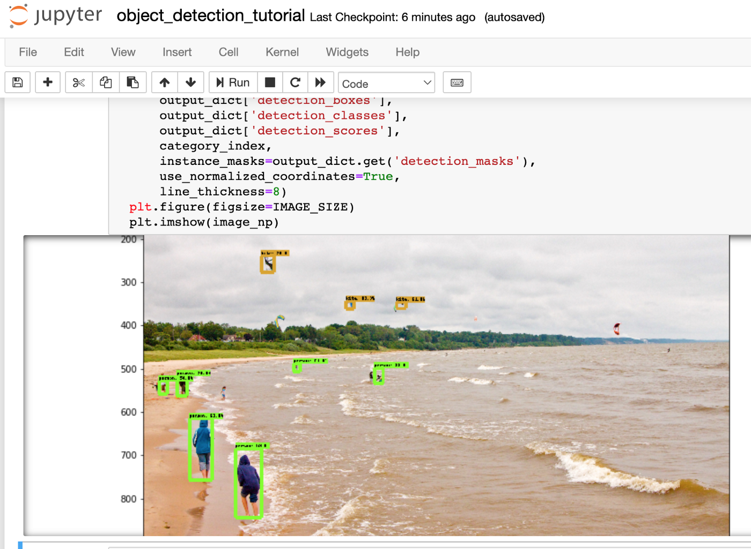
54455816
Results of the object detection

Slide 12
54455816
Stop the TensorFlow Docker container
docker rm -f tensorflow

Slide 13
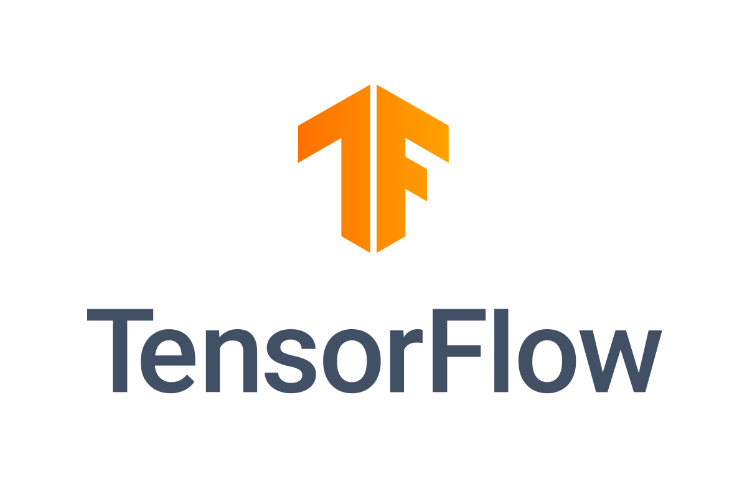
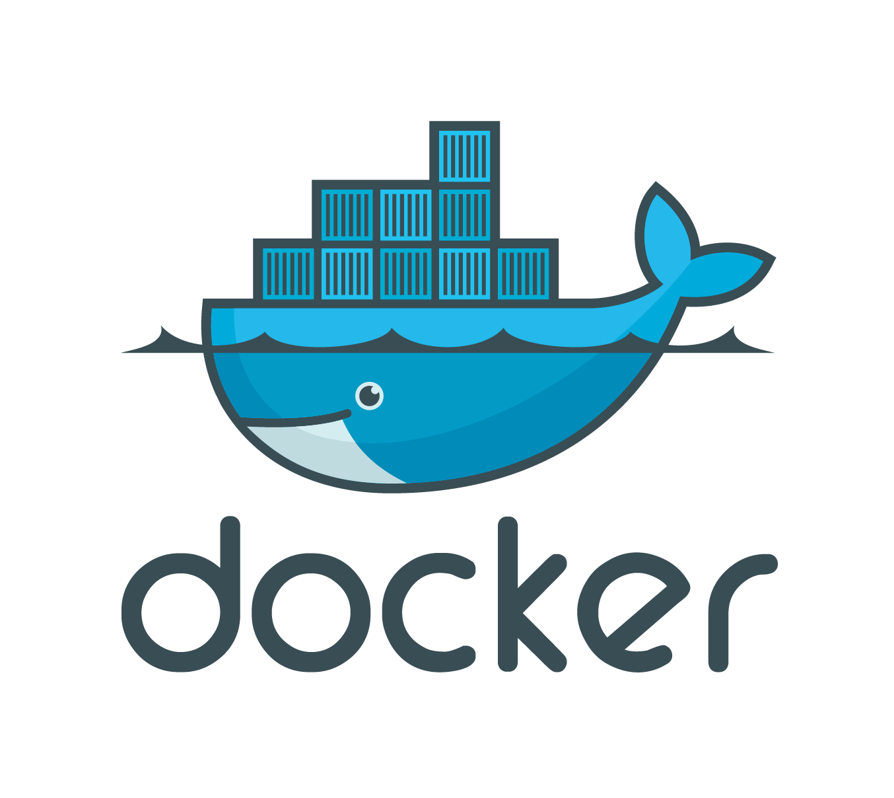
54455816
Conclusion
Why Docker?
Docker is my favourite containerisation platform. Why? Docker provides a way to run applications securely isolated in a container, packaged with all its dependencies and libraries which are required for the application to run. Please refer to my other Docker blogs for more learning on Docker.
Why TensorFlow?
TensorFlow supports various platforms for deploying ML models, be it desktop, mobile, web, or even cloud. Models can be trained using different programming languages like Python, JavaScript, or Swift.
As per the StackOverflow Developers Survey 2020, TensorFlow is one of the most popular frameworks among developers. Around 65% of the surveyed respondents have expressed their interest in continuing to develop models using TensorFlow. Also, with Google’s support, the library will be enhanced regularly to fulfill the growing needs of developers.

Slide 14
54455816
Questions

