Slide 1
Microservices e gRPC
Sviluppo di un’architettura basata sui microservizi utilizzando gRPC, .NET5, Blazor e Angular

Slide 2
Agenda
gRPC ?!?!
Novità .NET 5
Demo
Risorse

Slide 3

Personal profile
@morwalpiz
morganpizzini
MORGAN PIZZINI
morganpizzini

Slide 4
#CodeGen2021

Slide 5



gRPC ?!?!
Framework open source RPC
Cloud Native Computing Foundation
Costruito sopra
HTTP/2
Protobuf
Principi guida
Performance
Cross platform
+
=

Slide 6

Remote Procedure Calls vs HTTP APIs
Remote Procedure Calls
HTTP APIs
Contract first (proto file)
Content first (URL, HTTP method, JSON)
Computer-readable
Human-readable
Complessità gestita
HTTP
Performance
Vantaggio per il developer
Ampia diffusione
Facilità 101

Slide 7


Novità .NET 5
gRPC Web browser support
gRPC Web server middleware
gRPC Web Blazor client
Nuovo hosts gRPC su Windows
HTTP.sys
IIS
Inter process communication
.NET 5 <> .NET CORE 3.1

Slide 8
Performance – HTTP/2
HTTP/2 multiplexing
Più chiamate tramite singola connessione TCP
Rimozione “head of line blocking”

Slide 9
Performance - Bandwidth
Ottimizzazione del trasporto
Compressione header derivante da HTTP/2
Serializzazione Protobuf
{
"query": "myQuery",
"page_number": 42,
"result_per_page": 100,
"tickers": [
{
"name": "rPs",
"value": 9.768923
},
{
"name": "WEo",
"value": 6.067048
}
]
}
5052 4920 2a20 4854 5450 2f32
0d0a 534d 0d0a 0d0a 0000 0004
0000 0000 0401 0000 0000 0000

Slide 10
Performance - .NET5 improvements
HTTP/2 riduce allocazioni server del 92%
Compressione Hpack
Serializzazione Protobuf tramite Span<T>
Server requests/sec +65%
Client request/sec +220%

Slide 11
#CodeGen2021
DEMO
Console app e Blazor/Angular con gRPC

Slide 12
gRPC web client
Blazor
Grpc.Net.Client.Web Grpc.Net.ClientFactory Grpc.Net.Client Google.Protobuf Grpc.Tools
gRPCWeb
CORS
Angular / typescript
@improbable-eng/grpc-web
google-protobuf
grpc protoc
ts-protoc-gen
./node_modules/protoc/protoc/bin/protoc --plugin=protoc-gen-ts=./node_modules/.bin/protoc-gen-ts --js_out=import_style=commonjs,binary:src/app/proto --ts_out=service=true:src/app/proto -I ../protos/ ../protos/**/*.proto

Slide 13
Risorse - Docs
Tutorial 101
Creazione Chiamate servizi gRPC
Creazione messaggi Protobuf
Versionamento gRPC
gRPC new browser
gRPC e JSON Web APIs
Best practices
[…]
https://aka.ms/grpcdocs

Slide 14
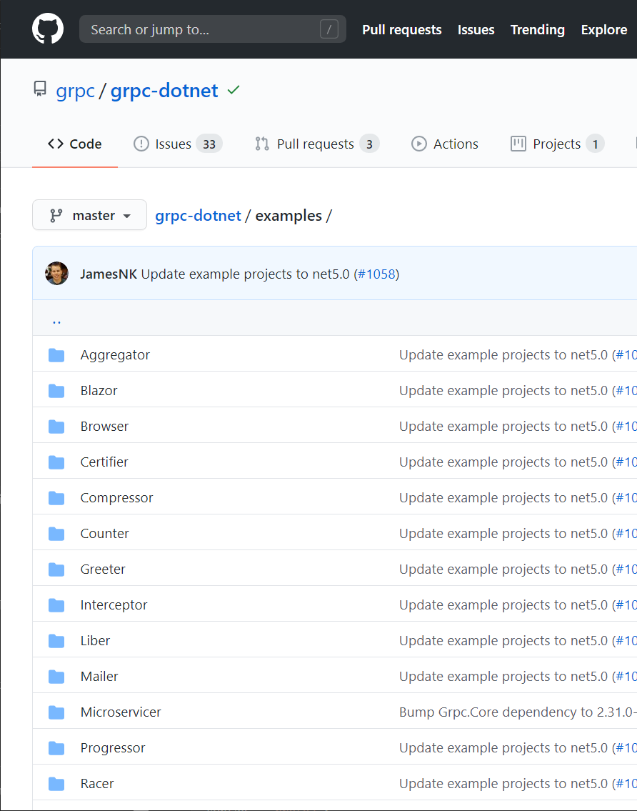
Esempi
Hello world
Streaming
Certificate authentication
JWT authentication
OpenTelemetry
Unix domain sockets
Unit testing
Cancellation
And more
https://aka.ms/grpcexamples

Slide 15
Morganpizzini
@morwalpiz
morganpizzini

