Slide 1
Functional Core and Imperative Shell
Rob A’Court
Elixir London. Feb 2016
Notes:
Prep: Github. Whiteboard.
Hello. Dev @ Cloudhouse
Core/Shell. may have heard before. How it applies to the sort of problems we face
Questions
Elixir for the past 6 months. It’s a WAN Accelerator for SQL Server.
problem we’ve encountered whilst developing Data Anywhere.

Slide 2
Functional Core
Imperative Shell
Referentially transparent
Lots of execution paths
No dependencies
Ideal for Unit Tests
Side effects
Few execution paths
Dependencies
Ideal for Integration Tests
Gary Bernhardt https://www.destroyallsoftware.com/talks/boundaries
Notes:
Not new
Applies to us
Watched 6 times

Slide 3
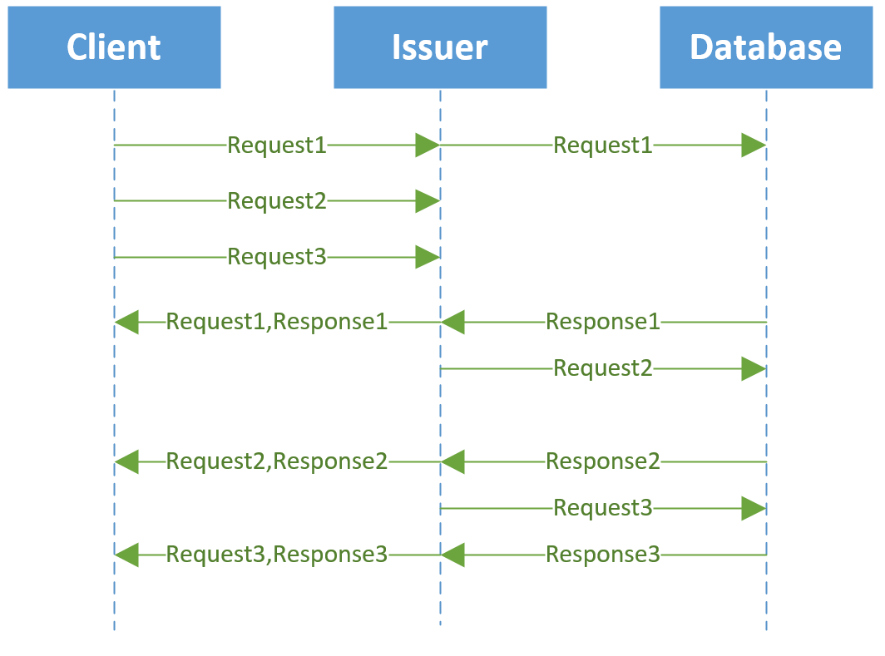
Notes:
ISSUER!!!!

Slide 4
Questions?
Notes:
About anything

Slide 5
rob@cloudhouse.com
https://github.com/cloudhousetech/issuer_example
(We’re Recruiting)

