Slide 1
EQ2401 Adaptive Signal Processing Project 1
Ziyue Yang Boyue Jiang
ziyuey@kth.se boyue@kth.se

Slide 2
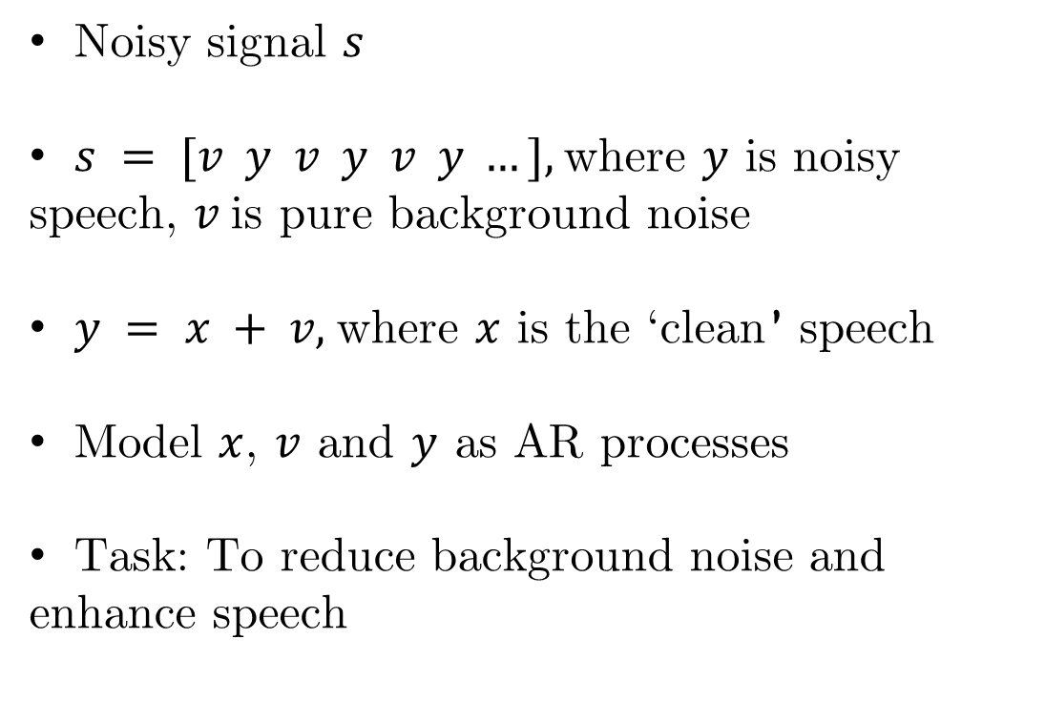
Project Description
Noisy signal $s$
$s = [v y v y v y …],$where $y$ is noisy speech, $v$is pure background noise
$y = x + v,$where $x$ is the ‘clean’ speech
Model $x$, $v$ and $y$ as AR processes
Task: To reduce background noise and enhance speech

Slide 3
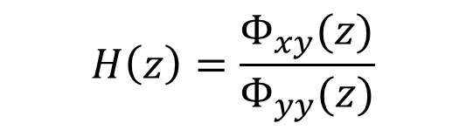


Wiener Filters
FIR
$$h\left[n\right]=θ_{opt}=Σ_{xY}Σ_{YY}^{−1}$$
$$H\left(z\right)=\frac{Φ_{xy}(z)}{Φ_{yy}(z)}$$
Non-Causal
$$H\left(z\right)=\frac{1}{{Φ^{+}}_{yy}(z)}{\left\{\frac{Φ_{xy}(z)}{{Φ^{−}}_{yy}(z)}\right\}}_{+}$$
Causal
Need to know the $r_{xy}(k)$ and$r_{yy}\left(k\right)$, cross/auto correlations

Slide 4
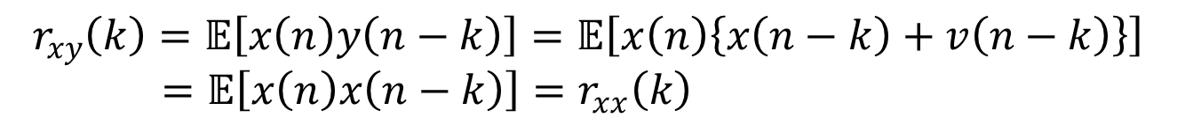
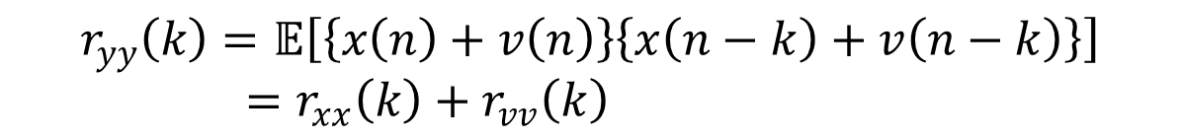

Compute Correlations
$r_{yy}\left(k\right)=𝔼\left[y\left(n\right)y\left(n−k\right)\right],$ directly computable
$r_{vv}\left(k\right)=𝔼\left[v\left(n\right)v\left(n−k\right)\right],$ directly computable
$$r_{xy}\left(k\right)=𝔼\left[x\left(n\right)y\left(n−k\right)\right]=𝔼\left[x\left(n\right)\left\{x\left(n−k\right)+v\left(n−k\right)\right\}\right]$$
$=𝔼\left[x\left(n\right)x\left(n−k\right)\right]=r_{xx}\left(k\right)$
Moreover,
$$r_{yy}\left(k\right)=𝔼\left[\left\{x\left(n\right)+v\left(n\right)\right\}\left\{x\left(n−k\right)+v\left(n−k\right)\right\}\right]$$
$=r_{xx}\left(k\right)+r_{vv}\left(k\right)$
Hence, we can compute $r_{xy}\left(k\right)$ via
$$r_{xy}\left(k\right)=r_{xx}\left(k\right)=r_{yy}\left(k\right)−r_{vv}\left(k\right)$$

Slide 5
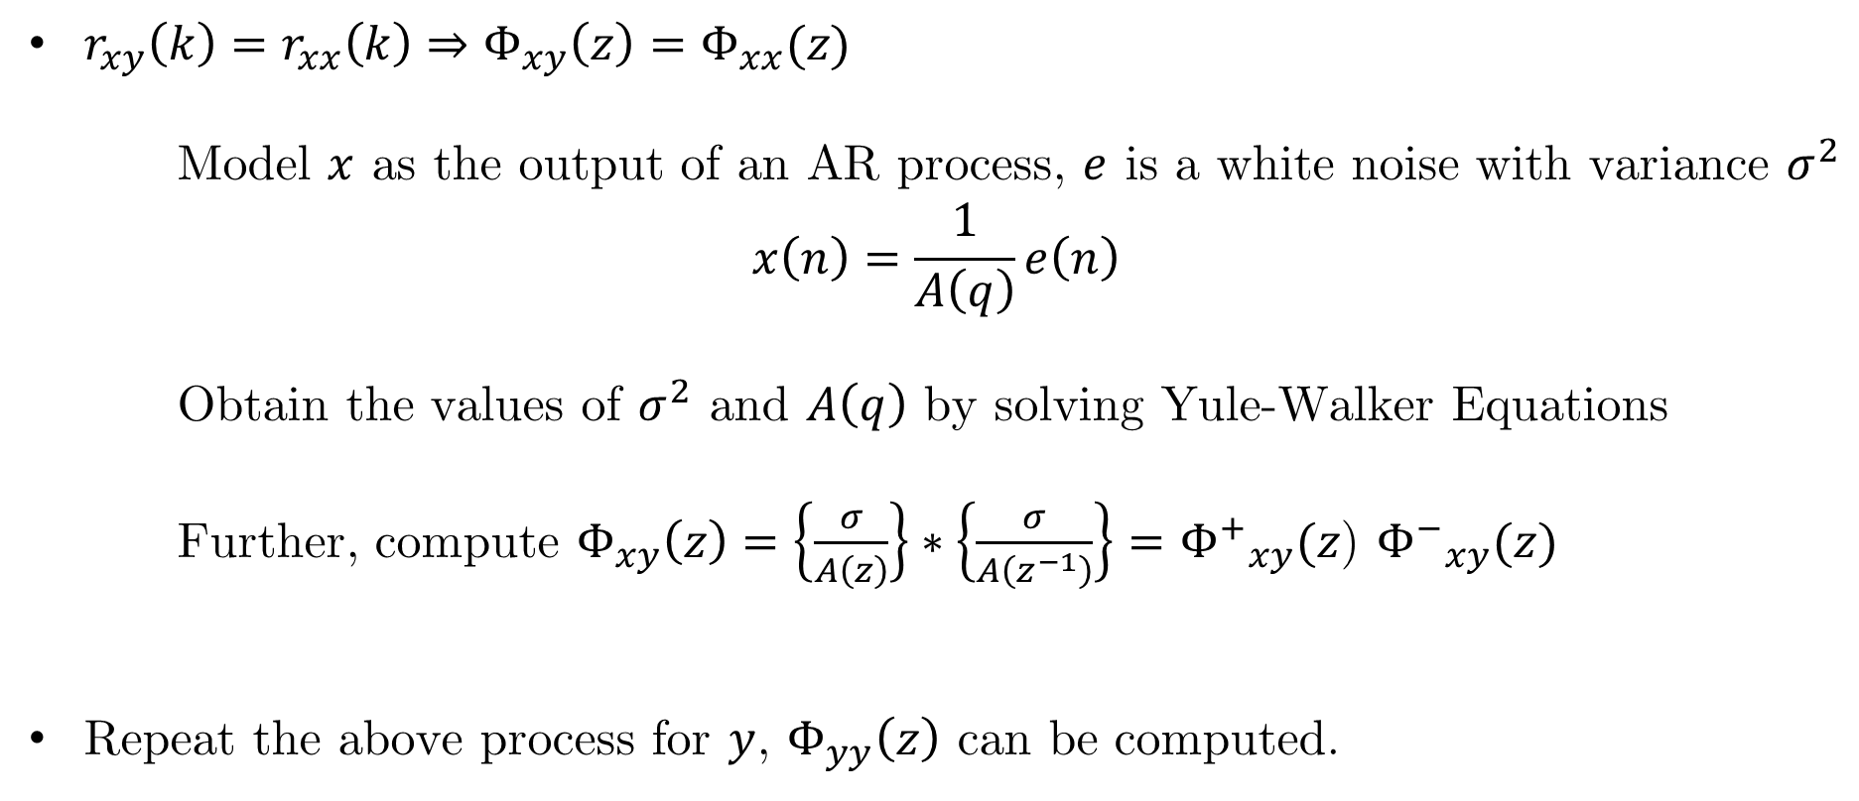
AR Processes / Spectrum Density
$r_{xy}\left(k\right)=r_{xx}\left(k\right)⇒Φ_{xy}\left(z\right)=Φ_{xx}(z)$
Model $x$ as the output of an AR process, $e$ is a white noise with variance $σ^{2}$
$$x\left(n\right)=\frac{1}{A\left(q\right)}e\left(n\right)$$
Obtain the values of $σ^{2}$ and $A\left(q\right)$ by solving Yule-Walker Equations
Further, compute $Φ_{xy}\left(z\right)=\left\{\frac{σ}{A\left(z\right)}\right\}∗\left\{\frac{σ}{A\left(z^{−1}\right)}\right\}={Φ^{+}}_{xy}(z$) ${Φ^{−}}_{xy}(z)$
Repeat the above process for $y$, $Φ_{yy}\left(z\right)$ can be computed.

