Slide 1
Ames House Price Prediction
Cloudy Liu

Slide 2
Buying a home is STRESSFUL
Help first-time home buyers to narrow down features
Help predict the house price
Help identify the features significantly impact the sale price

Slide 3
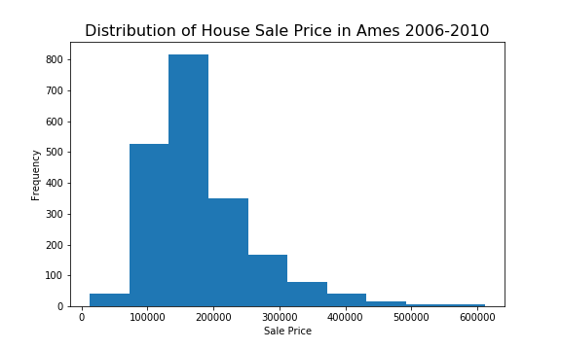
How Does the Distribution of Sale Price Look Like?

Slide 4
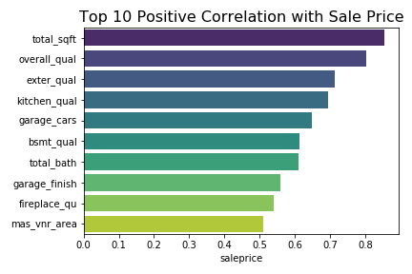
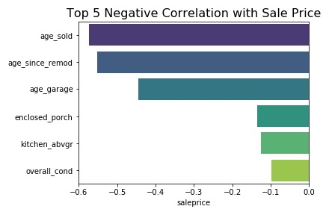
Feature Selections & Modeling
SF-related, Quality-related, age-related, Location

Slide 5
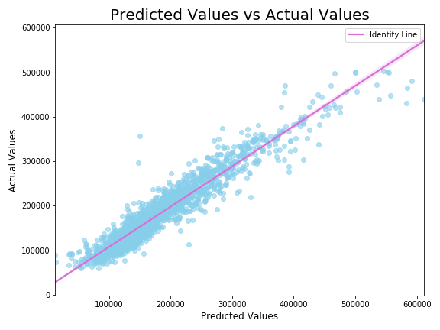
How Well Does The Model Fit?
R^2: 91%
RMSE: 22,274
Baseline Model: 83,323

Slide 6
How Much Does It Cost?
Newly-wedded couple
2500-3000 sqft
2 baths
3 bedrooms
A nice kitchen
Fair overall quality
$144,526
|
$197,682

Slide 7
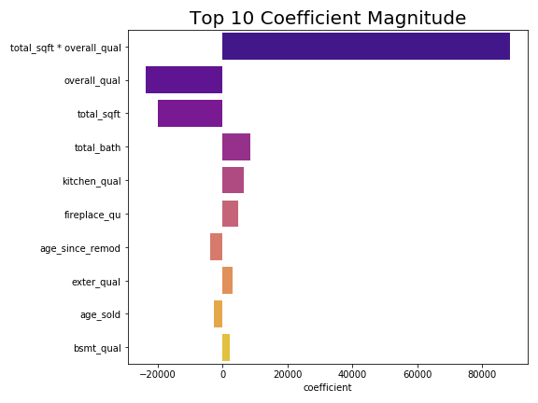
Most Impactful Features

Slide 8
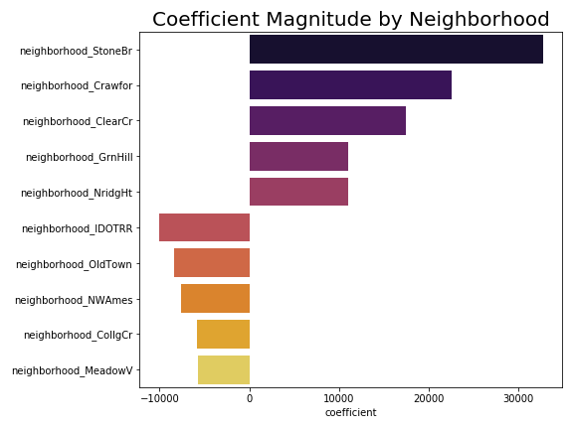
Most Desirable Neighborhood

Slide 9
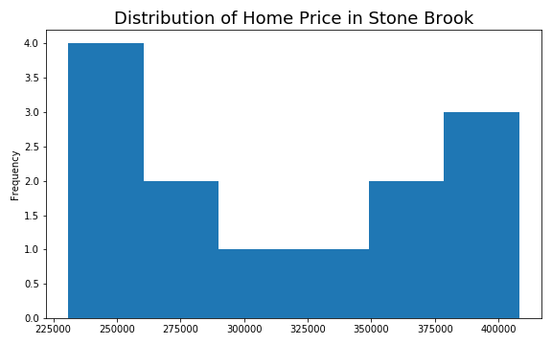
Can they find a house within their budget in Stone Brook?
$180,000?
Very likely
NO

Slide 10
Thoughts & Suggestions
Should consider a combined force of total square footage & overall quality
Houses with unusually large square footage might have smaller margin
Stone Brook, Crawford, Clear Creek, Green Hill, and Northridge Heights are the most desirable/ expensive neighborhoods
Iowa DOT and Rail Road, Old Town, Northwest Ames, College Creek, and Meadow Village are the most affordable neighborhoods

Slide 11
Limitations
Hard to interpret the exact impact with lasso model
Still too many features, need a simpler yet still well-fit model
Some data might not be statistically significant (neighborhood subsets)
Datasets contain non-residential info which may affect the performance of the model

