Slide 1
AI-Assisted Cloud Monitoring & Troubleshooting Dashboard
COMP 488 · Cloud Computing, DevOps, and AI · October 2026
Detect • Analyze • Explain • Resolve
Intermediate project progress and next steps
Khalidou Bass | Instructor: Gregor von Laszewski
COMP 488 • AI-Assisted Cloud Monitoring Dashboard
01

Slide 2
The problem and project goal
Why cloud monitoring needs more than raw metrics
Operational challenge
Project goal
Applications can fail, generate errors, or become unreachable. Metrics and alerts are useful, but understanding the cause still takes investigation.
Build a practical monitoring pipeline, then extend it with AI-generated incident explanations and recommended troubleshooting steps.
Current milestone: a working local monitoring stack with live metrics.
COMP 488 • AI-Assisted Cloud Monitoring Dashboard
02

Slide 3
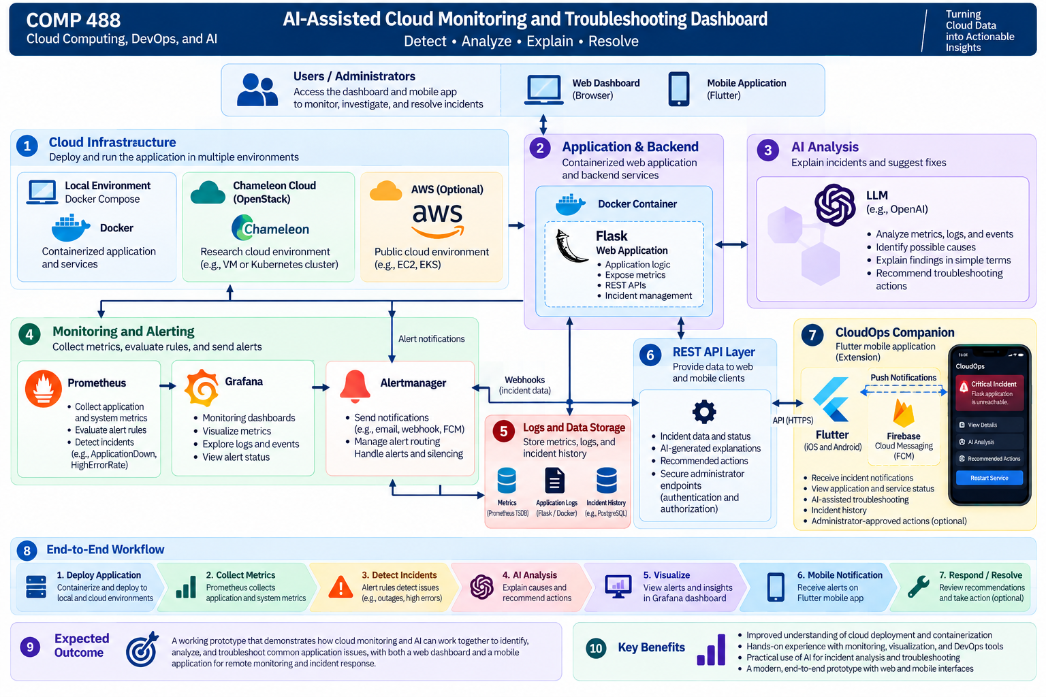
Target system architecture
Project vision — includes components not yet implemented
COMP 488 • AI-Assisted Cloud Monitoring Dashboard
03

Slide 4
Deployment environments
Local first, then research and public clouds
LOCAL: Lima + Docker
CHAMELEON CLOUD
AWS
Planned: use Lima to provide a local Linux VM environment. Docker Compose currently runs the monitoring stack on macOS.
Planned: deploy to an OpenStack-based research cloud and evaluate portability and monitoring behavior.
Planned: deploy to a public cloud environment and compare deployment and operational considerations.
Important: successful Lima tests in the separate Cloudmesh AI VM work do not yet establish deployment of this dashboard on Lima.
COMP 488 • AI-Assisted Cloud Monitoring Dashboard
04

Slide 5
What is implemented today?
Three running Docker Compose services
FLASK · Port 8000
PROMETHEUS · Port 9090
GRAFANA · Port 3000
GET / — application information
GET /health — health status
GET /metrics — Prometheus metrics
Scrapes Flask every 5 seconds. Evaluates alert rules every 5 seconds. Verified target status: up = 1.
Provisioned dashboard with four panels: request totals, successful requests, application status, and request rate.
Evidence: docker compose ps confirmed all three services running; Prometheus API returned up{job="flask-app"} = 1.
COMP 488 • AI-Assisted Cloud Monitoring Dashboard
05

Slide 6
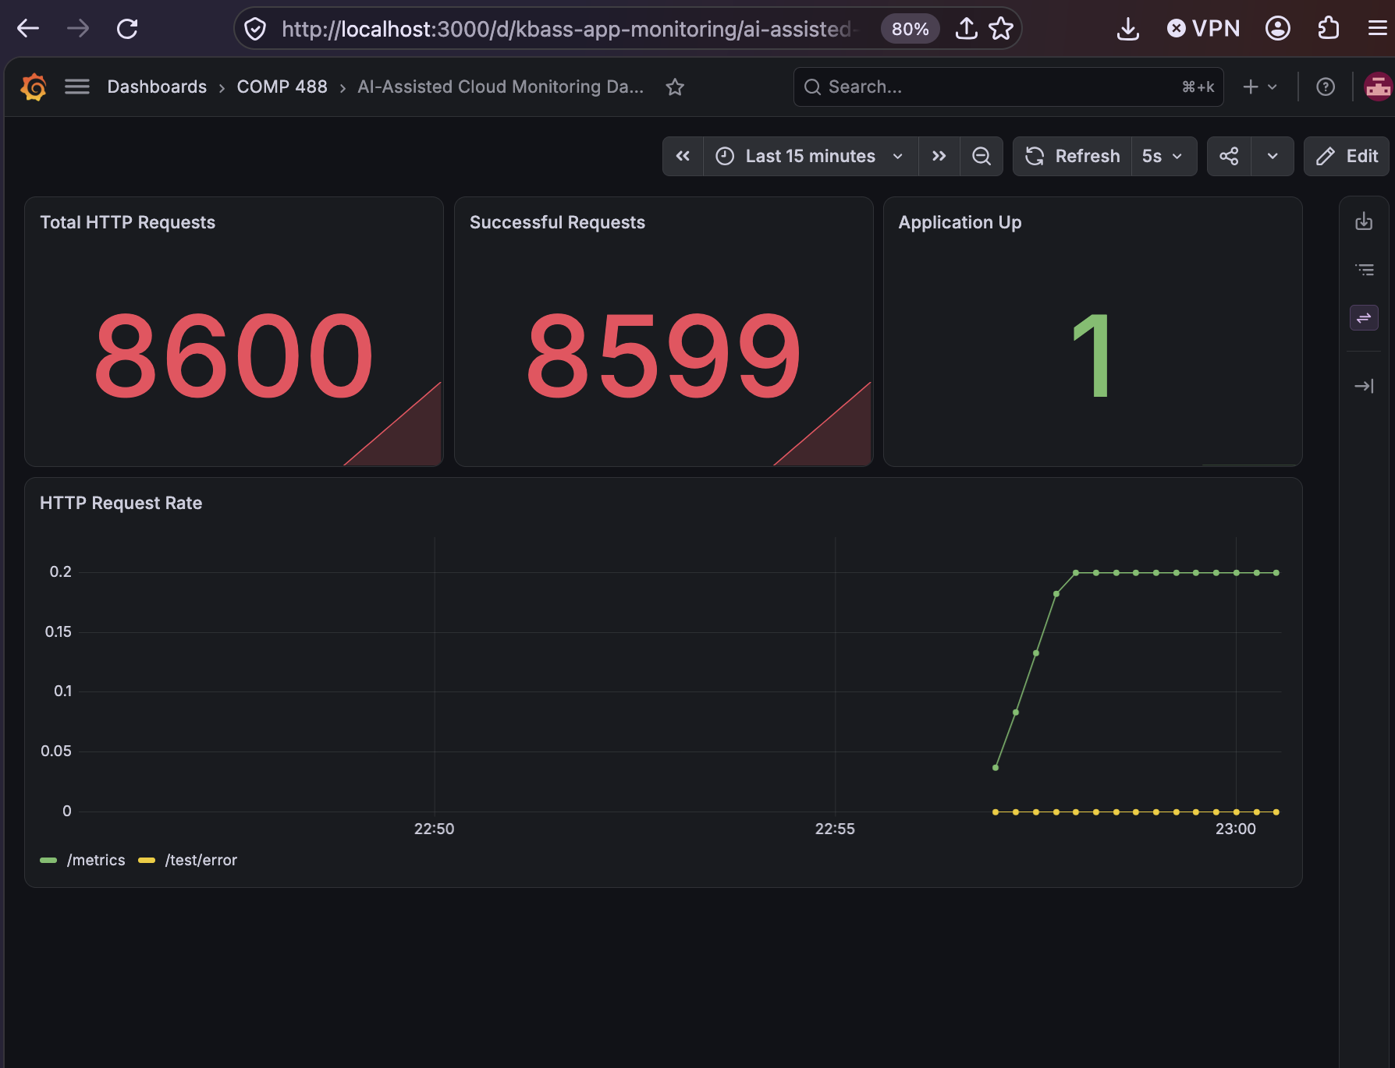
Live Grafana monitoring dashboard
Actual screenshot from the running prototype
COMP 488 • AI-Assisted Cloud Monitoring Dashboard
06

Slide 7
Incident detection and alerts
Prometheus rules are configured; incident firing still needs validation
APPLICATION DOWN
HIGH ERROR RATE
Condition: up{job="flask-app"} == 0
Duration: 15 seconds
Severity: critical
Condition: >5% HTTP 5xx requests
Duration: 30 seconds
Severity: warning
Demo idea: deliberately stop the Flask service and observe the Prometheus alert state.
COMP 488 • AI-Assisted Cloud Monitoring Dashboard
07

Slide 8
AI-assisted troubleshooting: next milestone
Planned capability — not yet implemented
1 · DETECT
2 · EXPLAIN
3 · RECOMMEND
Prometheus identifies a service outage or elevated error rate.
An LLM analyzes alert context and describes likely causes in plain language.
Suggest safe diagnostic steps; any remediation requires administrator approval.
Optional extension: CloudOps Companion mobile interface with notifications and incident details.
COMP 488 • AI-Assisted Cloud Monitoring Dashboard
08

Slide 9
Demonstration and remaining work
A practical plan for the rest of the semester
DEMO TODAY
NEXT STEPS
1. Open Flask /health
2. Show Prometheus target up = 1
3. Show live Grafana panels
4. Explain configured alert conditions
1. Validate alert firing
2. Build incident-analysis component
3. Deploy via Lima locally
4. Evaluate Chameleon and AWS
5. Explore Flutter mobile extension
COMP 488 • AI-Assisted Cloud Monitoring Dashboard
09

Slide 10
Key takeaways & acknowledgements
Intermediate progress — not the final system
Working containerized Flask–Prometheus–Grafana monitoring pipeline
Live metrics and dashboard visualizations verified
Alert rules configured; AI analysis and multi-cloud deployment are next
LLM assistance used for technical guidance, debugging, and documentation; implementation and verification remain the student’s responsibility
Thank you — Questions?
COMP 488 • AI-Assisted Cloud Monitoring Dashboard
10

