Slide 1


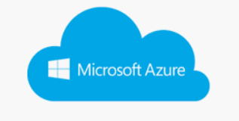
Data warehouse from multiple data cloud source
Cloud mesh
Get Source data
Load to target

