Slide 1


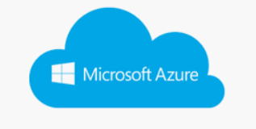
Data warehouse from multiple data cloud source(MongoDB)
Cloud mesh
Get Source data
Load to target

Slide 2

Data warehouse from multiple data cloud source(MariaDB)
Cloud mesh
Get Source data
Load to target

