Slide 1
Automated Sharded MongoDB Deployment and Benchmarking for Big Data Analysis
Mark McCombe, Gregor von Laszewski
laszewski@gmail.com
Indiana University
Inteligent Systems Engineering Department

Slide 2
Acknowledgement
This study has been conducted as part of the I524 class with the topic Big Data and Software Projects
The class used the following resources
  Students computers
  Futuresystems (DSC @ Indiana University) a continuation of the FutureGrid (NSF)
  Chameleon Cloud (NSF): Project CH-818664, KVM
  Jetstream (NSF)
Some students also elected to use
  AWS
  Azure
All resources as far as we know were provided to us for free.

Slide 3
Outline
Motivation for the project
  IU educates data scientists
Sharded Mongo DB deployment
Benchmarks
Usage Observations
Conclusion
  Why we did not do a large scale study …
  Implication for future classes …

Slide 4
Data Scientist
Analysis
Programming
Visualization
Domain Knowledge
Communication
Statistics
Machine Learning
Python, JavaScript
Distributed Comp.
Basic Skills
Customize for Data Set
Paper write-up
Infrastructure
Cloud Computing
Distributed Systems
Cloud Programming
Online Publication
DevOps
Optimization
Requires integrated knowledge in several key areas. We use a project that addresses:
  Communication
  Analysis
  Visualization
  Programming
  Infrastructure
  Domain knowledge
Education Programs need to address all of them
Data Scientist
Sharded Mongo DB Deployments
Sharded Mongo DB Deployments

Slide 5
Mongo DB Features
Document oriented NoSQL data base
  JSON-like documents
  Specified through schemas
Cross-platform compatible
Free open source
NoSQL = data that is modeled in means other than the tabular relations used in relational databases.
Ad-hoc queries
Indexing
Replication
Load Balancing with Sharding
File Storage
Aggregation
Server Side JavaScript
Capped collections

Slide 6
Mongo DB - Sharding
User selects shard key that determines how the data in a collection will be distributed.
  data is split into ranges (based on the shard key)
  distributed across multiple shards.
    (a) a shard is a master with one or more slaves.
    (b) or the shard key can be hashed to map to a shard allowing even data distribution.
MongoDB can run over multiple servers,
  balancing the load
  duplicating data for fault tollerance

Slide 7
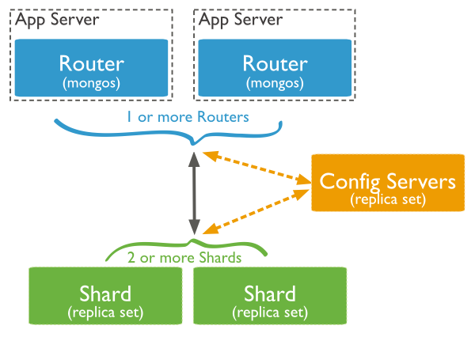
Architecture

Slide 8
Benchmarks on Clouds
Three clouds were selected for deployment:
  Chameleon Cloud
  Futuresystems
  Jetstream
Goal
  Compare within the allocation limitations of a class multiple cloud performances by varying a number of parameters.
Scripted Deployments
  We developed automated scripted deployment and benchmarking process
  cloud name is passed as a parameter
  Customization for the deployment of MongoDB is passed via commandline

Slide 9
Cloud Comparison
 | FutureSystems | Chameleon | Jetstream
CPU | Xeon E5-2670 | Xeon X5550 | Haswell E-2680
Cores | 1024 | 1008 | 7680
Speed | 2.66GHz | 2.3GHz | 2.5GHz
RAM | 3072GB | 5376GB | 40TBr
Storage | 335TB | 2TB | 2 TB
Deployment year | 2010 (?) | 2015 (?) | OS 2016

Slide 10
Flavor and OS
Ubuntu 16.04 LTS (Xenial Xerus) operating system.
Flavors – slightly different between clouds we use most alike
  m1.medium Chameleon Cloud
  m1.medium FutureSystems
  m1.small was used on Jetstream
    Flavors have more resources than Chameleon and FutureSystems
    Storage is lower on jetstream
Cloud | Flavor | VCPU | RAM | Size
Chameleon | m1.medium | 2 | 4 | 40
FutureSystems | m1.medium | 2 | 4 | 40
Jetstream | m1.small | 2 | 4 | 20

Slide 11
Requirements
Resource Requirements
  60 users -> VM hours were limited.
Capability Requirements
  creation of VMs and the execution of our applications within these VMs
Monitoring Requirements
  Monitoring and benchmarking was conducted by hand without need for specialized services.
New software created
  improved the cloudmesh client software [5][6] [7], essential to the success of the class.
Performance Comparison
  We have conducted a significant performance comparison among all clouds.

Slide 12
Benchmark
Deployment times
Comparing Mongo DB versions
Comparing Clouds

Slide 13
Deployment times

Slide 14
Deployments
Deployment A
  a simple deployment with only one of each component being created..
Deployment B
  variation in config servers and shards and an additional Mongos instance.
Deployment C
  focus on high performance.
  9 shards no replication
 | Config | Mongos | Shards | Replicas | Seconds
A | 1 | 1 | 1 | 1 | 330
B | 3 | 2 | 3 | 3 | 1059
C | 1 | 1 | 9 | 1 | 719

Slide 15
Variing other Deployment times
Config Servers -c | Mongos -m | Shards -s | Replicas -r | Time in Seconds
5 | 1 | 1 | 1 | 534
1 | 5 | 1 | 1 | 556
1 | 1 | 5 | 1 | 607
1 | 1 | 1 | 5 | 524

Slide 16
Version Comparison

Slide 17
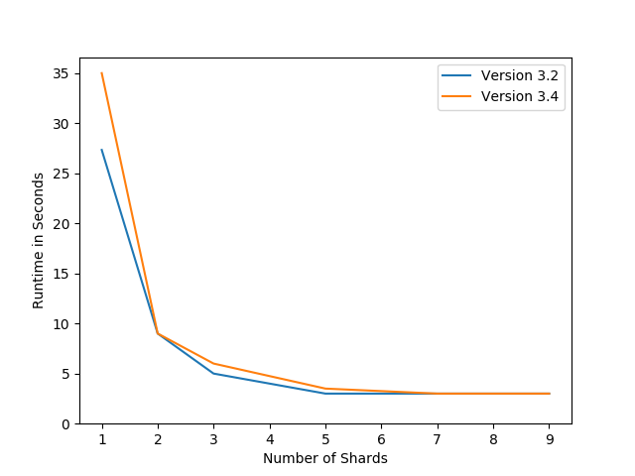
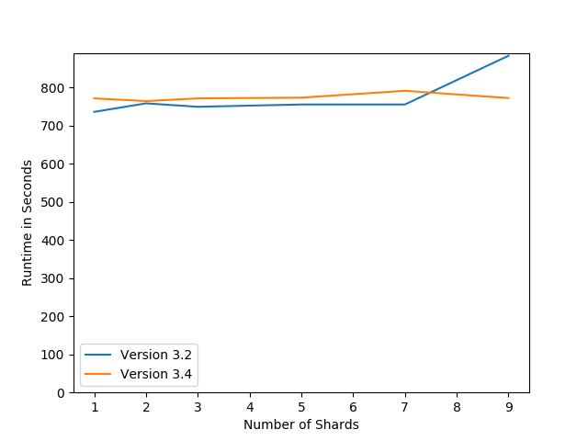
Version Comparison: 3.2 vs 3.4
(Chameleon Cloud)
Find Command
Mongoimport Command

Slide 18
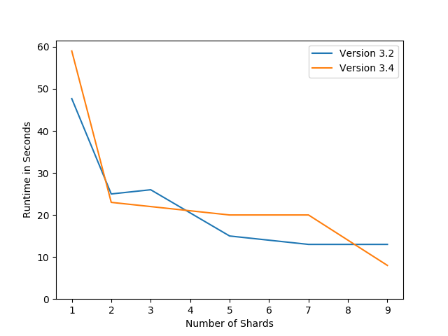
Version Comparison: 3.2 vs 3.4 Map Reduce
(Chameleon Cloud)
Map Reduce
Result: not too many changes

Slide 19
Cloud Comparison
Sharding Test

Slide 20
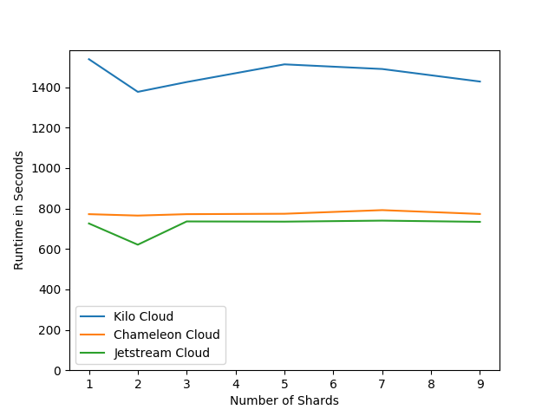
Figure 2: Mongoimport Command - Sharding Test

Slide 21
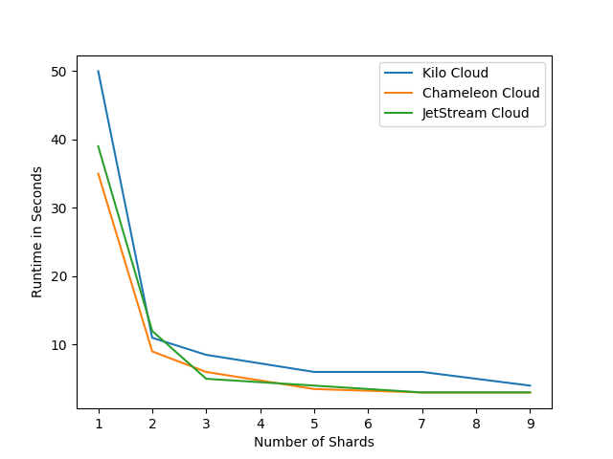
Figure 1: Find Command - Sharding Test
Chamelon – jet stream
  Same
FutureSystems
  Acceptable results with higher number of shards

Slide 22
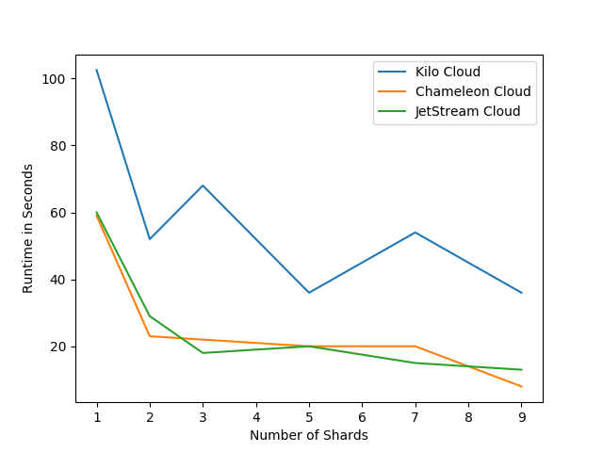
Figure 3: MapReduce - Sharding Test
Chameleon – jetstream
  Same
Futuresystems
  Significantly worse

Slide 23
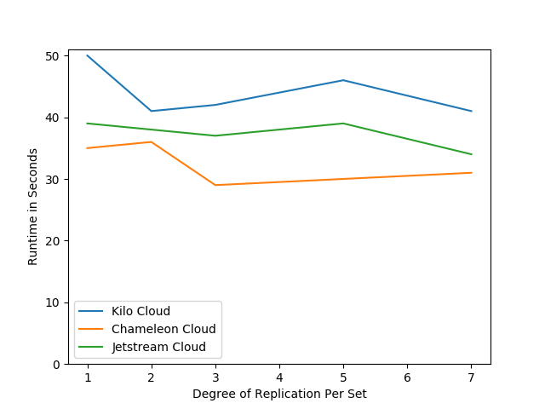
Figure 4: Find Command - Replication Test
Replication
  Chameleon cloud seems to perform slightly better
  Futiresystems performs surprisingly well

Slide 24
Cloud Comparison
Replication Test

Slide 25
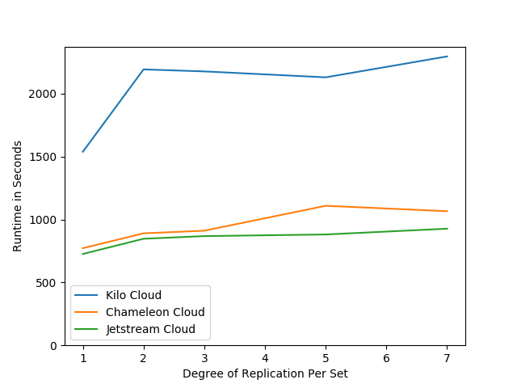
Figure 5: Mongoimport Command - Replication Test
Chameleon – jetstream
  Same
Futuresystems
  Significantly worse

Slide 26
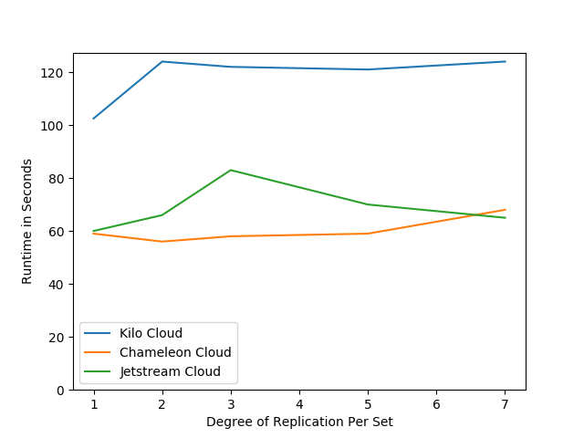
Figure 6: MapReduce - Replication Test
Chameleon
  Slightly better than Jetstream
Futuresystems
  Significantly worse

Slide 27
Conclusion
Jetstream and Chameleon Cloud are essentially the same.
In some instances Chameleon Cloud performs slightly better
  (disks/network …)
As expected FutureSystem is ole machine and performs not as well
  For some queries FutureSystem is surprisingly good
Experiments were limited by number of node hours for 60 students in class.
After class is over no time to run on larger examples
Its not obvious for a teacher when to give larger allocations for a student that performs well.
Allocation process broken
Futuresystems allocation process is superior

