Slide 1
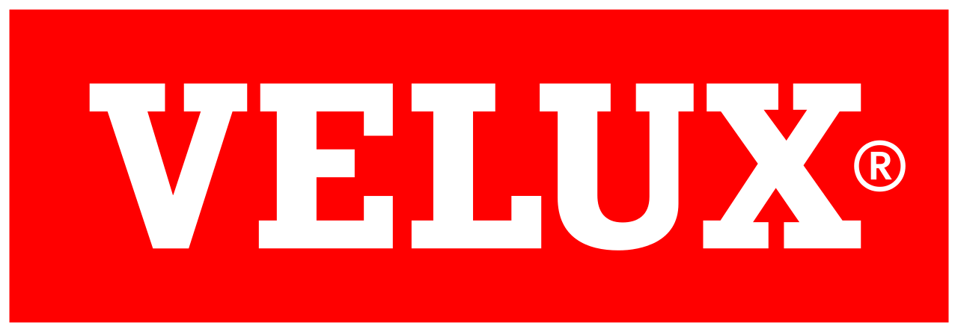





























Guardrails in Action
Policy as Code with Kyverno

Slide 2



















k auth whoami
Notes:
I’m Linda, Senior Platform Engineer, which I consider as a iteration or new rebranding of devops engineer. Have been working with Kubernetes and other open-source tooling almost 4 years now. I come from a team of platform engineers and our responsibility is taking care of internal developer platform for VELUX developers based in Kubernetes. We have around 25 clusters, most of them on-prem, while few also on Azure.
We create, update, upgrade, improve and break all around our platform. I have always liked when things done properly, not big of a fan of cowboys, so there is no surprise that quite early in my work in the team I became The Kyverno person and have been since then, but before we get to Kyverno.

Slide 3











At the end of every golden path…
Notes:
Whenever you are a devops or platform engineer, most likely we work with some sort of environment, and we help to get apps running on that environment. To get from A to B there is a process. Usually if we work with multiple teams and we provide those teams templates, we try to create golden paths that are easier, safer, convenient and faster. But at the end of every golden path lies the point B, the environment, the hosted infrastructure and not always we can be sure that no developer took a shortcut to get to your cluster. We can not always rely on the golden paths, we need something within our clusters, that makes sure that no dangerous shortcuts or misconfiguration gets in. And what that could possibly look like is the topic of my today's introduction into policy as code.

Slide 4



policy as code
Notes:
Back to the subject: policy as code.
I think that the name itself kind of explains it already just like Infrastructure as Code, right? But just to be aligned -- Policy as Code means managing and enforcing security, compliance, and operational rules through code instead of relying on manual processes, documents, or manual checks. This allows to treat your policies like software, applying them automatically and consistently. Of course, of course there are many tooling out there that can do similar things, and they do overlap in ways how they work. All are within the space of policy as code. Few notable mentions here are also within CNCF landscape: Gatekeeper/OPA, Kubewarden and Polaris. You can write policies in various languages, Golang, Rust, Rego and then distribute as library/package across your organization or environment. Obviously, there are helpful docs how to integrate these tools with Kubernetes and for example Polaris provides and agent and then you can give it configurations. Although I am going to talk about Kyverno, there are contexts and ways of working when other tools would be a better fit that what I am used to.

Slide 5




























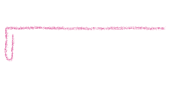










Why Kyverno?
Notes:
In my team we use Kyverno, which I think is the easiest, but then again of course I would think that. What I like about Kyverno that it works almost like any other tooling we manage in our platform and just extends K8s API to give us some extra stuff we can configure and all of it is YAML. No other language whatsoever, just regular YAML, which is very friendly approach for Kubernetes admins as we are familiar with YAML. Also when we started the platform more that those 4 years ago, there were much less options in CNCF landscape and OPA agent isn’t yaml, so Kyverno it was. And now we are just used to it, it does the work we require from the tool itself, so I don’t see how we would change at this moment.

Slide 6



















admission controller
Notes:
Admission controller

Slide 7
apiVersion: kyverno.io/v1
kind: ClusterPolicy
(..)
spec:
rules:
- match: (..)
failureAction: Audit
validate:
pattern: (..)
Notes:
So how kyverno works, you install kyverno agent as like any other tool, but it is very configurable, so I would suggest looking at the values files first.
And then separately you can install policies themselves, honestly it is up to you, but I like the separation between the engine and the rules and I can release them independently. It is expected that policies actually change frequently than the engine once configured.

Slide 8





admission controller

Slide 9















disclaimers first
flexibility
security
Notes:
Next question: what to police? As in what guardrails are needed and Trade-off between freedom vs consistency
When to add? Mostly from new lessons learned and sane defaults. And I can not tell you what is right and what is wrong, people hate “it depends”, but it does depend on your context. It is up to really the

Slide 10
Validate, validate and then a bit more validate
Notes:
Simple and ‘duh’ policies (latest tag, no default namespace)
Keep track of scale and workloads
Make sure a single misconfiguration does not break cluster

Slide 11


















A special kind of validation: Images
Registry
Path
Signature

Slide 12









Generate rules
Notes:
Our answer to what to do with core regcred secrets with GitOps
Utility tasks

Slide 13









No mutations though
Notes:
Although use-cases we could find plenty, but the loop between synchronization and mutating is exhausting.
And one policy rules over all other designs: Git over all - if important – put in git

Slide 14





























Real-life challenges
failureAction: Audit
Notes:
Stuck in Audit -- How elevating security on clusters when you no longer own what is running becomes a hard battle to wage against.
Dogfooding can be acquired taste. It takes discipline to keep ourselves in check when you can just edit to Audit.
Power of Kyverno, if it fails, then all the rest hangs
Showcasing and communicating policy errors to devs is work in progress

Slide 15
Kyverno Backstage plugin
Notes:
My teammates have donated our own made Kyverno backstage policy reporter plugin to Kyverno.io, but it still takes devs to add the annotions to enable it.

Slide 16
Nice to have
CEL
ValidatingAdmissionPolicy enabled by default in K8s API

Slide 17
Thank you!
Chasing daylight and fresh air

