Slide 1



Slide 2
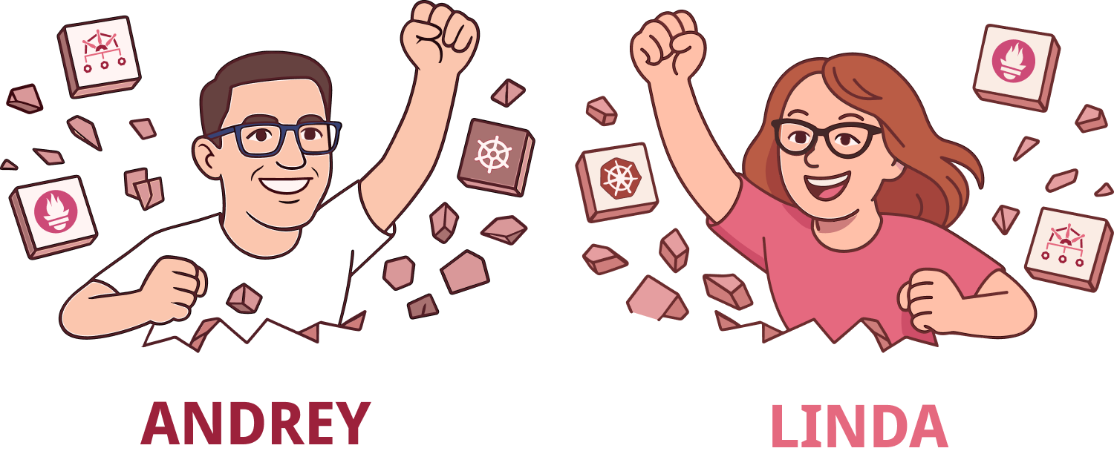

Notes:
Let us introduce ourselves, so you are aware who is talking

Slide 3
What is Cloud Native?
Cloud Native computing is an approach to software development.
Containers, microservices, declarative code and immutable infrastructure are core building blocks to this approach.
CNCF is a foundation that supports ecosystem of open source, vendor-neutral projects.
Notes:
What is cloud native?
It is NOT about using clouds like AWS, Google Cloud or Azure.
Cloud native technologies empower organizations to build and run scalable applications in modern, dynamic environments such as public, private, and hybrid clouds.
Containers, service meshes, microservices, immutable infrastructure, and declarative APIs exemplify this approach.
The Cloud Native Computing Foundation seeks to drive adoption of this paradigm by fostering and sustaining an ecosystem of open source, vendor-neutral projects. We democratize state-of-the-art patterns to make these innovations accessible for everyone.

Slide 4
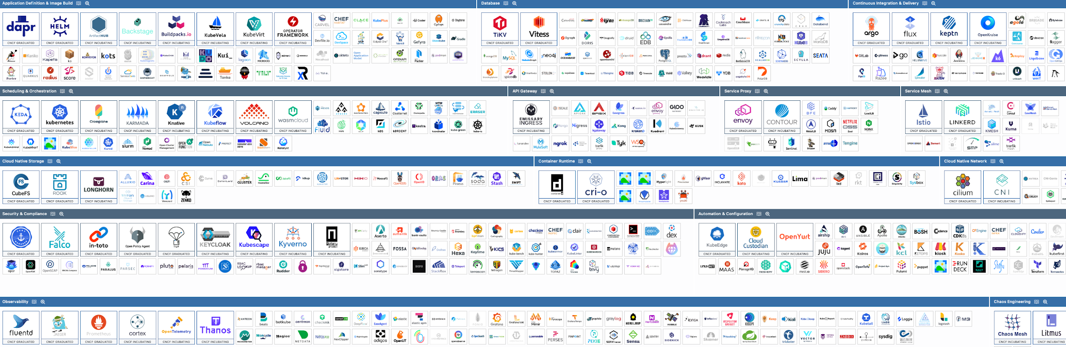
Just a snippet of the CNCF project landscape
Notes:
A snippet of topics and projects we can and will discuss.

Slide 5
Why Cloud Native Latvia?
We want to:
- bring more tech into local community
- level-up our collective knowledge
- give a place to rant, share and be curious
Overall vibe goals: tech-energy, introvert friendly (no icebreaker sessions), beginners welcome and knowledge is an unlimited resource to be shared

Slide 6
Expectations
Current plan: 6 events per year
As official chapter, we follow the values, mission and code of conduct of CNCF.
Topics will be around solutions and use-cases of open-source projects from CNCF landscape.
Notes:
Current plan: 6 events per year
As official chapter, we follow the values, mission and code of conduct of CNCF.
Therefore topics will be around solutions and use-cases of open-source projects from CNCF landscape.

Slide 7
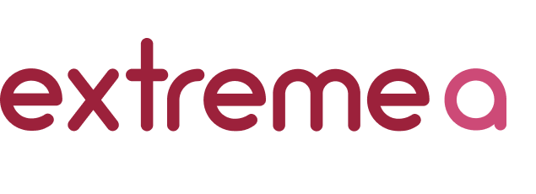

Sponsors
Wanna join?

Slide 8


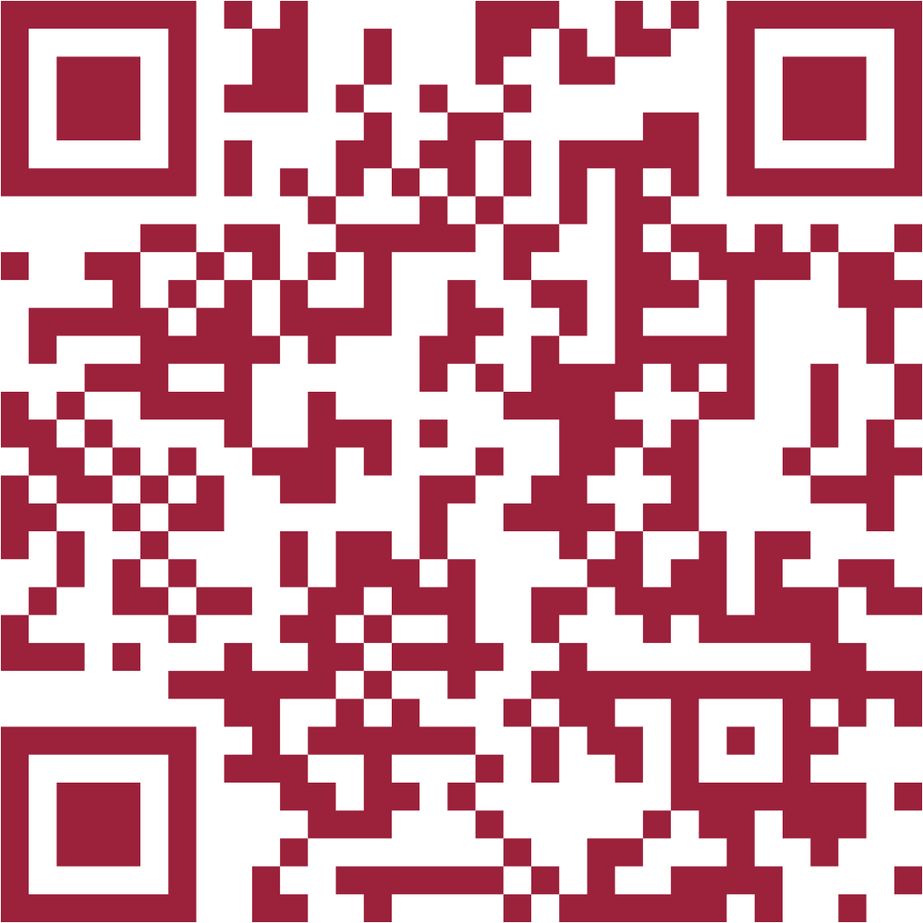
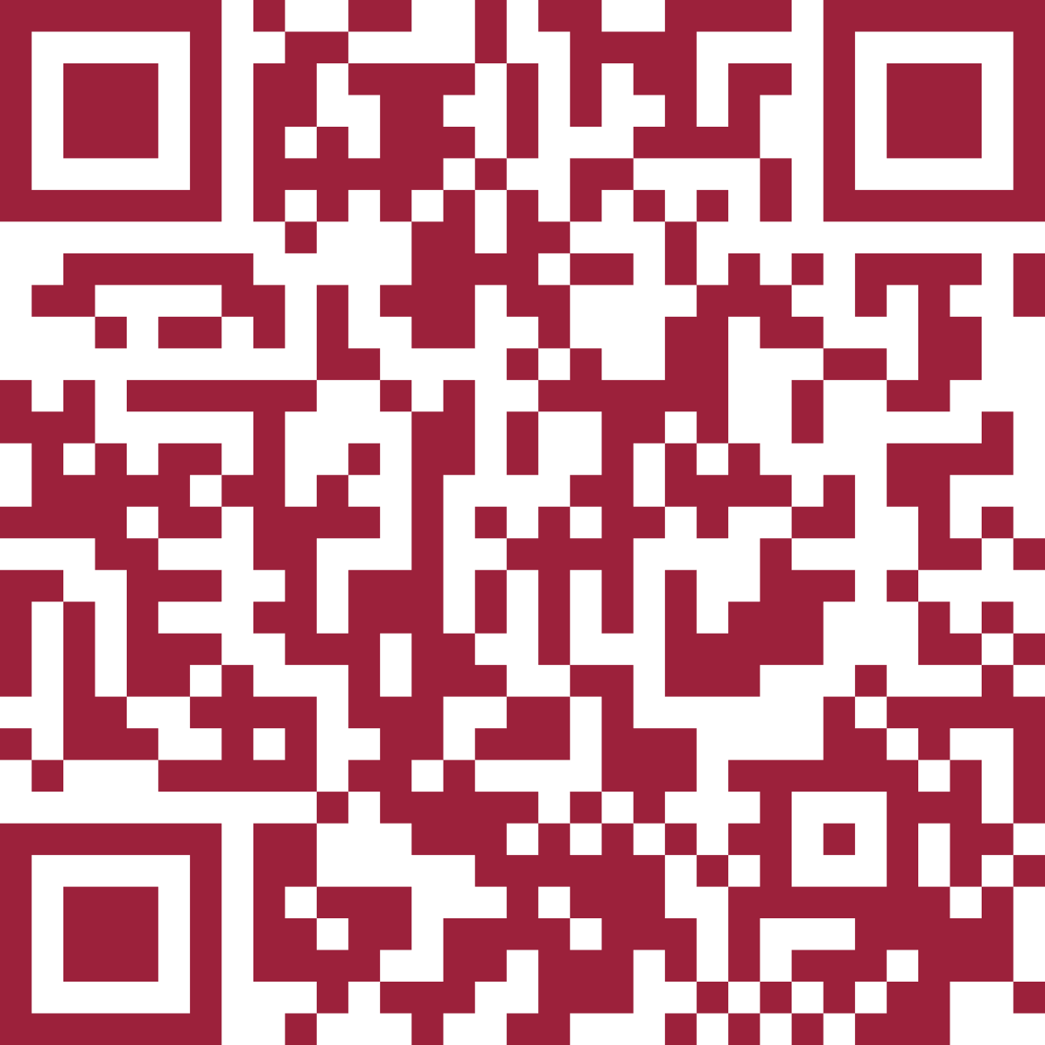
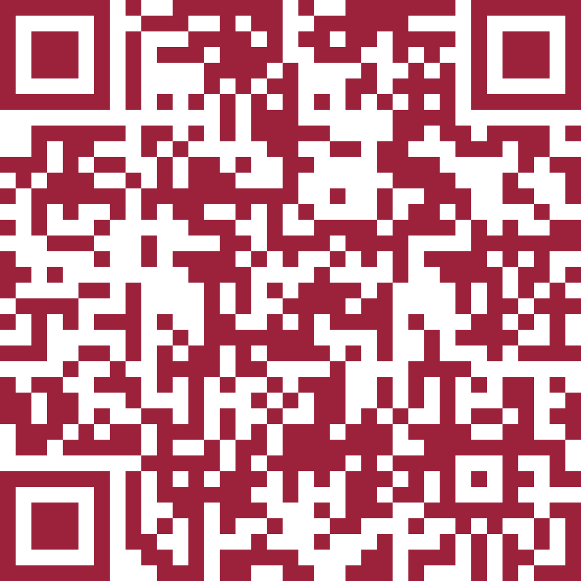
How to connect?
hello@cloudnative.lv

Slide 9
AGENDA
of today's meetup
18:00: Welcome by Cloud Native Latvia ← we are here
18:15: No More Secrets (in Code): How We Built our Secret Management Solution by Māris Titovs and Ieva Lapiņa
19:00: Break with snacks
19:15: Practical Hybrid Cloud by Alex Rimlin
20:00: Optional networking
20:30: Doors close

Slide 10
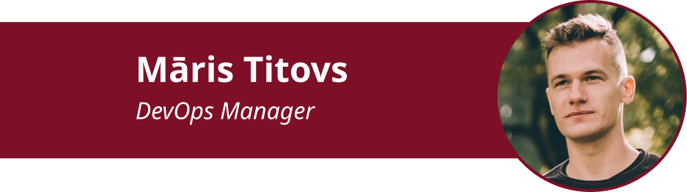

Next up:
No More Secrets (in Code): How We Built our Secret Management Solution

Slide 11
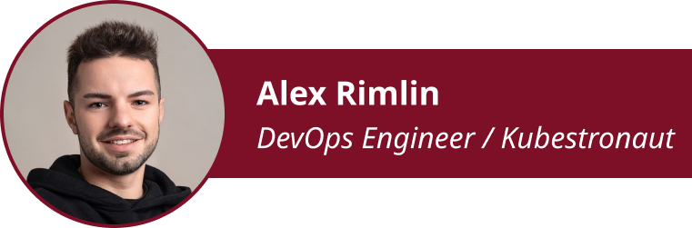
Next up:
Practical Hybrid Cloud

Slide 12
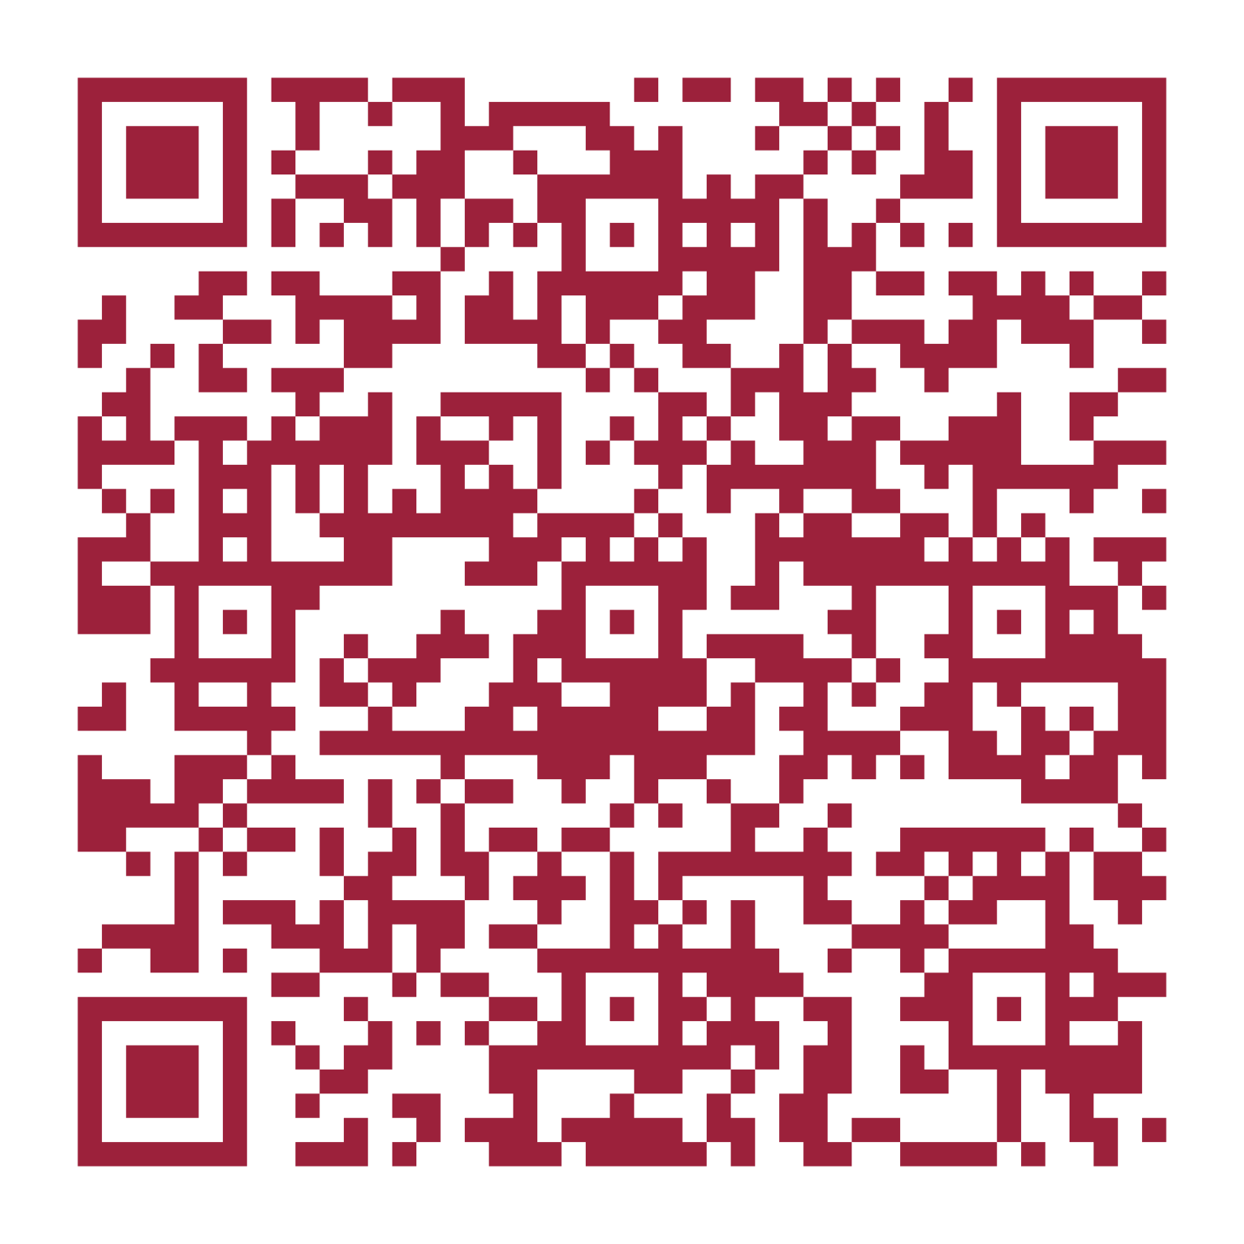
Help us get better for future events!

