Slide 1



Slide 2

AGENDA
of today's meetup
18:30: Welcome by Cloud Native Latvia ← we are here
18:45: Creating Platform That Can Move Where GPUs are Available
19:30: Break with snacks
19:45: Secret Agents: Identity for AI Workloads
20:30: Optional networking
21:00: Doors close

Slide 3

Notes:
Let us introduce ourselves, so you are aware who is talking

Slide 4




Sponsors

Slide 5


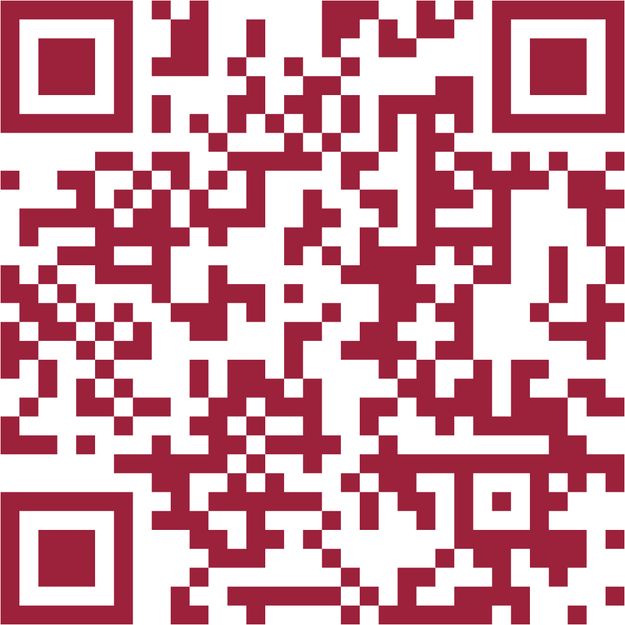
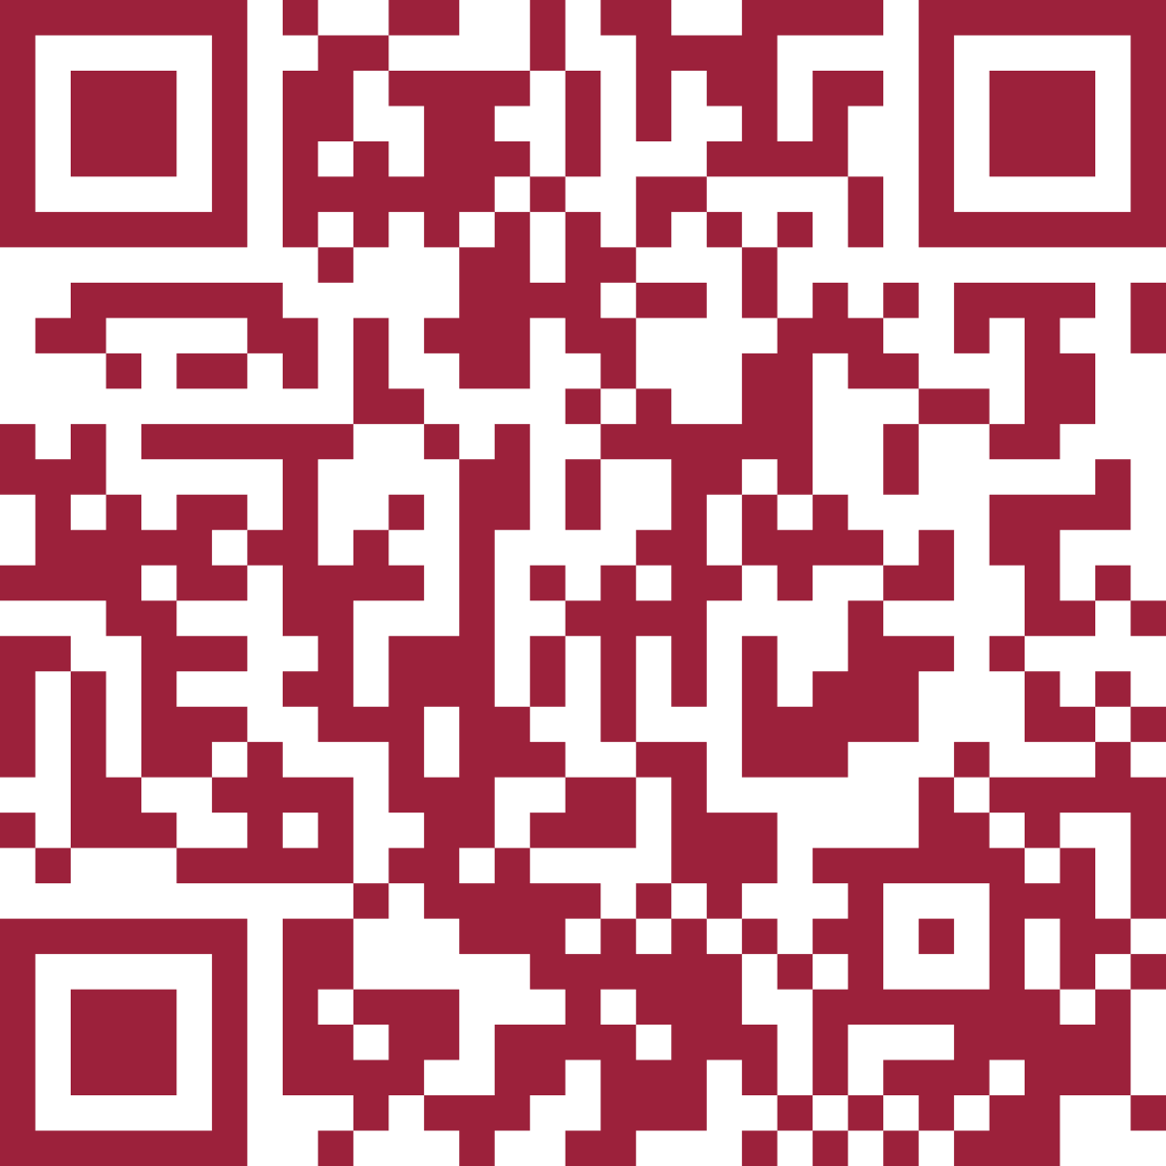
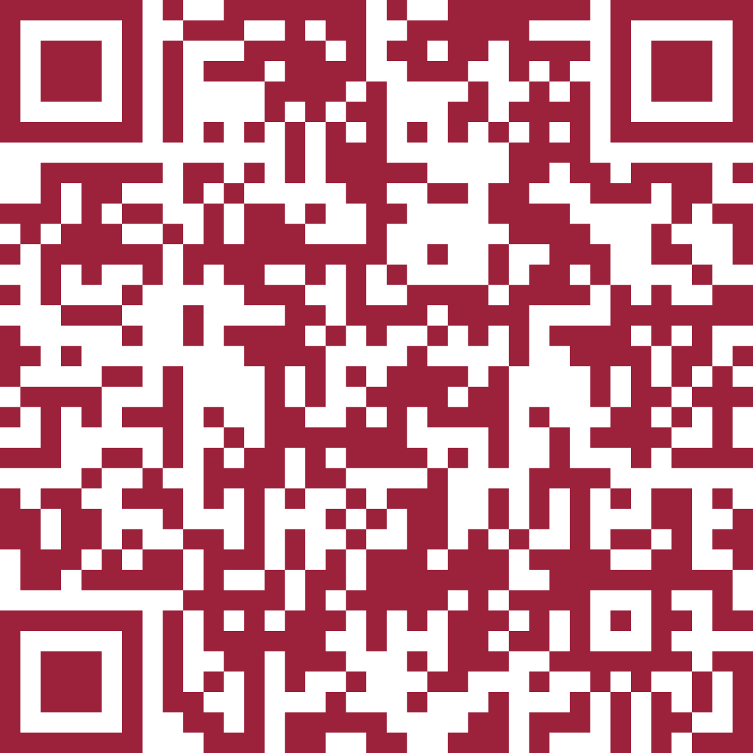
How to connect?
hello@cloudnative.lv

Slide 6
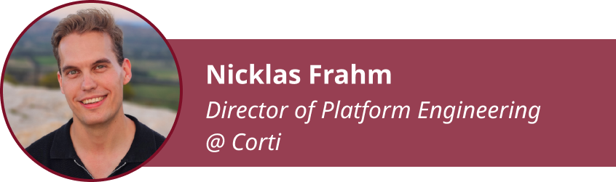
Next up:
Creating Platform That Can Move Where GPUs are Available

Slide 7

Next up:
Secret Agents: Identity for AI Workloads

Slide 8
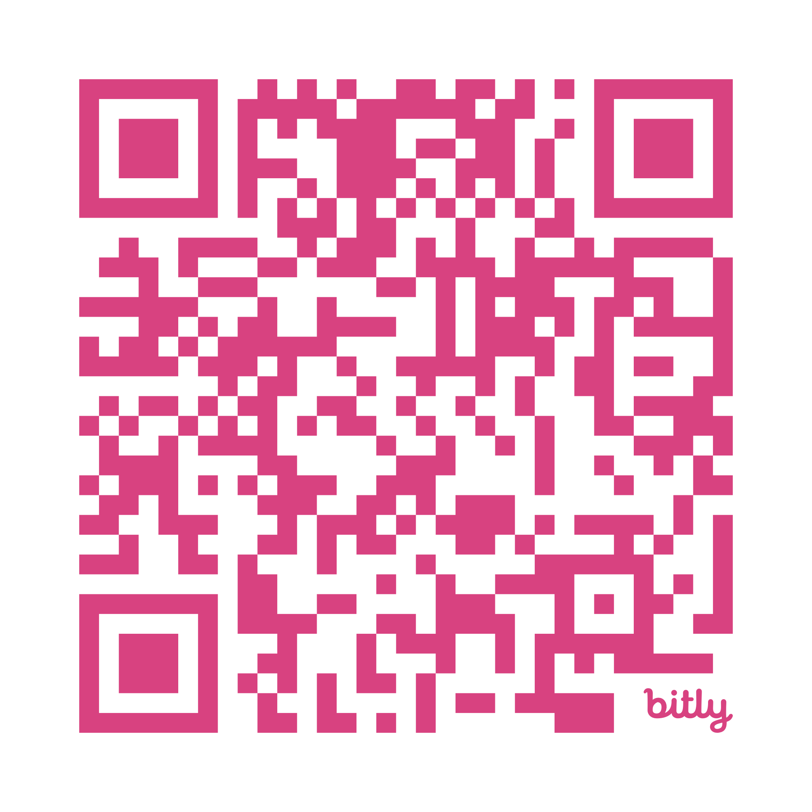
Help us get better for future events!

