Slide 1

OpenTelemetry From Core Concepts to Scaling Insights

Slide 2
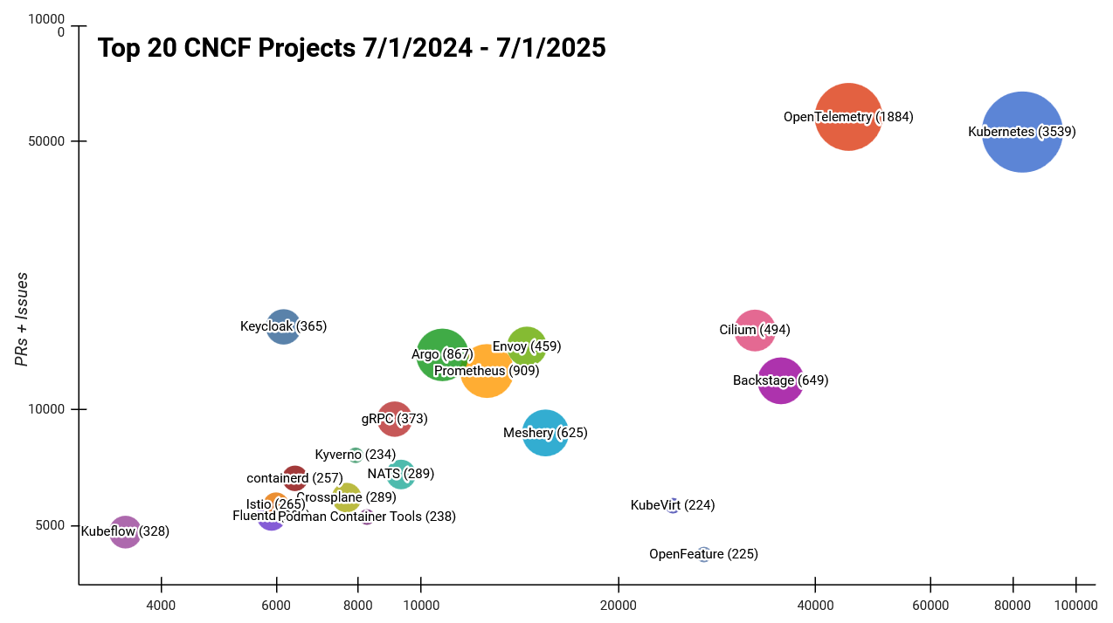
WE ARE TALKING ABOUT THIS

Slide 3

agenda
Brief history of Observability
Enter OpenTelemetry
OpenTelemetry core concepts
OpenTelemetry ecosystem
Good practices, pitfalls and other tidbits

Slide 4

Observability is the ability to understand the internal state of a system based on its external outputs.

Slide 5
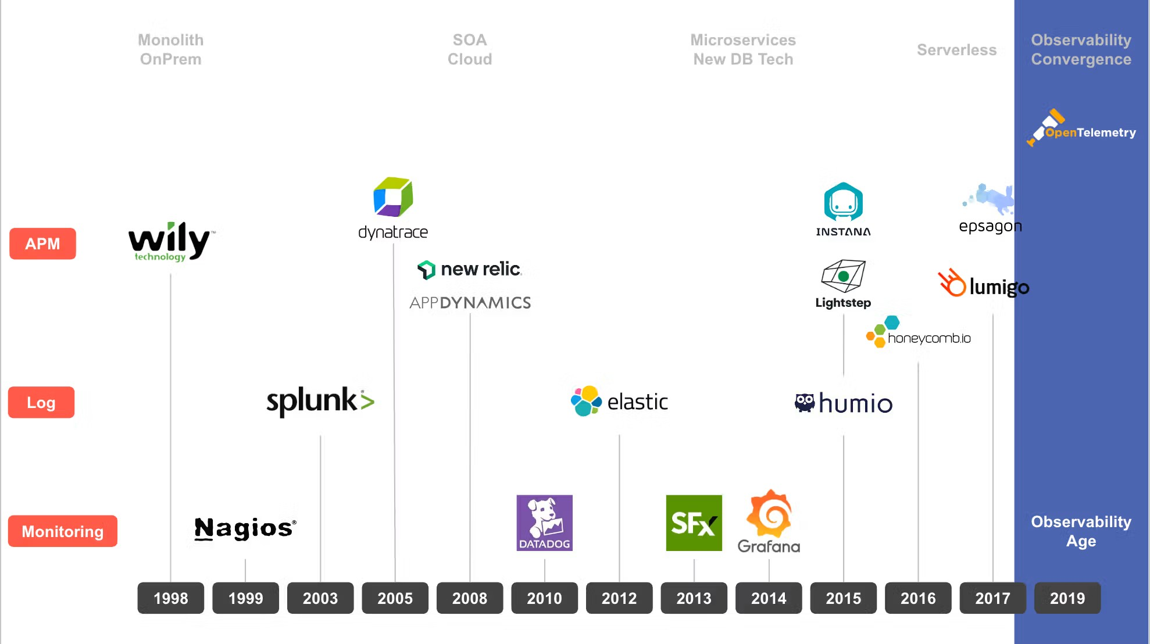



Slide 6

“Observability" is the convergence of the three distinct categories of tools: Application Performance Management Log Management Infrastructure Monitoring

Slide 7
2 pillars oF monitoring
Logs
Metrics
Text-based records.
Used since the 1970s with early mainframes, formalized with syslog in 1980, evolving to structured logging.
Time-series data points.
Rooted in early monitoring systems (1980s–1990s), evolved with SNMP, and modernized by Prometheus (2012).
Notes:
Logs: Logging started with simple text files in the 1970s, evolving into the syslog protocol (1980), which provided a standardized way to aggregate and manage logs. As systems grew more complex, structured logging became essential. Formats like JSON and logfmt allow logs to be easily parsed and analyzed, making them machine-readable while maintaining human readability. In cloud-native environments, structured logs are critical for scalability, with platforms like Elasticsearch, Fluentd, and Kibana (EFK stack) becoming popular for log aggregation and analysis.
Metrics: Metrics have been around since the 1980s, starting with basic system performance counters. Tools like SNMP (1988) enabled metric collection from network devices, while RRDTool (1999) and Ganglia (2000) facilitated time-series visualization. The introduction of Prometheus (2012) modernized metric collection with pull-based architecture, flexible querying (PromQL), and multidimensional labels, inspired by Google’s Borgmon.
Traces: Distributed tracing emerged to address the complexity of microservices architectures. Google’s Dapper paper (2010) introduced tracing concepts to track requests across services, inspiring open-source tools like Zipkin and Jaeger. The creation of OpenTracing (2016) and later OpenTelemetry (2019) standardized tracing, integrating it with metrics and logs for comprehensive observability.

Slide 8
2 pillars oF monitoring
3 observability
Logs
Metrics
Traces
Text-based records.
Time-series data points.
Records of the flow of a request through a system.
Introduced with Dapper at Google (2010), later standardized via OpenTracing (2016) and OpenTelemetry (2019).
Notes:
Logs: Logging started with simple text files in the 1970s, evolving into the syslog protocol (1980), which provided a standardized way to aggregate and manage logs. As systems grew more complex, structured logging became essential. Formats like JSON and logfmt allow logs to be easily parsed and analyzed, making them machine-readable while maintaining human readability. In cloud-native environments, structured logs are critical for scalability, with platforms like Elasticsearch, Fluentd, and Kibana (EFK stack) becoming popular for log aggregation and analysis.
Metrics: Metrics have been around since the 1980s, starting with basic system performance counters. Tools like SNMP (1988) enabled metric collection from network devices, while RRDTool (1999) and Ganglia (2000) facilitated time-series visualization. The introduction of Prometheus (2012) modernized metric collection with pull-based architecture, flexible querying (PromQL), and multidimensional labels, inspired by Google’s Borgmon.
Traces: Distributed tracing emerged to address the complexity of microservices architectures. Google’s Dapper paper (2010) introduced tracing concepts to track requests across services, inspiring open-source tools like Zipkin and Jaeger. The creation of OpenTracing (2016) and later OpenTelemetry (2019) standardized tracing, integrating it with metrics and logs for comprehensive observability.

Slide 9
3 4 pillars oF observability
Logs
Metrics
Traces
Profiles
Text-based records.
Time-series data points.
Records a flow of a request through a system.
Records resource utilization at code-level at runtime Early high-overhead tools (like gprof in the 1980s) evolved into low-overhead continuous profiling tools.
Notes:
Logs: Logging started with simple text files in the 1970s, evolving into the syslog protocol (1980), which provided a standardized way to aggregate and manage logs. As systems grew more complex, structured logging became essential. Formats like JSON and logfmt allow logs to be easily parsed and analyzed, making them machine-readable while maintaining human readability. In cloud-native environments, structured logs are critical for scalability, with platforms like Elasticsearch, Fluentd, and Kibana (EFK stack) becoming popular for log aggregation and analysis.
Metrics: Metrics have been around since the 1980s, starting with basic system performance counters. Tools like SNMP (1988) enabled metric collection from network devices, while RRDTool (1999) and Ganglia (2000) facilitated time-series visualization. The introduction of Prometheus (2012) modernized metric collection with pull-based architecture, flexible querying (PromQL), and multidimensional labels, inspired by Google’s Borgmon.
Traces: Distributed tracing emerged to address the complexity of microservices architectures. Google’s Dapper paper (2010) introduced tracing concepts to track requests across services, inspiring open-source tools like Zipkin and Jaeger. The creation of OpenTracing (2016) and later OpenTelemetry (2019) standardized tracing, integrating it with metrics and logs for comprehensive observability.

Slide 10
Enter Opentelemetry
Merge of OpenTracing and OpenCensus
Accepted to CNCF in 2019
Framework and toolkit for generation, collection and exporting of telemetry data
No backend (storage) and frontend (visualization) components by design
Notes:
OpenTelemetry is:
An observability framework and toolkit designed to facilitate the
Generation
Export
Collection
of telemetry data such as traces, metrics, and logs.

Slide 11
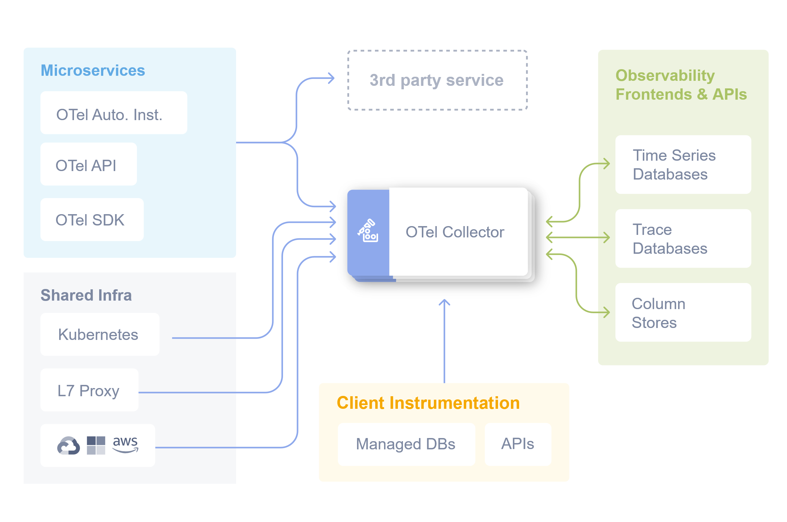

Slide 12
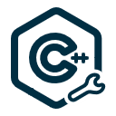










https://opentelemetry.io/docs/languages/
https://opentelemetry.io/docs/languages/

Slide 14
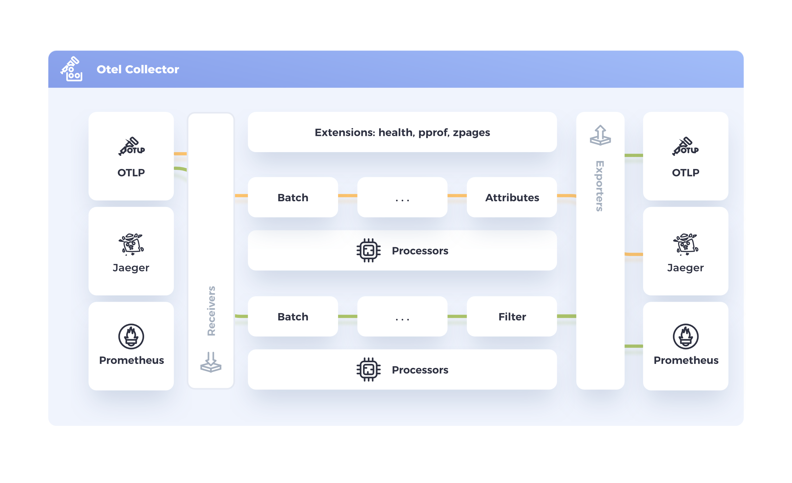

Slide 15
Connectors
+
Processors
Receivers
Exporters
109
45
52
* as of 2025.10.15

Slide 16
Useful Tidbits
Debug exporter is your friend
Test config correctness – collector is very sensitive
Separate infra and application collectors
Collector chaining is powerful
It is easier to scale OTel collector than the backends
Auto-instrumentation is a mixed-bag
Check release notes before updating
You can write your own components

Slide 17
How we use OTel (on 350+ clusters)
2 Helm charts – for infra and applications
Predefined default receivers
Predefined default processors
Predefined default exporters
Predefined default pipelines
Set custom environment metadata (account, cluster, team)
Possible to add more collectors or modify the existing one

Slide 18
References
CNCF mid-year 2025 look at projects – blog post
CNCF Project velocity July 2024 - July 2025 – data and graph
Dash0 – What is Observability? - https://www.dash0.com/knowledge/what-is-observability
O11y newsletter - https://o11y.news/
OTelBin configuration checker / visualizer - https://www.otelbin.io
OTTL Playground - https://ottl.run/
OTail – Policy Builder - https://app.otail.dev/
OTelGen – example signal generator - https://github.com/krzko/otelgen
OTel Collector Release Notes helper - https://wbollock.github.io/otel_upgrade_helper/

Slide 19

Questions?
Comments!?
Let’s connect!
Gundega Dēķena
Accenture Baltics

