Slide 1

Visual Studio Installation
Not Just Skill Training
Enabling environment and scope to grow career
PRESENTED BY: CloudnLoud Team
Notes:
1

Slide 2
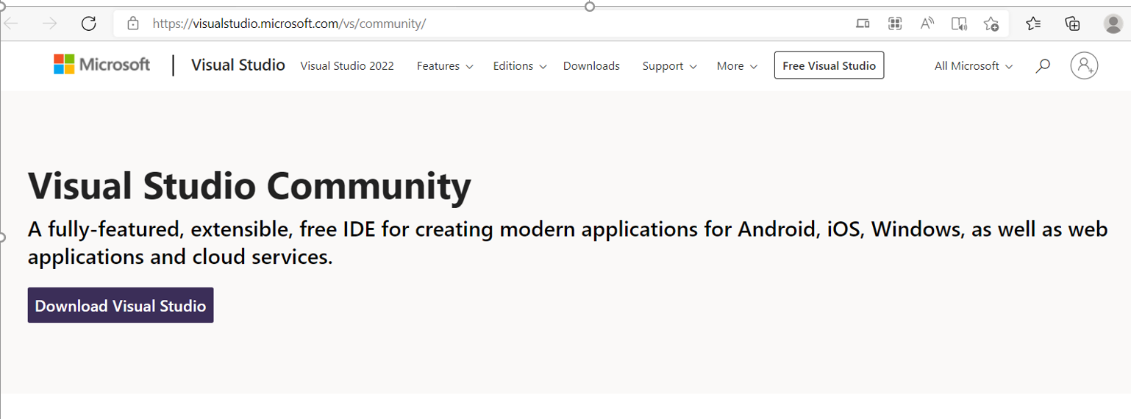
Download from Microsoft officially Page
Install the Visual Studio Community Edition which is free. Follow below link and click on download Visual Studio.
Note : Professional and enterprise version are licensed

Slide 3
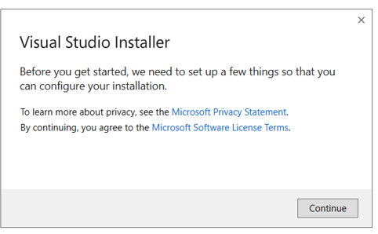
Open the Visualstudio.exc from download folder
After downloaded double click on VisualStudioSetup.exc file which is downloaded.

Slide 4
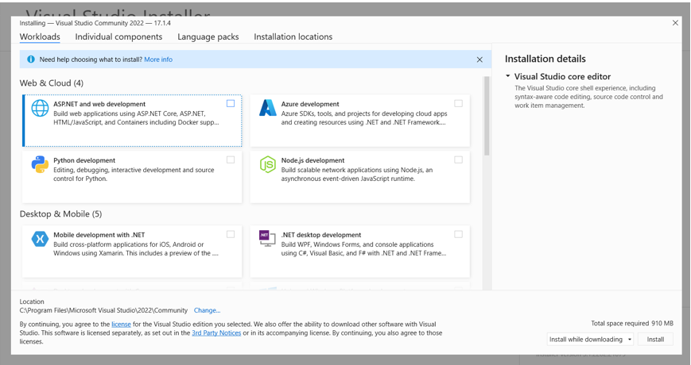
Select workload need to installed.
It will ask for workloads, Check all the necessary workloads to install in visual studio.

Slide 5
Select workload need to installed.
Workload:
ASP. Net and Web development.
Azure Development.
Visual Studio Extension Development.
Add if you need anything wanted.
Language packs:
Select English as default
Installation Location:
Keep all the installation in C:\Program files

Slide 6
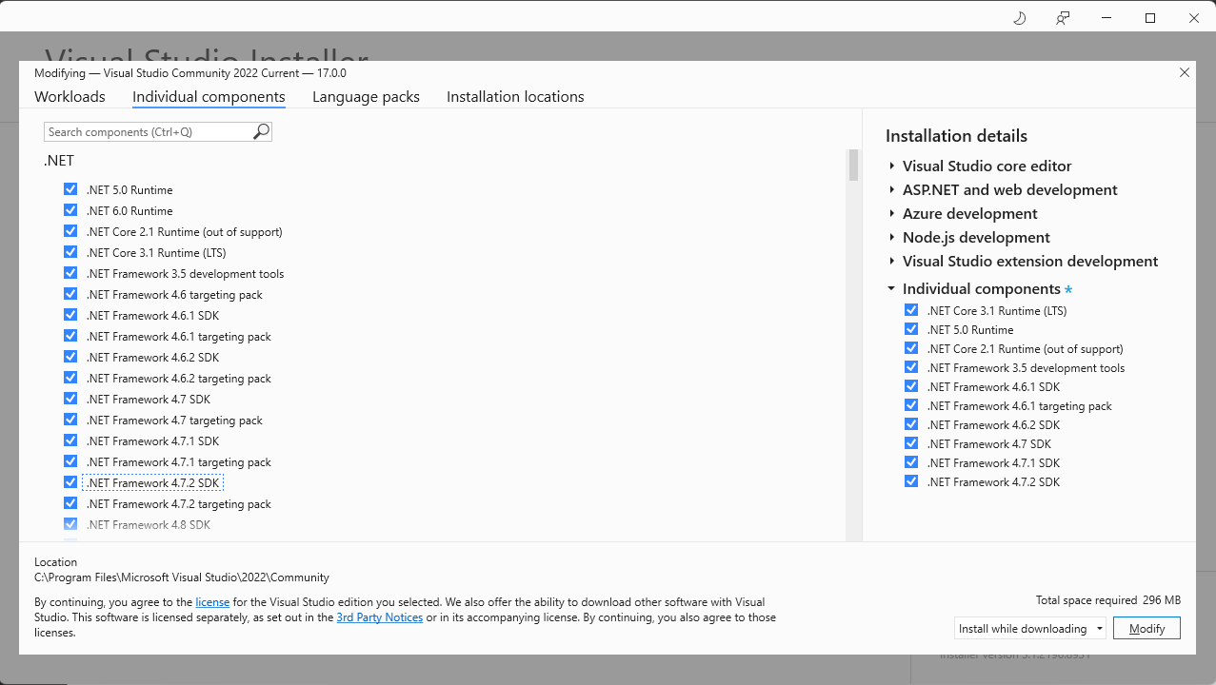
Open the Visualstudio.exc from download folder
Individual Components
Select all the .NET Framework(To support all downgraded project)

Slide 7
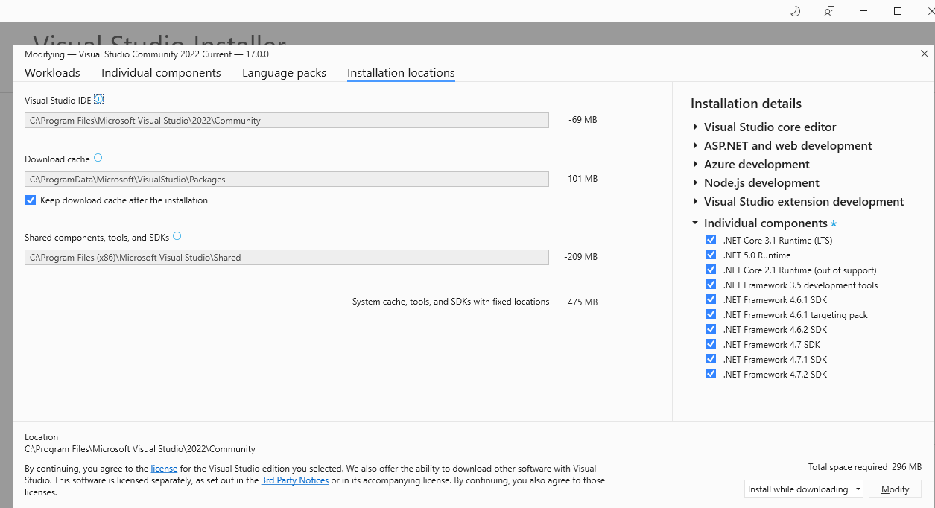
Provide Installation locations
Select Install and downloading, it will take some time to install VS

Slide 8
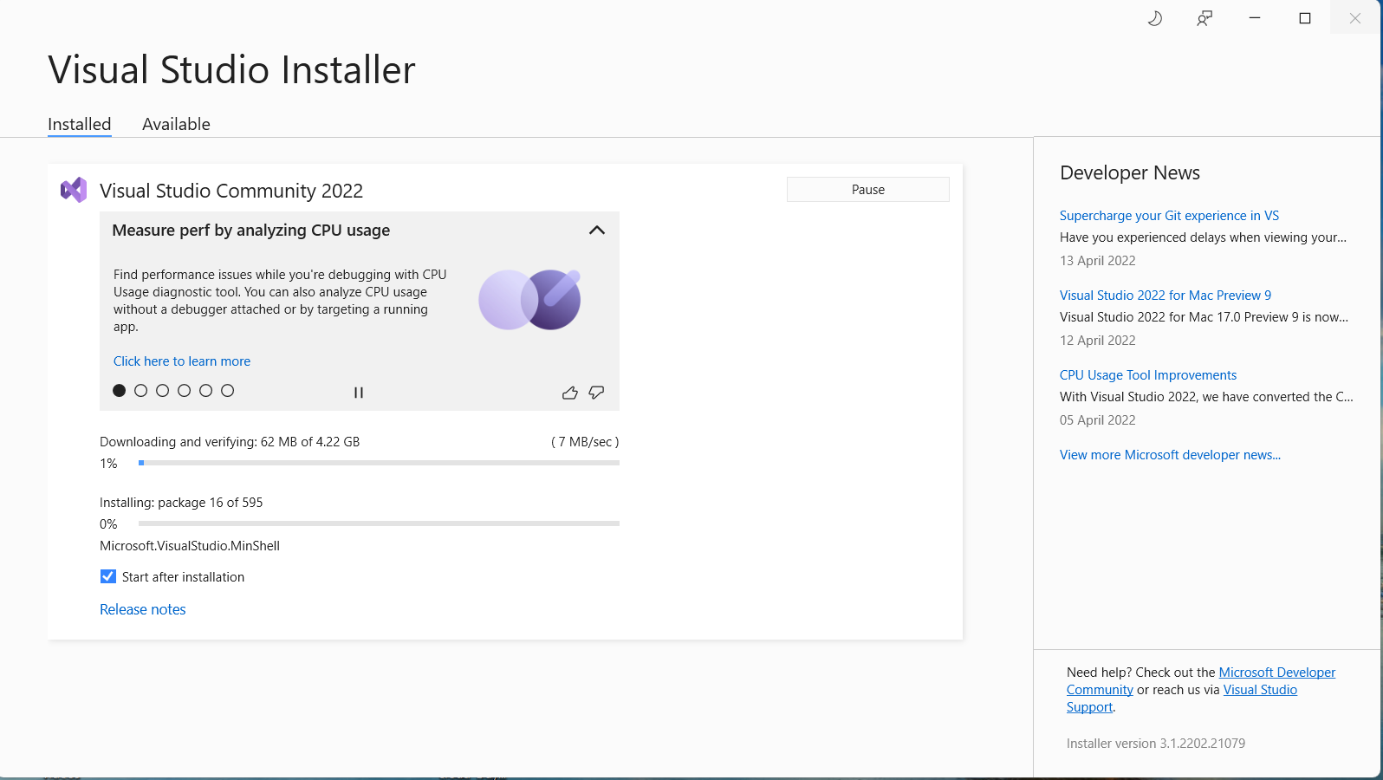
Install Visual Studio

Slide 9
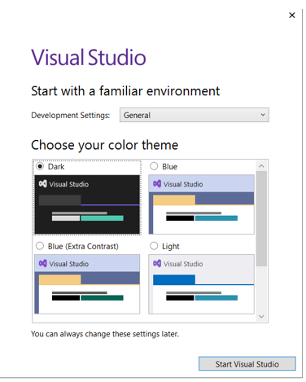
Select Theme to finish the installation
Select the Theme which you preferred.

Slide 10
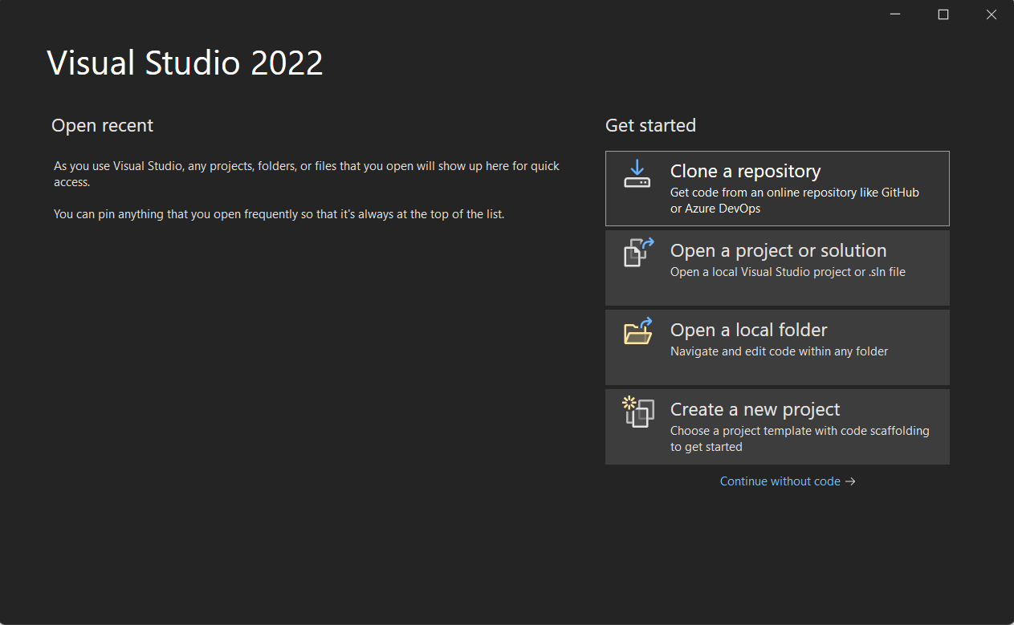
Installation Completed
When you see the window your are successfully installed VS
Clone a repository(You can clone project from github
Open a project(To open existing project)
Open a Folder(to open project folder)
Create a new project

Slide 11
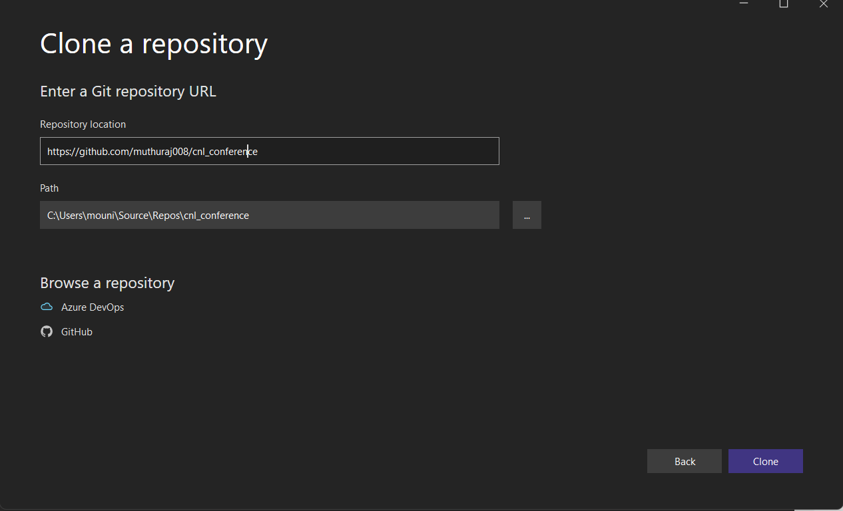
Clone project from GitHub using Visual studio
1. Enter the repository URL of GitHub in Repository location.
2. Provide the local path where to clone project.
3. After clicking on clone the project will be clone in respective path.

Slide 12
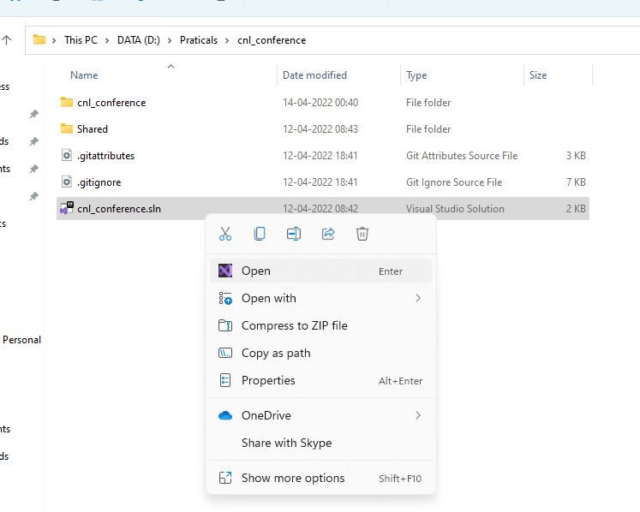
To Open a cloned project
Get into cloned project folder in local.
Open the solution file in Visual studio.

Slide 13

Thank you. We’d love to hear from you!

