Slide 1



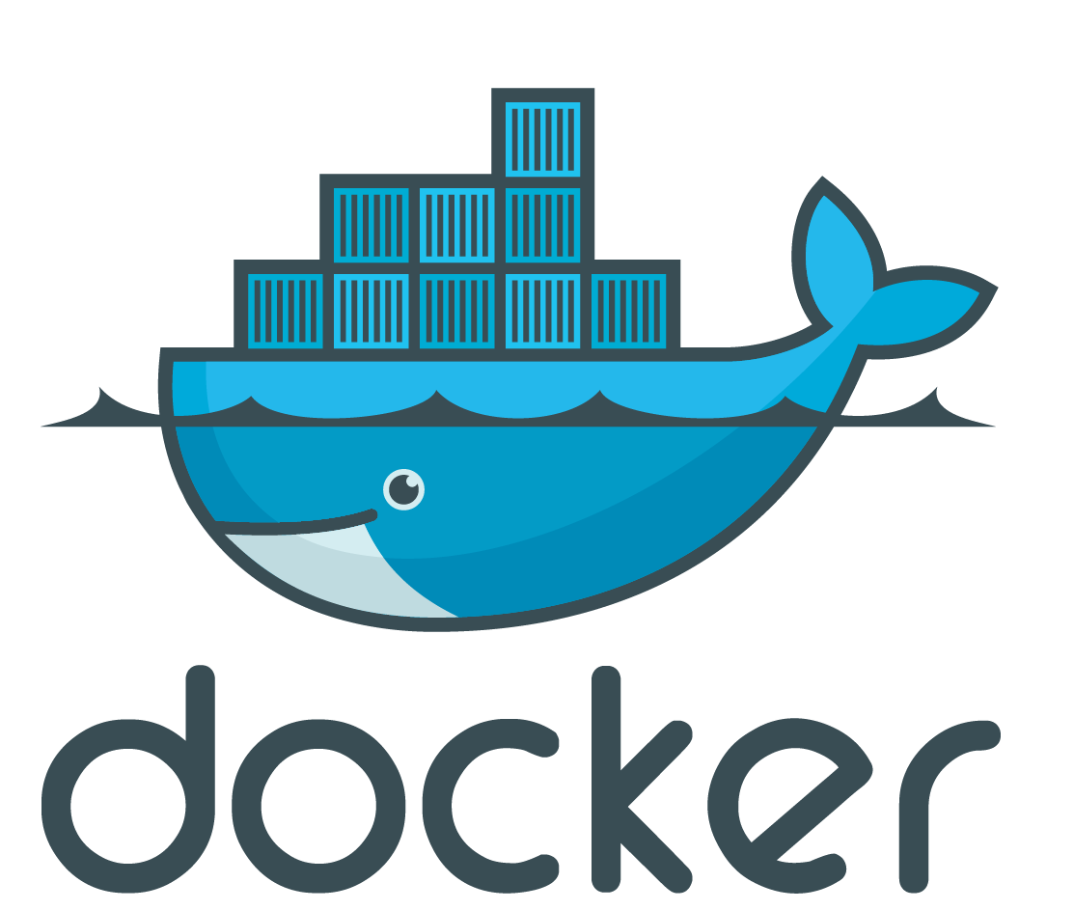

Dōgus (Containers)
Selenium Container
Reverse Proxy
selenium/standalone-chrome:3.3.0
Private Network, DHCP
Central
Configuration
5
Latest
from Cloudogu Registry
Integration Tests
cloudogu/gauge-java:latest
cloudogu/integration-tests:development
mvn test
2
Ecosystem under Test
Virtual Box+ Vagrant
From github – for each branch of cloudogu/ecosystem
Jenkins Node <<vagrant>>
Layers
Containers

