Slide 1



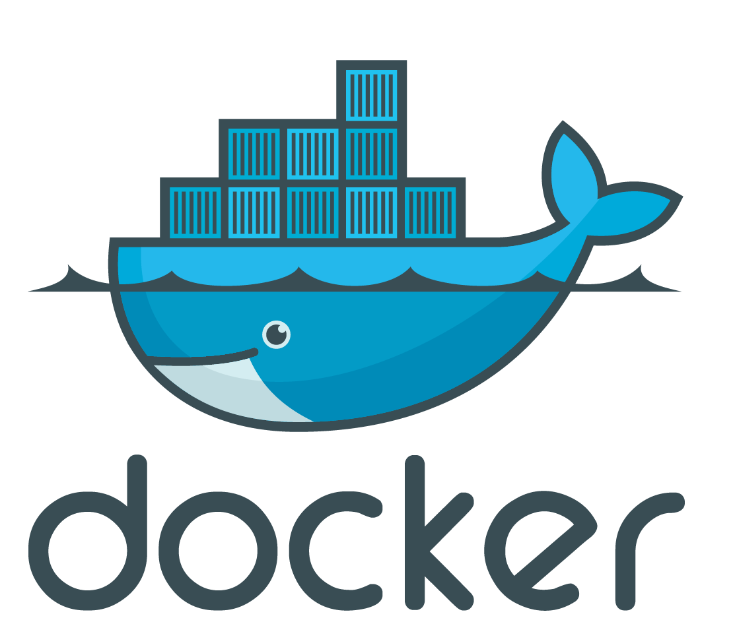

Ecosystem under Test
Private Network, DHCP
Jenkins Node <<vagrant>>
Dōgus (Containers)
Reverse Proxy
Selenium Container
selenium/standalone-chrome:3.3.0
Latest
from Cloudogu Registry
Central
Configuration
5
Integration Tests
cloudogu/gauge-java:latest
3
cloudogu/integration-tests:development
mvn test
2
1
From github – for each branch of cloudogu/ecosystem
Vagrant + Virtual Box

