Slide 1
Greenhouse Kick-Off PlusOne Operations Platform
Michael Schmidt, SAP

Slide 2
Menagerie of Tools
Monitoring | Logging | Compliance | Scaling | Tools
Supernova | SEM | CAM Integration | metrics-server | Ingress Controller
Pagerduty | SIEM | Vault | HPA | Cert Manager
Alertmanager | Octobus | Heureka | VPA | u8s
Grafana | Kibana | Doop | Descheduler | Manila Provisioner
Prometheus | ElasticSearch | Gatekeeper |  | Helm
Exporters |  | Secure by Default
 |  | RBAC Provisioning
 |  | Falco

Slide 3
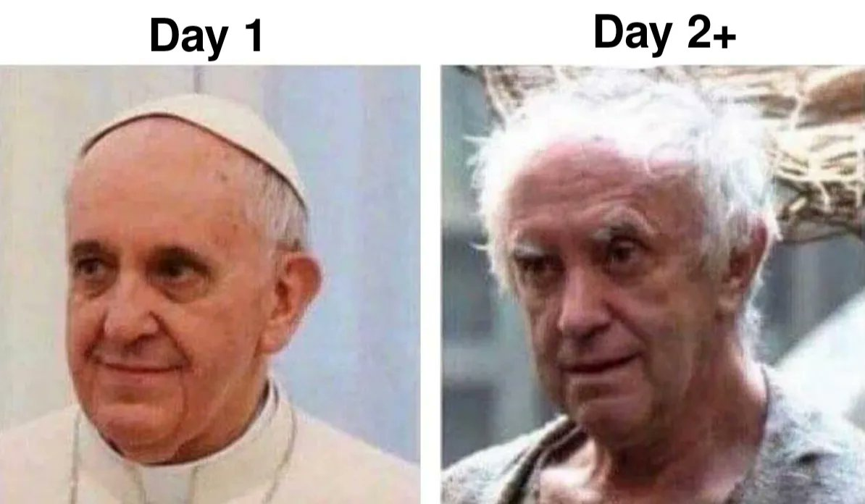

Slide 4
Pain Points
Usage
Step learning curve
Tool Zoo
Outdated tools
Automation
Too much manual work (CAM, Pagerduty, Slack, Github, Vault ,….)
Too hard to change
Too hard to onboard additional teams
Status Quo: Inconsistent, grown configuration. Easy to break.
Operations
Deployment complexity increasing
Platform vs Reuse
Fuzzy responsibilities
Development
Too many islands
Not enough framework to extend easily

Slide 5
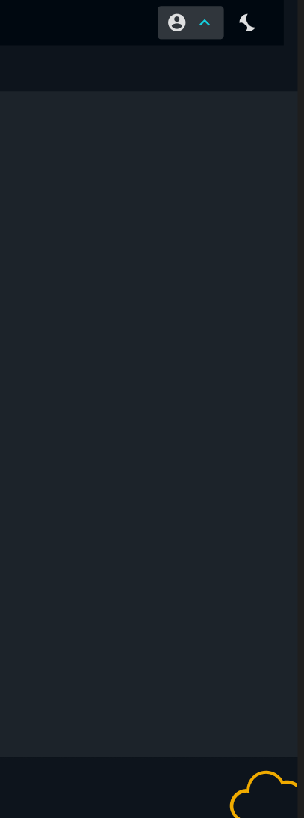
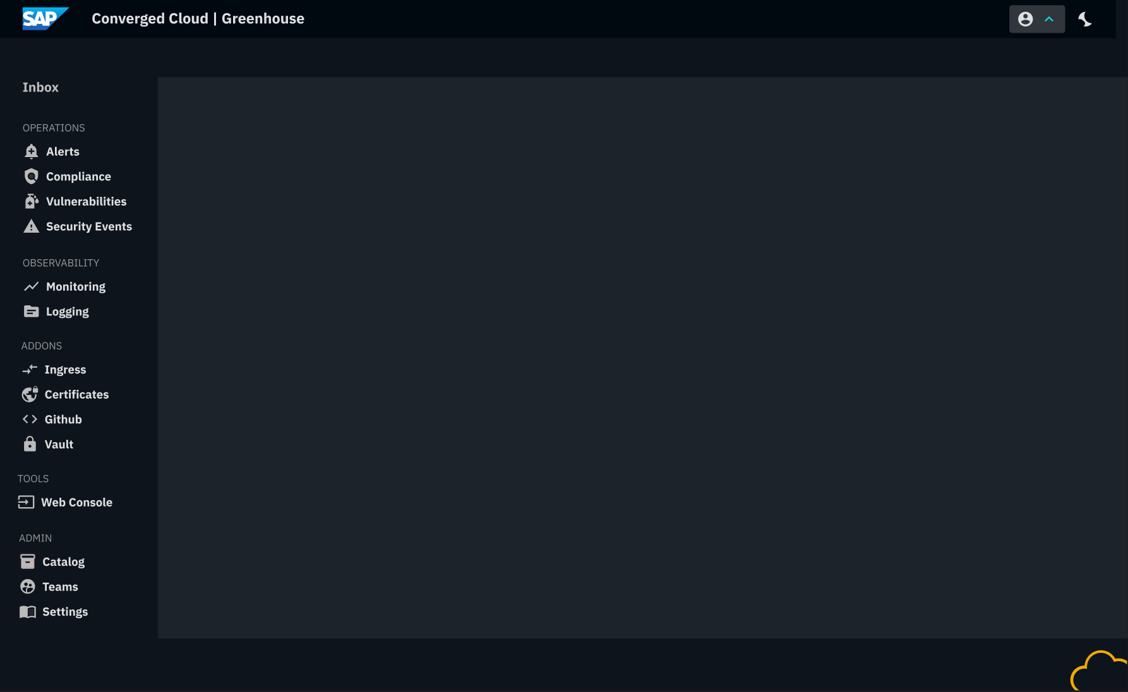
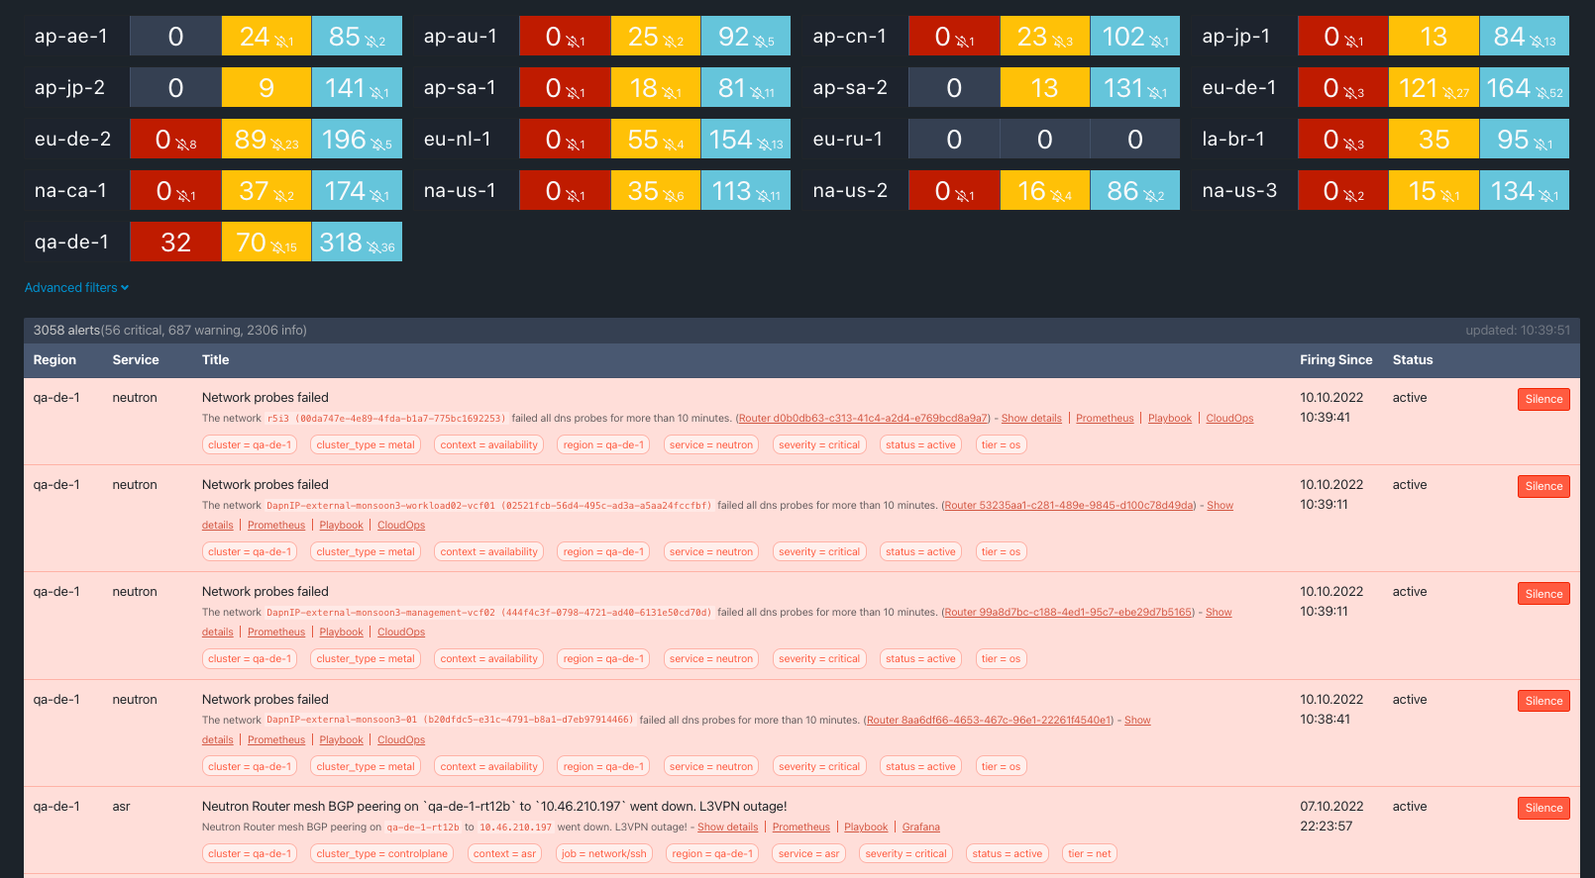
Inbox
Aggregated across Alerts, Violations, Vulnerabilities, Security Events
Aggregated across cluster fleet
Prefiltered according to users’ responsibilities
Additional filter by cluster, responsibility and custom metadata

Slide 6
Personal Supernova
Prefiltered according to users’ responsibilities
Additional filter by cluster, region and custom metadata

Slide 7
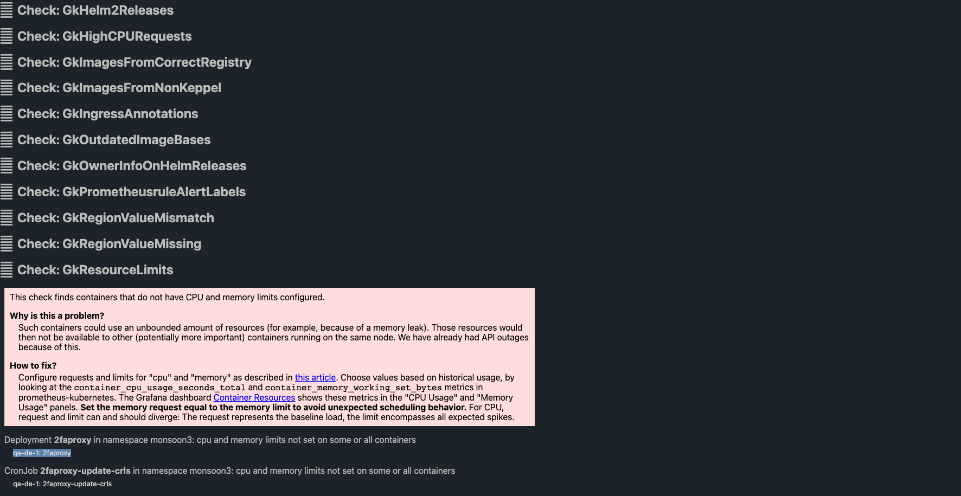
Personalized DooP
Prefiltered according to users’ responsibilities
Policy Bundles
Pick and Choose: SGS, GCS, PCI, Kubernetes Community Best Practices
Central Maintenance
Extendable with own policies
Surfaces Deprecations/Upgrade Blockers

Slide 8
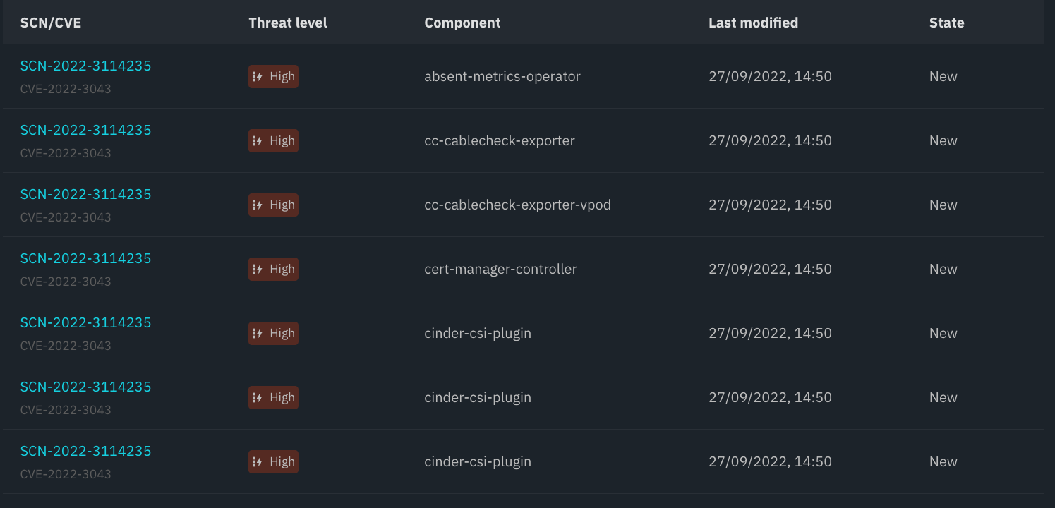
Vulnerability Analysis
Scans Images
Guides through ramification workflow
Creates compliance documentation

Slide 9
Greenhouse High Level Architecture
Greenhouse API
Greenhouse Frontend
API
Kubernetes CRDs and Controllers
Central framework
Configuration automation via plugins
Decentral Developed Plugins
Extendable Plugins
Frontend
End-user Portal
Plugins ReactJS MicroApps
CCloud Design System
1
Organization
1
n
n
Cluster
Team
Controllers
Dashboard
Framework
Plugins
Plugins
AuthZ
*
*
Supernova
Supernova
AuthN
*
AlertManager
*
Doop
*
*
IdP
Slack
Heureka
…
…
…

Slide 10
Roadmap - Stage 1
Enablement TOM model for CCloud DevOps
Alerts (Supernova)
Governance/Compliance (Doop/Gatekeeper)
Vulnerabilities (Heureka)
SIEM/SEM
Framework
UI Framework (Application L)
Authorization model (CAM/IAS)
CAM integration
Data model (Org, team, membership)
Plugins
Specification
Authentication

Slide 11
Next steps
Weekly greenhouse sync meeting
Initial Audience?
Initial work packages
Greenhouse data model (Arno & Fabus)
CAM Concept for Profiles, Support Groups, Teams (DavidR)
Spike CAM Integration (Arno & Fabus)
UI Concept (Esther)
Application L
Plugin concept
Supernova reimplementation

