Slide 1
Greenhouse PlusOne Operations Platform
Michael Schmidt, SAP

Slide 2
Menagerie of Tools
Monitoring | Logging | Compliance | Scaling | Tools
Supernova | SEM | CAM Integration | metrics-server | Ingress Controller
Pagerduty | SIEM | Vault | HPA | Cert Manager
Alertmanager | Octobus | Heureka | VPA | u8s
Grafana | Kibana | Doop | Descheduler | Manila Provisioner
Prometheus | ElasticSearch | Gatekeeper |  | Helm
Exporters |  | Secure by Default
 |  | RBAC Provisioning
 |  | Falco

Slide 3


Slide 4
Pain Points
Usage
Step learning curve
Tool Zoo
Outdated tools
Automation
Too much manual work (CAM, Pagerduty, Slack, Github, Vault ,….)
Too hard to change
Too hard to onboard additional teams
Status Quo: Inconsistent, grown configuration. Easy to break.
Operations
Deployment complexity increasing
Platform vs Reuse
Fuzzy responsibilities
Development
Too many islands
Not enough framework to extend easily

Slide 5
Greenhouse PlusOne Operations Platform
Catalog of Preconfigured Tools
Monitoring
Alerting
Logging
Compliance
Security
Scaling
Tooling
DevOps
Modern Stack
Kubernetes
Cloud-Native Tools
Best Practice Presets
Preconfigured real-world defaults
Battle proven in productive use
Extendable and customizable
Integrated by Default
Compliant with SGS, GCS and CCloud policies
Integrated with SAP IDS / Unified Identity
CAM, Github, Slack, ServiceNow, Pagerduty

Slide 6
Greenhouse High Level Architecture
Greenhouse API
Greenhouse Frontend
API
Kubernetes CRDs and Controllers
Central framework
Configuration automation via plugins
Decentral Developed Plugins
Extendable Plugins
Frontend
End-user Portal
Plugins ReactJS MicroApps
CCloud Design System
1
Organization
1
n
n
Cluster
Team
Controllers
Dashboard
Framework
Plugins
Plugins
AuthZ
*
*
Supernova
Supernova
AuthN
*
AlertManager
*
Doop
*
*
IdP
Slack
Heureka
…
…
…

Slide 7
Roadmap
 | Stage1 | Stage2 | Stage3
Focus | Support Process Framework Automation | Kubernetes Day-2 Extensions | Multi-Platform GaaS
Audience | Central Engineering | PlusOne | Public

Slide 8
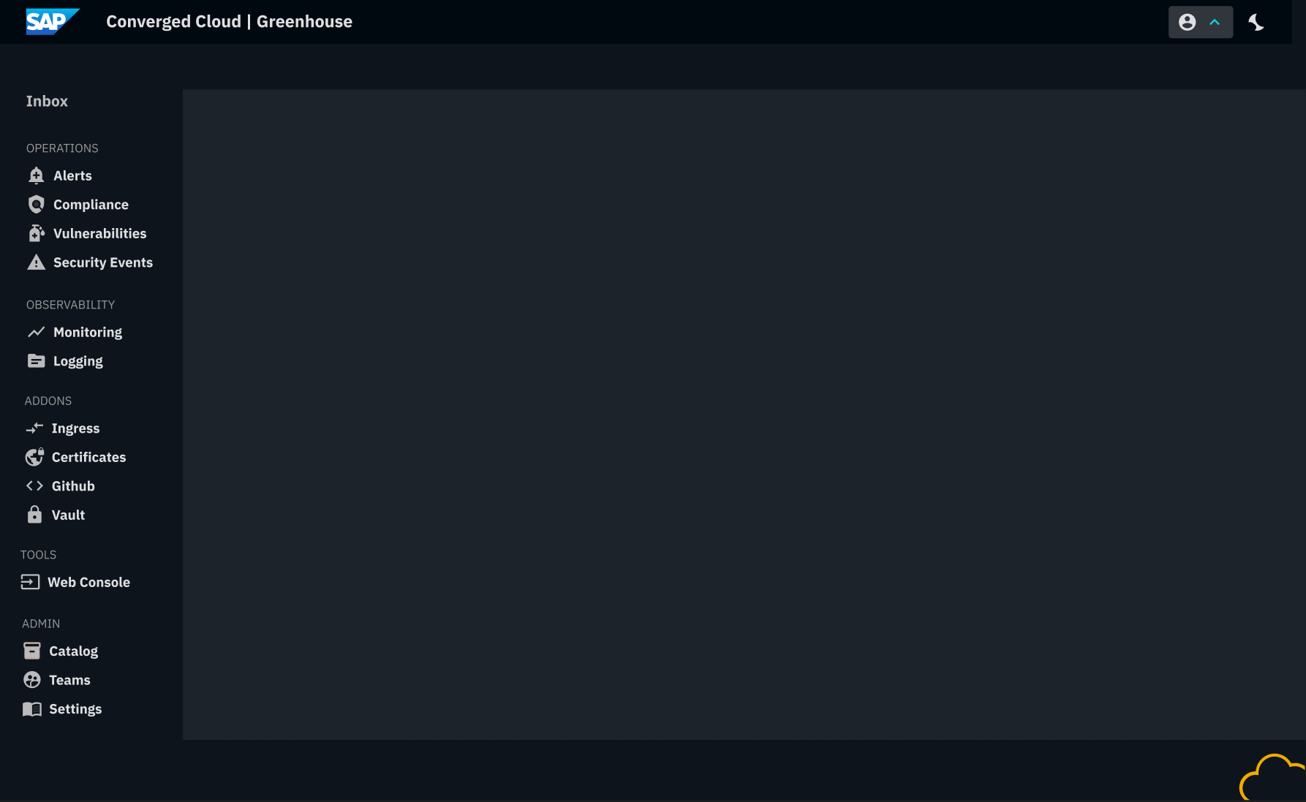
Dashboard
Holistic Operations Inbox
Aggregated across clusters
Operations Inbox - Prefiltered according to users’ responsibilities
Filter by cluster, responsibility and custom metadata
Central Configuration
Auto-configuration based on central settings
Drivers for external tools
Notifications: PagerDuty, Slack Alert/Group Channels, ServiceNow
Authorizations: Kubernetes RBAC, IDS OIDC Tenant, PagerDuty Team, Github Teams, CAM Profiles, Vault ACLs
User Management: CAM, AD Groups

Slide 9
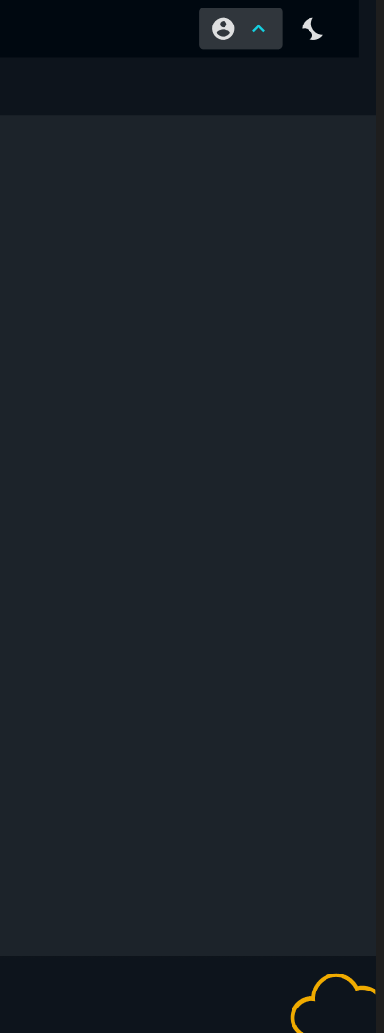
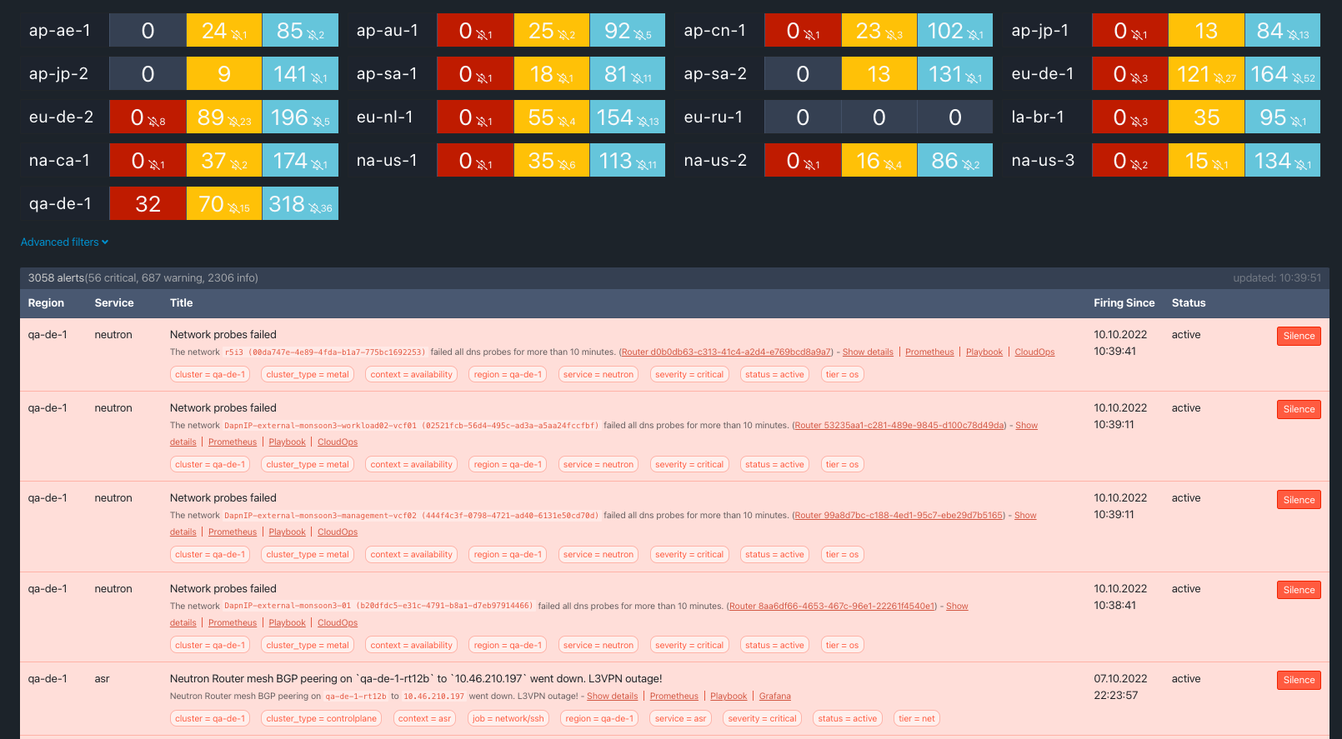
Inbox
Aggregated across Alerts, Violations, Vulnerabilities, Security Events
Aggregated across cluster fleet
Prefiltered according to users’ responsibilities
Additional filter by cluster, responsibility and custom metadata

Slide 10
Personal Supernova
Prefiltered according to users’ responsibilities
Additional filter by cluster, region and custom metadata

Slide 11
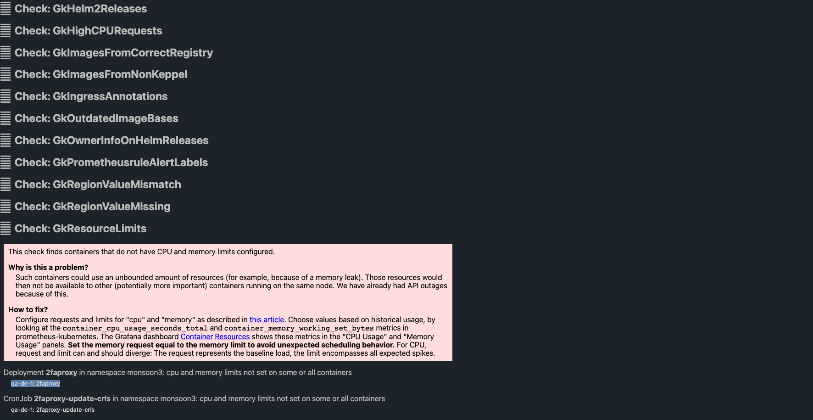
Personalized DooP
Prefiltered according to users’ responsibilities
Policy Bundles
Pick and Choose: SGS, GCS, PCI, Kubernetes Community Best Practices
Central Maintenance
Extendable with own policies
Surfaces Deprecations/Upgrade Blockers

Slide 12
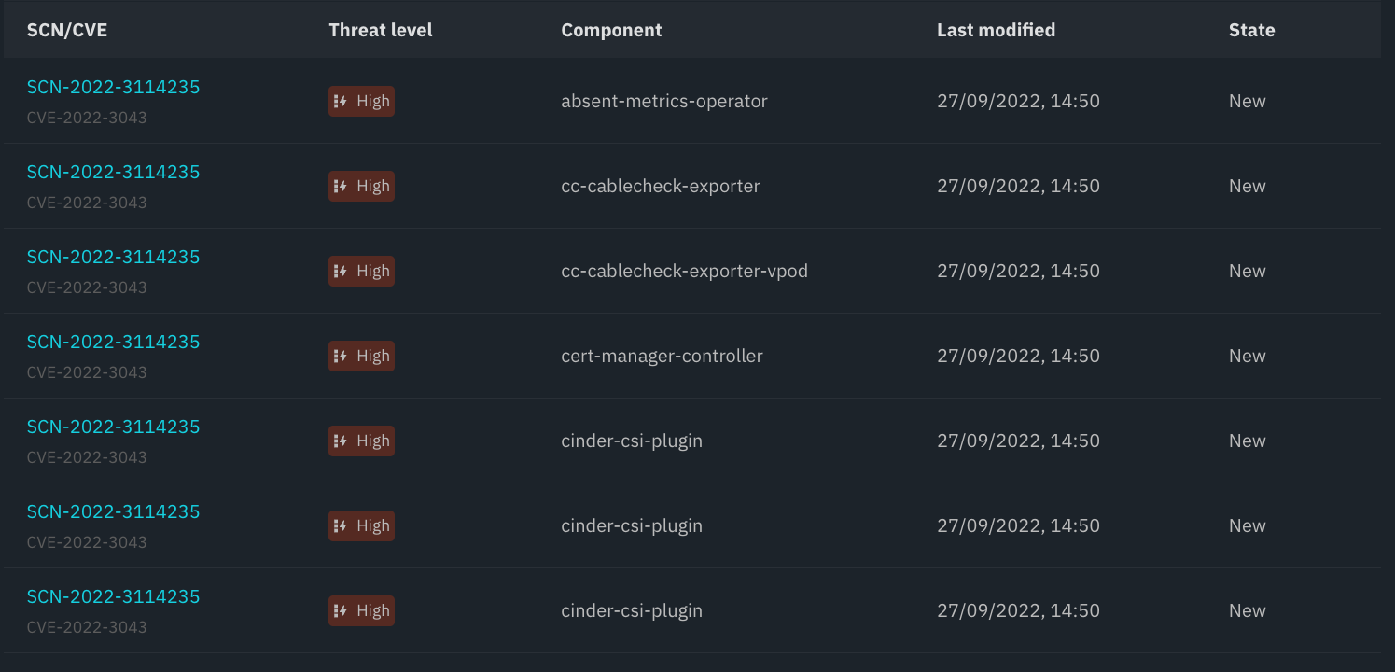
Vulnerability Analysis
Scans Images
Guides through ramification workflow
Creates compliance documentation

Slide 13
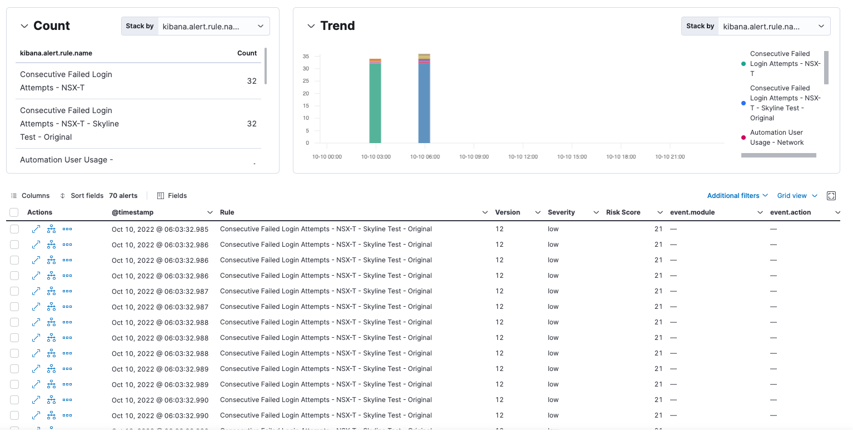

Slide 14
Access Control
User-Defined Teams
Authorization Distribution
Kubernetes RBAC
Predefined roles: prometheus_viewer, grafana_viewer, webconsole_support
Define responsibilities (label, namespace, resource-type matching)
Assign roles and responsibilities to teams/groups
Distribute and reconcile RBACs across fleet
IAS Tenant
Bring your own tenant
Distributes and reconciles groups and users
2FA against IDS
OIDC tenant for tools
Drivers to reconcile external Tools
Github, Pagerduty, Slack, Vault, Slack
User Management
Create and sync with CAM profiles
AD group to team Mapping

Slide 15
AuthN
Greenhouse API
Greenhouse Frontend
IDS
oidc
Users
1
Organization
1
n
n
n
Cluster
Team
1
Plugin
n
Dashboard
Role
Controllers
Plugins
AuthZ
IdP
Plugin
User
requests
CAM
IAS
SuperNova
Supernova
creates
KeyCloak
Slack
Heureka
AuthZ
CAM
reconciles
creates
Pagerduty
Doop
Profiles
SNow
…
Access Level
Vault
Github …
oidc
IaS
reconciles
GroupAssignments
Group
n
1

Slide 16
Monitoring
Prometheus
Sane Default Configuration
Alerting
Preconfigured and all batteries included
Routing configuration is generated from teams/responsibilities
Notification Drivers
Slack (Bring your own Slack Workspace)
PagerDuty
ServiceNow
Graphing
Ships with best-practice dashboards
Explore Grafana Successor
Logging
Collects logs Containers, Kubernetes, Audit
Explore ELK Successor

Slide 17
Secrets
Managed HashiCorp Vault
Integrated Authentication and Authorizations
HSM Integration for CCloud

Slide 18
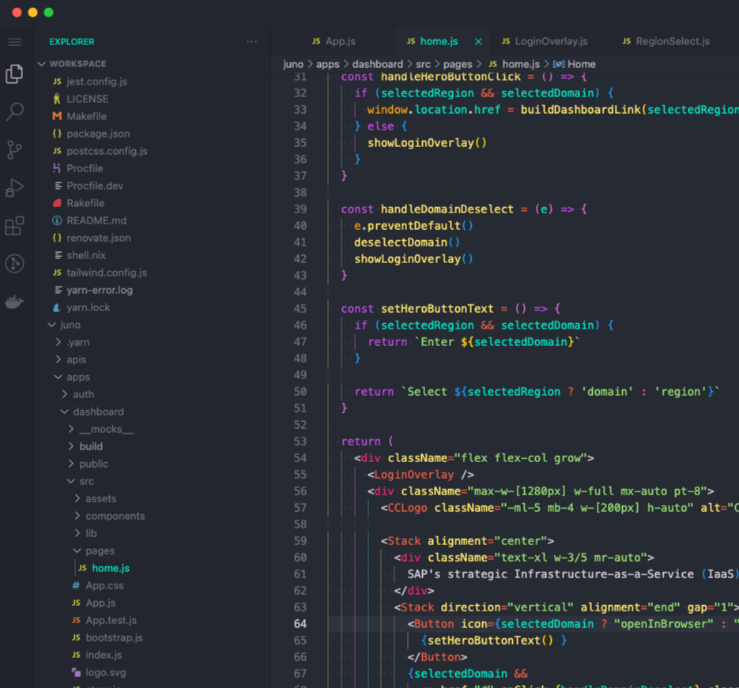
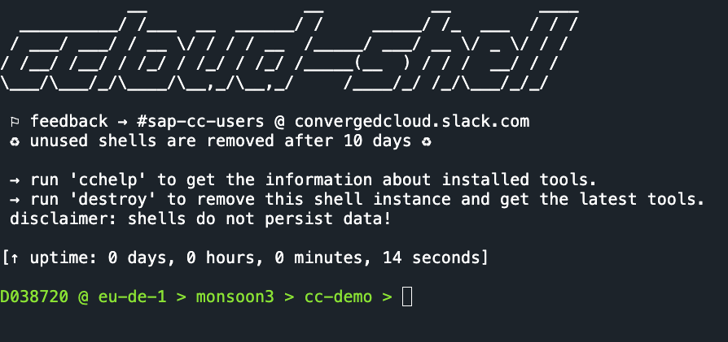
Web Console / Workspace
Browser based console
Required tools in the correct versions
Pre-authenticated

Slide 19
Greenhouse High-Level Architecture
Dashboard
Dashboard
Global Singleton
Multi-Tenant
Kubernetes Backend
Kubernetes Tenants
One-click adoption of existing clusters
4+1
Tools and Addons
Managed installation and upgrade
Pick and choose tools from catalog
Decentralized installation
Single-tenant applications
Operators for configuration, installation, upgrade
k8s
A
B
C
D
Tenant A
Tenant B
k8s
k8s
k8s
k8s
k8s
k8s
3
3
3
3
3
3
2
2
2
2
2
2
1
1
1
1
1
1
Tenant C
Tenant D
k8s
k8s
k8s
k8s
k8s
k8s
3
3
3
3
3
2
2
2
2
2
2
1
1
1
1
1
1
1
1

Slide 20
Cluster Management
Bring your own Cluster
Multiple clusters per Tenant
4+1
Dashboard
Singleton: https://greenhouse.global.cloud.sap
Multi-Tenant
Kubernetes-based
Decentralized Tools
Tools live in tenant’s clusters
Single-Tenant installed per tenant
Configuration from global settings via operators
Customizable tool suite per tenant

