Slide 1
Supplier workflow evidence
Run xdx-supplier-e2e-evidence-20261015
Supplier, Address, Contact, Site and Site Assignment
Actual workflow screens and recorded outcomes
2026-10-15T20:50:49.397Z
Notes:
Run: xdx-supplier-e2e-evidence-20261015
Source: docs/builds/xdx-supplier-e2e-evidence-20261015/results.json

Slide 2
Run scope and environment
Run xdx-supplier-e2e-evidence-20261015
Application: XDX_SUPPLIER_WORKSPACE
Workflow: XDX_SUPPLIER_CONVERSATION
Version: 88010729
Host: https://fa-eqil-dev21-saasfademo1.ds-fa.oraclepdemos.com
Surface: app-preview
Direct and template scenarios where supported
Query, create and independent readback
Notes:
{
"appCode": "XDX_SUPPLIER_WORKSPACE",
"workflowCode": "XDX_SUPPLIER_CONVERSATION",
"version": "88010729",
"host": "https://fa-eqil-dev21-saasfademo1.ds-fa.oraclepdemos.com",
"surface": "app-preview"
}

Slide 3
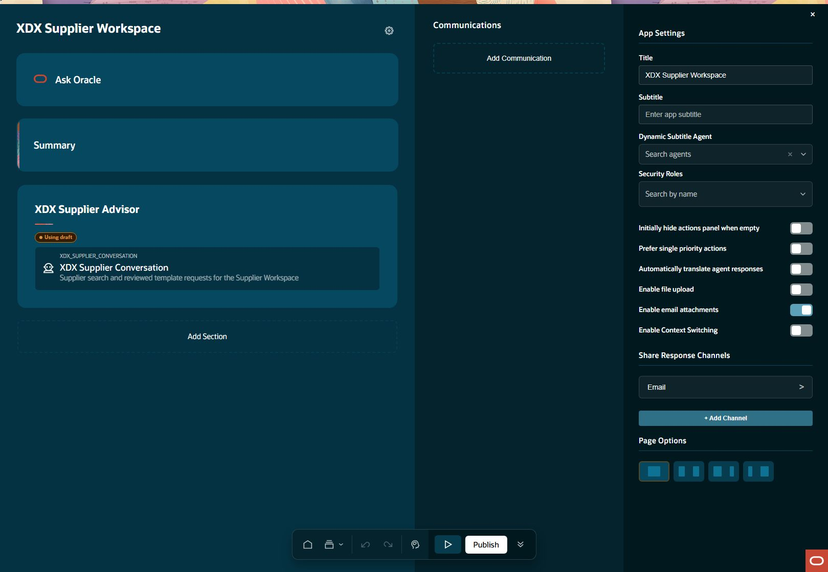
Supplier Workspace draft preview: studio identity
setup Step result: PASS
Notes:
Step: setup
Object: Supplier
Scenario: identity
Outcome: PASS
Expected: Execute declared business operation with current parent relationships and retained evidence
Actual: Correct signed-in app preview and current DRAFT88010729 verified.
Record IDs: {}
Fallback: false
Retries: []
Source results: docs/builds/xdx-supplier-e2e-evidence-20261015/results.json
Recorded action/stage key: studio-identity
Observed UTC: 2026-10-15T20:53:14.566Z
Screenshot: docs/builds/xdx-supplier-e2e-evidence-20261015/screens/setup-studio-identity-001.jpg
Semantic evidence: docs/builds/xdx-supplier-e2e-evidence-20261015/screens/setup-studio-identity-001.txt
Capture notes: Actual app configuration; current saved draft88010729 verified.
Timing qualification: Some retained setup captures use persistence time rather than original acquisition time. See run limitations.

Slide 4
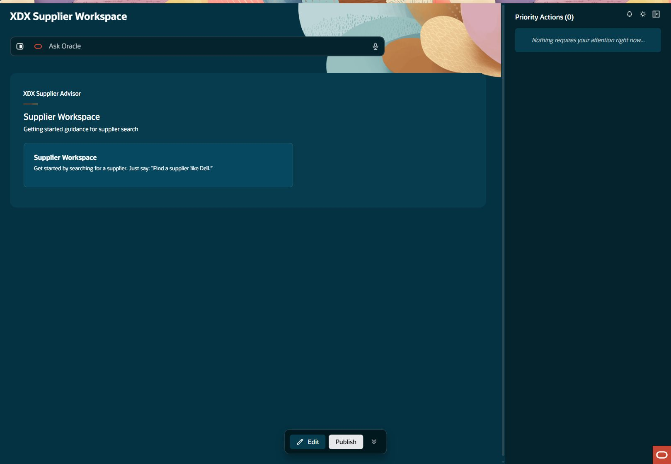
Supplier Workspace draft preview: preview start
setup Step result: PASS
Notes:
Step: setup
Object: Supplier
Scenario: identity
Outcome: PASS
Expected: Execute declared business operation with current parent relationships and retained evidence
Actual: Correct signed-in app preview and current DRAFT88010729 verified.
Record IDs: {}
Fallback: false
Retries: []
Source results: docs/builds/xdx-supplier-e2e-evidence-20261015/results.json
Recorded action/stage key: preview-start
Observed UTC: 2026-10-15T20:53:14.578Z
Screenshot: docs/builds/xdx-supplier-e2e-evidence-20261015/screens/setup-preview-start-002.jpg
Semantic evidence: docs/builds/xdx-supplier-e2e-evidence-20261015/screens/setup-preview-start-002.txt
Capture notes: Actual Studio Run app preview startup.
Timing qualification: Some retained setup captures use persistence time rather than original acquisition time. See run limitations.

Slide 5

Supplier search: entered request
supplier-query Step result: PASS
Notes:
Step: supplier-query
Object: Supplier
Scenario: query
Outcome: PASS
Expected: Execute declared business operation with current parent relationships and retained evidence
Actual: Known-hit Dell search returned three suppliers with no more results.
Record IDs: {"sourceSupplierNumber":"1255"}
Fallback: false
Retries: []
Source results: docs/builds/xdx-supplier-e2e-evidence-20261015/results.json
Recorded action/stage key: entered-request
Observed UTC: 2026-10-15T20:54:00.985Z
Screenshot: docs/builds/xdx-supplier-e2e-evidence-20261015/screens/supplier-query-entered-request-001.jpg
Semantic evidence: docs/builds/xdx-supplier-e2e-evidence-20261015/screens/supplier-query-entered-request-001.txt
Capture notes: Find a supplier like Dell
Timing qualification: Some retained setup captures use persistence time rather than original acquisition time. See run limitations.

Slide 6
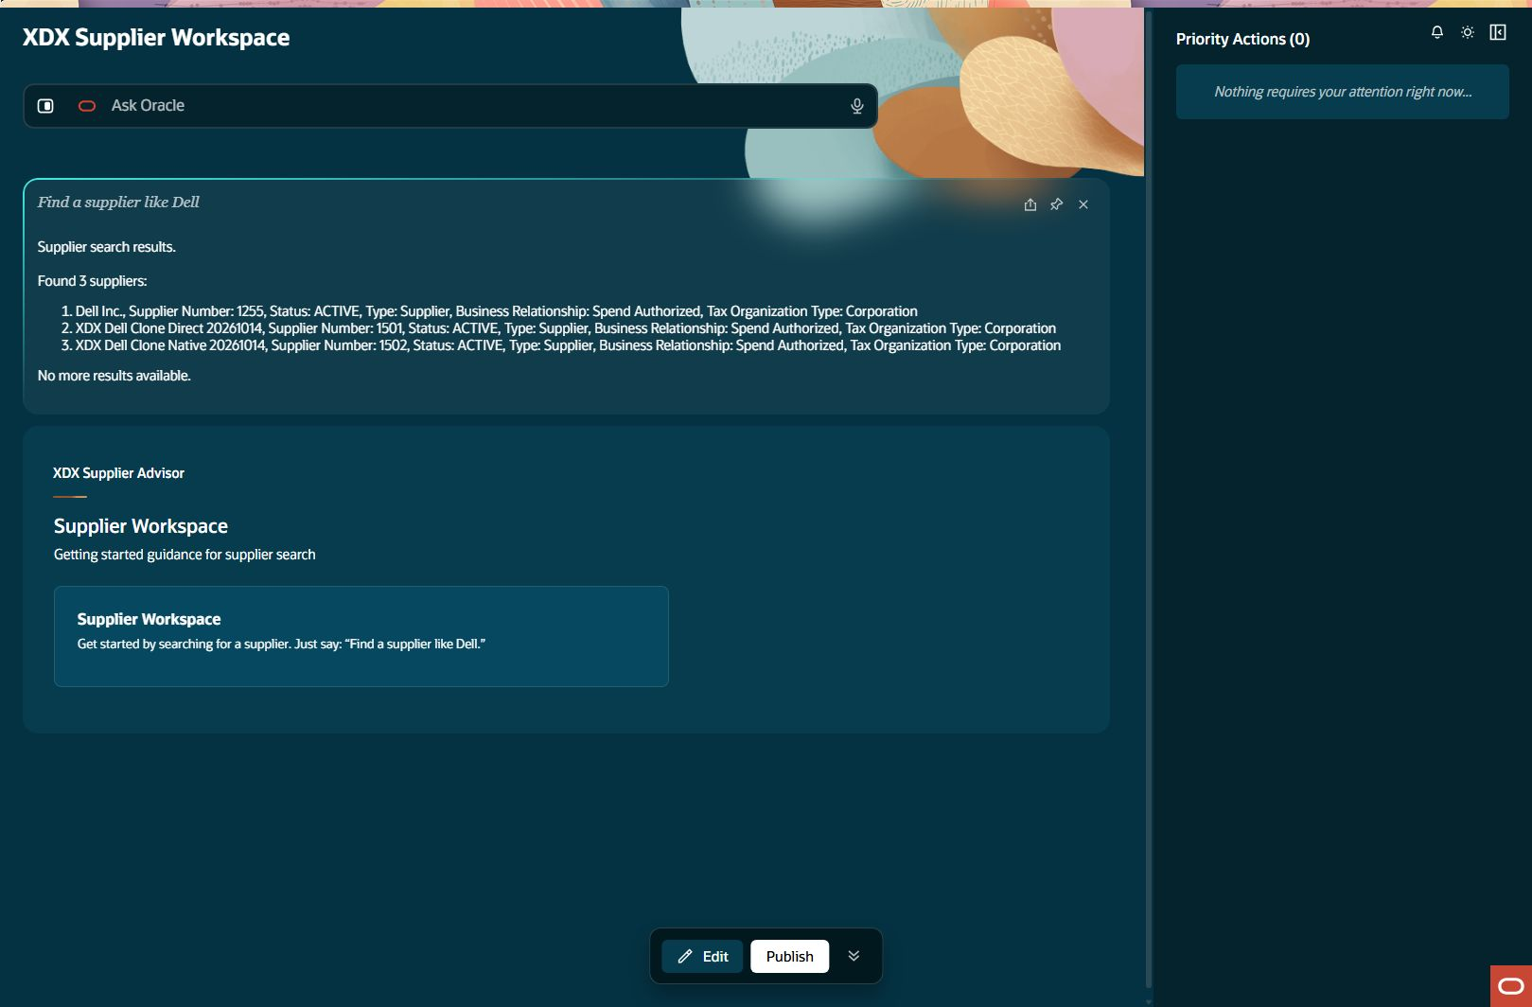
Supplier search: result
supplier-query Step result: PASS
Notes:
Step: supplier-query
Object: Supplier
Scenario: query
Outcome: PASS
Expected: Execute declared business operation with current parent relationships and retained evidence
Actual: Known-hit Dell search returned three suppliers with no more results.
Record IDs: {"sourceSupplierNumber":"1255"}
Fallback: false
Retries: []
Source results: docs/builds/xdx-supplier-e2e-evidence-20261015/results.json
Recorded action/stage key: result
Observed UTC: 2026-10-15T20:54:03.836Z
Screenshot: docs/builds/xdx-supplier-e2e-evidence-20261015/screens/supplier-query-result-002.jpg
Semantic evidence: docs/builds/xdx-supplier-e2e-evidence-20261015/screens/supplier-query-result-002.txt
Capture notes: Dell Inc. number1255 and two XDX clones; complete three-row response.
Timing qualification: Some retained setup captures use persistence time rather than original acquisition time. See run limitations.

Slide 7
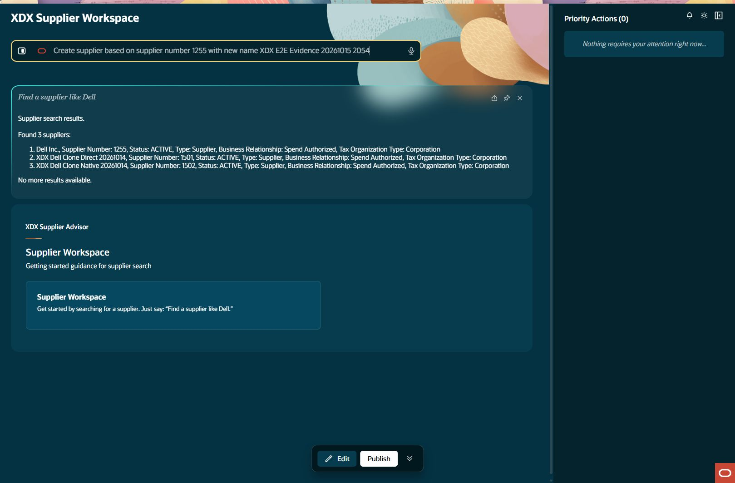
Supplier template creation: prepare input
supplier-create Step result: PASS
Notes:
Step: supplier-create
Object: Supplier
Scenario: template
Outcome: PASS
Expected: Execute declared business operation with current parent relationships and retained evidence
Actual: Created supplier1503 once; workflow independently verified name, type, relationship and tax organization type.
Record IDs: {"supplierId":"300000340604948","supplierNumber":"1503"}
Fallback: false
Retries: []
Source results: docs/builds/xdx-supplier-e2e-evidence-20261015/results.json
Recorded action/stage key: prepare-input
Observed UTC: 2026-10-15T20:54:04.006Z
Screenshot: docs/builds/xdx-supplier-e2e-evidence-20261015/screens/supplier-create-prepare-input-001.jpg
Semantic evidence: docs/builds/xdx-supplier-e2e-evidence-20261015/screens/supplier-create-prepare-input-001.txt
Capture notes: Entered request: Create supplier based on supplier number 1255 with new name XDX E2E Evidence 20261015 2054
Timing qualification: Some retained setup captures use persistence time rather than original acquisition time. See run limitations.

Slide 8
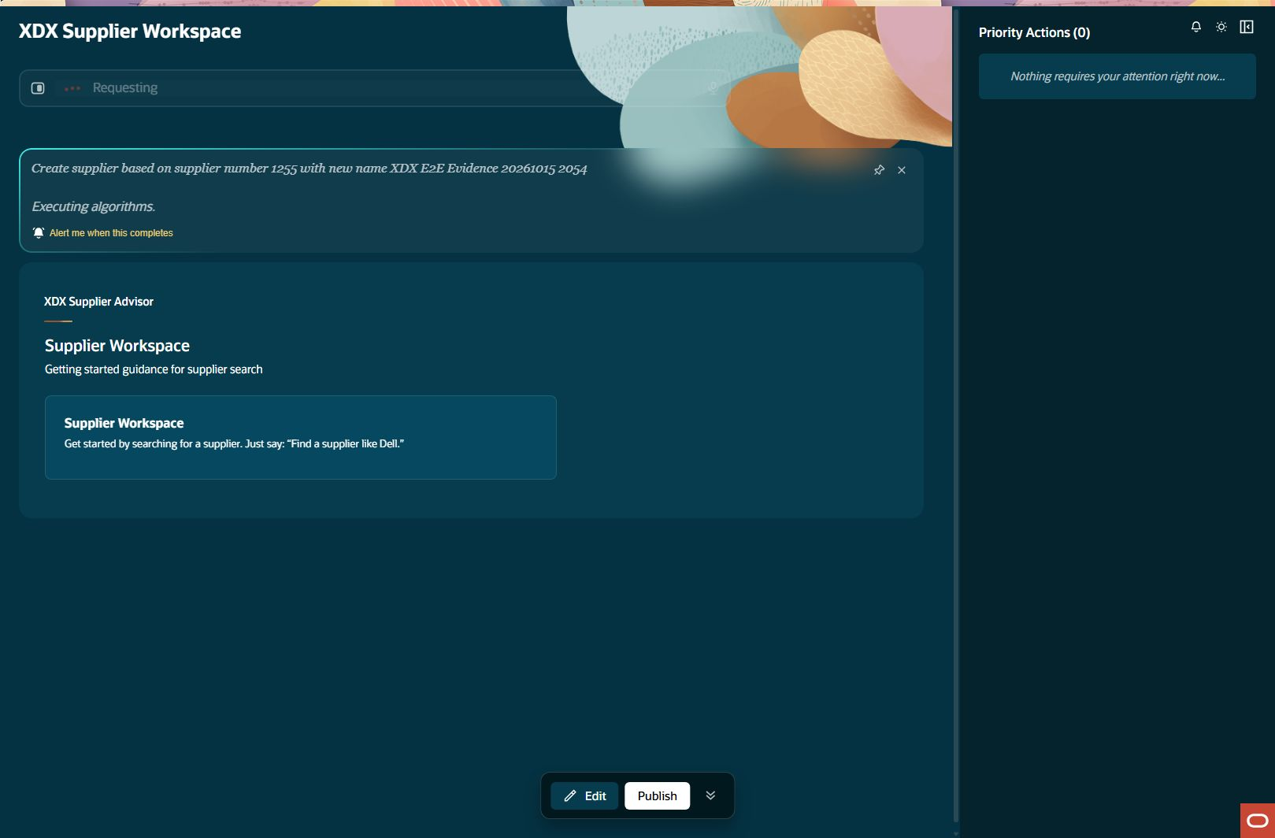
Supplier preparation in progress
supplier-create Step result: PASS
Notes:
Step: supplier-create
Object: Supplier
Scenario: template
Outcome: PASS
Expected: Execute declared business operation with current parent relationships and retained evidence
Actual: Created supplier1503 once; workflow independently verified name, type, relationship and tax organization type.
Record IDs: {"supplierId":"300000340604948","supplierNumber":"1503"}
Fallback: false
Retries: []
Source results: docs/builds/xdx-supplier-e2e-evidence-20261015/results.json
Recorded action/stage key: prepared
Observed UTC: 2026-10-15T20:54:13.592Z
Screenshot: docs/builds/xdx-supplier-e2e-evidence-20261015/screens/supplier-create-prepared-002.jpg
Semantic evidence: docs/builds/xdx-supplier-e2e-evidence-20261015/screens/supplier-create-prepared-002.txt
Capture notes: Actual intermediate loading screen. Final draft is captured separately at draft-ready.
Timing qualification: Some retained setup captures use persistence time rather than original acquisition time. See run limitations.

Slide 9
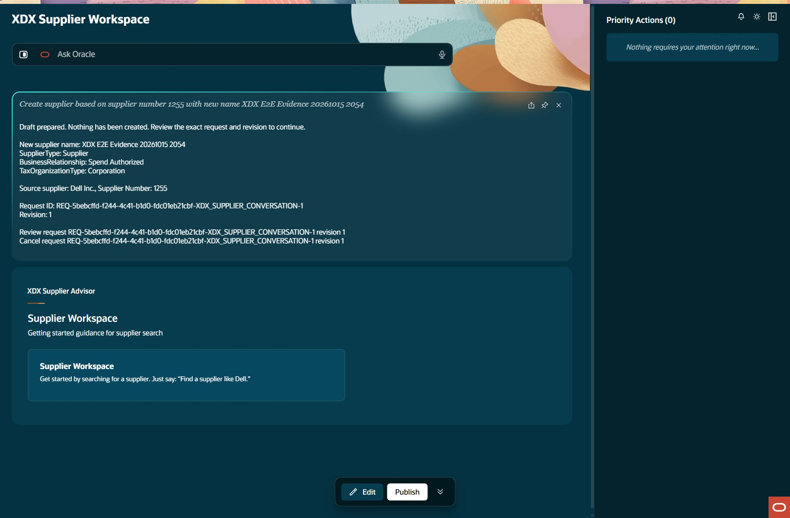
Supplier template creation: draft ready
supplier-create Step result: PASS
Notes:
Step: supplier-create
Object: Supplier
Scenario: template
Outcome: PASS
Expected: Execute declared business operation with current parent relationships and retained evidence
Actual: Created supplier1503 once; workflow independently verified name, type, relationship and tax organization type.
Record IDs: {"supplierId":"300000340604948","supplierNumber":"1503"}
Fallback: false
Retries: []
Source results: docs/builds/xdx-supplier-e2e-evidence-20261015/results.json
Recorded action/stage key: draft-ready
Observed UTC: 2026-10-15T20:54:41.241Z
Screenshot: docs/builds/xdx-supplier-e2e-evidence-20261015/screens/supplier-create-draft-ready-003.jpg
Semantic evidence: docs/builds/xdx-supplier-e2e-evidence-20261015/screens/supplier-create-draft-ready-003.txt
Capture notes: New supplier draft with source1255, expected classifications, exact request/revision; no record created.
Timing qualification: Some retained setup captures use persistence time rather than original acquisition time. See run limitations.

Slide 10
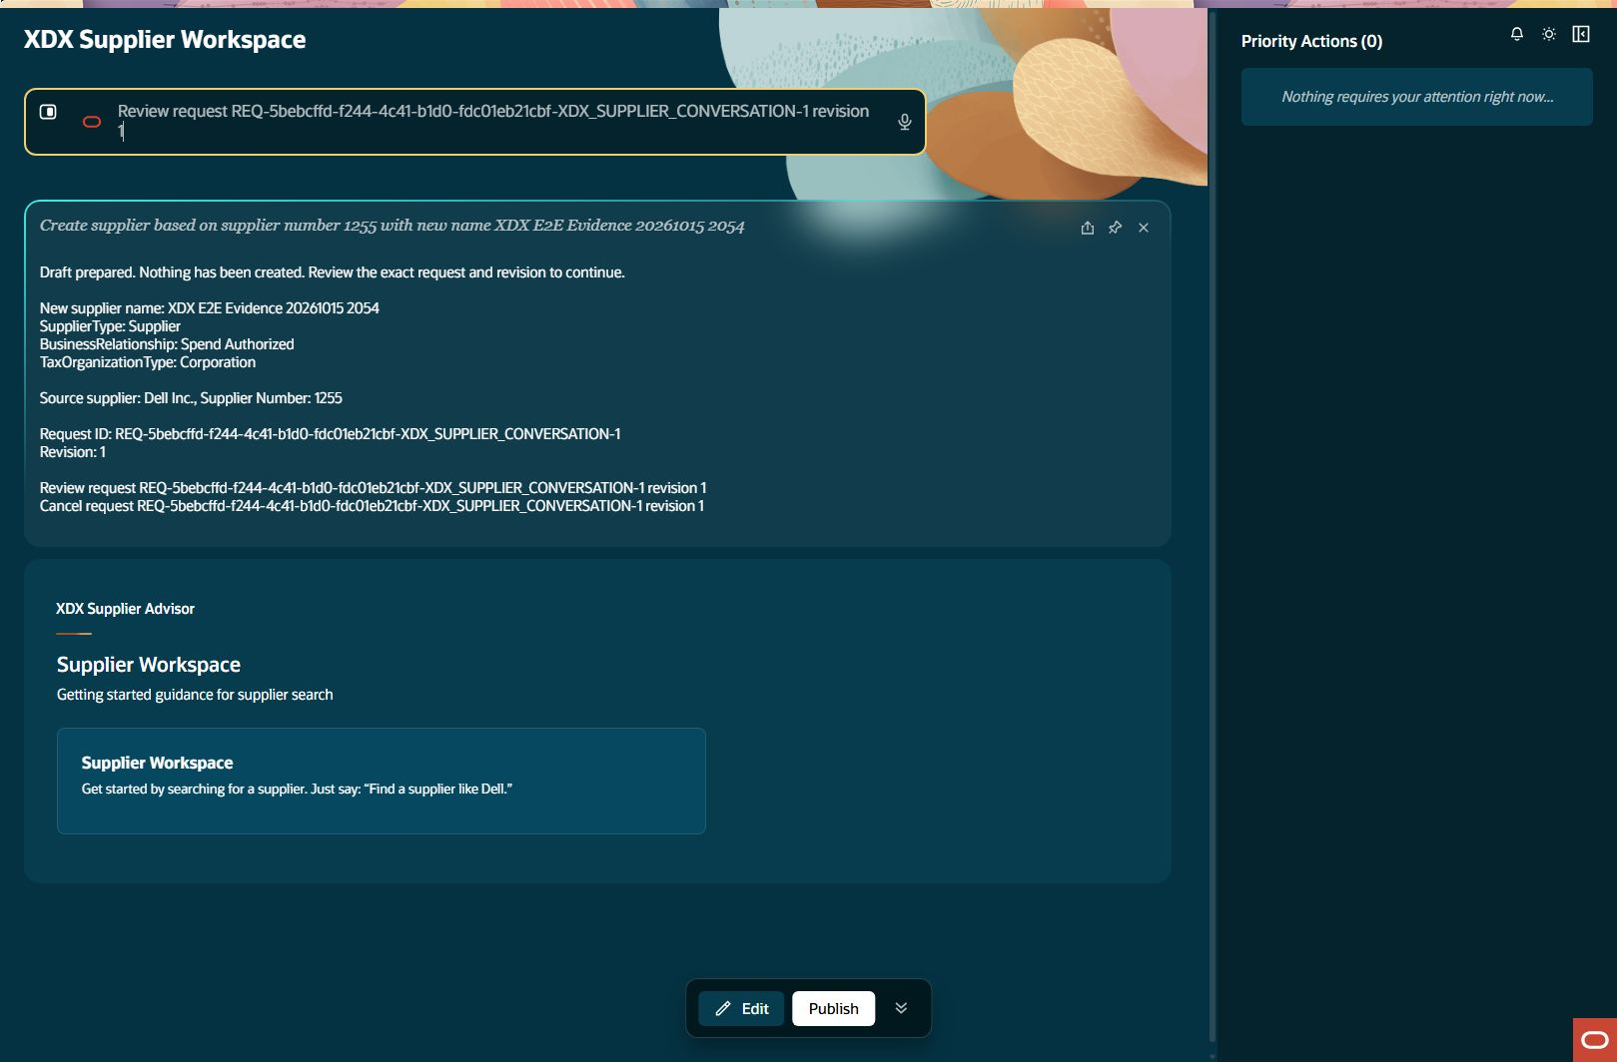
Supplier template creation: review input
supplier-create Step result: PASS
Notes:
Step: supplier-create
Object: Supplier
Scenario: template
Outcome: PASS
Expected: Execute declared business operation with current parent relationships and retained evidence
Actual: Created supplier1503 once; workflow independently verified name, type, relationship and tax organization type.
Record IDs: {"supplierId":"300000340604948","supplierNumber":"1503"}
Fallback: false
Retries: []
Source results: docs/builds/xdx-supplier-e2e-evidence-20261015/results.json
Recorded action/stage key: review-input
Observed UTC: 2026-10-15T20:54:41.413Z
Screenshot: docs/builds/xdx-supplier-e2e-evidence-20261015/screens/supplier-create-review-input-004.jpg
Semantic evidence: docs/builds/xdx-supplier-e2e-evidence-20261015/screens/supplier-create-review-input-004.txt
Capture notes: Entered request: Review request REQ-5bebcffd-f244-4c41-b1d0-fdc01eb21cbf-XDX_SUPPLIER_CONVERSATION-1 revision 1
Timing qualification: Some retained setup captures use persistence time rather than original acquisition time. See run limitations.

Slide 11
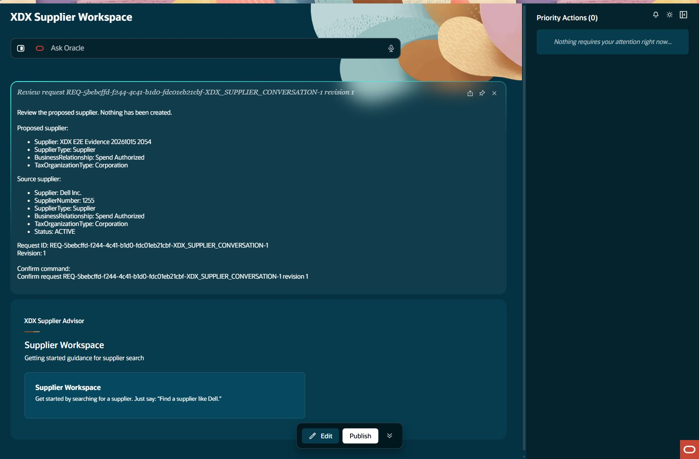
Supplier template creation: review ready
supplier-create Step result: PASS
Notes:
Step: supplier-create
Object: Supplier
Scenario: template
Outcome: PASS
Expected: Execute declared business operation with current parent relationships and retained evidence
Actual: Created supplier1503 once; workflow independently verified name, type, relationship and tax organization type.
Record IDs: {"supplierId":"300000340604948","supplierNumber":"1503"}
Fallback: false
Retries: []
Source results: docs/builds/xdx-supplier-e2e-evidence-20261015/results.json
Recorded action/stage key: review-ready
Observed UTC: 2026-10-15T20:54:57.203Z
Screenshot: docs/builds/xdx-supplier-e2e-evidence-20261015/screens/supplier-create-review-ready-005.jpg
Semantic evidence: docs/builds/xdx-supplier-e2e-evidence-20261015/screens/supplier-create-review-ready-005.txt
Capture notes: Exact supplier request reviewed before confirmation.
Timing qualification: Some retained setup captures use persistence time rather than original acquisition time. See run limitations.

Slide 12
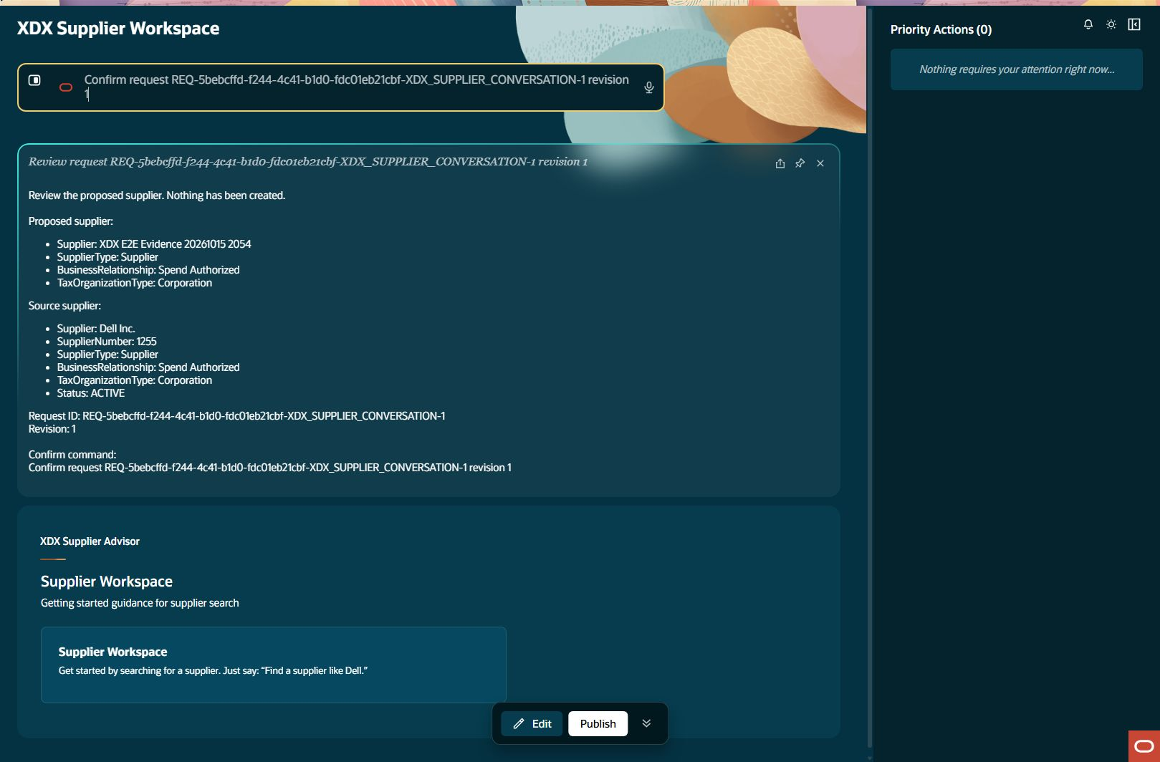
Supplier template creation: confirm input
supplier-create Step result: PASS
Notes:
Step: supplier-create
Object: Supplier
Scenario: template
Outcome: PASS
Expected: Execute declared business operation with current parent relationships and retained evidence
Actual: Created supplier1503 once; workflow independently verified name, type, relationship and tax organization type.
Record IDs: {"supplierId":"300000340604948","supplierNumber":"1503"}
Fallback: false
Retries: []
Source results: docs/builds/xdx-supplier-e2e-evidence-20261015/results.json
Recorded action/stage key: confirm-input
Observed UTC: 2026-10-15T20:55:08.851Z
Screenshot: docs/builds/xdx-supplier-e2e-evidence-20261015/screens/supplier-create-confirm-input-006.jpg
Semantic evidence: docs/builds/xdx-supplier-e2e-evidence-20261015/screens/supplier-create-confirm-input-006.txt
Capture notes: Entered request: Confirm request REQ-5bebcffd-f244-4c41-b1d0-fdc01eb21cbf-XDX_SUPPLIER_CONVERSATION-1 revision 1
Timing qualification: Some retained setup captures use persistence time rather than original acquisition time. See run limitations.

Slide 13
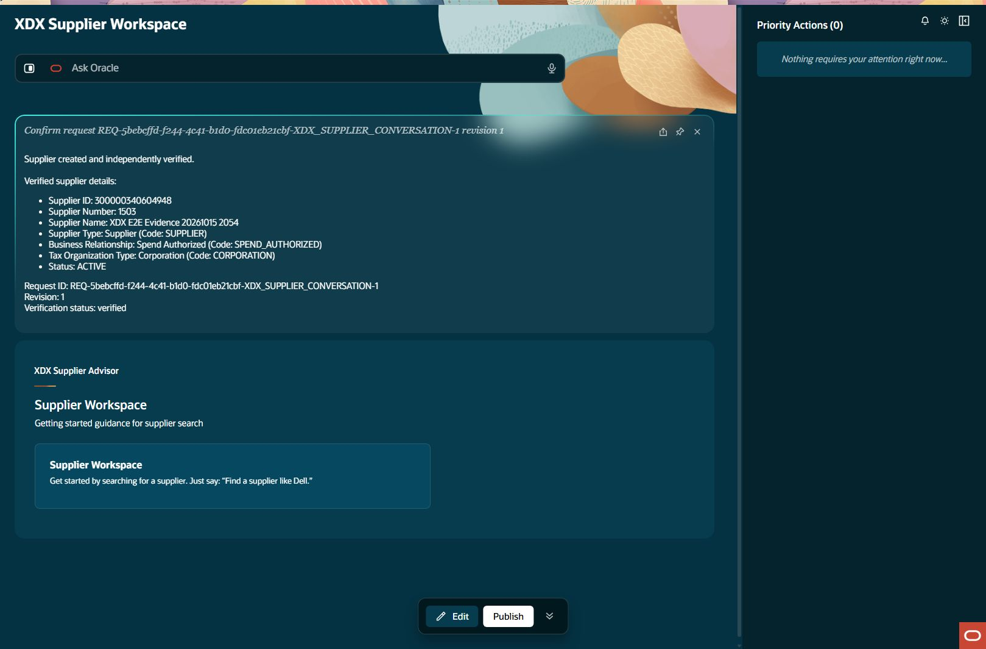
Supplier template creation: created readback
supplier-create Step result: PASS
Notes:
Step: supplier-create
Object: Supplier
Scenario: template
Outcome: PASS
Expected: Execute declared business operation with current parent relationships and retained evidence
Actual: Created supplier1503 once; workflow independently verified name, type, relationship and tax organization type.
Record IDs: {"supplierId":"300000340604948","supplierNumber":"1503"}
Fallback: false
Retries: []
Source results: docs/builds/xdx-supplier-e2e-evidence-20261015/results.json
Recorded action/stage key: created-readback
Observed UTC: 2026-10-15T20:55:19.657Z
Screenshot: docs/builds/xdx-supplier-e2e-evidence-20261015/screens/supplier-create-created-readback-007.jpg
Semantic evidence: docs/builds/xdx-supplier-e2e-evidence-20261015/screens/supplier-create-created-readback-007.txt
Capture notes: Supplier creation response and independent workflow verification.
Timing qualification: Some retained setup captures use persistence time rather than original acquisition time. See run limitations.

Slide 14
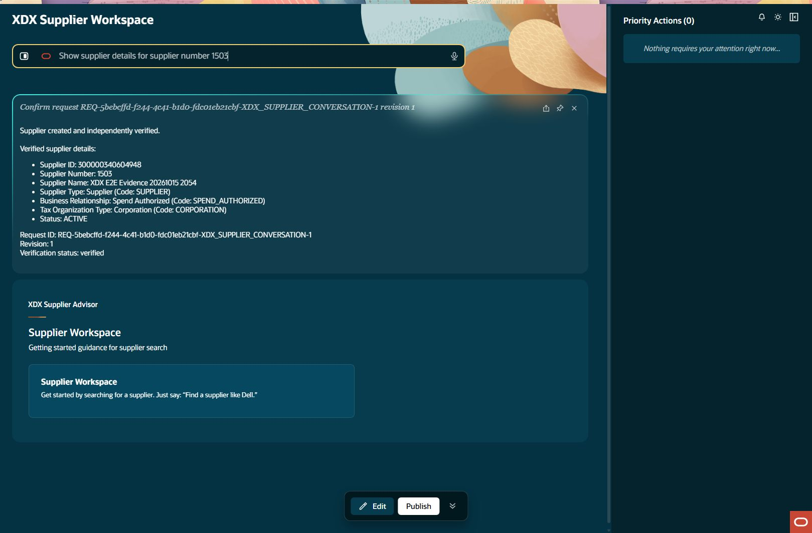
Created supplier details: query input
supplier-readback Step result: PASS
Notes:
Step: supplier-readback
Object: Supplier
Scenario: readback
Outcome: PASS
Expected: Execute declared business operation with current parent relationships and retained evidence
Actual: Ordinary detail query returned supplier1503 and all intended classifications.
Record IDs: {}
Fallback: false
Retries: []
Source results: docs/builds/xdx-supplier-e2e-evidence-20261015/results.json
Recorded action/stage key: query-input
Observed UTC: 2026-10-15T20:55:30.312Z
Screenshot: docs/builds/xdx-supplier-e2e-evidence-20261015/screens/supplier-readback-query-input-001.jpg
Semantic evidence: docs/builds/xdx-supplier-e2e-evidence-20261015/screens/supplier-readback-query-input-001.txt
Capture notes: Entered request: Show supplier details for supplier number 1503
Timing qualification: Some retained setup captures use persistence time rather than original acquisition time. See run limitations.

Slide 15
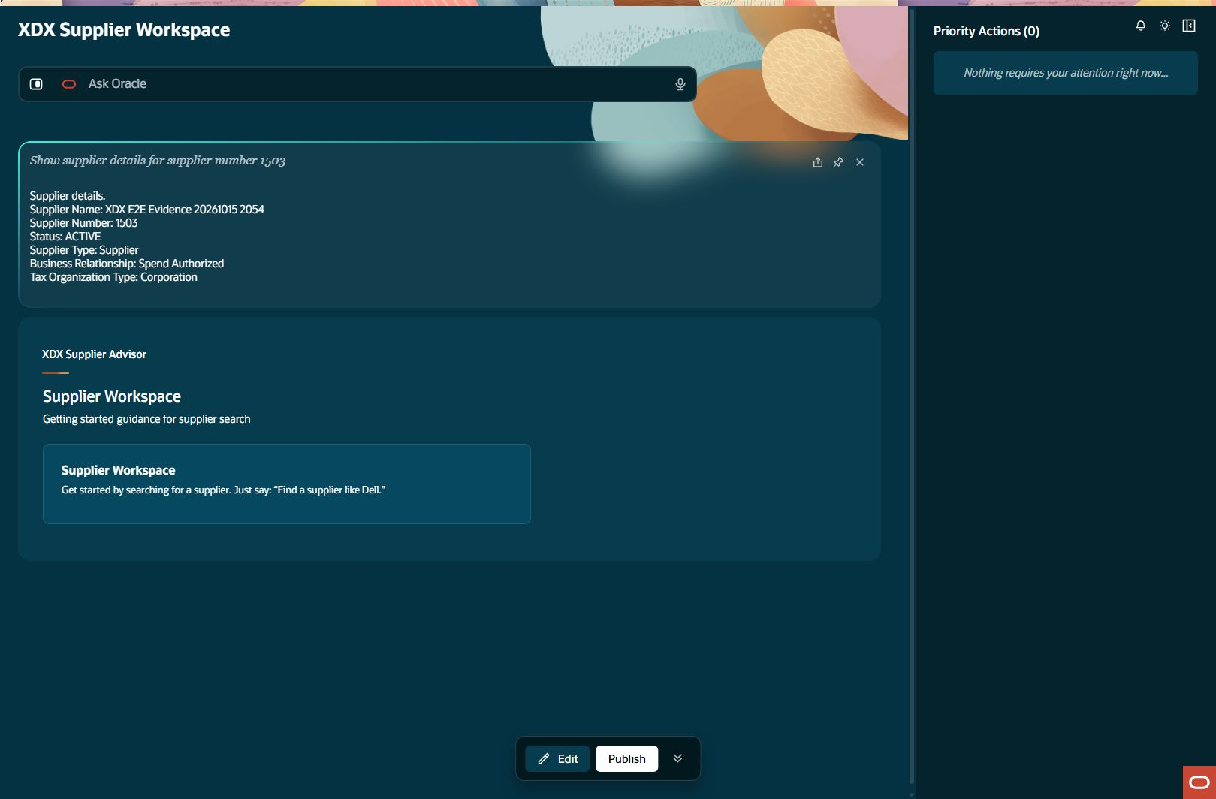
Created supplier details: details
supplier-readback Step result: PASS
Notes:
Step: supplier-readback
Object: Supplier
Scenario: readback
Outcome: PASS
Expected: Execute declared business operation with current parent relationships and retained evidence
Actual: Ordinary detail query returned supplier1503 and all intended classifications.
Record IDs: {}
Fallback: false
Retries: []
Source results: docs/builds/xdx-supplier-e2e-evidence-20261015/results.json
Recorded action/stage key: details
Observed UTC: 2026-10-15T20:55:57.167Z
Screenshot: docs/builds/xdx-supplier-e2e-evidence-20261015/screens/supplier-readback-details-002.jpg
Semantic evidence: docs/builds/xdx-supplier-e2e-evidence-20261015/screens/supplier-readback-details-002.txt
Capture notes: Ordinary supplier detail query by displayed supplier number1503.
Timing qualification: Some retained setup captures use persistence time rather than original acquisition time. See run limitations.

Slide 16

New supplier addresses: query input
address-query Step result: PASS
Notes:
Step: address-query
Object: Address
Scenario: query
Outcome: PASS
Expected: Execute declared business operation with current parent relationships and retained evidence
Actual: New supplier1503 has an empty Address collection with Has more false.
Record IDs: {}
Fallback: false
Retries: []
Source results: docs/builds/xdx-supplier-e2e-evidence-20261015/results.json
Recorded action/stage key: query-input
Observed UTC: 2026-10-15T20:56:20.640Z
Screenshot: docs/builds/xdx-supplier-e2e-evidence-20261015/screens/address-query-query-input-001.jpg
Semantic evidence: docs/builds/xdx-supplier-e2e-evidence-20261015/screens/address-query-query-input-001.txt
Capture notes: Entered request: Show addresses for supplier number 1503
Timing qualification: Some retained setup captures use persistence time rather than original acquisition time. See run limitations.

Slide 17

Address query in progress
address-query Step result: PASS
Notes:
Step: address-query
Object: Address
Scenario: query
Outcome: PASS
Expected: Execute declared business operation with current parent relationships and retained evidence
Actual: New supplier1503 has an empty Address collection with Has more false.
Record IDs: {}
Fallback: false
Retries: []
Source results: docs/builds/xdx-supplier-e2e-evidence-20261015/results.json
Recorded action/stage key: result
Observed UTC: 2026-10-15T20:56:31.326Z
Screenshot: docs/builds/xdx-supplier-e2e-evidence-20261015/screens/address-query-result-002.jpg
Semantic evidence: docs/builds/xdx-supplier-e2e-evidence-20261015/screens/address-query-result-002.txt
Capture notes: Actual image shows intermediate processing. Its AX snapshot already reports completion, so image and semantics are separate observations. The following entered-request screen visibly retains the completed prior result. No request or accepted create was repeated.
Timing qualification: Some retained setup captures use persistence time rather than original acquisition time. See run limitations.

Slide 18
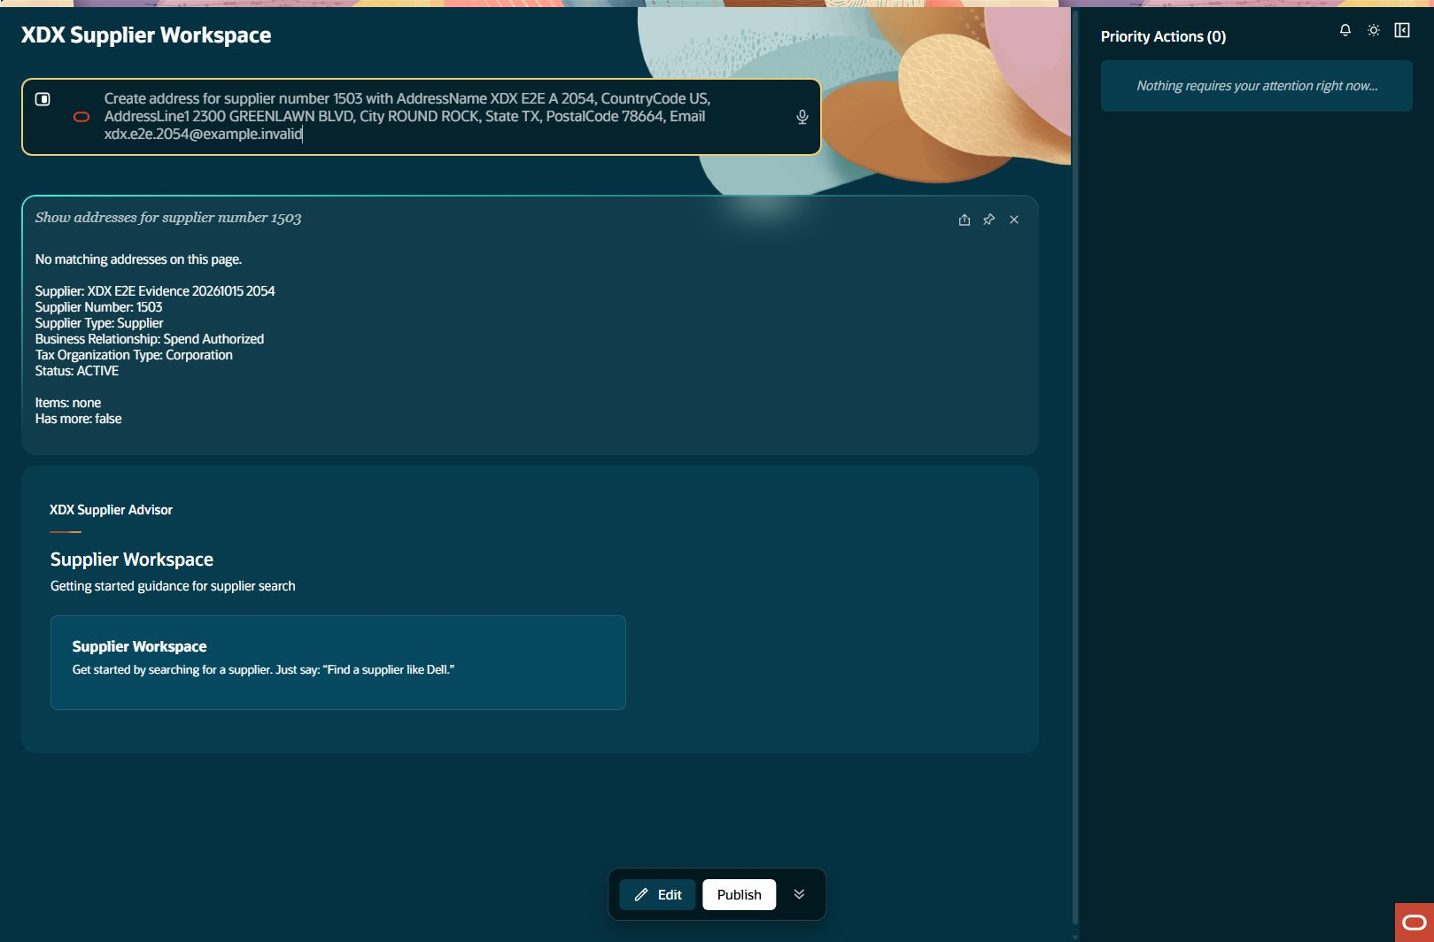
Direct address creation: prepare input
address-direct Step result: PASS
Notes:
Step: address-direct
Object: Address
Scenario: direct
Outcome: PASS
Expected: Execute declared business operation with current parent relationships and retained evidence
Actual: Created Address300000340604955 once under supplier1503; all eight approved fields independently verified.
Record IDs: {"addressId":"300000340604955"}
Fallback: false
Retries: []
Source results: docs/builds/xdx-supplier-e2e-evidence-20261015/results.json
Recorded action/stage key: prepare-input
Observed UTC: 2026-10-15T20:56:44.672Z
Screenshot: docs/builds/xdx-supplier-e2e-evidence-20261015/screens/address-direct-prepare-input-001.jpg
Semantic evidence: docs/builds/xdx-supplier-e2e-evidence-20261015/screens/address-direct-prepare-input-001.txt
Capture notes: Entered request: Create address for supplier number 1503 with AddressName XDX E2E A 2054, CountryCode US, AddressLine1 2300 GREENLAWN BLVD, City ROUND ROCK, State TX, PostalCode 78664, Email xdx.e2e.2054@example.invalid
Timing qualification: Some retained setup captures use persistence time rather than original acquisition time. See run limitations.

Slide 19
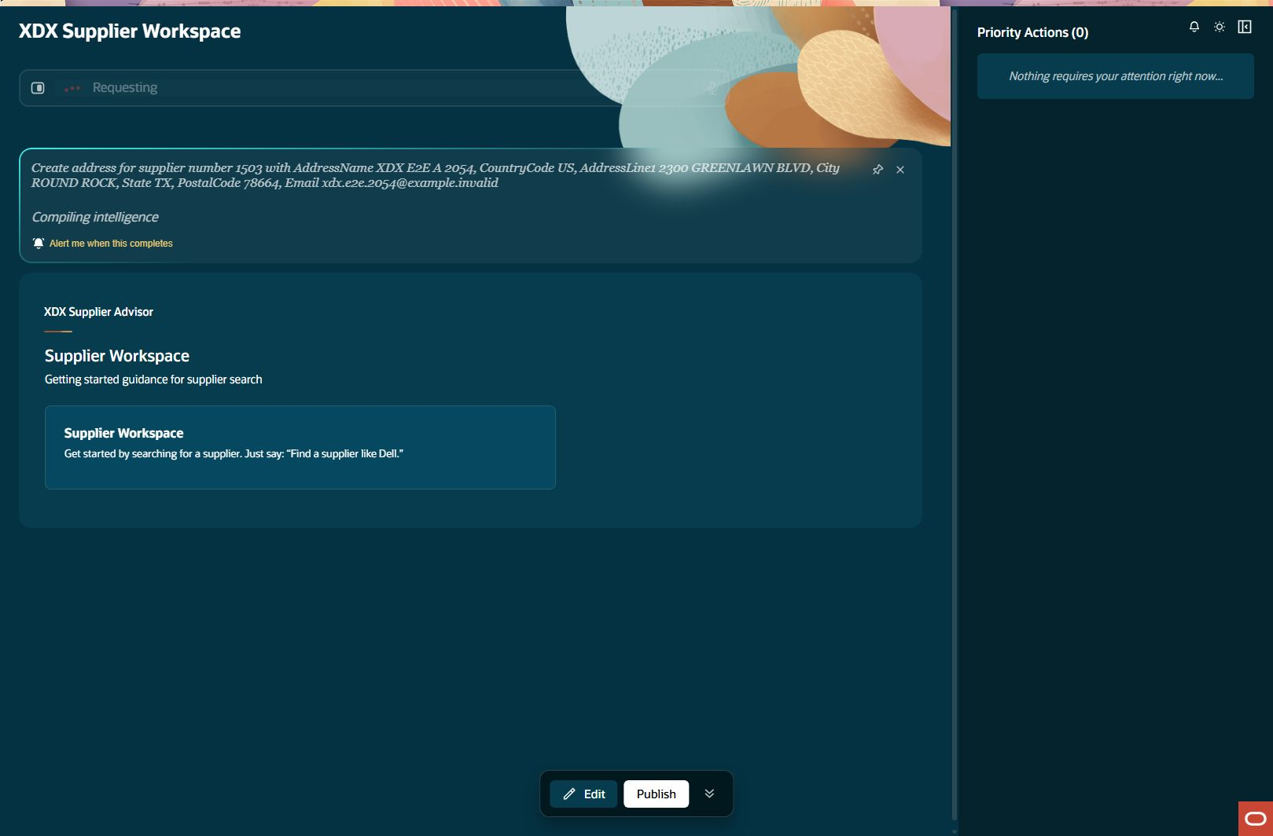
Address preparation in progress
address-direct Step result: PASS
Notes:
Step: address-direct
Object: Address
Scenario: direct
Outcome: PASS
Expected: Execute declared business operation with current parent relationships and retained evidence
Actual: Created Address300000340604955 once under supplier1503; all eight approved fields independently verified.
Record IDs: {"addressId":"300000340604955"}
Fallback: false
Retries: []
Source results: docs/builds/xdx-supplier-e2e-evidence-20261015/results.json
Recorded action/stage key: draft-ready
Observed UTC: 2026-10-15T20:56:57.294Z
Screenshot: docs/builds/xdx-supplier-e2e-evidence-20261015/screens/address-direct-draft-ready-002.jpg
Semantic evidence: docs/builds/xdx-supplier-e2e-evidence-20261015/screens/address-direct-draft-ready-002.txt
Capture notes: Actual image shows intermediate processing. Its AX snapshot already reports completion, so image and semantics are separate observations. The following entered-request screen visibly retains the completed prior result. No request or accepted create was repeated.
Timing qualification: Some retained setup captures use persistence time rather than original acquisition time. See run limitations.

Slide 20
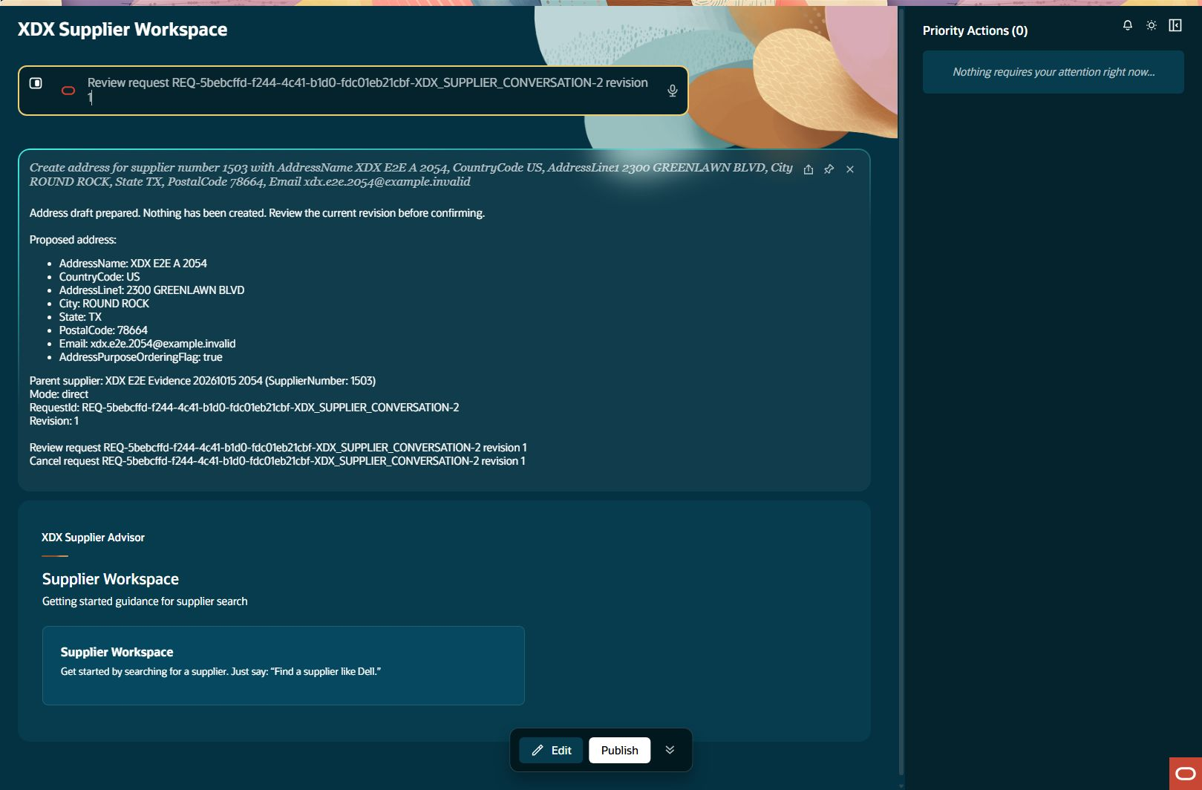
Direct address creation: review input
address-direct Step result: PASS
Notes:
Step: address-direct
Object: Address
Scenario: direct
Outcome: PASS
Expected: Execute declared business operation with current parent relationships and retained evidence
Actual: Created Address300000340604955 once under supplier1503; all eight approved fields independently verified.
Record IDs: {"addressId":"300000340604955"}
Fallback: false
Retries: []
Source results: docs/builds/xdx-supplier-e2e-evidence-20261015/results.json
Recorded action/stage key: review-input
Observed UTC: 2026-10-15T20:57:16.860Z
Screenshot: docs/builds/xdx-supplier-e2e-evidence-20261015/screens/address-direct-review-input-003.jpg
Semantic evidence: docs/builds/xdx-supplier-e2e-evidence-20261015/screens/address-direct-review-input-003.txt
Capture notes: Entered request: Review request REQ-5bebcffd-f244-4c41-b1d0-fdc01eb21cbf-XDX_SUPPLIER_CONVERSATION-2 revision 1
Timing qualification: Some retained setup captures use persistence time rather than original acquisition time. See run limitations.

Slide 21

Address review in progress
address-direct Step result: PASS
Notes:
Step: address-direct
Object: Address
Scenario: direct
Outcome: PASS
Expected: Execute declared business operation with current parent relationships and retained evidence
Actual: Created Address300000340604955 once under supplier1503; all eight approved fields independently verified.
Record IDs: {"addressId":"300000340604955"}
Fallback: false
Retries: []
Source results: docs/builds/xdx-supplier-e2e-evidence-20261015/results.json
Recorded action/stage key: review-ready
Observed UTC: 2026-10-15T20:57:24.875Z
Screenshot: docs/builds/xdx-supplier-e2e-evidence-20261015/screens/address-direct-review-ready-004.jpg
Semantic evidence: docs/builds/xdx-supplier-e2e-evidence-20261015/screens/address-direct-review-ready-004.txt
Capture notes: Actual image shows intermediate processing. Its AX snapshot already reports completion, so image and semantics are separate observations. The following entered-request screen visibly retains the completed prior result. No request or accepted create was repeated.
Timing qualification: Some retained setup captures use persistence time rather than original acquisition time. See run limitations.

Slide 22
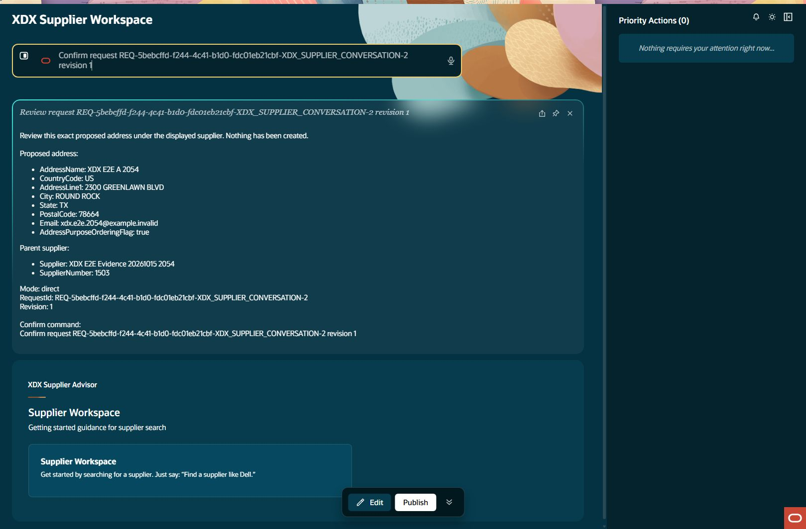
Direct address creation: confirm input
address-direct Step result: PASS
Notes:
Step: address-direct
Object: Address
Scenario: direct
Outcome: PASS
Expected: Execute declared business operation with current parent relationships and retained evidence
Actual: Created Address300000340604955 once under supplier1503; all eight approved fields independently verified.
Record IDs: {"addressId":"300000340604955"}
Fallback: false
Retries: []
Source results: docs/builds/xdx-supplier-e2e-evidence-20261015/results.json
Recorded action/stage key: confirm-input
Observed UTC: 2026-10-15T20:57:49.990Z
Screenshot: docs/builds/xdx-supplier-e2e-evidence-20261015/screens/address-direct-confirm-input-005.jpg
Semantic evidence: docs/builds/xdx-supplier-e2e-evidence-20261015/screens/address-direct-confirm-input-005.txt
Capture notes: Entered request: Confirm request REQ-5bebcffd-f244-4c41-b1d0-fdc01eb21cbf-XDX_SUPPLIER_CONVERSATION-2 revision 1
Timing qualification: Some retained setup captures use persistence time rather than original acquisition time. See run limitations.

Slide 23

Address confirmation in progress
address-direct Step result: PASS
Notes:
Step: address-direct
Object: Address
Scenario: direct
Outcome: PASS
Expected: Execute declared business operation with current parent relationships and retained evidence
Actual: Created Address300000340604955 once under supplier1503; all eight approved fields independently verified.
Record IDs: {"addressId":"300000340604955"}
Fallback: false
Retries: []
Source results: docs/builds/xdx-supplier-e2e-evidence-20261015/results.json
Recorded action/stage key: created-readback
Observed UTC: 2026-10-15T20:57:59.569Z
Screenshot: docs/builds/xdx-supplier-e2e-evidence-20261015/screens/address-direct-created-readback-006.jpg
Semantic evidence: docs/builds/xdx-supplier-e2e-evidence-20261015/screens/address-direct-created-readback-006.txt
Capture notes: Actual image shows intermediate processing. Its AX snapshot already reports completion, so image and semantics are separate observations. The following entered-request screen visibly retains the completed prior result. No request or accepted create was repeated.
Timing qualification: Some retained setup captures use persistence time rather than original acquisition time. See run limitations.

Slide 24
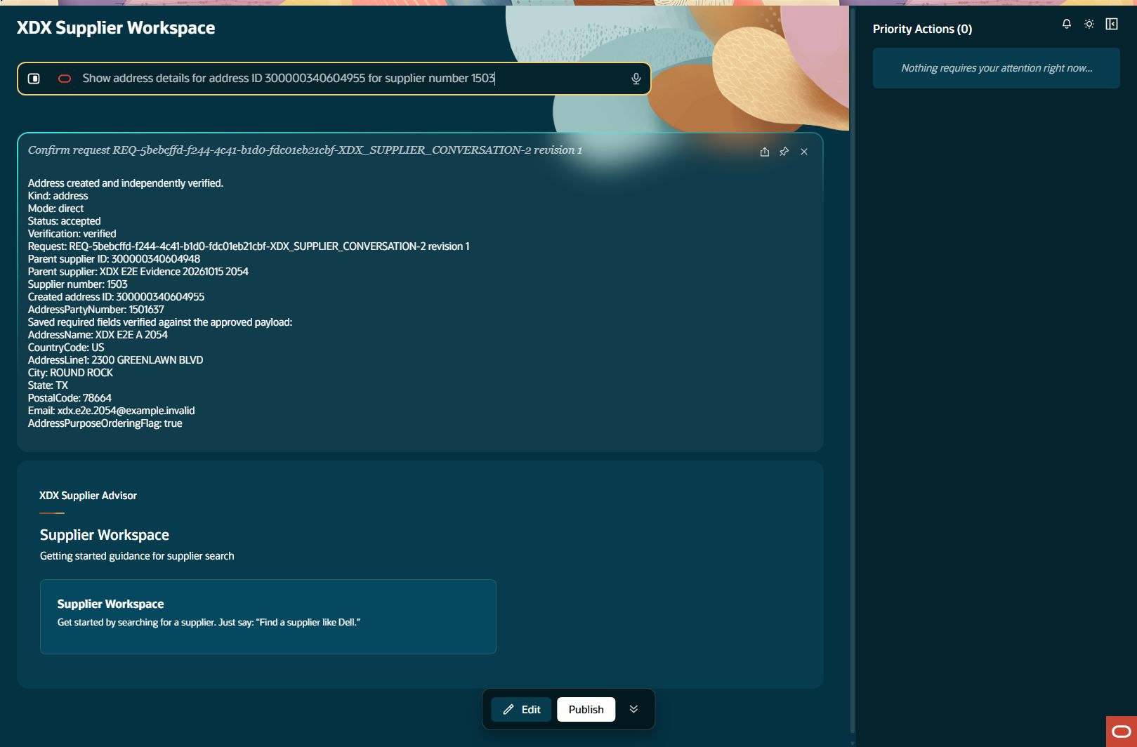
Created address details: query input
address-readback Step result: PASS
Notes:
Step: address-readback
Object: Address
Scenario: readback
Outcome: PASS
Expected: Execute declared business operation with current parent relationships and retained evidence
Actual: Separate Address detail query returned saved name, physical address, email and supplier1503; generatedID/ordering verified in independent create readback.
Record IDs: {}
Fallback: false
Retries: []
Source results: docs/builds/xdx-supplier-e2e-evidence-20261015/results.json
Recorded action/stage key: query-input
Observed UTC: 2026-10-15T20:58:10.269Z
Screenshot: docs/builds/xdx-supplier-e2e-evidence-20261015/screens/address-readback-query-input-001.jpg
Semantic evidence: docs/builds/xdx-supplier-e2e-evidence-20261015/screens/address-readback-query-input-001.txt
Capture notes: Entered request: Show address details for address ID 300000340604955 for supplier number 1503
Timing qualification: Some retained setup captures use persistence time rather than original acquisition time. See run limitations.

Slide 25
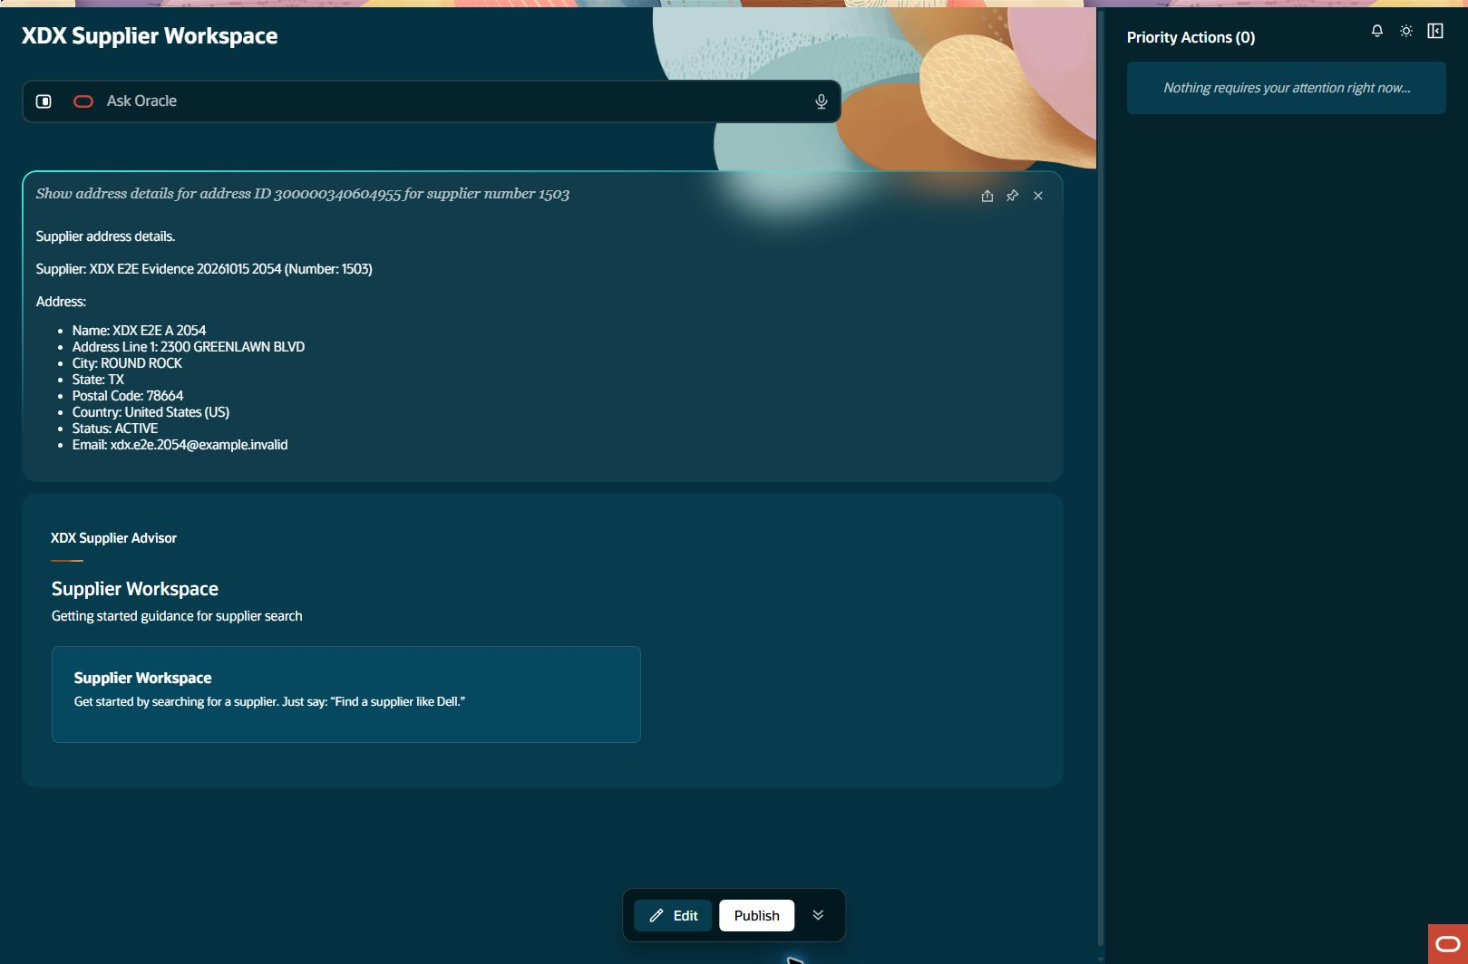
Created address details: details
address-readback Step result: PASS
Notes:
Step: address-readback
Object: Address
Scenario: readback
Outcome: PASS
Expected: Execute declared business operation with current parent relationships and retained evidence
Actual: Separate Address detail query returned saved name, physical address, email and supplier1503; generatedID/ordering verified in independent create readback.
Record IDs: {}
Fallback: false
Retries: []
Source results: docs/builds/xdx-supplier-e2e-evidence-20261015/results.json
Recorded action/stage key: details
Observed UTC: 2026-10-15T20:58:20.483Z
Screenshot: docs/builds/xdx-supplier-e2e-evidence-20261015/screens/address-readback-details-002.jpg
Semantic evidence: docs/builds/xdx-supplier-e2e-evidence-20261015/screens/address-readback-details-002.txt
Capture notes: Separate ordinary Address query using returned key and supplier1503.
Timing qualification: Some retained setup captures use persistence time rather than original acquisition time. See run limitations.

Slide 26
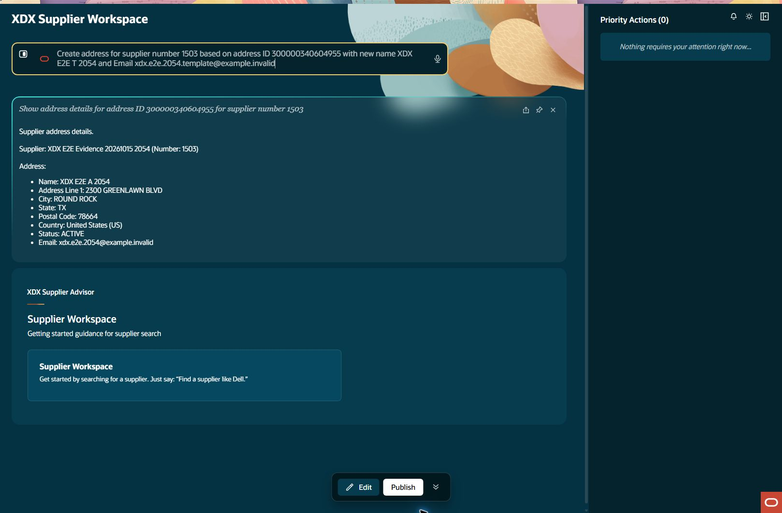
Address template creation: prepare input
address-template Step result: PASS
Notes:
Step: address-template
Object: Address
Scenario: template
Outcome: PASS
Expected: Execute declared business operation with current parent relationships and retained evidence
Actual: Template Address300000340604962 created once under supplier1503; distinct source/created IDs and all eight fields independently verified.
Record IDs: {"templateAddressId":"300000340604962"}
Fallback: false
Retries: []
Source results: docs/builds/xdx-supplier-e2e-evidence-20261015/results.json
Recorded action/stage key: prepare-input
Observed UTC: 2026-10-15T20:59:00.328Z
Screenshot: docs/builds/xdx-supplier-e2e-evidence-20261015/screens/address-template-prepare-input-001.jpg
Semantic evidence: docs/builds/xdx-supplier-e2e-evidence-20261015/screens/address-template-prepare-input-001.txt
Capture notes: Entered request: Create address for supplier number 1503 based on address ID 300000340604955 with new name XDX E2E T 2054 and Email xdx.e2e.2054.template@example.invalid
Timing qualification: Some retained setup captures use persistence time rather than original acquisition time. See run limitations.

Slide 27
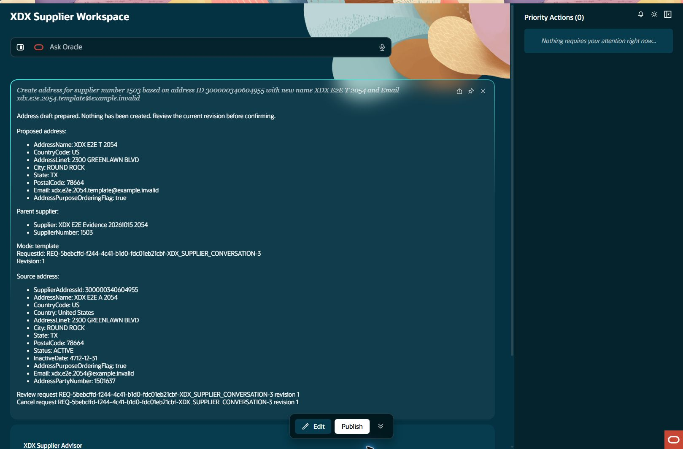
Address template creation: draft ready
address-template Step result: PASS
Notes:
Step: address-template
Object: Address
Scenario: template
Outcome: PASS
Expected: Execute declared business operation with current parent relationships and retained evidence
Actual: Template Address300000340604962 created once under supplier1503; distinct source/created IDs and all eight fields independently verified.
Record IDs: {"templateAddressId":"300000340604962"}
Fallback: false
Retries: []
Source results: docs/builds/xdx-supplier-e2e-evidence-20261015/results.json
Recorded action/stage key: draft-ready
Observed UTC: 2026-10-15T20:59:14.980Z
Screenshot: docs/builds/xdx-supplier-e2e-evidence-20261015/screens/address-template-draft-ready-002.jpg
Semantic evidence: docs/builds/xdx-supplier-e2e-evidence-20261015/screens/address-template-draft-ready-002.txt
Capture notes: Same-parent Address template, distinct name and Email; required physical fields inherited.
Timing qualification: Some retained setup captures use persistence time rather than original acquisition time. See run limitations.

Slide 28
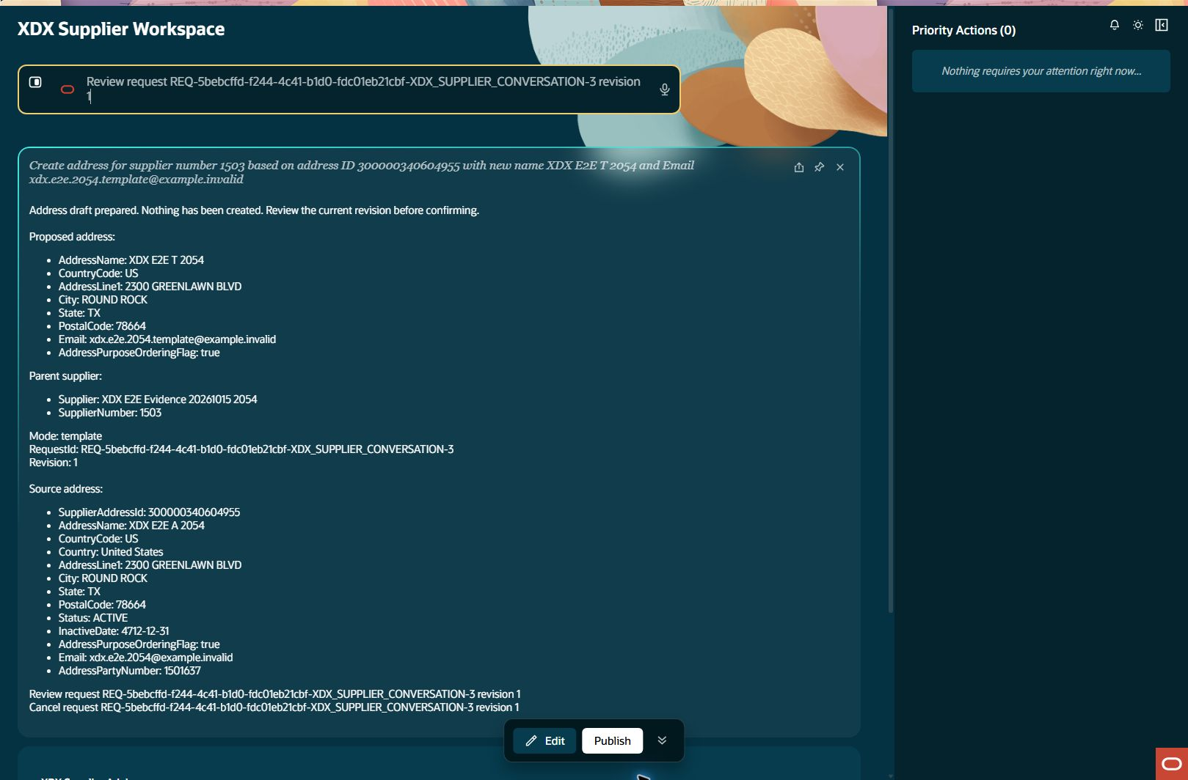
Address template creation: review input
address-template Step result: PASS
Notes:
Step: address-template
Object: Address
Scenario: template
Outcome: PASS
Expected: Execute declared business operation with current parent relationships and retained evidence
Actual: Template Address300000340604962 created once under supplier1503; distinct source/created IDs and all eight fields independently verified.
Record IDs: {"templateAddressId":"300000340604962"}
Fallback: false
Retries: []
Source results: docs/builds/xdx-supplier-e2e-evidence-20261015/results.json
Recorded action/stage key: review-input
Observed UTC: 2026-10-15T20:59:44.061Z
Screenshot: docs/builds/xdx-supplier-e2e-evidence-20261015/screens/address-template-review-input-003.jpg
Semantic evidence: docs/builds/xdx-supplier-e2e-evidence-20261015/screens/address-template-review-input-003.txt
Capture notes: Entered request: Review request REQ-5bebcffd-f244-4c41-b1d0-fdc01eb21cbf-XDX_SUPPLIER_CONVERSATION-3 revision 1
Timing qualification: Some retained setup captures use persistence time rather than original acquisition time. See run limitations.

Slide 29

Address template creation: review ready
address-template Step result: PASS
Notes:
Step: address-template
Object: Address
Scenario: template
Outcome: PASS
Expected: Execute declared business operation with current parent relationships and retained evidence
Actual: Template Address300000340604962 created once under supplier1503; distinct source/created IDs and all eight fields independently verified.
Record IDs: {"templateAddressId":"300000340604962"}
Fallback: false
Retries: []
Source results: docs/builds/xdx-supplier-e2e-evidence-20261015/results.json
Recorded action/stage key: review-ready
Observed UTC: 2026-10-15T20:59:53.176Z
Screenshot: docs/builds/xdx-supplier-e2e-evidence-20261015/screens/address-template-review-ready-004.jpg
Semantic evidence: docs/builds/xdx-supplier-e2e-evidence-20261015/screens/address-template-review-ready-004.txt
Capture notes: Same-parent template Address payload reviewed, exact revision1.
Timing qualification: Some retained setup captures use persistence time rather than original acquisition time. See run limitations.

Slide 30
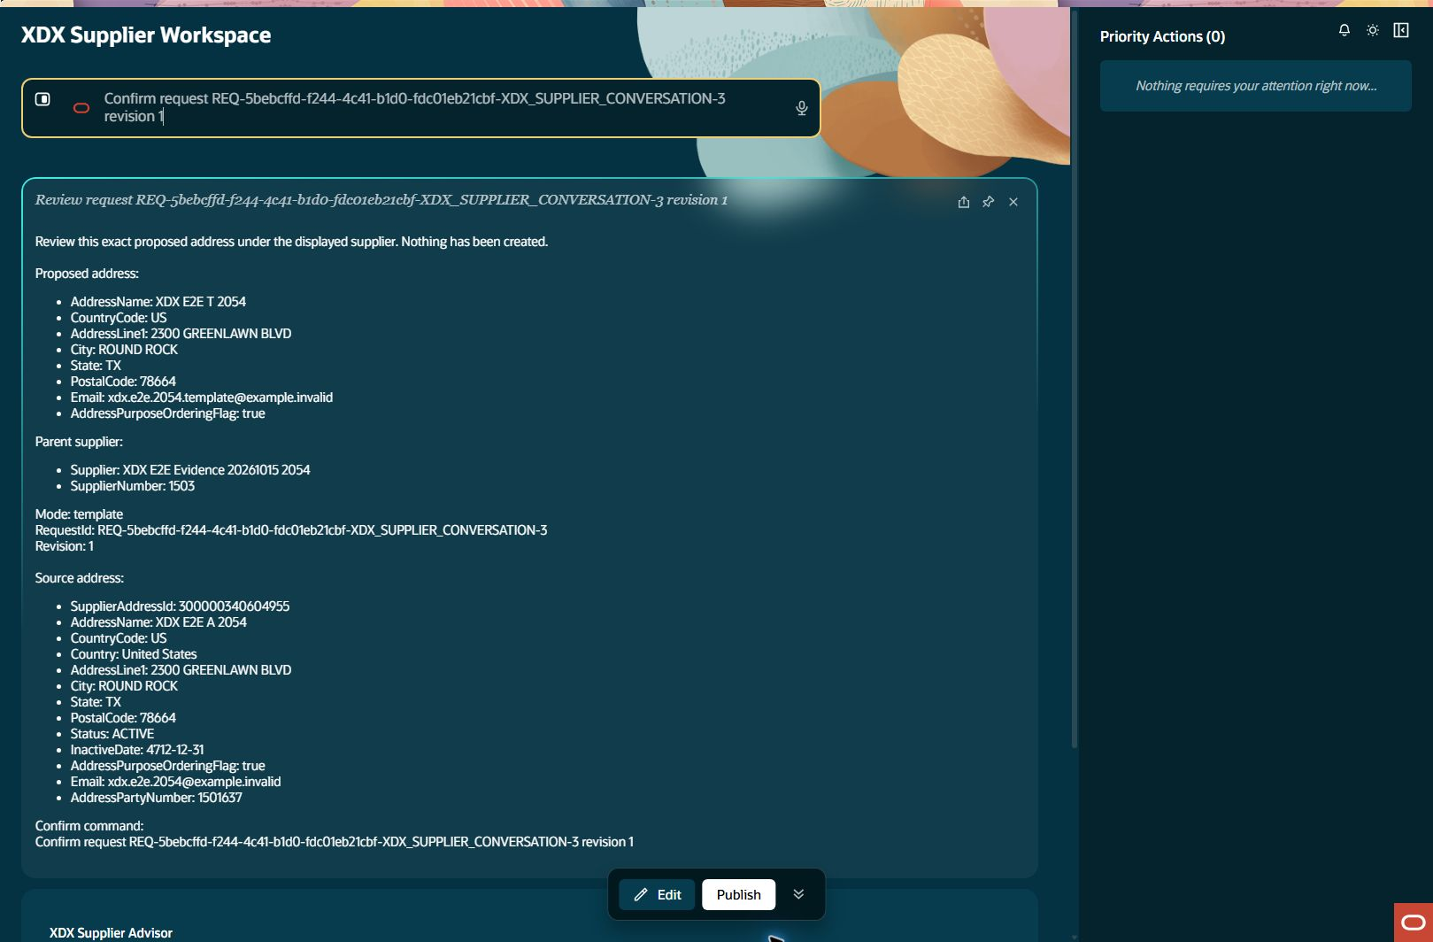
Address template creation: confirm input
address-template Step result: PASS
Notes:
Step: address-template
Object: Address
Scenario: template
Outcome: PASS
Expected: Execute declared business operation with current parent relationships and retained evidence
Actual: Template Address300000340604962 created once under supplier1503; distinct source/created IDs and all eight fields independently verified.
Record IDs: {"templateAddressId":"300000340604962"}
Fallback: false
Retries: []
Source results: docs/builds/xdx-supplier-e2e-evidence-20261015/results.json
Recorded action/stage key: confirm-input
Observed UTC: 2026-10-15T20:59:53.511Z
Screenshot: docs/builds/xdx-supplier-e2e-evidence-20261015/screens/address-template-confirm-input-005.jpg
Semantic evidence: docs/builds/xdx-supplier-e2e-evidence-20261015/screens/address-template-confirm-input-005.txt
Capture notes: Entered request: Confirm request REQ-5bebcffd-f244-4c41-b1d0-fdc01eb21cbf-XDX_SUPPLIER_CONVERSATION-3 revision 1
Timing qualification: Some retained setup captures use persistence time rather than original acquisition time. See run limitations.

Slide 31

Address template creation: created readback
address-template Step result: PASS
Notes:
Step: address-template
Object: Address
Scenario: template
Outcome: PASS
Expected: Execute declared business operation with current parent relationships and retained evidence
Actual: Template Address300000340604962 created once under supplier1503; distinct source/created IDs and all eight fields independently verified.
Record IDs: {"templateAddressId":"300000340604962"}
Fallback: false
Retries: []
Source results: docs/builds/xdx-supplier-e2e-evidence-20261015/results.json
Recorded action/stage key: created-readback
Observed UTC: 2026-10-15T21:00:03.459Z
Screenshot: docs/builds/xdx-supplier-e2e-evidence-20261015/screens/address-template-created-readback-006.jpg
Semantic evidence: docs/builds/xdx-supplier-e2e-evidence-20261015/screens/address-template-created-readback-006.txt
Capture notes: Template Address accepted response and independent persisted verification.
Timing qualification: Some retained setup captures use persistence time rather than original acquisition time. See run limitations.

Slide 32

New supplier contacts: query input
contact-query Step result: PASS
Notes:
Step: contact-query
Object: Contact
Scenario: query
Outcome: PASS
Expected: Execute declared business operation with current parent relationships and retained evidence
Actual: Supplier1503 returned an explicit No contacts found empty state. Paging is not rendered on this Contact screen.
Record IDs: {}
Fallback: false
Retries: []
Source results: docs/builds/xdx-supplier-e2e-evidence-20261015/results.json
Recorded action/stage key: query-input
Observed UTC: 2026-10-15T21:00:37.359Z
Screenshot: docs/builds/xdx-supplier-e2e-evidence-20261015/screens/contact-query-query-input-001.jpg
Semantic evidence: docs/builds/xdx-supplier-e2e-evidence-20261015/screens/contact-query-query-input-001.txt
Capture notes: Entered request: Show contacts for supplier number 1503
Timing qualification: Some retained setup captures use persistence time rather than original acquisition time. See run limitations.

Slide 33

New supplier contacts: result
contact-query Step result: PASS
Notes:
Step: contact-query
Object: Contact
Scenario: query
Outcome: PASS
Expected: Execute declared business operation with current parent relationships and retained evidence
Actual: Supplier1503 returned an explicit No contacts found empty state. Paging is not rendered on this Contact screen.
Record IDs: {}
Fallback: false
Retries: []
Source results: docs/builds/xdx-supplier-e2e-evidence-20261015/results.json
Recorded action/stage key: result
Observed UTC: 2026-10-15T21:00:48.611Z
Screenshot: docs/builds/xdx-supplier-e2e-evidence-20261015/screens/contact-query-result-002.jpg
Semantic evidence: docs/builds/xdx-supplier-e2e-evidence-20261015/screens/contact-query-result-002.txt
Capture notes: Contact collection for newly created supplier1503.
Timing qualification: Some retained setup captures use persistence time rather than original acquisition time. See run limitations.

Slide 34
Contact query assertion mismatch: observed empty state
contact-query-assertion Step result: FAIL
Notes:
Step: contact-query-assertion
Object: Test harness
Scenario: assertion-correction
Outcome: FAIL
Expected: Assess the actual Contact empty-state renderer without assuming Address paging labels
Actual: Harness assertion incorrectly expected Address-specific paging text in the Contact screen. Corrected assessment uses observed Contact empty-state and parent; no application failure or extra request.
Record IDs: {}
Fallback: false
Retries: []
Source results: docs/builds/xdx-supplier-e2e-evidence-20261015/results.json
Recorded action/stage key: observed-empty-state
Observed UTC: 2026-10-15T21:01:23.633Z
Screenshot: docs/builds/xdx-supplier-e2e-evidence-20261015/screens/contact-query-assertion-observed-empty-state-001.jpg
Semantic evidence: docs/builds/xdx-supplier-e2e-evidence-20261015/screens/contact-query-assertion-observed-empty-state-001.txt
Capture notes: Initial assessment expected Items:none and Has more:false from Address rendering. Contact instead renders No contacts found. No UI request retried; assertion corrected against actual Contact output.
Timing qualification: Some retained setup captures use persistence time rather than original acquisition time. See run limitations.

Slide 35

Direct contact creation: prepare input
contact-direct Step result: PASS
Notes:
Step: contact-direct
Object: Contact
Scenario: direct
Outcome: PASS
Expected: Execute declared business operation with current parent relationships and retained evidence
Actual: Contact300000340604973 created once under supplier1503; all three fields and parent independently verified.
Record IDs: {"contactId":"300000340604973"}
Fallback: false
Retries: []
Source results: docs/builds/xdx-supplier-e2e-evidence-20261015/results.json
Recorded action/stage key: prepare-input
Observed UTC: 2026-10-15T21:01:23.990Z
Screenshot: docs/builds/xdx-supplier-e2e-evidence-20261015/screens/contact-direct-prepare-input-001.jpg
Semantic evidence: docs/builds/xdx-supplier-e2e-evidence-20261015/screens/contact-direct-prepare-input-001.txt
Capture notes: Entered request: Create contact for supplier number 1503 with FirstName XDX, LastName E2E2054, Email xdx.e2e.2054.contact@example.invalid
Timing qualification: Some retained setup captures use persistence time rather than original acquisition time. See run limitations.

Slide 36
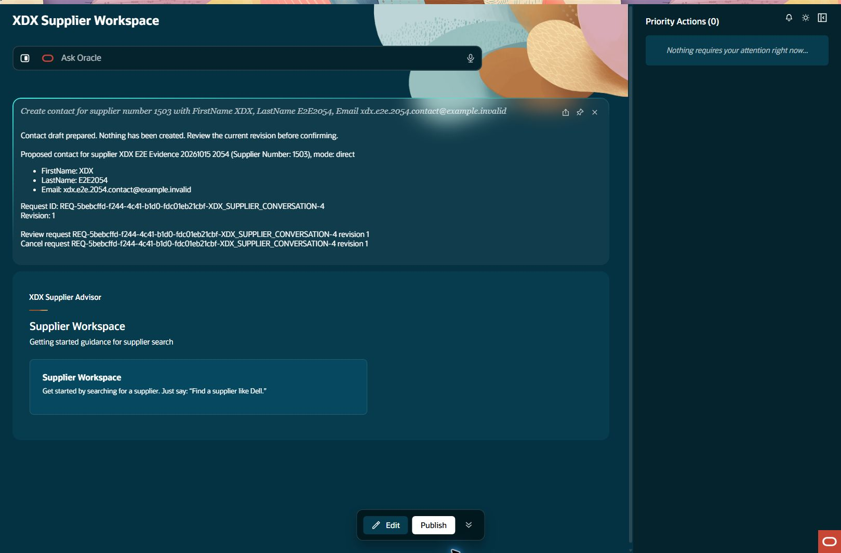
Direct contact creation: draft ready
contact-direct Step result: PASS
Notes:
Step: contact-direct
Object: Contact
Scenario: direct
Outcome: PASS
Expected: Execute declared business operation with current parent relationships and retained evidence
Actual: Contact300000340604973 created once under supplier1503; all three fields and parent independently verified.
Record IDs: {"contactId":"300000340604973"}
Fallback: false
Retries: []
Source results: docs/builds/xdx-supplier-e2e-evidence-20261015/results.json
Recorded action/stage key: draft-ready
Observed UTC: 2026-10-15T21:01:33.995Z
Screenshot: docs/builds/xdx-supplier-e2e-evidence-20261015/screens/contact-direct-draft-ready-002.jpg
Semantic evidence: docs/builds/xdx-supplier-e2e-evidence-20261015/screens/contact-direct-draft-ready-002.txt
Capture notes: Direct Contact draft under supplier1503, three intended fields.
Timing qualification: Some retained setup captures use persistence time rather than original acquisition time. See run limitations.

Slide 37
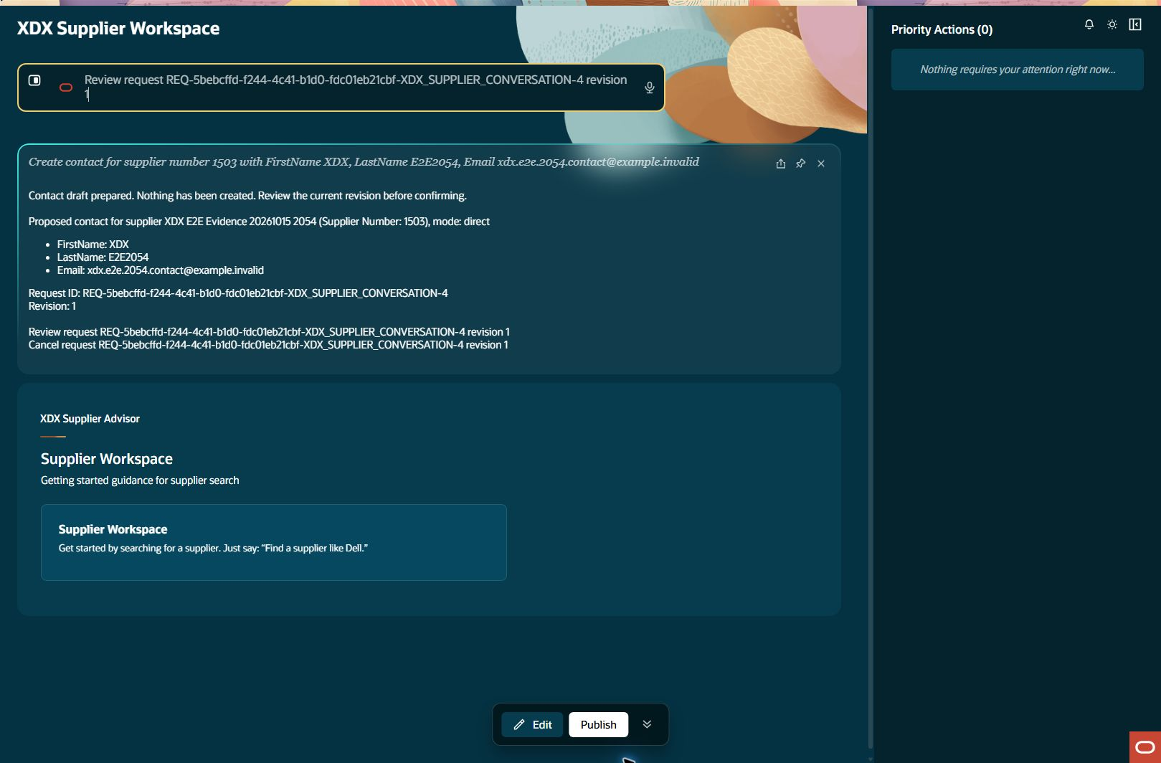
Direct contact creation: review input
contact-direct Step result: PASS
Notes:
Step: contact-direct
Object: Contact
Scenario: direct
Outcome: PASS
Expected: Execute declared business operation with current parent relationships and retained evidence
Actual: Contact300000340604973 created once under supplier1503; all three fields and parent independently verified.
Record IDs: {"contactId":"300000340604973"}
Fallback: false
Retries: []
Source results: docs/builds/xdx-supplier-e2e-evidence-20261015/results.json
Recorded action/stage key: review-input
Observed UTC: 2026-10-15T21:02:03.905Z
Screenshot: docs/builds/xdx-supplier-e2e-evidence-20261015/screens/contact-direct-review-input-003.jpg
Semantic evidence: docs/builds/xdx-supplier-e2e-evidence-20261015/screens/contact-direct-review-input-003.txt
Capture notes: Entered request: Review request REQ-5bebcffd-f244-4c41-b1d0-fdc01eb21cbf-XDX_SUPPLIER_CONVERSATION-4 revision 1
Timing qualification: Some retained setup captures use persistence time rather than original acquisition time. See run limitations.

Slide 38
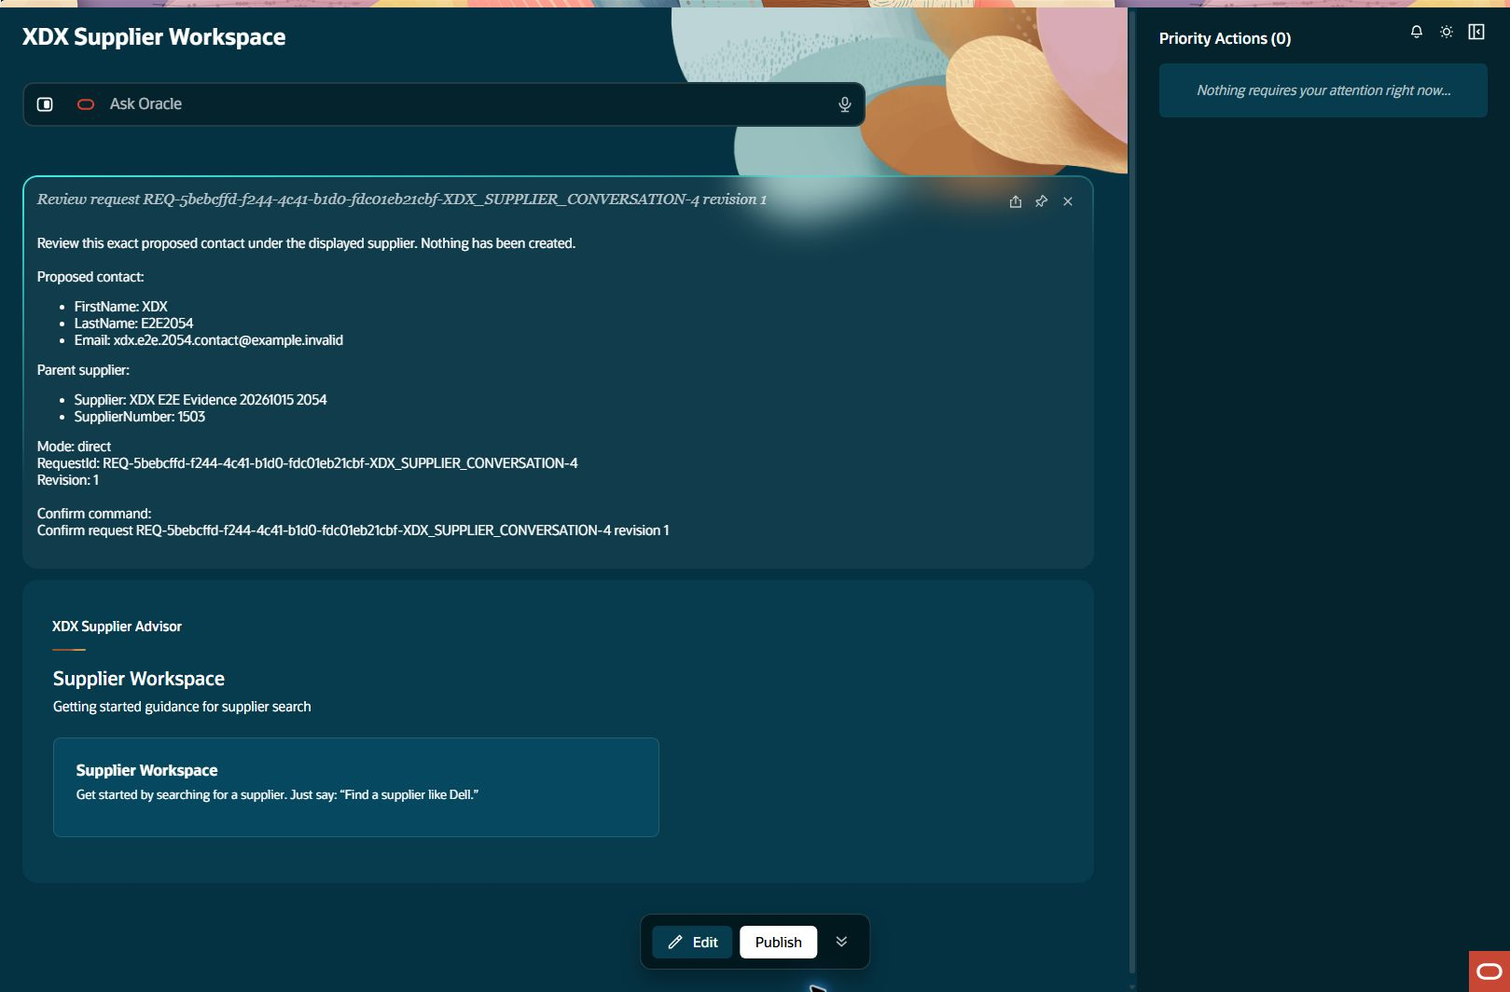
Direct contact creation: review ready
contact-direct Step result: PASS
Notes:
Step: contact-direct
Object: Contact
Scenario: direct
Outcome: PASS
Expected: Execute declared business operation with current parent relationships and retained evidence
Actual: Contact300000340604973 created once under supplier1503; all three fields and parent independently verified.
Record IDs: {"contactId":"300000340604973"}
Fallback: false
Retries: []
Source results: docs/builds/xdx-supplier-e2e-evidence-20261015/results.json
Recorded action/stage key: review-ready
Observed UTC: 2026-10-15T21:02:12.387Z
Screenshot: docs/builds/xdx-supplier-e2e-evidence-20261015/screens/contact-direct-review-ready-004.jpg
Semantic evidence: docs/builds/xdx-supplier-e2e-evidence-20261015/screens/contact-direct-review-ready-004.txt
Capture notes: Direct Contact exact revision reviewed under supplier1503.
Timing qualification: Some retained setup captures use persistence time rather than original acquisition time. See run limitations.

Slide 39
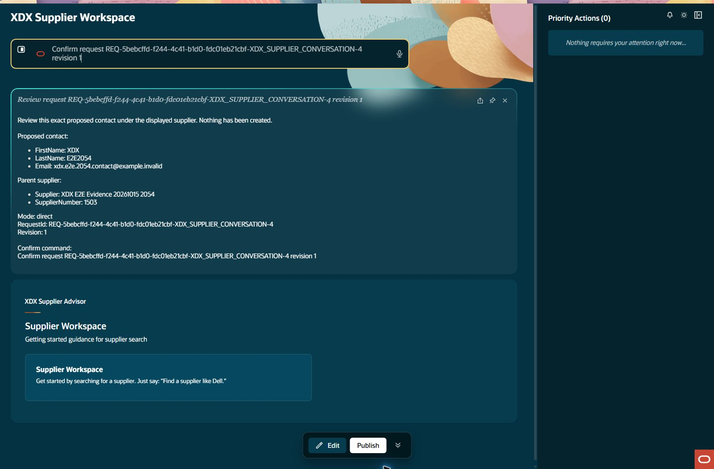
Direct contact creation: confirm input
contact-direct Step result: PASS
Notes:
Step: contact-direct
Object: Contact
Scenario: direct
Outcome: PASS
Expected: Execute declared business operation with current parent relationships and retained evidence
Actual: Contact300000340604973 created once under supplier1503; all three fields and parent independently verified.
Record IDs: {"contactId":"300000340604973"}
Fallback: false
Retries: []
Source results: docs/builds/xdx-supplier-e2e-evidence-20261015/results.json
Recorded action/stage key: confirm-input
Observed UTC: 2026-10-15T21:02:21.979Z
Screenshot: docs/builds/xdx-supplier-e2e-evidence-20261015/screens/contact-direct-confirm-input-005.jpg
Semantic evidence: docs/builds/xdx-supplier-e2e-evidence-20261015/screens/contact-direct-confirm-input-005.txt
Capture notes: Entered request: Confirm request REQ-5bebcffd-f244-4c41-b1d0-fdc01eb21cbf-XDX_SUPPLIER_CONVERSATION-4 revision 1
Timing qualification: Some retained setup captures use persistence time rather than original acquisition time. See run limitations.

Slide 40
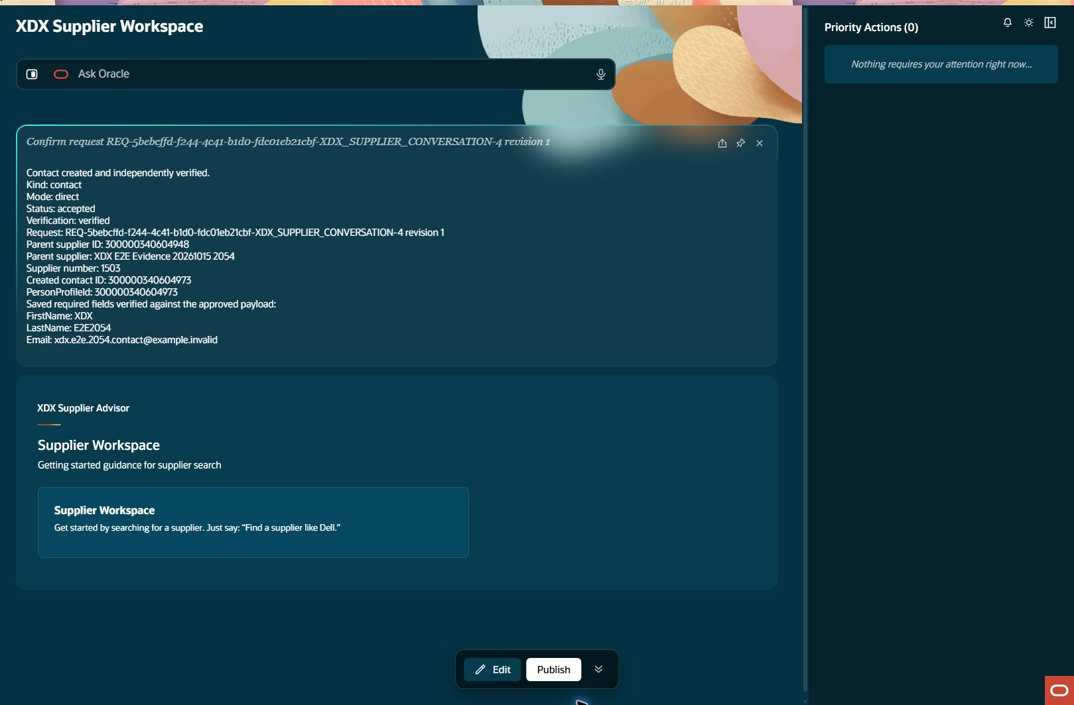
Direct contact creation: created readback
contact-direct Step result: PASS
Notes:
Step: contact-direct
Object: Contact
Scenario: direct
Outcome: PASS
Expected: Execute declared business operation with current parent relationships and retained evidence
Actual: Contact300000340604973 created once under supplier1503; all three fields and parent independently verified.
Record IDs: {"contactId":"300000340604973"}
Fallback: false
Retries: []
Source results: docs/builds/xdx-supplier-e2e-evidence-20261015/results.json
Recorded action/stage key: created-readback
Observed UTC: 2026-10-15T21:02:30.439Z
Screenshot: docs/builds/xdx-supplier-e2e-evidence-20261015/screens/contact-direct-created-readback-006.jpg
Semantic evidence: docs/builds/xdx-supplier-e2e-evidence-20261015/screens/contact-direct-created-readback-006.txt
Capture notes: Direct Contact accepted response and independent persisted field/parent verification.
Timing qualification: Some retained setup captures use persistence time rather than original acquisition time. See run limitations.

Slide 41
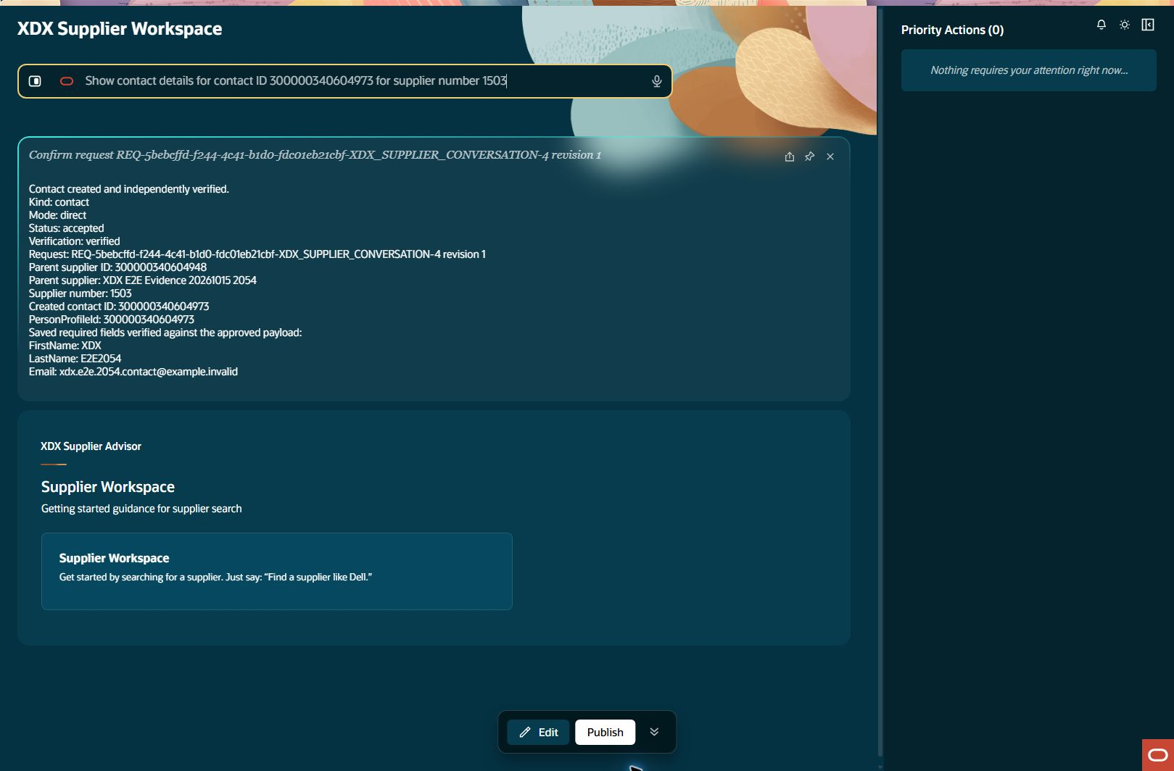
Created contact details: query input
contact-readback Step result: PASS
Notes:
Step: contact-readback
Object: Contact
Scenario: readback
Outcome: PASS
Expected: Execute declared business operation with current parent relationships and retained evidence
Actual: Ordinary Contact detail shows correct first/last name, email and supplier1503.
Record IDs: {}
Fallback: false
Retries: []
Source results: docs/builds/xdx-supplier-e2e-evidence-20261015/results.json
Recorded action/stage key: query-input
Observed UTC: 2026-10-15T21:02:39.596Z
Screenshot: docs/builds/xdx-supplier-e2e-evidence-20261015/screens/contact-readback-query-input-001.jpg
Semantic evidence: docs/builds/xdx-supplier-e2e-evidence-20261015/screens/contact-readback-query-input-001.txt
Capture notes: Entered request: Show contact details for contact ID 300000340604973 for supplier number 1503
Timing qualification: Some retained setup captures use persistence time rather than original acquisition time. See run limitations.

Slide 42

Created contact details: details
contact-readback Step result: PASS
Notes:
Step: contact-readback
Object: Contact
Scenario: readback
Outcome: PASS
Expected: Execute declared business operation with current parent relationships and retained evidence
Actual: Ordinary Contact detail shows correct first/last name, email and supplier1503.
Record IDs: {}
Fallback: false
Retries: []
Source results: docs/builds/xdx-supplier-e2e-evidence-20261015/results.json
Recorded action/stage key: details
Observed UTC: 2026-10-15T21:02:50.903Z
Screenshot: docs/builds/xdx-supplier-e2e-evidence-20261015/screens/contact-readback-details-002.jpg
Semantic evidence: docs/builds/xdx-supplier-e2e-evidence-20261015/screens/contact-readback-details-002.txt
Capture notes: Separate ordinary Contact query under supplier1503 by returned identifier.
Timing qualification: Some retained setup captures use persistence time rather than original acquisition time. See run limitations.

Slide 43
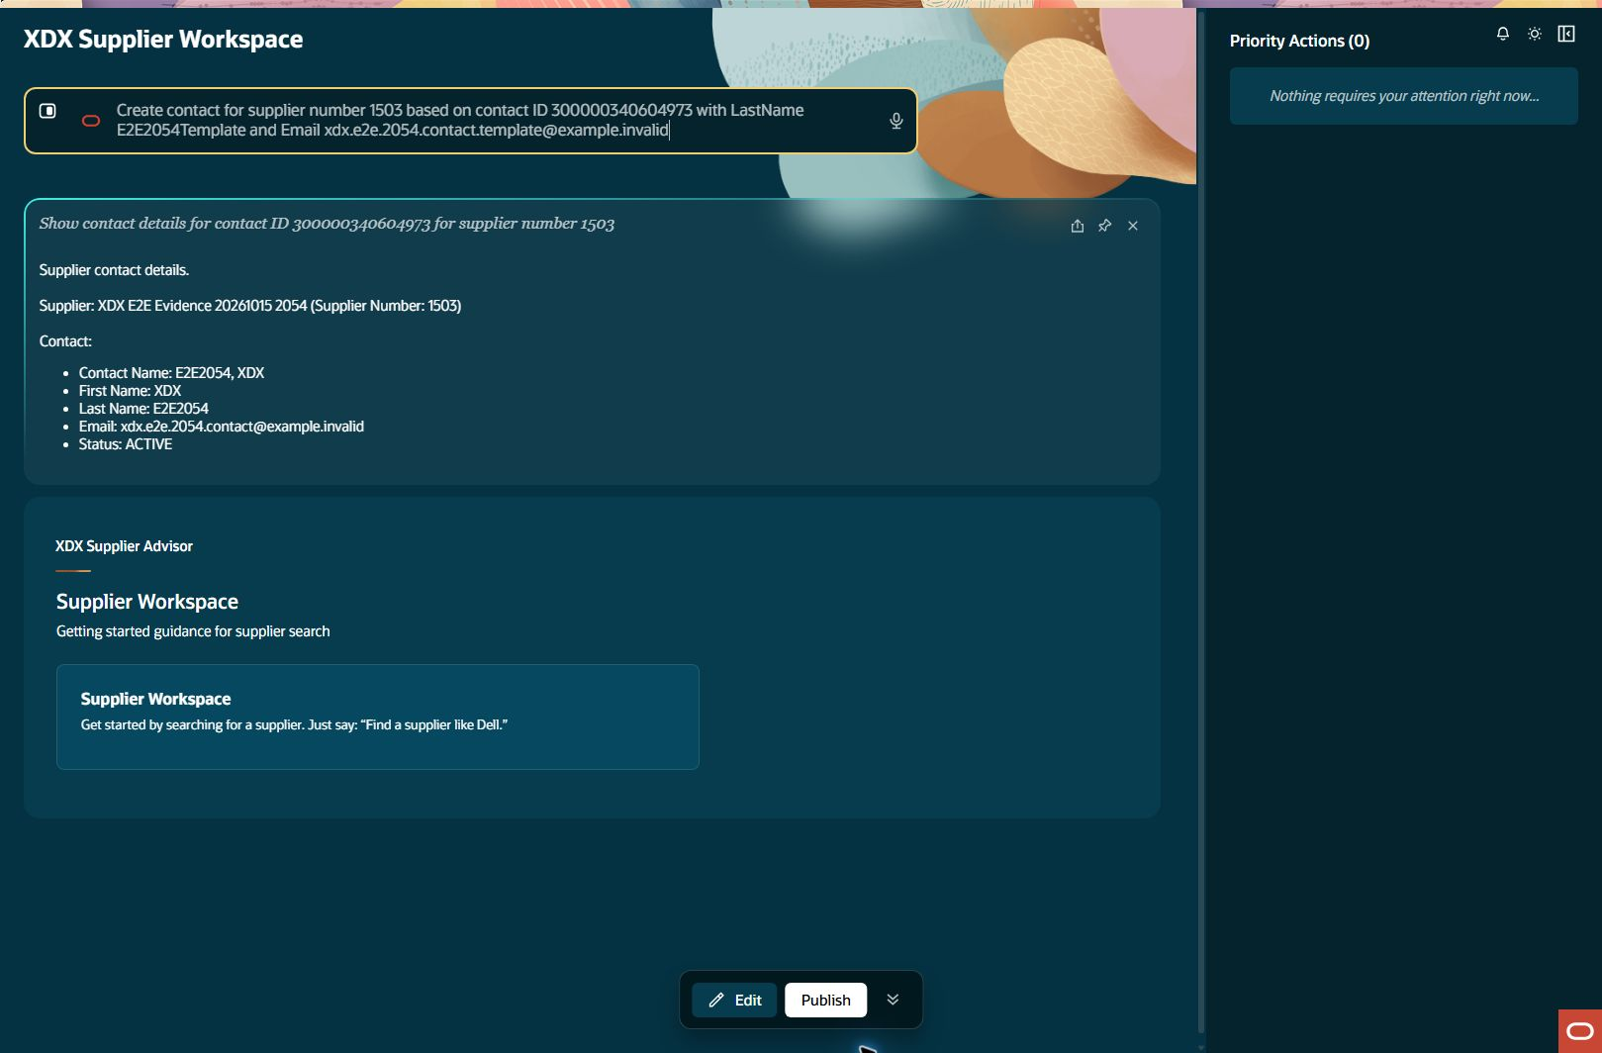
Contact template creation: prepare input
contact-template Step result: FAIL
Notes:
Step: contact-template
Object: Contact
Scenario: template
Outcome: FAIL
Expected: Execute declared business operation with current parent relationships and retained evidence
Actual: Template preparation failed: child source/address-name check could not finish. App reports no new create submitted. No Confirm or write reservation issued; screenshot retained.
Record IDs: {}
Fallback: false
Retries: []
Source results: docs/builds/xdx-supplier-e2e-evidence-20261015/results.json
Recorded action/stage key: prepare-input
Observed UTC: 2026-10-15T21:03:01.341Z
Screenshot: docs/builds/xdx-supplier-e2e-evidence-20261015/screens/contact-template-prepare-input-001.jpg
Semantic evidence: docs/builds/xdx-supplier-e2e-evidence-20261015/screens/contact-template-prepare-input-001.txt
Capture notes: Entered request: Create contact for supplier number 1503 based on contact ID 300000340604973 with LastName E2E2054Template and Email xdx.e2e.2054.contact.template@example.invalid
Timing qualification: Some retained setup captures use persistence time rather than original acquisition time. See run limitations.

Slide 44
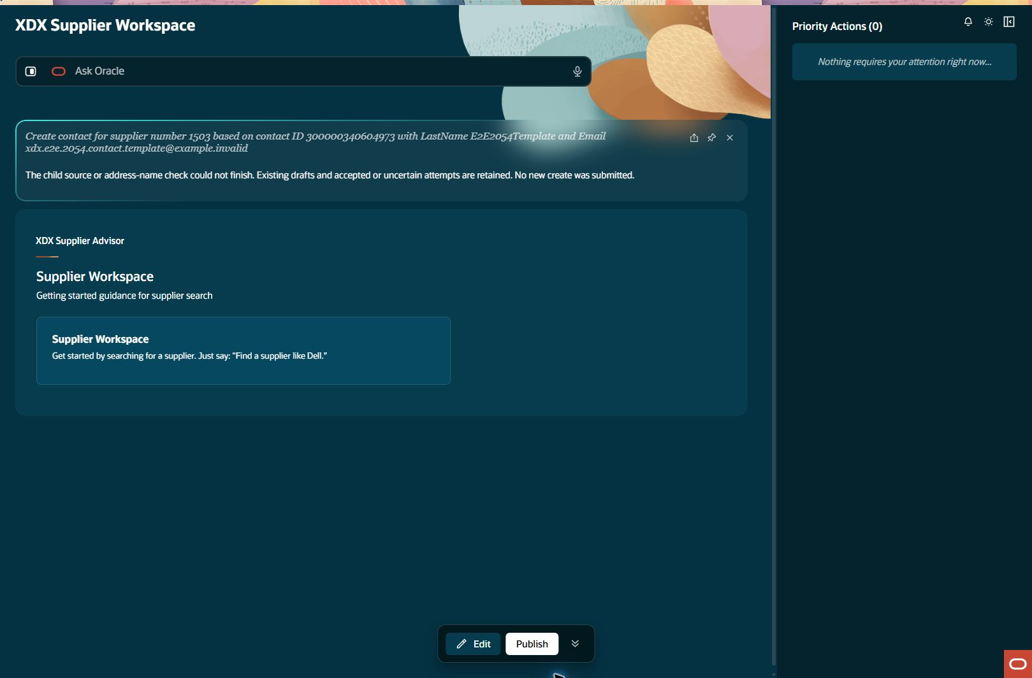
Contact template preparation failed
contact-template Step result: FAIL
Notes:
Step: contact-template
Object: Contact
Scenario: template
Outcome: FAIL
Expected: Execute declared business operation with current parent relationships and retained evidence
Actual: Template preparation failed: child source/address-name check could not finish. App reports no new create submitted. No Confirm or write reservation issued; screenshot retained.
Record IDs: {}
Fallback: false
Retries: []
Source results: docs/builds/xdx-supplier-e2e-evidence-20261015/results.json
Recorded action/stage key: draft-ready
Observed UTC: 2026-10-15T21:03:08.702Z
Screenshot: docs/builds/xdx-supplier-e2e-evidence-20261015/screens/contact-template-draft-ready-002.jpg
Semantic evidence: docs/builds/xdx-supplier-e2e-evidence-20261015/screens/contact-template-draft-ready-002.txt
Capture notes: Actual source-check error before any new create. No Review, Confirm or write reservation was issued.
Timing qualification: Some retained setup captures use persistence time rather than original acquisition time. See run limitations.

Slide 45
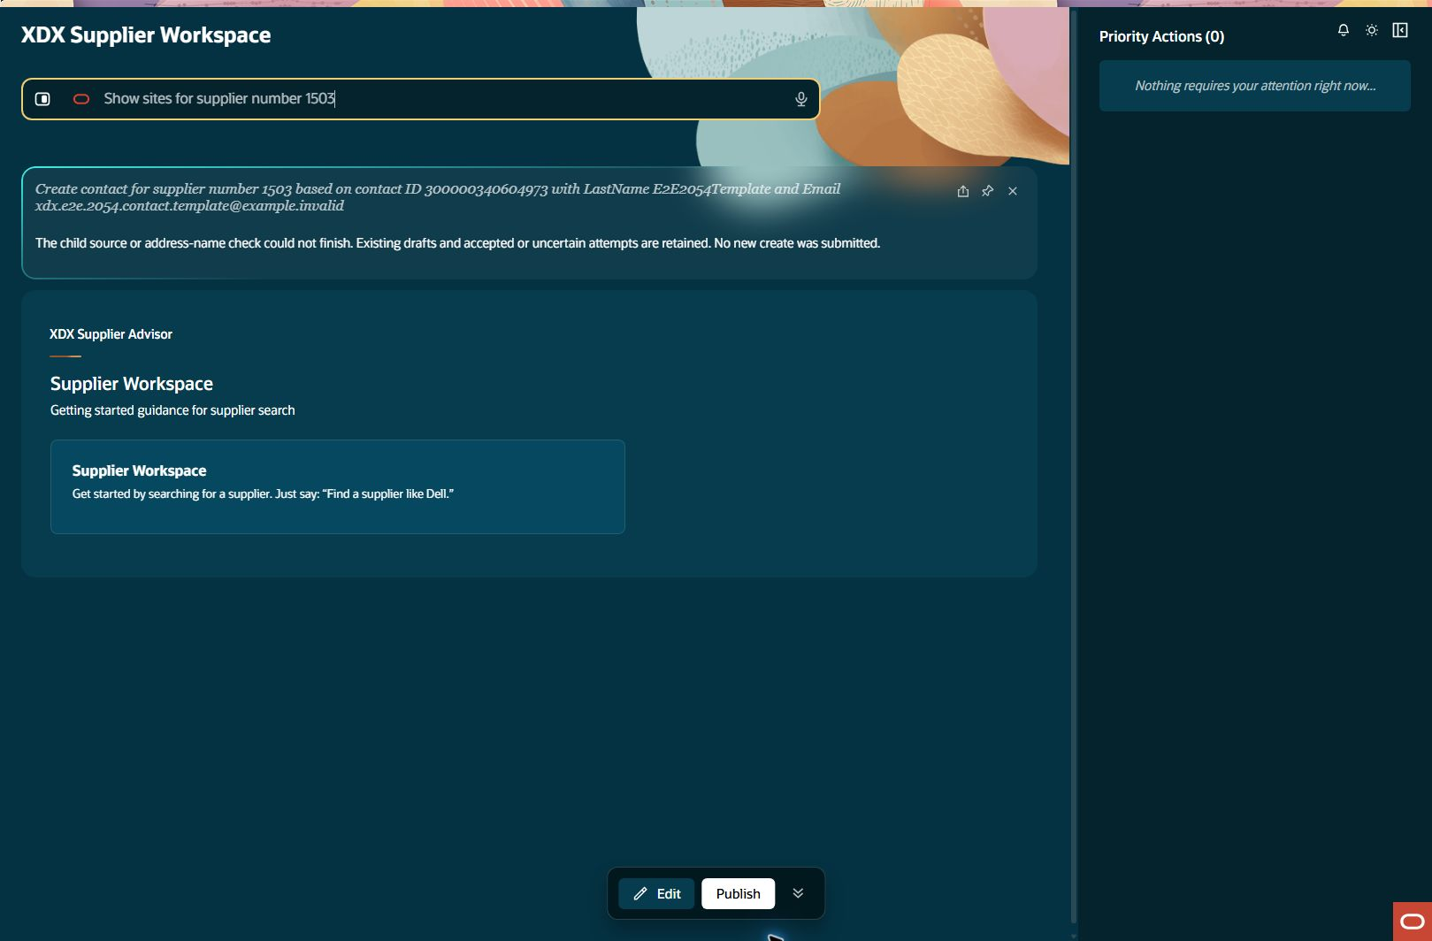
New supplier sites: query input
site-query Step result: PASS
Notes:
Step: site-query
Object: Site
Scenario: query
Outcome: PASS
Expected: Execute declared business operation with current parent relationships and retained evidence
Actual: New supplier1503 has no Site records; parent and empty state explicitly displayed.
Record IDs: {}
Fallback: false
Retries: []
Source results: docs/builds/xdx-supplier-e2e-evidence-20261015/results.json
Recorded action/stage key: query-input
Observed UTC: 2026-10-15T21:04:24.345Z
Screenshot: docs/builds/xdx-supplier-e2e-evidence-20261015/screens/site-query-query-input-001.jpg
Semantic evidence: docs/builds/xdx-supplier-e2e-evidence-20261015/screens/site-query-query-input-001.txt
Capture notes: Entered request: Show sites for supplier number 1503
Timing qualification: Some retained setup captures use persistence time rather than original acquisition time. See run limitations.

Slide 46

New supplier sites: result
site-query Step result: PASS
Notes:
Step: site-query
Object: Site
Scenario: query
Outcome: PASS
Expected: Execute declared business operation with current parent relationships and retained evidence
Actual: New supplier1503 has no Site records; parent and empty state explicitly displayed.
Record IDs: {}
Fallback: false
Retries: []
Source results: docs/builds/xdx-supplier-e2e-evidence-20261015/results.json
Recorded action/stage key: result
Observed UTC: 2026-10-15T21:04:35.687Z
Screenshot: docs/builds/xdx-supplier-e2e-evidence-20261015/screens/site-query-result-002.jpg
Semantic evidence: docs/builds/xdx-supplier-e2e-evidence-20261015/screens/site-query-result-002.txt
Capture notes: Site collection for new supplier1503 before attempting a first Site.
Timing qualification: Some retained setup captures use persistence time rather than original acquisition time. See run limitations.

Slide 47

First site on the new supplier: prepare input
site-connected Step result: BLOCKED
Notes:
Step: site-connected
Object: Site
Scenario: connected-template
Outcome: BLOCKED
Expected: Execute declared business operation with current parent relationships and retained evidence
Actual: New supplier1503 has no source Site; UI requires selecting a source Site under this same supplier. Current template-only behavior cannot bootstrap the connected first Site.
Record IDs: {}
Fallback: false
Retries: []
Source results: docs/builds/xdx-supplier-e2e-evidence-20261015/results.json
Recorded action/stage key: prepare-input
Observed UTC: 2026-10-15T21:04:44.674Z
Screenshot: docs/builds/xdx-supplier-e2e-evidence-20261015/screens/site-connected-prepare-input-001.jpg
Semantic evidence: docs/builds/xdx-supplier-e2e-evidence-20261015/screens/site-connected-prepare-input-001.txt
Capture notes: Entered request: Create site for supplier number 1503 based on selected site with new name XDX E2E S 2054
Timing qualification: Some retained setup captures use persistence time rather than original acquisition time. See run limitations.

Slide 48
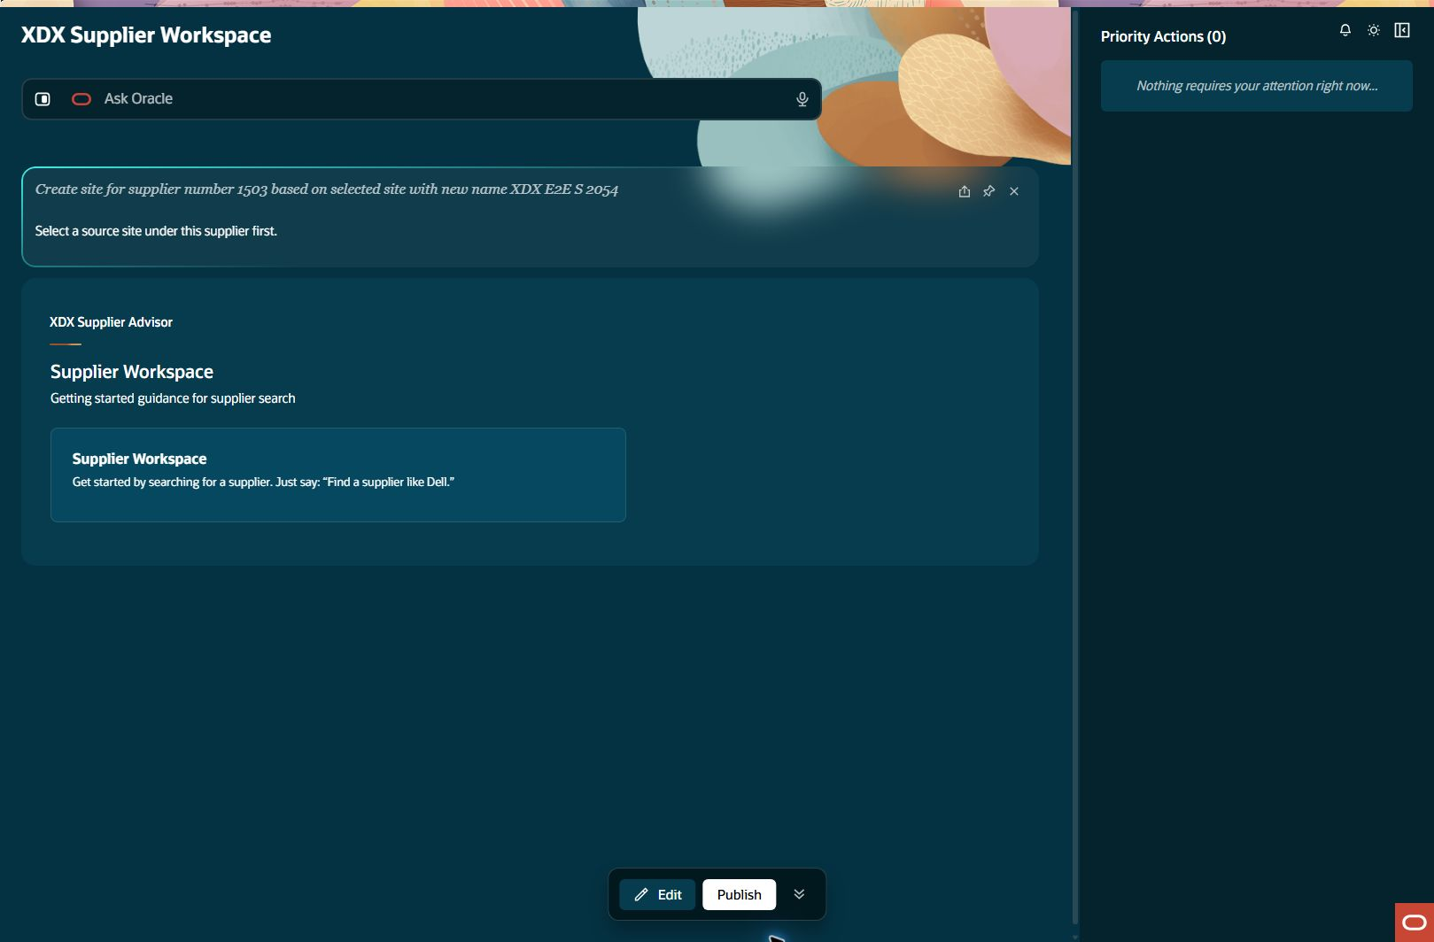
First site on the new supplier: capability result
site-connected Step result: BLOCKED
Notes:
Step: site-connected
Object: Site
Scenario: connected-template
Outcome: BLOCKED
Expected: Execute declared business operation with current parent relationships and retained evidence
Actual: New supplier1503 has no source Site; UI requires selecting a source Site under this same supplier. Current template-only behavior cannot bootstrap the connected first Site.
Record IDs: {}
Fallback: false
Retries: []
Source results: docs/builds/xdx-supplier-e2e-evidence-20261015/results.json
Recorded action/stage key: capability-result
Observed UTC: 2026-10-15T21:04:53.557Z
Screenshot: docs/builds/xdx-supplier-e2e-evidence-20261015/screens/site-connected-capability-result-002.jpg
Semantic evidence: docs/builds/xdx-supplier-e2e-evidence-20261015/screens/site-connected-capability-result-002.txt
Capture notes: Attempt first Site for new supplier; inspect template dependency and preserve any validation.
Timing qualification: Some retained setup captures use persistence time rather than original acquisition time. See run limitations.

Slide 49
Assignments for the new supplier site: dependency
assignment-connected Step result: BLOCKED
Notes:
Step: assignment-connected
Object: Site Assignment
Scenario: connected
Outcome: BLOCKED
Expected: Execute declared business operation with current parent relationships and retained evidence
Actual: Connected Assignment create/readback depends on a new supplier Site, which could not be prepared. Continue on clearly labeled existing-supplier fallback.
Record IDs: {}
Fallback: false
Retries: []
Source results: docs/builds/xdx-supplier-e2e-evidence-20261015/results.json
Recorded action/stage key: dependency
Observed UTC: 2026-10-15T21:05:08.071Z
Screenshot: docs/builds/xdx-supplier-e2e-evidence-20261015/screens/assignment-connected-dependency-001.jpg
Semantic evidence: docs/builds/xdx-supplier-e2e-evidence-20261015/screens/assignment-connected-dependency-001.txt
Capture notes: Assignments on the new supplier cannot execute because the first Site is blocked by same-parent template requirement.
Timing qualification: Some retained setup captures use persistence time rather than original acquisition time. See run limitations.

Slide 50
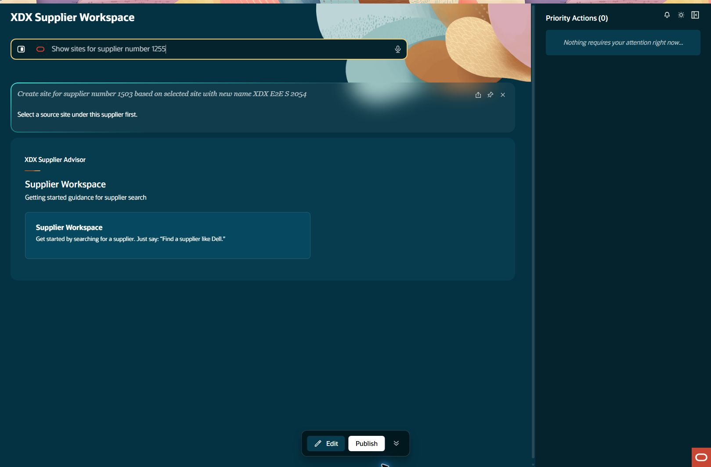
Fallback supplier sites: query input
site-fallback-query Step result: PASS FALLBACK TEST
Notes:
Step: site-fallback-query
Object: Site
Scenario: fallback-query
Outcome: PASS
Expected: Execute declared business operation with current parent relationships and retained evidence
Actual: Fallback Dell supplier1255 first Site page returned Dell US1 ID300000047414699 and explicit continuation; full collection completeness not claimed.
Record IDs: {"fallbackSourceSiteId":"300000047414699"}
Fallback: true
Retries: []
Source results: docs/builds/xdx-supplier-e2e-evidence-20261015/results.json
Recorded action/stage key: query-input
Observed UTC: 2026-10-15T21:05:08.409Z
Screenshot: docs/builds/xdx-supplier-e2e-evidence-20261015/screens/site-fallback-query-query-input-001.jpg
Semantic evidence: docs/builds/xdx-supplier-e2e-evidence-20261015/screens/site-fallback-query-query-input-001.txt
Capture notes: Entered request: Show sites for supplier number 1255
Timing qualification: Some retained setup captures use persistence time rather than original acquisition time. See run limitations.

Slide 51
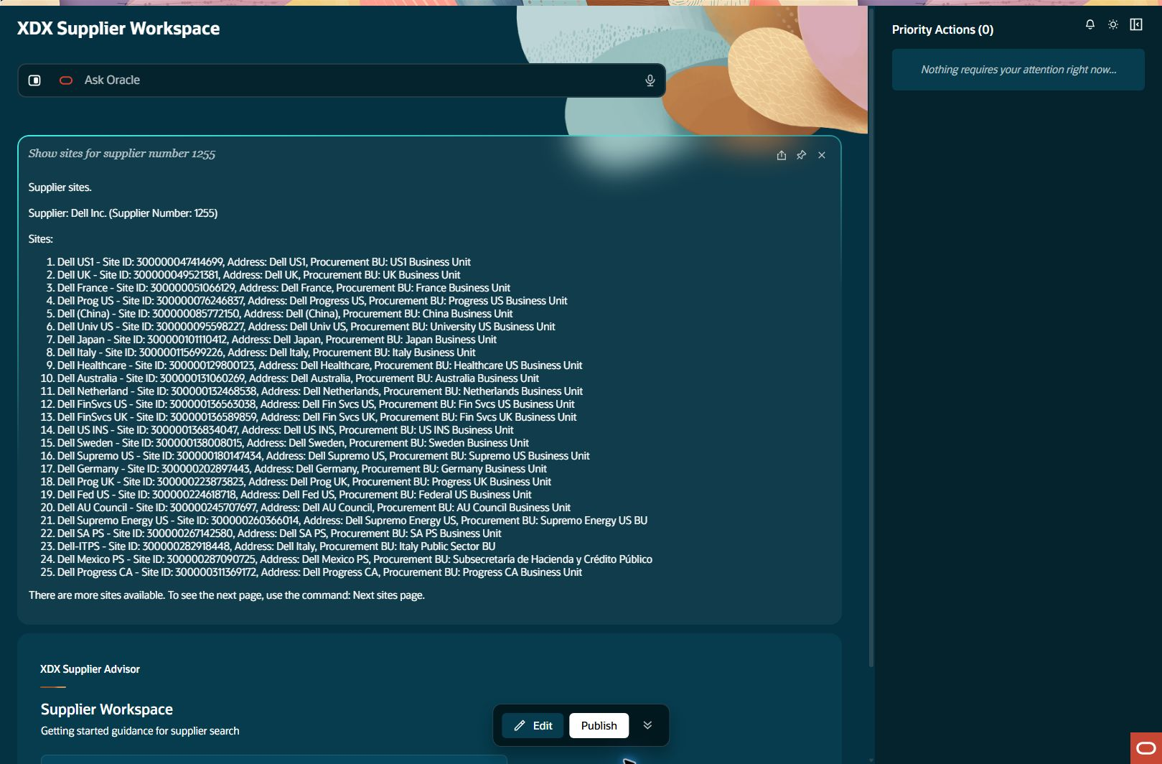
Fallback supplier sites: result
site-fallback-query Step result: PASS FALLBACK TEST
Notes:
Step: site-fallback-query
Object: Site
Scenario: fallback-query
Outcome: PASS
Expected: Execute declared business operation with current parent relationships and retained evidence
Actual: Fallback Dell supplier1255 first Site page returned Dell US1 ID300000047414699 and explicit continuation; full collection completeness not claimed.
Record IDs: {"fallbackSourceSiteId":"300000047414699"}
Fallback: true
Retries: []
Source results: docs/builds/xdx-supplier-e2e-evidence-20261015/results.json
Recorded action/stage key: result
Observed UTC: 2026-10-15T21:05:23.660Z
Screenshot: docs/builds/xdx-supplier-e2e-evidence-20261015/screens/site-fallback-query-result-002.jpg
Semantic evidence: docs/builds/xdx-supplier-e2e-evidence-20261015/screens/site-fallback-query-result-002.txt
Capture notes: Fallback coverage: existing Dell supplier1255 Site collection, not the new supplier1503.
Timing qualification: Some retained setup captures use persistence time rather than original acquisition time. See run limitations.

Slide 52
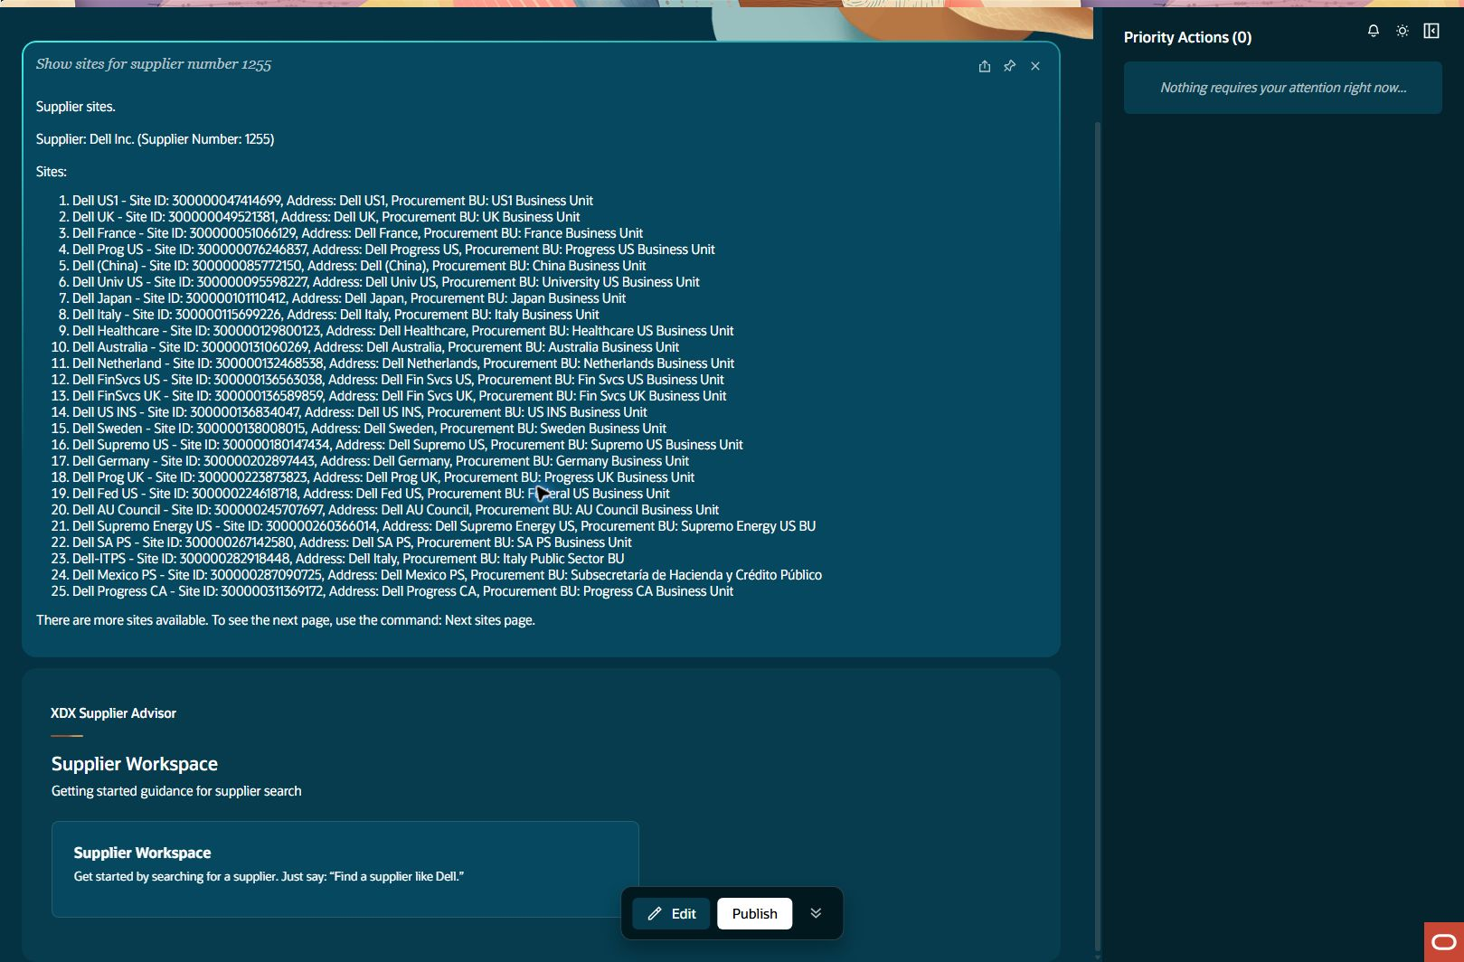
Fallback supplier sites: result lower section
site-fallback-query Step result: PASS FALLBACK TEST
Notes:
Step: site-fallback-query
Object: Site
Scenario: fallback-query
Outcome: PASS
Expected: Execute declared business operation with current parent relationships and retained evidence
Actual: Fallback Dell supplier1255 first Site page returned Dell US1 ID300000047414699 and explicit continuation; full collection completeness not claimed.
Record IDs: {"fallbackSourceSiteId":"300000047414699"}
Fallback: true
Retries: []
Source results: docs/builds/xdx-supplier-e2e-evidence-20261015/results.json
Recorded action/stage key: result-lower-section
Observed UTC: 2026-10-15T21:05:42.321Z
Screenshot: docs/builds/xdx-supplier-e2e-evidence-20261015/screens/site-fallback-query-result-lower-section-003.jpg
Semantic evidence: docs/builds/xdx-supplier-e2e-evidence-20261015/screens/site-fallback-query-result-lower-section-003.txt
Capture notes: Lower section of first25Site results and advertised continuation; this is a partial collection, not a claim all Sites were listed.
Timing qualification: Some retained setup captures use persistence time rather than original acquisition time. See run limitations.

Slide 53
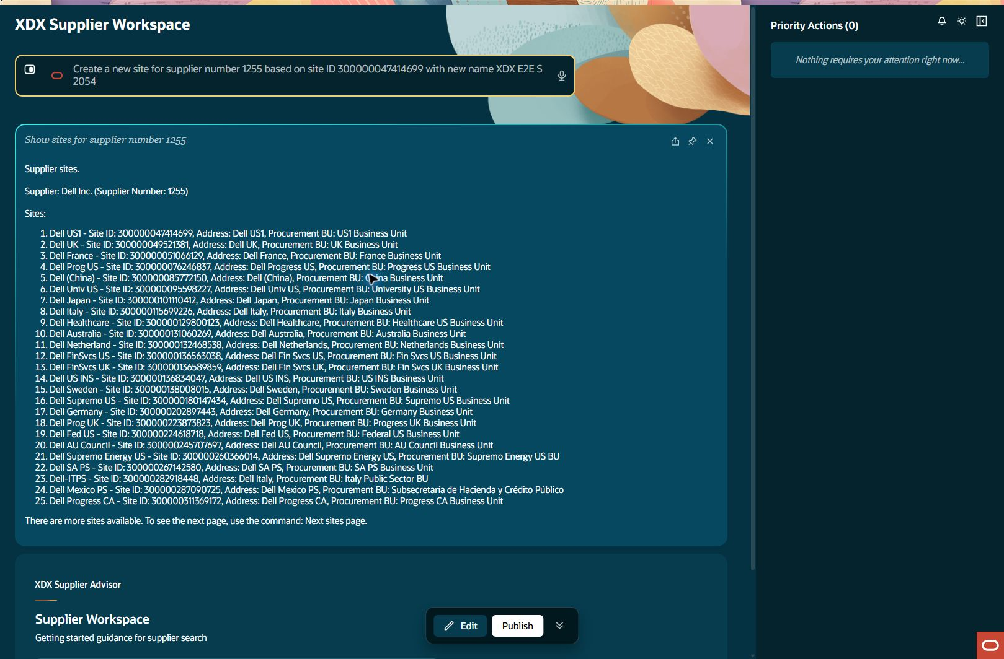
Fallback site and assignment creation: prepare input
site-fallback-create Step result: PASS FALLBACK TEST
Notes:
Step: site-fallback-create
Object: Site
Scenario: fallback-template
Outcome: PASS
Expected: Execute declared business operation with current parent relationships and retained evidence
Actual: Fallback Dell1255 Site300000340604984 and Assignment300000340604987 created once, independently verified serially. This is not connected supplier1503 coverage.
Record IDs: {"siteId":"300000340604984","assignmentId":"300000340604987","fallbackSupplierId":"300000047414679"}
Fallback: true
Retries: []
Source results: docs/builds/xdx-supplier-e2e-evidence-20261015/results.json
Recorded action/stage key: prepare-input
Observed UTC: 2026-10-15T21:05:43.645Z
Screenshot: docs/builds/xdx-supplier-e2e-evidence-20261015/screens/site-fallback-create-prepare-input-001.jpg
Semantic evidence: docs/builds/xdx-supplier-e2e-evidence-20261015/screens/site-fallback-create-prepare-input-001.txt
Capture notes: Entered request: Create a new site for supplier number 1255 based on site ID 300000047414699 with new name XDX E2E S 2054
Timing qualification: Some retained setup captures use persistence time rather than original acquisition time. See run limitations.

Slide 54
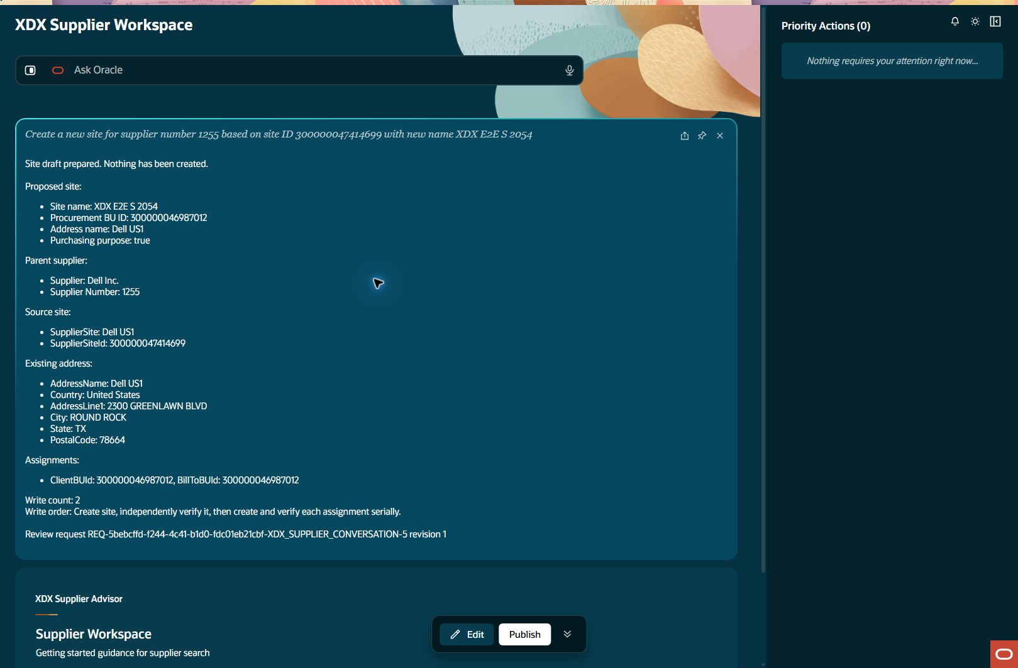
Fallback site and assignment creation: draft ready
site-fallback-create Step result: PASS FALLBACK TEST
Notes:
Step: site-fallback-create
Object: Site
Scenario: fallback-template
Outcome: PASS
Expected: Execute declared business operation with current parent relationships and retained evidence
Actual: Fallback Dell1255 Site300000340604984 and Assignment300000340604987 created once, independently verified serially. This is not connected supplier1503 coverage.
Record IDs: {"siteId":"300000340604984","assignmentId":"300000340604987","fallbackSupplierId":"300000047414679"}
Fallback: true
Retries: []
Source results: docs/builds/xdx-supplier-e2e-evidence-20261015/results.json
Recorded action/stage key: draft-ready
Observed UTC: 2026-10-15T21:05:58.234Z
Screenshot: docs/builds/xdx-supplier-e2e-evidence-20261015/screens/site-fallback-create-draft-ready-002.jpg
Semantic evidence: docs/builds/xdx-supplier-e2e-evidence-20261015/screens/site-fallback-create-draft-ready-002.txt
Capture notes: Fallback Site template under existing supplier1255; cannot claim connected supplier1503 creation.
Timing qualification: Some retained setup captures use persistence time rather than original acquisition time. See run limitations.

Slide 55
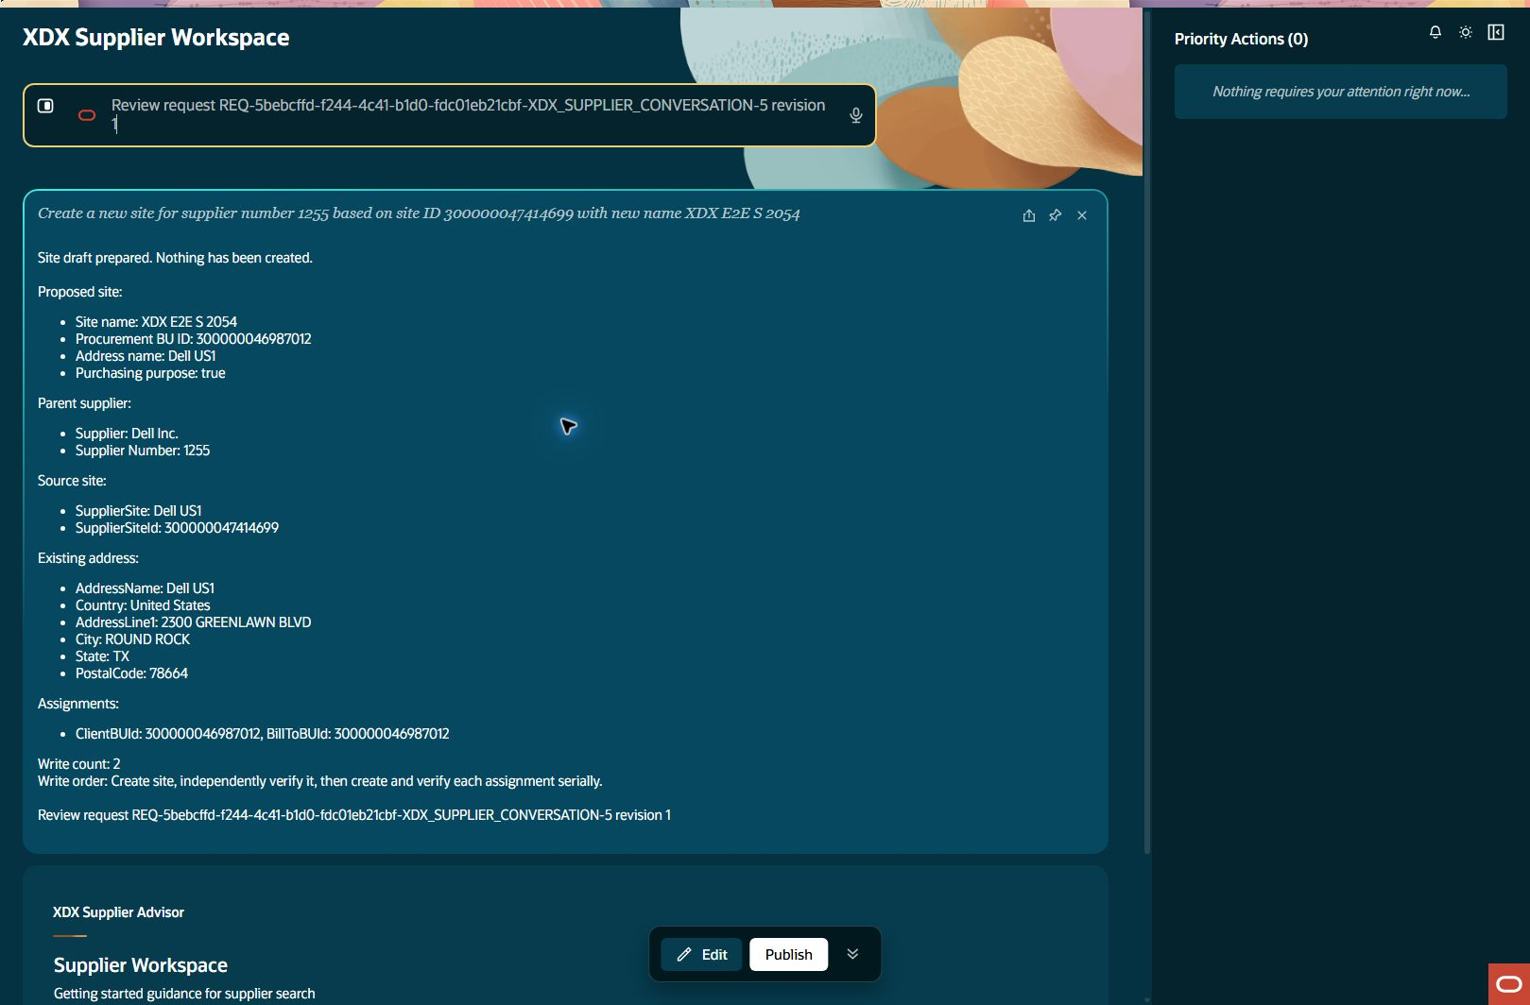
Fallback site and assignment creation: review input
site-fallback-create Step result: PASS FALLBACK TEST
Notes:
Step: site-fallback-create
Object: Site
Scenario: fallback-template
Outcome: PASS
Expected: Execute declared business operation with current parent relationships and retained evidence
Actual: Fallback Dell1255 Site300000340604984 and Assignment300000340604987 created once, independently verified serially. This is not connected supplier1503 coverage.
Record IDs: {"siteId":"300000340604984","assignmentId":"300000340604987","fallbackSupplierId":"300000047414679"}
Fallback: true
Retries: []
Source results: docs/builds/xdx-supplier-e2e-evidence-20261015/results.json
Recorded action/stage key: review-input
Observed UTC: 2026-10-15T21:06:15.593Z
Screenshot: docs/builds/xdx-supplier-e2e-evidence-20261015/screens/site-fallback-create-review-input-003.jpg
Semantic evidence: docs/builds/xdx-supplier-e2e-evidence-20261015/screens/site-fallback-create-review-input-003.txt
Capture notes: Entered request: Review request REQ-5bebcffd-f244-4c41-b1d0-fdc01eb21cbf-XDX_SUPPLIER_CONVERSATION-5 revision 1
Timing qualification: Some retained setup captures use persistence time rather than original acquisition time. See run limitations.

Slide 56
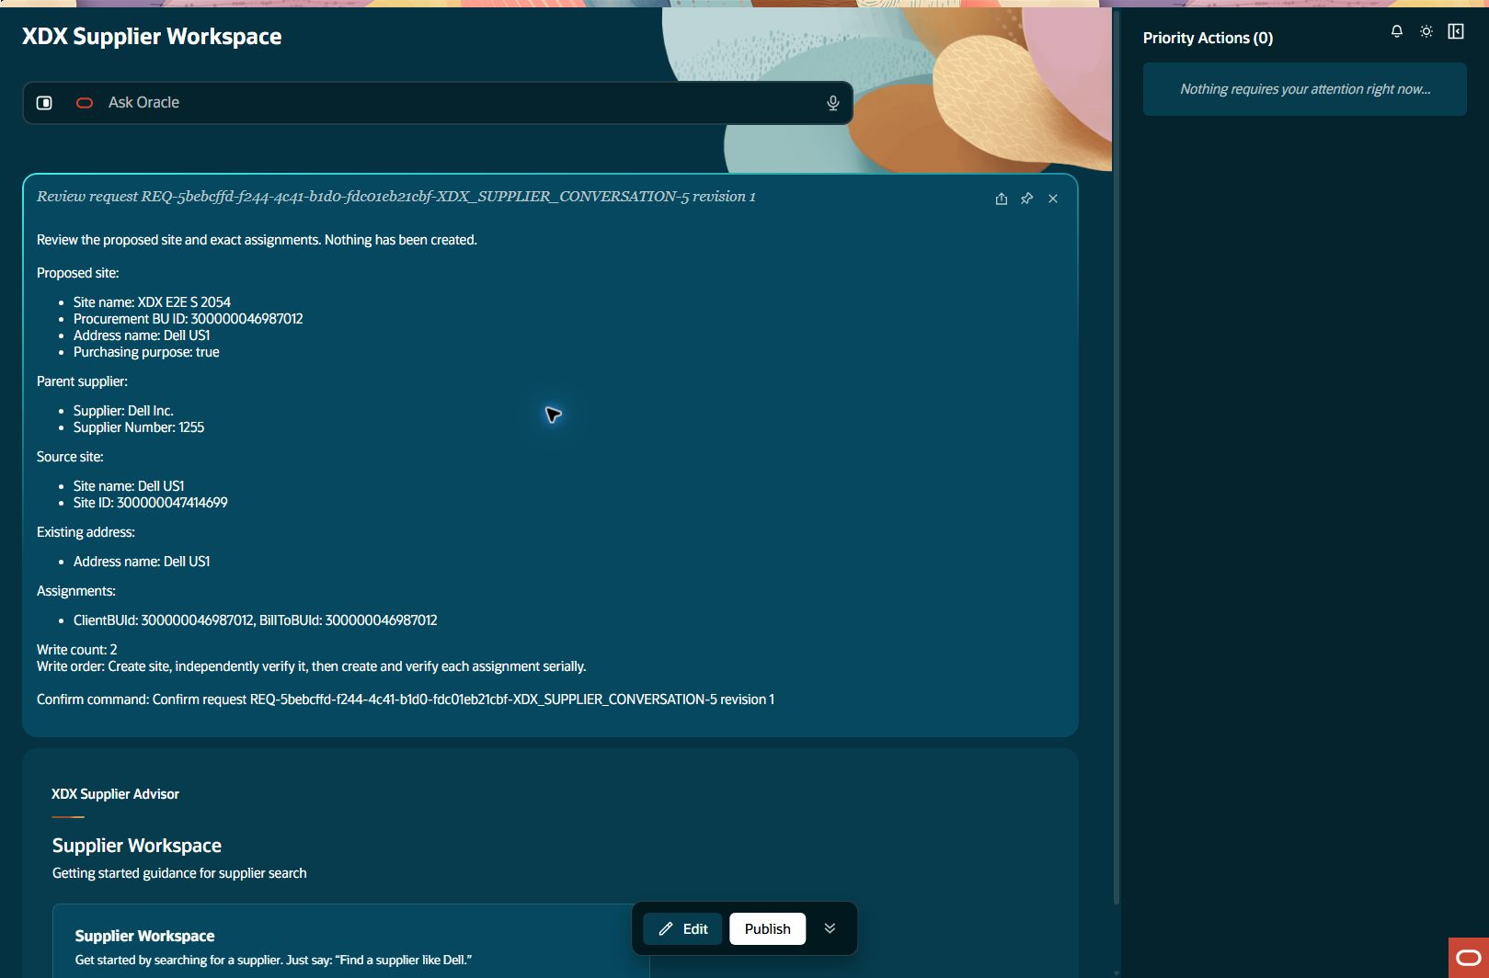
Fallback site and assignment creation: review ready
site-fallback-create Step result: PASS FALLBACK TEST
Notes:
Step: site-fallback-create
Object: Site
Scenario: fallback-template
Outcome: PASS
Expected: Execute declared business operation with current parent relationships and retained evidence
Actual: Fallback Dell1255 Site300000340604984 and Assignment300000340604987 created once, independently verified serially. This is not connected supplier1503 coverage.
Record IDs: {"siteId":"300000340604984","assignmentId":"300000340604987","fallbackSupplierId":"300000047414679"}
Fallback: true
Retries: []
Source results: docs/builds/xdx-supplier-e2e-evidence-20261015/results.json
Recorded action/stage key: review-ready
Observed UTC: 2026-10-15T21:06:23.815Z
Screenshot: docs/builds/xdx-supplier-e2e-evidence-20261015/screens/site-fallback-create-review-ready-004.jpg
Semantic evidence: docs/builds/xdx-supplier-e2e-evidence-20261015/screens/site-fallback-create-review-ready-004.txt
Capture notes: Fallback Site+oneAssignment exact request/revision review under Dell1255; two planned business writes.
Timing qualification: Some retained setup captures use persistence time rather than original acquisition time. See run limitations.

Slide 57
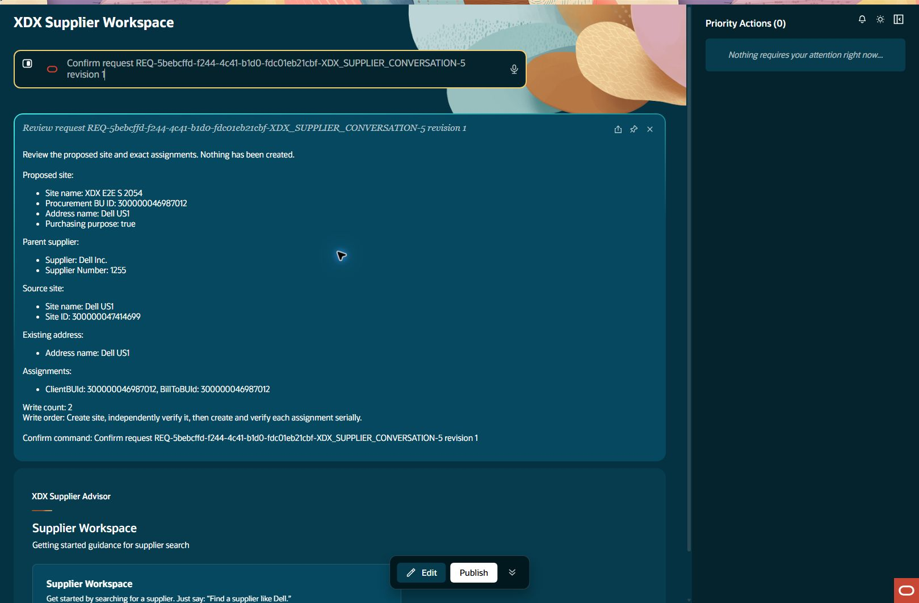
Fallback site and assignment creation: confirm input
site-fallback-create Step result: PASS FALLBACK TEST
Notes:
Step: site-fallback-create
Object: Site
Scenario: fallback-template
Outcome: PASS
Expected: Execute declared business operation with current parent relationships and retained evidence
Actual: Fallback Dell1255 Site300000340604984 and Assignment300000340604987 created once, independently verified serially. This is not connected supplier1503 coverage.
Record IDs: {"siteId":"300000340604984","assignmentId":"300000340604987","fallbackSupplierId":"300000047414679"}
Fallback: true
Retries: []
Source results: docs/builds/xdx-supplier-e2e-evidence-20261015/results.json
Recorded action/stage key: confirm-input
Observed UTC: 2026-10-15T21:06:56.082Z
Screenshot: docs/builds/xdx-supplier-e2e-evidence-20261015/screens/site-fallback-create-confirm-input-005.jpg
Semantic evidence: docs/builds/xdx-supplier-e2e-evidence-20261015/screens/site-fallback-create-confirm-input-005.txt
Capture notes: Entered request: Confirm request REQ-5bebcffd-f244-4c41-b1d0-fdc01eb21cbf-XDX_SUPPLIER_CONVERSATION-5 revision 1
Timing qualification: Some retained setup captures use persistence time rather than original acquisition time. See run limitations.

Slide 58
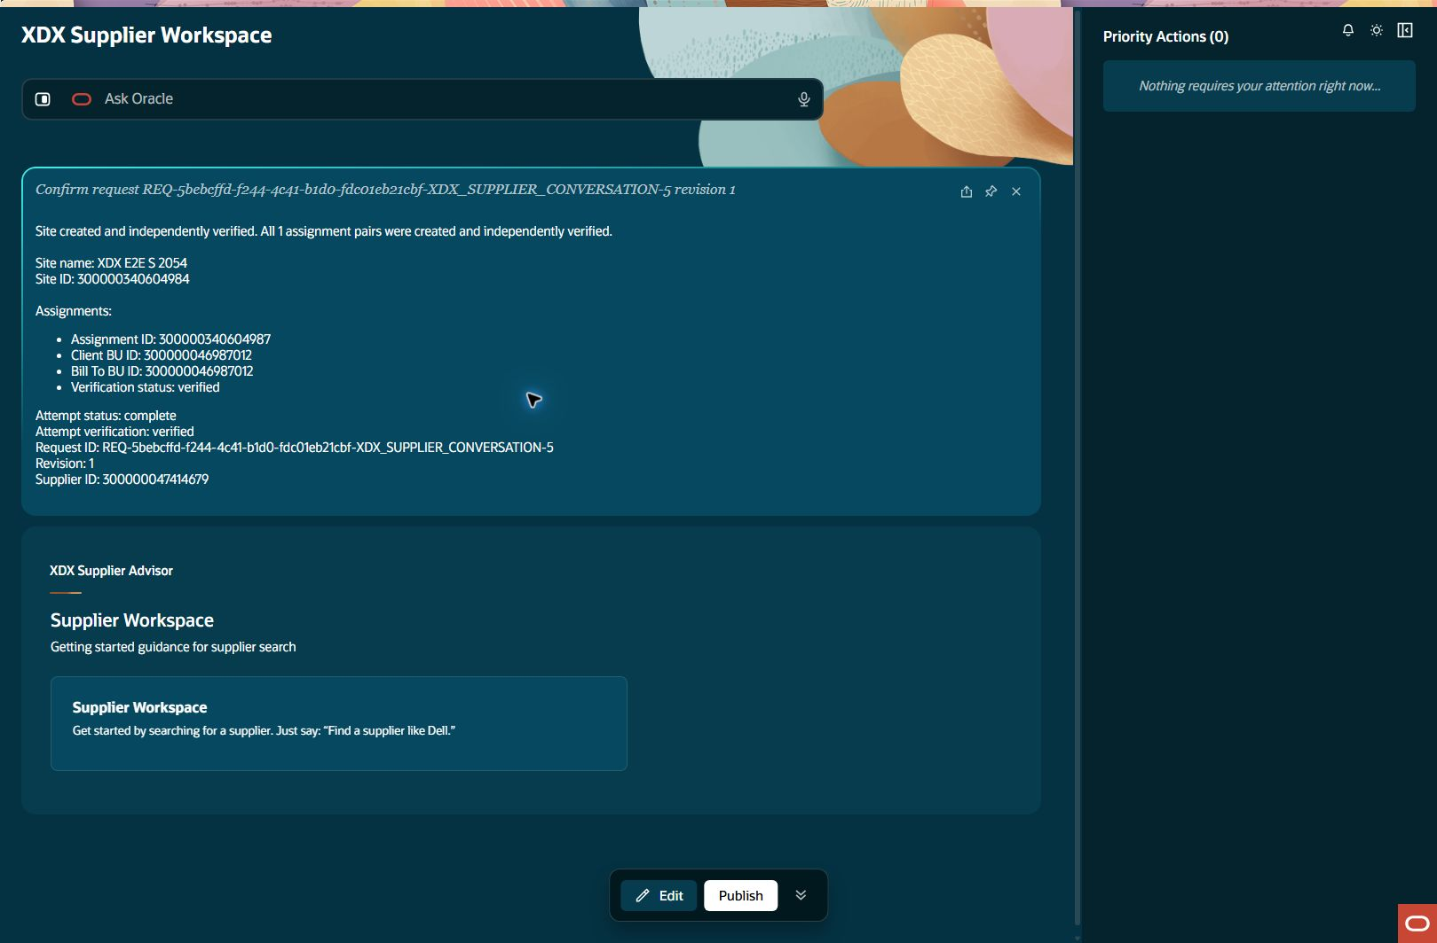
Fallback site and assignment creation: created readback
site-fallback-create Step result: PASS FALLBACK TEST
Notes:
Step: site-fallback-create
Object: Site
Scenario: fallback-template
Outcome: PASS
Expected: Execute declared business operation with current parent relationships and retained evidence
Actual: Fallback Dell1255 Site300000340604984 and Assignment300000340604987 created once, independently verified serially. This is not connected supplier1503 coverage.
Record IDs: {"siteId":"300000340604984","assignmentId":"300000340604987","fallbackSupplierId":"300000047414679"}
Fallback: true
Retries: []
Source results: docs/builds/xdx-supplier-e2e-evidence-20261015/results.json
Recorded action/stage key: created-readback
Observed UTC: 2026-10-15T21:07:13.820Z
Screenshot: docs/builds/xdx-supplier-e2e-evidence-20261015/screens/site-fallback-create-created-readback-006.jpg
Semantic evidence: docs/builds/xdx-supplier-e2e-evidence-20261015/screens/site-fallback-create-created-readback-006.txt
Capture notes: Fallback Site then one Assignment accepted/verified serially under existing Dell1255.
Timing qualification: Some retained setup captures use persistence time rather than original acquisition time. See run limitations.

Slide 59
Copied assignment verification: verified assignment
assignment-readback Step result: PASS FALLBACK TEST
Notes:
Step: assignment-readback
Object: Site Assignment
Scenario: embedded-readback
Outcome: PASS
Expected: Execute declared business operation with current parent relationships and retained evidence
Actual: Original fallback workflow independently read back Assignment300000340604987 and both Client/Bill BU300000046987012.
Record IDs: {"assignmentId":"300000340604987"}
Fallback: true
Retries: []
Source results: docs/builds/xdx-supplier-e2e-evidence-20261015/results.json
Recorded action/stage key: verified-assignment
Observed UTC: 2026-10-15T21:07:36.423Z
Screenshot: docs/builds/xdx-supplier-e2e-evidence-20261015/screens/assignment-readback-verified-assignment-001.jpg
Semantic evidence: docs/builds/xdx-supplier-e2e-evidence-20261015/screens/assignment-readback-verified-assignment-001.txt
Capture notes: Observed independent Assignment verification in the original Site completion, not a repeated POST; assignmentID and both BU keys visible.
Timing qualification: Some retained setup captures use persistence time rather than original acquisition time. See run limitations.

Slide 60

Fallback site details: query input
site-fallback-readback Step result: PASS FALLBACK TEST
Notes:
Step: site-fallback-readback
Object: Site
Scenario: fallback-readback
Outcome: PASS
Expected: Execute declared business operation with current parent relationships and retained evidence
Actual: Ordinary fallback Site detail verifies Site984, Dell1255, BU300000046987012, DellUS1 address and purchasing purpose Yes.
Record IDs: {}
Fallback: true
Retries: []
Source results: docs/builds/xdx-supplier-e2e-evidence-20261015/results.json
Recorded action/stage key: query-input
Observed UTC: 2026-10-15T21:07:36.948Z
Screenshot: docs/builds/xdx-supplier-e2e-evidence-20261015/screens/site-fallback-readback-query-input-001.jpg
Semantic evidence: docs/builds/xdx-supplier-e2e-evidence-20261015/screens/site-fallback-readback-query-input-001.txt
Capture notes: Entered request: Show site details for site ID 300000340604984 for supplier number 1255
Timing qualification: Some retained setup captures use persistence time rather than original acquisition time. See run limitations.

Slide 61
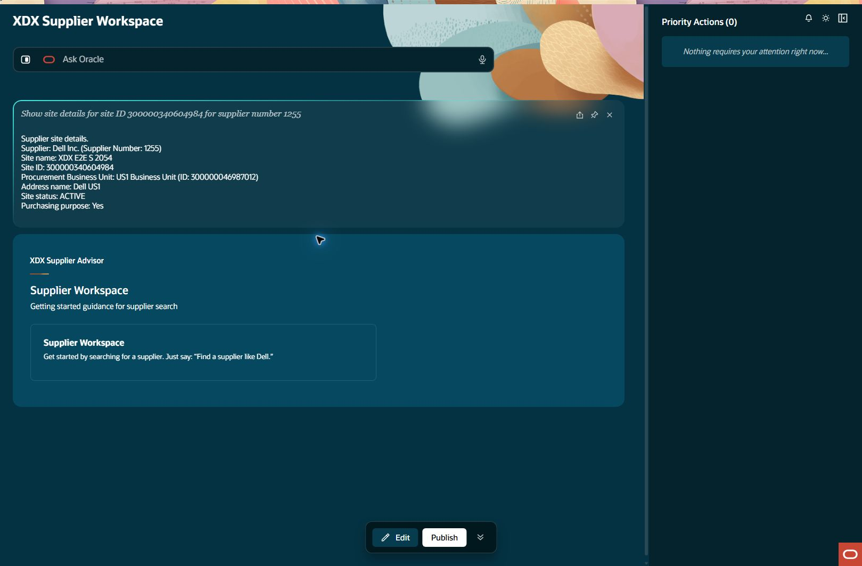
Fallback site details: details
site-fallback-readback Step result: PASS FALLBACK TEST
Notes:
Step: site-fallback-readback
Object: Site
Scenario: fallback-readback
Outcome: PASS
Expected: Execute declared business operation with current parent relationships and retained evidence
Actual: Ordinary fallback Site detail verifies Site984, Dell1255, BU300000046987012, DellUS1 address and purchasing purpose Yes.
Record IDs: {}
Fallback: true
Retries: []
Source results: docs/builds/xdx-supplier-e2e-evidence-20261015/results.json
Recorded action/stage key: details
Observed UTC: 2026-10-15T21:07:47.876Z
Screenshot: docs/builds/xdx-supplier-e2e-evidence-20261015/screens/site-fallback-readback-details-002.jpg
Semantic evidence: docs/builds/xdx-supplier-e2e-evidence-20261015/screens/site-fallback-readback-details-002.txt
Capture notes: Separate ordinary Site detail query under fallback supplier1255 using newly created SiteID.
Timing qualification: Some retained setup captures use persistence time rather than original acquisition time. See run limitations.

Slide 62

Standalone assignment query: query input
assignment-query Step result: FAIL FALLBACK TEST
Notes:
Step: assignment-query
Object: Site Assignment
Scenario: query
Outcome: FAIL
Expected: Execute declared business operation with current parent relationships and retained evidence
Actual: Standalone Assignment query returned Supplier site details instead of Assignment records; expected Assignment ID, Client BU and Bill To BU were absent. Embedded create/readback remains separately PASS.
Record IDs: {}
Fallback: true
Retries: []
Source results: docs/builds/xdx-supplier-e2e-evidence-20261015/results.json
Recorded action/stage key: query-input
Observed UTC: 2026-10-15T21:08:20.755Z
Screenshot: docs/builds/xdx-supplier-e2e-evidence-20261015/screens/assignment-query-query-input-001.jpg
Semantic evidence: docs/builds/xdx-supplier-e2e-evidence-20261015/screens/assignment-query-query-input-001.txt
Capture notes: Entered request: Show assignments for site ID 300000340604984 for supplier number 1255
Timing qualification: Some retained setup captures use persistence time rather than original acquisition time. See run limitations.

Slide 63

Standalone assignment query: result
assignment-query Step result: FAIL FALLBACK TEST
Notes:
Step: assignment-query
Object: Site Assignment
Scenario: query
Outcome: FAIL
Expected: Execute declared business operation with current parent relationships and retained evidence
Actual: Standalone Assignment query returned Supplier site details instead of Assignment records; expected Assignment ID, Client BU and Bill To BU were absent. Embedded create/readback remains separately PASS.
Record IDs: {}
Fallback: true
Retries: []
Source results: docs/builds/xdx-supplier-e2e-evidence-20261015/results.json
Recorded action/stage key: result
Observed UTC: 2026-10-15T21:08:37.912Z
Screenshot: docs/builds/xdx-supplier-e2e-evidence-20261015/screens/assignment-query-result-002.jpg
Semantic evidence: docs/builds/xdx-supplier-e2e-evidence-20261015/screens/assignment-query-result-002.txt
Capture notes: Standalone Assignment query attempt; compare with separately passing embedded create/readback evidence.
Timing qualification: Some retained setup captures use persistence time rather than original acquisition time. See run limitations.

Slide 64

Assignment query returned Site details: final painted result
assignment-query Step result: FAIL FALLBACK TEST
Notes:
Step: assignment-query
Object: Site Assignment
Scenario: query
Outcome: FAIL
Expected: Execute declared business operation with current parent relationships and retained evidence
Actual: Standalone Assignment query returned Supplier site details instead of Assignment records; expected Assignment ID, Client BU and Bill To BU were absent. Embedded create/readback remains separately PASS.
Record IDs: {}
Fallback: true
Retries: []
Source results: docs/builds/xdx-supplier-e2e-evidence-20261015/results.json
Recorded action/stage key: final-painted-result
Observed UTC: 2026-10-15T21:13:41.628Z
Screenshot: docs/builds/xdx-supplier-e2e-evidence-20261015/screens/assignment-query-final-painted-result-003.jpg
Semantic evidence: docs/builds/xdx-supplier-e2e-evidence-20261015/screens/assignment-query-final-painted-result-003.txt
Capture notes: Read-only capture after the UI had fully painted. No request or business write repeated. Expected Assignment records remain absent; Site detail response is the observed failure.
Timing qualification: Some retained setup captures use persistence time rather than original acquisition time. See run limitations.

Slide 65
Coverage by object
Run xdx-supplier-e2e-evidence-20261015
Supplier
PASS 4 FAIL 0 BLOCKED 0 PENDING 0
Fallback steps 0
Address
PASS 4 FAIL 0 BLOCKED 0 PENDING 0
Fallback steps 0
Contact
PASS 3 FAIL 1 BLOCKED 0 PENDING 0
Fallback steps 0
Site
PASS 4 FAIL 0 BLOCKED 1 PENDING 0
Fallback steps 3
Notes:
Counts represent planned step outcomes. The extra Test harness finding is separate from the business plan. Fallback outcomes remain separate from the original connected journey.

Slide 66
Coverage by object
Run xdx-supplier-e2e-evidence-20261015
Site Assignment
PASS 1 FAIL 1 BLOCKED 1 PENDING 0
Fallback steps 2
Test harness
PASS 0 FAIL 1 BLOCKED 0 PENDING 0
Fallback steps 0
Notes:
Counts represent planned step outcomes. The extra Test harness finding is separate from the business plan. Fallback outcomes remain separate from the original connected journey.

Slide 67
Retained records
Run xdx-supplier-e2e-evidence-20261015
supplier-query
sourceSupplierNumber: 1255
supplier-create
supplierId: 300000340604948
supplierNumber: 1503
Notes:
[
{
"stepId": "supplier-query",
"recordIds": {
"sourceSupplierNumber": "1255"
}
},
{
"stepId": "supplier-create",
"recordIds": {
"supplierId": "300000340604948",
"supplierNumber": "1503"
}
}
]

Slide 68
Retained records
Run xdx-supplier-e2e-evidence-20261015
address-direct
addressId: 300000340604955
address-template
templateAddressId: 300000340604962
Notes:
[
{
"stepId": "address-direct",
"recordIds": {
"addressId": "300000340604955"
}
},
{
"stepId": "address-template",
"recordIds": {
"templateAddressId": "300000340604962"
}
}
]

Slide 69
Retained records
Run xdx-supplier-e2e-evidence-20261015
contact-direct
contactId: 300000340604973
site-fallback-query (fallback)
fallbackSourceSiteId: 300000047414699
Notes:
[
{
"stepId": "contact-direct",
"recordIds": {
"contactId": "300000340604973"
}
},
{
"stepId": "site-fallback-query",
"recordIds": {
"fallbackSourceSiteId": "300000047414699"
}
}
]

Slide 70
Retained records
Run xdx-supplier-e2e-evidence-20261015
site-fallback-create (fallback)
siteId: 300000340604984
assignmentId: 300000340604987
fallbackSupplierId: 300000047414679
assignment-readback (fallback)
assignmentId: 300000340604987
Notes:
[
{
"stepId": "site-fallback-create",
"recordIds": {
"siteId": "300000340604984",
"assignmentId": "300000340604987",
"fallbackSupplierId": "300000047414679"
}
},
{
"stepId": "assignment-readback",
"recordIds": {
"assignmentId": "300000340604987"
}
}
]

Slide 71
Run results and timing
Run xdx-supplier-e2e-evidence-20261015
Connected journey: FAIL
Planned journey: 20 steps (includes setup identity)
16 PASS, 2 FAIL, 2 BLOCKED
Additional harness findings: 1
Report accounting: All steps have final outcomes
Business retries: 0
Screens captured: 62
Durable result window: 1108.6 seconds
First UI request to execution end: 1344.8 seconds
Fallback tests demonstrate separate downstream coverage
Notes:
Durable result tracking started UTC: 2026-10-15T20:50:49.397Z
First UI submission UTC: 2026-10-15T20:46:53.218Z
UI execution ended UTC: 2026-10-15T21:09:17.973Z
Connected outcomes exclude fallback tests. A complete report does not imply a passing connected journey.
Timing source: result timestamps, separate from build ledger effort. Retained setup capture metadata may be persistence time.
{}

Slide 72
Failures and blocked stages
Run xdx-supplier-e2e-evidence-20261015
Contact template creation: FAIL
Template preparation failed: child source/address-name check could not finish. App reports no
new create submitted. No Confirm or write reservation issued; screenshot retained.
First site on the new supplier: BLOCKED
New supplier1503 has no source Site; UI requires selecting a source Site under this same
supplier. Current template-only behavior cannot bootstrap the connected first Site.
Notes:
[
{
"id": "contact-template",
"status": "FAIL",
"actual": "Template preparation failed: child source/address-name check could not finish. App reports no new create submitted. No Confirm or write reservation issued; screenshot retained.",
"fallback": false
},
{
"id": "site-connected",
"status": "BLOCKED",
"actual": "New supplier1503 has no source Site; UI requires selecting a source Site under this same supplier. Current template-only behavior cannot bootstrap the connected first Site.",
"fallback": false
}
]

Slide 73
Failures and blocked stages
Run xdx-supplier-e2e-evidence-20261015
Assignments for the new supplier site: BLOCKED
Connected Assignment create/readback depends on a new supplier Site, which could not be
prepared. Continue on clearly labeled existing-supplier fallback.
Standalone assignment query: FAIL (fallback)
Standalone Assignment query returned Supplier site details instead of Assignment records;
expected Assignment ID, Client BU and Bill To BU were absent. Embedded create/readback remains
separately PASS.
Notes:
[
{
"id": "assignment-connected",
"status": "BLOCKED",
"actual": "Connected Assignment create/readback depends on a new supplier Site, which could not be prepared. Continue on clearly labeled existing-supplier fallback.",
"fallback": false
},
{
"id": "assignment-query",
"status": "FAIL",
"actual": "Standalone Assignment query returned Supplier site details instead of Assignment records; expected Assignment ID, Client BU and Bill To BU were absent. Embedded create/readback remains separately PASS.",
"fallback": true
}
]

Slide 74
Failures and blocked stages
Run xdx-supplier-e2e-evidence-20261015
Contact query assertion mismatch: FAIL
Harness assertion incorrectly expected Address-specific paging text in the Contact screen.
Corrected assessment uses observed Contact empty-state and parent; no application failure or
extra request.
Notes:
[
{
"id": "contact-query-assertion",
"status": "FAIL",
"actual": "Harness assertion incorrectly expected Address-specific paging text in the Contact screen. Corrected assessment uses observed Contact empty-state and parent; no application failure or extra request.",
"fallback": false
}
]

Slide 75
Evidence scope and limitations
Run xdx-supplier-e2e-evidence-20261015
Connected first Site/Assignment blocked by same-parent Site template requirement.
Contact template preparation failed before create; no retry without changed prerequisite.
Standalone Assignment query returned Site details.
One Contact empty-state harness assertion failure retained separately; no UI request repeated.
Notes:
Connected first Site/Assignment blocked by same-parent Site template requirement.
Contact template preparation failed before create; no retry without changed prerequisite.
Standalone Assignment query returned Site details.
One Contact empty-state harness assertion failure retained separately; no UI request repeated.

Slide 76
Evidence scope and limitations
Run xdx-supplier-e2e-evidence-20261015
Six accepted business writes retained: Supplier1 Address2 Contact1 fallbackSite1 fallbackAssignment1.
Some setup/query-input screenshots retained from earlier observations; capture metadata records persistence time, not original acquisition time.
Notes:
Six accepted business writes retained: Supplier1 Address2 Contact1 fallbackSite1 fallbackAssignment1.
Some setup/query-input screenshots retained from earlier observations; capture metadata records persistence time, not original acquisition time.

Slide 77
Implementation appendix: F001
Run xdx-supplier-e2e-evidence-20261015
Implementation/preflight finding, separate from business outcomes
Scope: governance Ledger status at deck generation: closed
Empty-ledger rationale omitted
Disposition: Captured actual issue; future zero-failure initialization must state
noFailuresReason
Notes:
Implementation or preflight finding. Separate from application test results.
{
"id": "F001",
"scope": "governance",
"blocks": [
"governance"
],
"status": "closed",
"observedUtc": "2026-10-15T20:40:06.821Z",
"symptom": "Empty-ledger rationale omitted",
"evidenceGap": "Predispatch blocked; no child or timing runID",
"occurrenceEvidence": [
{
"path": "docs/builds/xdx-supplier-e2e-evidence-20261015/startup-ledger-finding.json",
"sha256": "eaa9573cca54ef7d9bb9b51b03b3b68a0cdcb2ed8ee5b5b5446d48968c42d0bd"
}
],
"cause": "Initializer omitted required empty-ledger field",
"correction": "Captured actual issue; future zero-failure initialization must state noFailuresReason",
"prevention": {
"kind": "procedure",
"owner": "docs/lessons/AI_STUDIO_AGENT_APP_LIVING_BUILD_PLAYBOOK.md",
"rule": "Validate initial failure-ledger structure before dependent commands",
"reason": "Existing requirement; no product defect"
},
"verification": {
"result": "pass",
"command": "Transactional candidate Startup integrity check",
"reviewer": "/root",
"sources": [
{
"path": "scripts/verify-build-learning.cjs",
"sha256": "411033ad51e8f5f7dd56c57d16e246e98e0b44d1aab56944726f9aed69361f32"
}
],
"evidence": [
{
"path": "docs/builds/xdx-supplier-e2e-evidence-20261015/startup-ledger-finding.json",
"sha256": "eaa9573cca54ef7d9bb9b51b03b3b68a0cdcb2ed8ee5b5b5446d48968c42d0bd"
}
]
}
}

Slide 78
Implementation appendix: F002
Run xdx-supplier-e2e-evidence-20261015
Implementation/preflight finding, separate from business outcomes
Scope: governance Ledger status at deck generation: closed
Worker Startup rejected missing exact task registrations
Disposition: Both full worker IDs registered in intake and tracker; candidate owner corrected
to canonical lessons after transactional validator rejected BUILD_STANDARD owner, active
ledger remained unchanged.
Notes:
Implementation or preflight finding. Separate from application test results.
{
"id": "F002",
"observedUtc": "2026-10-15T20:41:33.488Z",
"scope": "governance",
"blocks": [
"governance"
],
"status": "closed",
"commandRunIds": [
"34cc2c2e-de69-4a18-9935-0001b01a3df5",
"2ce7eb32-b93b-47f8-911a-d77c49c7419a"
],
"symptom": "Worker Startup rejected missing exact task registrations",
"occurrenceEvidence": [
{
"path": "docs/builds/xdx-supplier-e2e-evidence-20261015/worker-registration-proof.json",
"sha256": "61a5f772940fc436a34e187d96d5700cf33cd1829f7347f2607c3727acb80fc7"
}
],
"cause": "Short aliases did not satisfy full session-ID contract",
"correction": "Both full worker IDs registered in intake and tracker; candidate owner corrected to canonical lessons after transactional validator rejected BUILD_STANDARD owner, active ledger remained unchanged.",
"prevention": {
"kind": "procedure",
"owner": "docs/lessons/AI_STUDIO_AGENT_APP_LIVING_BUILD_PLAYBOOK.md",
"rule": "Register exact delegated task identities and literal output contracts before dispatch",
"reason": "Existing delegated ownership rule; checked actual serialized documents"
},
"verification": {
"result": "pass",
"command": "Node exact task-ID presence in both owner documents",
"reviewer": "/root",
"sources": [
{
"path": "scripts/verify-session-compliance.cjs",
"sha256": "e966739cea0bd72c5d632d3ee3f2b40db68c1c61fe97f8ff1380339b1403562e"
}
],
"evidence": [
{
"path": "docs/builds/xdx-supplier-e2e-evidence-20261015/worker-registration-proof.json",
"sha256": "61a5f772940fc436a34e187d96d5700cf33cd1829f7347f2607c3727acb80fc7"
}
]
}
}

Slide 79
Implementation appendix: F003
Run xdx-supplier-e2e-evidence-20261015
Implementation/preflight finding, separate from business outcomes
Scope: runner Ledger status at deck generation: closed
Wrong historical environment selected before login
Disposition: Root/worktree configuration compared without secrets; exact eqil target selected
for subsequent testing
Notes:
Implementation or preflight finding. Separate from application test results.
{
"id": "F003",
"observedUtc": "2026-10-15T20:42:30.522Z",
"scope": "runner",
"blocks": [
"runner"
],
"status": "closed",
"symptom": "Wrong historical environment selected before login",
"evidenceGap": "Browser action unwrapped; no command runID",
"occurrenceEvidence": [
{
"path": "docs/builds/xdx-supplier-e2e-evidence-20261015/target-host-finding.json",
"sha256": "df94ba98d6fd8914faefa50be2ad9eb33bc691a7c057c705f389451c899dddd1"
}
],
"cause": "Historical handoff URL mistaken for active configuration",
"correction": "Root/worktree configuration compared without secrets; exact eqil target selected for subsequent testing",
"prevention": {
"kind": "procedure",
"owner": "docs/lessons/AI_STUDIO_AGENT_APP_LIVING_BUILD_PLAYBOOK.md",
"rule": "Resolve active configured host before opening test surface; compare runtime URL to it",
"reason": "Existing environment identity gate; no app logic change"
},
"verification": {
"result": "pass",
"command": "Root and worktree configured host and credential equality comparison",
"reviewer": "/root",
"sources": [
{
"path": "scripts/verify-session-compliance.cjs",
"sha256": "e966739cea0bd72c5d632d3ee3f2b40db68c1c61fe97f8ff1380339b1403562e"
}
],
"evidence": [
{
"path": "docs/builds/xdx-supplier-e2e-evidence-20261015/target-host-finding.json",
"sha256": "df94ba98d6fd8914faefa50be2ad9eb33bc691a7c057c705f389451c899dddd1"
}
]
}
}

Slide 80
Implementation appendix: F004
Run xdx-supplier-e2e-evidence-20261015
Implementation/preflight finding, separate from business outcomes
Scope: deck Ledger status at deck generation: closed
Deck tooling smoke API style usage failed; dependent worker Startup correctly blocked until
shared failure capture; next smoke caught style font field mismatch in finalizer
Disposition: Assign full documented text style using typeface; source sibling style audit and
seven-slide image+notes+render smoke PASS
Notes:
Implementation or preflight finding. Separate from application test results.
{
"id": "F004",
"observedUtc": "2026-10-15T20:45:22.544Z",
"scope": "deck",
"blocks": [
"deck"
],
"status": "closed",
"commandRunIds": [
"5ef14bca-5360-4e0f-8d78-8ad9895f730c",
"b2066a62-9354-4016-a7d8-9f283af9fa62",
"286ab3ca-3700-462c-a394-4b8e40dfbc6f"
],
"symptom": "Deck tooling smoke API style usage failed; dependent worker Startup correctly blocked until shared failure capture; next smoke caught style font field mismatch in finalizer",
"occurrenceEvidence": [
{
"path": "docs/builds/xdx-supplier-e2e-evidence-20261015/deck-style-finding.json",
"sha256": "6d9cd134caebc5cd1dd42b982e956f2a0d8ee50fbf151e01c119900cf377b1f6"
}
],
"cause": "Unsupported read of style facade and incorrect fontFamily field",
"correction": "Assign full documented text style using typeface; source sibling style audit and seven-slide image+notes+render smoke PASS",
"prevention": {
"kind": "regression",
"owner": "docs/lessons/AI_STUDIO_AGENT_APP_LIVING_BUILD_PLAYBOOK.md",
"rule": "Use documented presentation API and qualify exported image/notes/layout before real evidence generation",
"reason": "Existing first-result and dependency qualification requirements"
},
"verification": {
"result": "pass",
"command": "Artifact-tool local seven-slide smoke with exported notes/image/finalizer and render review",
"reviewer": "/root plus /root/e2e_deck",
"sources": [
{
"path": "scripts/xdx-supplier-e2e-deck.mjs",
"sha256": "18ce14be93ab51897819b03ed68520179408c9c7d3b5d63218d57486fb9f7ce8"
}
],
"evidence": [
{
"path": "docs/builds/xdx-supplier-e2e-evidence-20261015/deck-qualification.json",
"sha256": "5df354aaacda60d6ba778f2f0d07903d50bc00cb28c0ffd514efde074cd5c30c"
},
{
"path": "docs/builds/xdx-supplier-e2e-evidence-20261015/deck/smoke/output/2026-10-15T20-46-53-686Z/private/validation.json",
"sha256": "e3e4ce3a3fa7d33e66a5f902e0ba6692f37244b54fb6a9bbaace10b74b5fcdb0"
},
{
"path": "docs/builds/xdx-supplier-e2e-evidence-20261015/deck/smoke/output/2026-10-15T20-46-53-686Z/private/inspection.ndjson",
"sha256": "5b32a37ef34fbac7e504dd84487e0028e778ba68a241dcfb06d9a5f1fe8c06bf"
}
]
}
}

Slide 81
Implementation appendix: F005
Run xdx-supplier-e2e-evidence-20261015
Implementation/preflight finding, separate from business outcomes
Scope: governance Ledger status at deck generation: closed
Discovery command/path assumed rather than inventoried
Disposition: Only use actual CLI catalog and existing inventoried directories
Notes:
Implementation or preflight finding. Separate from application test results.
{
"id": "F005",
"observedUtc": "2026-10-15T20:45:22.545Z",
"scope": "governance",
"blocks": [
"governance"
],
"status": "closed",
"symptom": "Discovery command/path assumed rather than inventoried",
"evidenceGap": "Unwrapped discovery; no measured runIDs",
"occurrenceEvidence": [
{
"path": "docs/builds/xdx-supplier-e2e-evidence-20261015/discovery-contract-findings.json",
"sha256": "87636e9a772d5d803e4e2234b342df87c180104db746be5bb4712eba63510a45"
}
],
"cause": "Unverified metadata discovery inputs",
"correction": "Only use actual CLI catalog and existing inventoried directories",
"prevention": {
"kind": "procedure",
"owner": ".agents/skills/aistudio/SKILL.md",
"rule": "Verify documented command and literal existing source path before dispatch",
"reason": "Existing supported discovery contract; no runtime defect"
},
"verification": {
"result": "pass",
"command": "Read installed prompt index and exact inventoried source workflow",
"reviewer": "/root",
"sources": [
{
"path": ".agents/skills/aistudio/SKILL.md",
"sha256": "fd66dff43e918955681b3cc6220f4ee88599e3b056104e0b51f9d4c25205e426"
}
],
"evidence": [
{
"path": "docs/builds/xdx-supplier-e2e-evidence-20261015/discovery-contract-findings.json",
"sha256": "87636e9a772d5d803e4e2234b342df87c180104db746be5bb4712eba63510a45"
}
]
}
}

Slide 82
Implementation appendix: F006
Run xdx-supplier-e2e-evidence-20261015
Implementation/preflight finding, separate from business outcomes
Scope: runner Ledger status at deck generation: closed
Runner CUA module import rejected .cjs dependency
Disposition: Explicit runtime-safe imports and original JPEG support; actual CUA resume and
two screenshot/AX captures persisted successfully
Notes:
Implementation or preflight finding. Separate from application test results.
{
"id": "F006",
"observedUtc": "2026-10-15T20:48:25.550Z",
"scope": "runner",
"blocks": [
"runner"
],
"status": "closed",
"symptom": "Runner CUA module import rejected .cjs dependency",
"evidenceGap": "CUA import failure, no shell timing runID",
"occurrenceEvidence": [
{
"path": "docs/builds/xdx-supplier-e2e-evidence-20261015/cua-module-finding.json",
"sha256": "6a8762108fe7923dbbcbc39f3cfc1ef940416be1d591c5c713beddbc0a8a2f20"
},
{
"path": "docs/builds/xdx-supplier-e2e-evidence-20261015/cua-process-finding.json",
"sha256": "2f4b40fc7afd7b394964b45c190c120acc0ec0e4a159a366666c020028d850de"
}
],
"cause": "Browser runtime CJS/process assumptions and actual JPEG screenshot format differed from Node-only fixture",
"correction": "Explicit runtime-safe imports and original JPEG support; actual CUA resume and two screenshot/AX captures persisted successfully",
"prevention": {
"kind": "regression",
"owner": "docs/lessons/AI_STUDIO_AGENT_APP_LIVING_BUILD_PLAYBOOK.md",
"rule": "Qualify representative capture in actual browser host and preserve observed image format before scaling",
"reason": "Existing representative/runtime boundary gate"
},
"verification": {
"result": "pass",
"command": "Actual CUA resume and capture two observed originalJPEG states",
"reviewer": "/root",
"sources": [
{
"path": "scripts/xdx-supplier-e2e.mjs",
"sha256": "daf0a904d5975d0fb0796412bdb41bbf3da4bd26edc2b53ce22f4ac1c31de57d"
}
],
"evidence": [
{
"path": "docs/builds/xdx-supplier-e2e-evidence-20261015/actual-capture-proof.json",
"sha256": "78544434e46461c5f2447bf7564960da5b459d3c148575a5f267288a99aa51fa"
},
{
"path": "docs/builds/xdx-supplier-e2e-evidence-20261015/screens/setup-studio-identity-001.jpg",
"sha256": "78a134f73137f1f5236d2a7e6af88b7a15d6b80c550617e97defe5f151bb2918"
},
{
"path": "docs/builds/xdx-supplier-e2e-evidence-20261015/screens/setup-preview-start-002.jpg",
"sha256": "9dc4d10c34729e9debb8848dff3e43d1e3fcd4529573b33715939a742f76517e"
},
{
"path": "docs/builds/xdx-supplier-e2e-evidence-20261015/runner-final-impact-review.json",
"sha256": "9bec10fdd4af956600d98123bffef01a29de093a195c9d89d5ffa8c9117dd9d2"
}
]
}
}

Slide 83
Implementation appendix: F007
Run xdx-supplier-e2e-evidence-20261015
Implementation/preflight finding, separate from business outcomes
Scope: runner Ledger status at deck generation: closed
Native screenshot format does not match PNG-only capture assumption
Disposition: Explicit runtime-safe imports and original JPEG support; actual CUA resume and
two screenshot/AX captures persisted successfully
Notes:
Implementation or preflight finding. Separate from application test results.
{
"id": "F007",
"observedUtc": "2026-10-15T20:51:53.469Z",
"scope": "runner",
"blocks": [
"runner"
],
"status": "closed",
"symptom": "Native screenshot format does not match PNG-only capture assumption",
"evidenceGap": "Actual CUA capture failure; no shell runID",
"occurrenceEvidence": [
{
"path": "docs/builds/xdx-supplier-e2e-evidence-20261015/screenshot-format-finding.json",
"sha256": "127d54aa3d4483d322258883fd698596ec6e2dd46fb746bb229c5d7b92992a7d"
}
],
"cause": "Browser runtime CJS/process assumptions and actual JPEG screenshot format differed from Node-only fixture",
"correction": "Explicit runtime-safe imports and original JPEG support; actual CUA resume and two screenshot/AX captures persisted successfully",
"prevention": {
"kind": "regression",
"owner": "docs/lessons/AI_STUDIO_AGENT_APP_LIVING_BUILD_PLAYBOOK.md",
"rule": "Qualify representative capture in actual browser host and preserve observed image format before scaling",
"reason": "Existing representative/runtime boundary gate"
},
"verification": {
"result": "pass",
"command": "Actual CUA resume and capture two observed originalJPEG states",
"reviewer": "/root",
"sources": [
{
"path": "scripts/xdx-supplier-e2e.mjs",
"sha256": "daf0a904d5975d0fb0796412bdb41bbf3da4bd26edc2b53ce22f4ac1c31de57d"
}
],
"evidence": [
{
"path": "docs/builds/xdx-supplier-e2e-evidence-20261015/actual-capture-proof.json",
"sha256": "78544434e46461c5f2447bf7564960da5b459d3c148575a5f267288a99aa51fa"
},
{
"path": "docs/builds/xdx-supplier-e2e-evidence-20261015/screens/setup-studio-identity-001.jpg",
"sha256": "78a134f73137f1f5236d2a7e6af88b7a15d6b80c550617e97defe5f151bb2918"
},
{
"path": "docs/builds/xdx-supplier-e2e-evidence-20261015/screens/setup-preview-start-002.jpg",
"sha256": "9dc4d10c34729e9debb8848dff3e43d1e3fcd4529573b33715939a742f76517e"
},
{
"path": "docs/builds/xdx-supplier-e2e-evidence-20261015/runner-final-impact-review.json",
"sha256": "9bec10fdd4af956600d98123bffef01a29de093a195c9d89d5ffa8c9117dd9d2"
}
]
}
}

Slide 84
Implementation appendix: F008
Run xdx-supplier-e2e-evidence-20261015
Implementation/preflight finding, separate from business outcomes
Scope: runner Ledger status at deck generation: closed
Concrete journey native observation/parser contract mismatch
Disposition: Actual response-only observer with resource-specific labels and explicit
proposed/source/parent scopes; Site accepted IDs retained pending planned readback; original
Assignment proof; pinned fixture mutation checks
Notes:
Implementation or preflight finding. Separate from application test results.
{
"id": "F008",
"observedUtc": "2026-10-15T20:58:36.523Z",
"scope": "runner",
"blocks": [
"runner"
],
"status": "closed",
"symptom": "Concrete journey native observation/parser contract mismatch",
"evidenceGap": "Independent static review finding before module runtime; no command failure",
"occurrenceEvidence": [
{
"path": "docs/builds/xdx-supplier-e2e-evidence-20261015/journey-parser-finding.json",
"sha256": "c618f2fadeb80d1699fd18012001377c9ea1878c6a2765cab0b9da2997becba4"
}
],
"commandRunIds": [
"64ea2c6e-8bda-45fe-8217-d2bb9485fd12"
],
"cause": "Native UI observation field/scope assumptions and one unpinned local negative fixture",
"correction": "Actual response-only observer with resource-specific labels and explicit proposed/source/parent scopes; Site accepted IDs retained pending planned readback; original Assignment proof; pinned fixture mutation checks",
"prevention": {
"kind": "regression",
"owner": "docs/lessons/AI_STUDIO_AGENT_APP_LIVING_BUILD_PLAYBOOK.md",
"rule": "Qualify actual interface observations and reject echoed input/stale source values before business execution",
"reason": "Existing output/fixture readiness requirements; no app behavior changed"
},
"verification": {
"result": "pass",
"command": "Final focused actual snapshot observer18checks with independent root review; no live replay",
"reviewer": "/root and /root/e2e_plan_review",
"sources": [
{
"path": "scripts/xdx_supplier_e2e_journey.mjs",
"sha256": "041efc634a4ff9bd4c6f2aa15c56bd4e9943e02f2091581fa68b5e200cd09664"
}
],
"evidence": [
{
"path": "docs/builds/xdx-supplier-e2e-evidence-20261015/journey-current-qualification.json",
"sha256": "650bf58b89a633c2d0e3e50fad5bba57615a021d814506130c7bec5f2fa38e46"
},
{
"path": "docs/builds/xdx-supplier-e2e-evidence-20261015/screens/supplier-create-created-readback-007.txt",
"sha256": "99833cf956f113b3b890d7ad22661df7a5dd8f5ffc321884fef006f99c41264d"
},
{
"path": "docs/builds/xdx-supplier-e2e-evidence-20261015/screens/address-direct-created-readback-006.txt",
"sha256": "557448732b2a68d9b78f6638b2965876ead80bec22c270fce49d582169089890"
},
{
"path": "docs/builds/xdx-supplier-e2e-evidence-20261015/screens/contact-direct-created-readback-006.txt",
"sha256": "c9a44aca18a00e2f0e403c2dbc4598b8918595f30648c54e29f10a3eb86509f0"
},
{
"path": "docs/builds/xdx-supplier-e2e-evidence-20261015/screens/site-query-result-002.txt",
"sha256": "ab8553d5a84c5c873758b5c04b7c4cb365aadc20392a42d23b277a6e6a0df0a8"
},
{
"path": "docs/builds/xdx-supplier-e2e-evidence-20261015/screens/site-fallback-query-result-lower-section-003.txt",
"sha256": "cdff0404184bf60aac2875f2eed1b39332ebb57c9631d3bb9363bb01f51b00e7"
},
{
"path": "docs/builds/xdx-supplier-e2e-evidence-20261015/screens/site-fallback-create-created-readback-006.txt",
"sha256": "6e63585542d34e92e56ba16018e5c7bb746d828a866a6cdef7dfea8cd064cffd"
},
{
"path": "docs/builds/xdx-supplier-e2e-evidence-20261015/screens/site-fallback-readback-details-002.txt",
"sha256": "333622e5ab7c4bceb1546f298acf60fd65a63db601dc2a2a5a0f8c3b0a4021b1"
},
{
"path": "docs/builds/xdx-supplier-e2e-evidence-20261015/screens/assignment-query-result-002.txt",
"sha256": "6457091d555180e7f248fa65b04748511ebcd8c097779c97048a028850ec5865"
}
]
}
}

Slide 85
Implementation appendix: F009
Run xdx-supplier-e2e-evidence-20261015
Implementation/preflight finding, separate from business outcomes
Scope: governance Ledger status at deck generation: closed
Contact empty-state assertion shape mismatch
Disposition: Separate historical harnessFAIL retained in deck; actual
parent+Contact-empty-state assertion PASS on samecapture
Notes:
Implementation or preflight finding. Separate from application test results.
{
"id": "F009",
"observedUtc": "2026-10-15T21:01:49.997Z",
"scope": "governance",
"blocks": [
"governance"
],
"status": "closed",
"symptom": "Contact empty-state assertion shape mismatch",
"evidenceGap": "CUA assessment rejected PASS; no new request dispatched",
"occurrenceEvidence": [
{
"path": "docs/builds/xdx-supplier-e2e-evidence-20261015/contact-empty-assertion-finding.json",
"sha256": "e703c0d641c03924e1191d1f1e26fd610cfc30099b640039019719fda38cd841"
}
],
"cause": "Reused Address renderer labels without inspecting Contact output",
"correction": "Separate historical harnessFAIL retained in deck; actual parent+Contact-empty-state assertion PASS on samecapture",
"prevention": {
"kind": "procedure",
"owner": "docs/lessons/AI_STUDIO_AGENT_APP_LIVING_BUILD_PLAYBOOK.md",
"rule": "Use current actual resource-specific output contract rather than inferred sibling labels",
"reason": "Existing source/output readiness owner; pure-observation correction, no runtime change"
},
"verification": {
"result": "pass",
"command": "Inspect same immutable Contact AX snapshot and assert parent1503+No contacts found",
"reviewer": "/root",
"sources": [
{
"path": "scripts/verify-session-compliance.cjs",
"sha256": "e966739cea0bd72c5d632d3ee3f2b40db68c1c61fe97f8ff1380339b1403562e"
}
],
"evidence": [
{
"path": "docs/builds/xdx-supplier-e2e-evidence-20261015/contact-empty-assertion-finding.json",
"sha256": "e703c0d641c03924e1191d1f1e26fd610cfc30099b640039019719fda38cd841"
},
{
"path": "docs/builds/xdx-supplier-e2e-evidence-20261015/screens/contact-query-assertion-observed-empty-state-001.txt",
"sha256": "a6fa19327a232e0e8e238481063fdbcdceb7304ff2e711e9f110cc0569b9d85b"
}
]
}
}

Slide 86
Application finding: F010
Run xdx-supplier-e2e-evidence-20261015
Application test failure retained. No product repair claimed.
Scope: contact Ledger status at deck generation: closed
Contact template source check failed before draft/POST
Disposition: No product repair claimed; failed step preserved in results/PPT and unchanged
affected path retired from this run
Notes:
Application failure retained. No product repair claimed.
{
"id": "F010",
"observedUtc": "2026-10-15T21:04:05.618Z",
"scope": "contact",
"blocks": [
"contact"
],
"status": "closed",
"disposition": "retained-product-failure-no-repair-in-evidence-run",
"symptom": "Contact template source check failed before draft/POST",
"evidenceGap": "NativeUI failure, no shell runID or exported backend error detail",
"occurrenceEvidence": [
{
"path": "docs/builds/xdx-supplier-e2e-evidence-20261015/contact-template-failure.json",
"sha256": "4f4fcb8269afd10ce649d75f0215884aa9183fc31a161873d7ba77693a929b1f"
},
{
"path": "docs/builds/xdx-supplier-e2e-evidence-20261015/screens/contact-template-draft-ready-002.txt",
"sha256": "d8f99f66f9e11960d0067d9f3666ccc26cc8b122bcd0ac91a6a722d3e73a8995"
}
],
"cause": "Unknown; current-source lookup failure reported by app",
"correction": "No product repair claimed; failed step preserved in results/PPT and unchanged affected path retired from this run",
"prevention": {
"kind": "procedure",
"owner": "docs/lessons/AI_STUDIO_AGENT_APP_LIVING_BUILD_PLAYBOOK.md",
"rule": "Freeze failed/uncertain transactions, retain original evidence and do not replay unchanged writes",
"reason": "User explicitly requested completed evidence run with failures, not product repair; failed step had no reservation/Confirm"
},
"verification": {
"result": "pass",
"command": "Inspect durable Contact template step and assert zero reservations; retain applicationFAIL; continue independent stages only",
"reviewer": "/root",
"sources": [
{
"path": "scripts/xdx-supplier-e2e.mjs",
"sha256": "daf0a904d5975d0fb0796412bdb41bbf3da4bd26edc2b53ce22f4ac1c31de57d"
}
],
"evidence": [
{
"path": "docs/builds/xdx-supplier-e2e-evidence-20261015/contact-template-failure.json",
"sha256": "4f4fcb8269afd10ce649d75f0215884aa9183fc31a161873d7ba77693a929b1f"
},
{
"path": "docs/builds/xdx-supplier-e2e-evidence-20261015/runner-final-impact-review.json",
"sha256": "9bec10fdd4af956600d98123bffef01a29de093a195c9d89d5ffa8c9117dd9d2"
}
]
}
}

Slide 87
Application finding: F011
Run xdx-supplier-e2e-evidence-20261015
Application test failure retained. No product repair claimed.
Scope: assignment Ledger status at deck generation: closed
Standalone Assignment query returned Site details
Disposition: No product repair claimed. The standalone Assignment query remains FAIL. Embedded
Assignment creation and readback remain separately PASS. No unchanged retry.
Notes:
Application failure retained. No product repair claimed.
{
"id": "F011",
"observedUtc": "2026-10-15T21:11:22.160Z",
"scope": "assignment",
"blocks": [
"assignment"
],
"status": "closed",
"disposition": "retained-product-failure-no-repair-in-evidence-run",
"symptom": "Standalone Assignment query returned Site details",
"evidenceGap": "NativeUI observed route; no exportedbackendtrace",
"occurrenceEvidence": [
{
"path": "docs/builds/xdx-supplier-e2e-evidence-20261015/assignment-query-failure.json",
"sha256": "2f8faee94f4d6c587168f8ec1b4db73f33b67323543879971c13e11dc1a7ef3a"
},
{
"path": "docs/builds/xdx-supplier-e2e-evidence-20261015/screens/assignment-query-result-002.txt",
"sha256": "6457091d555180e7f248fa65b04748511ebcd8c097779c97048a028850ec5865"
}
],
"cause": "Current interpreter has no standaloneAssignmentresource; visible result selectedSite route",
"correction": "No product repair claimed; preserve explicitFAIL and distinguish embeddedAssignmentPASS; no unchangedretry",
"prevention": {
"kind": "procedure",
"owner": "docs/lessons/AI_STUDIO_AGENT_APP_LIVING_BUILD_PLAYBOOK.md",
"rule": "Preserve expected-vs-actual capability failures and stop unchanged affected replays while independent approved coverage continues",
"reason": "User explicitly requests complete run including failures; no product repair scope"
},
"verification": {
"result": "pass",
"command": "Inspect immutable actual Assignment query output: Site details, noAssignmentID/Client/Billfields; allplannedstepsaccounted",
"reviewer": "/root",
"sources": [
{
"path": "scripts/xdx-supplier-e2e.mjs",
"sha256": "daf0a904d5975d0fb0796412bdb41bbf3da4bd26edc2b53ce22f4ac1c31de57d"
}
],
"evidence": [
{
"path": "docs/builds/xdx-supplier-e2e-evidence-20261015/assignment-query-failure.json",
"sha256": "2f8faee94f4d6c587168f8ec1b4db73f33b67323543879971c13e11dc1a7ef3a"
},
{
"path": "docs/builds/xdx-supplier-e2e-evidence-20261015/runner-final-impact-review.json",
"sha256": "9bec10fdd4af956600d98123bffef01a29de093a195c9d89d5ffa8c9117dd9d2"
}
]
}
}

Slide 88
Implementation appendix: F012
Run xdx-supplier-e2e-evidence-20261015
Implementation/preflight finding, separate from business outcomes
Scope: deck Ledger status at deck generation: closed
Some screenshot captions described completion while the image still showed processing.
Disposition: Retained all original images. Labeled processing and error frames accurately.
Preserved later completed screens and added a final Assignment result capture without
repeating a request. Final package review records delivery acceptance.
Notes:
Implementation or preflight finding. Separate from application test results.
{
"id": "F012",
"observedUtc": "2026-10-15T21:13:10.472Z",
"scope": "deck",
"blocks": [
"deck"
],
"status": "closed",
"symptom": "Evidencecapture image/title paint mismatch found byvisualreview",
"evidenceGap": "Independentvisualreview notshelltestfailure",
"occurrenceEvidence": [
{
"path": "docs/builds/xdx-supplier-e2e-evidence-20261015/capture-paint-finding.json",
"sha256": "ae25ab8c8951610f99323cf64d3f217acb71070a20ccdddf87eac291c565c127"
},
{
"path": "docs/builds/xdx-supplier-e2e-evidence-20261015/capture-metadata-script-finding.json",
"sha256": "72e95be1c1ec9121c1b745650ce99f71f0d4ff8e369b0abd8e1717d072490591"
}
],
"cause": "Screenshot paint lagged semantic readiness; five labels inferred from AX rather than visualframe",
"correction": "All originalbytes retained; fourloadingframesexplicitlylabelledintermediate, errorframeexplicitfailure, complete laterframesretained and finalAssignmentpaintcapturedreadonly; actualfinalPPTvalidationstillrequired",
"prevention": {
"kind": "procedure",
"owner": "docs/lessons/AI_STUDIO_AGENT_APP_LIVING_BUILD_PLAYBOOK.md",
"rule": "Independently inspect every rendered evidenceimage and label actualvisualstate separately from semanticobservations",
"reason": "Existing visualacceptance requires bothscreenshot andsemanticproof; noUIwrite replay"
},
"verification": {
"result": "pass",
"command": "Independent61image visualreview and deterministic5label/62capture reconciliation; nextdeckexportsamequalifiedmetadata",
"reviewer": "/root, /root/e2e_deck, /root/e2e_runner",
"sources": [
{
"path": "docs/builds/xdx-supplier-e2e-evidence-20261015/reconcile-capture-labels.cjs",
"sha256": "dce8d992844428041885791b4e2e366b741d4cdba57847842f0e302971b079db"
}
],
"evidence": [
{
"path": "docs/builds/xdx-supplier-e2e-evidence-20261015/capture-metadata-corrections.json",
"sha256": "400c190e19ea506df571c3fbaabddf9411b71db1ab8a6d67e4db2e0e5efaadba"
},
{
"path": "docs/builds/xdx-supplier-e2e-evidence-20261015/deck-visual-findings.json",
"sha256": "52e5835197991b36e5dc05cd27ce1902899e730962f31ad6e3028393dfc00f17"
},
{
"path": "docs/builds/xdx-supplier-e2e-evidence-20261015/runner-deck-review.json",
"sha256": "c69a2e98f349f1cce3d6d149dda5cf69e546441f24bdeb7d89fbcb4008aafcb8"
}
]
}
}

Slide 89
Implementation appendix: F013
Run xdx-supplier-e2e-evidence-20261015
Implementation/preflight finding, separate from business outcomes
Scope: deck Ledger status at deck generation: closed
Deck caption contradicted actual preparation failure with draft-ready stage suffix; local
qualification imported wrong relative source path before any checks/export
Disposition: Explicit failure/progress captions override old stage labels; product findings
remain applicationFAIL; verified absolute helperimport and actualfunction7checksPASS
Notes:
Implementation or preflight finding. Separate from application test results.
{
"id": "F013",
"observedUtc": "2026-10-15T21:18:33.271Z",
"scope": "deck",
"blocks": [
"deck"
],
"status": "closed",
"symptom": "Deck caption contradicted actual preparation failure with draft-ready stage suffix; local qualification imported wrong relative source path before any checks/export",
"evidenceGap": "Visualreviewfinding, no failedbusinessorcommandrun",
"occurrenceEvidence": [
{
"path": "docs/builds/xdx-supplier-e2e-evidence-20261015/deck-caption-finding.json",
"sha256": "9406e72a73a853dea96193d22d4a21489e10cd8267a2e8485b0b186f1b251e10"
}
],
"commandRunIds": [
"8bb39afc-231b-4554-8848-287cc2ab91c5"
],
"cause": "Caption suffix classifier omitted failed/failure; local helper also used unverified relative importdepth",
"correction": "Explicit failure/progress captions override old stage labels; product findings remain applicationFAIL; verified absolute helperimport and actualfunction7checksPASS",
"prevention": {
"kind": "regression",
"owner": "docs/lessons/AI_STUDIO_AGENT_APP_LIVING_BUILD_PLAYBOOK.md",
"rule": "Inspect final actualscreen captions and qualify exact emitted text before export",
"reason": "Existing nativevisual evidence and literal delegatedpath requirements"
},
"verification": {
"result": "pass",
"command": "Actual exported caption/classificationfunctions7checks on current metadata",
"reviewer": "/root and /root/e2e_deck",
"sources": [
{
"path": "scripts/xdx-supplier-e2e-deck.mjs",
"sha256": "46b12087ecdc0c64ba21970eed369c19b0c5d90149ac7d219755aa359a1f0600"
}
],
"evidence": [
{
"path": "docs/builds/xdx-supplier-e2e-evidence-20261015/deck-caption-qualification.json",
"sha256": "5cd084b350feed796b42df63a9b1110874578076a0d4d53f27ebd9795d959ab4"
}
]
}
}

Slide 90
Implementation appendix: F014
Run xdx-supplier-e2e-evidence-20261015
Implementation/preflight finding, separate from business outcomes
Scope: runner Ledger status at deck generation: closed
Reusable runner resume-plan and queued-finalizer acceptance gaps
Disposition: Reject mismatched IDs beforelock/write and verify rootbounded realartifact hash
before finished; queuedstayspending
Notes:
Implementation or preflight finding. Separate from application test results.
{
"id": "F014",
"observedUtc": "2026-10-15T21:19:23.709Z",
"scope": "runner",
"blocks": [
"runner"
],
"status": "closed",
"symptom": "Reusable runner resume-plan and queued-finalizer acceptance gaps",
"evidenceGap": "Staticreview beforehandoff; no remote/test failure",
"occurrenceEvidence": [
{
"path": "docs/builds/xdx-supplier-e2e-evidence-20261015/runner-resume-finalization-finding.json",
"sha256": "998c46a43dead52ae19d2ae2cd203806eadf25a8951e0c5c3cd6ce074a9a465d"
}
],
"cause": "Resume inventory and renderer queued/completed status were not independently validated",
"correction": "Reject mismatched IDs beforelock/write and verify rootbounded realartifact hash before finished; queuedstayspending",
"prevention": {
"kind": "regression",
"owner": "docs/lessons/AI_STUDIO_AGENT_APP_LIVING_BUILD_PLAYBOOK.md",
"rule": "Preserve accepted writes across resume and require verified artifact evidence before completion",
"reason": "Existing no-replay and completion requirements"
},
"verification": {
"result": "pass",
"command": "One focused local retained-copy two-branch check; currentoriginalresultsunchanged",
"reviewer": "/root and /root/e2e_runner",
"sources": [
{
"path": "scripts/xdx-supplier-e2e.mjs",
"sha256": "daf0a904d5975d0fb0796412bdb41bbf3da4bd26edc2b53ce22f4ac1c31de57d"
}
],
"evidence": [
{
"path": "docs/builds/xdx-supplier-e2e-evidence-20261015/runner-finalproof.json",
"sha256": "4716950ec72cfd57fe9834bc252be071cfff3384beab22062c9c35f002ceaf01"
},
{
"path": "docs/builds/xdx-supplier-e2e-evidence-20261015/runner-final-impact-review.json",
"sha256": "9bec10fdd4af956600d98123bffef01a29de093a195c9d89d5ffa8c9117dd9d2"
}
]
}
}

