Slide 1
Python 网络编程
中国矿业大学（北京）机电学院
蒋磊

Slide 2
Django 是什么?
Django 是一个高级的 Python 网络框架，可以快速开发安全和可维护的网站。由经验丰富的开发者构建，Django负责处理网站开发中麻烦的部分，因此你可以专注于编写应用程序，而无需重新开发。
它是免费和开源的，有活跃繁荣的社区，丰富的文档，以及很多免费和付费的解决方案。

Slide 3
Django它的出生?
Django 最初由2003年到2005年间由负责创建和维护报纸网站的网络团队开发。在创建了许多网站后，团队开始考虑并重用许多常见的代码和设计模式。这个共同的代码演变一个通用的网络开发框架，2005年7月被开源“Django”项目。
Django 不断发展壮大—从2008年9月的第一个里程碑版本（1.0）到最近发布的（1.11）-（2017）版本。每个版本都添加了新功能和错误修复，从支持新类型的数据库，模版引擎和缓存，到添加“通用”视图函数和类（这减少了开发人员必须编写的代码量）一些编程任务。

Slide 4
Django有多受欢迎?
服务器端框架的受欢迎程度没有任何可靠和明确的测量（尽管Hot Frameworks网站 尝试使用诸如计算每个平台的GitHub项目数量和StackOverflow问题的机制来评估流行度）。一个更好的问题是Django是否“足够流行”，以避免不受欢迎的平台的问题。它是否继续发展？如果您需要帮助，可以帮您吗？如果您学习Django，有机会获得付费工作吗？
基于使用Django的流行网站数量，为代码库贡献的人数以及提供免费和付费支持的人数，那么是的，Django是一个流行的框架！
使用Django的流行网站包括：Disqus，Instagram，骑士基金会，麦克阿瑟基金会，Mozilla，国家地理，开放知识基金会，Pinterest和开放栈（来源：Django home page).

Slide 5
Django代码是什么样的?
在传统的数据驱动网站中，Web应用程序会等待来自Web浏览器（或其他客户端）的 HTTP 请求。当接收到请求时，应用程序根据 URL 和可能的 POST 数据或 GET 数据中的信息确定需要的内容。根据需要，可以从数据库读取或写入信息，或执行满足请求所需的其他任务。然后，该应用程序将返回对Web浏览器的响应，通常通过将检索到的数据插入 HTML模板中的占位符来动态创建用于浏览器显示的 HTML 页面。

Slide 6
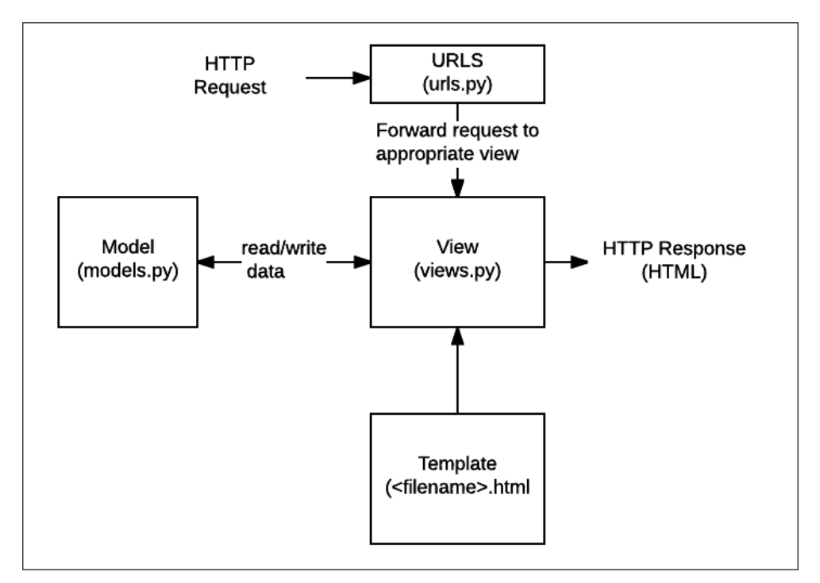
Django代码是什么样的?

Slide 7
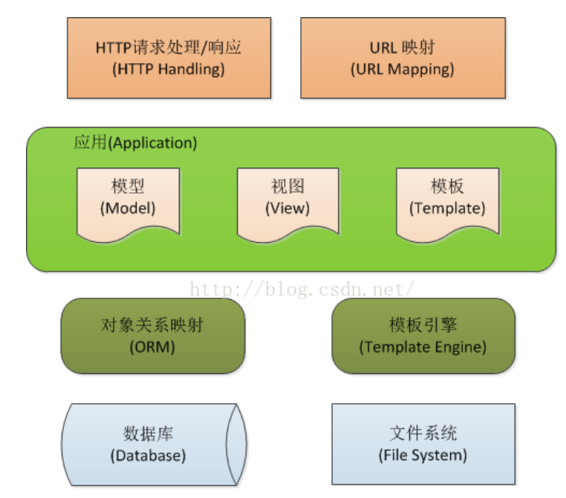
Django

Slide 8
Django
URLs: 虽然可以通过单个功能来处理来自每个URL的请求，但是编写单独的视图函数来处理每个资源是更加可维护的。URL映射器用于根据请求URL将HTTP请求重定向到相应的视图。URL映射器还可以匹配出现在URL中的字符串或数字的特定模式，并将其作为数据传递给视图功能。
View: 视图 是一个请求处理函数，它接收HTTP请求并返回HTTP响应。视图通过模型访问满足请求所需的数据，并将响应的格式委托给 模板。
Models: 模型 是定义应用程序数据结构的Python对象，并提供在数据库中管理（添加，修改，删除）和查询记录的机制。
Templates: 模板 是定义文件（例如HTML页面）的结构或布局的文本文件，用于表示实际内容的占位符。一个视图可以使用HTML模板，从数据填充它动态地创建一个HTML页面模型。可以使用模板来定义任何类型的文件的结构; 它不一定是HTML！

Slide 9
Django 开发环境概述
开发环境是在本地计算机上安装 Django，你可以在将Django部署到生产环境之前用于开发和测试 Django 应用程序
Django 本身提供的主要工具是一组用于创建和使用Django项目的Python脚本，以及可用于测试本地（即，你的计算机，而不是外部Web服务器）的简单开发网络服务器。Django 网络应用程序在你的计算机网络中浏览。
还有其他外部工具, 它们构成了开发环境的一部分, 我们将不再赘述。这些包括 文本编辑器 或编辑代码的IDE，以及像 Git 这样的源代码控制管理工具，用于安全地管理不同版本的代码。我们假设你已经安装了一个文本编辑器。

Slide 10
Django 开发环境概述
Django 如何在安装和配置方面非常灵活。Django可以：
安装在不同的操作系统上。
可以一起使用 Python 3 和 Python 2.
通过Python包索引（Pip）安装，和在许多情况下主机的包管理器应用程序。
配置为使用几个数据库之一，可能需要单独安装和配置。
运行在主系统Python环境中或在单独的Python虚拟环境中运行

Slide 11
Django支持哪些操作系统?
几乎任何可以运行Python编程语言的机器可以运行Django 网络应用程序：Windows，Mac OSX，Linux/Unix，Solaris，仅举几例。几乎任何计算机都应该在开发过程中运行Django所需的性能。
在本文中。我们将提供Windows，Mac OS X 和Linux/Unix的说明。

Slide 12
Django支持哪个数据库?
Django支持四个主要数据库（PostgreSQL，MySQL，Oracle和SQLite），还有一些社区库可以为其他流行的SQL和NOSQL数据库提供不同级别的支持。我们建议你为生产和开发选择相同的数据库（尽管Django使用其对象关系映射器（ORM）抽象出许多数据库差异，但是仍然存在可以避免的潜在问题 ).
对于本文（和本模块的大部分），我们将使用将数据存储在文件中的SQLite数据库。SQLite旨在用作轻量级数据库，不能支持高级并发。然而，这确实是只读的应用程序的绝佳选择。

Slide 13
安装Django
一旦你安装了Python 3和pip3，你可以使用pip3来安装Django。
pip3 install Django
pip3 install -i https://pypi.tuna.tsinghua.edu.cn/simple Django
您可以通过运行以下命令来测试Django是否安装（这只是测试Python可以找到Django模块）：
python3 -m django --version

Slide 14
测试你的安装
先在你的命令提示符/终端导航到你想存储你Django应用程序的位置。为您的测试站点创建一个文件夹并浏览它。
mkdir django_test
cd django_test
然后，您可以使用django-admin工具创建一个名为“ mytestsite ” 的新骨架站点，如图所示。创建网站后，您可以导航到文件夹，您将在其中找到管理项目的主要脚本，名为manage.py。
django-admin startproject mytestsite
cd mytestsite

Slide 15
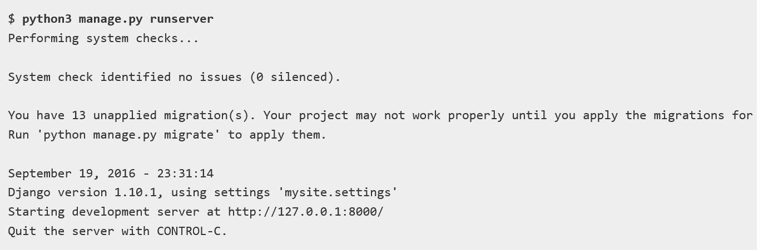
测试你的安装
我们可以使用manage.py和命令从此文件夹内运行开发Web服务器，如图所示。runserver

Slide 16
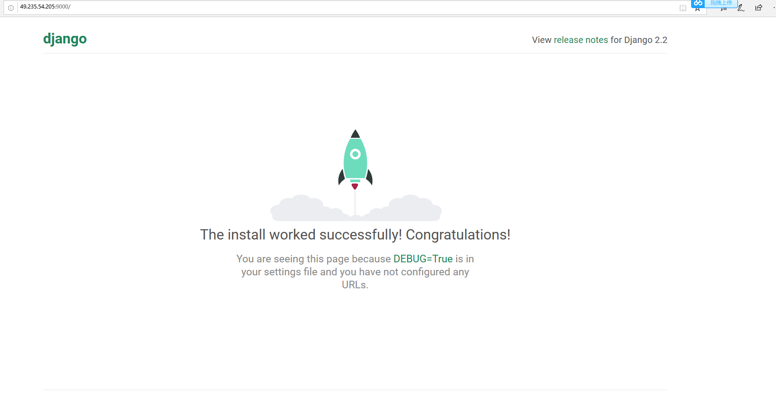
测试你的安装

Slide 17
创建网站
搭建“框架”的过程很直接:
使用django-admin工具创建工程的文件夹，基本的文件模板和工程管理脚本（manage.py）。
用manage.py 创建一个或多个应用。
在工程里注册新的应用。
为每个应用分配url

Slide 18
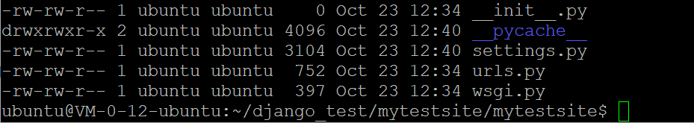
创建网站
settings.py 包含所有的网站设置。这是可以注册所有创建的应用的地方，也是静态文件，数据库配置的地方，等等。
urls.py 定义了网站url到view的映射。
wsgi.py 帮助Django应用和网络服务器间的通讯。你可以把这个当作模板。

Slide 19
创建 Polls app
python3 manage.py startapp poll
这个工具创建了一个新的文件夹，并为该应用创建了不同的文件（下面黑体所示）。绝大多数文件的命令和它们的目的有关（比如视图函数就是views.py，模型就是models.py，测试是tests.py，网站管理设置是admin.py，注册应用是apps.py），并且还包含了为项目所用的最小模板。

Slide 20
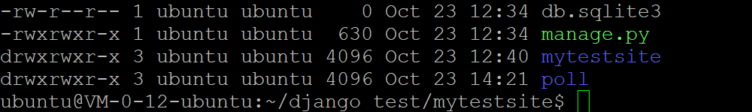
创建 Polls app
执行命令后的文件夹结构如下所示：

Slide 21
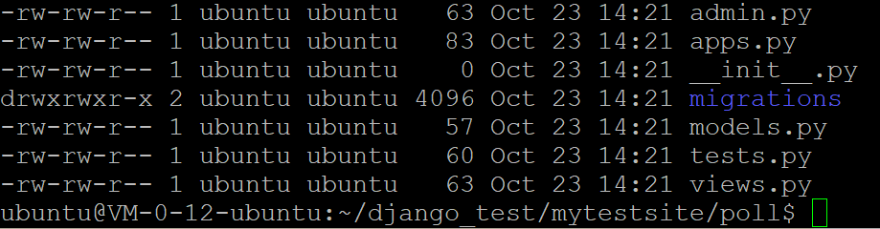
创建 Polls app
执行命令后的文件夹结构如下所示：

Slide 22
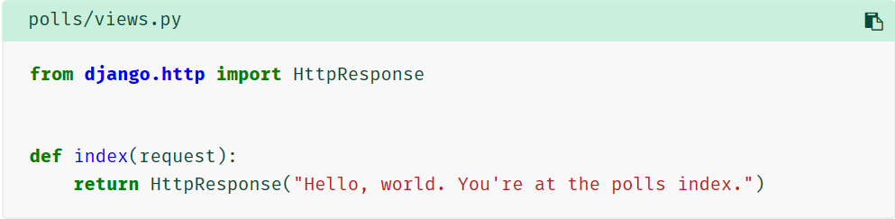
写第一个view程序
Let’s write the first view. Open the file polls/views.py and put the following Python code in it:

Slide 23
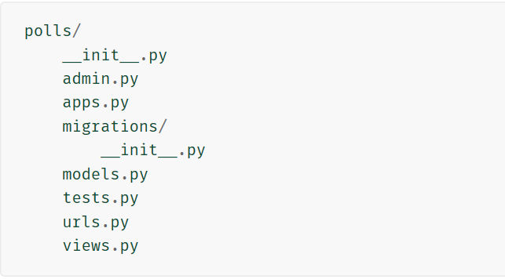
写第一个view程序
This is the simplest view possible in Django. To call the view, we need to map it to a URL - and for this we need a URLconf.
To create a URLconf in the polls directory, create a file called urls.py. Your app directory should now look like:

Slide 24
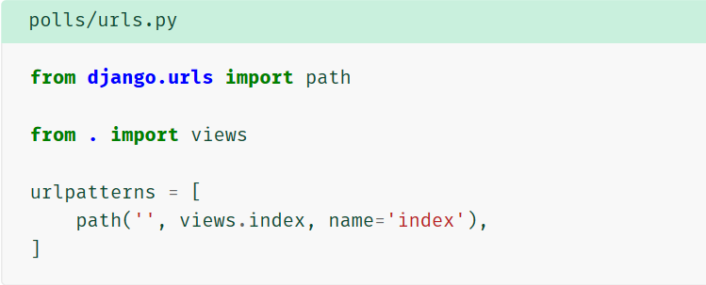
写第一个view程序
In the polls/urls.py file include the following code:

Slide 25
写第一个view程序
函数 path() 具有四个参数，两个必须参数：route 和 view，两个可选参数：kwargs 和 name。现在，是时候来研究这些参数的含义了。
path() 参数： route¶
route 是一个匹配 URL 的准则（类似正则表达式）。当 Django 响应一个请求时，它会从 urlpatterns 的第一项开始，按顺序依次匹配列表中的项，直到找到匹配的项。

Slide 26
写第一个view程序
这些准则不会匹配 GET 和 POST 参数或域名。例如，URLconf 在处理请求 https://www.example.com/myapp/ 时，它会尝试匹配 myapp/ 。处理请求 https://www.example.com/myapp/?page=3 时，也只会尝试匹配 myapp/。
path() 参数： view¶
当 Django 找到了一个匹配的准则，就会调用这个特定的视图函数，并传入一个 HttpRequest 对象作为第一个参数，被“捕获”的参数以关键字参数的形式传入。稍后，我们会给出一个例子。

Slide 27
写第一个view程序
path() 参数： kwargs¶
任意个关键字参数可以作为一个字典传递给目标视图函数。本教程中不会使用这一特性。
path() 参数： name¶
为你的 URL 取名能使你在 Django 的任意地方唯一地引用它，尤其是在模板中。这个有用的特性允许你只改一个文件就能全局地修改某个 URL 模式。

Slide 28
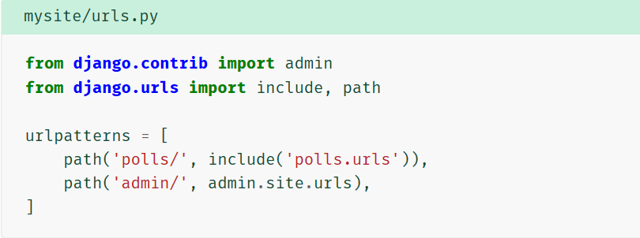
写第一个view程序
The next step is to point the root URLconf at the polls.urls module. In mysite/urls.py, add an import for django.urls.include and insert an include() in the urlpatterns list, so you have:
Notes:
this point, it’s worth reviewing what these arguments are for.
path() argument: route¶
route is a string that contains a URL pattern. When processing a request, Django starts at the first pattern in urlpatterns and makes its way down the list, comparing the requested URL against each pattern until it finds one that matches.
Patterns don’t search GET and POST parameters, or the domain name. For example, in a request to https://www.example.com/myapp/, the URLconf will look for myapp/. In a request to https://www.example.com/myapp/?page=3, the URLconf will also look for myapp/.
path() argument: view¶
When Django finds a matching pattern, it calls the specified view function with an HttpRequest object as the first argument and any “captured” values from the route as keyword arguments. We’ll give an example of this in a bit.
path() argument: kwargs¶
Arbitrary keyword arguments can be passed in a dictionary to the target view. We aren’t going to use this feature of Django in the tutorial.
path() argument: name¶
Naming your URL lets you refer to it unambiguously from elsewhere in Django, especially from within templates. This powerful feature allows you to make global changes to the URL patterns of your project while only touching a single file.
When you’re comfortable with the basic request and response flow, read part 2 of this tutorial to start working with the database.

Slide 29
写第一个view程序
The include() function allows referencing other URLconfs. Whenever Django encounters include(), it chops off whatever part of the URL matched up to that point and sends the remaining string to the included URLconf for further processing.
.
Notes:
this point, it’s worth reviewing what these arguments are for.
path() argument: route¶
route is a string that contains a URL pattern. When processing a request, Django starts at the first pattern in urlpatterns and makes its way down the list, comparing the requested URL against each pattern until it finds one that matches.
Patterns don’t search GET and POST parameters, or the domain name. For example, in a request to https://www.example.com/myapp/, the URLconf will look for myapp/. In a request to https://www.example.com/myapp/?page=3, the URLconf will also look for myapp/.
path() argument: view¶
When Django finds a matching pattern, it calls the specified view function with an HttpRequest object as the first argument and any “captured” values from the route as keyword arguments. We’ll give an example of this in a bit.
path() argument: kwargs¶
Arbitrary keyword arguments can be passed in a dictionary to the target view. We aren’t going to use this feature of Django in the tutorial.
path() argument: name¶
Naming your URL lets you refer to it unambiguously from elsewhere in Django, especially from within templates. This powerful feature allows you to make global changes to the URL patterns of your project while only touching a single file.
When you’re comfortable with the basic request and response flow, read part 2 of this tutorial to start working with the database.

Slide 30
配置数据库
现在，打开 mysite/settings.py 。这是个包含了 Django 项目设置的 Python 模块。
通常，这个配置文件使用 SQLite 作为默认数据库。如果你不熟悉数据库，或者只是想尝试下 Django，这是最简单的选择。Python 内置 SQLite，所以你无需安装额外东西来使用它。当你开始一个真正的项目时，你可能更倾向使用一个更具扩展性的数据库，例如 PostgreSQL，避免中途切换数据库这个令人头疼的问题。
Notes:
this point, it’s worth reviewing what these arguments are for.
path() argument: route¶
route is a string that contains a URL pattern. When processing a request, Django starts at the first pattern in urlpatterns and makes its way down the list, comparing the requested URL against each pattern until it finds one that matches.
Patterns don’t search GET and POST parameters, or the domain name. For example, in a request to https://www.example.com/myapp/, the URLconf will look for myapp/. In a request to https://www.example.com/myapp/?page=3, the URLconf will also look for myapp/.
path() argument: view¶
When Django finds a matching pattern, it calls the specified view function with an HttpRequest object as the first argument and any “captured” values from the route as keyword arguments. We’ll give an example of this in a bit.
path() argument: kwargs¶
Arbitrary keyword arguments can be passed in a dictionary to the target view. We aren’t going to use this feature of Django in the tutorial.
path() argument: name¶
Naming your URL lets you refer to it unambiguously from elsewhere in Django, especially from within templates. This powerful feature allows you to make global changes to the URL patterns of your project while only touching a single file.
When you’re comfortable with the basic request and response flow, read part 2 of this tutorial to start working with the database.

Slide 31
配置数据库
如果你想使用其他数据库，你需要安装合适的 database bindings ，然后改变设置文件中 DATABASES 'default' 项目中的一些键值：
ENGINE -- 可选值有 'django.db.backends.sqlite3'，'django.db.backends.postgresql'，'django.db.backends.mysql'，或 'django.db.backends.oracle'。其它 可用后端。
NAME -- The name of your database. If you're using SQLite, the database will be a file on your computer; in that case, NAME should be the full absolute path, including filename, of that file. The default value, BASE_DIR / 'db.sqlite3', will store the file in your project directory.
如果你不使用 SQLite，则必须添加一些额外设置，比如 USER 、 PASSWORD 、 HOST 等等。想了解更多数据库设置方面的内容，请看文档：DATABASES 。
Notes:
this point, it’s worth reviewing what these arguments are for.
path() argument: route¶
route is a string that contains a URL pattern. When processing a request, Django starts at the first pattern in urlpatterns and makes its way down the list, comparing the requested URL against each pattern until it finds one that matches.
Patterns don’t search GET and POST parameters, or the domain name. For example, in a request to https://www.example.com/myapp/, the URLconf will look for myapp/. In a request to https://www.example.com/myapp/?page=3, the URLconf will also look for myapp/.
path() argument: view¶
When Django finds a matching pattern, it calls the specified view function with an HttpRequest object as the first argument and any “captured” values from the route as keyword arguments. We’ll give an example of this in a bit.
path() argument: kwargs¶
Arbitrary keyword arguments can be passed in a dictionary to the target view. We aren’t going to use this feature of Django in the tutorial.
path() argument: name¶
Naming your URL lets you refer to it unambiguously from elsewhere in Django, especially from within templates. This powerful feature allows you to make global changes to the URL patterns of your project while only touching a single file.
When you’re comfortable with the basic request and response flow, read part 2 of this tutorial to start working with the database.

Slide 32
配置数据库
现在可以为项目配置数据库了——为了避免性能上的差异，最好在生产和开发中使用同一种数据库。你可以在数据库 里找到不同的设置方法(Django文档)。
在这个项目里，我们使用SQLite。因为在展示用的数据库中，我们不会有很多并发存取的行为。同时，也因为SQLite不需要额外的配置工作。你可以在settings.py里看到这个数据库怎样配置的。（更多信息如下所示）
python3 manage.py migrate
Notes:
this point, it’s worth reviewing what these arguments are for.
path() argument: route¶
route is a string that contains a URL pattern. When processing a request, Django starts at the first pattern in urlpatterns and makes its way down the list, comparing the requested URL against each pattern until it finds one that matches.
Patterns don’t search GET and POST parameters, or the domain name. For example, in a request to https://www.example.com/myapp/, the URLconf will look for myapp/. In a request to https://www.example.com/myapp/?page=3, the URLconf will also look for myapp/.
path() argument: view¶
When Django finds a matching pattern, it calls the specified view function with an HttpRequest object as the first argument and any “captured” values from the route as keyword arguments. We’ll give an example of this in a bit.
path() argument: kwargs¶
Arbitrary keyword arguments can be passed in a dictionary to the target view. We aren’t going to use this feature of Django in the tutorial.
path() argument: name¶
Naming your URL lets you refer to it unambiguously from elsewhere in Django, especially from within templates. This powerful feature allows you to make global changes to the URL patterns of your project while only touching a single file.
When you’re comfortable with the basic request and response flow, read part 2 of this tutorial to start working with the database.

Slide 33
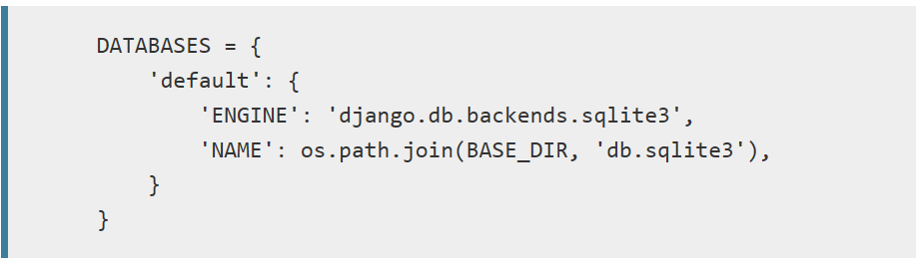
配置数据库
Notes:
this point, it’s worth reviewing what these arguments are for.
path() argument: route¶
route is a string that contains a URL pattern. When processing a request, Django starts at the first pattern in urlpatterns and makes its way down the list, comparing the requested URL against each pattern until it finds one that matches.
Patterns don’t search GET and POST parameters, or the domain name. For example, in a request to https://www.example.com/myapp/, the URLconf will look for myapp/. In a request to https://www.example.com/myapp/?page=3, the URLconf will also look for myapp/.
path() argument: view¶
When Django finds a matching pattern, it calls the specified view function with an HttpRequest object as the first argument and any “captured” values from the route as keyword arguments. We’ll give an example of this in a bit.
path() argument: kwargs¶
Arbitrary keyword arguments can be passed in a dictionary to the target view. We aren’t going to use this feature of Django in the tutorial.
path() argument: name¶
Naming your URL lets you refer to it unambiguously from elsewhere in Django, especially from within templates. This powerful feature allows you to make global changes to the URL patterns of your project while only touching a single file.
When you’re comfortable with the basic request and response flow, read part 2 of this tutorial to start working with the database.

Slide 34
建立模型
在 Django 里写一个数据库驱动的 Web 应用的第一步是定义模型 - 也就是数据库结构设计和附加的其它元数据。
在这个投票应用中，需要创建两个模型：问题 Question 和选项 Choice。Question 模型包括问题描述和发布时间。Choice 模型有两个字段，选项描述和当前得票数。每个选项属于一个问题。
Notes:
this point, it’s worth reviewing what these arguments are for.
path() argument: route¶
route is a string that contains a URL pattern. When processing a request, Django starts at the first pattern in urlpatterns and makes its way down the list, comparing the requested URL against each pattern until it finds one that matches.
Patterns don’t search GET and POST parameters, or the domain name. For example, in a request to https://www.example.com/myapp/, the URLconf will look for myapp/. In a request to https://www.example.com/myapp/?page=3, the URLconf will also look for myapp/.
path() argument: view¶
When Django finds a matching pattern, it calls the specified view function with an HttpRequest object as the first argument and any “captured” values from the route as keyword arguments. We’ll give an example of this in a bit.
path() argument: kwargs¶
Arbitrary keyword arguments can be passed in a dictionary to the target view. We aren’t going to use this feature of Django in the tutorial.
path() argument: name¶
Naming your URL lets you refer to it unambiguously from elsewhere in Django, especially from within templates. This powerful feature allows you to make global changes to the URL patterns of your project while only touching a single file.
When you’re comfortable with the basic request and response flow, read part 2 of this tutorial to start working with the database.

Slide 35
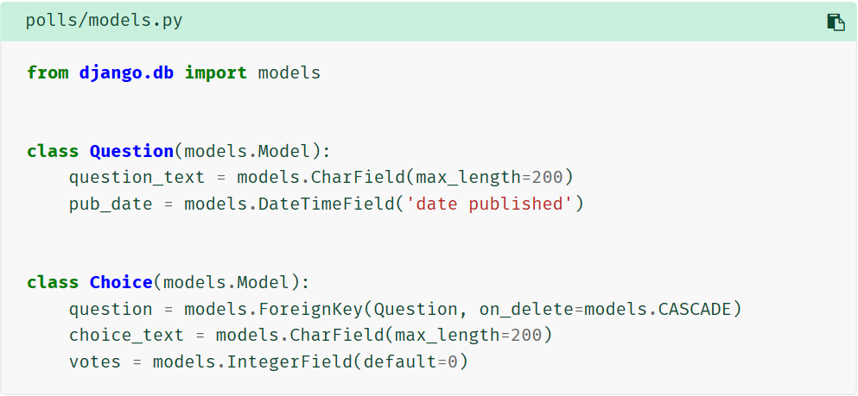
建立模型
Notes:
this point, it’s worth reviewing what these arguments are for.
path() argument: route¶
route is a string that contains a URL pattern. When processing a request, Django starts at the first pattern in urlpatterns and makes its way down the list, comparing the requested URL against each pattern until it finds one that matches.
Patterns don’t search GET and POST parameters, or the domain name. For example, in a request to https://www.example.com/myapp/, the URLconf will look for myapp/. In a request to https://www.example.com/myapp/?page=3, the URLconf will also look for myapp/.
path() argument: view¶
When Django finds a matching pattern, it calls the specified view function with an HttpRequest object as the first argument and any “captured” values from the route as keyword arguments. We’ll give an example of this in a bit.
path() argument: kwargs¶
Arbitrary keyword arguments can be passed in a dictionary to the target view. We aren’t going to use this feature of Django in the tutorial.
path() argument: name¶
Naming your URL lets you refer to it unambiguously from elsewhere in Django, especially from within templates. This powerful feature allows you to make global changes to the URL patterns of your project while only touching a single file.
When you’re comfortable with the basic request and response flow, read part 2 of this tutorial to start working with the database.

Slide 36
建立模型
每个模型被表示为 django.db.models.Model 类的子类。每个模型有许多类变量，它们都表示模型里的一个数据库字段。
每个字段都是 Field 类的实例 - 比如，字符字段被表示为 CharField ，日期时间字段被表示为 DateTimeField 。这将告诉 Django 每个字段要处理的数据类型。
每个 Field 类实例变量的名字（例如 question_text 或 pub_date ）也是字段名，所以最好使用对机器友好的格式。你将会在 Python 代码里使用它们，而数据库会将它们作为列名。
你可以使用可选的选项来为 Field 定义一个人类可读的名字。这个功能在很多 Django 内部组成部分中都被使用了，而且作为文档的一部分。如果某个字段没有提供此名称，Django 将会使用对机器友好的名称，也就是变量名。在上面的例子中，我们只为 Question.pub_date 定义了对人类友好的名字。对于模型内的其它字段，它们的机器友好名也会被作为人类友好名使用。
Notes:
this point, it’s worth reviewing what these arguments are for.
path() argument: route¶
route is a string that contains a URL pattern. When processing a request, Django starts at the first pattern in urlpatterns and makes its way down the list, comparing the requested URL against each pattern until it finds one that matches.
Patterns don’t search GET and POST parameters, or the domain name. For example, in a request to https://www.example.com/myapp/, the URLconf will look for myapp/. In a request to https://www.example.com/myapp/?page=3, the URLconf will also look for myapp/.
path() argument: view¶
When Django finds a matching pattern, it calls the specified view function with an HttpRequest object as the first argument and any “captured” values from the route as keyword arguments. We’ll give an example of this in a bit.
path() argument: kwargs¶
Arbitrary keyword arguments can be passed in a dictionary to the target view. We aren’t going to use this feature of Django in the tutorial.
path() argument: name¶
Naming your URL lets you refer to it unambiguously from elsewhere in Django, especially from within templates. This powerful feature allows you to make global changes to the URL patterns of your project while only touching a single file.
When you’re comfortable with the basic request and response flow, read part 2 of this tutorial to start working with the database.

Slide 37
建立模型
上面的一小段用于创建模型的代码给了 Django 很多信息，通过这些信息，Django 可以：
为这个应用创建数据库 schema（生成 CREATE TABLE 语句）。
创建可以与 Question 和 Choice 对象进行交互的 Python 数据库 API。
但是首先得把 polls 应用安装到我们的项目里。
Notes:
this point, it’s worth reviewing what these arguments are for.
path() argument: route¶
route is a string that contains a URL pattern. When processing a request, Django starts at the first pattern in urlpatterns and makes its way down the list, comparing the requested URL against each pattern until it finds one that matches.
Patterns don’t search GET and POST parameters, or the domain name. For example, in a request to https://www.example.com/myapp/, the URLconf will look for myapp/. In a request to https://www.example.com/myapp/?page=3, the URLconf will also look for myapp/.
path() argument: view¶
When Django finds a matching pattern, it calls the specified view function with an HttpRequest object as the first argument and any “captured” values from the route as keyword arguments. We’ll give an example of this in a bit.
path() argument: kwargs¶
Arbitrary keyword arguments can be passed in a dictionary to the target view. We aren’t going to use this feature of Django in the tutorial.
path() argument: name¶
Naming your URL lets you refer to it unambiguously from elsewhere in Django, especially from within templates. This powerful feature allows you to make global changes to the URL patterns of your project while only touching a single file.
When you’re comfortable with the basic request and response flow, read part 2 of this tutorial to start working with the database.

Slide 38
建立模型
为了在我们的工程中包含这个应用，我们需要在配置类 INSTALLED_APPS 中添加设置。因为 PollsConfig 类写在文件 polls/apps.py 中，所以它的点式路径是 'polls.apps.PollsConfig'。在文件 mysite/settings.py 中 INSTALLED_APPS 子项添加点式路径后，它看起来像这样：
Notes:
this point, it’s worth reviewing what these arguments are for.
path() argument: route¶
route is a string that contains a URL pattern. When processing a request, Django starts at the first pattern in urlpatterns and makes its way down the list, comparing the requested URL against each pattern until it finds one that matches.
Patterns don’t search GET and POST parameters, or the domain name. For example, in a request to https://www.example.com/myapp/, the URLconf will look for myapp/. In a request to https://www.example.com/myapp/?page=3, the URLconf will also look for myapp/.
path() argument: view¶
When Django finds a matching pattern, it calls the specified view function with an HttpRequest object as the first argument and any “captured” values from the route as keyword arguments. We’ll give an example of this in a bit.
path() argument: kwargs¶
Arbitrary keyword arguments can be passed in a dictionary to the target view. We aren’t going to use this feature of Django in the tutorial.
path() argument: name¶
Naming your URL lets you refer to it unambiguously from elsewhere in Django, especially from within templates. This powerful feature allows you to make global changes to the URL patterns of your project while only touching a single file.
When you’re comfortable with the basic request and response flow, read part 2 of this tutorial to start working with the database.

Slide 39
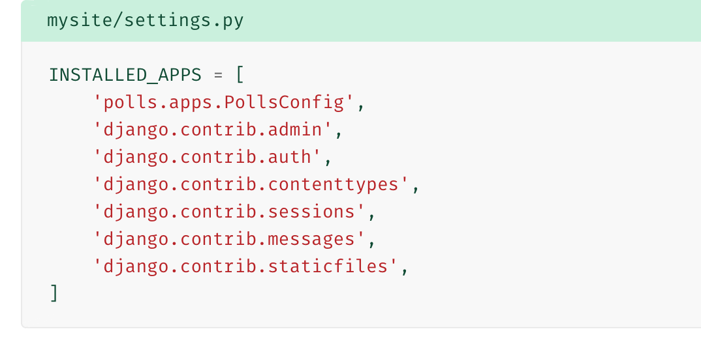
建立模型
Notes:
this point, it’s worth reviewing what these arguments are for.
path() argument: route¶
route is a string that contains a URL pattern. When processing a request, Django starts at the first pattern in urlpatterns and makes its way down the list, comparing the requested URL against each pattern until it finds one that matches.
Patterns don’t search GET and POST parameters, or the domain name. For example, in a request to https://www.example.com/myapp/, the URLconf will look for myapp/. In a request to https://www.example.com/myapp/?page=3, the URLconf will also look for myapp/.
path() argument: view¶
When Django finds a matching pattern, it calls the specified view function with an HttpRequest object as the first argument and any “captured” values from the route as keyword arguments. We’ll give an example of this in a bit.
path() argument: kwargs¶
Arbitrary keyword arguments can be passed in a dictionary to the target view. We aren’t going to use this feature of Django in the tutorial.
path() argument: name¶
Naming your URL lets you refer to it unambiguously from elsewhere in Django, especially from within templates. This powerful feature allows you to make global changes to the URL patterns of your project while only touching a single file.
When you’re comfortable with the basic request and response flow, read part 2 of this tutorial to start working with the database.

Slide 40
建立模型
现在你的 Django 项目会包含 polls 应用。接着运行下面的命令：
python manage.py makemigrations polls
Notes:
this point, it’s worth reviewing what these arguments are for.
path() argument: route¶
route is a string that contains a URL pattern. When processing a request, Django starts at the first pattern in urlpatterns and makes its way down the list, comparing the requested URL against each pattern until it finds one that matches.
Patterns don’t search GET and POST parameters, or the domain name. For example, in a request to https://www.example.com/myapp/, the URLconf will look for myapp/. In a request to https://www.example.com/myapp/?page=3, the URLconf will also look for myapp/.
path() argument: view¶
When Django finds a matching pattern, it calls the specified view function with an HttpRequest object as the first argument and any “captured” values from the route as keyword arguments. We’ll give an example of this in a bit.
path() argument: kwargs¶
Arbitrary keyword arguments can be passed in a dictionary to the target view. We aren’t going to use this feature of Django in the tutorial.
path() argument: name¶
Naming your URL lets you refer to it unambiguously from elsewhere in Django, especially from within templates. This powerful feature allows you to make global changes to the URL patterns of your project while only touching a single file.
When you’re comfortable with the basic request and response flow, read part 2 of this tutorial to start working with the database.

Slide 41
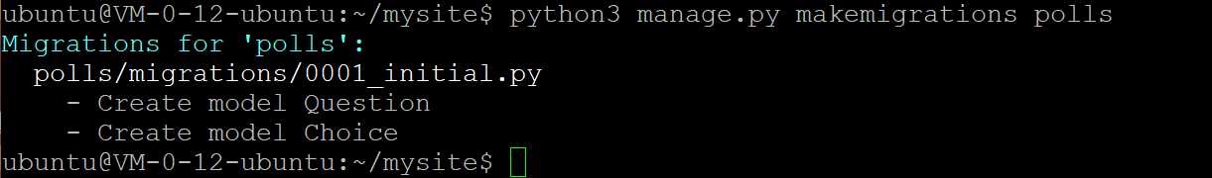
激活模型
Notes:
this point, it’s worth reviewing what these arguments are for.
path() argument: route¶
route is a string that contains a URL pattern. When processing a request, Django starts at the first pattern in urlpatterns and makes its way down the list, comparing the requested URL against each pattern until it finds one that matches.
Patterns don’t search GET and POST parameters, or the domain name. For example, in a request to https://www.example.com/myapp/, the URLconf will look for myapp/. In a request to https://www.example.com/myapp/?page=3, the URLconf will also look for myapp/.
path() argument: view¶
When Django finds a matching pattern, it calls the specified view function with an HttpRequest object as the first argument and any “captured” values from the route as keyword arguments. We’ll give an example of this in a bit.
path() argument: kwargs¶
Arbitrary keyword arguments can be passed in a dictionary to the target view. We aren’t going to use this feature of Django in the tutorial.
path() argument: name¶
Naming your URL lets you refer to it unambiguously from elsewhere in Django, especially from within templates. This powerful feature allows you to make global changes to the URL patterns of your project while only touching a single file.
When you’re comfortable with the basic request and response flow, read part 2 of this tutorial to start working with the database.

Slide 42
激活模型
通过运行 makemigrations 命令，Django 会检测你对模型文件的修改（在这种情况下，你已经取得了新的），并且把修改的部分储存为一次 迁移。
迁移是 Django 对于模型定义（也就是你的数据库结构）的变化的储存形式 - 它们其实也只是一些你磁盘上的文件。如果你想的话，你可以阅读一下你模型的迁移数据，它被储存在 polls/migrations/0001_initial.py 里。别担心，你不需要每次都阅读迁移文件，但是它们被设计成人类可读的形式，这是为了便于你手动调整Django的修改方式。
Notes:
this point, it’s worth reviewing what these arguments are for.
path() argument: route¶
route is a string that contains a URL pattern. When processing a request, Django starts at the first pattern in urlpatterns and makes its way down the list, comparing the requested URL against each pattern until it finds one that matches.
Patterns don’t search GET and POST parameters, or the domain name. For example, in a request to https://www.example.com/myapp/, the URLconf will look for myapp/. In a request to https://www.example.com/myapp/?page=3, the URLconf will also look for myapp/.
path() argument: view¶
When Django finds a matching pattern, it calls the specified view function with an HttpRequest object as the first argument and any “captured” values from the route as keyword arguments. We’ll give an example of this in a bit.
path() argument: kwargs¶
Arbitrary keyword arguments can be passed in a dictionary to the target view. We aren’t going to use this feature of Django in the tutorial.
path() argument: name¶
Naming your URL lets you refer to it unambiguously from elsewhere in Django, especially from within templates. This powerful feature allows you to make global changes to the URL patterns of your project while only touching a single file.
When you’re comfortable with the basic request and response flow, read part 2 of this tutorial to start working with the database.

Slide 43
激活模型
Django 有一个自动执行数据库迁移并同步管理你的数据库结构的命令 - 这个命令是 migrate，我们马上就会接触它 - 但是首先，让我们看看迁移命令会执行哪些 SQL 语句。sqlmigrate 命令接收一个迁移的名称，然后返回对应的 SQL：
python manage.py sqlmigrate polls 0001
Notes:
this point, it’s worth reviewing what these arguments are for.
path() argument: route¶
route is a string that contains a URL pattern. When processing a request, Django starts at the first pattern in urlpatterns and makes its way down the list, comparing the requested URL against each pattern until it finds one that matches.
Patterns don’t search GET and POST parameters, or the domain name. For example, in a request to https://www.example.com/myapp/, the URLconf will look for myapp/. In a request to https://www.example.com/myapp/?page=3, the URLconf will also look for myapp/.
path() argument: view¶
When Django finds a matching pattern, it calls the specified view function with an HttpRequest object as the first argument and any “captured” values from the route as keyword arguments. We’ll give an example of this in a bit.
path() argument: kwargs¶
Arbitrary keyword arguments can be passed in a dictionary to the target view. We aren’t going to use this feature of Django in the tutorial.
path() argument: name¶
Naming your URL lets you refer to it unambiguously from elsewhere in Django, especially from within templates. This powerful feature allows you to make global changes to the URL patterns of your project while only touching a single file.
When you’re comfortable with the basic request and response flow, read part 2 of this tutorial to start working with the database.

Slide 44
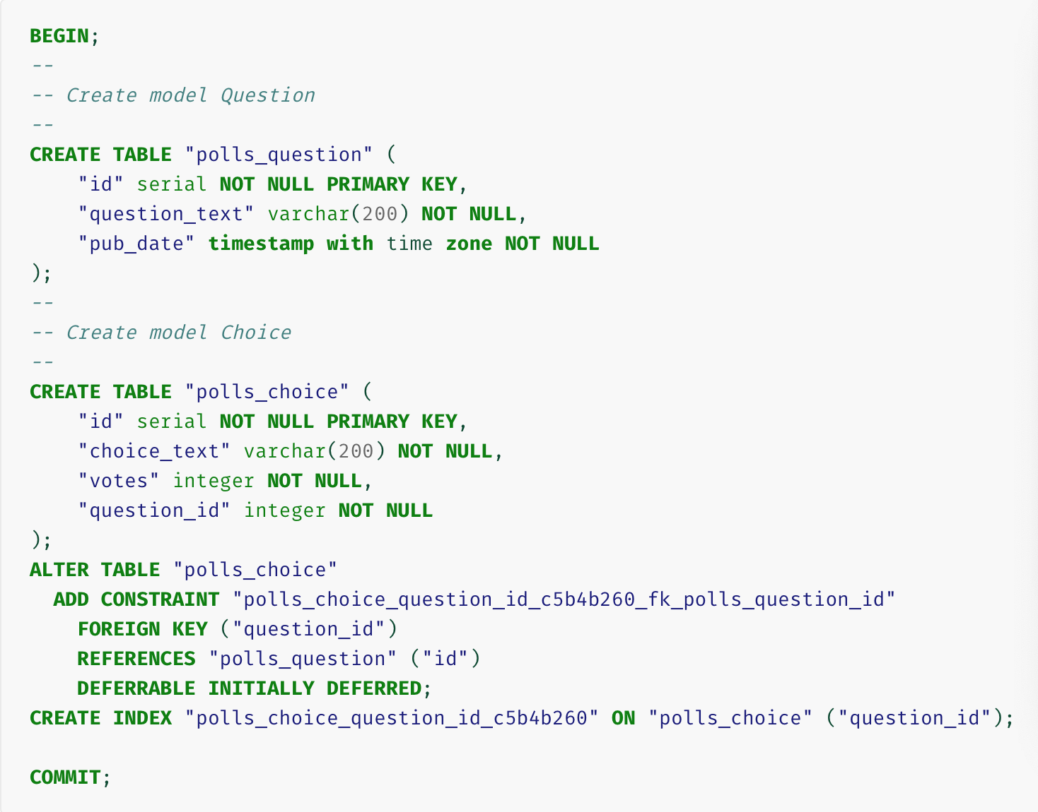
激活模型
Notes:
this point, it’s worth reviewing what these arguments are for.
path() argument: route¶
route is a string that contains a URL pattern. When processing a request, Django starts at the first pattern in urlpatterns and makes its way down the list, comparing the requested URL against each pattern until it finds one that matches.
Patterns don’t search GET and POST parameters, or the domain name. For example, in a request to https://www.example.com/myapp/, the URLconf will look for myapp/. In a request to https://www.example.com/myapp/?page=3, the URLconf will also look for myapp/.
path() argument: view¶
When Django finds a matching pattern, it calls the specified view function with an HttpRequest object as the first argument and any “captured” values from the route as keyword arguments. We’ll give an example of this in a bit.
path() argument: kwargs¶
Arbitrary keyword arguments can be passed in a dictionary to the target view. We aren’t going to use this feature of Django in the tutorial.
path() argument: name¶
Naming your URL lets you refer to it unambiguously from elsewhere in Django, especially from within templates. This powerful feature allows you to make global changes to the URL patterns of your project while only touching a single file.
When you’re comfortable with the basic request and response flow, read part 2 of this tutorial to start working with the database.

Slide 45
激活模型
现在，再次运行 migrate 命令，在数据库里创建新定义的模型的数据表：
python manage.py migrate
Notes:
this point, it’s worth reviewing what these arguments are for.
path() argument: route¶
route is a string that contains a URL pattern. When processing a request, Django starts at the first pattern in urlpatterns and makes its way down the list, comparing the requested URL against each pattern until it finds one that matches.
Patterns don’t search GET and POST parameters, or the domain name. For example, in a request to https://www.example.com/myapp/, the URLconf will look for myapp/. In a request to https://www.example.com/myapp/?page=3, the URLconf will also look for myapp/.
path() argument: view¶
When Django finds a matching pattern, it calls the specified view function with an HttpRequest object as the first argument and any “captured” values from the route as keyword arguments. We’ll give an example of this in a bit.
path() argument: kwargs¶
Arbitrary keyword arguments can be passed in a dictionary to the target view. We aren’t going to use this feature of Django in the tutorial.
path() argument: name¶
Naming your URL lets you refer to it unambiguously from elsewhere in Django, especially from within templates. This powerful feature allows you to make global changes to the URL patterns of your project while only touching a single file.
When you’re comfortable with the basic request and response flow, read part 2 of this tutorial to start working with the database.

Slide 46
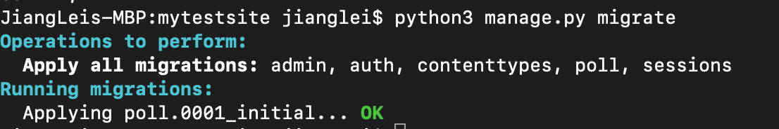
激活模型
现在，再次运行 migrate 命令，在数据库里创建新定义的模型的数据表：
python manage.py migrate
Notes:
this point, it’s worth reviewing what these arguments are for.
path() argument: route¶
route is a string that contains a URL pattern. When processing a request, Django starts at the first pattern in urlpatterns and makes its way down the list, comparing the requested URL against each pattern until it finds one that matches.
Patterns don’t search GET and POST parameters, or the domain name. For example, in a request to https://www.example.com/myapp/, the URLconf will look for myapp/. In a request to https://www.example.com/myapp/?page=3, the URLconf will also look for myapp/.
path() argument: view¶
When Django finds a matching pattern, it calls the specified view function with an HttpRequest object as the first argument and any “captured” values from the route as keyword arguments. We’ll give an example of this in a bit.
path() argument: kwargs¶
Arbitrary keyword arguments can be passed in a dictionary to the target view. We aren’t going to use this feature of Django in the tutorial.
path() argument: name¶
Naming your URL lets you refer to it unambiguously from elsewhere in Django, especially from within templates. This powerful feature allows you to make global changes to the URL patterns of your project while only touching a single file.
When you’re comfortable with the basic request and response flow, read part 2 of this tutorial to start working with the database.

Slide 47
激活模型
现在，再次运行 migrate 命令，在数据库里创建新定义的模型的数据表：
python manage.py migrate
Notes:
this point, it’s worth reviewing what these arguments are for.
path() argument: route¶
route is a string that contains a URL pattern. When processing a request, Django starts at the first pattern in urlpatterns and makes its way down the list, comparing the requested URL against each pattern until it finds one that matches.
Patterns don’t search GET and POST parameters, or the domain name. For example, in a request to https://www.example.com/myapp/, the URLconf will look for myapp/. In a request to https://www.example.com/myapp/?page=3, the URLconf will also look for myapp/.
path() argument: view¶
When Django finds a matching pattern, it calls the specified view function with an HttpRequest object as the first argument and any “captured” values from the route as keyword arguments. We’ll give an example of this in a bit.
path() argument: kwargs¶
Arbitrary keyword arguments can be passed in a dictionary to the target view. We aren’t going to use this feature of Django in the tutorial.
path() argument: name¶
Naming your URL lets you refer to it unambiguously from elsewhere in Django, especially from within templates. This powerful feature allows you to make global changes to the URL patterns of your project while only touching a single file.
When you’re comfortable with the basic request and response flow, read part 2 of this tutorial to start working with the database.

Slide 48
初试API
现在让我们进入交互式 Python 命令行，尝试一下 Django 为你创建的各种 API。通过以下命令打开 Python 命令行：
python manage.py shell
Notes:
this point, it’s worth reviewing what these arguments are for.
path() argument: route¶
route is a string that contains a URL pattern. When processing a request, Django starts at the first pattern in urlpatterns and makes its way down the list, comparing the requested URL against each pattern until it finds one that matches.
Patterns don’t search GET and POST parameters, or the domain name. For example, in a request to https://www.example.com/myapp/, the URLconf will look for myapp/. In a request to https://www.example.com/myapp/?page=3, the URLconf will also look for myapp/.
path() argument: view¶
When Django finds a matching pattern, it calls the specified view function with an HttpRequest object as the first argument and any “captured” values from the route as keyword arguments. We’ll give an example of this in a bit.
path() argument: kwargs¶
Arbitrary keyword arguments can be passed in a dictionary to the target view. We aren’t going to use this feature of Django in the tutorial.
path() argument: name¶
Naming your URL lets you refer to it unambiguously from elsewhere in Django, especially from within templates. This powerful feature allows you to make global changes to the URL patterns of your project while only touching a single file.
When you’re comfortable with the basic request and response flow, read part 2 of this tutorial to start working with the database.

Slide 49
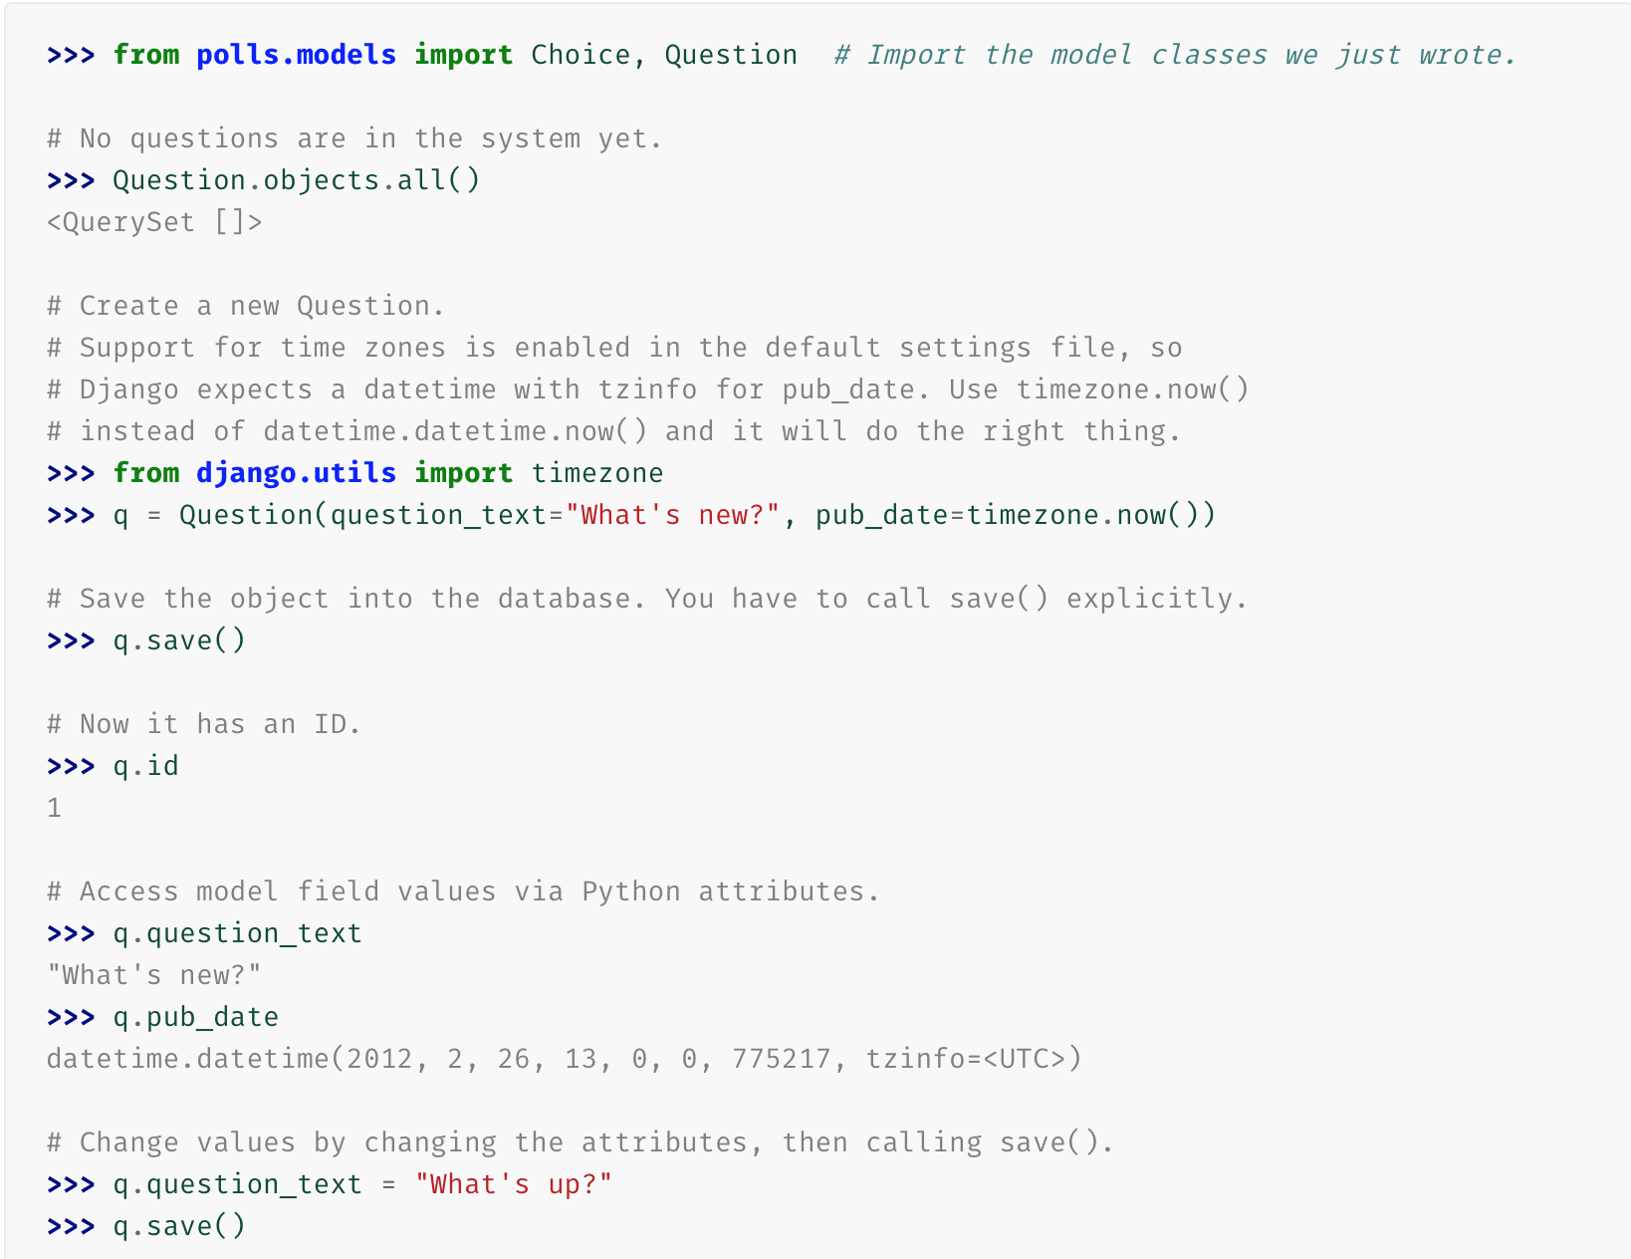
初试API
Notes:
this point, it’s worth reviewing what these arguments are for.
path() argument: route¶
route is a string that contains a URL pattern. When processing a request, Django starts at the first pattern in urlpatterns and makes its way down the list, comparing the requested URL against each pattern until it finds one that matches.
Patterns don’t search GET and POST parameters, or the domain name. For example, in a request to https://www.example.com/myapp/, the URLconf will look for myapp/. In a request to https://www.example.com/myapp/?page=3, the URLconf will also look for myapp/.
path() argument: view¶
When Django finds a matching pattern, it calls the specified view function with an HttpRequest object as the first argument and any “captured” values from the route as keyword arguments. We’ll give an example of this in a bit.
path() argument: kwargs¶
Arbitrary keyword arguments can be passed in a dictionary to the target view. We aren’t going to use this feature of Django in the tutorial.
path() argument: name¶
Naming your URL lets you refer to it unambiguously from elsewhere in Django, especially from within templates. This powerful feature allows you to make global changes to the URL patterns of your project while only touching a single file.
When you’re comfortable with the basic request and response flow, read part 2 of this tutorial to start working with the database.

Slide 50
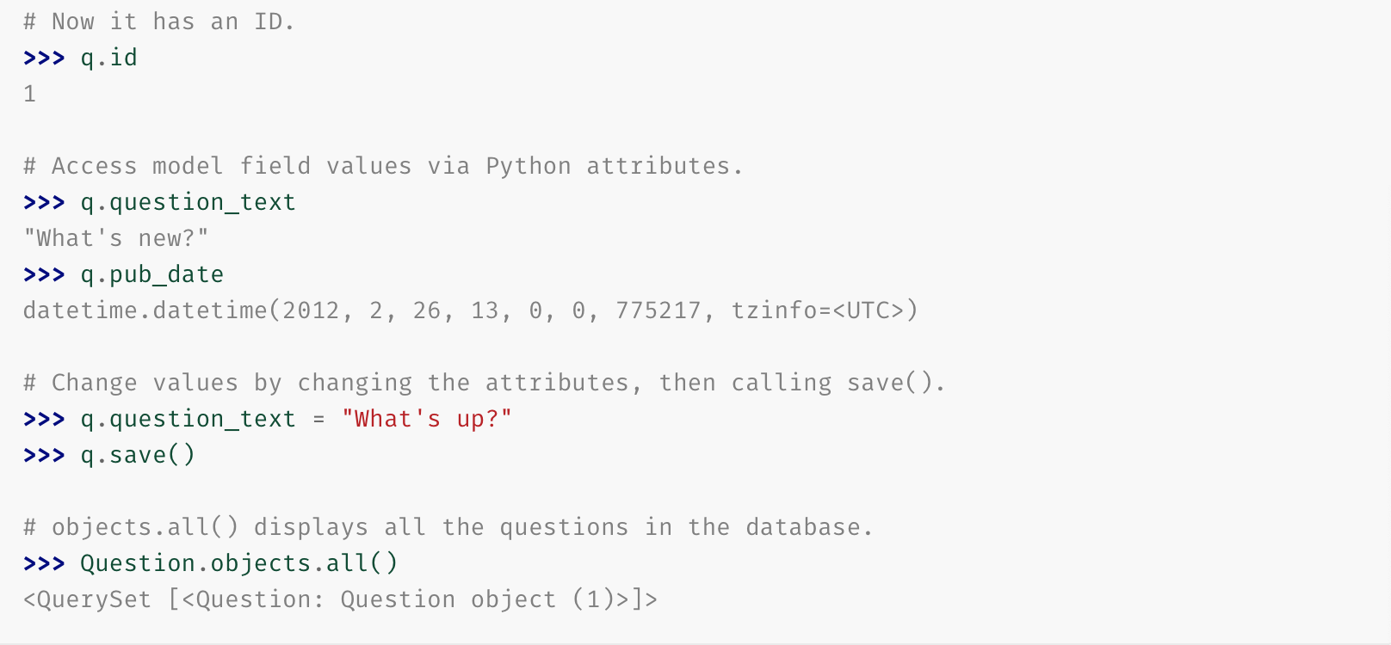
初试API
Notes:
this point, it’s worth reviewing what these arguments are for.
path() argument: route¶
route is a string that contains a URL pattern. When processing a request, Django starts at the first pattern in urlpatterns and makes its way down the list, comparing the requested URL against each pattern until it finds one that matches.
Patterns don’t search GET and POST parameters, or the domain name. For example, in a request to https://www.example.com/myapp/, the URLconf will look for myapp/. In a request to https://www.example.com/myapp/?page=3, the URLconf will also look for myapp/.
path() argument: view¶
When Django finds a matching pattern, it calls the specified view function with an HttpRequest object as the first argument and any “captured” values from the route as keyword arguments. We’ll give an example of this in a bit.
path() argument: kwargs¶
Arbitrary keyword arguments can be passed in a dictionary to the target view. We aren’t going to use this feature of Django in the tutorial.
path() argument: name¶
Naming your URL lets you refer to it unambiguously from elsewhere in Django, especially from within templates. This powerful feature allows you to make global changes to the URL patterns of your project while only touching a single file.
When you’re comfortable with the basic request and response flow, read part 2 of this tutorial to start working with the database.

Slide 51
初试API
<Question: Question object (1)> 对于我们了解这个对象的细节没什么帮助。让我们通过编辑 Question 模型的代码（位于 polls/models.py 中）来修复这个问题。给 Question 和 Choice 增加 __str__() 方法。
from django.db import models
class Question(models.Model):
# ...
def __str__(self):
return self.question_text
class Choice(models.Model):
# ...
def __str__(self):
return self.choice_text
Notes:
this point, it’s worth reviewing what these arguments are for.
path() argument: route¶
route is a string that contains a URL pattern. When processing a request, Django starts at the first pattern in urlpatterns and makes its way down the list, comparing the requested URL against each pattern until it finds one that matches.
Patterns don’t search GET and POST parameters, or the domain name. For example, in a request to https://www.example.com/myapp/, the URLconf will look for myapp/. In a request to https://www.example.com/myapp/?page=3, the URLconf will also look for myapp/.
path() argument: view¶
When Django finds a matching pattern, it calls the specified view function with an HttpRequest object as the first argument and any “captured” values from the route as keyword arguments. We’ll give an example of this in a bit.
path() argument: kwargs¶
Arbitrary keyword arguments can be passed in a dictionary to the target view. We aren’t going to use this feature of Django in the tutorial.
path() argument: name¶
Naming your URL lets you refer to it unambiguously from elsewhere in Django, especially from within templates. This powerful feature allows you to make global changes to the URL patterns of your project while only touching a single file.
When you’re comfortable with the basic request and response flow, read part 2 of this tutorial to start working with the database.

Slide 52
初试API
给模型增加 __str__() 方法是很重要的，这不仅仅能给你在命令行里使用带来方便，Django 自动生成的 admin 里也使用这个方法来表示对象。
让我们再为此模型添加一个自定义方法：
import datetime
from django.db import models
from django.utils import timezone
class Question(models.Model):
# ...
def was_published_recently(self):
return self.pub_date >= timezone.now() - datetime.timedelta(days=1)
Notes:
this point, it’s worth reviewing what these arguments are for.
path() argument: route¶
route is a string that contains a URL pattern. When processing a request, Django starts at the first pattern in urlpatterns and makes its way down the list, comparing the requested URL against each pattern until it finds one that matches.
Patterns don’t search GET and POST parameters, or the domain name. For example, in a request to https://www.example.com/myapp/, the URLconf will look for myapp/. In a request to https://www.example.com/myapp/?page=3, the URLconf will also look for myapp/.
path() argument: view¶
When Django finds a matching pattern, it calls the specified view function with an HttpRequest object as the first argument and any “captured” values from the route as keyword arguments. We’ll give an example of this in a bit.
path() argument: kwargs¶
Arbitrary keyword arguments can be passed in a dictionary to the target view. We aren’t going to use this feature of Django in the tutorial.
path() argument: name¶
Naming your URL lets you refer to it unambiguously from elsewhere in Django, especially from within templates. This powerful feature allows you to make global changes to the URL patterns of your project while only touching a single file.
When you’re comfortable with the basic request and response flow, read part 2 of this tutorial to start working with the database.

Slide 53
初试API
新加入的 import datetime 和 from django.utils import timezone 分别导入了 Python 的标准 datetime 模块和 Django 中和时区相关的 django.utils.timezone 工具模块。保存文件然后通过 python manage.py shell 命令再次打开 Python 交互式命令行：
Notes:
this point, it’s worth reviewing what these arguments are for.
path() argument: route¶
route is a string that contains a URL pattern. When processing a request, Django starts at the first pattern in urlpatterns and makes its way down the list, comparing the requested URL against each pattern until it finds one that matches.
Patterns don’t search GET and POST parameters, or the domain name. For example, in a request to https://www.example.com/myapp/, the URLconf will look for myapp/. In a request to https://www.example.com/myapp/?page=3, the URLconf will also look for myapp/.
path() argument: view¶
When Django finds a matching pattern, it calls the specified view function with an HttpRequest object as the first argument and any “captured” values from the route as keyword arguments. We’ll give an example of this in a bit.
path() argument: kwargs¶
Arbitrary keyword arguments can be passed in a dictionary to the target view. We aren’t going to use this feature of Django in the tutorial.
path() argument: name¶
Naming your URL lets you refer to it unambiguously from elsewhere in Django, especially from within templates. This powerful feature allows you to make global changes to the URL patterns of your project while only touching a single file.
When you’re comfortable with the basic request and response flow, read part 2 of this tutorial to start working with the database.

Slide 54
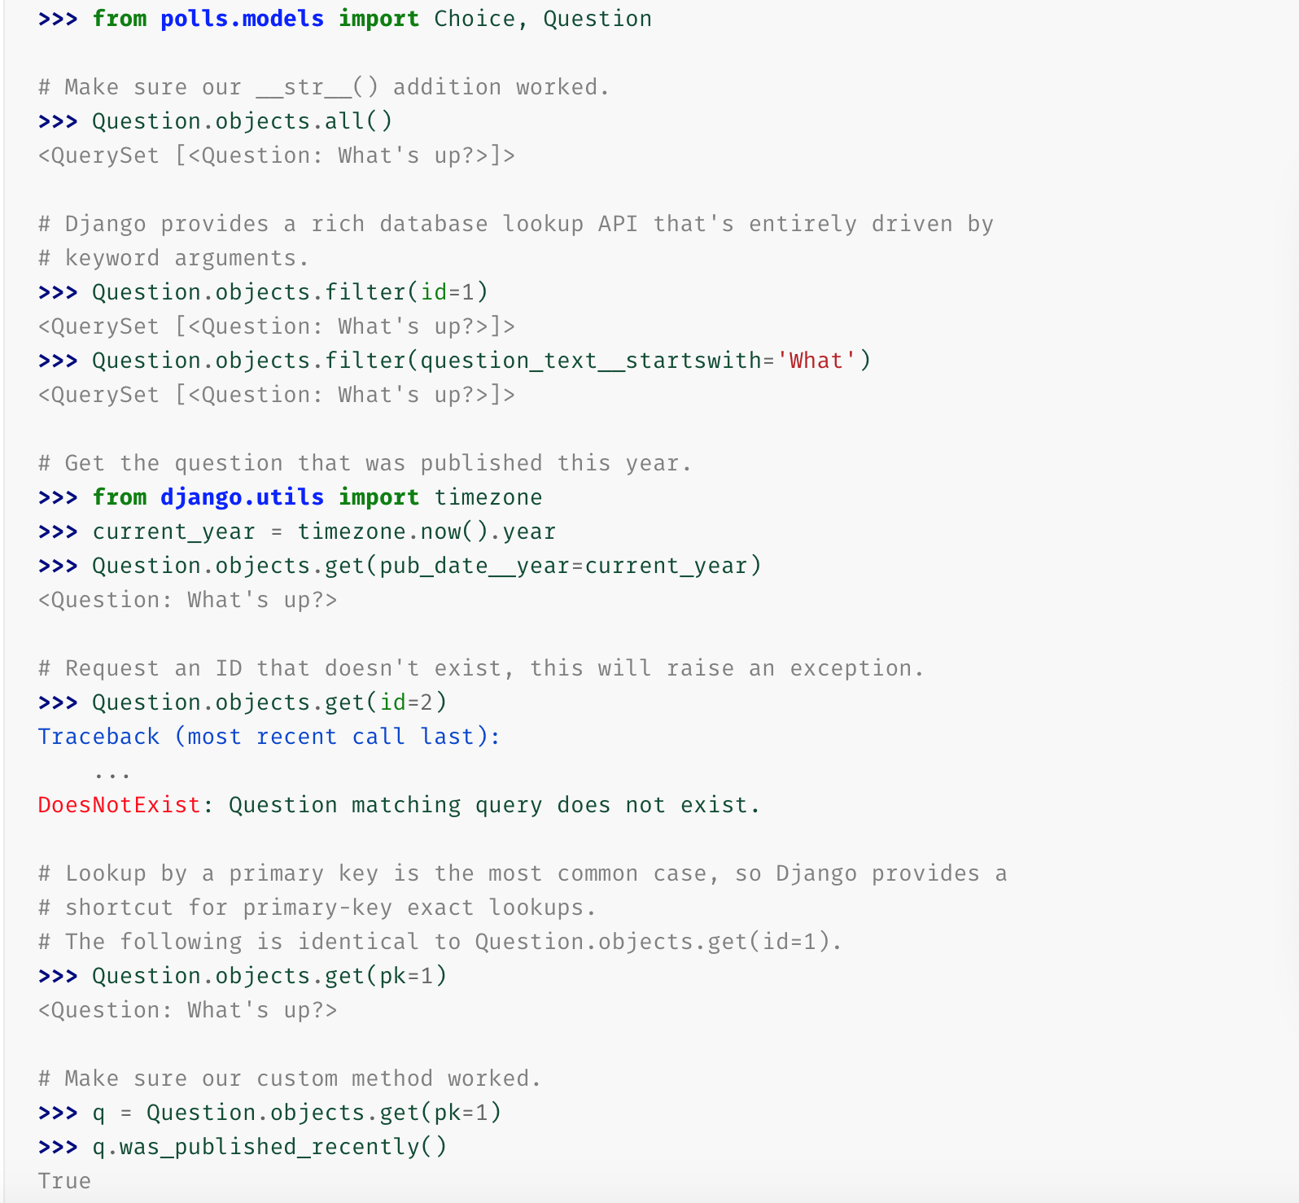
初试API
Notes:
this point, it’s worth reviewing what these arguments are for.
path() argument: route¶
route is a string that contains a URL pattern. When processing a request, Django starts at the first pattern in urlpatterns and makes its way down the list, comparing the requested URL against each pattern until it finds one that matches.
Patterns don’t search GET and POST parameters, or the domain name. For example, in a request to https://www.example.com/myapp/, the URLconf will look for myapp/. In a request to https://www.example.com/myapp/?page=3, the URLconf will also look for myapp/.
path() argument: view¶
When Django finds a matching pattern, it calls the specified view function with an HttpRequest object as the first argument and any “captured” values from the route as keyword arguments. We’ll give an example of this in a bit.
path() argument: kwargs¶
Arbitrary keyword arguments can be passed in a dictionary to the target view. We aren’t going to use this feature of Django in the tutorial.
path() argument: name¶
Naming your URL lets you refer to it unambiguously from elsewhere in Django, especially from within templates. This powerful feature allows you to make global changes to the URL patterns of your project while only touching a single file.
When you’re comfortable with the basic request and response flow, read part 2 of this tutorial to start working with the database.

Slide 55
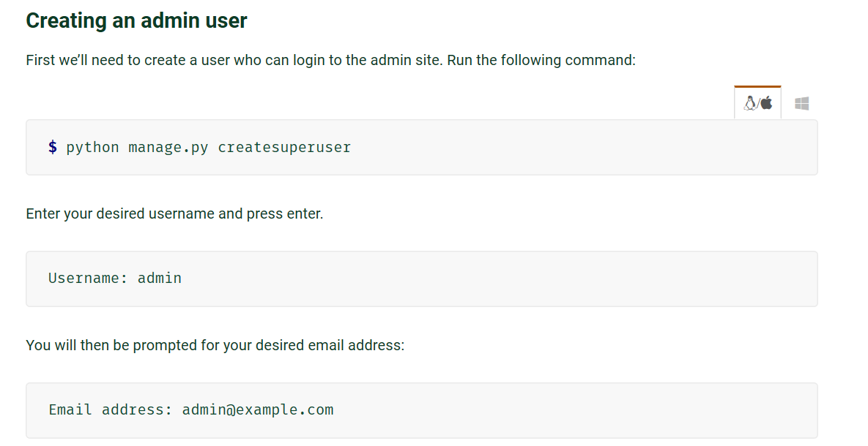
创建超级用户
Notes:
this point, it’s worth reviewing what these arguments are for.
path() argument: route¶
route is a string that contains a URL pattern. When processing a request, Django starts at the first pattern in urlpatterns and makes its way down the list, comparing the requested URL against each pattern until it finds one that matches.
Patterns don’t search GET and POST parameters, or the domain name. For example, in a request to https://www.example.com/myapp/, the URLconf will look for myapp/. In a request to https://www.example.com/myapp/?page=3, the URLconf will also look for myapp/.
path() argument: view¶
When Django finds a matching pattern, it calls the specified view function with an HttpRequest object as the first argument and any “captured” values from the route as keyword arguments. We’ll give an example of this in a bit.
path() argument: kwargs¶
Arbitrary keyword arguments can be passed in a dictionary to the target view. We aren’t going to use this feature of Django in the tutorial.
path() argument: name¶
Naming your URL lets you refer to it unambiguously from elsewhere in Django, especially from within templates. This powerful feature allows you to make global changes to the URL patterns of your project while only touching a single file.
When you’re comfortable with the basic request and response flow, read part 2 of this tutorial to start working with the database.

Slide 56
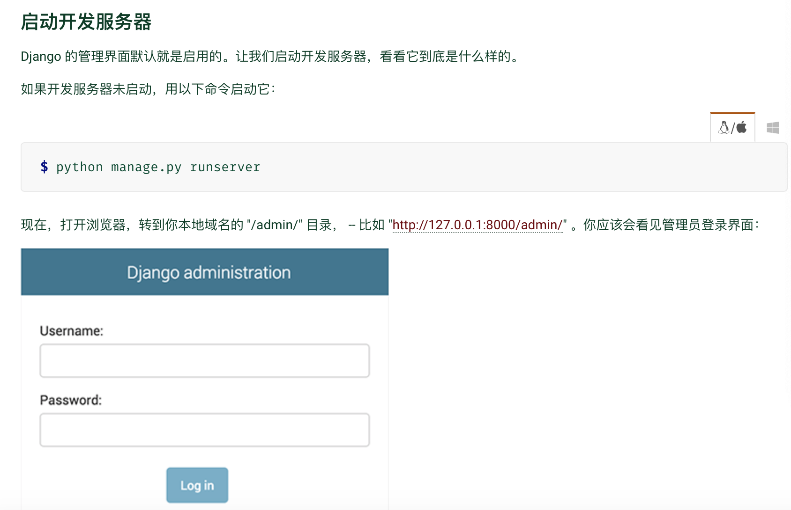
创建超级用户
Notes:
this point, it’s worth reviewing what these arguments are for.
path() argument: route¶
route is a string that contains a URL pattern. When processing a request, Django starts at the first pattern in urlpatterns and makes its way down the list, comparing the requested URL against each pattern until it finds one that matches.
Patterns don’t search GET and POST parameters, or the domain name. For example, in a request to https://www.example.com/myapp/, the URLconf will look for myapp/. In a request to https://www.example.com/myapp/?page=3, the URLconf will also look for myapp/.
path() argument: view¶
When Django finds a matching pattern, it calls the specified view function with an HttpRequest object as the first argument and any “captured” values from the route as keyword arguments. We’ll give an example of this in a bit.
path() argument: kwargs¶
Arbitrary keyword arguments can be passed in a dictionary to the target view. We aren’t going to use this feature of Django in the tutorial.
path() argument: name¶
Naming your URL lets you refer to it unambiguously from elsewhere in Django, especially from within templates. This powerful feature allows you to make global changes to the URL patterns of your project while only touching a single file.
When you’re comfortable with the basic request and response flow, read part 2 of this tutorial to start working with the database.

Slide 57
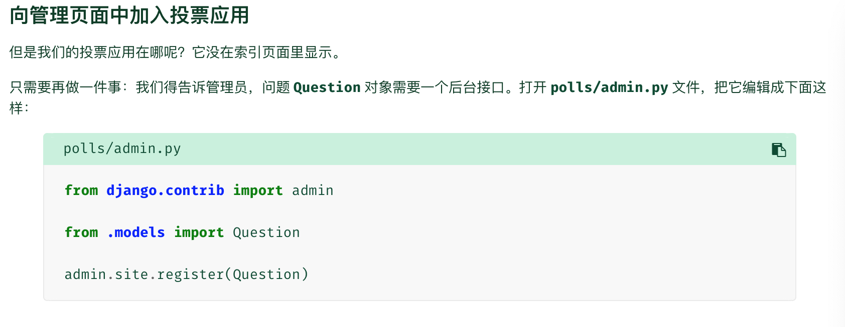
创建超级用户
Notes:
this point, it’s worth reviewing what these arguments are for.
path() argument: route¶
route is a string that contains a URL pattern. When processing a request, Django starts at the first pattern in urlpatterns and makes its way down the list, comparing the requested URL against each pattern until it finds one that matches.
Patterns don’t search GET and POST parameters, or the domain name. For example, in a request to https://www.example.com/myapp/, the URLconf will look for myapp/. In a request to https://www.example.com/myapp/?page=3, the URLconf will also look for myapp/.
path() argument: view¶
When Django finds a matching pattern, it calls the specified view function with an HttpRequest object as the first argument and any “captured” values from the route as keyword arguments. We’ll give an example of this in a bit.
path() argument: kwargs¶
Arbitrary keyword arguments can be passed in a dictionary to the target view. We aren’t going to use this feature of Django in the tutorial.
path() argument: name¶
Naming your URL lets you refer to it unambiguously from elsewhere in Django, especially from within templates. This powerful feature allows you to make global changes to the URL patterns of your project while only touching a single file.
When you’re comfortable with the basic request and response flow, read part 2 of this tutorial to start working with the database.

