Slide 1
Motivatr Storyboards
Hector alvarez

Slide 2
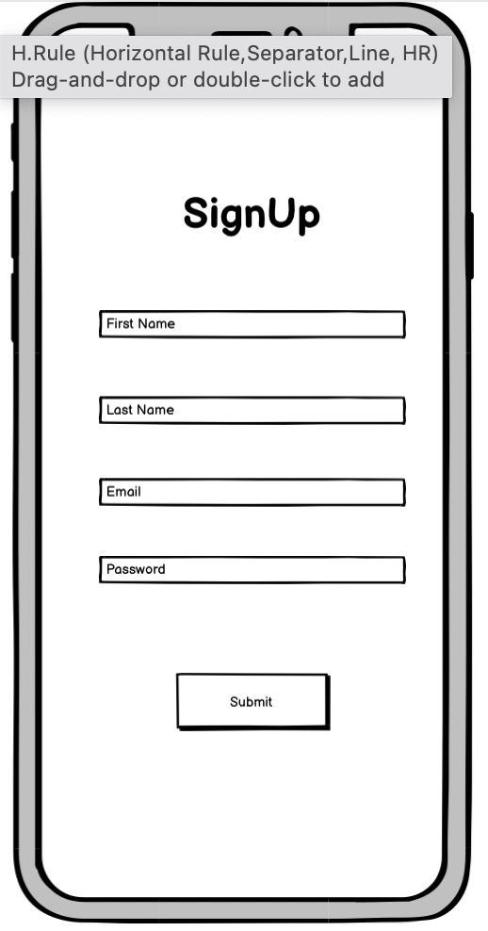
Mike Has found Motivatr. He needs to sign up and create an account

Slide 3
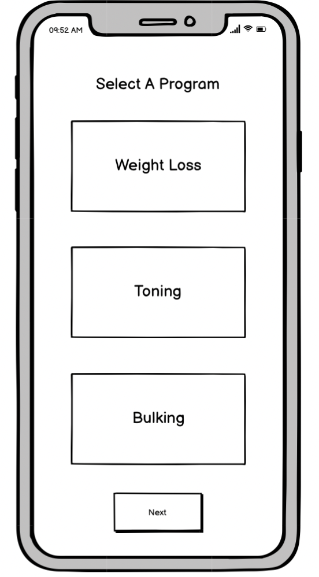
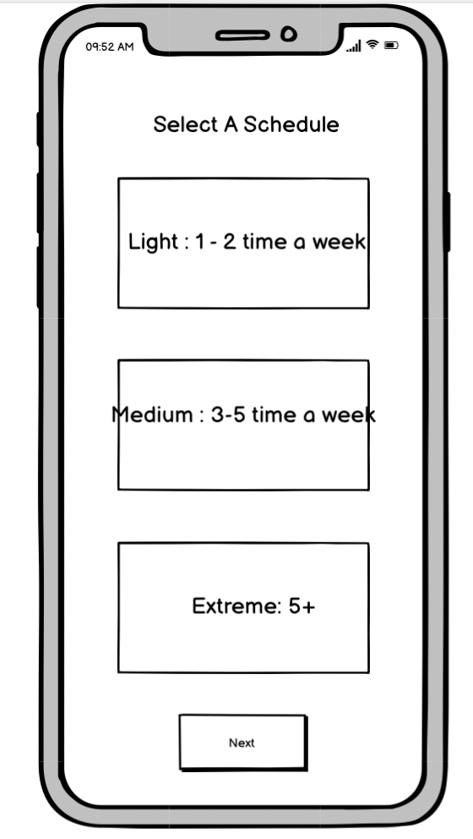
Motivatr will ask what mike’s fitness goals are and create a program for mike

Slide 4
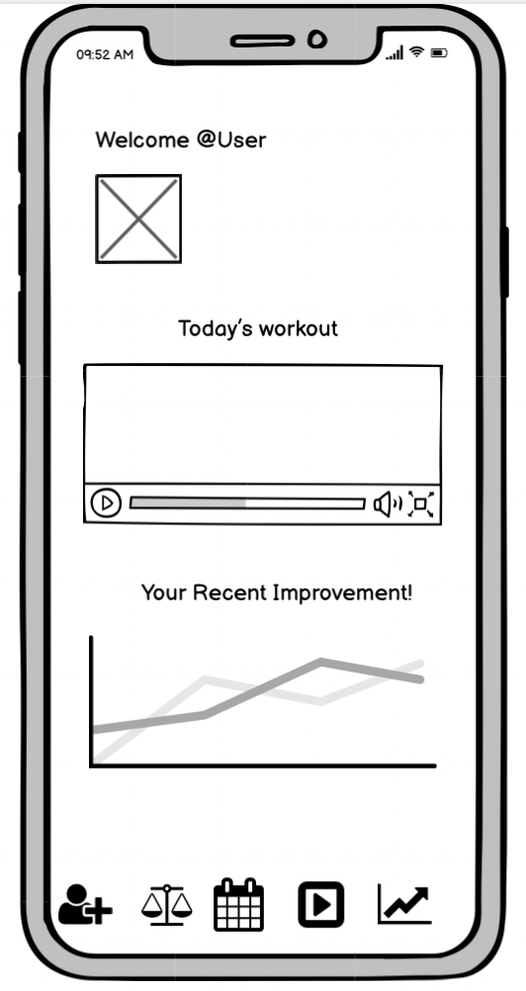
Mike has access to his dashboard: displays recent info and upcoming workouts

Slide 5
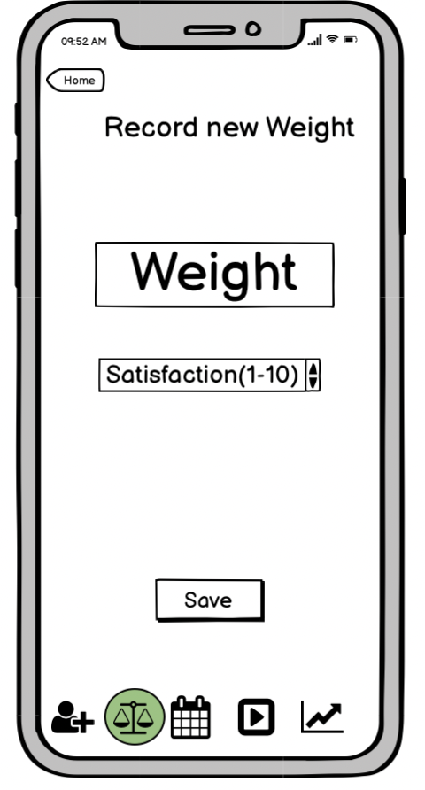
Mike records a weight data point

Slide 6
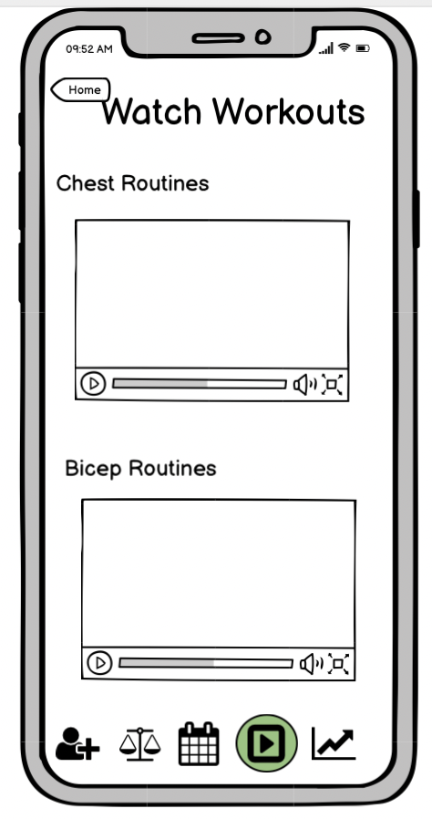
Mike is about to start a workout. the program selects a workout video for him

Slide 7
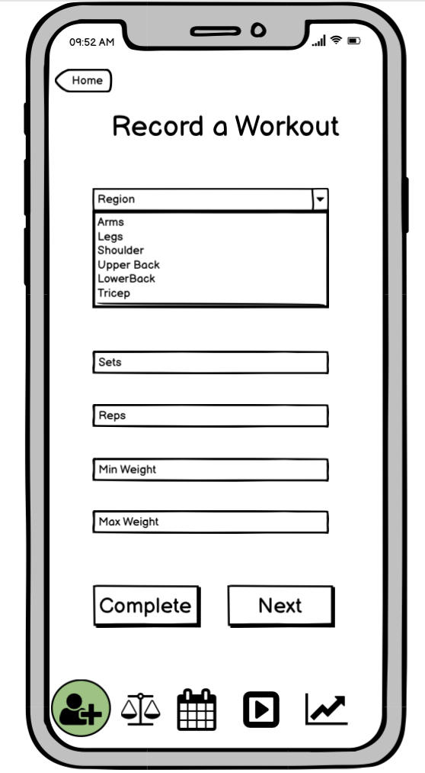
At the end of that workout, mike can enter in his workout data

Slide 8
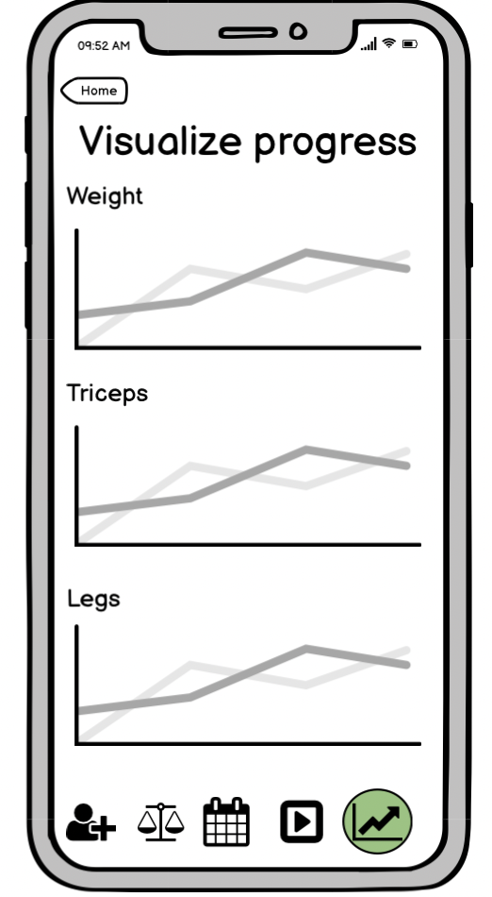
A month from now, mike wants to check his progress

