Slide 1
PRSA
Skating Academy
Management Platform
One app for the academy office, the coach at the rink, and every family — skaters, batches, schedule, bookings, attendance, fees and progress in one place.
Client presentation · September 2026
Notes:
Opening: what the platform is in one sentence. Four roles, one system of record.

Slide 2
Running an academy today
What the office, the coach and the parent each struggle with — and what changes
Today
With PRSA
Registers and WhatsApp
Enrolment, attendance and who is coming are scattered across notebooks, chats and memory.
One roster, live counts, a schedule everyone sees.
Cash book reconciliation
Receipts, partial payments, advances and refunds are hard to tie out at month-end.
Numbered receipts, an append-only payment ledger, a daily reconciliation report.
Who actually turned up?
Pay-per-class families argue over how many classes are left.
A credit ledger driven by attendance — every class explained, line by line.
Parents kept in the dark
Fee reminders, cancellations and confirmations go out by hand.
Parents see credits, bookings, fees and news on their phone, with notifications.
PRSA Skating Academy · Academy Management Platform
2

Slide 3
One platform, four roles
Each person sees only their own screens and their own data
A
C
P
S
Academy admin
Coach
Parent
Super admin
The office
Rink-side, on a phone
On a phone
Platform owner
Skaters, coaches, batches
Schedule & holidays
Fees, receipts, reports
Booking approvals
Announcements
Today’s sessions
Mark attendance
Approve booking requests
Assess skills
Inbox
Credits & expiry
Book classes
Fees & receipts
Attendance calendar
News & notifications
Academies
Health & errors
Audit trail
PRSA Skating Academy · Academy Management Platform
3

Slide 4
The platform at a glance
12
4
187
130
modules — from enrolment to reconciliation
roles with separate apps and data access
QA test cases executed in the browser
automated tests run before every release
1
Skaters & families
2
Scheduling
Profiles, parents, batches, levels, photos, activity trail
Weekly calendar generated from batch days; holidays; extra & make-up sessions
3
Bookings with approval
4
Attendance
Parents request, coach or admin confirms; credit held until decided
One-tap marking on a phone; attendance is the source of truth for credits
5
Fees & payments
6
Pay-per-class credits
Plans, calendar-aligned billing, receipts, partial payments, advances, voids
Prepaid top-ups with a term and expiry; ledger explains every class
7
Reports
8
Communication
Attendance, collection, reconciliation, progress, coach activity — CSV & PDF
Announcements by audience; in-app notifications for every money and booking event
PRSA Skating Academy · Academy Management Platform
4

Slide 5
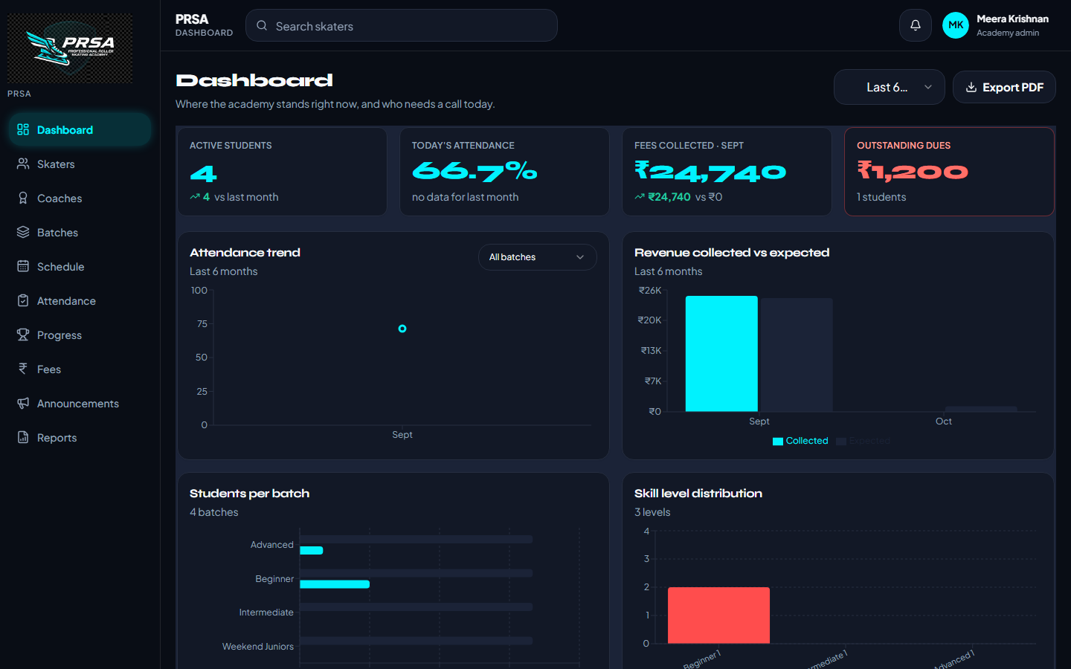
Admin dashboard
Where the academy stands right now, and who needs a call today
Active skaters, today’s attendance, fees collected this month and outstanding dues — with last-month comparisons
Attendance trend, revenue collected vs expected, students per batch, skill distribution, retention, coach load
Renewals due — pay-per-class terms ending within 7 days, with a one-tap reminder
Needs attention — skaters under 60% attendance in the last 30 days
Export the dashboard to PDF for the monthly committee meeting
PRSA Skating Academy · Academy Management Platform
5

Slide 6
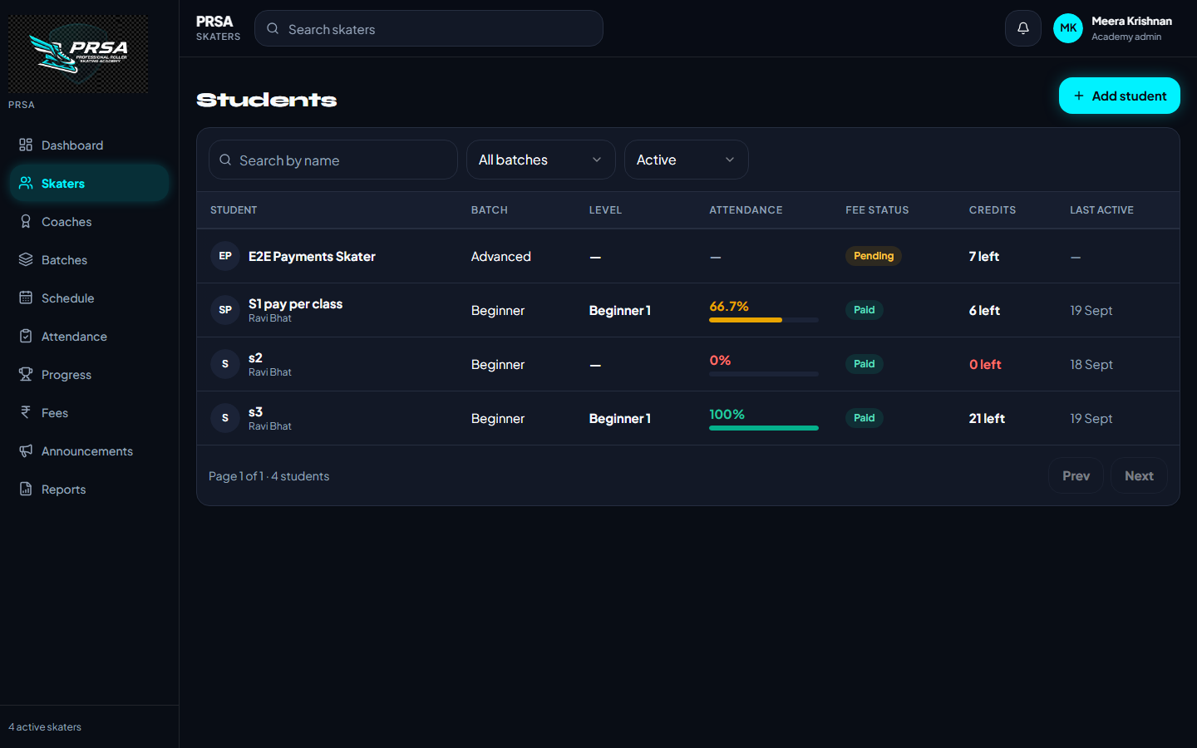
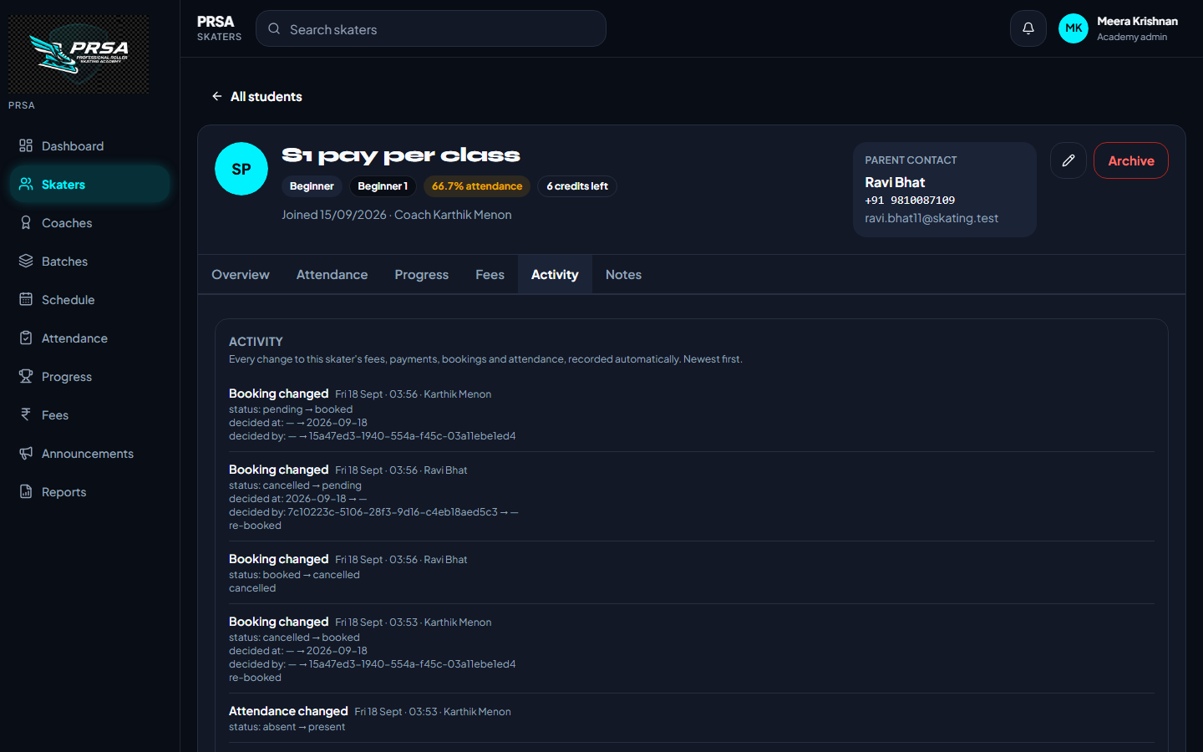
Skaters & families
Everything about a skater on one profile — and every change recorded automatically
✓
Search & filter
✓
Add in one form
✓
Profile tabs
By name, batch, status; sort any column
Skater, emergency contact, batch, level, fee plan, parent (invite or link)
Overview · Attendance & credits · Progress · Fees · Activity · Notes
✓
Activity trail
✓
Archive & restore
Fees, payments, bookings, attendance — who changed what, when
Leaving skaters keep their history; nothing is deleted
PRSA Skating Academy · Academy Management Platform
6

Slide 7
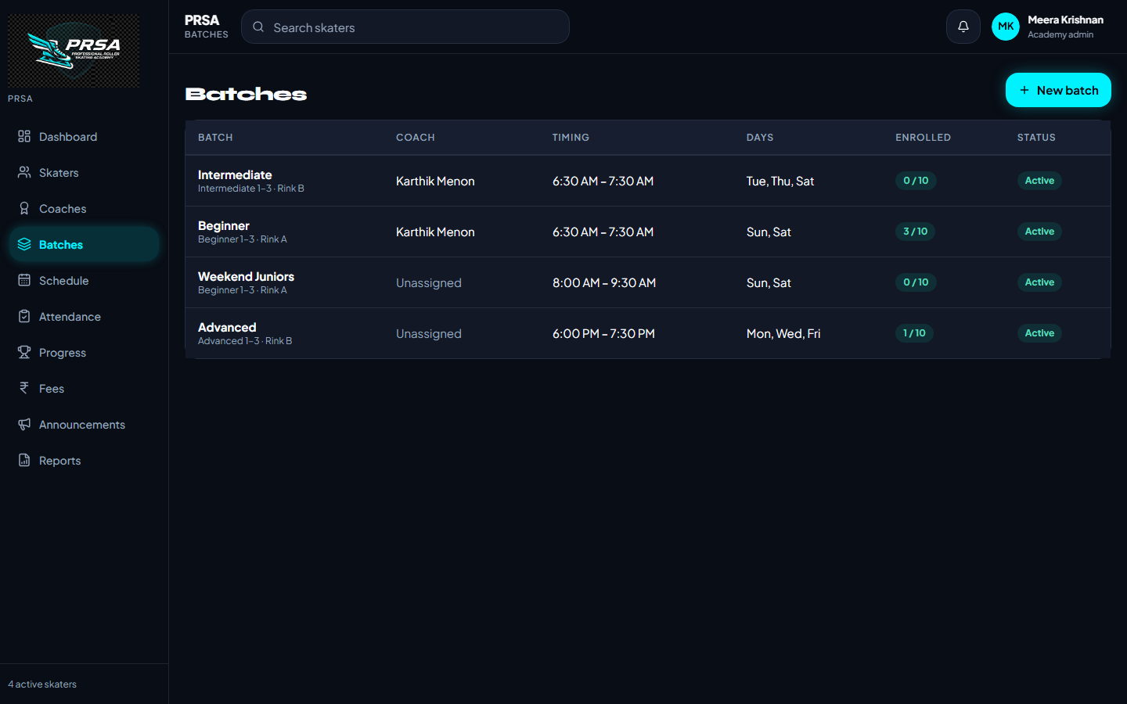
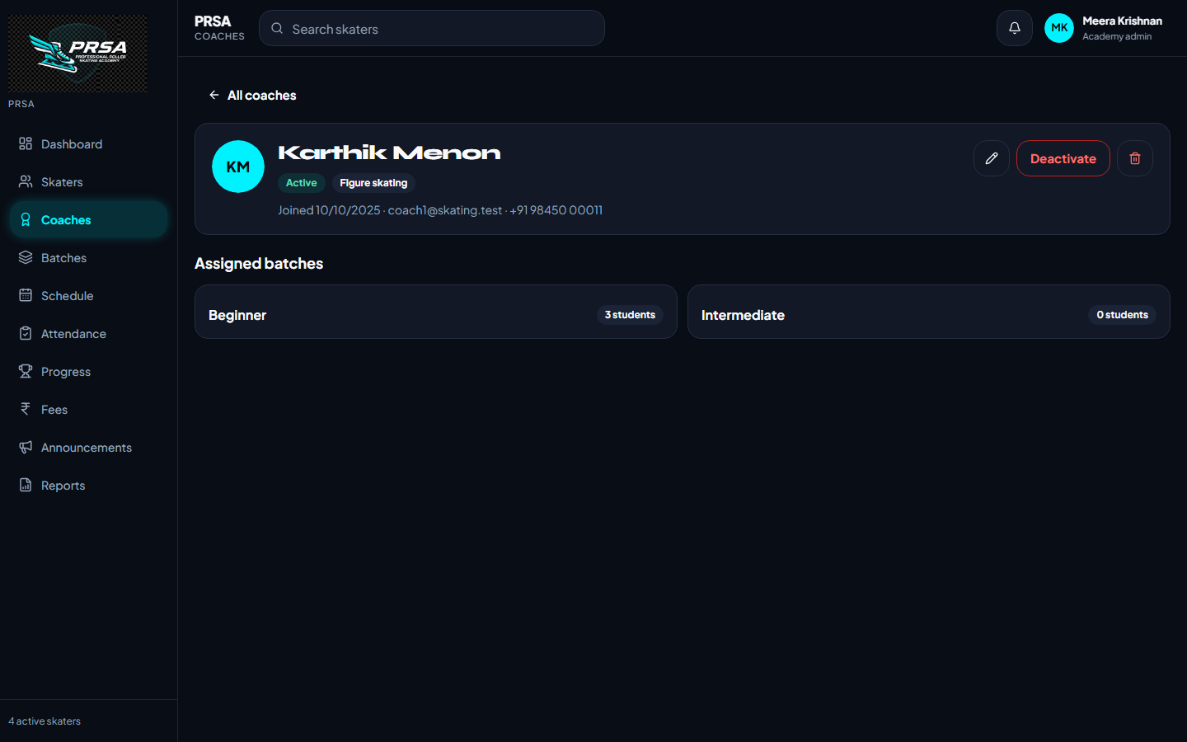
Batches & coaches
Timing, days, venue, capacity and a coach per batch
Batch = days of the week + start/end time + venue + capacity; enrolment is tracked against capacity
Generate the schedule for any date range from the batch’s days — holidays skipped, coach clashes reported, existing sessions left alone
Coaches are invited by email, assigned to batches, and see only their own sessions in the coach app
Removing a batch is explicit and explained: sessions and attendance go with it; deactivating pauses it instead
PRSA Skating Academy · Academy Management Platform
7

Slide 8
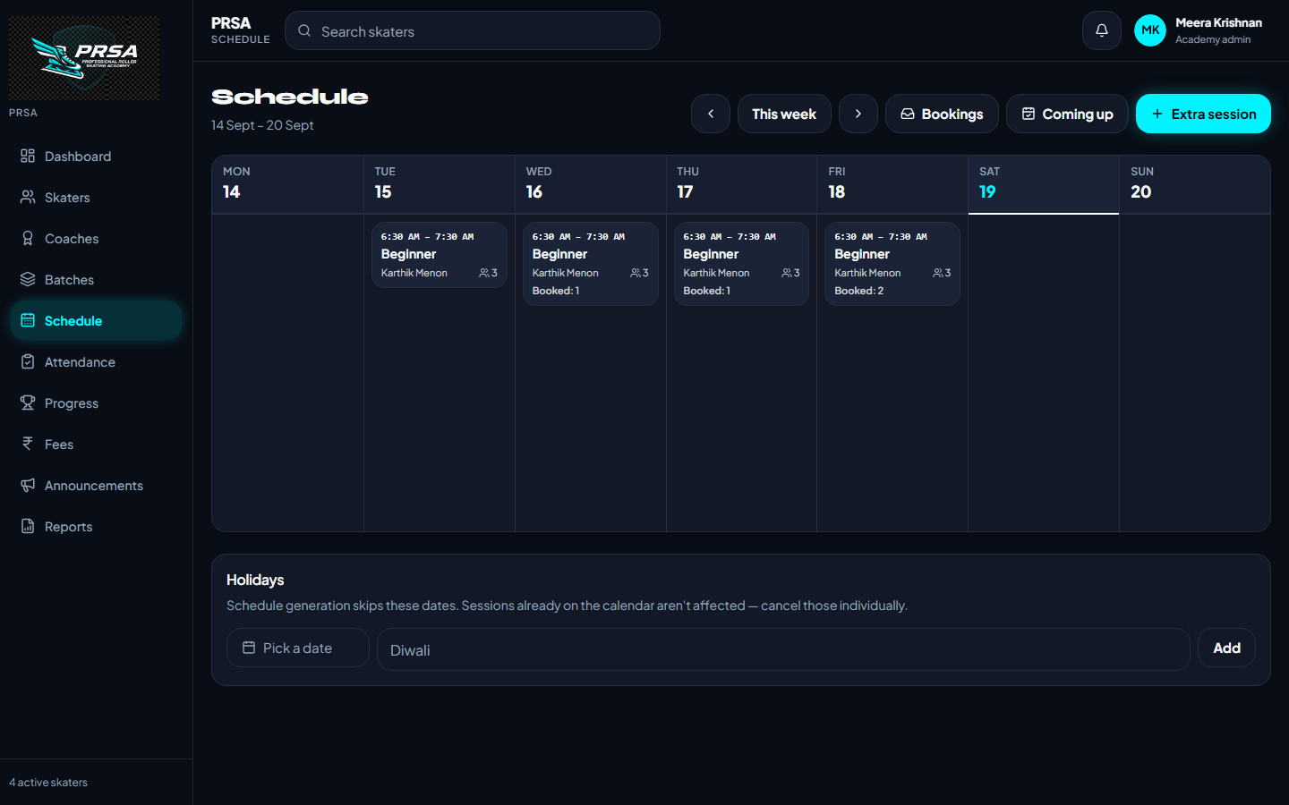
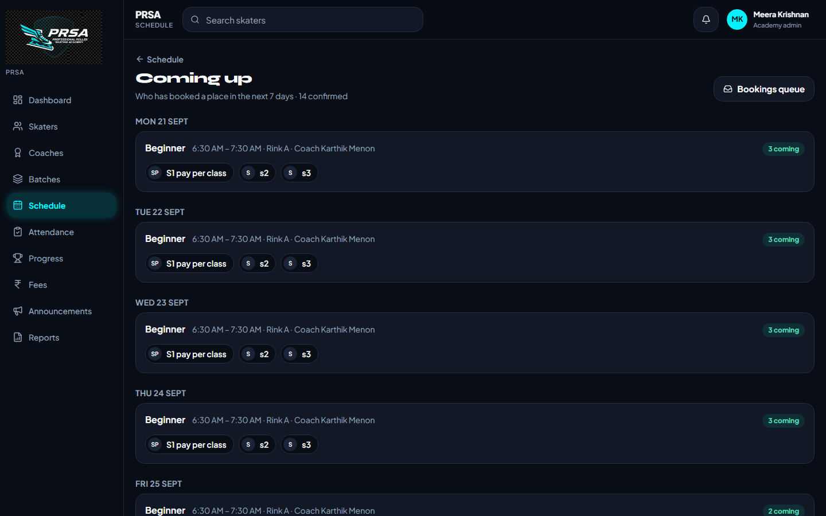
Scheduling
A weekly calendar the office, the coach and the parents all read from
1
Week view
Booked and requested counts on every card
2
Extra & make-up sessions
Cancelled classes get a linked make-up
3
Holidays
Dates the generator skips
4
Coming up
Who has booked in the next 7 days
PRSA Skating Academy · Academy Management Platform
8

Slide 9
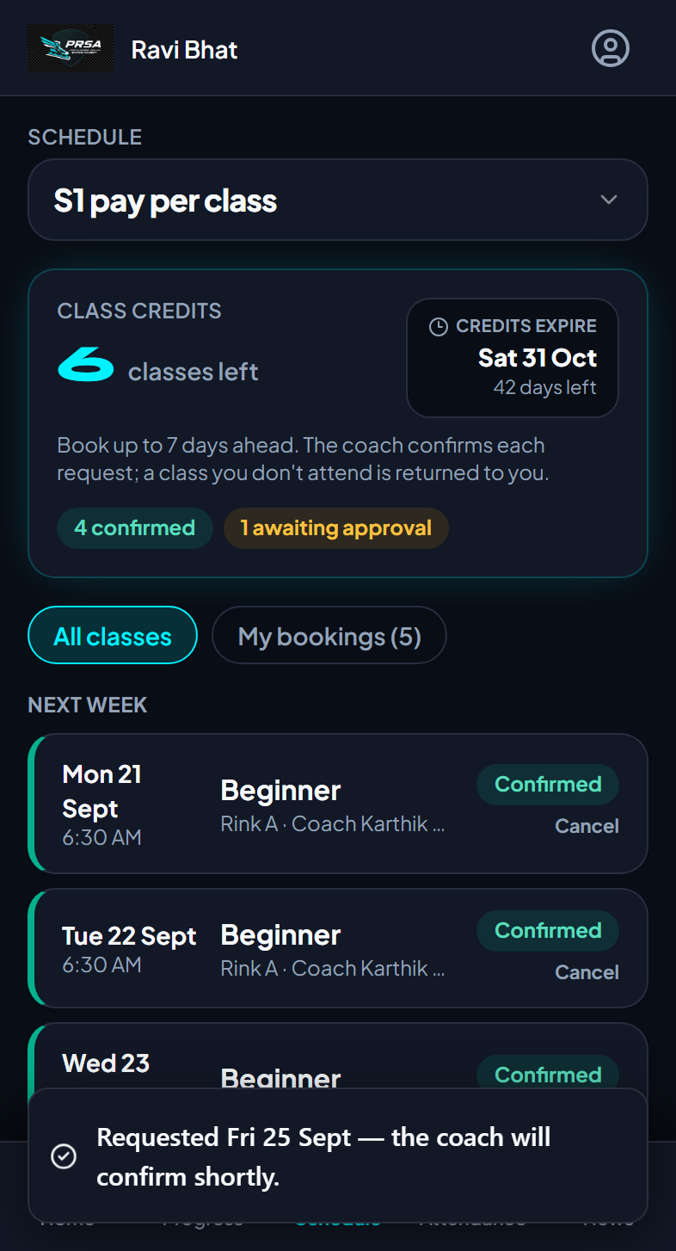
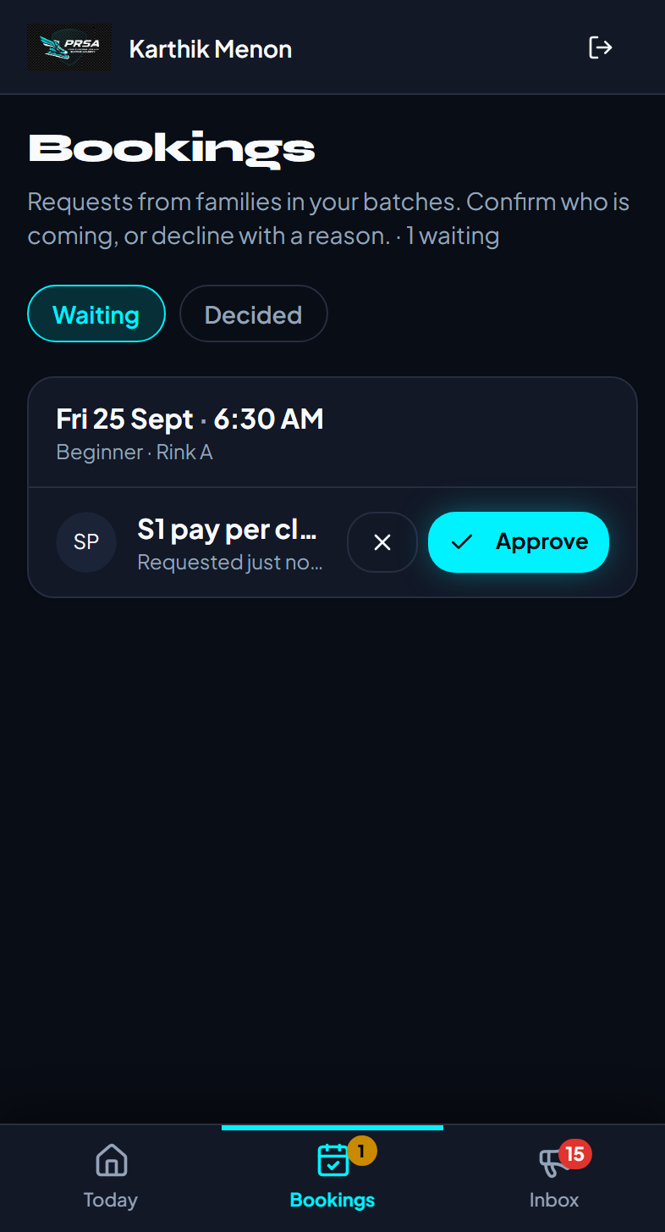
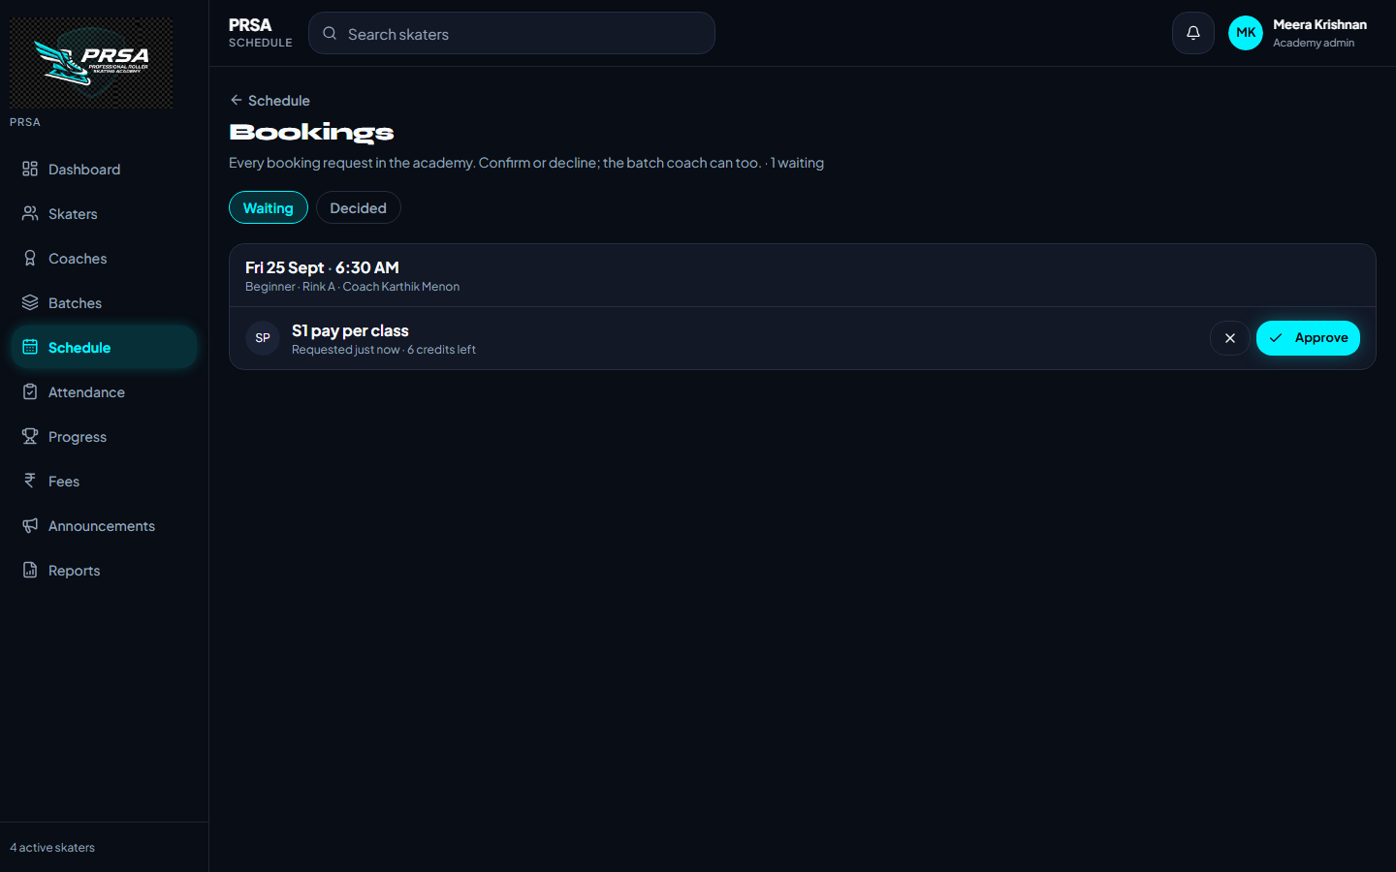
Bookings with approval
A parent requests a class; the batch coach or the office confirms it
Admin: the whole academy’s queue
Credit is held at request time, returned if declined or withdrawn
Decline with a reason the parent sees; “Approve all” per session
Everyone sees the status: Requested · Confirmed · Declined
Attendance still wins — a request marked present is confirmed
Parent: “Awaiting approval”
Coach: approve or decline
PRSA Skating Academy · Academy Management Platform
9

Slide 10
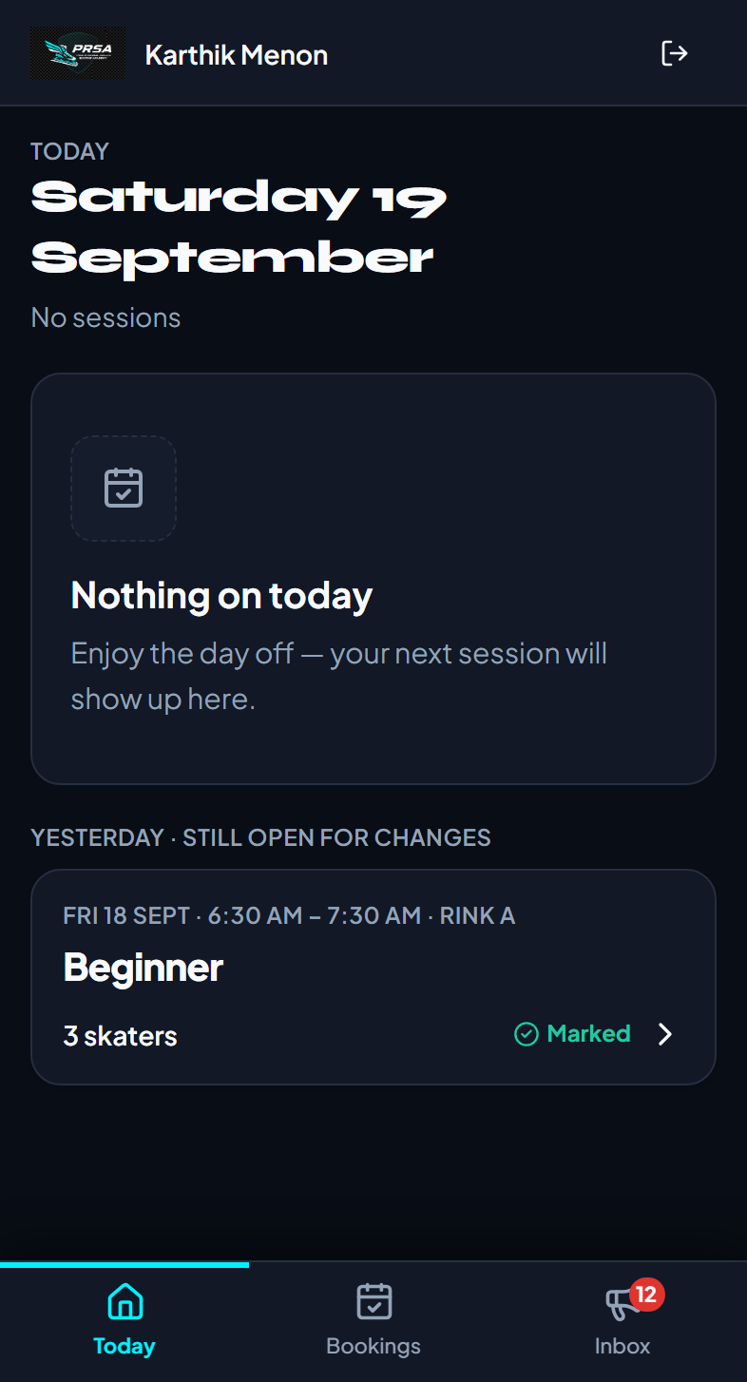
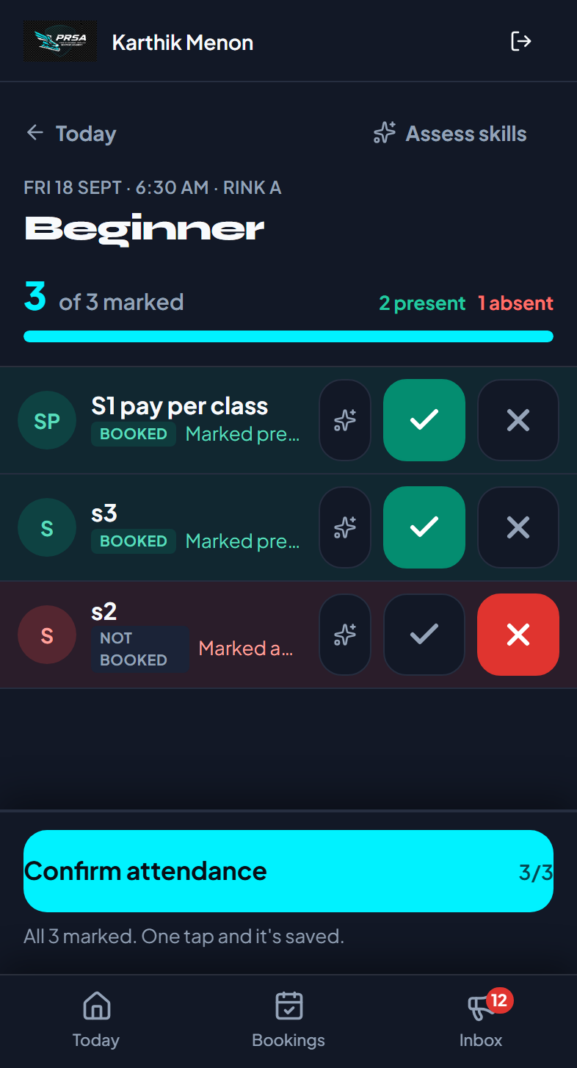
Attendance at the rink
One tap per skater on the coach’s phone — and it drives the credits
Credit rules
How it works
Booked · present
Roster shows Booked / Requested / Not booked per skater
“Mark all present”, then tap the exceptions
Works offline — marks queue on the phone and save when the signal returns
Yesterday stays open for corrections; older sessions are locked
Admin sees attendance by date, batch or skater
Credit spent (already held at booking)
Booked · absent
Credit returned to the family
Not booked · present
Walk-in: one credit spent
Never marked
Released when the session is closed
Coach: today’s sessions
Tap to mark, confirm once
PRSA Skating Academy · Academy Management Platform
10

Slide 11
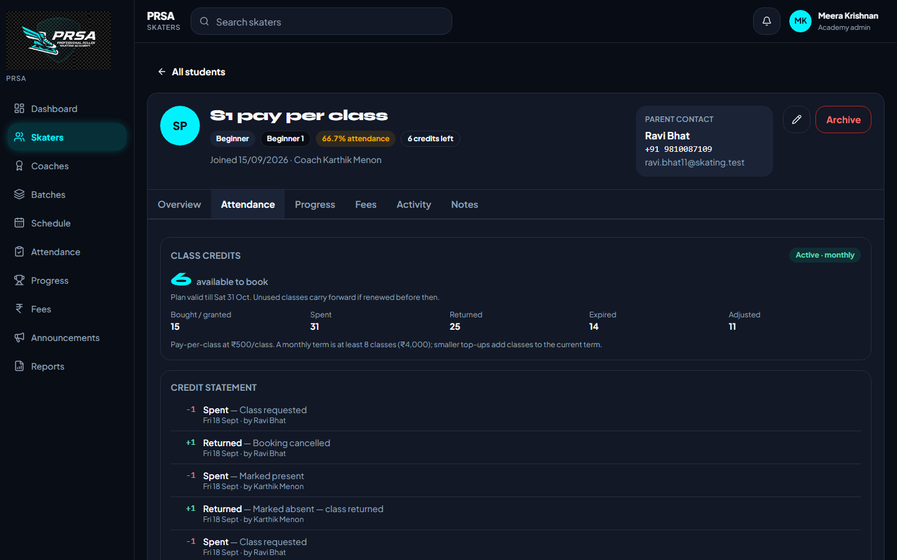
Class credits, explained line by line
Pay-per-class families buy classes in blocks; the ledger shows where each one went
1
Prepaid top-ups
Blocks of classes at the batch rate; minimum 8 / 24 / 96 for monthly, quarterly, annual
2
A term with an expiry
Credits are valid till the term ends; renew before then to carry unused classes forward
3
Append-only ledger
Bought · spent · returned · expired · adjusted — every line with who and why
4
No negative surprises
A void that would take back used credits shows the consequence first (clawback preview)
PRSA Skating Academy · Academy Management Platform
11

Slide 12
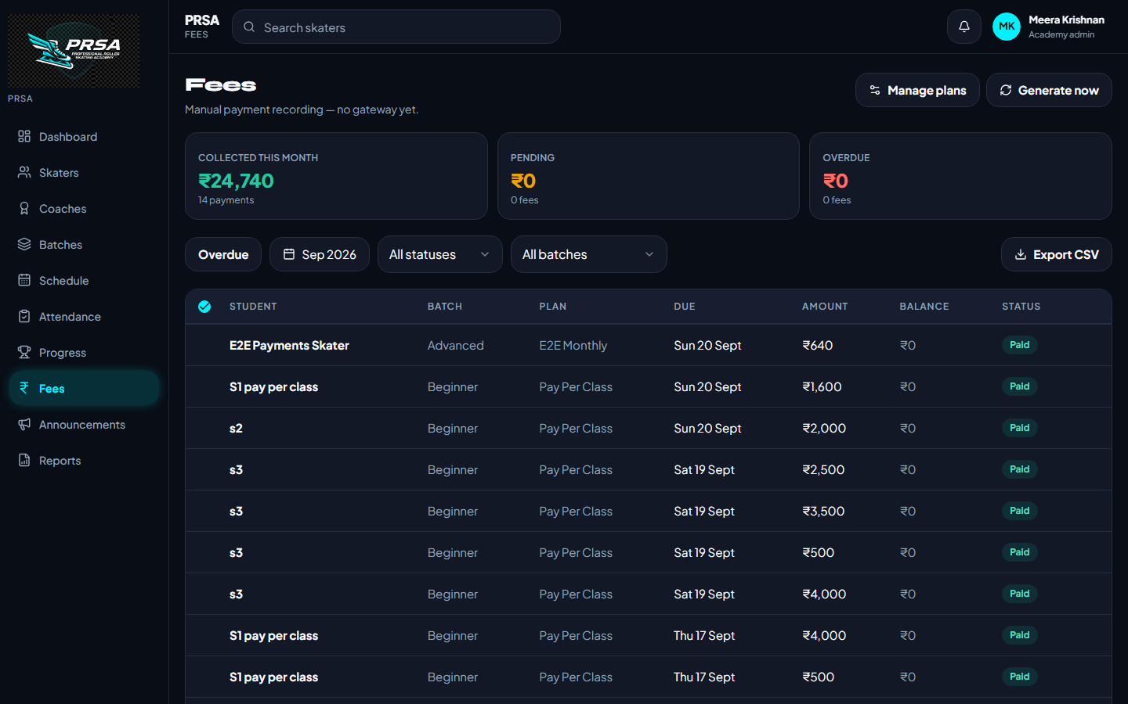
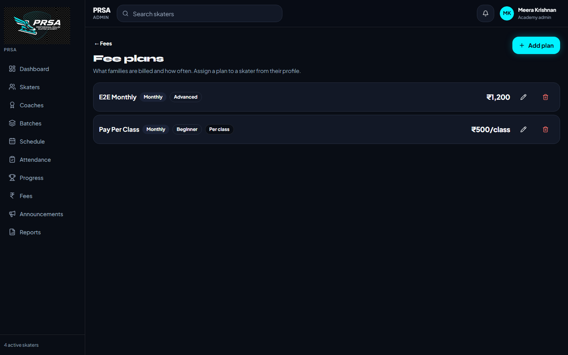
Fees & billing
Plans, calendar-aligned periods, and a dashboard that answers “who owes what”
1
Fee plans
Flat cycle (monthly / quarterly / annual) or per-class; scoped to a batch
2
Billing that can’t stop
Generated ahead, pro-rated for mid-month joins, re-priced when a plan changes
3
Collected · Pending · Overdue
Month picker, batch and status filters, CSV export, bulk reminders
PRSA Skating Academy · Academy Management Platform
12

Slide 13
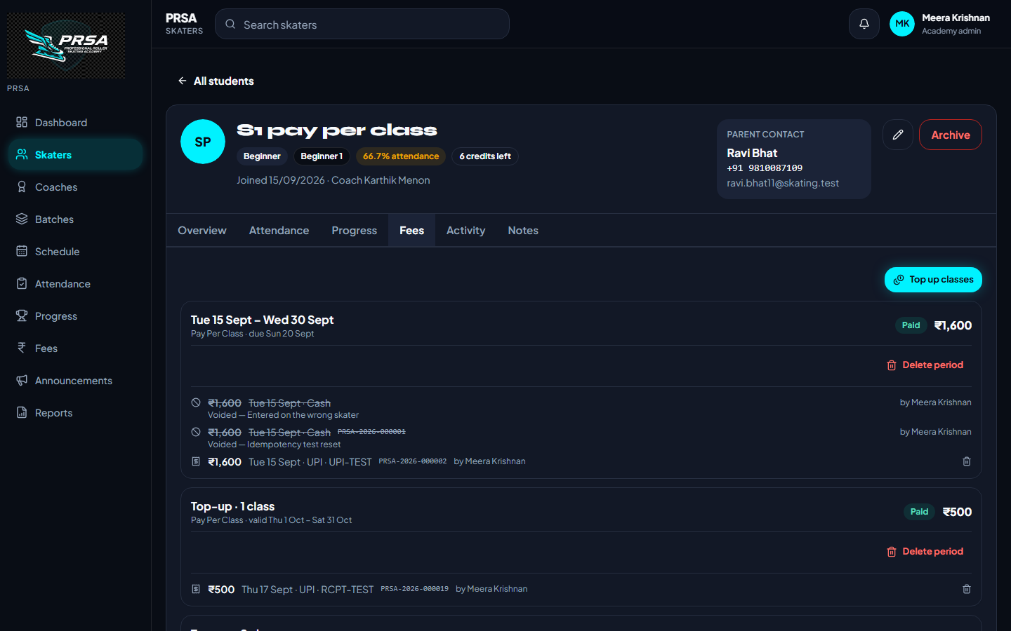
Payments you can trust
Numbered receipts, partial payments, advances and voids — nothing is ever deleted
₹
Receipt numbers
PRSA-2026-000027 — sequential per year; the parent gets the receipt as a notification
₹
Partial & overpayment
Pay in parts; extra is kept as an advance and applied to the next fee (or “Apply now”)
₹
Void, never delete
A wrong entry is crossed out with a reason; status and balance recalculate
₹
Waive with a reason
Sibling discounts and hardship cases are recorded, not hidden
PRSA Skating Academy · Academy Management Platform
13

Slide 14
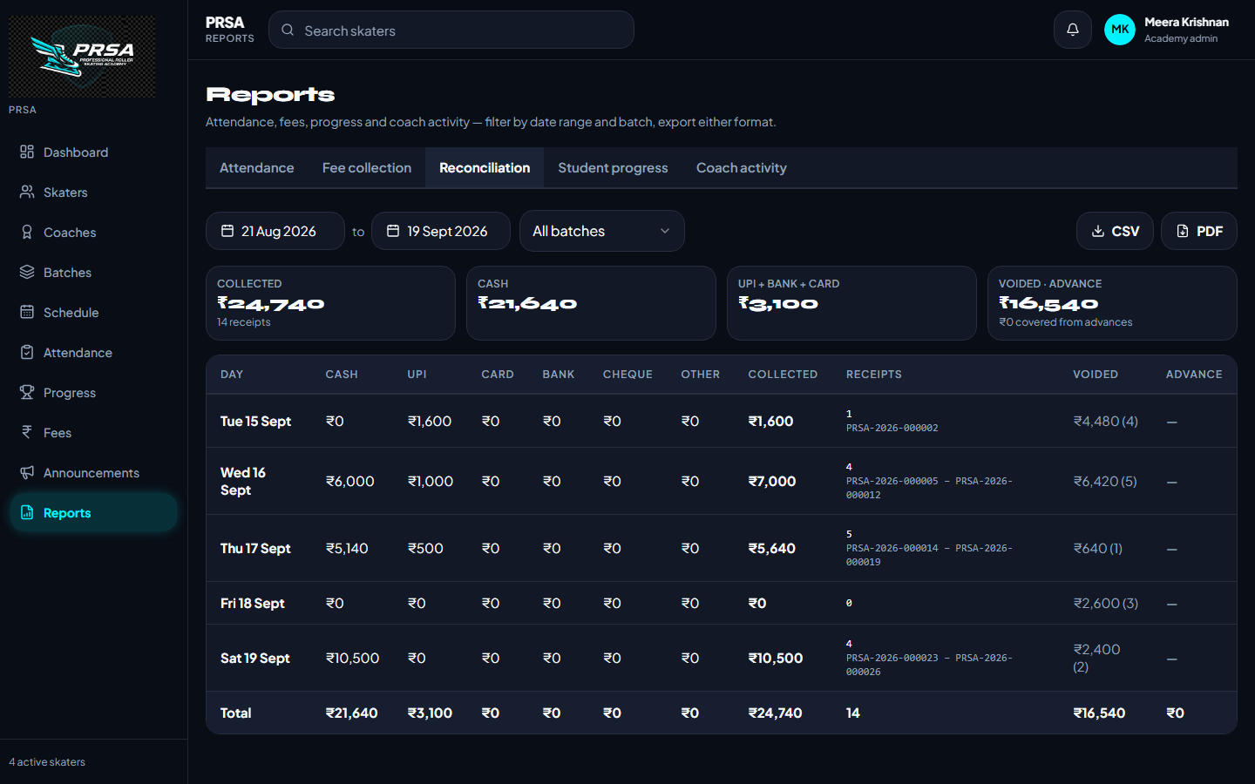
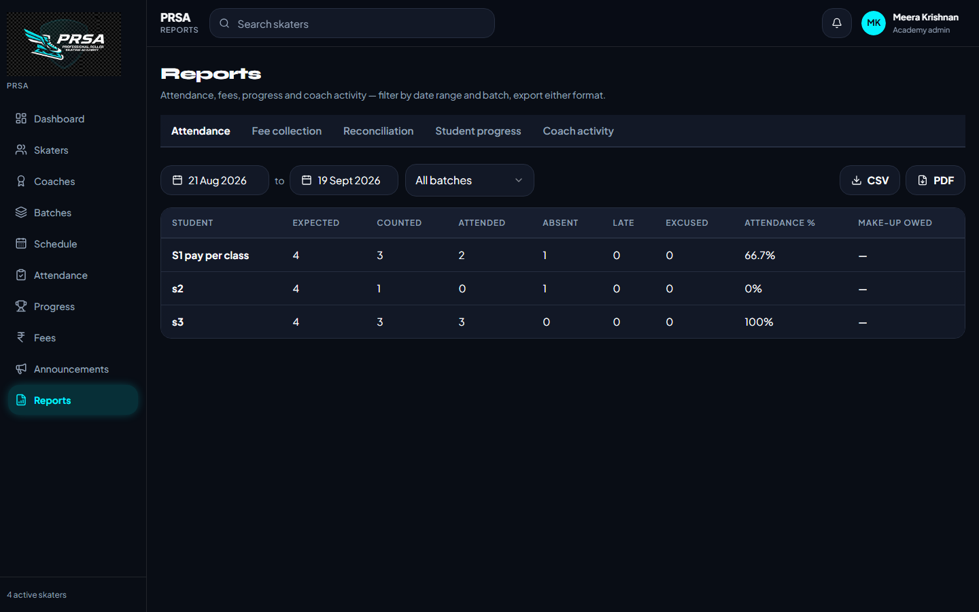
Reports & month-end reconciliation
Five reports, any date range, CSV and PDF
1
Reconciliation
Per day: cash / UPI / card / bank / cheque, receipt range, voided, advances
2
Attendance & fee collection
Per skater, per batch, for any range
3
Progress & coach activity
Skills achieved, sessions taken, attendance per coach
PRSA Skating Academy · Academy Management Platform
14

Slide 15
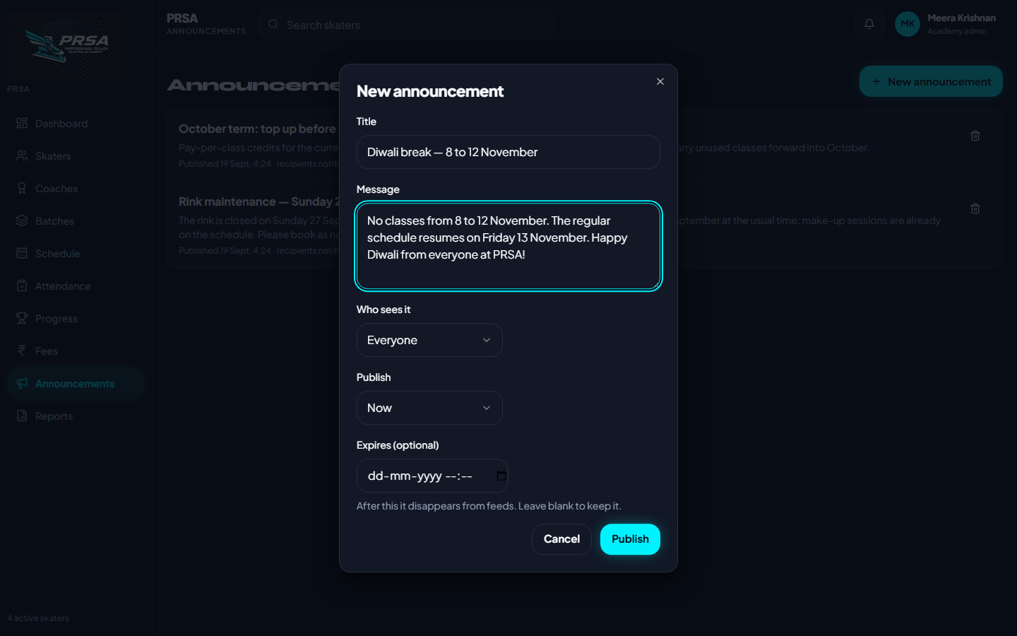
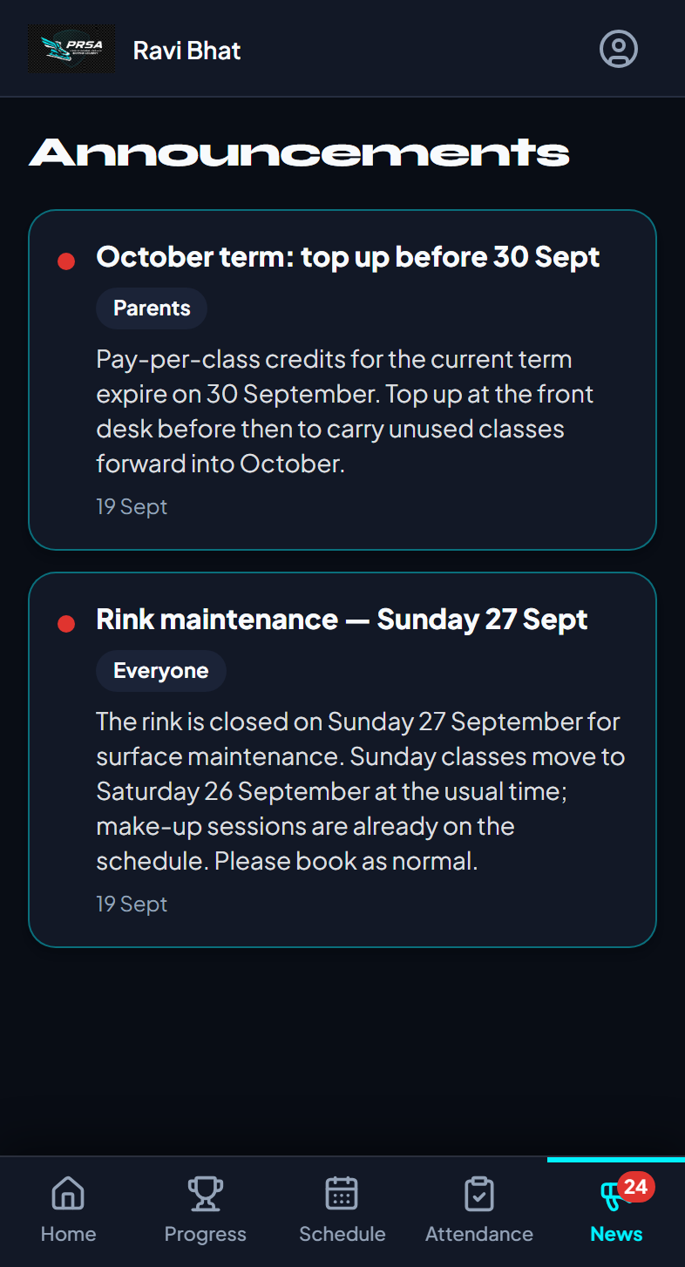
Announcements & notifications
Reach everyone, only parents, only coaches, or one batch
Automatic notifications
Payment received (with receipt no.)
Fee due / overdue reminders (opt-in, nightly)
Plan term ending — renew
Booking confirmed / declined
Session cancelled · make-up scheduled
New announcement
Parent: News tab
PRSA Skating Academy · Academy Management Platform
15

Slide 16
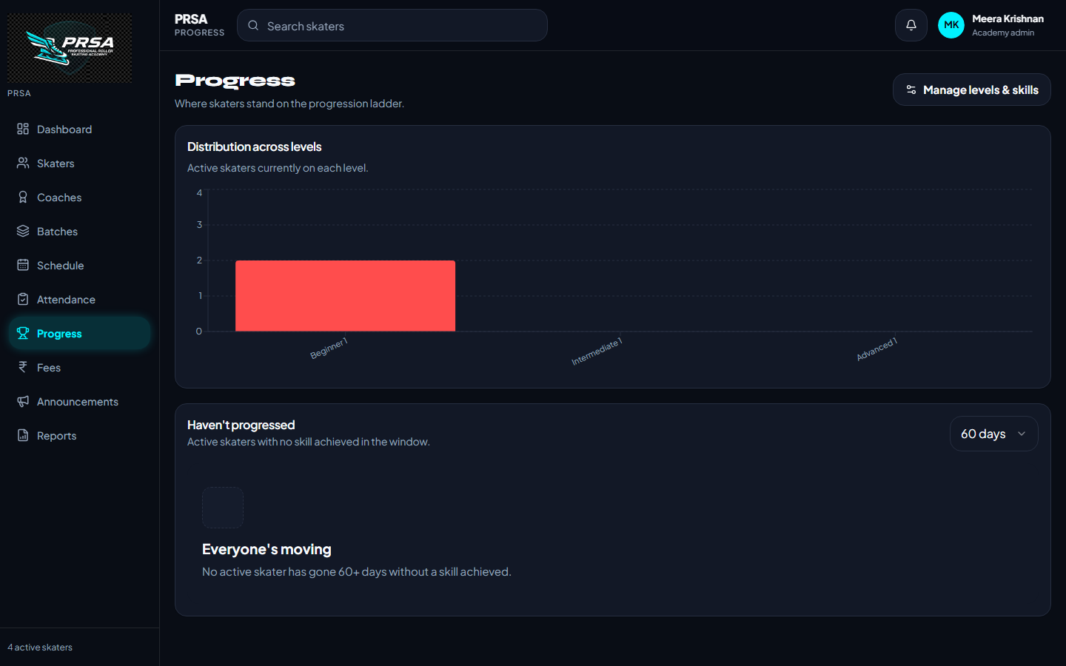
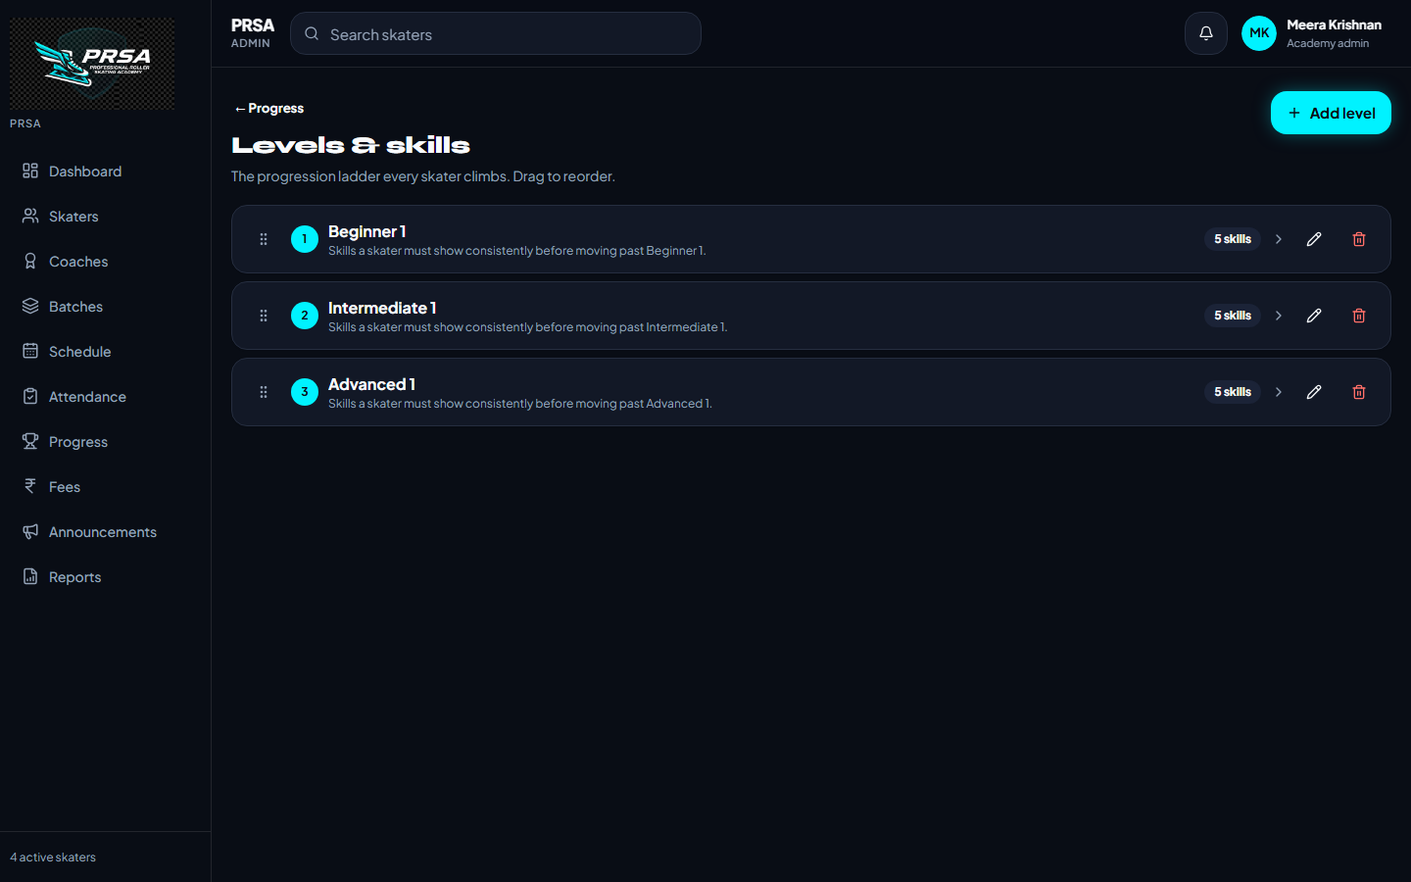
Skill progression
A ladder of levels and skills the coach assesses from the roster
Levels & skills are the academy’s own — add, rename, reorder by drag
Coach taps “Assess skills” on any skater from the attendance roster; achievements are dated
Dashboard shows the distribution across levels and who hasn’t progressed in 60 days
Parents see their child’s level and achievements on the Progress tab
PRSA Skating Academy · Academy Management Platform
16

Slide 17
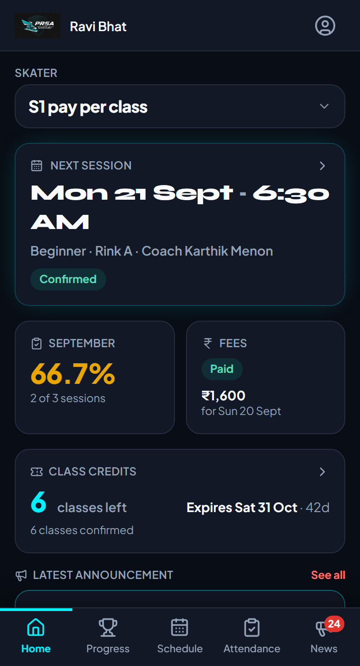
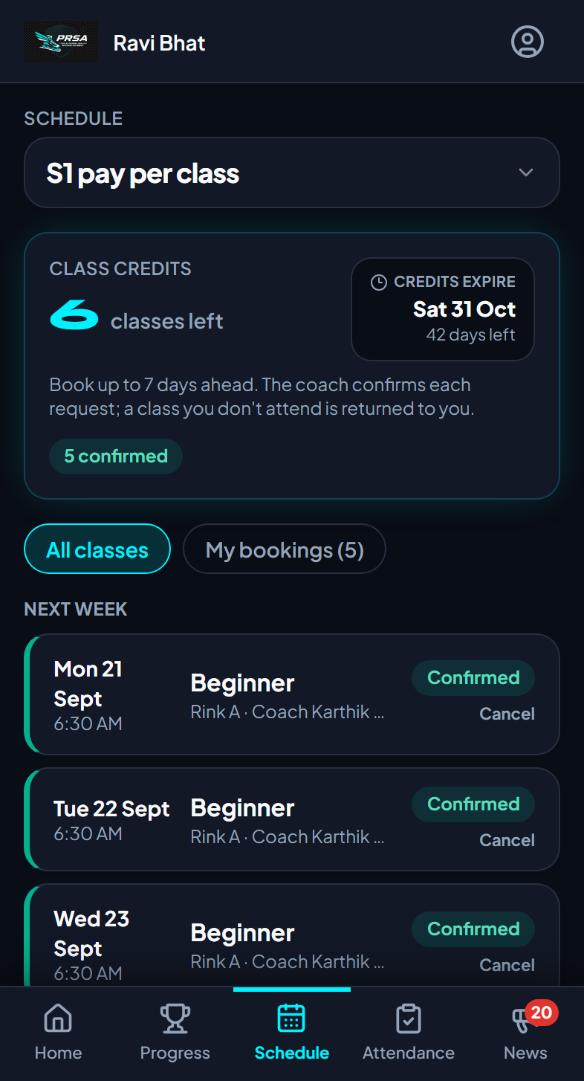
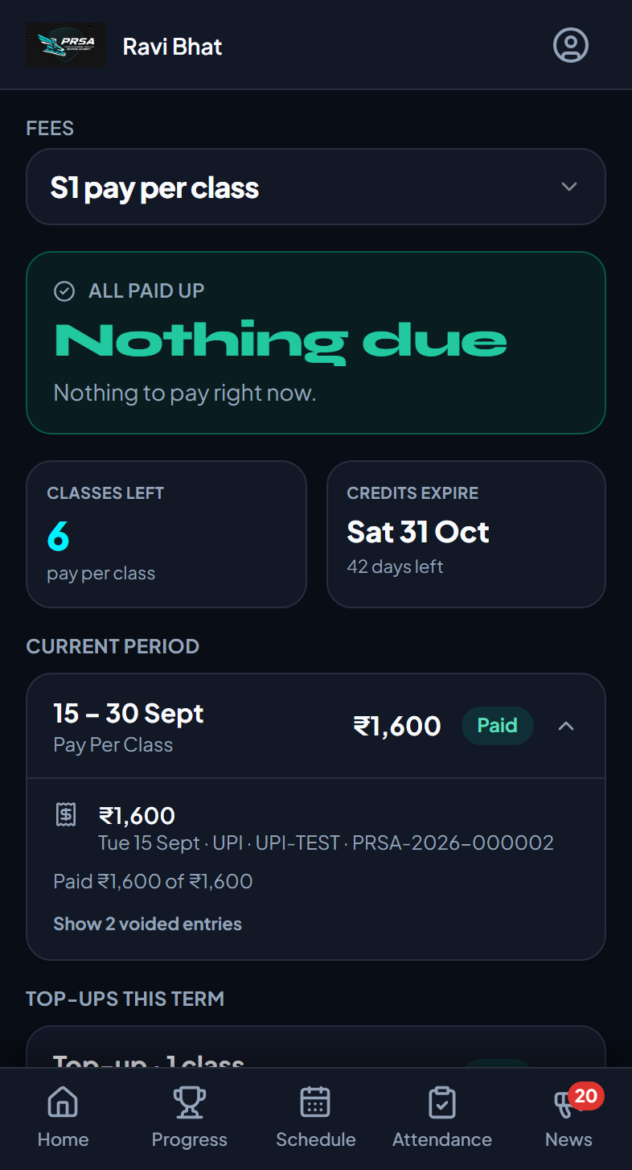
The parent app
Phone-first. Credits, bookings and fees at a glance
1
Credits & expiry
Classes left and the date they expire, on every screen that matters
2
Book in seconds
This week / next week; Book, Withdraw, Cancel; see Requested → Confirmed
3
Fees, simply
“Due now” or “All paid up”, current period, top-ups, last receipt; older periods folded away
Home
Schedule & bookings
Fees
PRSA Skating Academy · Academy Management Platform
17

Slide 18
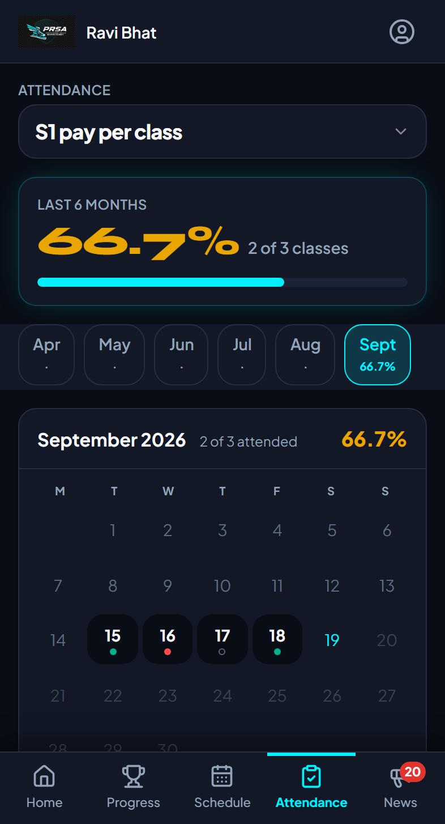
The parent app
Attendance as a calendar, news that reaches them, one login for every child
1
Month at a glance
A dot per class — present, late, absent, not marked; tap a day for detail
2
Family login
Switch between children; each has their own credits, bookings and fees
3
Profile
Update phone, change password
4
Only their own data
Row-level security in the database — a parent can never see another family
Attendance calendar
News & notifications
PRSA Skating Academy · Academy Management Platform
18

Slide 19
Built for trust
The rules live in the database, not just on the screen
1
Role-based access
2
Row-level security
Admin, coach, parent and platform owner each get their own app; the wrong URL shows a 403.
Every table is fenced by academy and by role — a parent’s query only ever returns their children.
3
Append-only money
4
Ledgers for credits & advances
Payments are never edited or deleted; voids keep the record with a reason. Fee status is derived, never typed.
Class credits and advance balances are sums of dated, attributed lines.
5
Audit trail
6
Guards in the database
Every change to a skater’s fees, payments, bookings and attendance is logged automatically and shown on the Activity tab.
A payment can’t be dated in the future; a booking can’t exceed the window; a fee can’t be flipped to paid by hand.
PRSA Skating Academy · Academy Management Platform
19

Slide 20
It runs itself overnight
A scheduled job keeps billing, credits and reminders current without anyone logging in
1
2
3
4
5
Generate fees
Mark overdue
Expire lapsed credits
Apply advances
Send reminders
Next period for every skater, 7 days ahead, pro-rated
Past the grace period → overdue, in the academy’s timezone
Unused classes on an ended term are expired, with a ledger line
Money paid ahead goes onto the open fee
Fee due, overdue, renewal — opt-in, never more than weekly per family
Academy settings the office can change without a developer
Timezone & currency
Fee lead & grace days
Receipt prefix
Top-up minimums (8 / 24 / 96)
Booking window (days)
Booking approval on / off
Auto-reminders & days before
PRSA Skating Academy · Academy Management Platform
20

Slide 21
Tested like a product, not a prototype
A full QA cycle was executed in the browser, every defect fixed and re-verified
187
21 → 0
122
8
test cases executed across every module and role
defects found → open after the fix cycle
unit tests on the business rules
end-to-end browser tests (login, payments, bookings)
Smoke, functional, negative, boundary, role isolation, responsive (375 / 768 / 1280), error handling, regression
Money rules proven end to end: partial payments, overpay cap, voids, receipts, reconciliation all matched the ledger
Credits verified in the ledger for every attendance transition
Typecheck, lint, unit and browser tests must be green before any release
PRSA Skating Academy · Academy Management Platform
21

Slide 22
Built to be maintained
Modern, mainstream stack — and documentation written for a non-technical owner
Web app
React 18 · TypeScript · Vite · Tailwind
Documentation that ships with the code
RUNBOOK — step-by-step operations: settings, month-end, email provider, approvals
CHANGELOG — every change in plain language, dated
DECISIONS — why each rule works the way it does, with the alternatives considered
DATA-MODEL — every table, column and policy
Feature guides — screens, rules, edge cases and known limits per module
QA pack — test plan, 187 cases, execution report, readiness report (PDF)
Data & auth
Supabase (Postgres, row-level security, storage)
Server logic
34 versioned database migrations; nightly Edge Function
Quality
Vitest · Playwright · ESLint · strict TypeScript · Sentry
PRSA Skating Academy · Academy Management Platform
22

Slide 23
Go-live plan
What happens between today and the first family logging in
1
Configure email
Custom SMTP provider in Supabase so invites and reminders are not rate-limited (the only open item from QA)
2
Load the academy
Batches, coaches, fee plans, levels & skills; import skaters and parents; set timezone, receipt prefix and minimums
3
Pilot with one batch
Two weeks: coach marks attendance, parents book, office records fees; adjust settings
4
Roll out
Invite every family; announce through the app; switch reminders on
5
Hand over
Owner walkthrough of the RUNBOOK; monthly reconciliation routine; support contact
PRSA Skating Academy · Academy Management Platform
23

Slide 24
Thank you
Questions, a live walkthrough, or a pilot batch — whenever you are ready.
PRSA · Skating Academy Management Platform

