Slide 1
Cloud Scale Machine Learning
The Intersection of Data Science and DevOps
aka.ms/cloudmlfeedback

Slide 2
Preamble – The Agenda
An Overview of Machine Learning
Lab – Hands on with scikit-learn and TensorFlow
Understanding Azure Machine Learning service
Lab – Your First Machine Learning Experiment in the Cloud
Advanced Experimentation Techniques in Azure Machine Learning service
Lab – Hands-on Advanced Experimentation in Azure Machine Learning service
The Intersection of Data Science and DevOps
Lab – Automating your Machine Learning Pipeline in the Cloud

Slide 3
Preamble – The Agenda
An Overview of Machine Learning
Lab – Hands on with scikit-learn and TensorFlow
Understanding Azure Machine Learning service
Lab – Your First Machine Learning Experiment in the Cloud
Advanced Experimentation Techniques in Azure Machine Learning service
Lab – Hands-on Advanced Experimentation in Azure Machine Learning service
The Intersection of Data Science and DevOps
Lab – Automating your Machine Learning Pipeline in the Cloud

Slide 4


Preamble – Some Initial Thoughts

Slide 5

Preamble – Some Initial Thoughts
https://github.com/cloudscaleml/

Slide 6


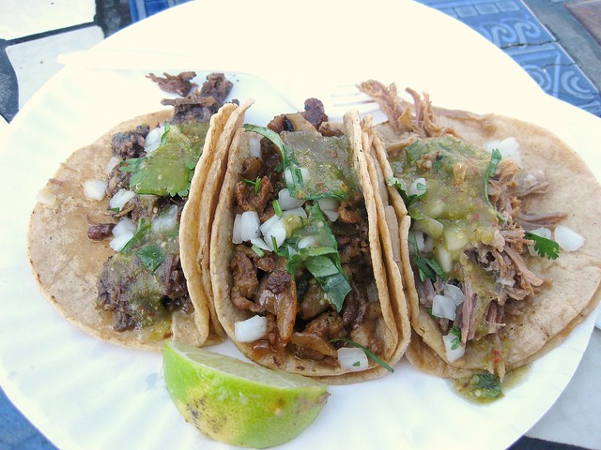
Preamble – What are we making?
burrito
tacos

Slide 7
ok, now for reals

Slide 8
Machine Learning Process
Prepare data
Evaluate
Production
Build and train
Notes:
Let’s talk about the work that happens when creating a predictive model
Usually, there’s some data discovery, transformation, and preparation… some building of a model and training using that data… then an evaluation of the suitability of that model
This is a highly iterative, experimental process that might mean going back to the drawing board many times over, over a long period of time.
When it’s time to actually deploy a model, it’s often similar to the way we used to do software – package it up, and let the developers or operations team deploy it somehow

Slide 9
Machine Learning Process
Notes:
The creation process often happens on a data scientist’s machine, or shared hardware for intensive training
And deployment quite often happens by passing USB drives around, or even by email.

Slide 10




DevOps Process
1
4
Plan
Monitor + Learn
Development
Production
2
3
Develop + Test
Release
Notes:
Let’s contrast this to a good devops process where we plan, develop and test, release to test then production environnments, then monitor what happens in production…
But is DevOps just for software development? The algorithms we spoke about at the start?

Slide 11
DevOps
DevOps is the union of people, process, and products to enable continuous delivery of value to our end users.
Notes:
Let’s look at Microsoft’s definition of DevOps (read it).
The most important word here is “value”. DevOps is not about code or bug fixes, it’s about continuously delivering value.
If you have a predictive model, and you can make that model better – that is absolutely valuable.
So this definition doesn’t exclude ML.
Let’s look at a product that can help.

Slide 12


Pipelines
Azure ML Pipelines
Azure Pipelines
Notes:
You may have heard of Azure Pipelines, but it’s important to note these are different products.
We’ll talk about the differences in a minute, but at a high level, ML pipelines are good for training workflows, and Azure Pipelines are good for orchestration. They have different focuses.

Slide 13
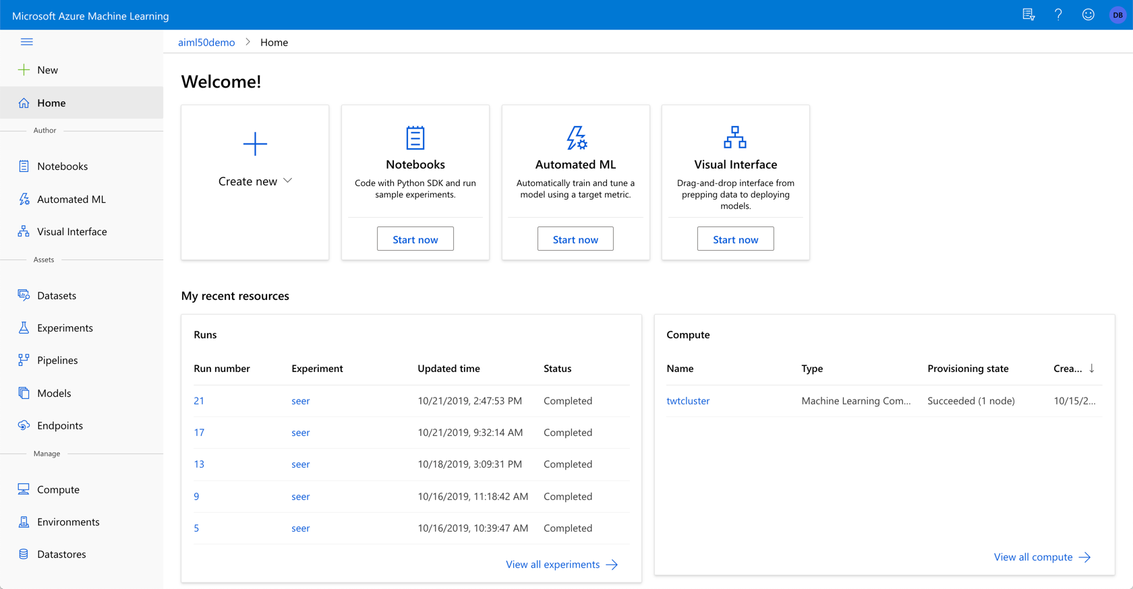
ml.azure.com
Notes:
Azure Machine Learning Service is a set of services for helping your MLOps (or DevOps for ML) efforts.
You can get to it by going to ml.azure.com
Let’s drill into a few of the things it helps you manage

Slide 14
Azure Machine Learning
Datasets – registered, known data sets
Experiments – Training runs
Pipelines – Training workflows
Models – Registered, versioned models
Endpoints:
Real-time Endpoints – Deployed model endpoints
Pipeline Endpoints – Training workflow endpoints
Compute – Managed compute
Environments – defined training and inference environments
Datastores – Connections to data
Notes:
[Just list and describe as per the individual points]

Slide 15
Azure Machine Learning
Datasets – registered, known data sets
Experiments – Training runs
Pipelines – Training workflows
Models – Registered, versioned models
Endpoints:
Real-time Endpoints – Deployed model endpoints
Pipeline Endpoints – Training workflow endpoints
Compute – Managed compute
Environments – defined training and inference environments
Datastores – Connections to data
Notes:
We’re going to focus for the moment on Pipelines. Pipelines are workflows for training our models, and we want to build one so we can have a repeatable way to build our predictive model.

Slide 16
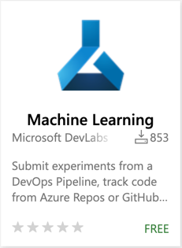
Pipelines
az extension add -n azure-cli-ml
Azure ML Pipelines
Azure Pipelines
pip install --upgrade azureml-sdk
Notes:
What’s the difference? Why use both?

Slide 17

Azure Machine Learning Pipelines
Workflows with of steps that can use Data Sources, Datasets, and Compute targets
Unattended runs
Reusability
Tracking and versioning of ML concepts
Notes:
ML Pipelines are designed for ML-specific workflows.
Unattended runs – ML training can be very long-running, and ML pipelines can handle that extremely well
Reusability – individual steps in a workflow can be resource intensive, and may not need to be run every time. If your data prep step doesn’t need to be run again, you can just reuse the output from last time.
Tracking… - Everything that’s stored is focused on ML, rather than building general software

Slide 18
Azure Pipelines
Orchestration for Continuous Integration and Continuous Delivery
Gates, tasks, and processes for quality
Integration with other services
Triggers on code and non-code events
Notes:
By contrast, Azure Pipelines are really designed for CI/CD
Gates… - They’re a great place to build in quality and checks and balances
Integration – with other applications, artifacts, and dependencies
Triggers – You way want to trigger orchestration for any number of reasons

Slide 19
Azure Machine Learning
Datasets – registered, known data sets
Experiments – Training runs
Pipelines – Training workflows
Models – Registered, versioned models
Endpoints:
Real-time Endpoints – Deployed model endpoints
Pipeline Endpoints – Training workflow endpoints
Compute – Managed compute
Environments – defined training and inference environments
Datastores – Connections to data
Notes:
We’re going to focus for the moment on Pipelines. Pipelines are workflows for training our models, and we want to build one so we can have a repeatable way to build our predictive model.

Slide 20
Azure Machine Learning
Datasets – registered, known data sets
Experiments – Training runs
Pipelines – Training workflows
Models – Registered, versioned models
Endpoints:
Real-time Endpoints – Deployed model endpoints
Pipeline Endpoints – Training workflow endpoints
Compute – Managed compute
Environments – defined training and inference environments
Datastores – Connections to data
Notes:
While we’re focusing on pipelines, the pipeline we create uses most of the other features of Azure Machine Learning

Slide 21
AML Pipelines
… a demo

Slide 22
Azure Machine Learning Pipelines
Data Preparation
Notes:
So here’s what we built – the AML pipeline
Data prep

Slide 23
Azure Machine Learning Pipelines
Data Preparation
Training
Notes:
Training step

Slide 24
Azure Machine Learning Pipelines
Data Preparation
Training
Model Registration
Notes:
Registration of the model

Slide 25
Azure Machine Learning Pipelines
Dataset
Compute
Data Preparation
Training
Model Registration
Notes:
We also made use of a Dataset (or data source), and compute

Slide 26
(Some) DevOps Good Practices
Source Control
Continuous Integration
Continuous Delivery
Notes:
Some of the good DevOps practices we use in software development can also apply for ML projects – let’s talk about them.

Slide 27
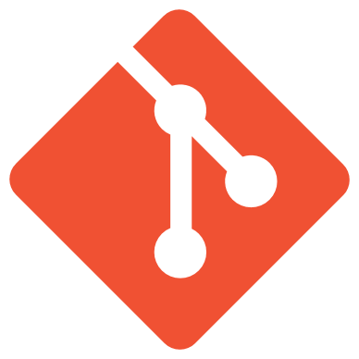
Source Control
Code and comments only (not Jupyter output)
Plus every part of the pipeline
And Infrastructure and dependencies
And maybe a subset of data
Notes:
Jupyter Notebook files contain not just the input, but also the output. This can be confusing and make files difficult to merge. So we only want the input cells – the code that gets run.
We also want to define everything in our pipeline (which we are)
As well as infrastructure – like the compute – and any dependencies – python dependencies, libraries, etc.
And maybe some data – not the whole lot (because there can be many PB in ML projects), but maybe enough to try some proofs of concept

Slide 28
Everything should be in source control!
Except your training data which should be a known, shared data source
Notes:
A known shared data source means every data scientist is training against the same training data… and that training data is also being used to produce models

Slide 29

Continuous Integration
Triggered on code change
Refresh and execute AML Pipeline
Code quality, linting, and unit testing
Pull request process
aka.ms/mitt/azuredevops
Notes:
Let’s talk about CI. We want to:
Know when code changes in our source repository
Refresh then execute our AML Pipeline if we’ve change the way we’re training
We also want to check code quality – it’s code, so we want tests, linting, etc.
We can also add PR processes to ensure code still compiles before merging into master (and kicking off a potentially expensive training job!)
If you want to know more about Azure DevOps, go here.

Slide 30
Code quality matters!
Even in data science
Notes:
The important point is – this is all code and software. The quality of your code matters even if it’s not what you’re used to writing!

Slide 31
Azure Pipelines “Build”
… a demo

Slide 32
Azure Machine Learning Pipelines
Data Preparation
Training
Model Registration
Notes:
We could just add another step to the AML pipeline, but we don’t want to do that – we want a bit more control over our deployment.

Slide 33
Azure Machine Learning
Datasets – registered, known data sets
Experiments – Training runs
Pipelines – Training workflows
Models – Registered, versioned models
Endpoints:
Real-time Endpoints – Deployed model endpoints
Pipeline Endpoints – Training workflow endpoints
Compute – Managed compute
Environments – defined training and inference environments
Datastores – Connections to data
Notes:
But we still haven’t deployed anything – we have a newly trained model, so how do we deploy?
AML Service has the ability to take a model and deploy it to ACI or AKS – we are going to make use of it, but not directly from the UI here.

Slide 34
Continuous Delivery
Trigger on model registration
Deploy to test and staging environments
Run integration and load tests
Control: rollout, feature flags, A/B testing
Notes:
Continuous Delivery can absolutely be applied to ML.
We’re going to use Azure Pipelines for our Continuous Delivery.
When a new model is registered, we’ll kick off our deployment
With Azure Pipelines, We can deploy to test and staging sites before putting our new model live
We can run tests in pre-prod environments
Importantly – what we’re doing is controlling our rollout using the same techniques we use for the rest of our software.

Slide 35
Control model rollout!
The same way you do with other software
Notes:
Don’t just put new models in production – you wouldn’t do it with the rest of your software, why do it with your ML?

Slide 36
Azure Pipelines Release
… a demo

Slide 37
Complete Pipeline
AML Pipeline
Data Preparation
Training
Model Registration
Azure DevOps Release Pipeline
Deployment to ACI
Deployment to AKS
Notes:
Here’s what we’ve created:
A pipeline for training, which is an AML pipeline – specific to training our model
When we get a new model, we kick off a deployment pipeline in Azure DevOps
Deploy to ACI, run some tests, then if all is well, maybe deploy to AKS

Slide 38
Retraining
AML Pipeline
Data Preparation
Training
Model Registration
Azure DevOps Release Pipeline
Deployment to ACI
Deployment to AKS
Notes:
Just like the rest of our software, we don’t want to put our model in production and leave it there, assuming it will always work.
So we need a retraining strategy.
Either periodically, or when the data is different enough in production that we’re not getting the results we want.
Azure ML Service has a solution for this

Slide 39
Retraining
Training
Dataset
Data Preparation
Training
Model Registration
Inference
Dataset
Deployment to ACI
Deployment to AKS
Notes:
When we train, we can do so from a known training data set
When we ultimately deploy a model to production, we can store the inputs into another dataset – our inference dataset

Slide 40
Complete Pipeline
AML Pipeline
Data Preparation
Training
Model Registration
Azure DevOps Release Pipeline
Deployment to ACI
Deployment to AKS
Notes:
Periodically, AML Service will let us compare these two data sets looking for “data drift”. If what we’re seeing in production drifts too much from what we trained our model on, we can kick off a new training process to produce a new model.
This can be done automatically

Slide 41
Complete Pipeline
AML Pipeline
Data Preparation
Training
Model Registration
Azure DevOps Release Pipeline
Deployment to ACI
Deployment to AKS
Notes:
Of course, if we change our code, we also want to change our training pipeline, which is what we saw today.

Slide 42
This was just an example…
Models may be embedded in software
Azure Cognitive Services has a great API
Azure Pipelines can orchestrate anything
Notes:
Importantly, this is just an example – we’re deploying our model to containers, but maybe we want to embed the models into our software
Or maybe we’re not using AML at all – maybe we’re using different cognitive services – and they all have great APIs that Azure Pipelines can talk to.
Ultimately, Azure Pipelines can orchestrate anything, so whatever set of tools you’re using, you can use it to manage your training.

Slide 43
Summary
All code and infra in source control
Known, shared data sources
AML Pipelines and Azure Pipelines
Have retraining strategies
DevOps good practices for delivery
Notes:
In summary.

Slide 44
How does Seer work??
A demo

Slide 45
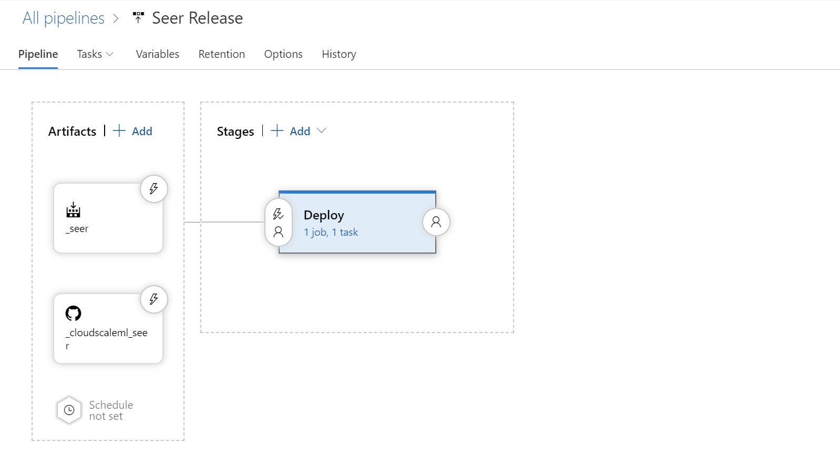

Slide 46
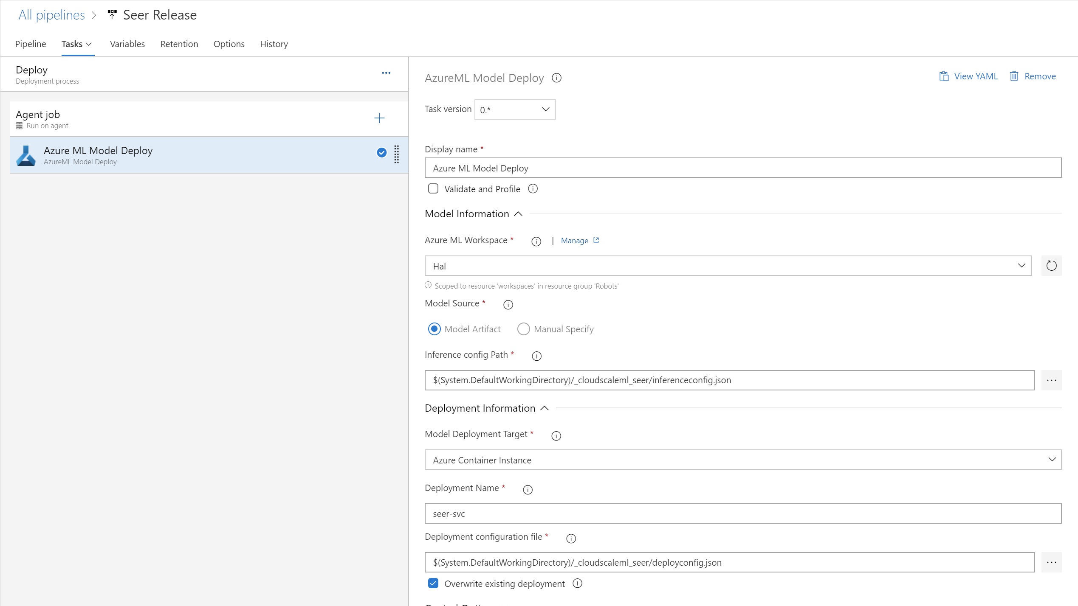

Slide 47

MLOps
Questions?

Slide 48
Lab
Automating your Machine Learning Pipeline in the Cloud

Slide 49
http://aka.ms/cloudmlfeedback
Please send us your feedback!!!

