Slide 1
Winter Storm Season Crew Briefing 2026 to 2027
Distribution Operations, all regions
Presented by Dale Hutchins, Storm Coordinator Lead
Notes:
Welcome crews. This briefing is mandatory for all line, forestry and damage assessment staff before November 1. Attendance is recorded in the learning system.

Slide 2
Agenda
• Season at a glance
• Where to report: this season's staging areas
• How call-outs work
• The three critical safety numbers
• Work and rest rules
• Restoration priorities
• Mutual assistance crews
• Questions
Notes:
Keep this under 45 minutes. Leave time for questions at the end.

Slide 3
Season at a glance
• Winter storm season runs November 1, 2026 to March 31, 2027
• Forecast review twice daily; readiness levels Green, Amber, Red
• Last season: 11 storm events, 3 reached L3 Major, 1 reached L4 Emergency
• Focus this year: fewer strain injuries, faster damage assessment
Notes:
Remind crews that readiness levels come from the Storm Restoration Playbook. Last season's L4 event was the February ice storm in Eastern Ontario.

Slide 4
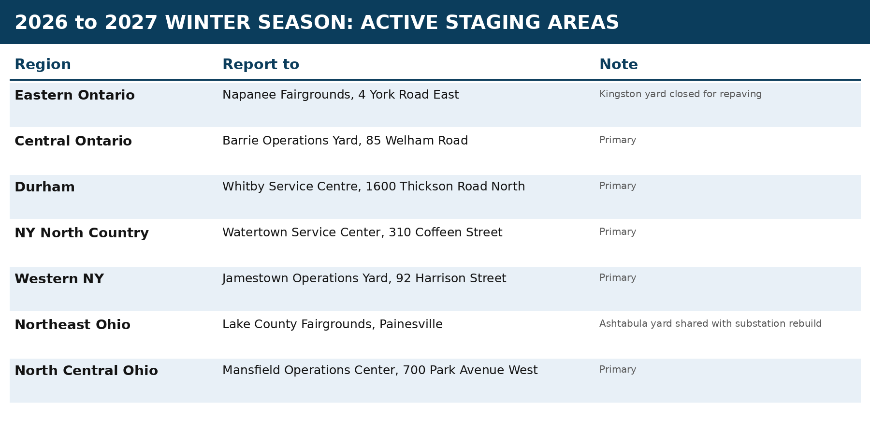
Where to report this season
Notes:
Walk through the table on the slide region by region. Two regions are not using their usual yard this season, so point those out and make sure crews in those regions know where to go.

Slide 5
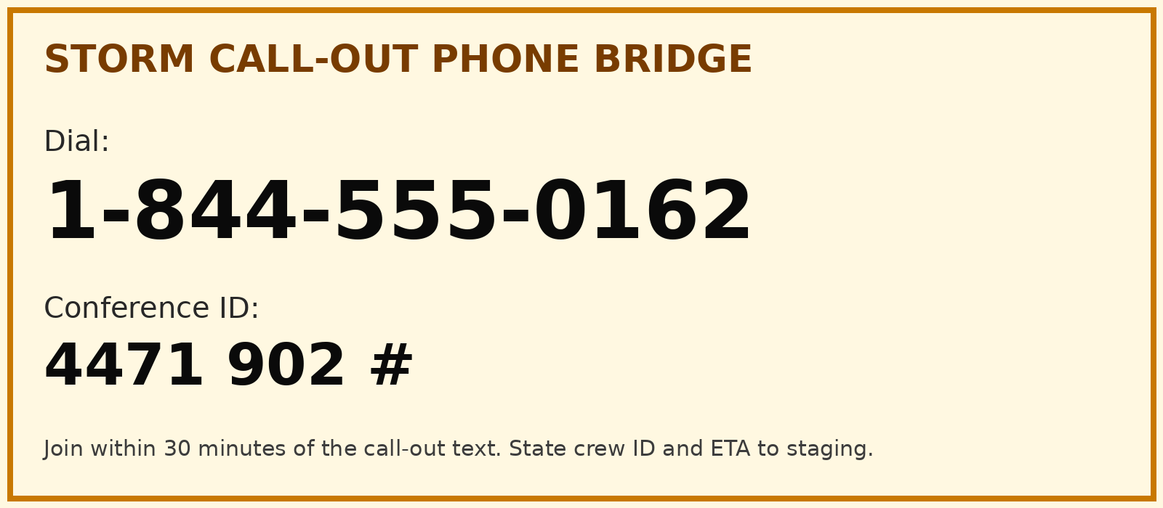
How call-outs work
• You receive a call-out text from the storm dispatch system
• Join the phone bridge shown on the right
• Confirm crew ID, members and ETA to staging
• No answer within 30 minutes: dispatch moves to the next crew on the list
Notes:
Everyone should save the bridge details from this slide in their phone today. Do not rely on searching for it during an event.

Slide 6
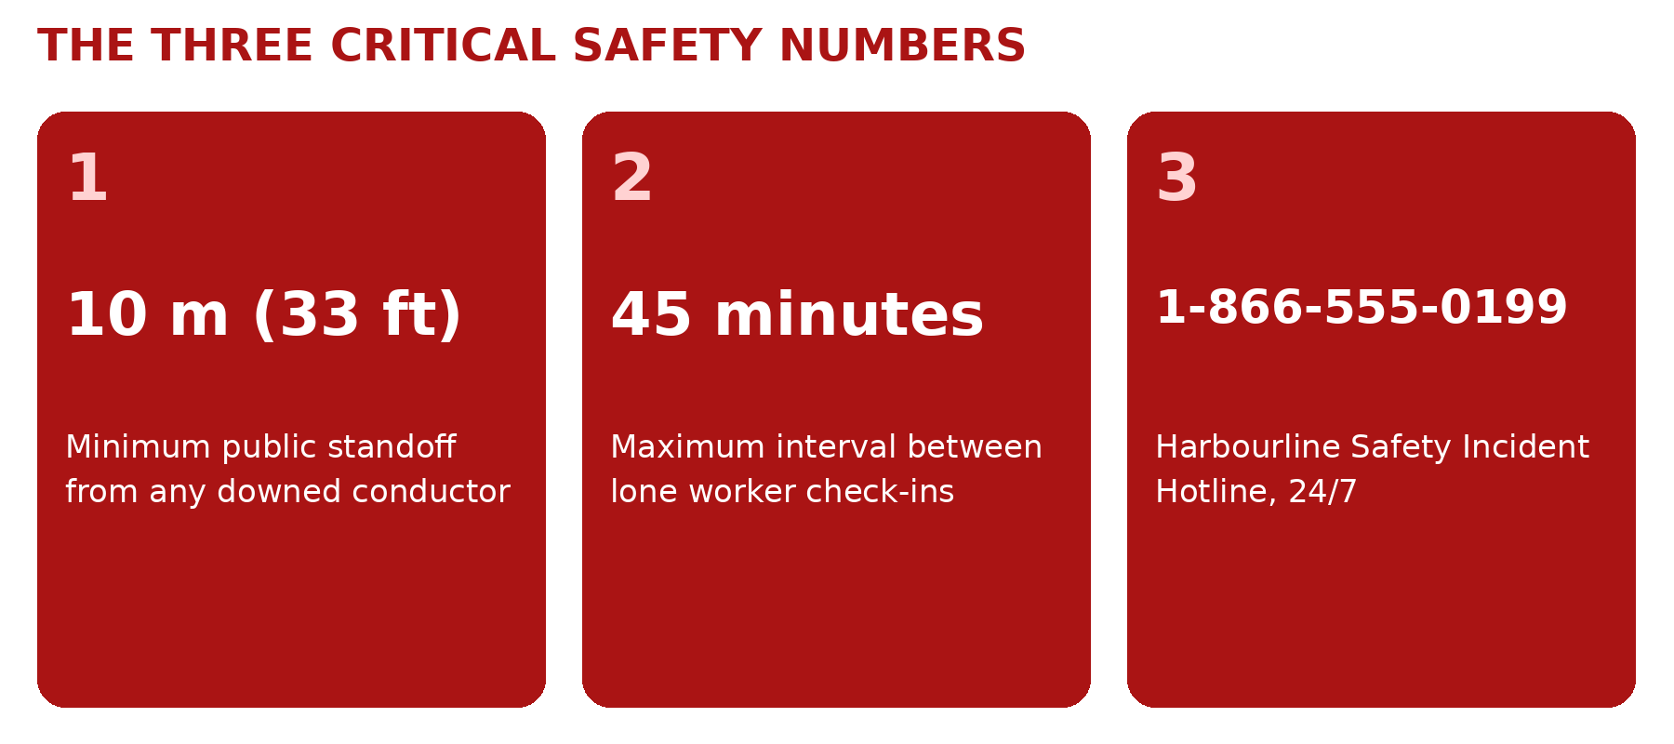
The three critical safety numbers
Notes:
Ask each crew leader to repeat the three numbers back. These are checked at every storm tailboard.

Slide 7
Work and rest rules
• Maximum 16 consecutive hours, then at least 8 consecutive hours of rest
• Travel to and from lodging counts as work time
• Extension to 18 hours only to remove an immediate public safety hazard, approved and logged
• Meal break at least every 5 hours
• Fatigue checklist at the start of every shift
Notes:
These rules match the Storm Restoration Playbook, section 6. They apply to contractors and mutual assistance crews too.

Slide 8
Restoration priorities
• 1. Public safety hazards and wires down
• 2. Hospitals and long term care homes
• 3. Water and wastewater treatment and pumping
• 4. 911 centres, police, fire and EMS
• 5. Life support customers
• 6. Stations and feeder mainlines, then taps, then individual services
Notes:
From the Outage Response Procedure, section 7. The Storm Coordinator sets the sequence within this order.

Slide 9
Working with mutual assistance crews
• Incoming crews complete a 90 minute onboarding at staging
• One Harbourline escort for every 4 incoming crews
• Share our grounding and lockout rules at every tailboard
• Released longest travel distance first
Notes:
Be welcoming. Most incoming crews have not worked on 27.6 kV or 44 kV systems before.

Slide 10
Questions
• Contact your Regional Storm Lead
• Playbook and procedures are on the Harbourline-Operations site, Procedures library
Notes:
Close by reminding crews to check their call-out contact details in the storm dispatch system.

