Slide 1


Docker

Slide 2

Credits
Some of the slides have been taken from Docker training ppt published by Docker
The Docker logo is visible in these slides
Images in the other slides have been taken from the Docker website (https://www.docker.com)

Slide 3

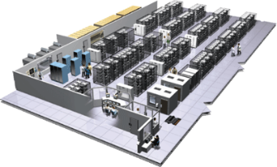
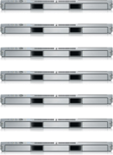
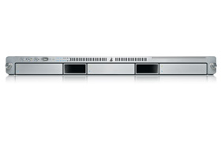
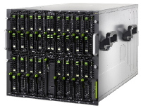

The Challenge
User DB
Static website
postgresql + pgv8 + v8
Queue
Analytics DB
nginx 1.5 + modsecurity + openssl + bootstrap 2
Do services and apps interact appropriately?
Redis + redis-sentinel
hadoop + hive + thrift + OpenJDK
Multiplicity of Stacks
Background workers
Web frontend
Python 3.0 + celery + pyredis + libcurl + ffmpeg + libopencv + nodejs + phantomjs
Ruby + Rails + sass + Unicorn
API endpoint
Python 2.7 + Flask + pyredis + celery + psycopg + postgresql-client
Production Cluster
Development VM
Public Cloud
Multiplicity of hardware environments
QA server
Can I migrate smoothly and quickly?
Disaster recovery
Customer Data Center
Contributor’s laptop
Production Servers

Slide 4
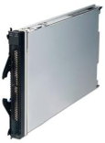
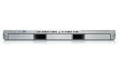
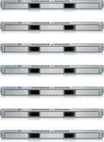

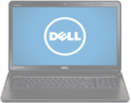
The Matrix From Hell
? | ? | ? | ? | ? | ? | ?
? | ? | ? | ? | ? | ? | ?
? | ? | ? | ? | ? | ? | ?
? | ? | ? | ? | ? | ? | ?
? | ? | ? | ? | ? | ? | ?
? | ? | ? | ? | ? | ? | ?
Static website
Web frontend
Background workers
User DB
Analytics DB
Queue
 | Development VM | QA Server | Single Prod Server | Onsite Cluster | Public Cloud | Contributor’s laptop | Customer Servers

Slide 5
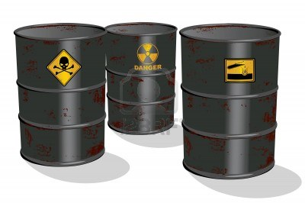
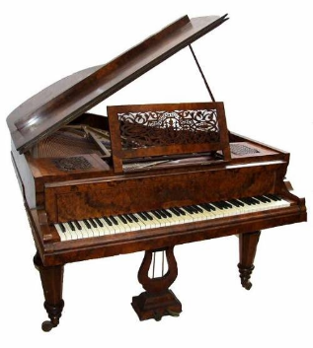

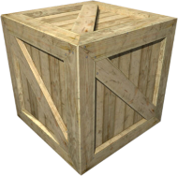
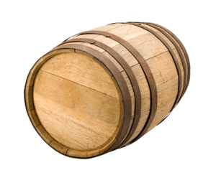
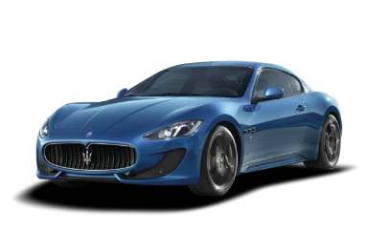
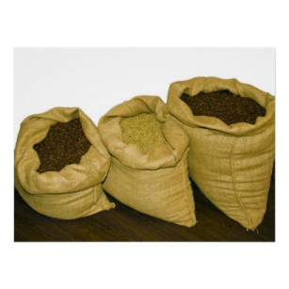

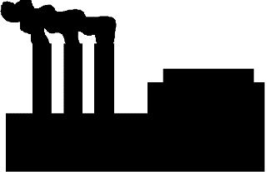

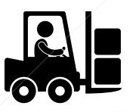
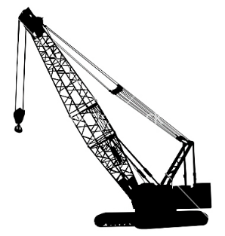
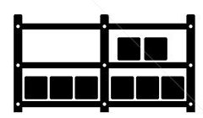

Cargo Transport Pre-1960
Do I worry about how goods interact (e.g. coffee beans next to spices)
Multiplicity of Goods
Multipilicity of methods for transporting/storing
Can I transport quickly and smoothly
(e.g. from boat to train to truck)

Slide 6
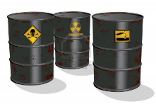

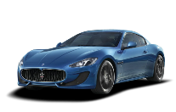


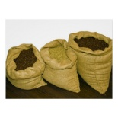


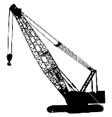



Also a matrix from hell
 | ? | ? | ? | ? | ? | ? | ?
 | ? | ? | ? | ? | ? | ? | ?
 | ? | ? | ? | ? | ? | ? | ?
 | ? | ? | ? | ? | ? | ? | ?
 | ? | ? | ? | ? | ? | ? | ?
 | ? | ? | ? | ? | ? | ? | ?

Slide 7

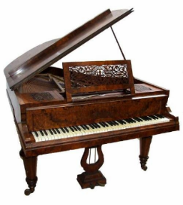

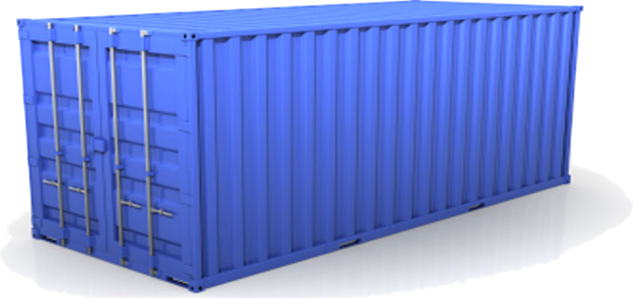
Solution: Intermodal Shipping Container
Do I worry about how goods interact (e.g. coffee beans next to spices)
Multiplicity of Goods
A standard container that is loaded with virtually any goods, and stays sealed until it reaches final delivery.
…in between, can be loaded and unloaded, stacked, transported efficiently over long distances, and transferred from one mode of transport to another
Can I transport quickly and smoothly
(e.g. from boat to train to truck)
Multiplicity of methods for transporting/storing

Slide 8
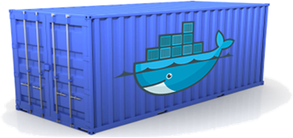
Docker is a shipping container system for code
Static website
User DB
Web frontend
Queue
Analytics DB
Do services and apps interact appropriately?
Multiplicity of Stacks
An engine that enables any payload to be encapsulated as a lightweight, portable, self-sufficient container…
…that can be manipulated using standard operations and run consistently on virtually any hardware platform
Multiplicity of hardware environments
Can I migrate smoothly and quickly
Development VM
QA server
Customer Data Center
Public Cloud
Production Cluster
Contributor’s laptop

Slide 9

Docker eliminates the matrix from Hell
Static website
Web frontend
Background workers
User DB
Analytics DB
Queue
 | Development VM | QA Server | Single Prod Server | Onsite Cluster | Public Cloud | Contributor’s laptop | Customer Servers

Slide 10
Why Developers Care
Build once…(finally) run anywhere*
A clean, safe, hygienic and portable runtime environment for your app.
No worries about missing dependencies, packages and other pain points during subsequent deployments.
Run each app in its own isolated container, so you can run various versions of libraries and other dependencies for each app without worrying
Automate testing, integration, packaging…anything you can script
Reduce/eliminate concerns about compatibility on different platforms, either your own or your customers.
Cheap, zero-penalty containers to deploy services? A VM without the overhead of a VM? Instant replay and reset of image snapshots? That’s the power of Docker
* With the 0.7 release, we support any x86 server running a modern Linux kernel (3.2+ generally. 2.6.32+ for RHEL 6.5+, Fedora, & related)

Slide 11
Why Devops Cares?
Configure once…run anything
Make the entire lifecycle more efficient, consistent, and repeatable
Increase the quality of code produced by developers.
Eliminate inconsistencies between development, test, production, and customer environments
Support segregation of duties
Significantly improves the speed and reliability of continuous deployment and continuous integration systems
Because the containers are so lightweight, address significant performance, costs, deployment, and portability issues normally associated with VMs

Slide 12
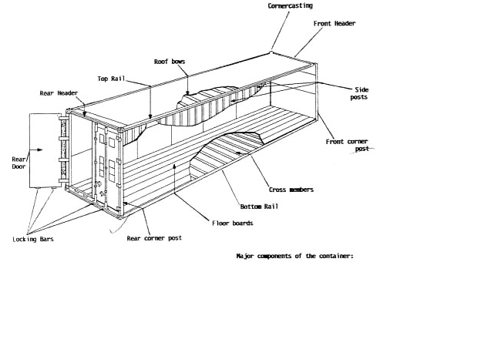
Why it works—separation of concerns
Dan the Developer
Worries about what’s “inside” the container
His code
His Libraries
His Package Manager
His Apps
His Data
All Linux servers look the same
Oscar the Ops Guy
Worries about what’s “outside” the container
Logging
Remote access
Monitoring
Network config
All containers start, stop, copy, attach, migrate, etc. the same way

Slide 13
More technical explanation
WHY
WHAT
Run everywhere
Regardless of kernel version (2.6.32+)
Regardless of host distro
Physical or virtual, cloud or not
Container and host architecture must match*
Run anything
If it can run on the host, it can run in the container
i.e. if it can run on a Linux kernel, it can run
High Level—It’s a lightweight VM
Own process space
Own network interface
Can run stuff as root
Can have its own /sbin/init (different from host)
<<machine container>>
Low Level—It’s chroot on steroids
Can also not have its own /sbin/init
Container=isolated processes
Share kernel with host
No device emulation (neither HVM nor PV) from host)
<<application container>>

Slide 14
Containers vs. VMs
App
A
App
A’
App
B
Containers are isolated,
but share OS and, where
appropriate, bins/libraries
Bins/
Libs
Bins/
Libs
Bins/
Libs
VM
Guest
OS
Guest
OS
Guest
OS
…result is significantly faster deployment, much less overhead, easier migration, faster restart
Guest
OS
Guest
OS
App A
App A’
App B
App B’
App B’
App B’
Container
Docker
Hypervisor (Type 2)
Bins/Libs
Bins/Libs
Host OS
Host OS
Server
Server

Slide 15
Docker History
Started as a PaaS platform
Called dotCloud
In 2013, dotCloud was struggling
Re-branded as Docker Inc
Bringing containers to the world
Now it is valued close to $1Bn
Has raised more than $259million
Docker has two editions
Community Edition (CE)
Enterprise Edition (EE)

Slide 16
Container Ecosystem
Core philosophy of Docker: “Batteries included, but removeable”
Ex: Network stack
Open Container Initiative
Responsible for standardizing fundamental components of container infra
Ex: Image formats, Container run time

Slide 17
Lab 1: Install Docker
Create
Create a Docker Hub account
Download
Download Docker for Windows
Install
Install Docker for Windows
Install
Optional: Install docker on Amazon Linux

Slide 18
Docker: A brief lab

Slide 19
Docker
When Docker is installed you get two components
Docker Daemon
Docker Client
In Linux case, client talks to daemon using Unix socket
In Windows case, client talks to daemon using named pipes
Type ‘docker version’ to check if both client and server are running

Slide 20
Images
Docker image is like a VM template
Similar to AWS AMI
Contains the OS and the application
‘docker image ls’ will provide a list of images available in the local host
Downloading an image is also called ‘pulling an image”
‘docker pull ubuntu:latest’

Slide 21
Containers
The image we pulled will be run inside a container
‘docker container run –it ubuntu:latest /bin/bash’
Here were are specifying which command should be run first
We are also specifying which image to be used
The prompt will change
We are inside the container
Issue any linux command like ls or ps

Slide 22
Lab 2
List the images available
docker images ls
Pull an image
docker image pull ubuntu:latest
List the images again and verify in ubuntu is available
Run the container with this image
docker container run –it ubuntu:latest /bin/bash
You are in bash now. Proceed to give Linux commnds (ls, pwd etc)

Slide 23
Lab 2
Stop
Stop the container
Use Ctrl-pq to come out of the container
Get the container name using docker container ls
Reattach
Reattach using docker exec command
docker exec –it <container name> bash
Stop
Stop the container
docker stop <container name>
Remove
Remove the container
docker rm <container name>

Slide 24
Lab 3
Create an account in GitHub
Download GitHub for Windows
Ensure Github cli works

Slide 25


Thanks

