Slide 1


Kubernetes

Slide 2


What is Kubernetes
Orchestrator of containerized Apps
Deploy and Maintain Applications which are built on containers
Performs
Scaling
Placement
Load Balancing
Updates
Self healing

Slide 3
Kubernetes History
Was developed initially by Google
Open Sourced in 2014
Was handed over to Cloud Native Compute Foundation
Written in Go Language
Borg->Omega->Kubernetes

Slide 4
Kubernetes & Docker
Kubernetes and Docker work together
Kubernetes orchestrates the hosts that run containers
Docker controls the containers

Slide 5


Principle of Operation

Slide 6
High Level View
Kubernetes is an orchestration software
Orchestrator of containerized apps
Basically for MicroServices apps
An app is made of multiple services
Each service is packaged
These packaged services are then given to Kubernetes
Kubernetes cluster
Master and nodes
Deploy the application using JSON or YAML manifest file

Slide 7
How Kubernetes works
Describe your cluster’s desired state
what applications or other workloads you want to run
what container images they use
the number of replicas
what network and disk resources you want to make available etc
Once you’ve set your desired state, the Kubernetes Control Plane makes the cluster’s current state match the desired state
Starting or restarting containers
Scaling the number of replicas of a given application etc

Slide 8
Kubernetes Cluster : Master & Nodes
Kubernetes Cluster is made up of Master & Nodes
Nodes are also called Minions
These are Linux hosts running on VM, Bare Metal or Cloud
Kubernetes has six components that make up a running cluster
API server
Scheduler
Controller manager
kubelet
kube-proxy
etcd

Slide 9
Kubernetes Cluster Master
The cluster master runs the Kubernetes control plane processes
Kubernetes API server
Scheduler
Control Manager
API server
Exposes a highly-configurable REST interface to all of the Kubernetes resources
Scheduler
Place the containers on the node in the cluster according to various policies, metrics, and resource requirements
Control Manager
Responsible for reconciling the state of the cluster with the desired state
Cluster Store

Slide 10
Kubernetes Control Plane (cont)
Cluster store
The configuration and state of the cluster is stored in Cluster store
Cluster store is based on etcd, the popular key value store
Cluster store needs to be protected as this is the single source of truth
Kubernetes master runs all control plane services
We interact with control plane via the API Server
API Server exposes a RESTful endpoint at port 443
All Master services can run on a single node
Multi node HA Master is preferrable

Slide 11
Kubernetes Cluster Nodes
Nodes typically run
kubelet
Network Proxy
Container engine
kublet
Interacts with container engine to bring up containers as needed
Network Proxy aka kube-proxy
Is in charge of managing network connectivity to the containers
Container engine
Docker engine in our case

Slide 12
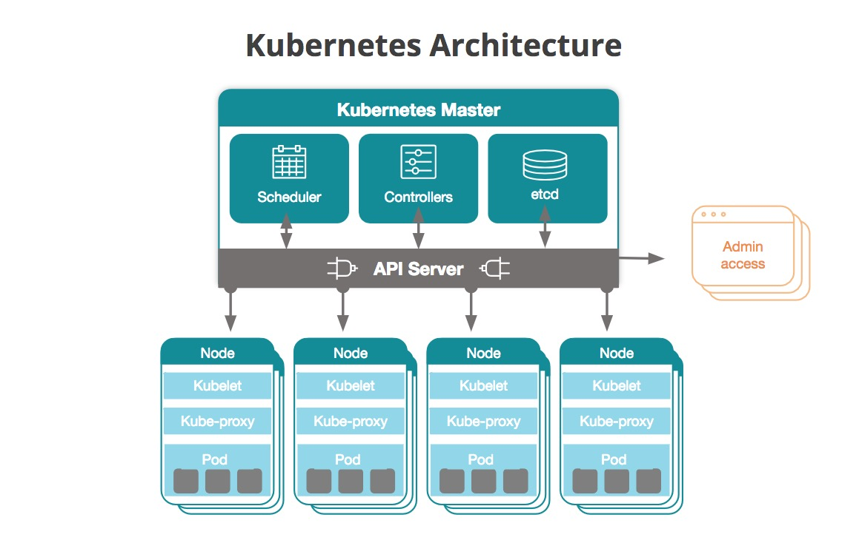
Kubernetes Architecture
Img: New Relic blog

Slide 13
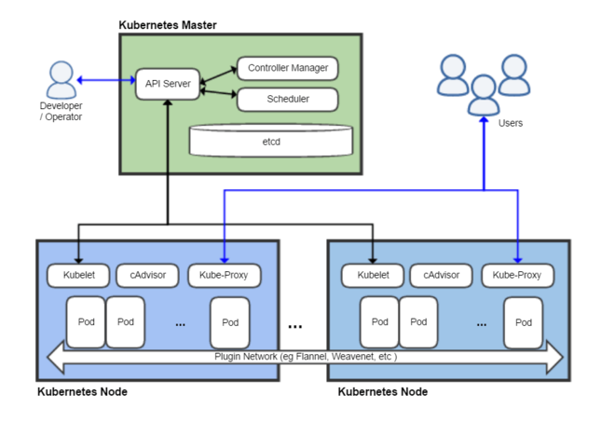
Kubernetes Architecture
Img: Wikipedia

Slide 14
API Server & Cluster Store
API Server
Front end of the Kubernetes control plane
Exposes a RESTful API
We post manifest files to it (JSON or YAML)
Manifest files are validated by API server and work is performed
This is the brains of the Cluster
Cluster store
Is the memory of the Cluster
The only stateful component of the cluster
Configuration and state of cluster stored in a persistent manner
Based on etcd

Slide 15
Controller Manager & Scheduler
Controller Manager
A monolith as of now
Contains node controller, endpoint controller, namespace controller etc
Watches for changes in configuration
Aim is to make current state match the desired state
Scheduler
kube-scheduler
Watches for new workloads and assigns them to nodes
Does resource management

Slide 16
Kubelet & kube-proxy
kubelet
Agent that runs on all nodes
Registers the host with the master as a node
Watches API server for new work assignments
Carries out assigned tasks and reports back to Master
kube-proxy
The networking brains on the node
Assigning IPs to Pods
Does some lightweight load balancing

Slide 17
Kubernetes Objects
Kubernetes Objects are abstractions that represent the state of the system
They can describe
What containerized applications are running (and on which nodes)
The resources available to those applications
The policies around how those applications behave, such as restart policies, upgrades, and fault-tolerance
To work with Kubernetes objects we need to use Kubernetes API
kubectl command-line interface can be used to make the necessary calls to the API

Slide 18
Basic Kubernetes Objects
Pod
Service
Volume
Namespace

Slide 19
Controllers
Higher level abstraction
Build upon the basic objects, and provide additional functionality and convenience
ReplicaSet
Deployment
StatefulSet
DaemonSet
Job

Slide 20

Pods

Slide 21
Pods
Smallest deployable object in Kubernetes Object Model
Also represents a process running on the cluster
Containers run inside the pods
Pod is a group of one or more containers, with networking, and with a specification of how to run the container
Single container in a Pod
Advance cases: Multiple containers in a Pod
A Pod’s contents are always co-located and co-scheduled, and run in a shared context

Slide 22
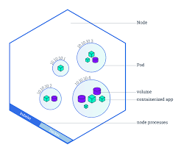
Kubernetes Pods and Node
Img: Kubernetes Bootcamp

Slide 23
Pods and Scaling
Pods are the smallest unit of scaling
If you want to scale the application, add more Pods
You cannot scale an application by adding more containers to a Pod
Multi container Pods are to host containers that communicate with each other
Multi container Pods are not for scaling
A Pod can only exist on single node
Pod cannot spread over multiple nodes

Slide 24

Service

Slide 25
Motivation for Service
Each Pod gets its own IP address, however in a Deployment, the set of Pods running in one moment in time could be different from the set of Pods running that application a moment later
If some set of Pods (call them “backends”) provides functionality to other Pods (call them “frontends”) inside your cluster, how do the frontends find out and keep track of which IP address to connect to

Slide 26
Service Object
A Service in Kubernetes is an abstraction which defines a logical set of Pods and a policy by which to access them
Services enable a loose coupling between dependent Pods
Although each Pod has a unique IP address, those IPs are not exposed outside the cluster without a Service
Services allow your applications to receive traffic

Slide 27
Exposing a Service
ClusterIP (default)
Exposes the Service on an internal IP in the cluster
This type makes the Service only reachable from within the cluster
NodePort
Exposes the Service on the same port of each selected Node in the cluster using NAT
Makes a Service accessible from outside the cluster using <NodeIP>:<NodePort>
Load Balancer
Creates an external load balancer in the current cloud (if supported) and assigns a fixed, external IP to the Service
External Name
Exposes the Service using an arbitrary name (specified by externalName in the spec) by returning a CNAME record with the name

Slide 28
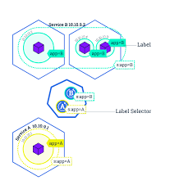
Service

Slide 29

Declarative Model

Slide 30
Declarative Model
Declarative model and desired state
These are the core of Kubernetes
The way these work in Kubernetes
Clearly state your desired state in your manifest file
Then ensure you POST this state to the API server
Kubernetes stores your desired state in the Cluster Store
Then Kubernetes acts by deploying your application to the cluster
Once your app is deployed, Kubernetes watches you application to ensure that it does not drift away from the desired state

Slide 31
MANIFEST File
The MANIFEST file is a JSON or YAML file
In this file we clearly state the required state of our application
We can state things like
Number of replicas to use
Which image to use
Which network to use and so on
We then POST this manifest file to Kubernetes API server
We use kubectl command for the purpose
Port 443 on the master is used

Slide 32
How the Manifest file is used
Once the Manifest file is uploaded, Kubernetes starts its work
It identifies the concerned controller (say the Deployment controller) and sends task to it
It also records the desired state in the cluster store
It issues the workloads to the nodes
Nodes then pull the image, start containers and build networks
Once the application is running, Kubernetes starts a watch loop to watch whether the application is always in the desired state

Slide 33
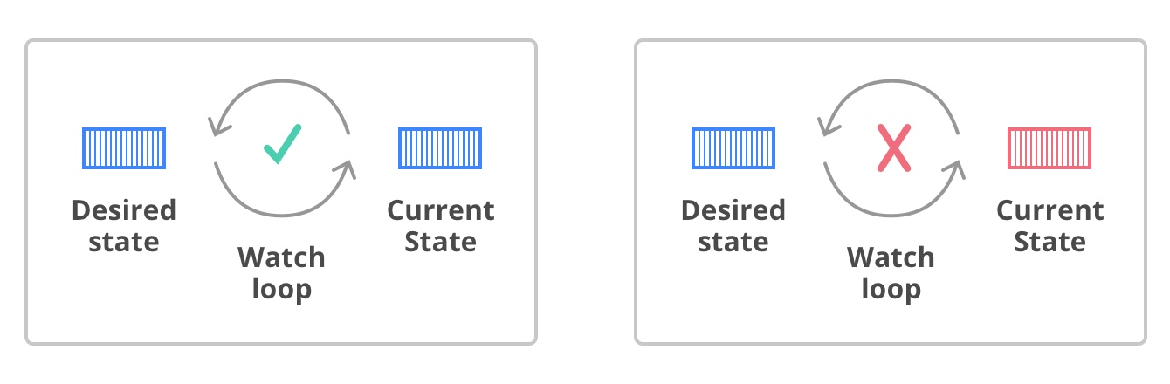
Kubernetes Watch Loop
Img Credit: Kubernetes Book

Slide 34
An example Manifest file
https://kubernetes.io/docs/concepts/cluster-administration/manage-deployment/#organizing-resource-configurations

Slide 35

Thanks

