Slide 1


Describe Once, Run Wherever?
A quirky guide to Spring in the cloud with Apache Brooklyn
Oct 2022, Iuliana Cosmina
Notes:
Good morning! I am surprised to have an audience after last night’s debauchery. I am honestly surprised I made it.
But since we are all here, let me entertain you the next 45 minutes with who I am, what I do and to introduce you to some interesting ways of working with/on (?) the cloud, or pretend to, until you have no choice.

Slide 2




Hello!
Iuliana Cosmina
Full Stack Engineer at Cloudsoft, Edinburgh
Technical Author for Apress
Apache Committer
@_iulianacosmina
iuliana.cosmina@gmail.com
Notes:
Before diving into the technical stuff, any of you here are familiar with my work, my face? Any of you has bought my books?
I am Romanian, born, raised and educated and I reside in Scotland.
I’ve been coding since 1997, getting paid for it since 2006. I’m still getting paid for it, so I must be doing something right. :D
I like mostly anything tech, I write Java and Spring Books for Apress – well not for Apress, for you guys, Apress just provides support for the books to realize and reach you guys.
I am a Full Stack Engineer for Cloudsoft, Edinburgh, I’ve been working for this company for three years now. I am doing mostly Java, Bash and Go.
In all honesty, a 45 minutes presentation is not going to properly cover any subject related to working in the cloud. The best I can give you is the means to remember me and keep an eye on my online activity and books I write.
So, I will give myself a few minutes to impress you with my technical prowess and achievements
I appreciate the power of cloud services, but I am an old school engineer, I grew up hosting my blog on my own server located under my desk and sometimes I think the learning curve of using cloud services is too steep and they cost is too high.
There are companies that consult other companies to reduce cloud costs. Cloudsoft also has a department for that. It’s like learning to drive a car, but you to still consult a driving instructor from time to time to avoid gas costs from bankrupting you, and avoid accidents.

Slide 3
Agenda
Working on the Cloud
Apache Brooklyn
Demo Time!
Conclusions & Questions

Slide 4
Working on the cloud

Slide 5

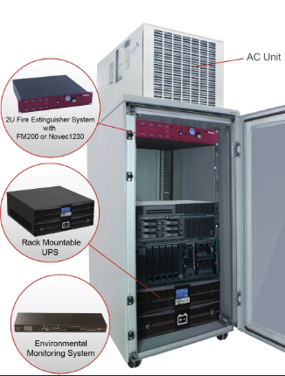
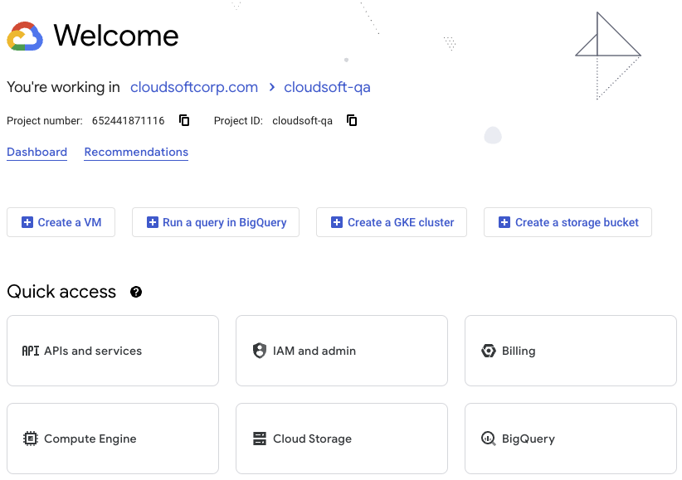
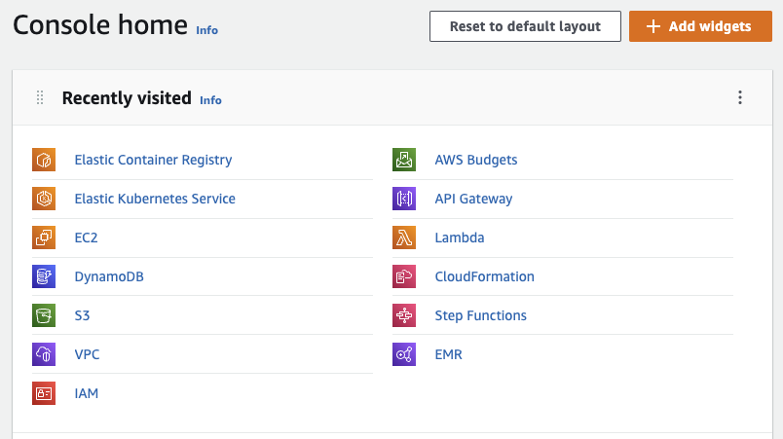
Resources Management
Who remembers the old times?
How do the new times look like?
Notes:
History lesson – ask here about the age of the audience
Disadvantages of old style:
Resources: hardware + software + networks
Costs or equipment
Cost of electricity
Cost or people to maintain them
You set up everything: software & hardware, including networking
Biggest advantage:
Total control over it: direct access to software and hardware
Public clouds, you get a web interface and various CLIs:
Amazon – this looks familiar
Google Cloud platform
Microsoft Azure
Alibaba
Oracle
Advantages:
Scalability – old style -> that server you had in your office was all you had
Disaster recovery -> old style, recovery was costly and limited (you could have a backup server, or hard discs in a RAID setup
Keeping up to date - <- also a disadvantage because you can only update to the supported version
Cost savings -> technically yes, unless you configure your services wrong, or write a recursive lambda
Biggest disadvantage:
- You are stuck to it. Moving from a cloud provider to another is very… close to impossible. Moving from one mac to another analogy.

Slide 6






Provisioning Cloud Resources
CloudFormation
Deployment Manager
Configuration files
THE
CLOUD
Terraform
Pulumi
Notes:
The process of deploying your applications to the cloud is called: provisioning cloud resources. You write some configuration files with the resources you need to be created on the cloud provider and their properties, and some tool is responsible for making it happen.
Big cloud providers provide their own tools for create, deploy and manage infrastructure as code.
Terraform & Pulumi are opensource and free to use.
The crazy way: do it manually. This actually works, if all you have is a blog. :D I know from personal experience.
This can be done in a few ways:
Design your application for the cloud
Use static frontends
Scalable backends & databases
Manually – eh … setup the network, VMs, and all other resources using the cloud provider web console and CLI
CloudFormation <-provided by AWS -> you describe your infrastructure using a JSON based resource specification
Deployment Manager <- provided by GCP-> you describe your infrastructure using a YAML based resource specification
Terraform <- uses a JSON-like based specification, the native syntax of the Terraform language, called also HCL - HashiCorp Configuration Language (JSON can also be used)
Pulumi <- describes infrastructure using various programming languages: Java, JavaScript, Go etc…
Each of these tools offer the possibility of describing your infrastructure using code or structured test, provide the means to instruct a cloud provider to create those resources for you and monitor those resources to an extent.
Each of them has drawbacks, for example using tools specific to a cloud provider ties you to that cloud provider, using open-source tools brings the risk of vulnerabilities and bug that take long to fix.
If you want to avoid tying yourself to a cloud provider even more than you already are, or you want to give control over creating and destroying the resources to a Continuous integration tool for example.

Slide 7

Introducing Apache Brooklyn

Slide 8
Apache Brooklyn
https://brooklyn.apache.org
https://github.com/apache/brooklyn
An open-source agnostic control plane for your cloud applications and infrastructure
Model the application & infrastructure
Deploy it (anywhere)
Monitor it
Notes:
Apache Brooklyn is an open-source software for creation, management and destruction of cloud resources – infrastructure and code. Thus, this makes it a cloud orchestration software.
Mention CAMP + types + DSL
Cloud Application Management for Platforms (CAMP) is a specification designed to ease management of applications, including packaging and deployment, across public and private cloud computing platforms.
Deploy it anywhere - public or private, cloud or Kubernetes cluster
Apache Brooklyn is built for agile deployment of applications across cloud and other targets, and real-time autonomic management. "Autonomic computing" is the concept of components looking after themselves where possible (self-healing, self-optimizing, etc).
Basically, Apache Brooklyn is a swiss army knife – helps you easily model your cloud application, deploy it, monitor it and if used right it can keep your application available at all times.
But two things that I keep telling Cloudsoft they should brag more about Apache Brooklyn:
Avoid cloud costs during development
Relaxing the tie you have with your cloud provider -> example: if your application does not use specific cloud services like lambda functions -> e.g. it just represented by a bunch of services that can be installed on any VM, or a bunch of containers that can be run in any Kubernets cluster, you can use the same CAMP configuration, change the location in Apache Brooklyn and deploy it in the new cloud of your choice. You still have to do some work if you want to move data from a database to another, but oh well…

Slide 9
Apache Brooklyn: Concepts
Blueprint – what?
Location – where?
Entity (Application) – how?
Sensor – what is going on?
Effector – what are you doing?
Policy – when this happens, then do this
Notes:
Apache Brooklyn is an open-source software for creation, management and destruction of cloud resources – infrastructure and code. Thus, this makes it a cloud orchestration software.
TODO –
Mention CAMP + types + DSL
Concepts:
Blueprints – descriptor or patterns telling Apache Brooklyn how applications should be deployed. Written in a YAML specification called CAMP - Cloud Application Management for Platforms (CAMP) - also supports DSL expressions to link your components together in various ways. The blueprint also specifies the inter-relationships between the configurations of the components.
Locations: used to configure the cloud where your entities are deployed, and all the properties specific to that cloud provider. Or cluster – because a location can point to a Kuberbetes or vSphere cluster
Entities – a resource managed by Apache Brooklyn, every entity has a single parent entity called Application. An entity represents a resource under management (individual machines or software processes) or logical collections of these. Entities are arranged hierarchically. A number of common entity types are available in the Brooklyn catalog -> eg. – Apache Tomcat server, various databases, etc. You can write your own in Java or any other language and add them to the catalog.
Sensors - (activity information and notifications)
Effectors - (operations that can be invoked on the entity)
Policies - perform the active management enabled by Brooklyn. Policies can subscribe to sensors from entities or run periodically, and when they run they can perform calculations, look up other values, and if deemed necessary invoke effectors or emit sensor values from the entity with which they are associated. – use an an example an auto-scaling policy

Slide 10
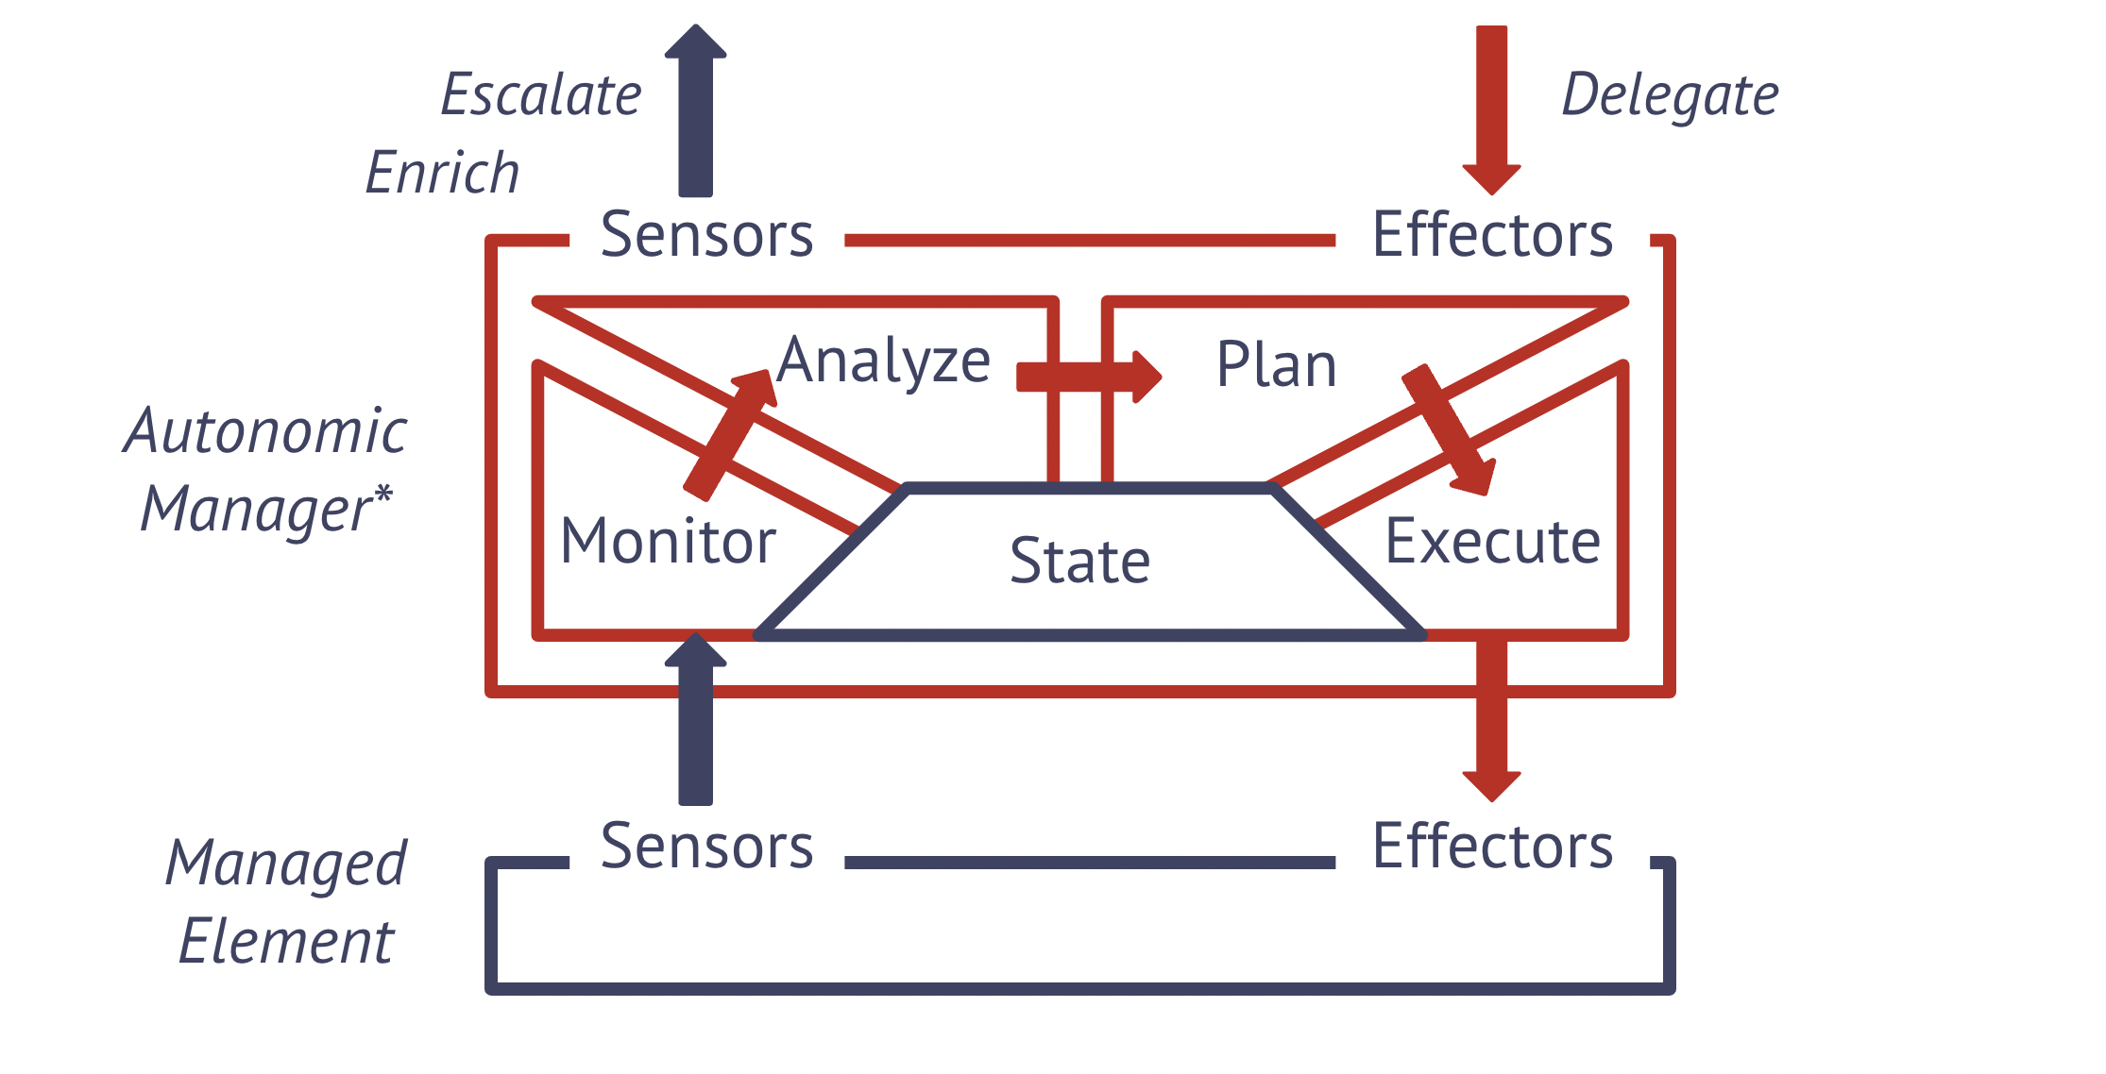
Autonomic Management
Notes:
Apache Brooklyn is built for agile deployment of applications across cloud and other targets, and real-time autonomic management. "Autonomic computing" is the concept of components looking after themselves where possible (self-healing, self-optimizing, etc)

Slide 11
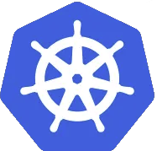




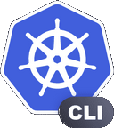
Apache Brooklyn: Even More
Vanilla SoftwareProcess
K8S
THE CLOUD
Apache
Brooklyn
Terraform
K8S
LOCAL
Kubectl
Notes:
SSH mode: Basically Apache Brooklyn ssh-es into VM and installs there what you tell it to install.
For AWS cloud the module the library that support remote manipulation of resources is named JClouds.
The terraform module – provides a few types for the catalog that allow Apache Brooklyn to interact with terraform on your behalf. You don’t have to touch the CLI anymore, and Apache Brooklyn renders the resources state via various sensors… and you can add your own. I don’t want to brag but I worked on it, and had a blast writing the code.
The advantage of this module is that you can actually import an existing terraform deployment into Apache Brooklyn.
We have a Kubernetes module - provides a few types for the catalog that allow Apache Brooklyn to interact with kubectl on your behalf and deploy and monitor applications ona Kubernetes cluster

Slide 12
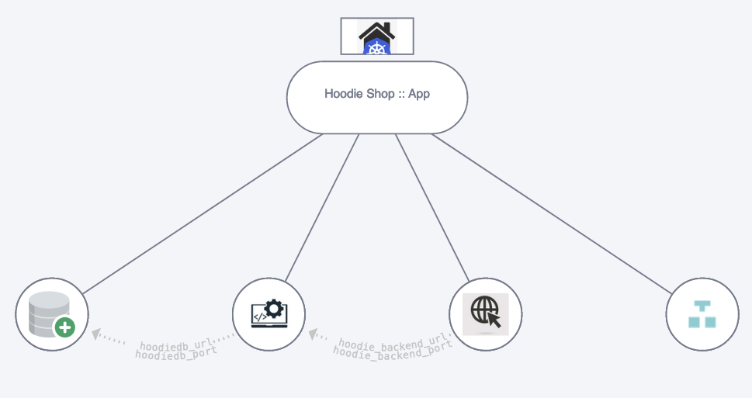
Demo time!

Slide 13
The App: Hoodie Shop
Spring Application made of 3 modules:
Database : MariaDB
Backend: Spring Boot Native Application
Frontend: Static TypeScript/React app
Notes:
Yes, I added a native Spring Boot App, running on GraalVM because this is the hype right now, and I have to write about it in my latest book.

Slide 14
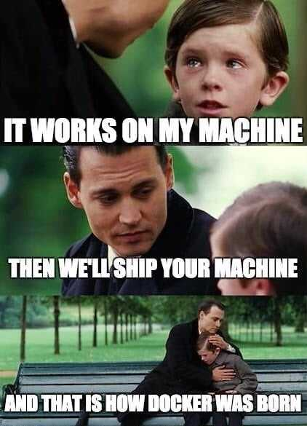
The App: Hoodie Shop
We will deploy it locally and in AWS
And to keep all things working as expected…
Thus, we’ll do it on:
Local Kubernetes on Docker
AWS EKS
Notes:
Yes, I added a native Spring Boot App, running on GraalVM because this is the hype right now, and I have to write about it in my latest book.
Well.. Not all worked as expected, as you will see – because I need different images for EKS, since I have a mac with Silicone M1 chip.
After demo, use text comparator to compare the types -> show that there are barely any differences
On EKS we also need ECR to load our Docker images
And because we are Scottish, we don’t have a progress bar, or a pie chart, we have a kilt diagram

Slide 15

Conclusions & Questions
Can you describe once, run wherever?
Is Apache Brooklyn great for cloud applications development?
Oct 2022, Iuliana Cosmina
Notes:
Working in the cloud is like driving a car – you do not need to know what individual parts are made of, most time you do not even have to know how they work together, but you do have to customize a few details, right? You have to adjust mirrors, the chair, the air conditioning and the music.
It depends
Obviously if you are developing on a computer with a different architecture, you need to build different Docker images.
On your local you are not worries with details such as domains and public access, when deploying to the cloud you have to take care of these, and might require additional configuration.

Slide 16
Thank you!
Oct 2022, Iuliana Cosmina
Notes:
Working in the cloud is like driving a car – you do not need to know what individual parts are made of, most time you do not even have to know how they work together, but you do have to customize a few details, right? You have to adjust mirrors, the chair, the air conditioning and the music.

Slide 17
References
https://brooklyn.apache.org
https://cloudsoft.io
https://www.terraform.io
https://kubernetes.io
https://github.com/cloudsoft/brooklyn-terraform
https://github.com/cloudsoft/java-cro

