Slide 1


Describe Once, Run Wherever?
A quirky guide to Spring in the cloud with Apache Brooklyn
Oct 2022, Iuliana Cosmina

Slide 2
Agenda
Working on the Cloud
Apache Brooklyn
Demo Time!
Conclusions & Questions

Slide 3




Hello!
Iuliana Cosmina
Full Stack Engineer at Cloudsoft, Edinburgh
Technical Author for Apress
Apache Commiter
@_iulianacosmina
iuliana.cosmina@gmail.com
Notes:
There is this trend nowadays where people jump directly to technical stuff and introduce themselves at the end of a presentation. I prefer to keep it classic and introduce myself at the beginning.
Let’s be honest, a 45 minutes presentation is not going to properly cover any subject related to working in the cloud. The best I can give you is the means to remember me and keep an eye on my online activity and books I write. So, I will give myself a few minutes to impress you with my technical prowess.
I am Romanian, born, raised and educated and I live in Scotland.
I’ve been coding since 1997, getting paid for it since 2006. I’m still getting paid for it, so I must be doing something right. :D
I like mostly anything tech, I write Java and Spring Books for Apress – well not for Apress, for you guys, Apress just provides support for the books to realize and reach you guys.
I am a Full Stack Engineer for Cloudsoft, Edinburgh, I’ve been working for this company for three years now. I am doing mostly Java, Bash and Go.
I appreciate the power of cloud services, but I am an old school engineer, I grew up hosting my blog on my own server located under my desk and sometimes I think the learning curve of using cloud services is too steep and they cost sooo… much.
There are companies that consult other companies to reduce cloud costs. Cloudsoft also has a department for that. It’s like learning to drive a car, but you to still consult a driving instructor from time to tome to avoid gas costs from bankrupting you, and avoid accidents.
Yes, this presentation will (probably )contain a lot of car and driving analogies.

Slide 4
Working on the cloud

Slide 5

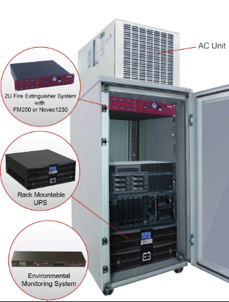
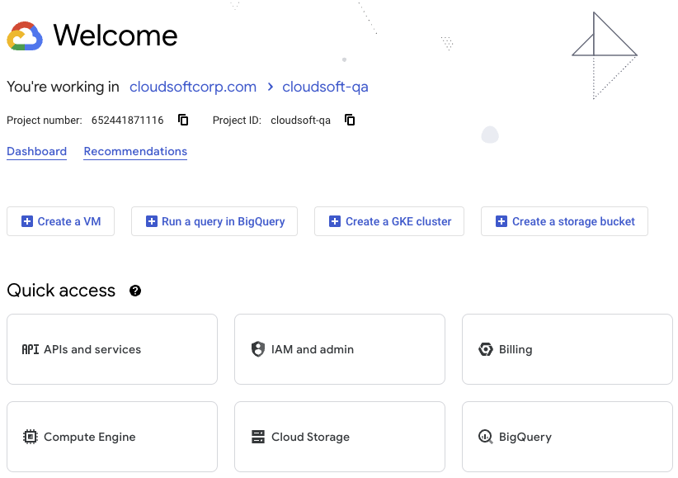
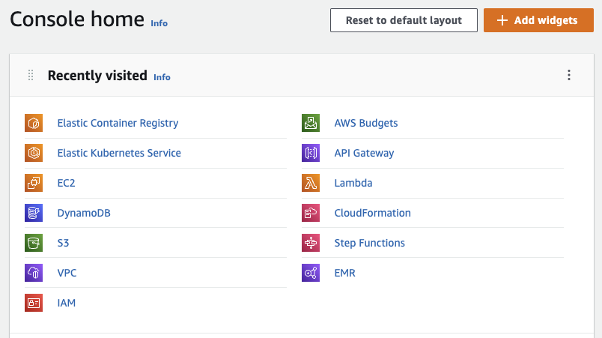
Resources Management
Who remembers the old times?
How do the new times look like?
Notes:
History lesson – ask here about the age of the audience
Disadvantages of old style:
Resources: hardware + software + networks
Costs or equipment
Cost of electricity
Cost or people to maintain them
You set up everything: software & hardware, including networking
Biggest advantage:
Total control over it: direct access to software and hardware
Public clouds:
Amazon
Google Cloud platform
Microsoft Azure
Alibaba
Oracle
Advantages:
Scalability – old style -> that server you had in your office was all you had
Disaster recovery -> old style, recovery was costly and limited (you could have a backup server, or hard discs in a RAID setup
Keeping up to date - <- also a disadvantage because you can only update to the supported version
Cost savings -> technically yes, unless you configure your services wrong, or write a recursive lambda
Biggest disadvantage:
- You are stuck to it. Moving from a cloud provider to another is very… close to impossible.

Slide 6




Provisioning Cloud Resources
Manually (scp, ssh commands)
CloudFormation (AWS)
Deployment Manager
Terraform
Pulumi
Notes:
The process of deploying your applications to the cloud is called: provisioning cloud resources. You write some configuration files with the resources you need to be created on the cloud provider and their properties, and some tool is responsible for making it happen.
Big cloud providers provide their own tools for create, deploy and manage infrastructure as code.
Terraform & Pulumi are opensource and free to use.
This can be done in a few ways:
Design your application for the cloud
Use static frontends
Scalable backends & databases
Manually – eh … setup the network, VMs, and all other resources using the cloud provider web console and CLI
CloudFormation <-provided by AWS -> you describe your infrastructure using a JSON based resource specification
Deployment Manager <- provided by GCP-> you describe your infrastructure using a YAML based resource specification
Terraform <- uses a JSON-like based specification, the native syntax of the Terraform language, called also HCL - HashiCorp Configuration Language (JSON can also be used)
Pulumi <- describes infrastructure using various programming languages: Java, JavaScript, Go etc…

Slide 7
Apache Brooklyn
Where does Apache Brooklyn fit in?
Notes:
Apache Brooklyn is an open-source software for creation, management and destruction of cloud resources – infrastructure and code. Thus, this makes it a cloud orchestration software.
TODO –
Mention CAMP + types + DSL
Concepts:
Locations
Apps
Entities
Sensors
Effectors

Slide 8
Apache Brooklyn
TODO: introduce the Terrafrom SSH & Kube drivers
TODO: pictures!!!
Notes:
Apache Brooklyn is an open-source software for is software for managing cloud applications. Since it can also be used to deploy them, this makes it an cloud orchestration software.

Slide 9
Demo Time!
Spring Application made of 3 modules:
Database : MariaDB
Backend: Spring Boot Native application
Frontend: static TypeScript/React app
Notes:
Yes, I added a native Spring Boot App, running on GraalVM because this is the hype right now, and I have to write about it in my latest book.

Slide 10
Conclusions & Questions
Working in the cloud is like driving a car
Oct 2022, Iuliana Cosmina
Notes:
Working in the cloud is like driving a car – you do not need to know what individual parts are made of, most time you do not even have to know how they work together, but you do have to customize a few details, right? You have to adjust mirrors, the chair, the air conditioning and the music.

Slide 11
References
https://brooklyn.apache.org
https://cloudsoft.io
https://www.terraform.io
https://kubernetes.io
https://github.com/cloudsoft/java-cro

