Slide 1

Training Roadmap: GenAI to Spring AI
1
2
3
4
5
GenAI & LLM Basics
Spring AI + OpenAI
Local Models with Ollama
Multiple Models
Going Further
Tokens, context, temperature and prompts
Call cloud models with ChatClient
Run Llama and friends on your own machine
Configure and switch between several LLMs
Streaming, structured output and RAG
By the end of this training you will be able to
Explain how LLMs work and use the vocabulary developers need every day
Build Spring Boot apps that talk to OpenAI and to local Ollama models
Choose, tune and secure the right model for each use case
Notes:
Set expectations. The first block gives the vocabulary (GenAI, LLM, tokens, prompts). Then we build with OpenAI (cloud) and Ollama (local) through Spring AI, and finish with advanced features.

Slide 2
What is Generative AI?
Generative AI creates new content by learning patterns from huge amounts of existing data.
Text
Chat, summaries, translation
Code
Completion, review, tests
Traditional AI / ML
Classifies or predicts: spam or not spam, next month’s sales, fraud risk.
Images
Generate and edit visuals
Audio
Speech-to-text and voice
Generative AI
Produces something new: write an email, generate code, summarise a report.
Video
Short clips from prompts
Structured data
Extract JSON, write SQL
In this training: we focus on text generation (chat models) using OpenAI and Ollama.
Notes:
Contrast predictive AI (classify, forecast) with generative AI (create). Stress that in this course we focus on text generation, which is what chat models do.

Slide 3
Large Language Models (LLMs)
A neural network (Transformer) trained on vast amounts of text
Core skill: predict the most likely next token, one token at a time
Billions of parameters: the numeric weights learned during training
A good prompt turns that skill into writing, summarising, translating, coding and reasoning
Popular LLM families
GPT (OpenAI)
Llama (Meta)
Gemma (Google)
Mistral and Qwen
Claude (Anthropic)
How an LLM is built and used
Pre-training
Learns language patterns from huge text collections
Fine-tuning
Specialises on instructions, dialogue and tasks
Alignment
Human feedback (RLHF) makes answers helpful and safe
Inference
You send a prompt and the model generates tokens
Notes:
An LLM is a very large neural network (a Transformer) trained to predict the next token. Walk through the four stages from training to your prompt.

Slide 4
How an LLM Generates a Response
1 Prompt
The capital of India is
2 Tokenize
Text is split into tokens and mapped to IDs
3 Transformer
Attention weighs every token against the rest of the context
4 Scores
Every possible next token gets a probability
Next-token probabilities (illustrative)
Steps 5 and 6: pick and repeat
Pick one token. Temperature controls how adventurous the pick is.
Append it to the text and run the model again.
Stop at the end-of-sequence token or the max-token limit.
Result: “The capital of India is New Delhi.”
New
82%
Delhi
9%
the
5%
Mumbai
2%
Notes:
The model never writes a whole answer at once. It repeats: score all possible next tokens, pick one, append it, and go again. The probabilities shown are illustrative only.

Slide 5
Key LLM Concepts for Developers
1
Token
2
Context window
3
Temperature
A chunk of text the model reads and writes: roughly 4 characters or ¾ of an English word. Limits and billing are counted in tokens.
The maximum tokens (prompt plus response) the model can handle at once. Go over it and old content is cut or the call fails.
Controls randomness. Low (0 to 0.3) gives focused, repeatable answers. High (0.8+) gives creative, varied ones.
4
Top-p
5
Max tokens
6
Hallucination
Nucleus sampling: choose only from the smallest set of tokens whose probabilities add up to p. Tune this or temperature, not both.
Upper limit on response length. It protects cost and latency.
A fluent answer that is wrong or invented. Ground the model with your own data (RAG) and validate outputs.
Notes:
These six terms appear in every API and every bill. Ask students to predict what happens when the context window is exceeded.

Slide 6
Prompt Engineering Basics
SYSTEM
You are a patient Java tutor. Answer in at most 3 bullet points.
Be specific
State the role, task, format, length and constraints.
Zero-shot
Ask directly, with no examples.
USER
What is dependency injection?
Few-shot
Show 2 or 3 examples of the output you want.
ASSISTANT
Objects receive the things they need instead of creating them. This makes code easier to test and swap.
Chain-of-thought
Ask the model to reason step by step before it answers.
Notes:
Every chat request is a list of messages with roles. The system message sets behaviour, the user message asks, the assistant message is the reply. Then cover the four techniques on the right.

Slide 7
Two Ways to Run an LLM: Cloud vs Local
 | OpenAI (cloud API) | Ollama (local)
Where it runs | OpenAI servers, over HTTPS | Your laptop or server
Cost | Pay per token | Free software; you pay for hardware
Privacy | Prompts leave your network | Data stays on your machine
Setup | API key and a billing account | Install the app and pull a model
Model power | Largest frontier models | Smaller open models (1B to 70B)
Internet | Required | Works offline after the download
Scaling | Handled for you | You manage the capacity
Best for | Production quality and hard tasks | Learning, prototypes, private data
Good news: Spring AI’s ChatClient lets you use either one with the same application code.
Notes:
This is the decision students will face in real projects. OpenAI is the cloud example, Ollama the local one. Spring AI lets you switch with very little code change.

Slide 8
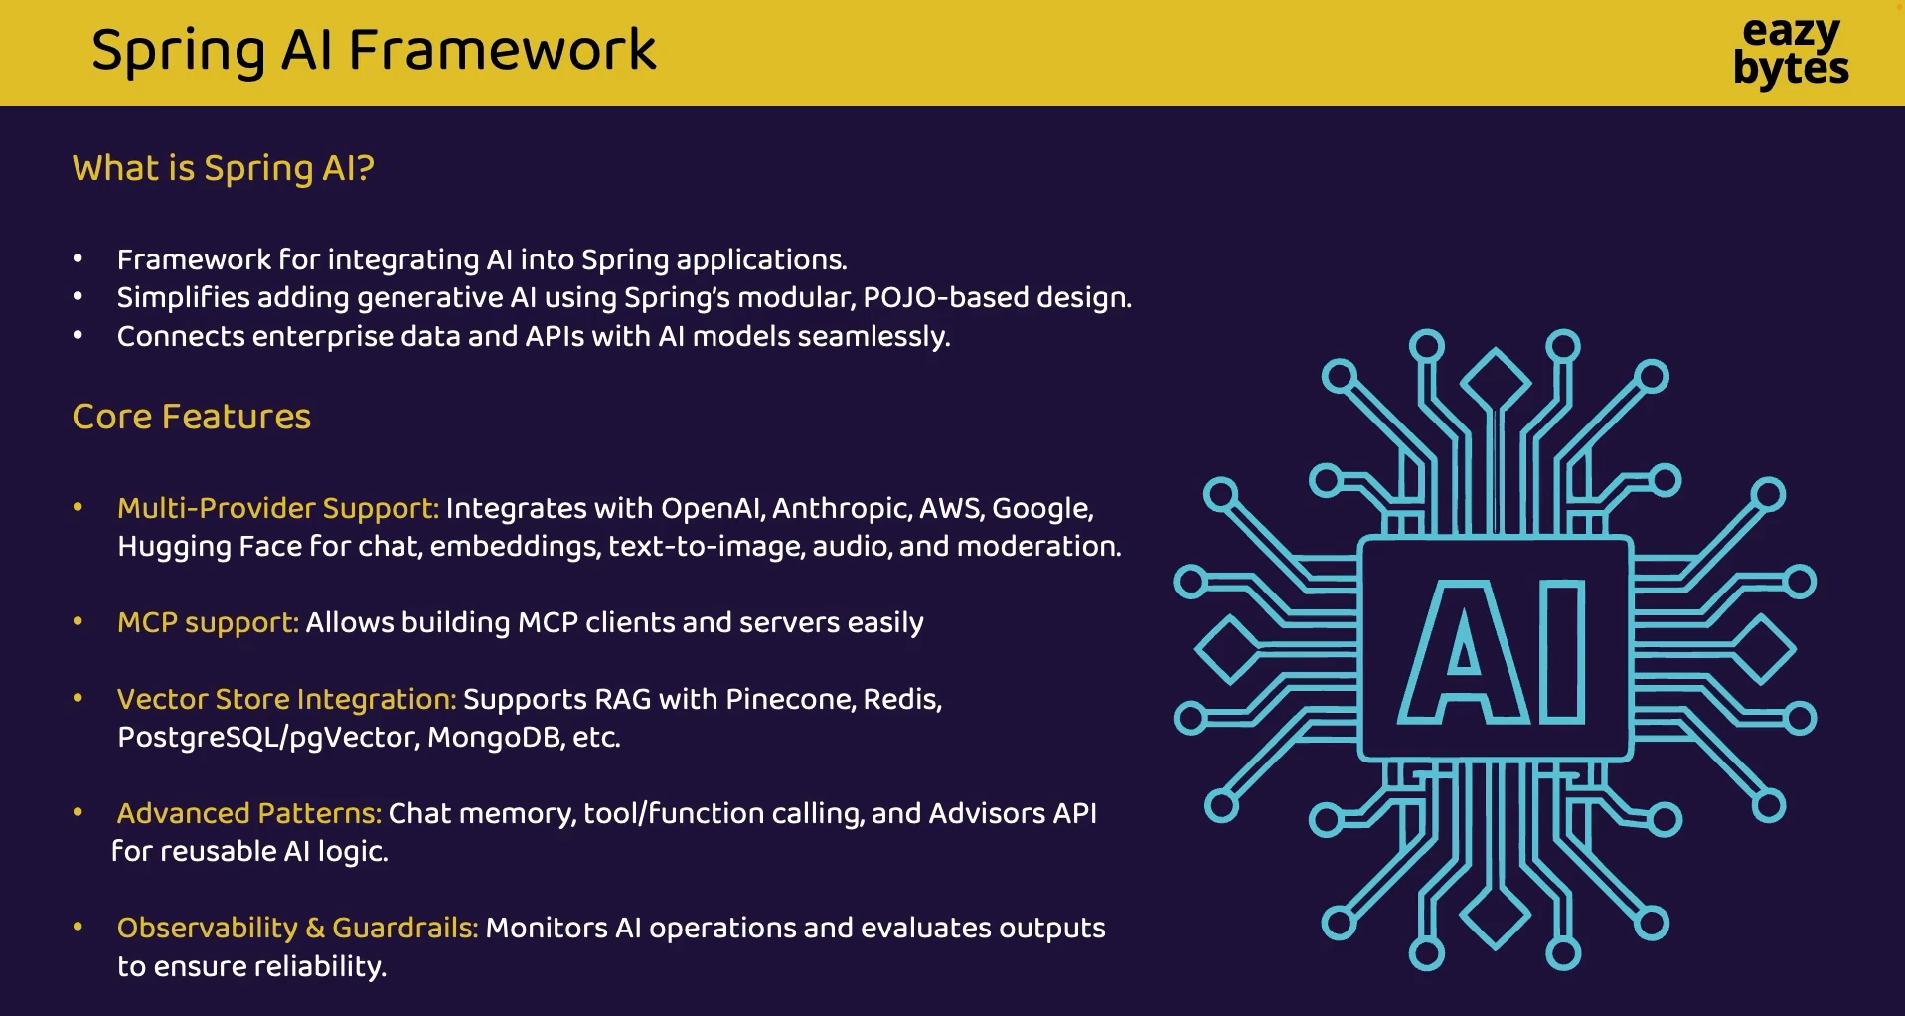

Slide 9
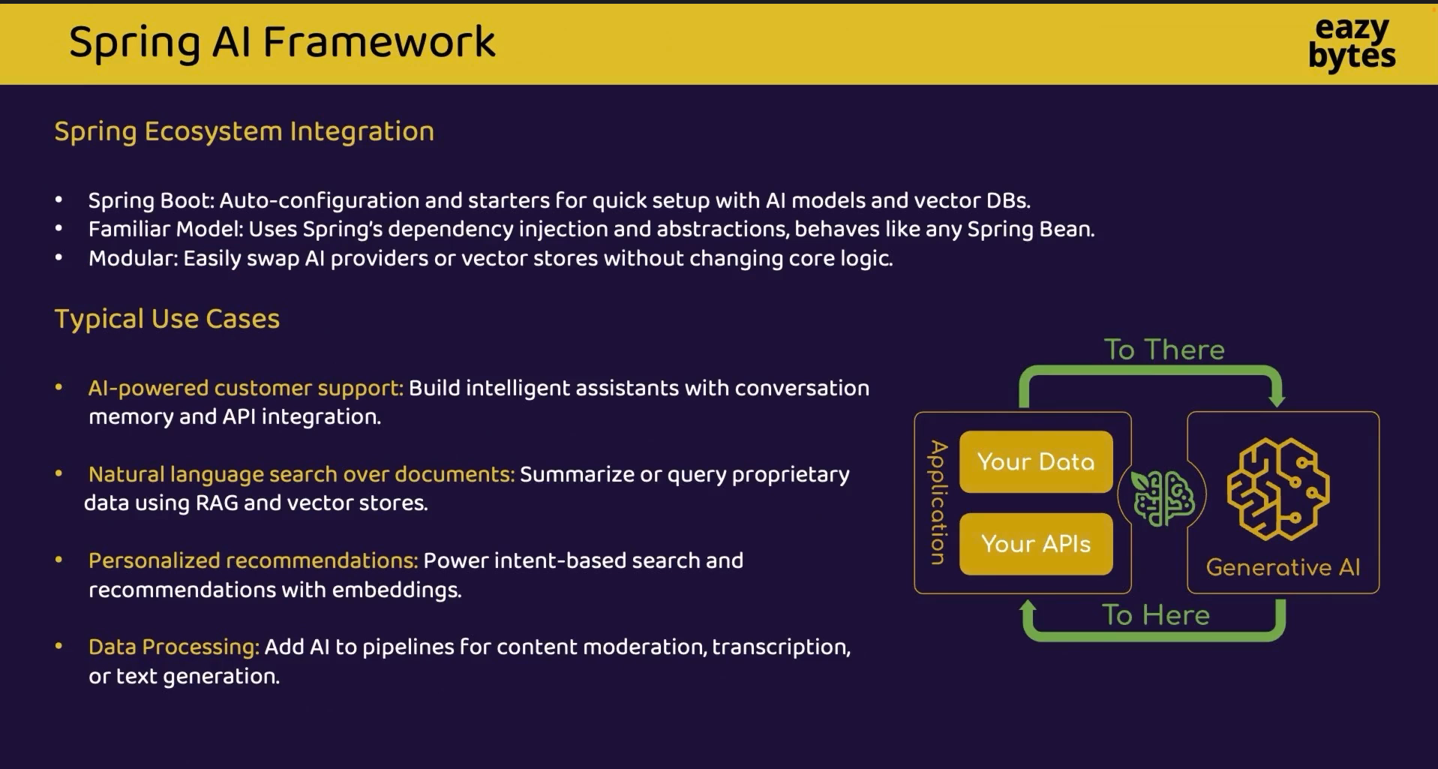

Slide 10
OpenAI Platform: What You Can Build
Chat and reasoning
GPT models for conversation, writing and code
Spring AI class
OpenAiChatModel
Embeddings
Turn text into vectors for search and RAG
Spring AI class
OpenAiEmbeddingModel
Image generation
Create images from a text description
Spring AI class
OpenAiImageModel
Speech to text
Transcribe audio recordings
Spring AI class
OpenAiAudioTranscriptionModel
Text to speech
Generate natural-sounding voice
Spring AI class
OpenAiAudioSpeechModel
Moderation
Flag unsafe or policy-breaking content
Spring AI class
OpenAiModerationModel
Tip: model names and prices change often. Check platform.openai.com/docs for the current list.
Notes:
OpenAI exposes several model families through one API. Spring AI wraps each capability in its own model class. Model names change often, so always check the official docs for the current list.

Slide 11
Getting Started with the OpenAI API
1
Create an account at platform.openai.com
Set the variable
# macOS / Linux
export OPENAI_API_KEY="sk-..."
# Windows (PowerShell)
setx OPENAI_API_KEY "sk-..."
2
Add billing credit and set a monthly usage limit
3
Create an API key (it is shown only once, so copy it)
application.properties
spring.ai.openai.api-key=${OPENAI_API_KEY}
spring.ai.openai.chat.options.model=gpt-4o-mini
spring.ai.openai.chat.options.temperature=0.7
4
Store it in the environment variable OPENAI_API_KEY
5
Reference the variable in application.properties
Security rule
Never hard-code API keys or commit them to Git. Rotate any key that leaks.
Notes:
Walk through the account and key creation live. Stress that the key is a secret: environment variable first, then referenced from application.properties.

Slide 12
Anatomy of an OpenAI Chat Request
Request
Response (trimmed)
POST https://api.openai.com/v1/chat/completions
Authorization: Bearer $OPENAI_API_KEY
{
"model": "gpt-4o-mini",
"temperature": 0.7,
"max_tokens": 200,
"messages": [
{"role": "system", "content": "You are a Java tutor."},
{"role": "user", "content": "What is a bean?"}
]
}
{
"choices": [{
"message": {
"role": "assistant",
"content": "A bean is..."
}
}],
"usage": {
"prompt_tokens": 28,
"completion_tokens": 45,
"total_tokens": 73
}
}
messages
The whole conversation. The API is stateless, so resend the history each time.
usage
Prompt plus completion tokens: this is what you are billed for.
Spring AI
ChatClient builds this request and parses the response for you.
Notes:
This is what Spring AI sends for you under the hood. Point out that the API is stateless, so the full message history is sent each time, and that usage shows the tokens you are billed for.

Slide 13
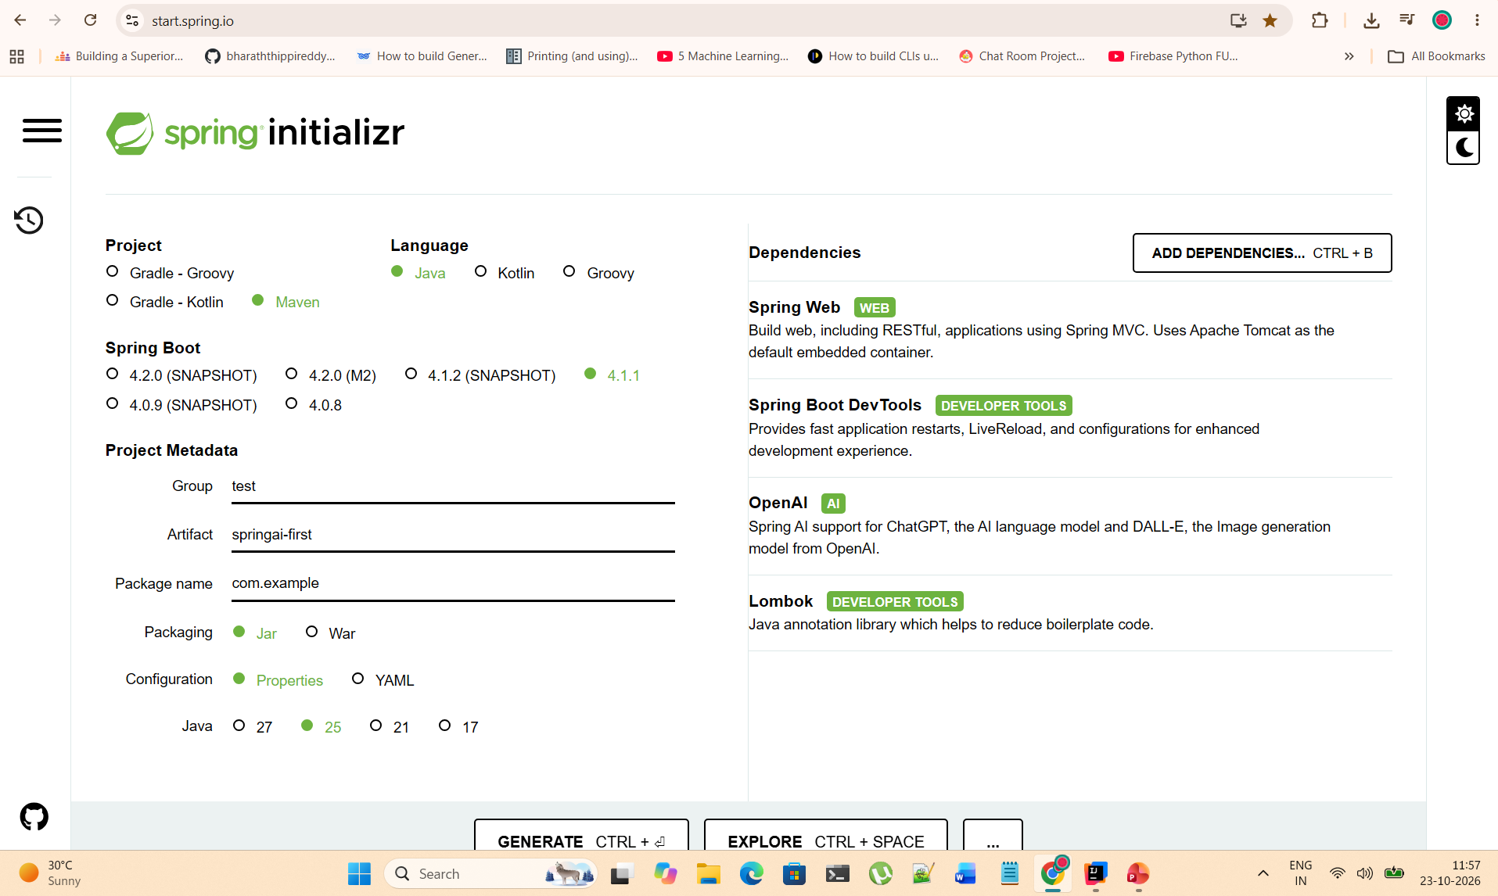

Slide 14
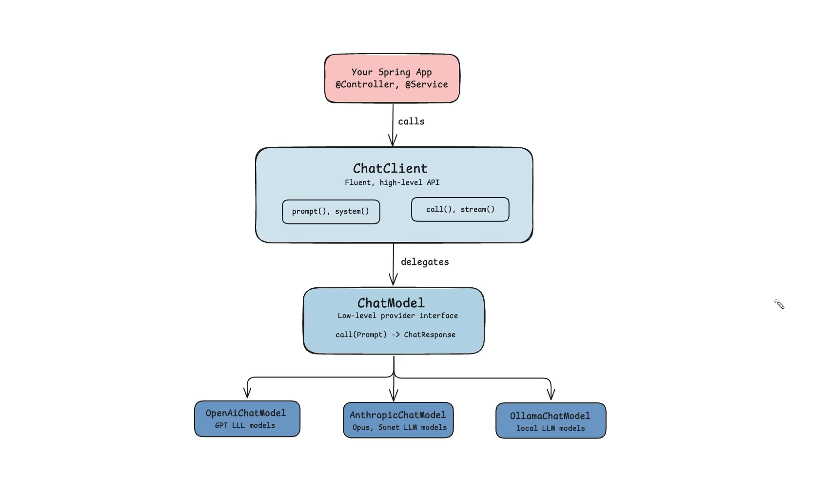

Slide 15
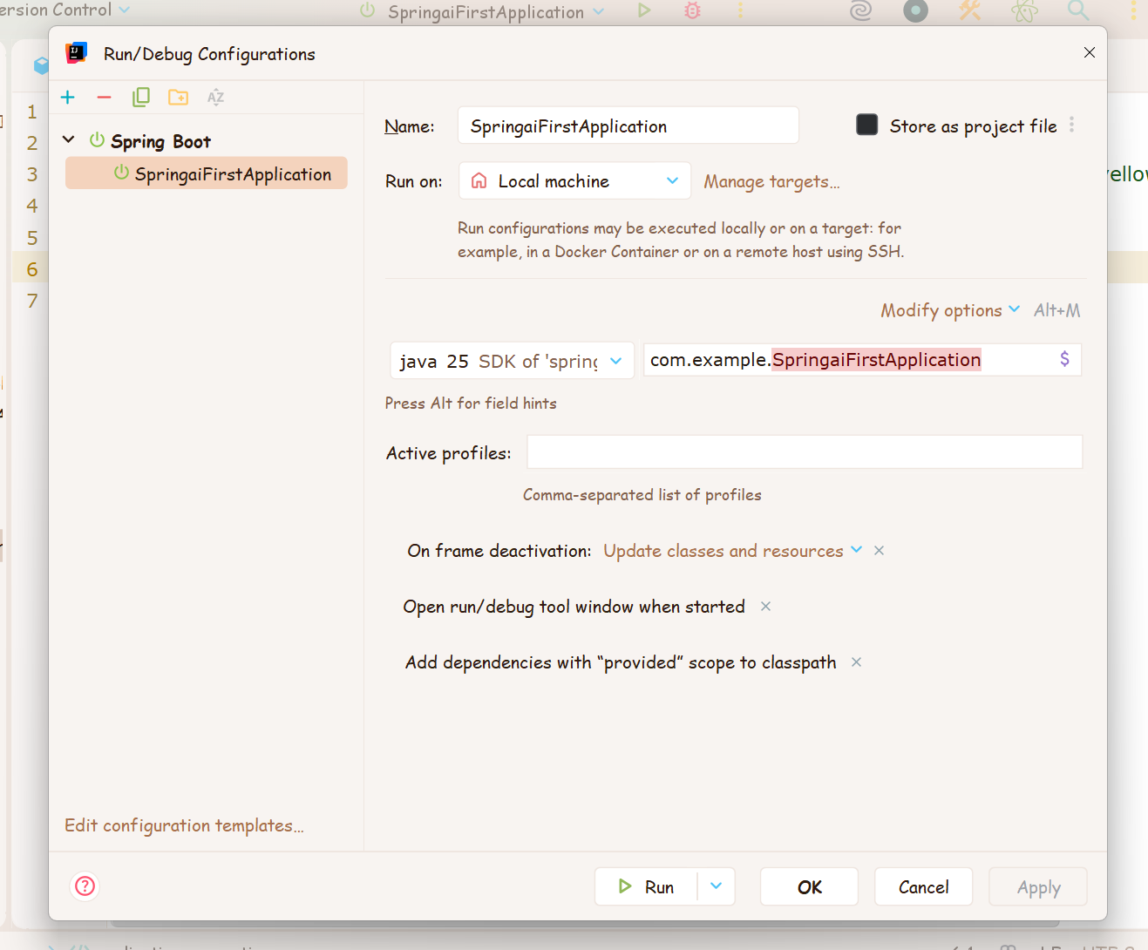

Slide 16
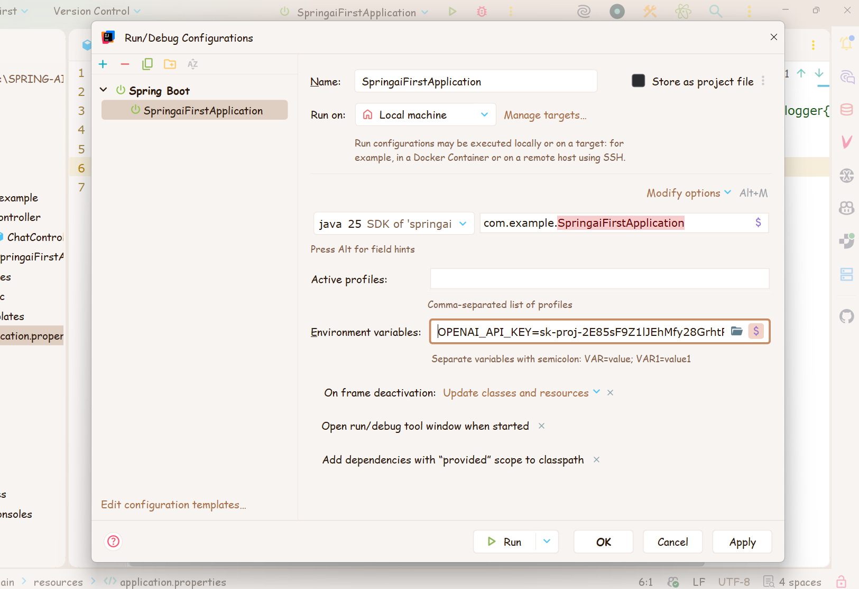

Slide 17
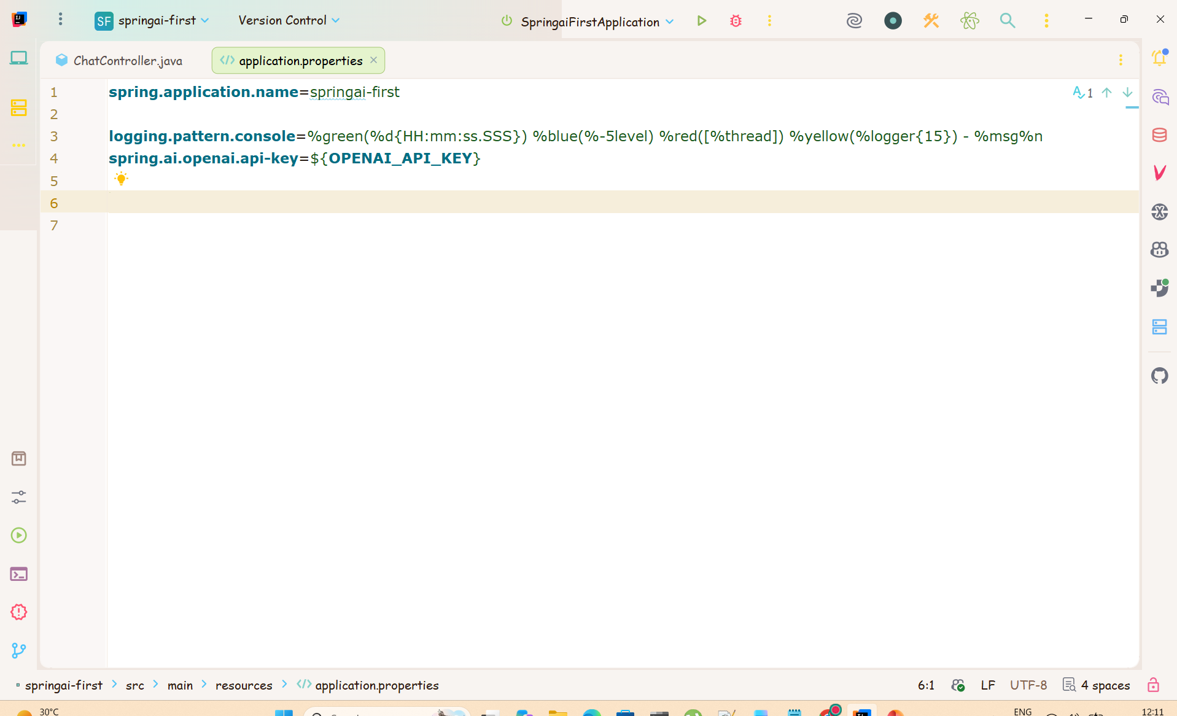

Slide 18
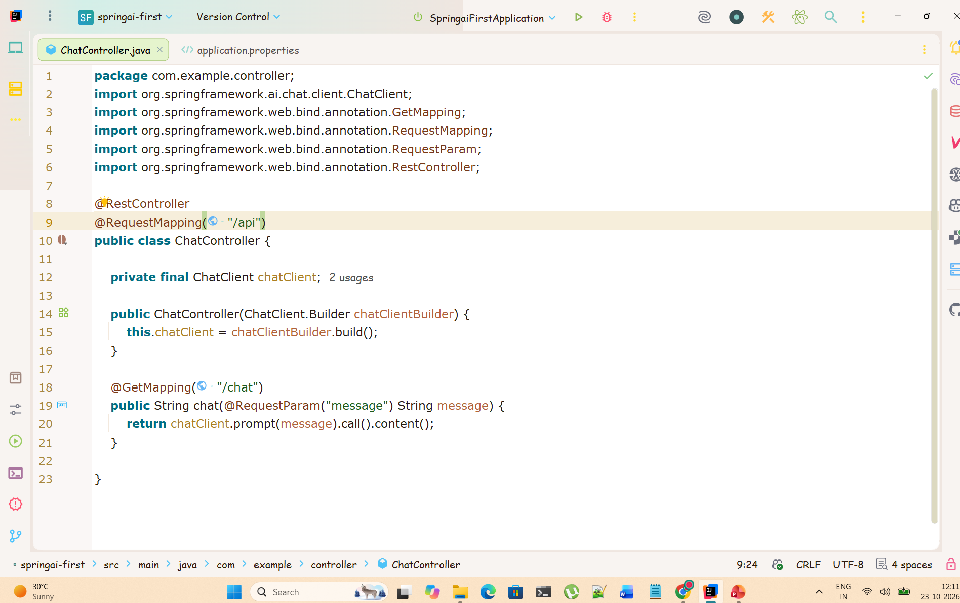

Slide 19
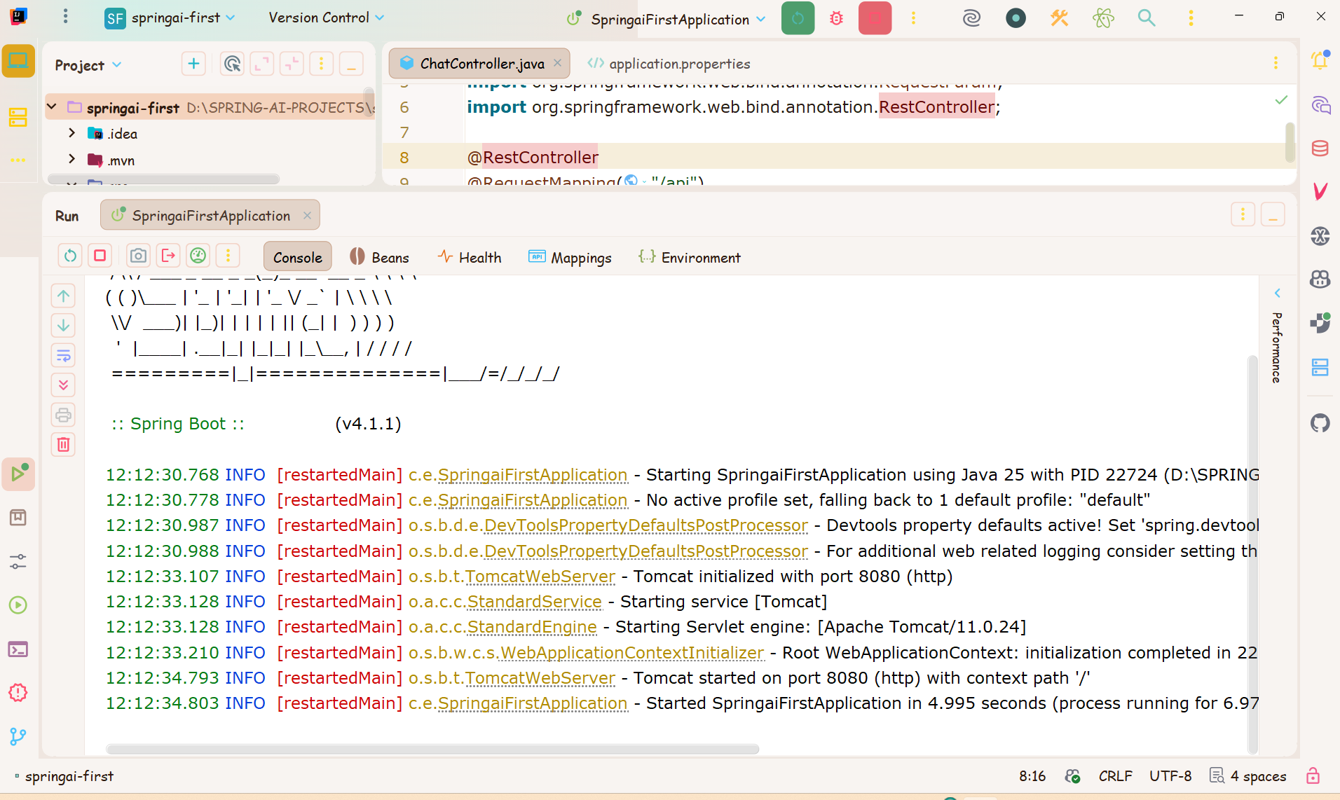

Slide 20
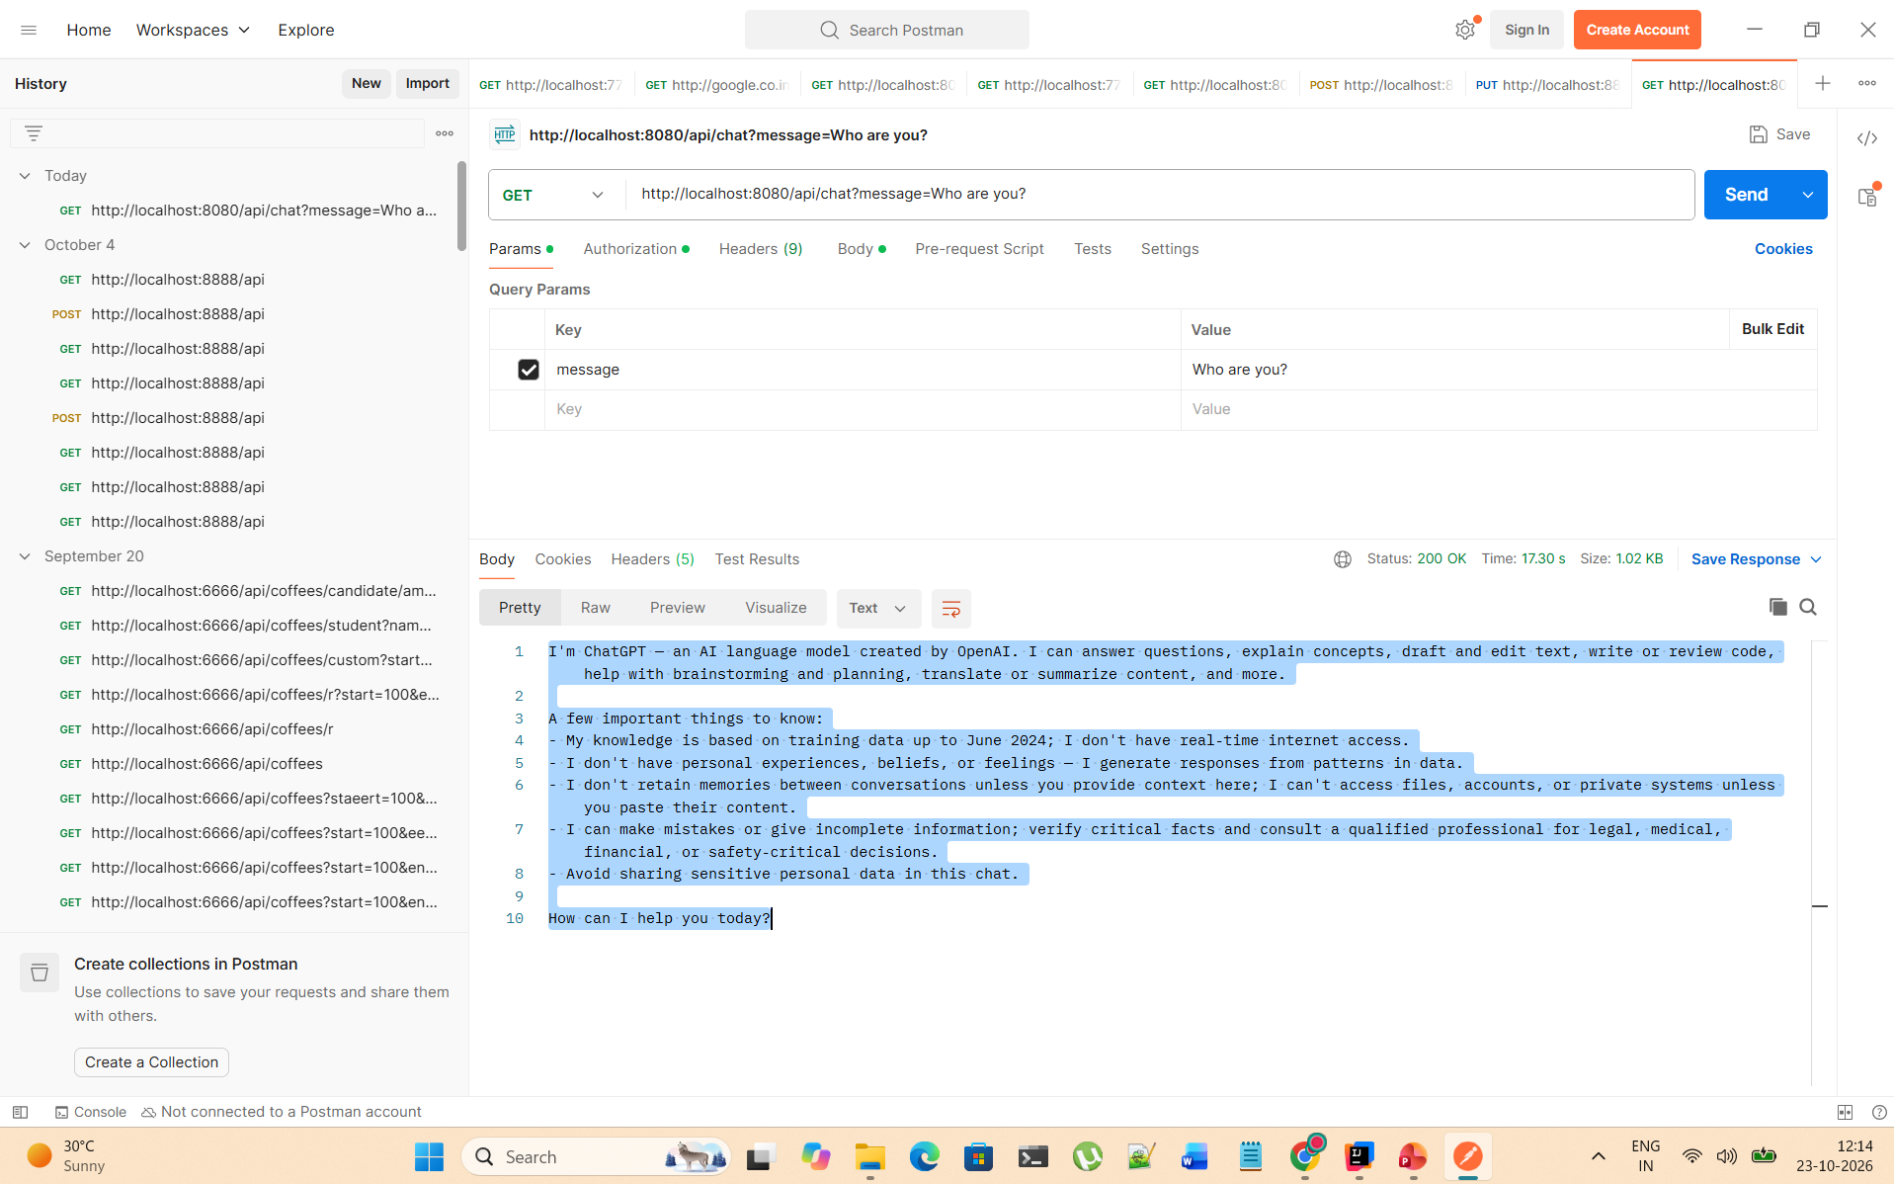

Slide 21
How Ollama Works
Your Spring Boot app
ChatClient and the spring-ai-ollama starter
Ollama server
Local REST API on localhost:11434
Model library
llama3.2, mistral, gemma and more, stored locally
CPU / GPU
Runs inference on your own hardware
Why teams choose Ollama
Private
Prompts and data never leave your machine.
Free to run
No per-token fees for local models.
Works offline
No internet needed once a model is pulled.
Simple
One command to download and run a model.
Remember: Ollama is the runtime; the model (Llama, Mistral, Gemma…) is the brain.
Notes:
Ollama is the runtime, the model is the brain. Spring AI talks to a local REST server on port 11434; Ollama loads the model files and runs inference on CPU or GPU.

Slide 22
Ollama Command Cheat Sheet
Everyday commands
Modelfile (custom model)
ollama pull llama3.2 # download a model
ollama run llama3.2 # chat in the terminal
ollama list # models on this machine
ollama ps # models loaded in memory
ollama show llama3.2 # model details
ollama rm llama3.2 # delete a model
ollama serve # start the API server
ollama create my-bot -f Modelfile
FROM llama3.2
PARAMETER temperature 0.3
SYSTEM """
You are a concise Java tutor.
"""
In the chat prompt
Type /bye to exit.
Type /? to list commands.
The desktop app starts the server for you; use ollama serve if it is not running.
Model tags
name:tag picks a variant, for example llama3.2:1b (small) or llama3.2:3b. No tag means the default.
Notes:
Let students run each command. Point out that the tag after the colon selects a variant of the model.

Slide 23
Choosing a Model: Size and Hardware
Parameters (B = billions) and a rough hardware guide
70B and up
64 GB+ RAM or a GPU server
13B to 34B
16 to 32 GB RAM or GPU
7B to 8B
8 to 16 GB RAM
1B to 3B
4 to 8 GB RAM
Quick Q&A, demos, small devices
Chat, summaries, coding help
Better reasoning and longer answers
Near-frontier quality for teams
Quantization: stores weights in fewer bits (for example 4-bit). Models become much smaller and faster with a small quality loss. Most default Ollama tags are already quantized.
Notes:
Bigger models are usually smarter but need more memory and are slower. The RAM numbers are rough guides for 4-bit quantized models, not guarantees.

Slide 24
Ollama REST API and OpenAI Compatibility
Call Ollama directly
Native API
POST /api/chat and /api/generate for text, /api/embed for embeddings, GET /api/tags to list local models.
curl http://localhost:11434/api/chat -d '{
"model": "llama3.2",
"messages": [
{"role": "user", "content": "Why is the sky blue?"}
],
"stream": false
}'
OpenAI-compatible API
Ollama also serves /v1/chat/completions, so OpenAI client libraries can talk to it with any placeholder API key.
Good to know
stream: false returns one JSON reply. The default is a stream of JSON lines.
The Ollama server must be running (the desktop app starts it for you).
In Spring AI
Use spring-ai-starter-model-ollama, or reuse the OpenAI starter and change spring.ai.openai.base-url.
Notes:
Because Ollama is just an HTTP server, any language can call it. The OpenAI-compatible endpoint means existing OpenAI client code can often be pointed at Ollama.

Slide 25
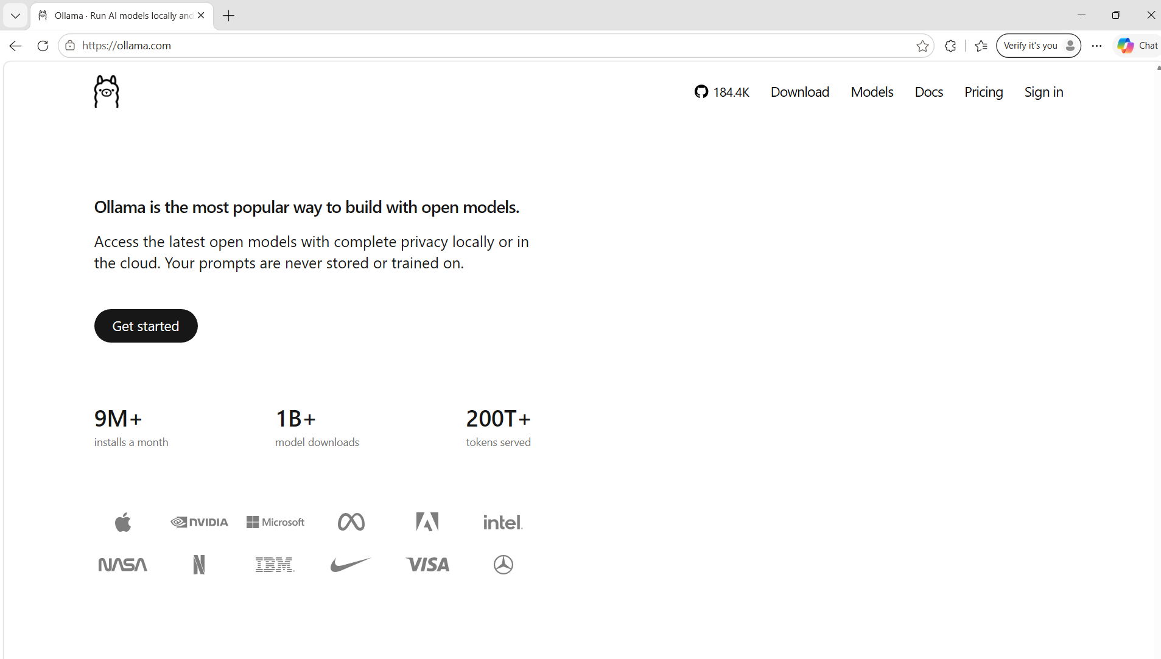

Slide 26
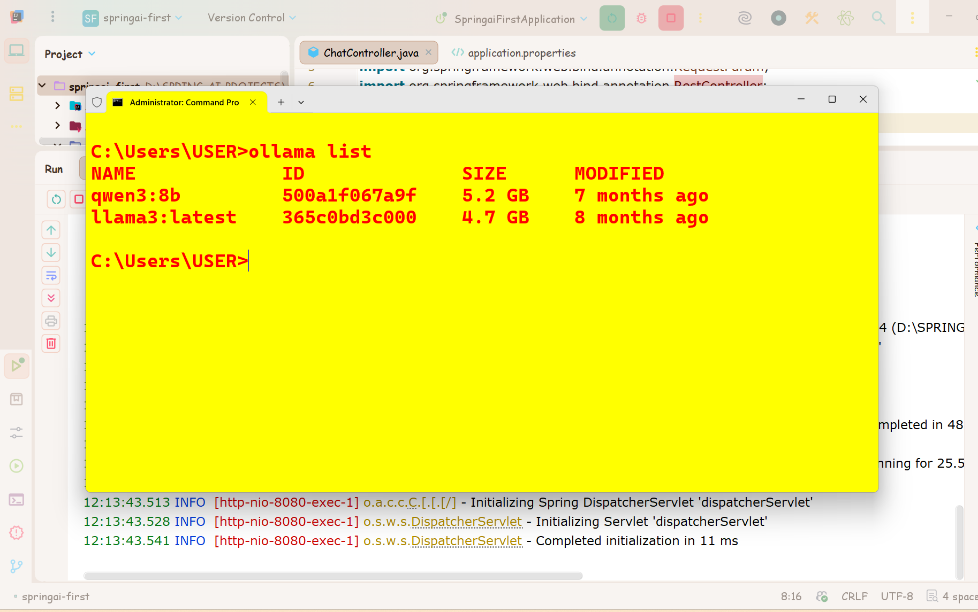

Slide 27
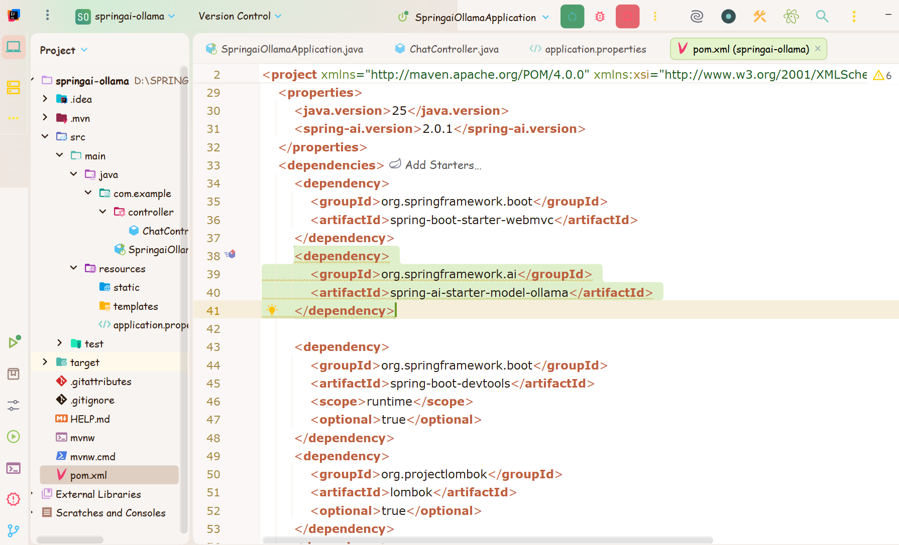

Slide 28
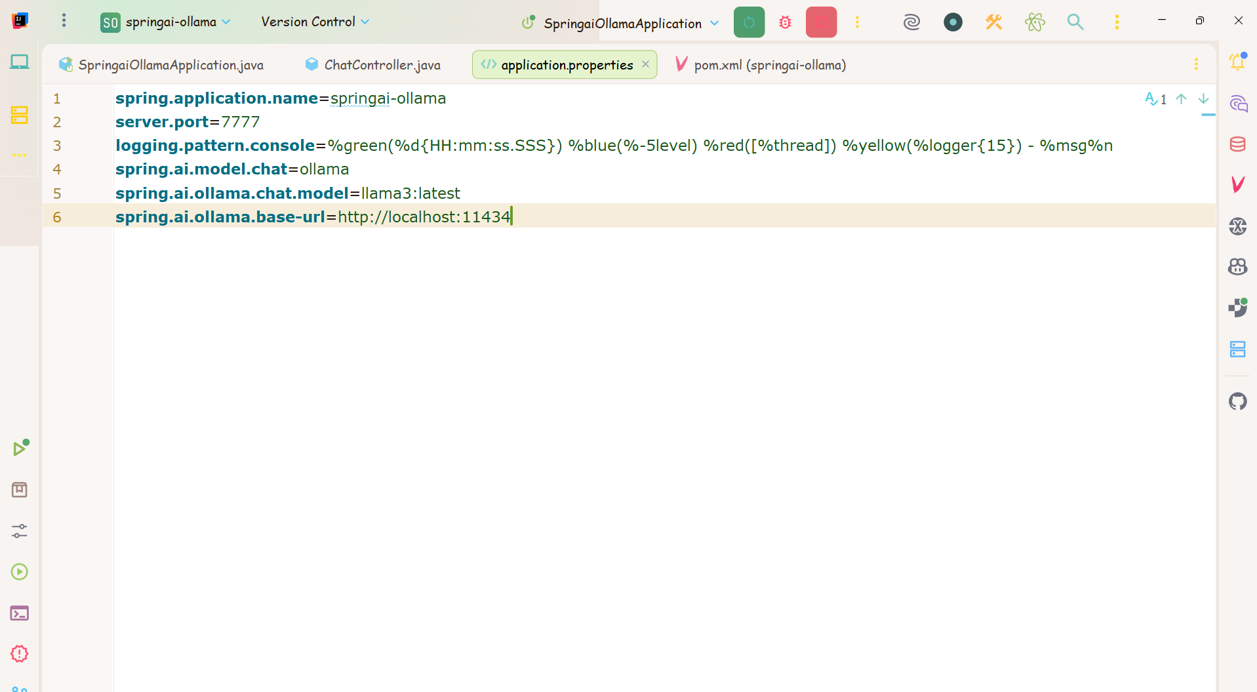

Slide 29
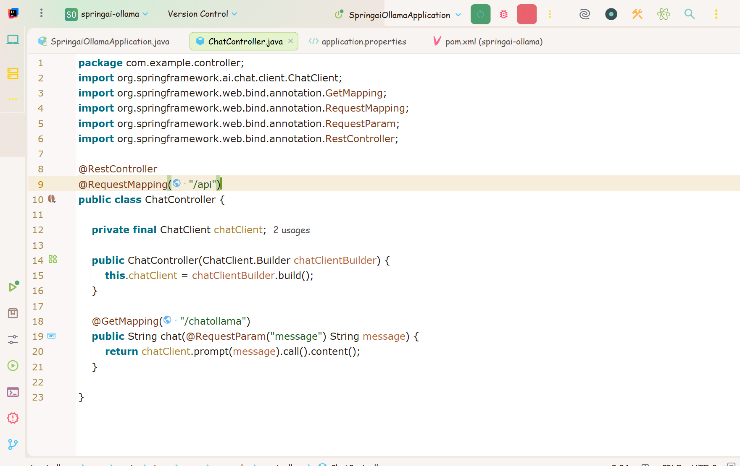

Slide 30
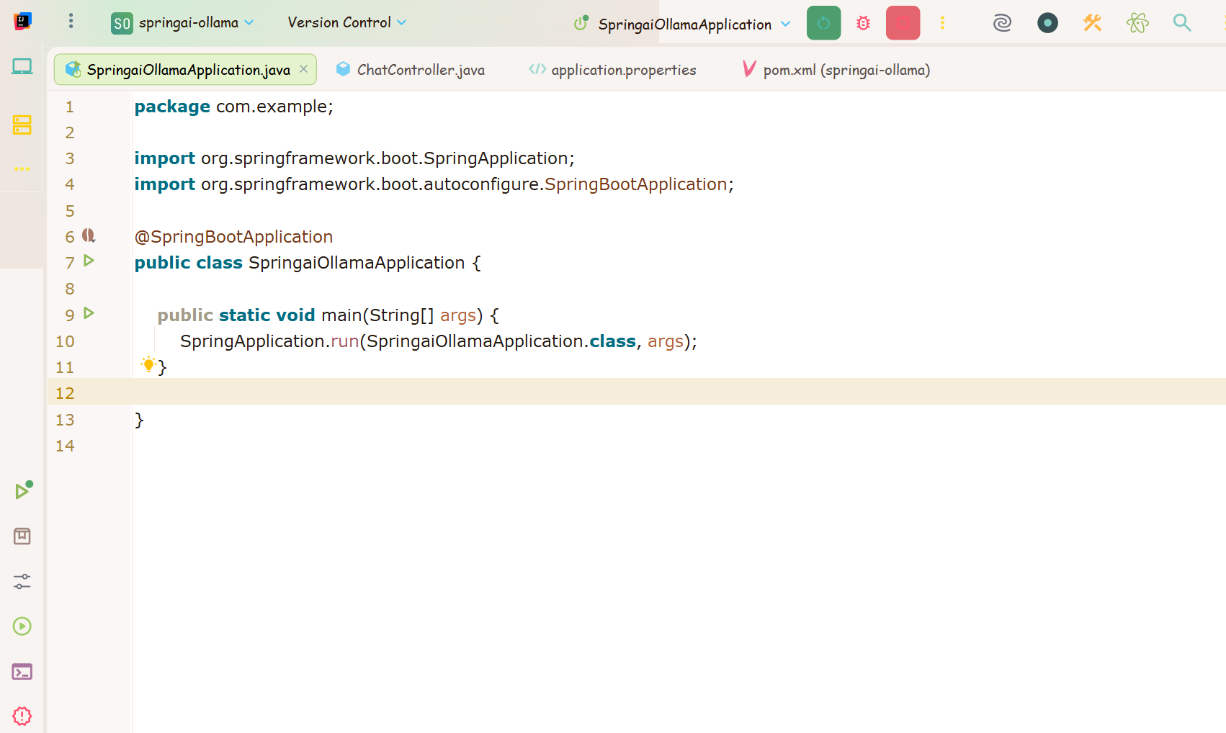

Slide 31
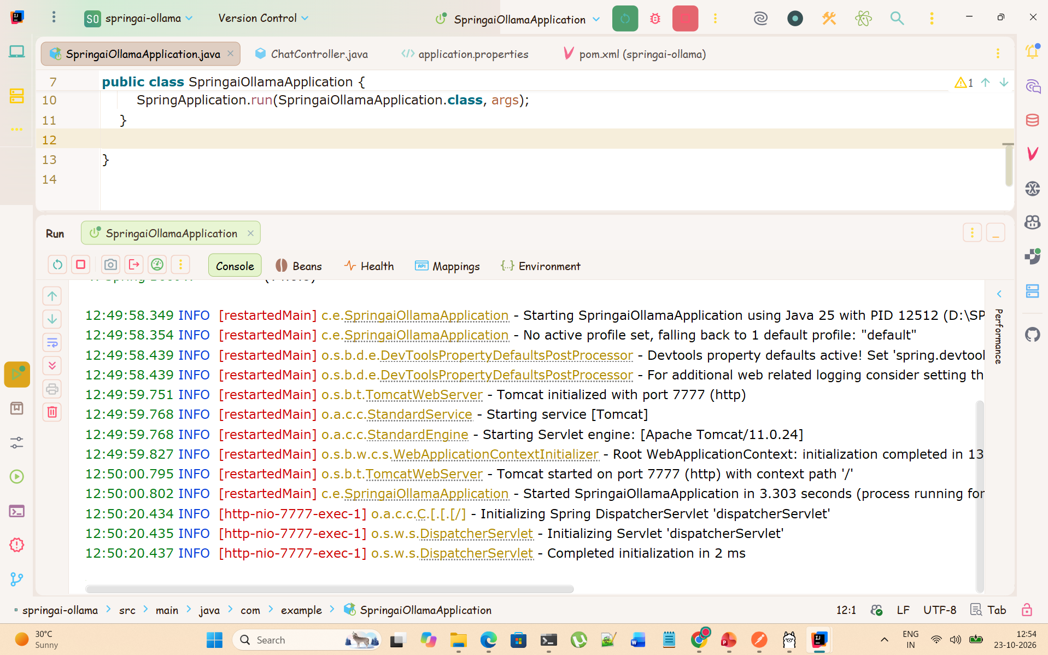

Slide 32
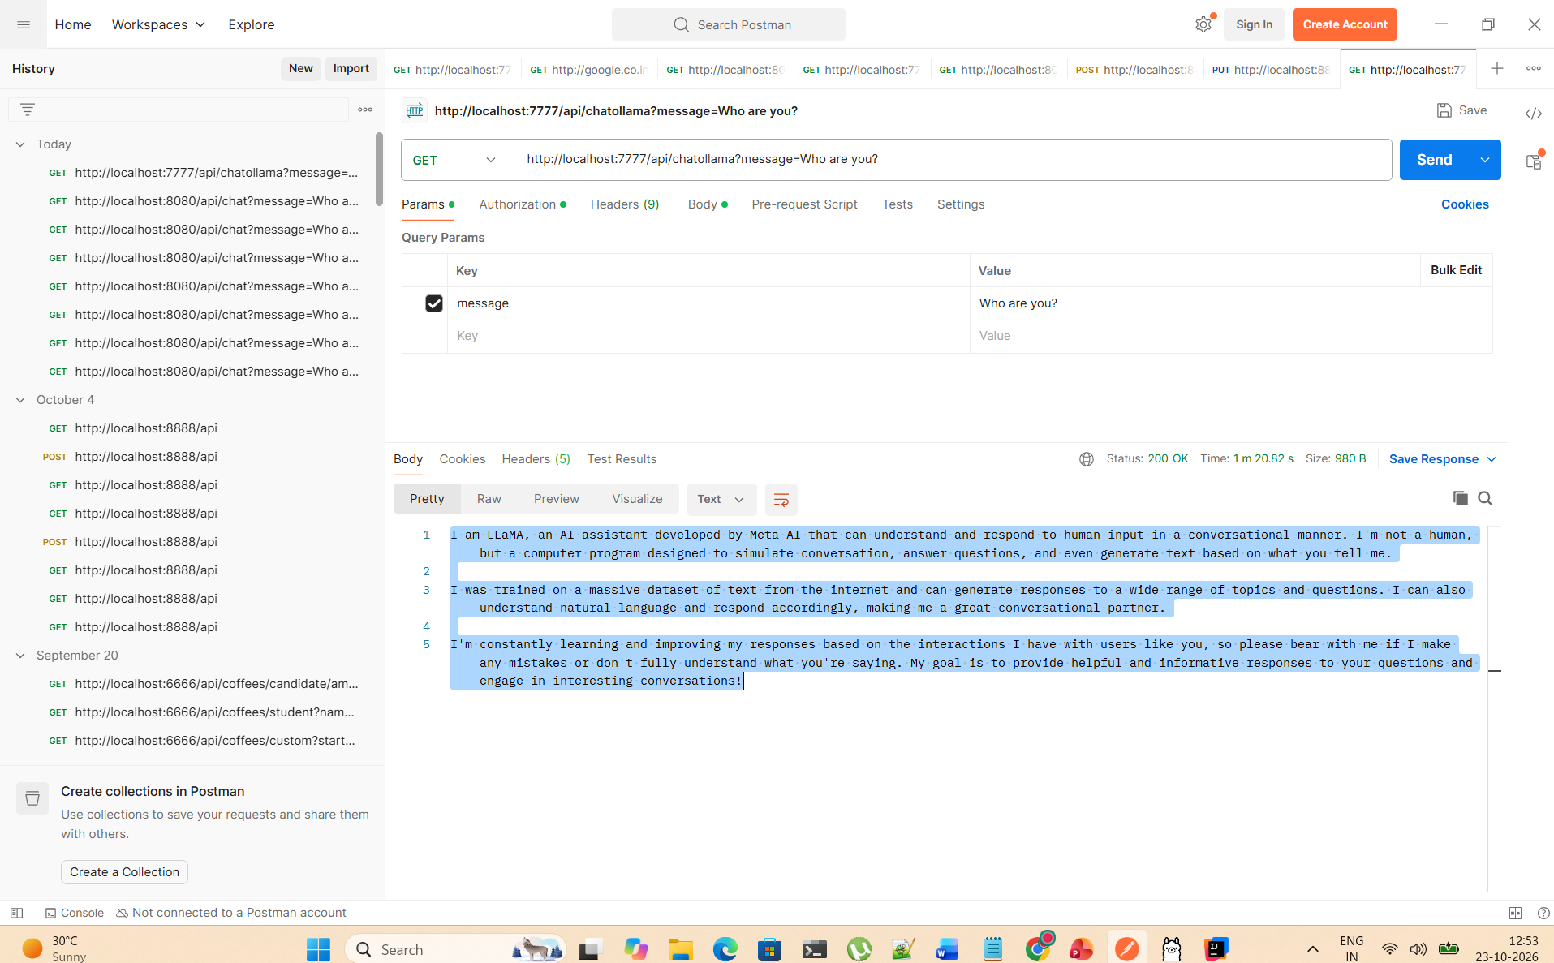

Slide 33
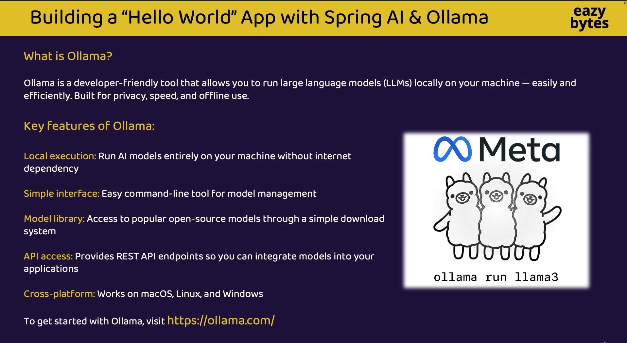

Slide 34
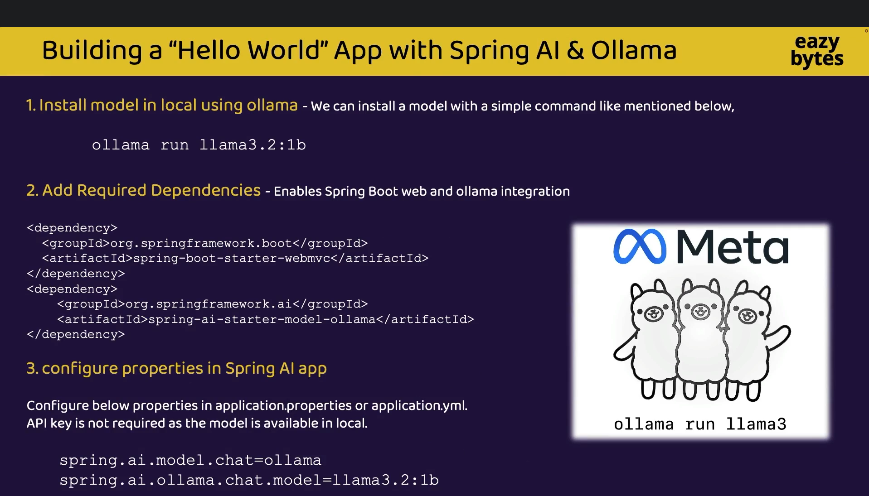

Slide 35
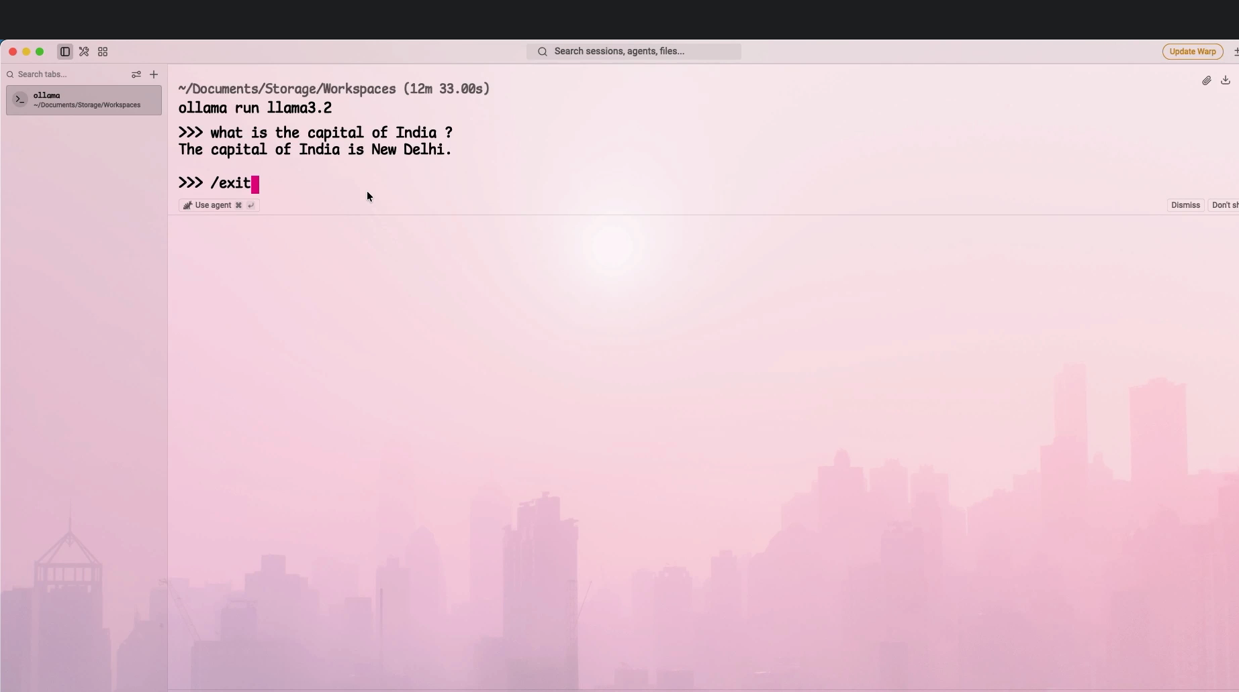

Slide 36
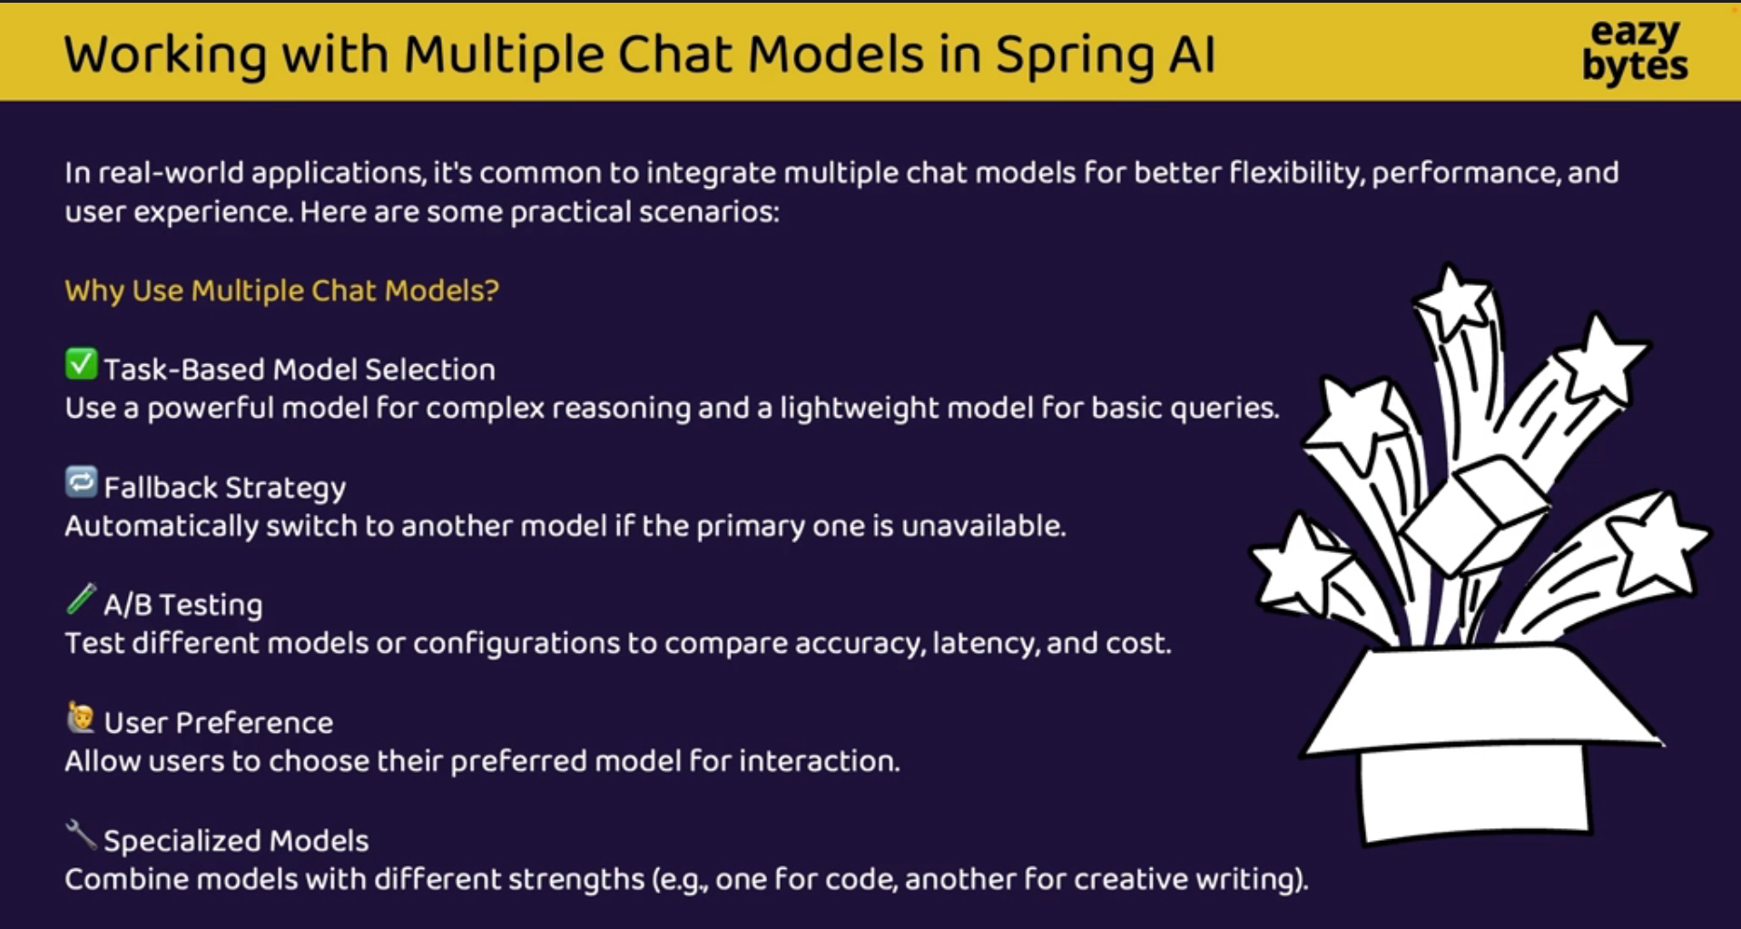

Slide 37
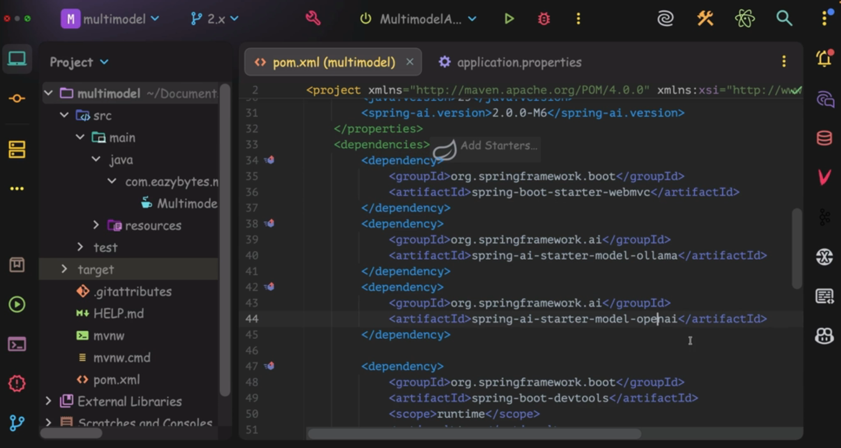

Slide 38
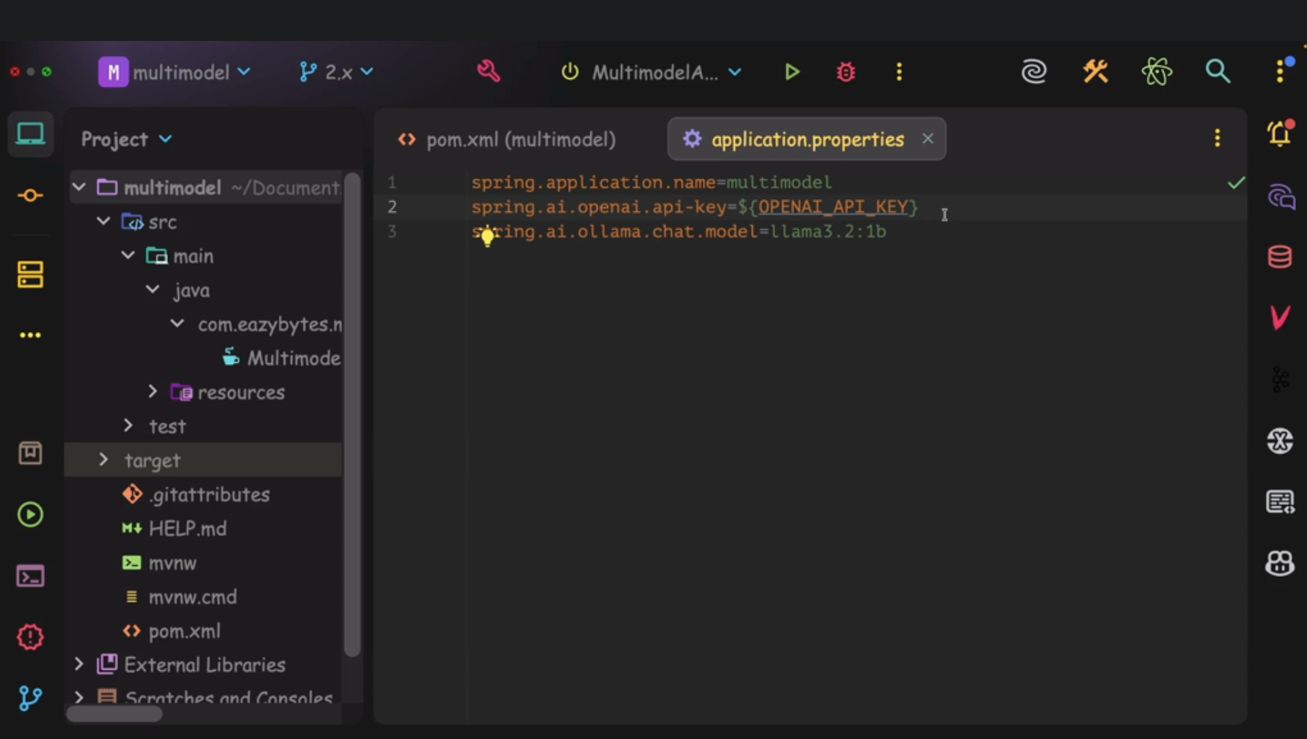

Slide 39
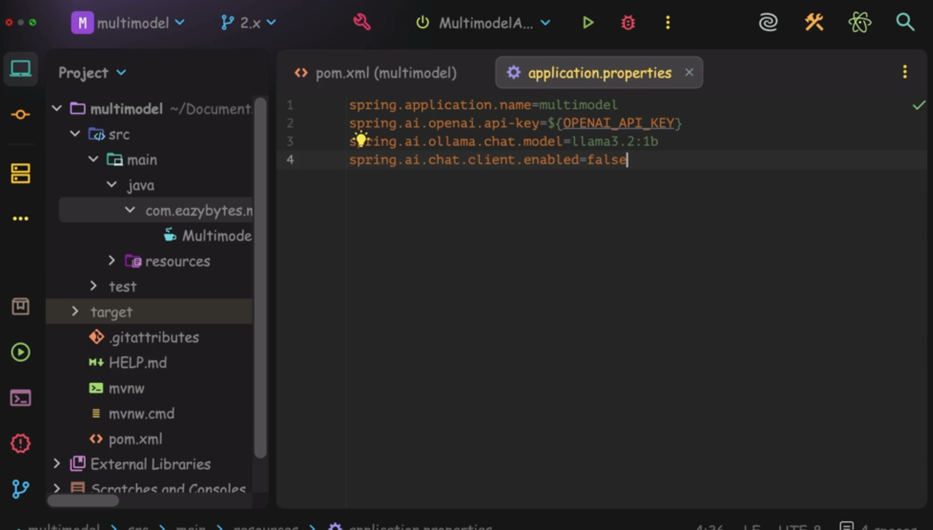

Slide 40
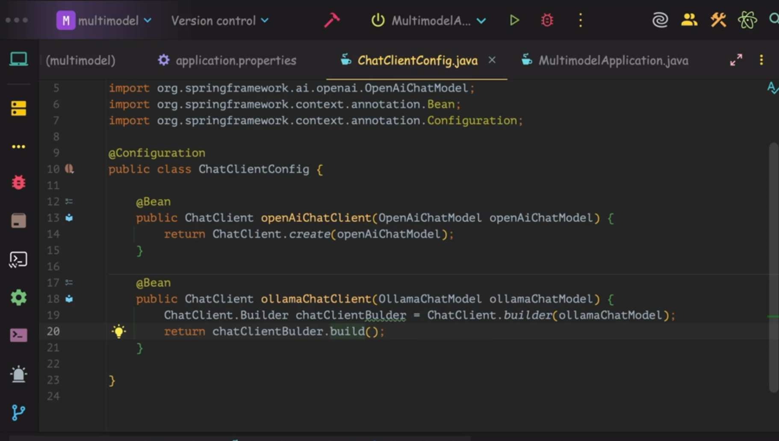

Slide 41
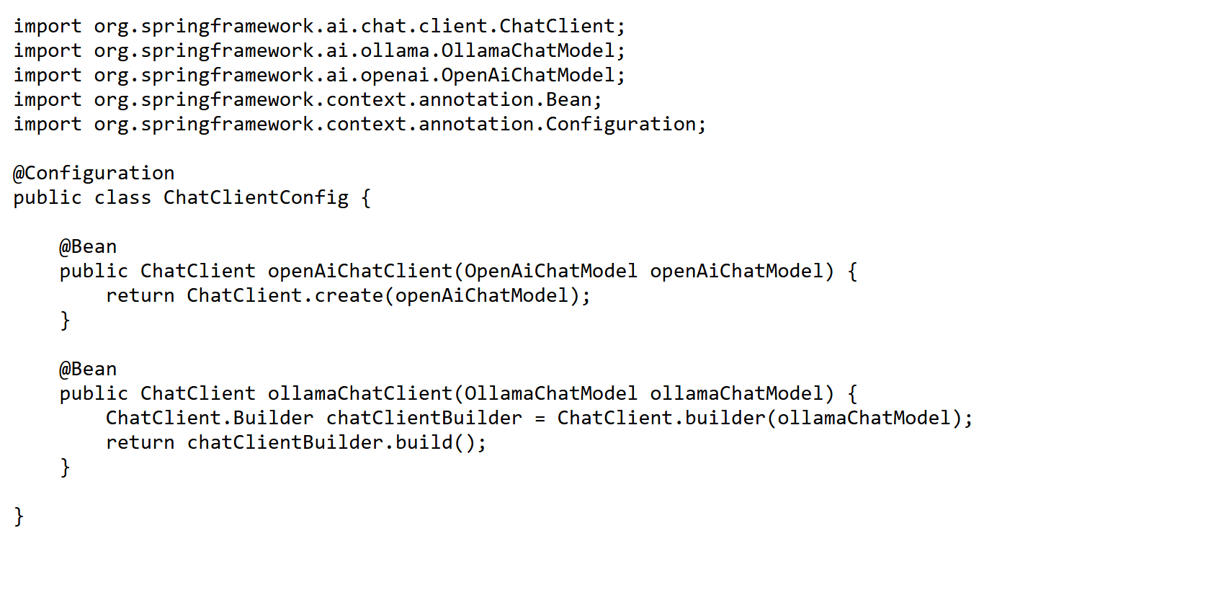
Configuration for multiple LLM

Slide 42
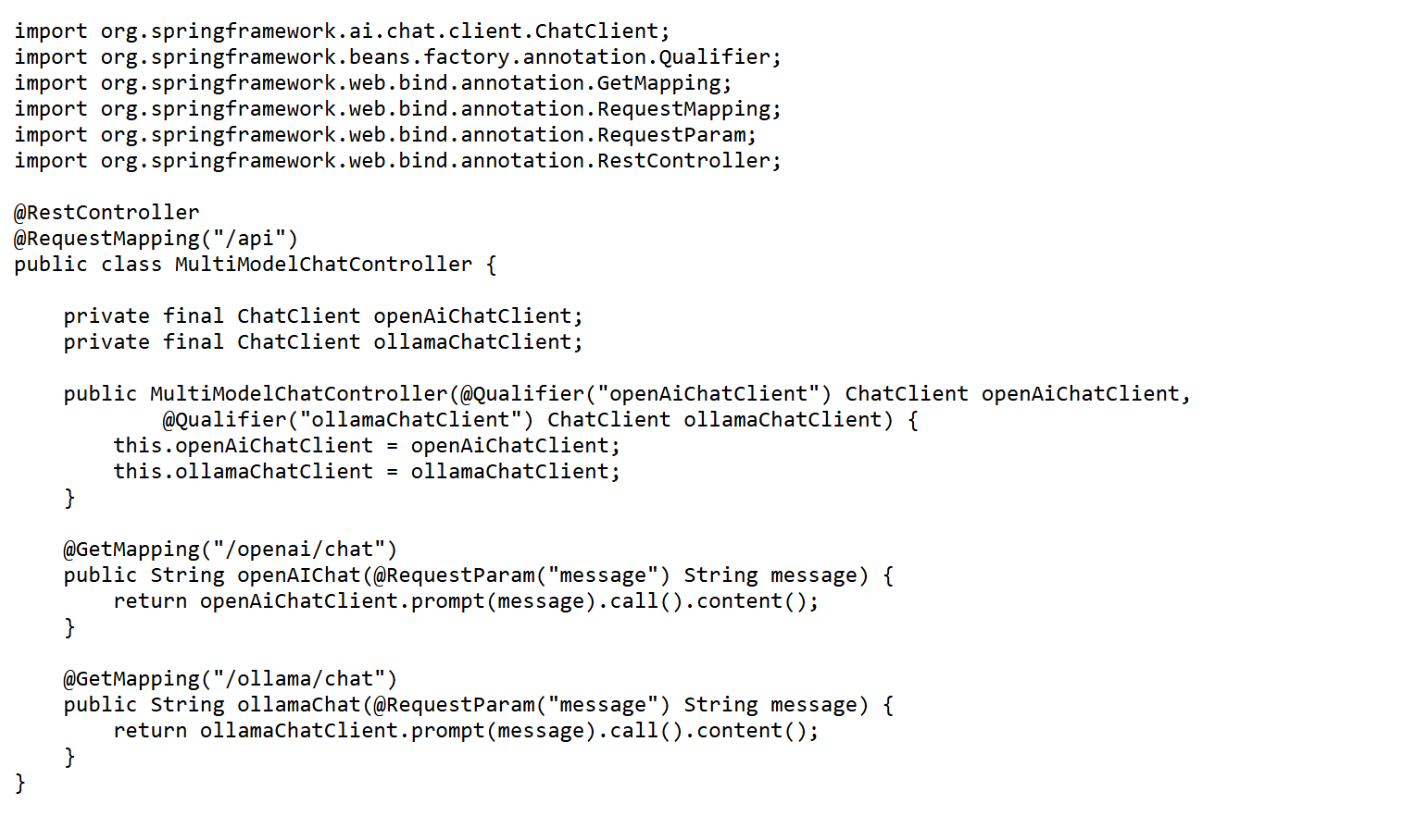
Controller

Slide 43
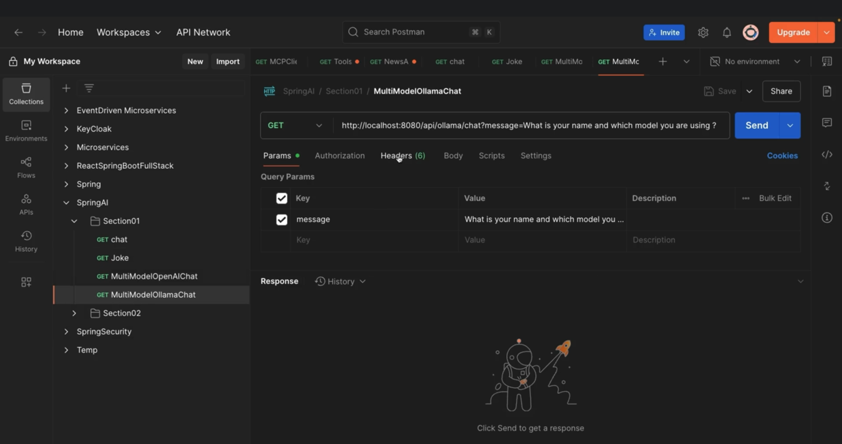

Slide 44
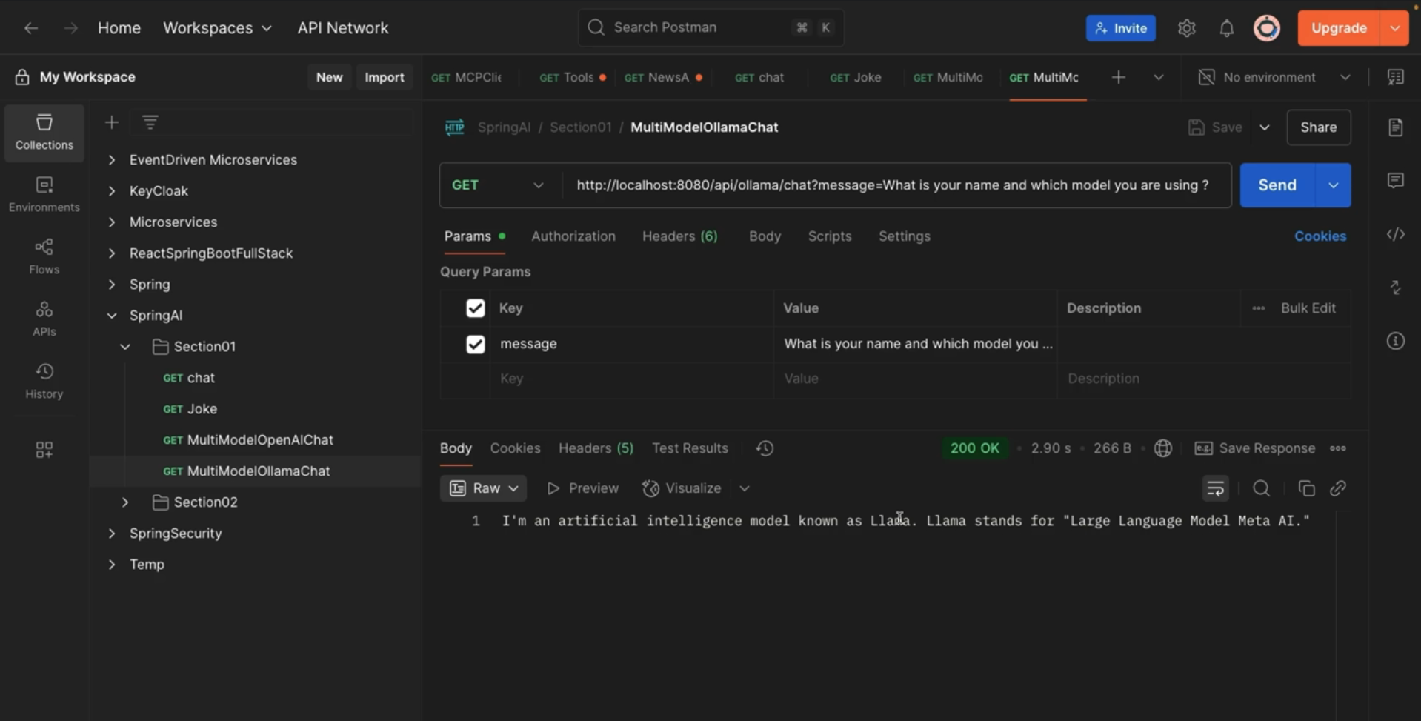

Slide 45
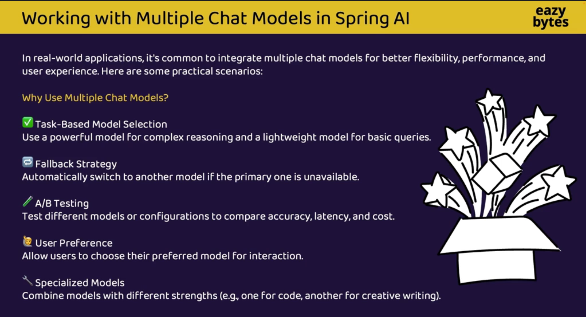

Slide 46
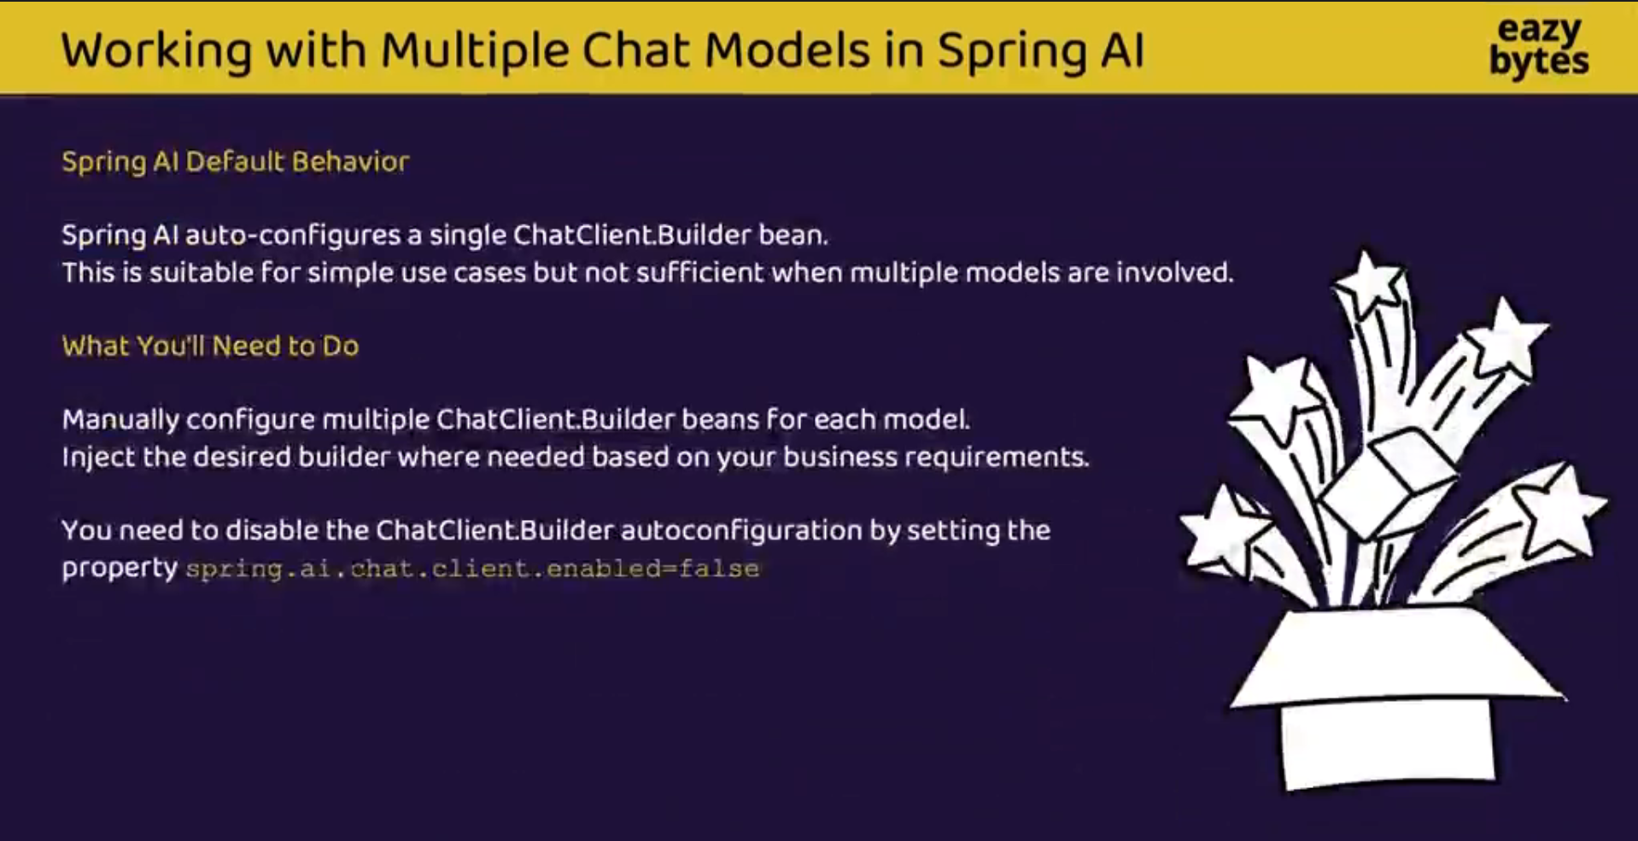

Slide 47
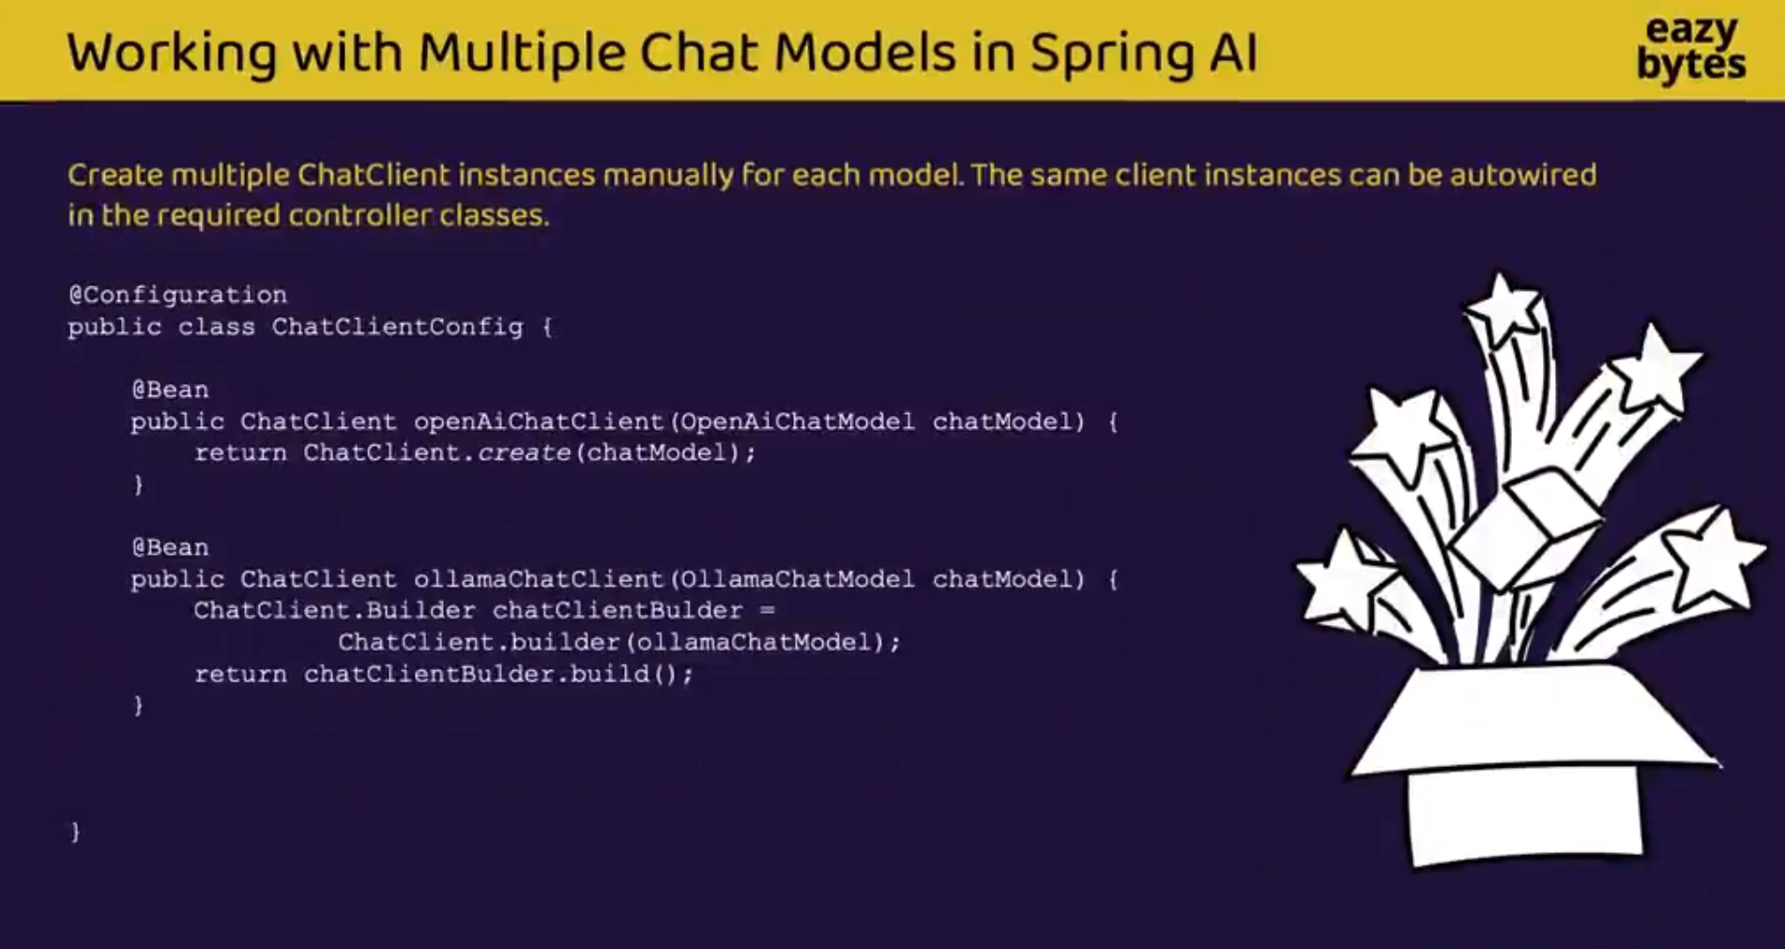

Slide 48
Tuning Models with Chat Options
Global defaults
Temperature guide
# OpenAI
spring.ai.openai.chat.options.model=gpt-4o-mini
spring.ai.openai.chat.options.temperature=0.2
# Ollama
spring.ai.ollama.chat.options.model=llama3.2
spring.ai.ollama.chat.options.temperature=0.2
0.0
Deterministic: facts, code, data extraction
0.3
Focused: Q&A and summaries
0.7
Balanced: everyday chat
Per-request override
chatClient.prompt()
.user(message)
.options(OpenAiChatOptions.builder()
.model("gpt-4o-mini")
.temperature(0.2)
.build())
.call().content();
1.0+
Creative: brainstorming and stories
Change temperature or top-p, not both.
Notes:
Options can be set globally in application.properties or per request in code. Property names follow Spring AI 1.x; check the reference docs for your version.

Slide 49
System Prompts and Prompt Templates
Default system prompt
System prompt
Sets role, tone and rules for every call.
@Bean
ChatClient tutorClient(ChatClient.Builder builder) {
return builder
.defaultSystem("You are a patient Java tutor. "
+ "Answer in at most 3 bullet points.")
.build();
}
User prompt
The actual request from your user.
Templates
{placeholders} are filled at runtime, so prompts stay reusable.
Template with parameters
String answer = tutorClient.prompt()
.user(u -> u.text("Explain {topic} to a {level}")
.param("topic", "dependency injection")
.param("level", "beginner"))
.call()
.content();
Tip
Keep long prompts in resource files such as prompts/tutor.st.
Notes:
A default system prompt gives every call the same persona. Templates with placeholders make prompts reusable and testable.

Slide 50
Streaming Responses
Streaming endpoint
Why stream?
Users see the first words almost immediately.
Long answers feel responsive.
Returns a reactive Flux<String> (Project Reactor).
Try it: curl -N "localhost:8080/stream?message=hi"
@GetMapping(value = "/stream",
produces = MediaType.TEXT_EVENT_STREAM_VALUE)
public Flux<String> stream(@RequestParam String message) {
return chatClient.prompt()
.user(message)
.stream()
.content();
}
Same answer, different experience
call()
Waiting for the complete answer…
Whole answer appears
stream()
Spring
AI
makes
LLM
calls
easy
.
Notes:
Streaming sends tokens to the client as soon as they are generated. Use curl -N to see it in the terminal.

Slide 51
Structured Output: LLM to Java Objects
Ask for a typed result
What the model returns
record Course(String title, String level,
List<String> topics) { }
Course course = chatClient.prompt()
.user("Create a short course on Spring AI")
.call()
.entity(Course.class);
{
"title": "Spring AI Basics",
"level": "Beginner",
"topics": ["ChatClient", "RAG"]
}
Prompt
plus format instructions
LLM
replies with JSON
Converter
maps JSON to your type
Course
a ready-to-use record
Lists: use .entity(new ParameterizedTypeReference<List<Course>>() {}). Always validate the result.
Notes:
Spring AI adds format instructions to the prompt and converts the JSON reply into your Java type. Models can still return bad JSON, so always handle errors.

Slide 52
Embeddings and RAG at a Glance
A. Ingest your documents (once)
Documents
PDFs, web pages, notes
Split
Cut into small chunks
EmbeddingModel
Text to vector (OpenAI text-embedding-3-small or Ollama nomic-embed-text)
VectorStore
Stores vectors for similarity search
B. Answer a question (every request)
Question
from the user
Search
find the top-k similar chunks
Prompt
question plus retrieved context
LLM
OpenAI or Ollama
Answer
grounded in your data
chatClient.prompt().user(question)
.advisors(QuestionAnswerAdvisor.builder(vectorStore).build()).call().content();
Notes:
RAG = Retrieval-Augmented Generation. Embeddings turn text into vectors; similar meaning means nearby vectors. We retrieve the closest chunks and give them to the LLM as context.

Slide 53
Best Practices and Common Pitfalls
1
Protect secrets
2
Control cost
Keep API keys in environment variables or a secrets manager, never in Git.
Set max tokens, use small models for simple tasks and monitor token usage.
3
Handle failures
4
Validate outputs
Set timeouts and retries, and plan a fallback model such as OpenAI to Ollama.
Treat answers as untrusted: check JSON, facts and anything users will see.
5
Keep data private
6
Test and observe
Do not send personal or confidential data to cloud models. Use Ollama for sensitive work.
Version your prompts, test with fixed inputs and log latency and token usage.
Notes:
Use this as a checklist for the lab work and for production projects.

Slide 54
Summary: Key Takeaways
1
GenAI creates new content. LLMs do it by predicting the next token.
Choose OpenAI when
You need top quality or complex reasoning
You want zero infrastructure
Traffic must scale quickly
2
Tokens, context window and temperature control cost, limits and style.
3
OpenAI: powerful cloud models, API key, pay per token.
Choose Ollama when
Data must stay private or offline
You are learning or prototyping for free
Smaller models are good enough
4
Ollama: free local models on localhost:11434, private and offline.
5
Spring AI’s ChatClient gives one API for both, plus streaming, structured output and RAG.
Notes:
Recap the five takeaways, then ask students which model they would choose for three example projects.

Slide 55
Hands-On Practice Exercises
1
Temperature experiment: Ask the same question at temperature 0 and at 1.0. Compare the answers.
Easy
2
Model swap: Run one endpoint with llama3.2:1b and llama3.2:3b. Compare speed and quality.
Easy
3
Persona bot: Add a system prompt so the assistant is a pirate, a tutor or a code reviewer.
Medium
4
Stream it: Build a /stream endpoint and watch the tokens arrive with curl -N.
Medium
5
Course generator: Return a Course record with .entity() from /course?topic=...
Hard
Stretch goal: a mini RAG app that answers questions from a text file.
Notes:
Suggested lab time: 60 to 90 minutes. Students can work in pairs. Exercise 5 is a good take-home challenge.

Slide 56
Knowledge Check
What is a token, and why does it matter for cost?
What does a lower temperature do to the answers?
Q1
Q2
Why can a long conversation start to forget early messages?
Give two reasons to choose Ollama over a cloud API.
Q3
Q4
Which Ollama command downloads a model, and which lists installed ones?
How does .entity(Course.class) differ from .content()?
Q5
Q6
Answers are in the speaker notes.
Notes:
ANSWERS. 1) A token is a chunk of text; providers bill and limit by tokens. 2) Lower temperature gives more focused, repeatable answers. 3) The context window is limited, so old messages get cut off. 4) Privacy, no per-token cost, offline use, free experimentation. 5) ollama pull downloads; ollama list shows installed models. 6) .content() returns plain text; .entity(Course.class) converts the reply into a Java object.

