Slide 1
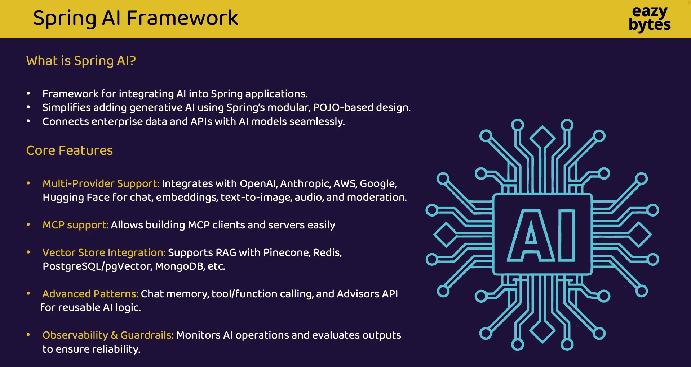

Slide 3
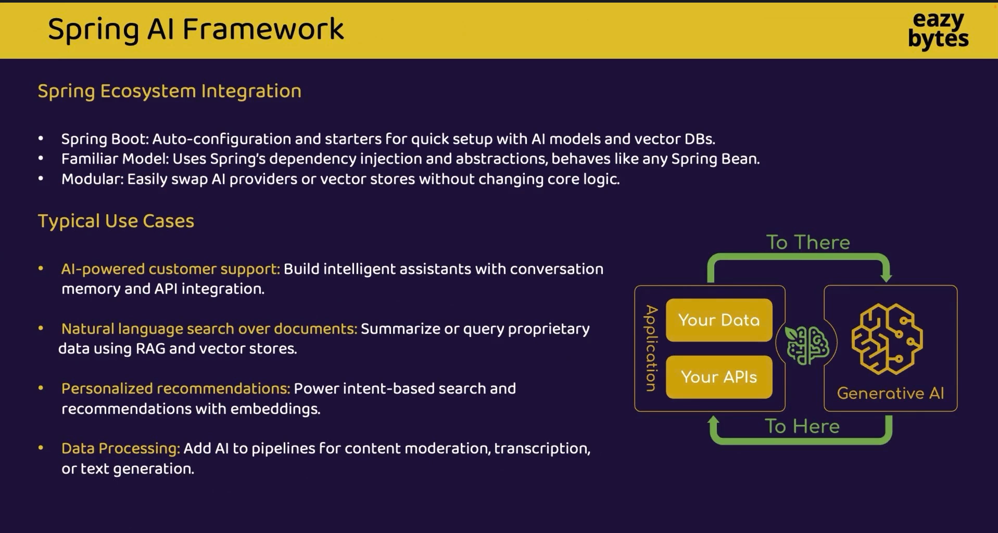

Slide 4
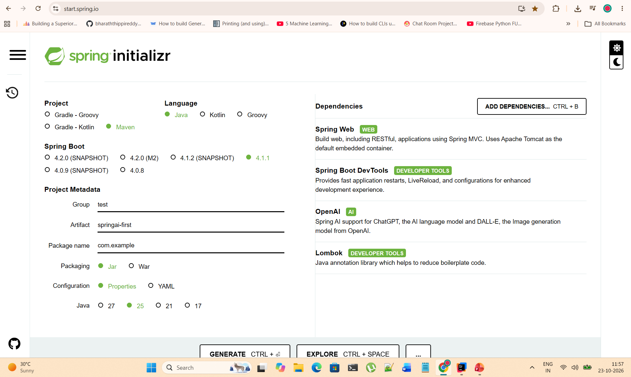

Slide 5
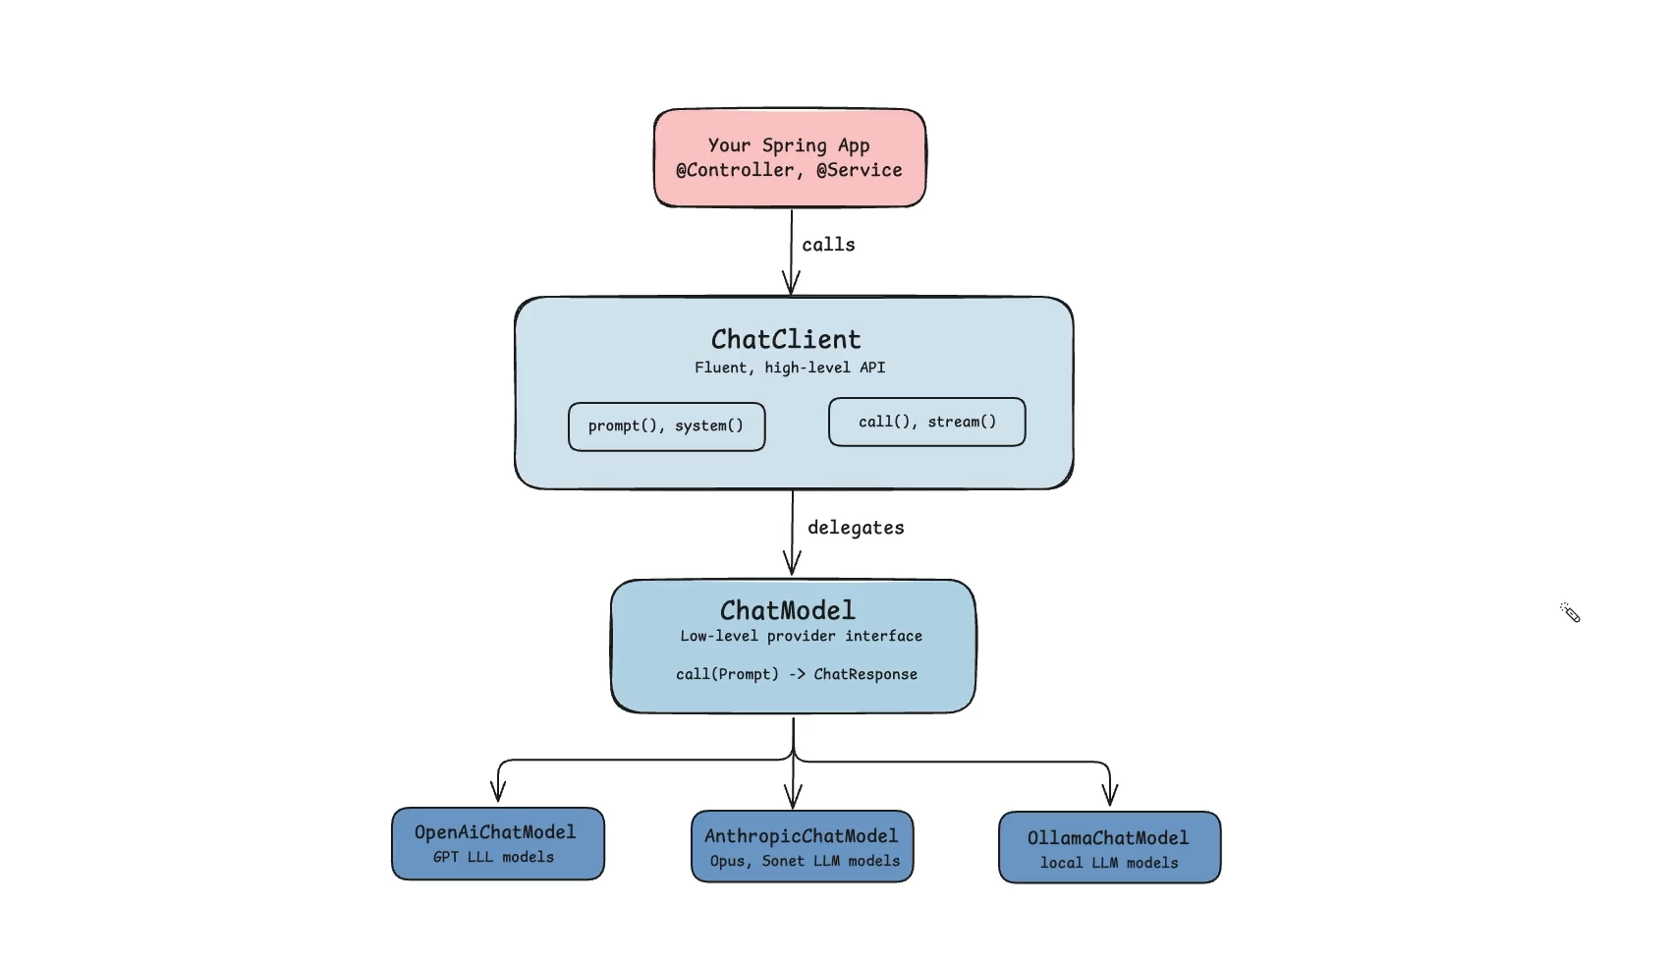

Slide 6
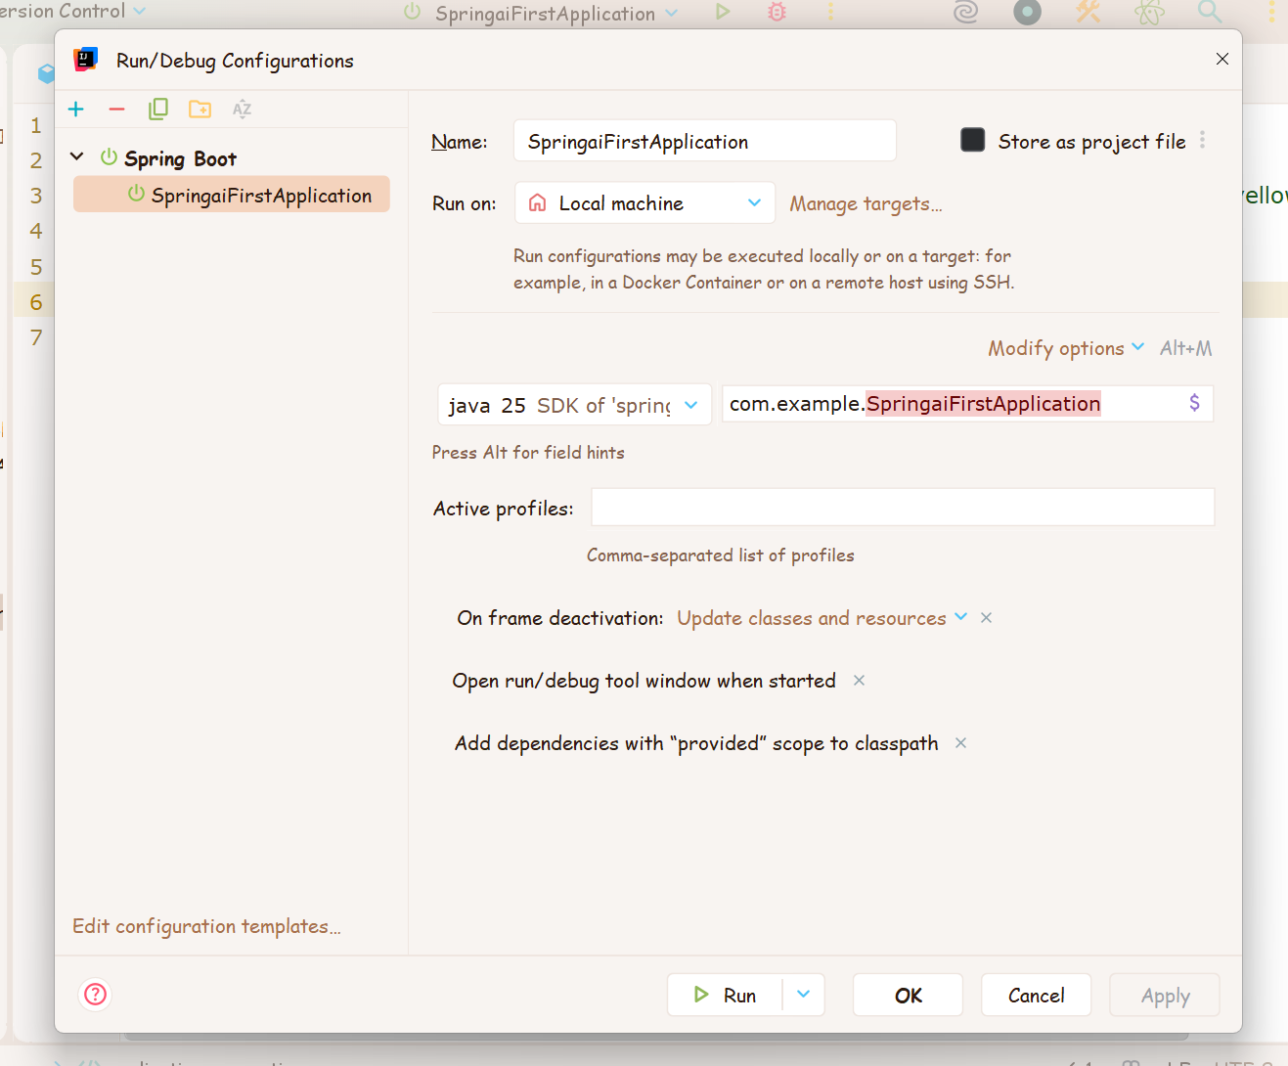

Slide 7
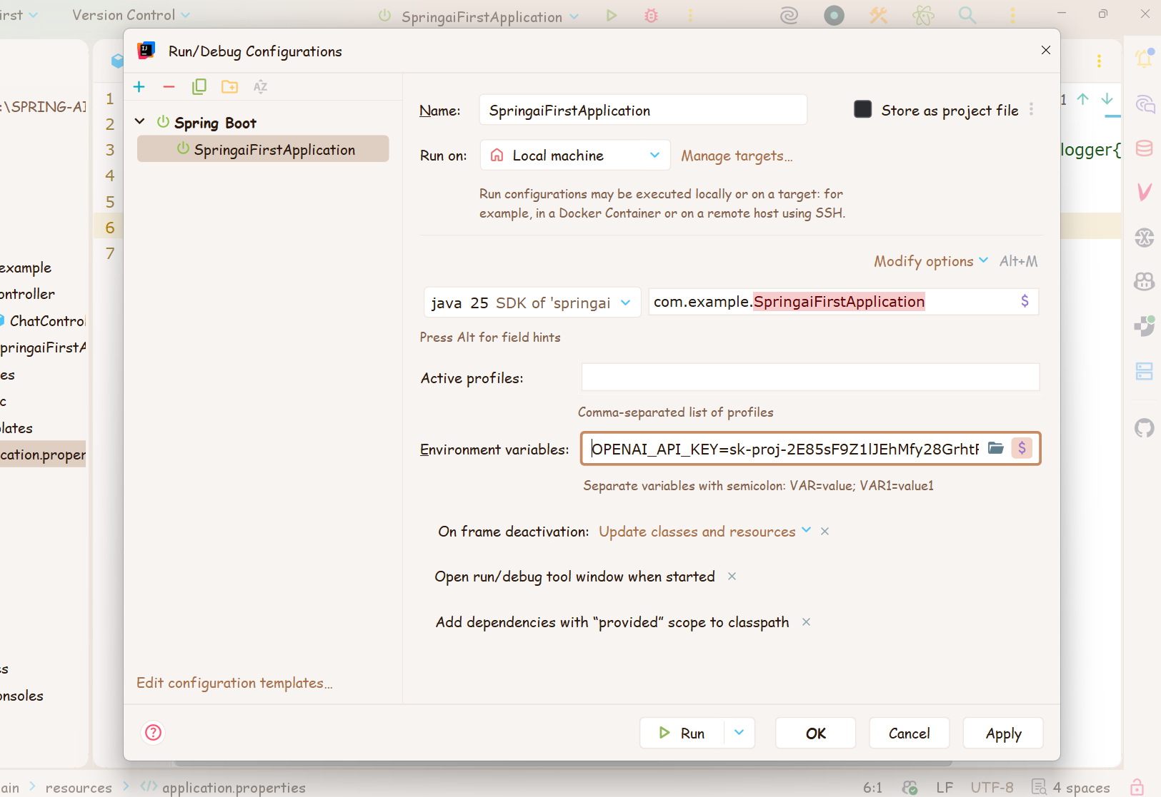
REDACTED — use an environment variable for API keys

Slide 8
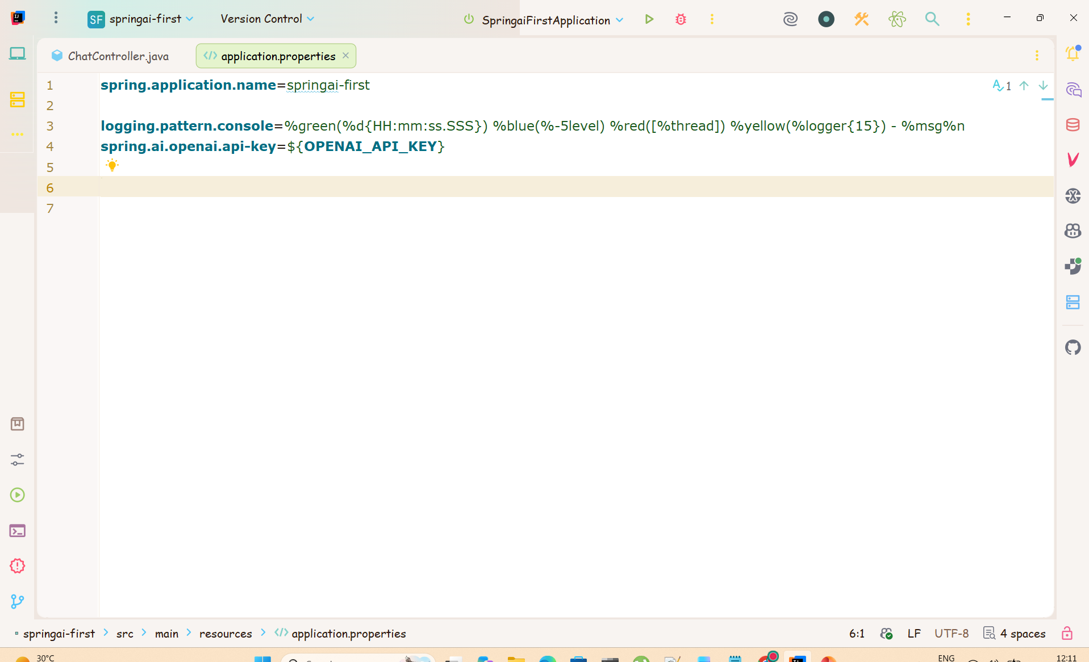

Slide 9
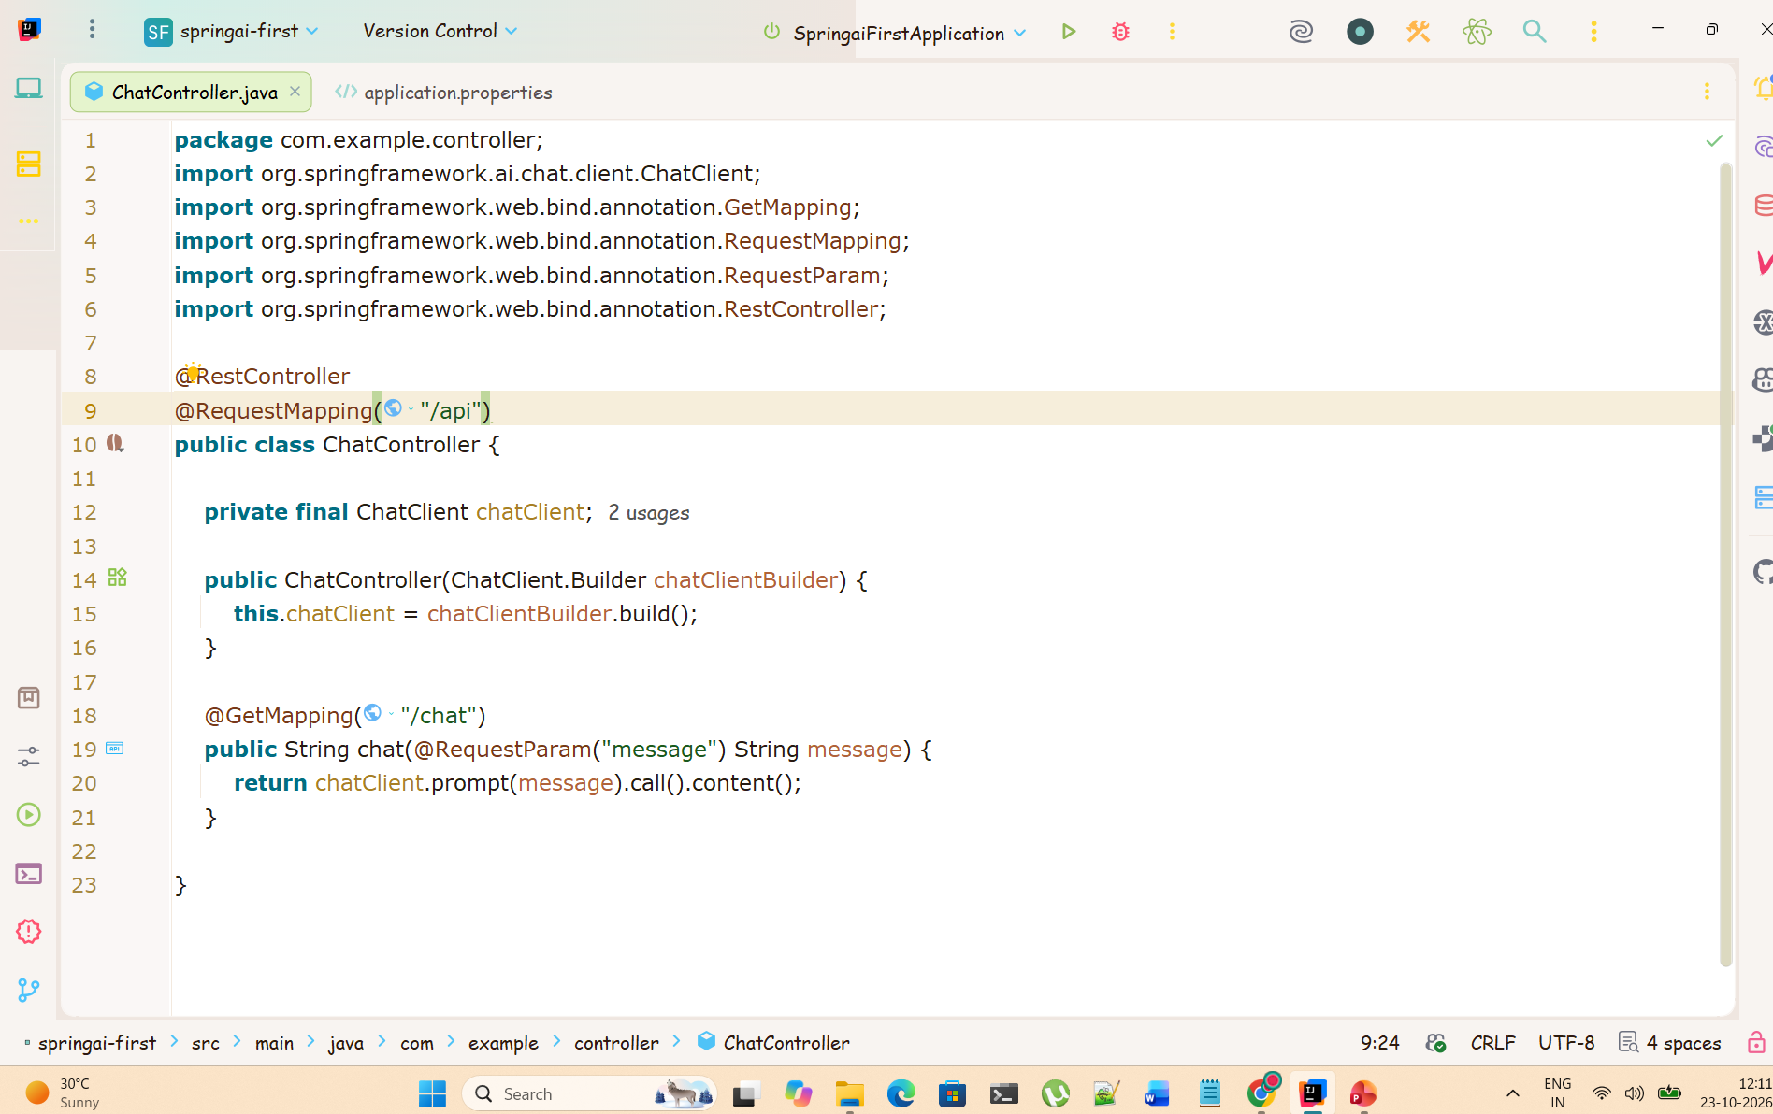

Slide 10
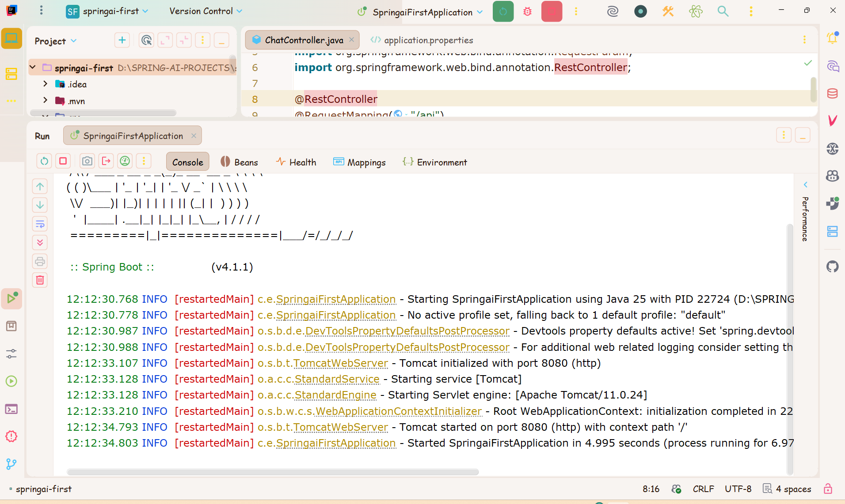

Slide 11
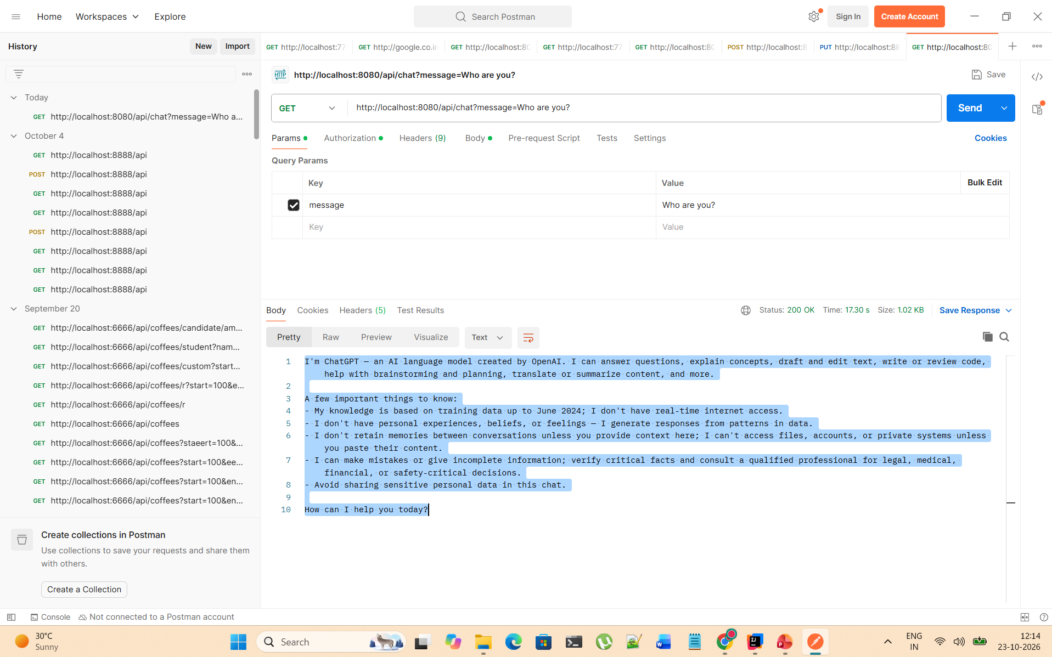

Slide 12
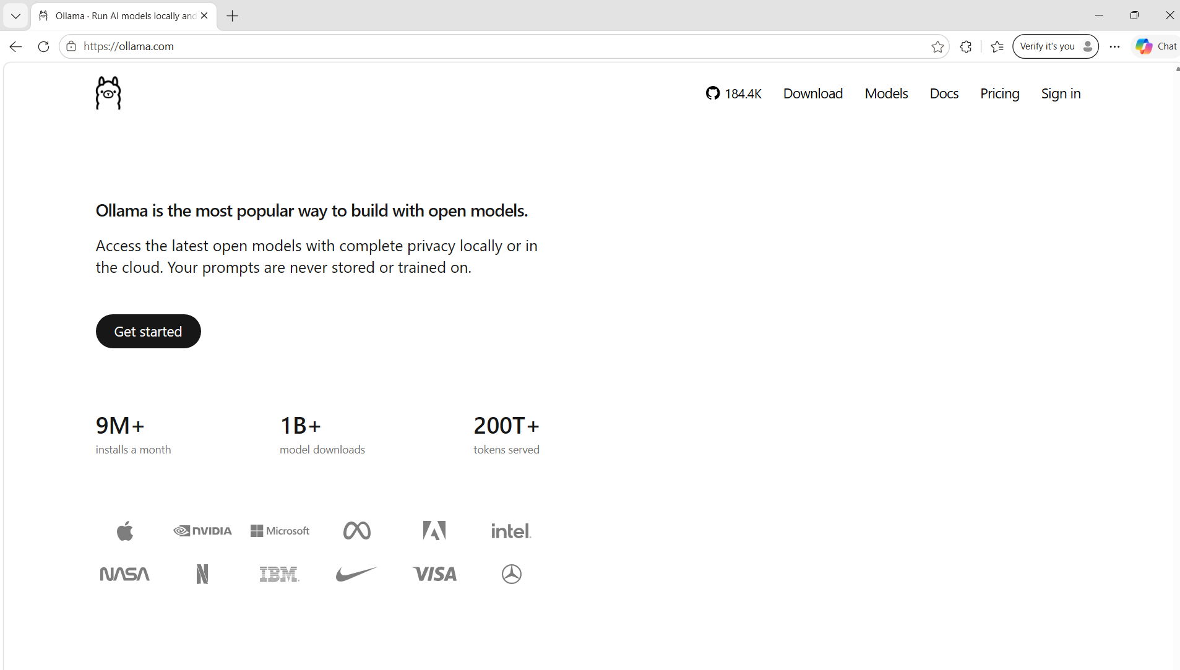

Slide 13
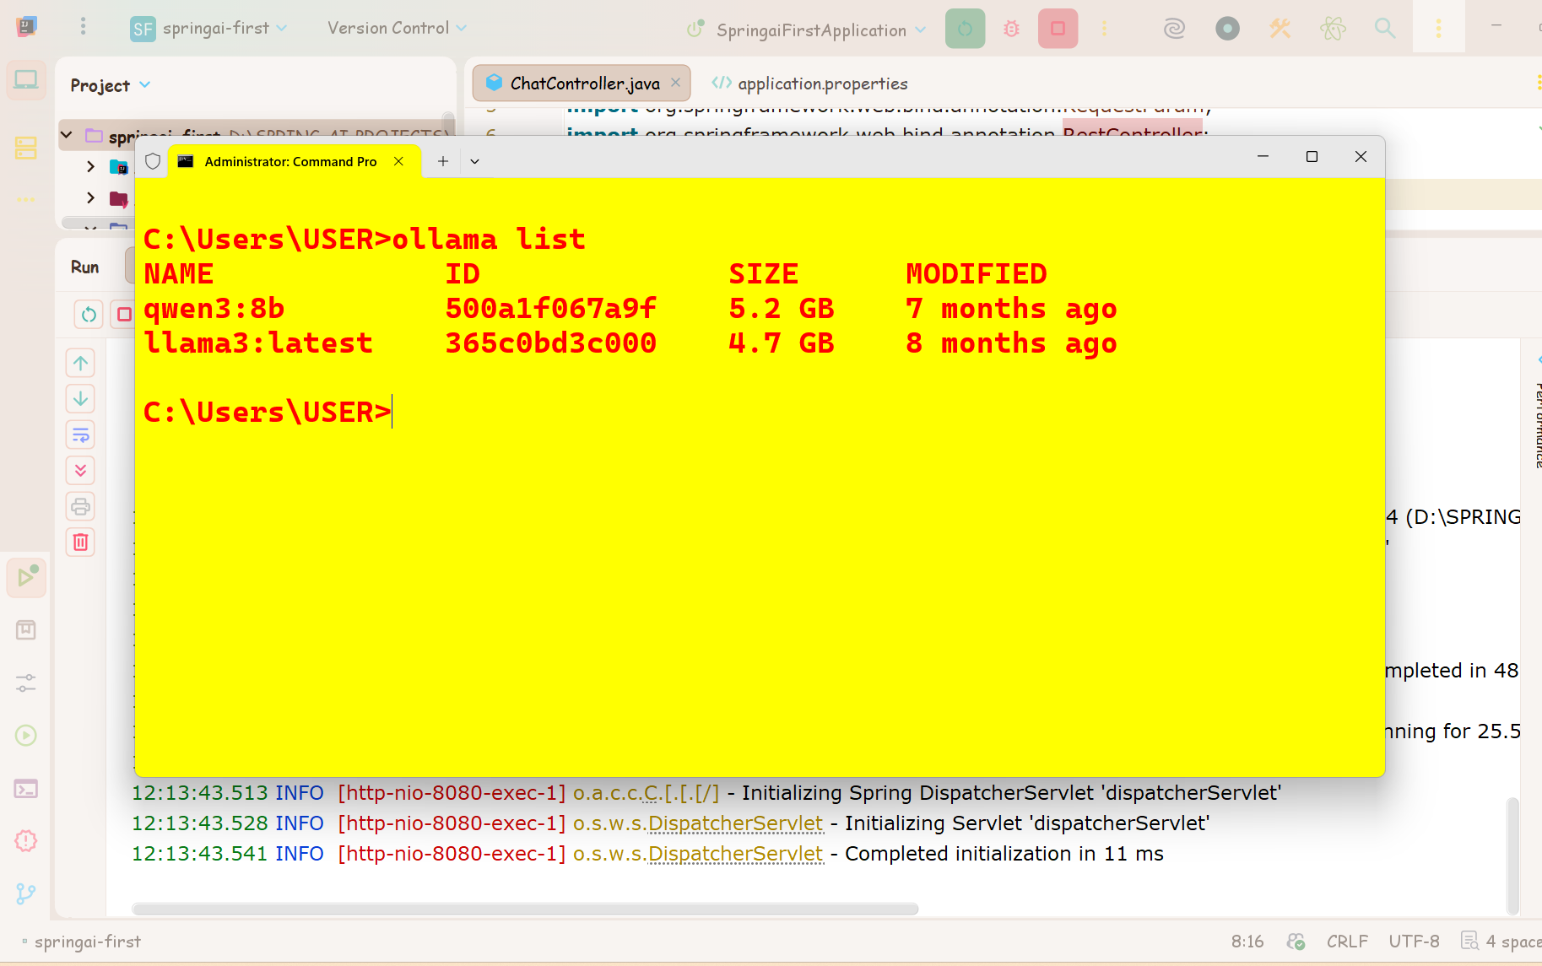

Slide 14
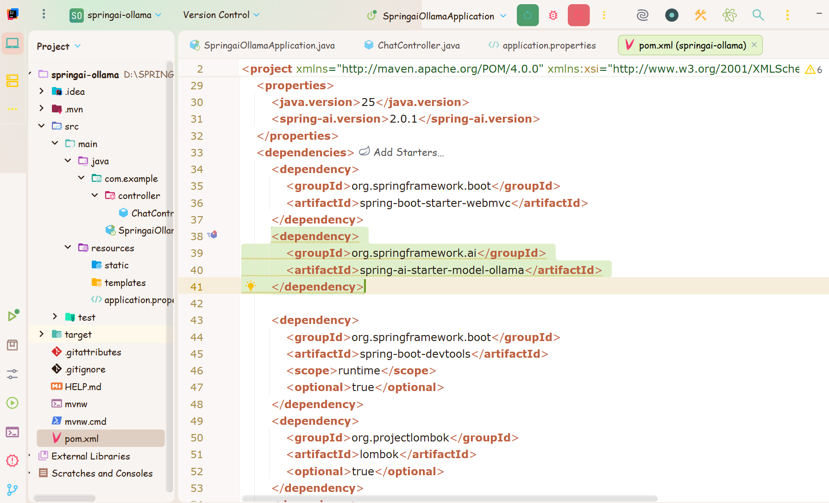

Slide 15
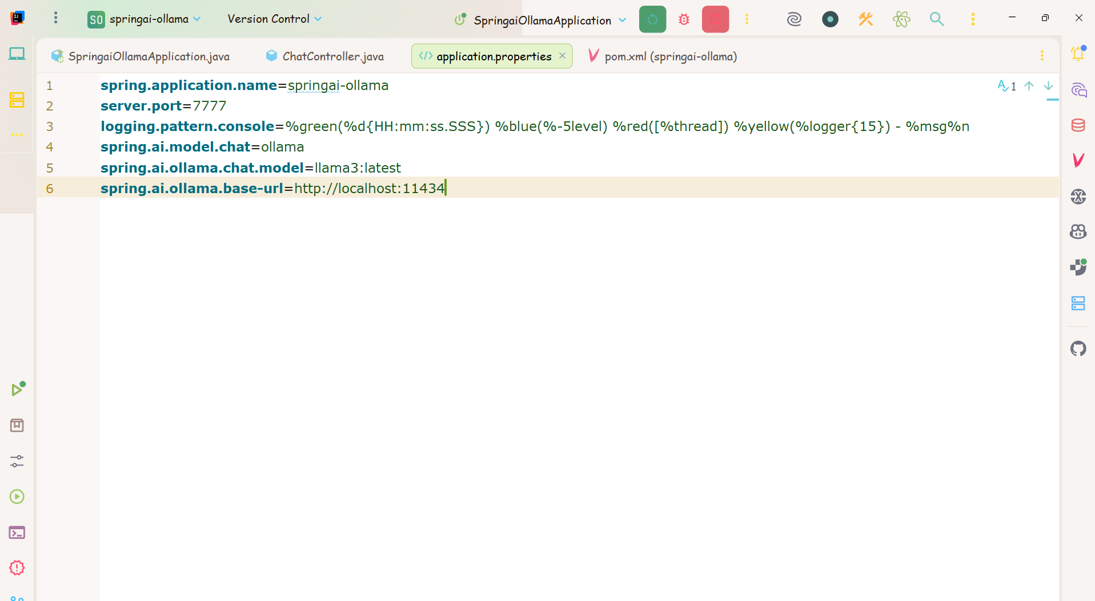

Slide 16
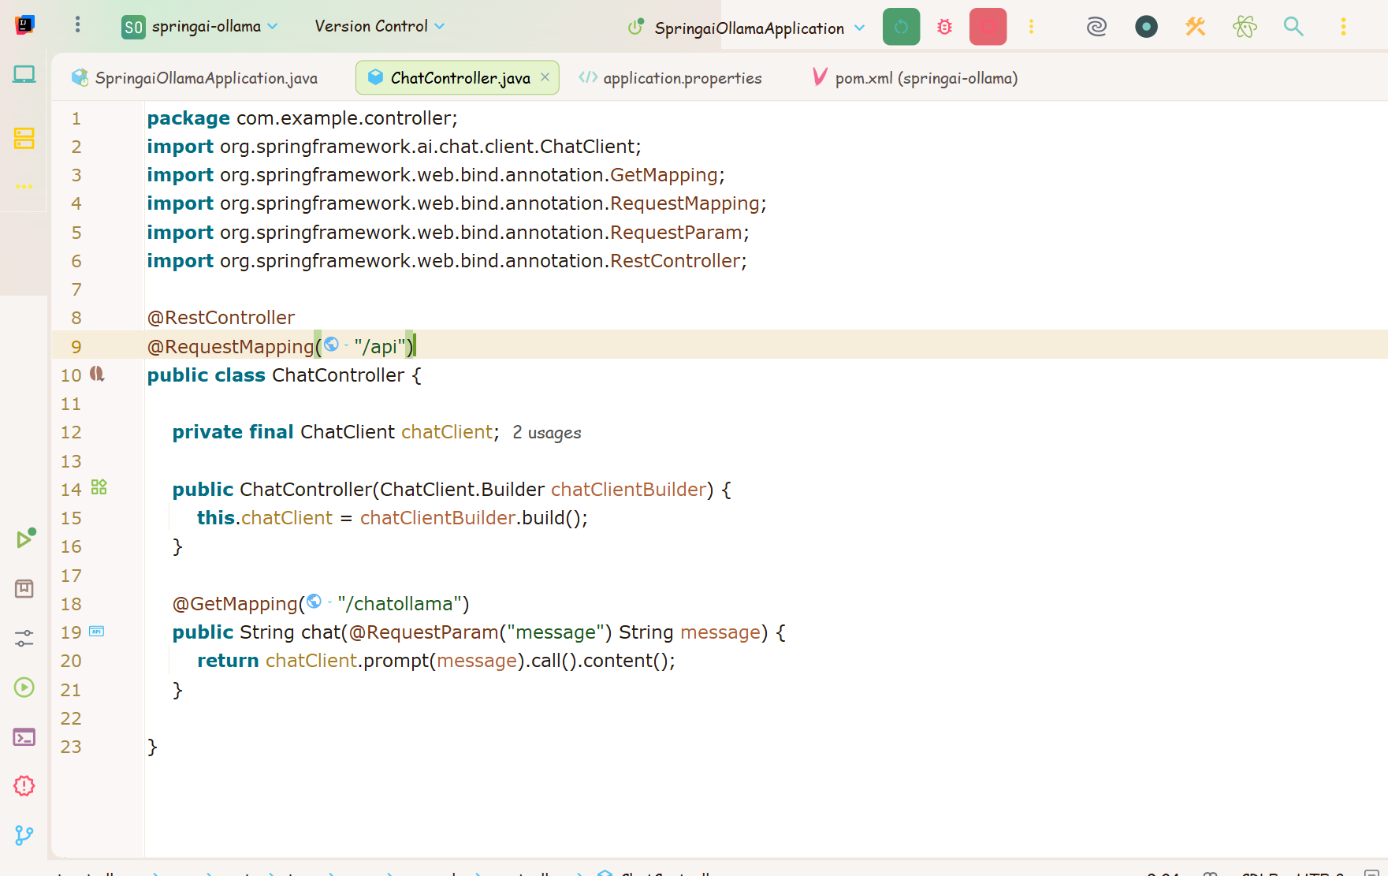

Slide 17
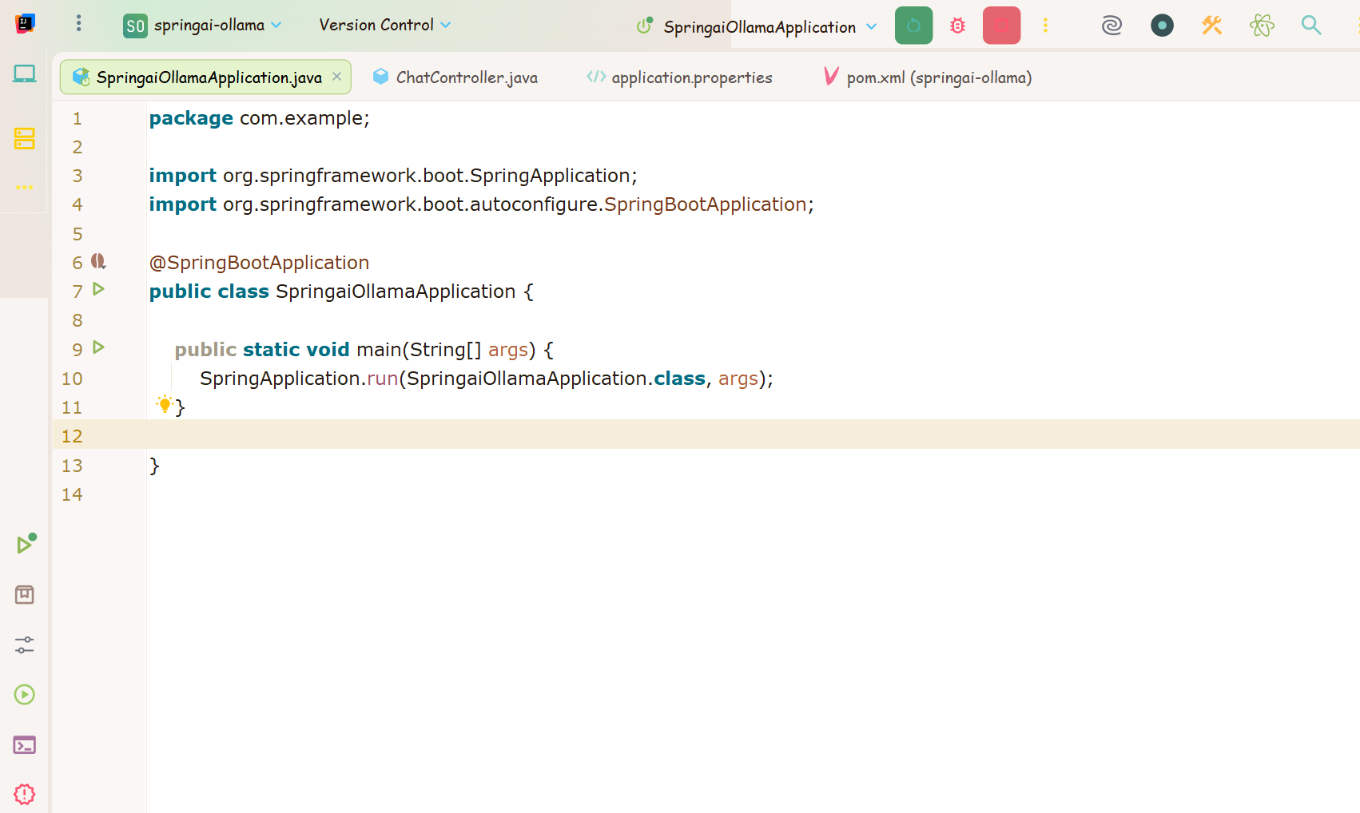

Slide 18
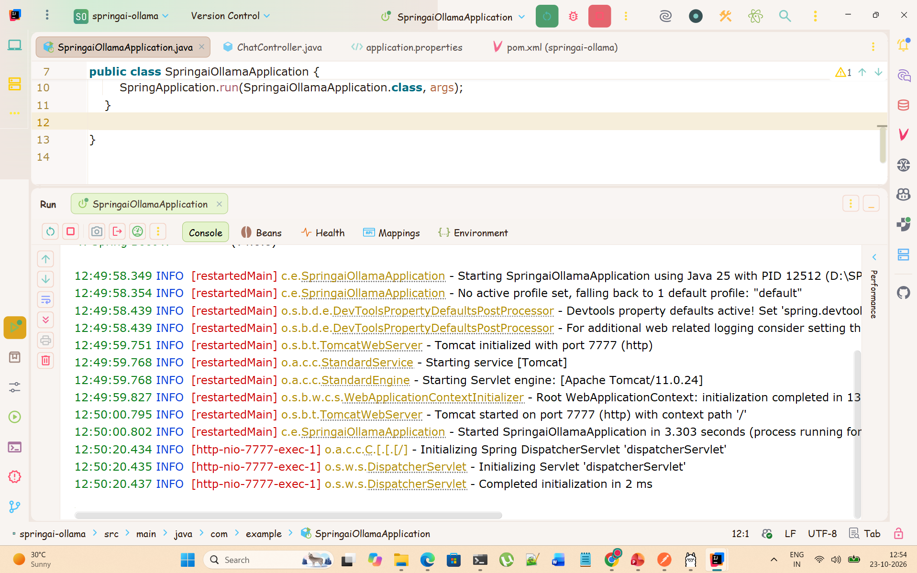

Slide 19
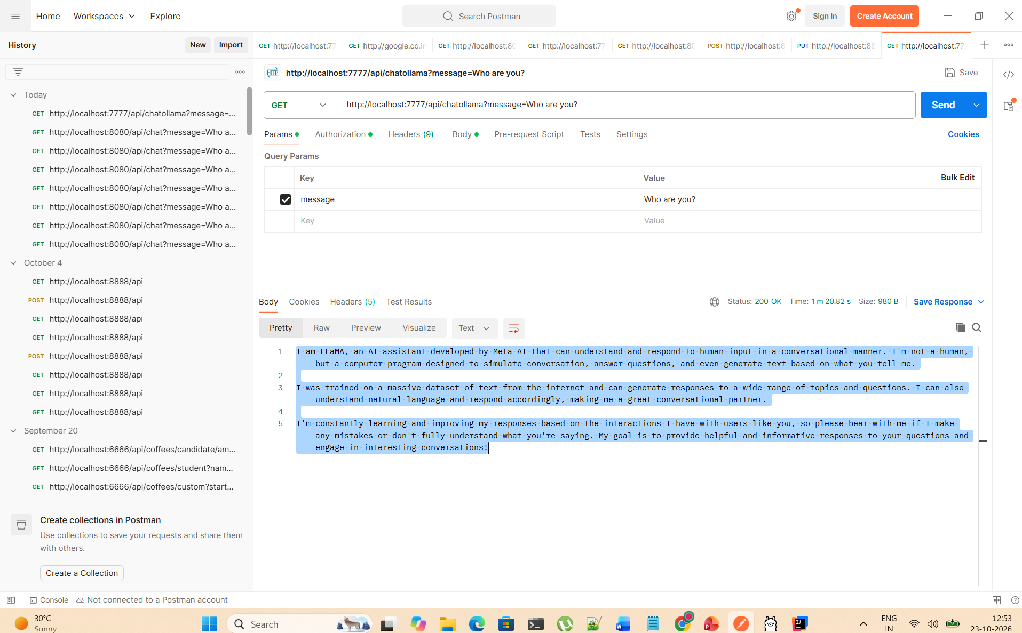

Slide 20
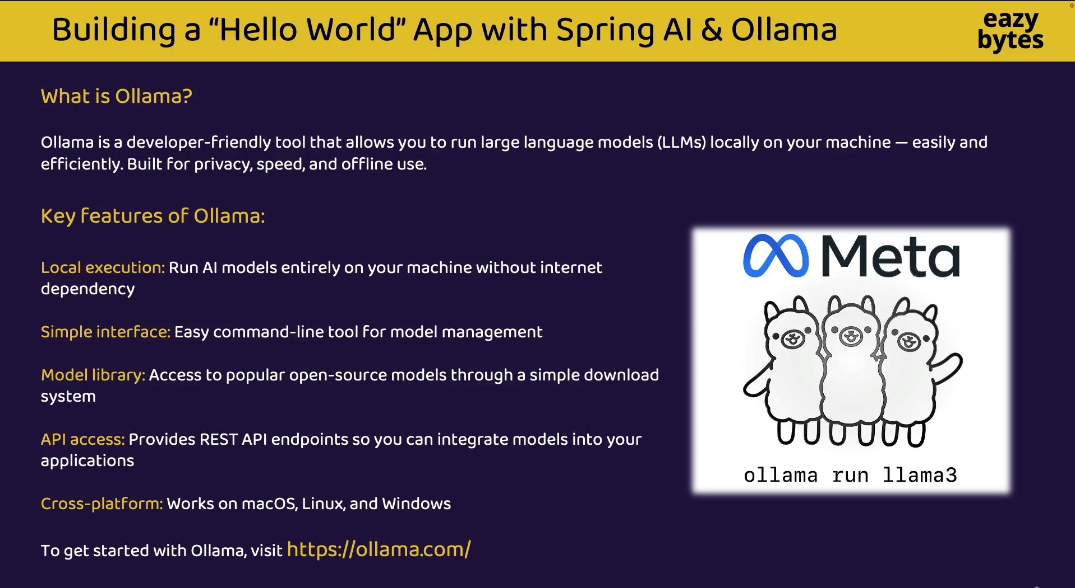

Slide 21
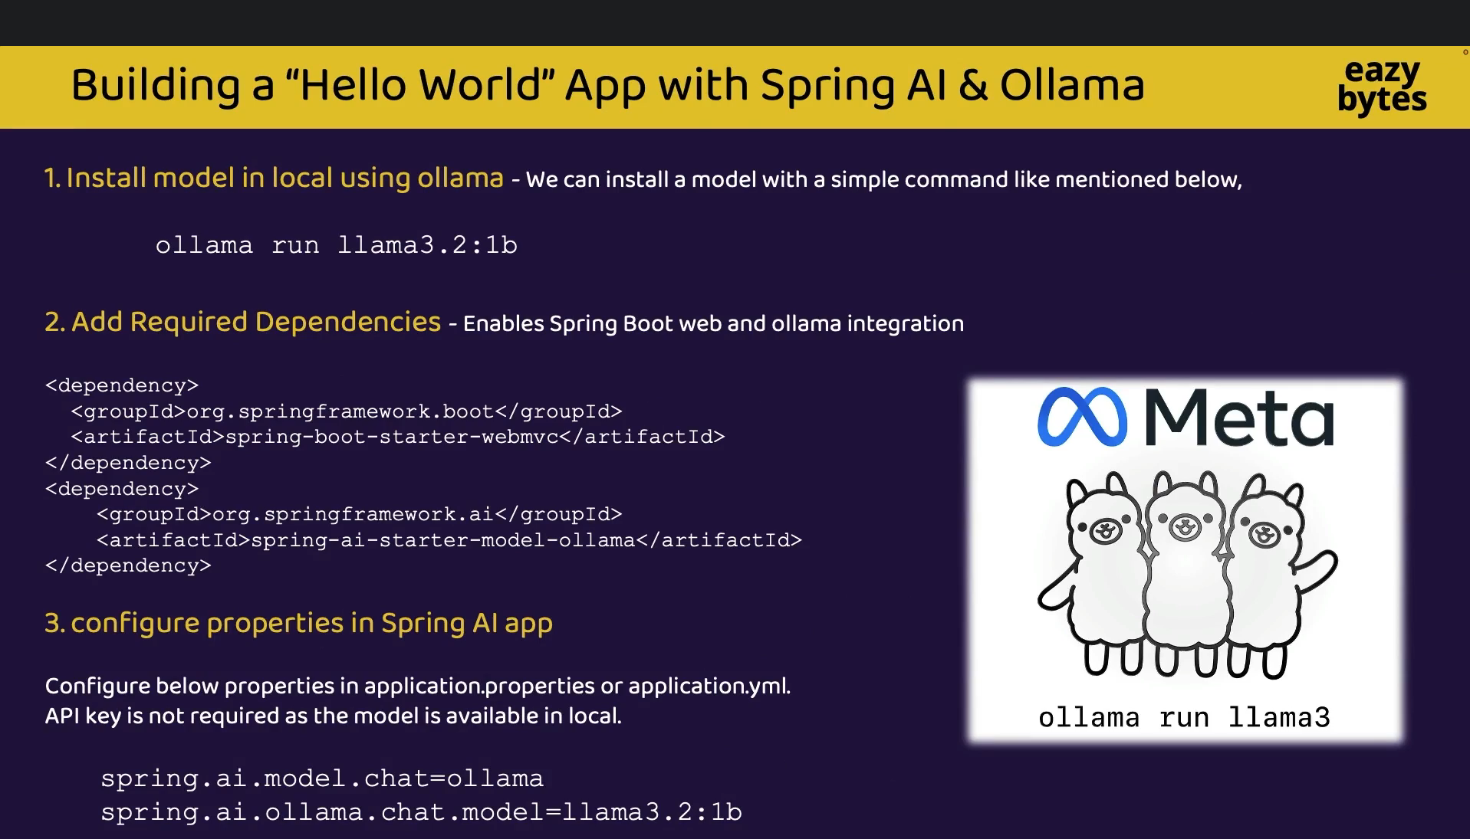

Slide 22
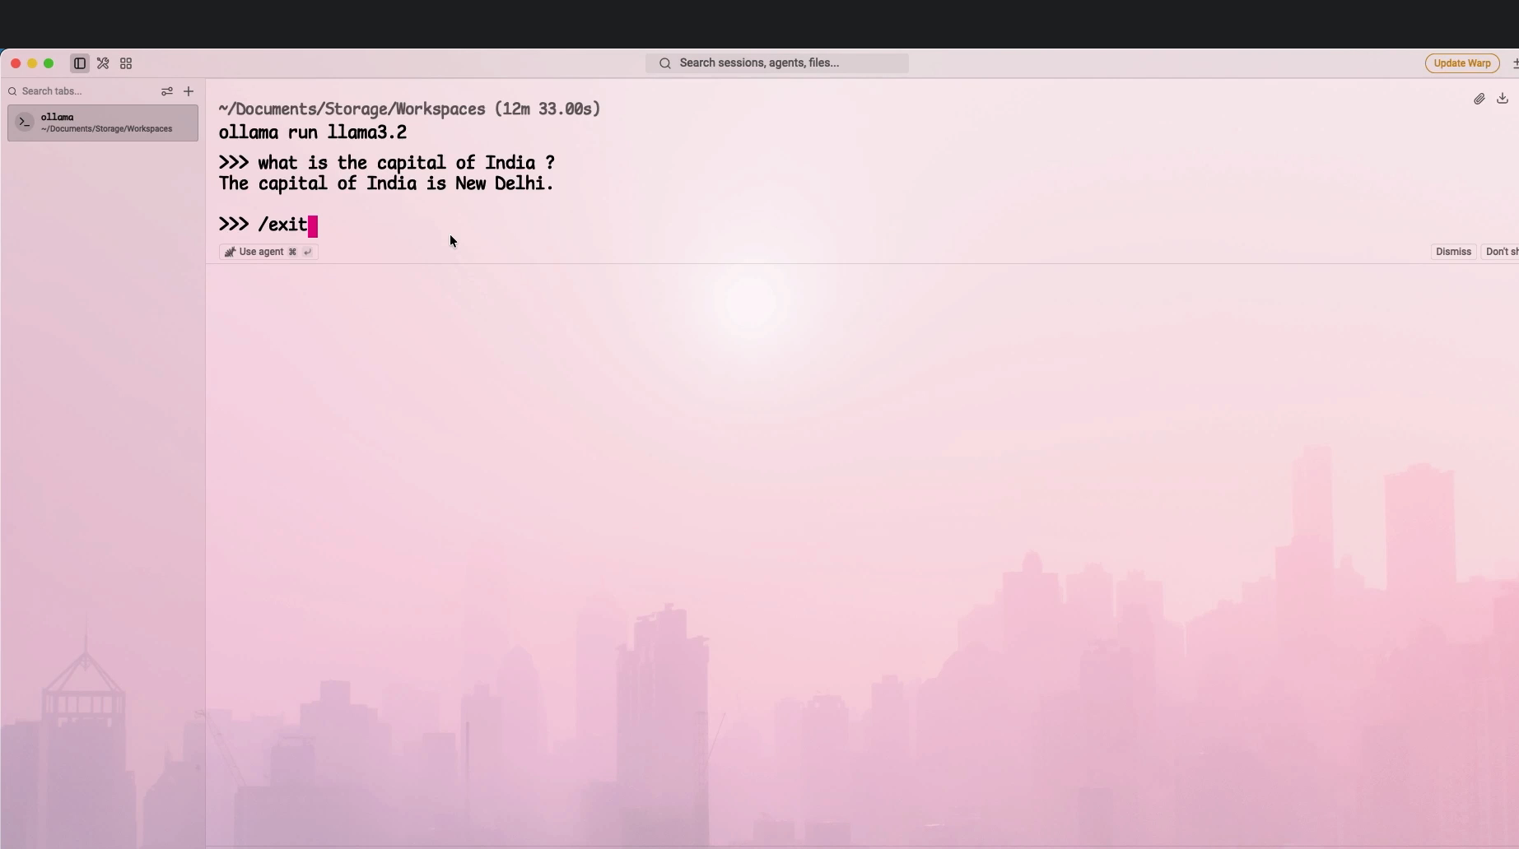

Slide 23
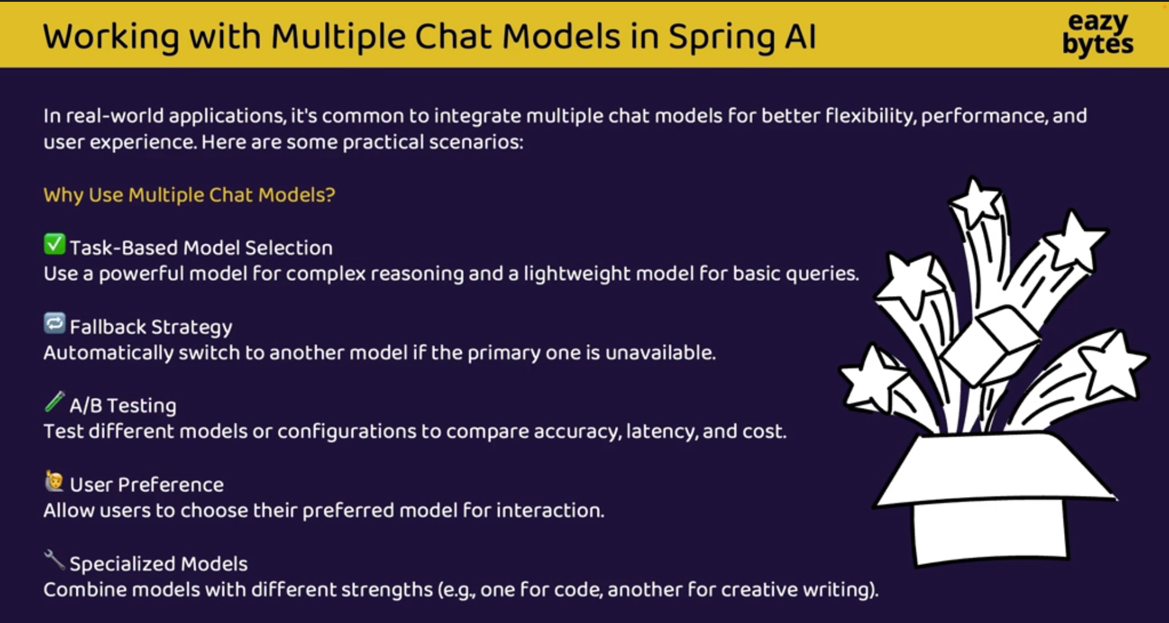

Slide 24
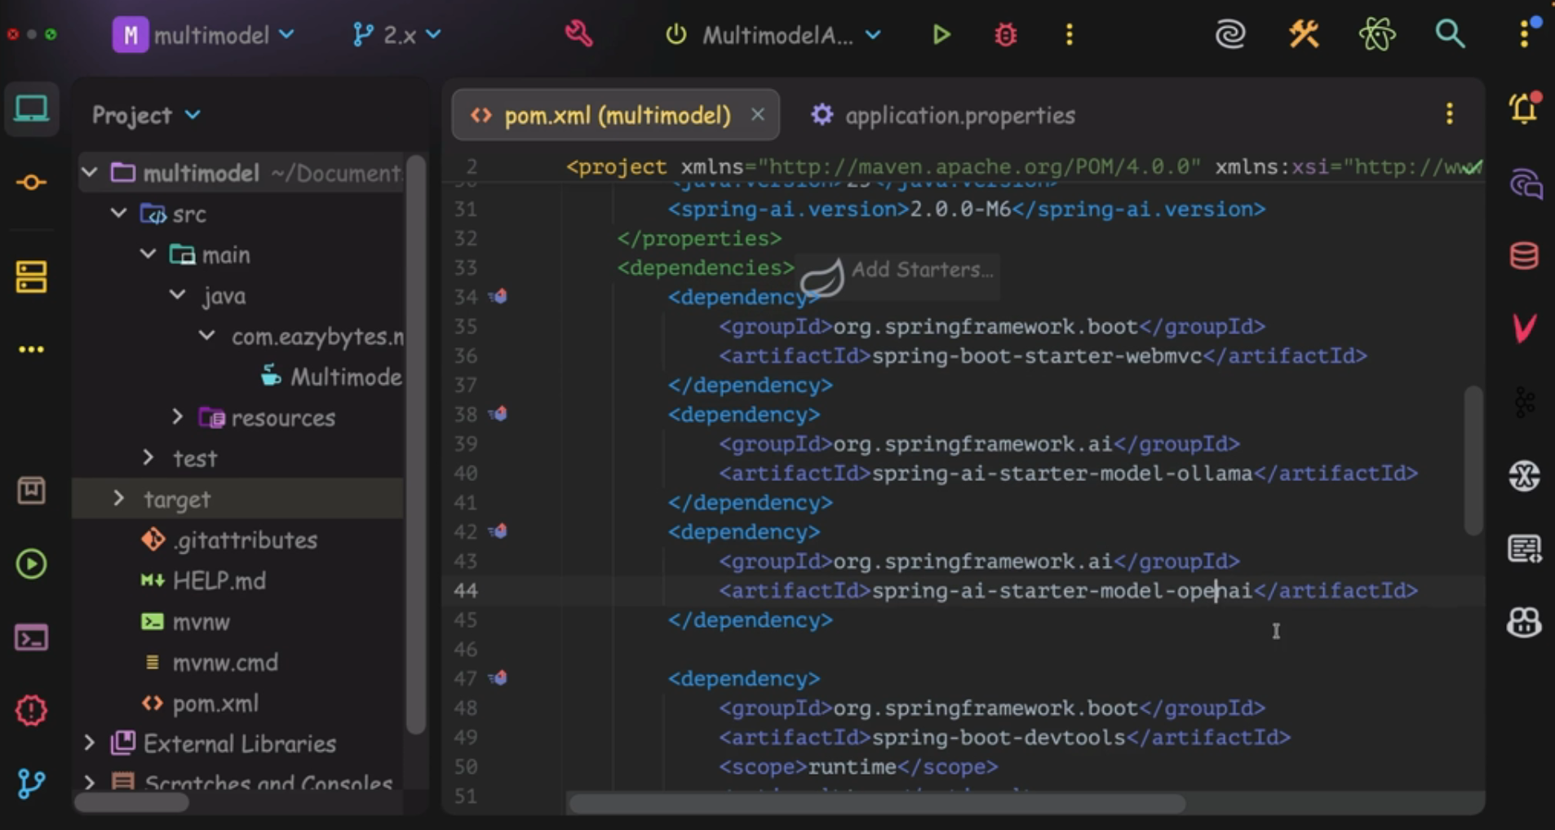

Slide 25
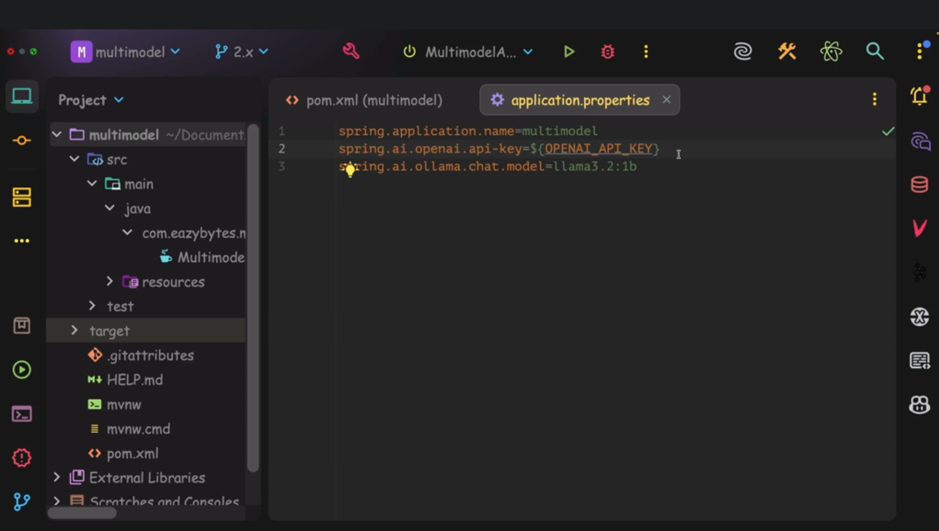

Slide 26
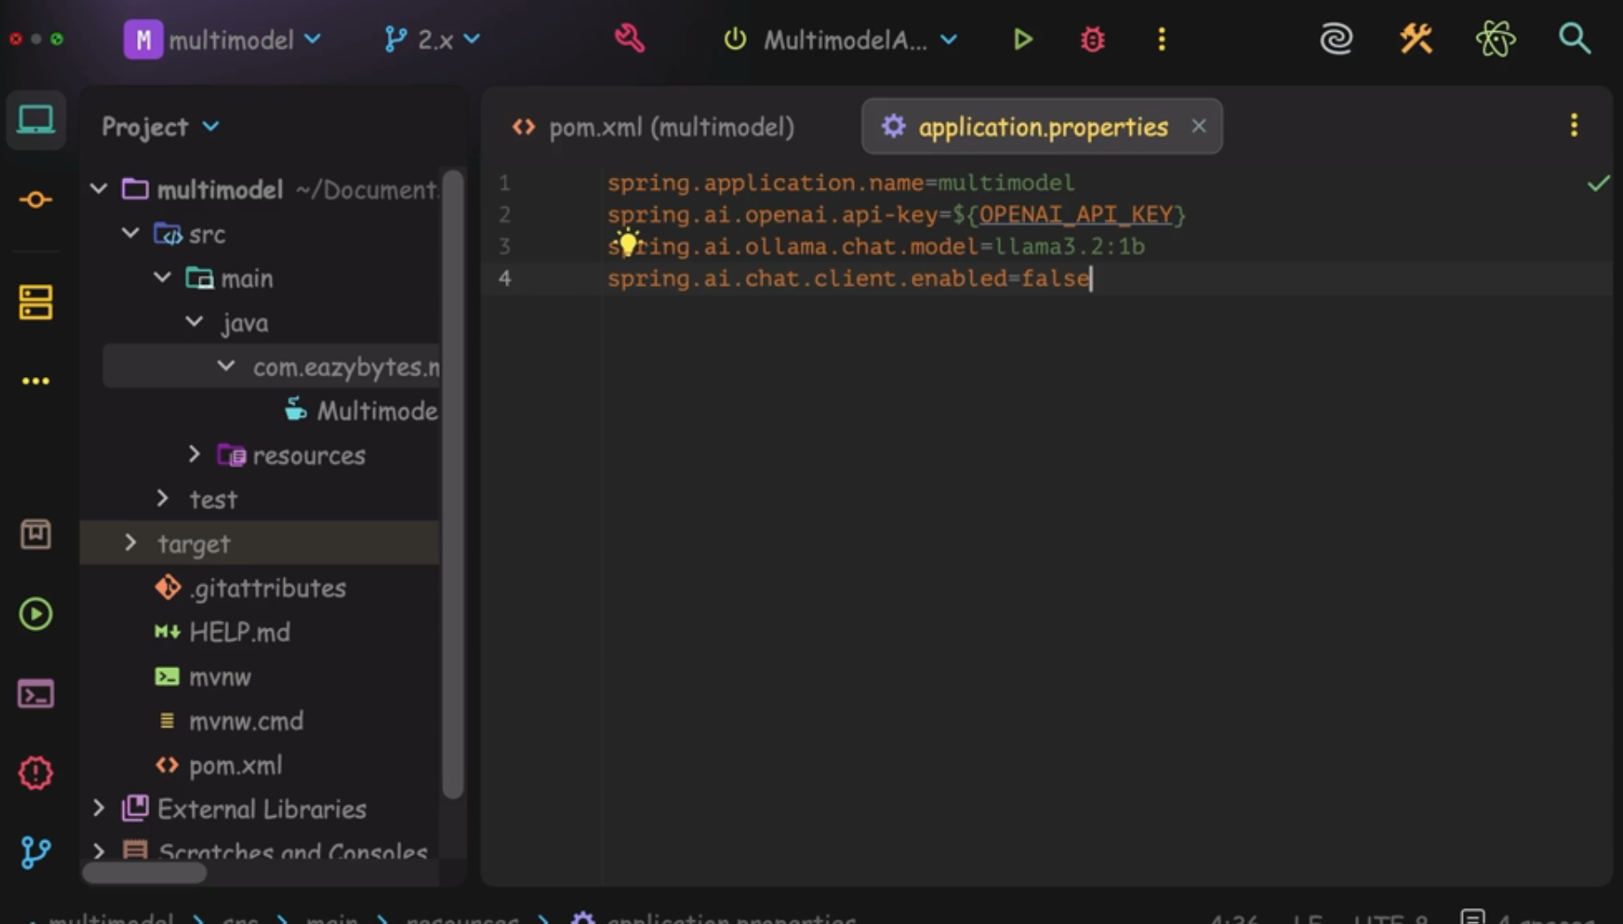

Slide 27
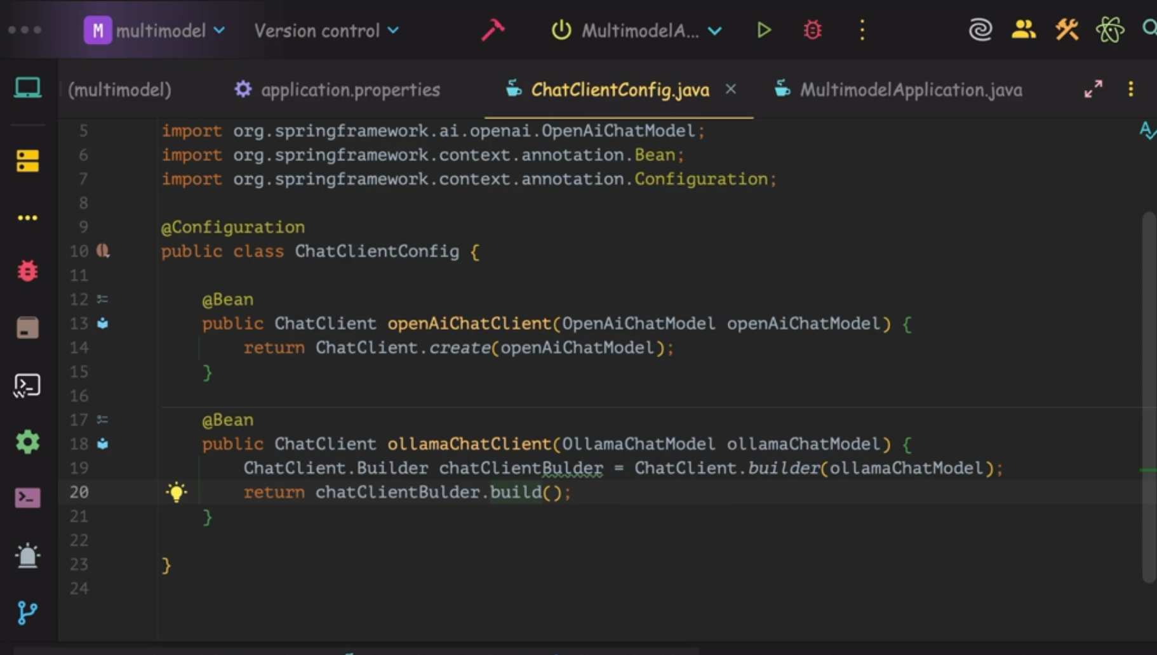

Slide 28
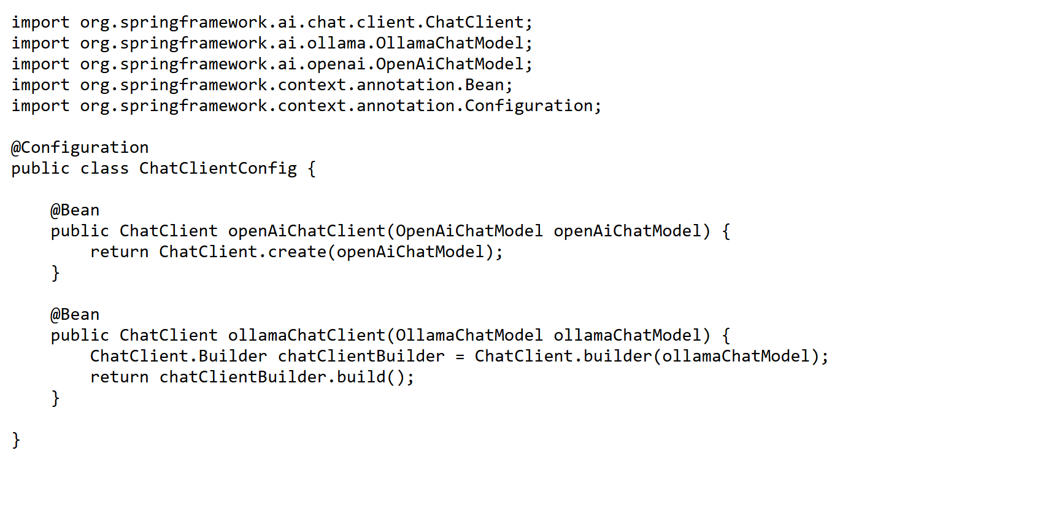
Configuration for multiple LLM

Slide 29
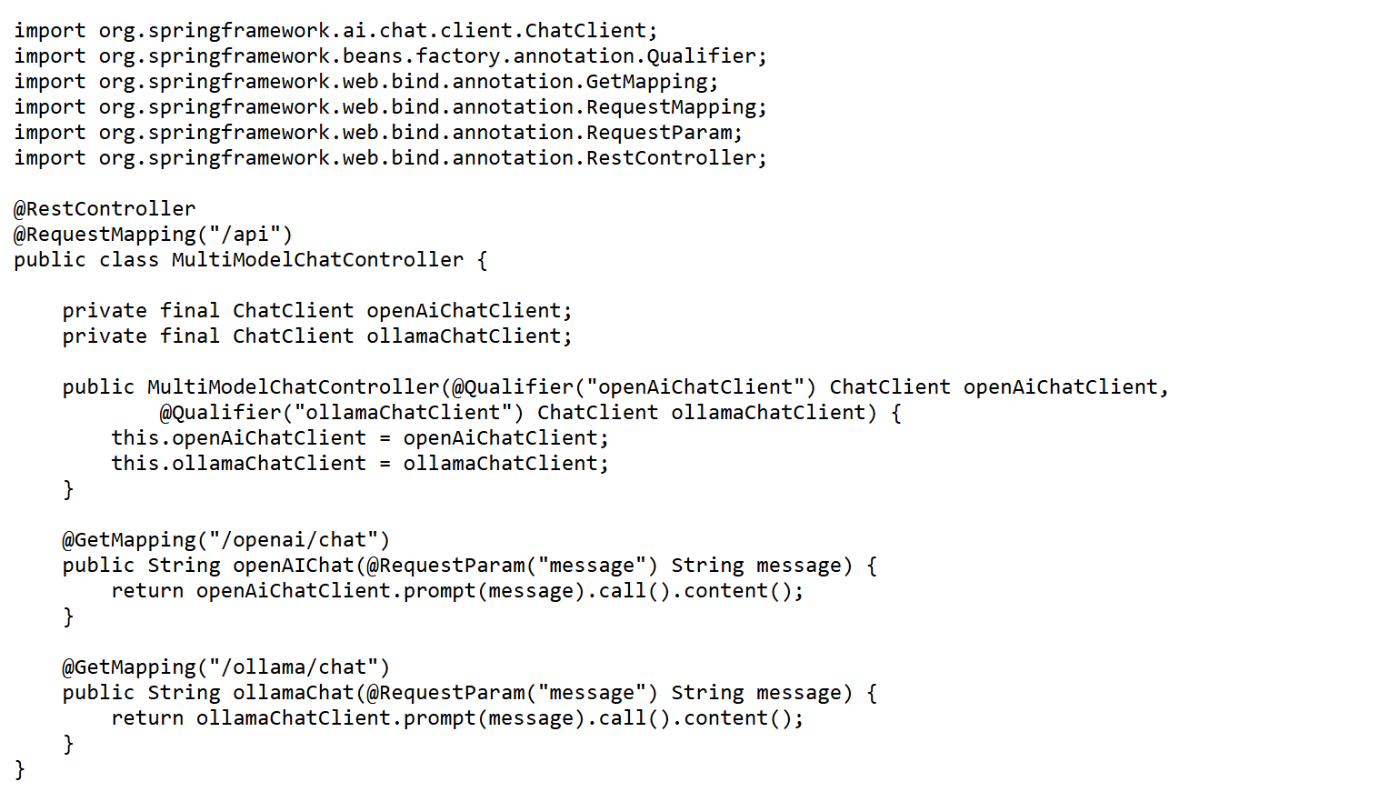
Controller

Slide 30
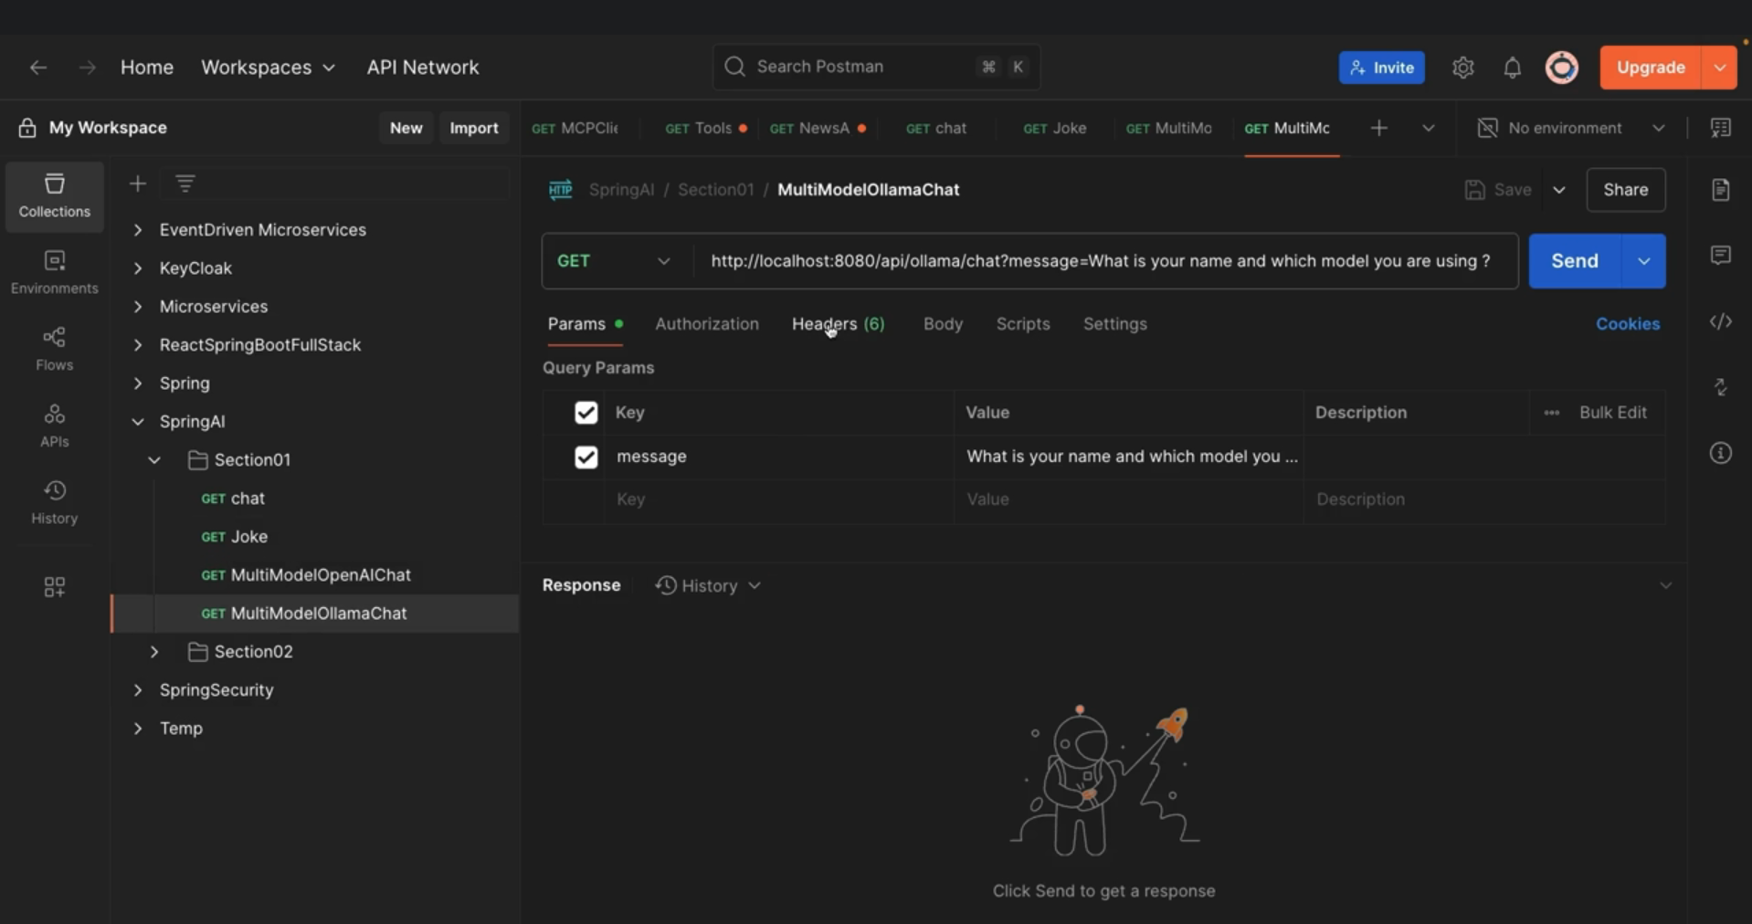

Slide 31
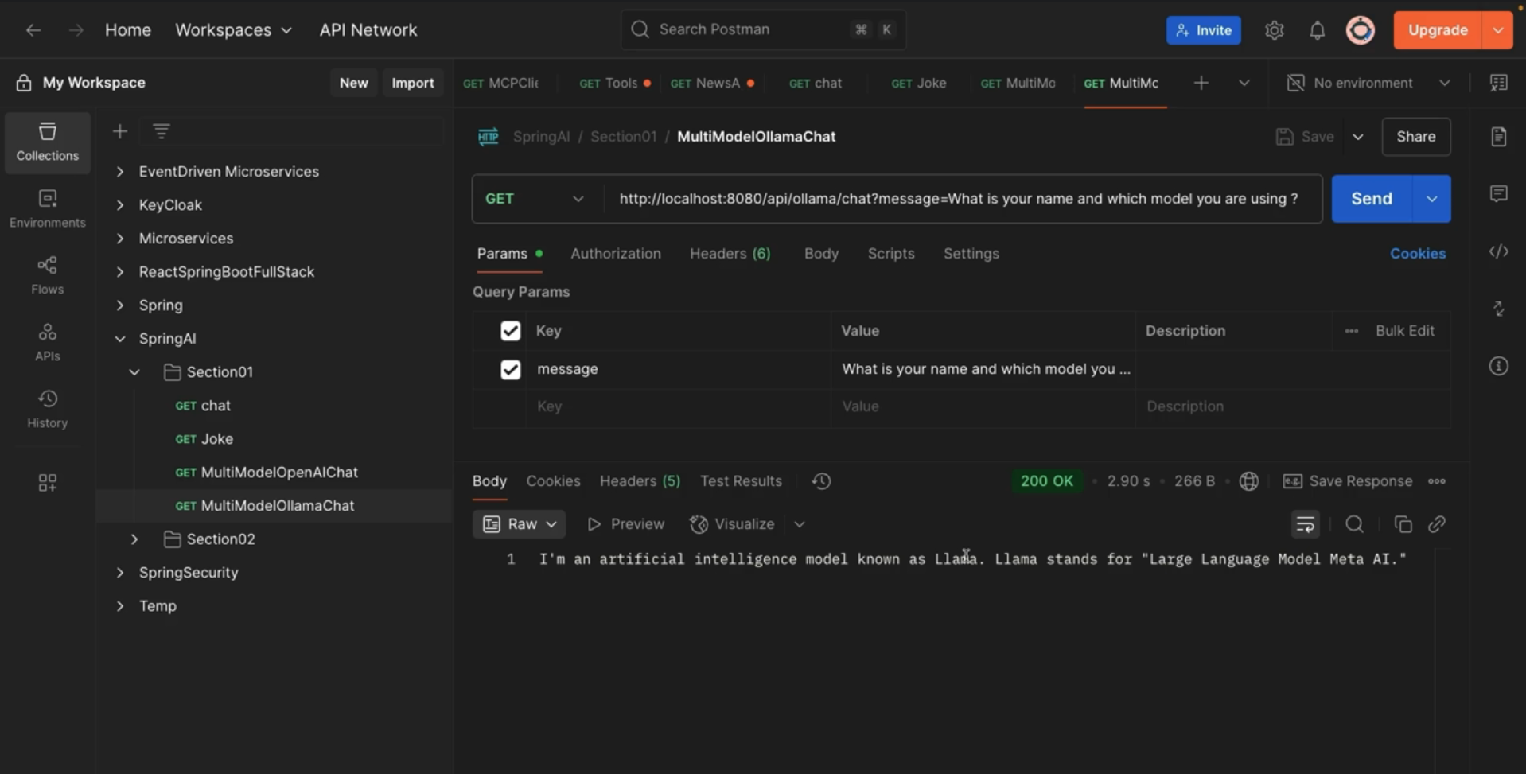

Slide 32
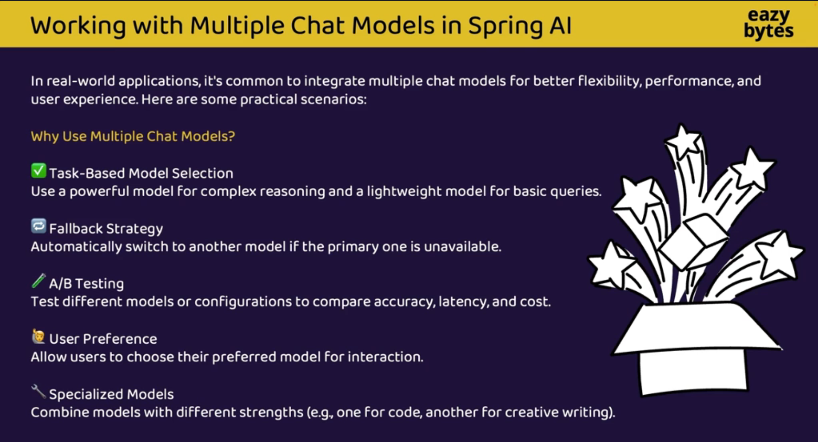

Slide 33
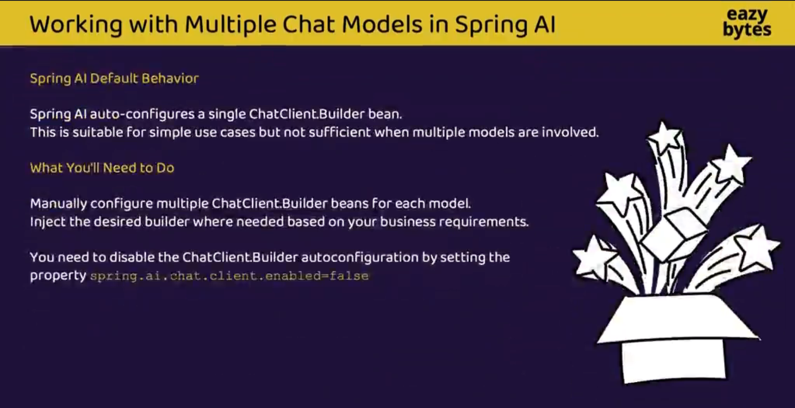

Slide 34
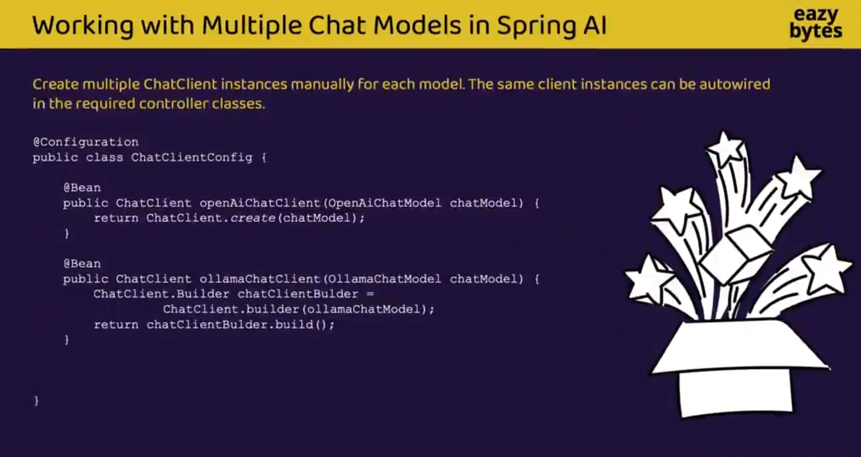

Slide 35
SPRING AI • GENAI TRAINING
STUDENT LAB
Learning path: from LLM basics to Spring AI
New student-training section • appended to the original 33-slide deck
01 UNDERSTAND
GenAI, LLMs, tokens, prompts
02 CONNECT
OpenAI API and Ollama models
03 BUILD
Spring Boot REST endpoints
By the end, students should be able to explain the LLM request lifecycle, configure a cloud or local model, write a safe prompt, expose a REST endpoint, and test the result.
Training material • Verify model names and provider settings against the versions installed in your lab.

Slide 36
SPRING AI • GENAI TRAINING
STUDENT LAB
1. What is Generative AI?
Generative AI creates new content from patterns learned during training.
• It can generate text, code, summaries, explanations, structured output, and (with suitable models) images, audio, or other media.
• A Large Language Model (LLM) predicts likely next tokens based on its input and learned parameters.
• An LLM response is generated—not guaranteed to be true. It can make mistakes or invent unsupported details.
• Traditional software follows explicit rules; GenAI adds flexible language understanding and generation.
• Use cases: tutoring, customer support, document summarization, coding assistance, classification, and drafting.
Training material • Verify model names and provider settings against the versions installed in your lab.

Slide 37
SPRING AI • GENAI TRAINING
STUDENT LAB
2. How an LLM request works
A simplified lifecycle for a chat request
• 1. Application builds a message or prompt with instructions and user input.
• 2. Provider receives the request along with model and generation settings.
• 3. Text is tokenized; the model computes a likely continuation using its learned weights.
• 4. Decoding settings influence which tokens are selected and how much output is produced.
• 5. The application receives text plus metadata such as finish reason and token usage (when available).
• 6. The application validates, displays, logs safely, or uses the answer in the next workflow step.
Training material • Verify model names and provider settings against the versions installed in your lab.

Slide 38
SPRING AI • GENAI TRAINING
STUDENT LAB
3. Core LLM vocabulary
Students should be comfortable with these terms before writing code.
• Token: a chunk of text processed by the model; not always equal to one word.
• Context window: the amount of input and output the model can handle in one request.
• Prompt: instructions, context, examples, and the task supplied to the model.
• Inference: running a trained model to produce an output; it is different from training.
• Multimodal: a model or system that can process more than one modality, such as text and images.
• Latency, throughput, and cost: practical measures for evaluating an LLM-powered application.
Training material • Verify model names and provider settings against the versions installed in your lab.

Slide 39
SPRING AI • GENAI TRAINING
STUDENT LAB
4. OpenAI vs Ollama
Two ways to provide a chat model to a Spring AI application
OPENAI (CLOUD API)
• Hosted model accessed over HTTPS
• Requires an API key and network access
• Model availability, limits, and pricing depend on account and model
• Useful when you need hosted capabilities and managed infrastructure
OLLAMA (LOCAL / SELF-HOSTED)
• Runs supported models on your machine or server
• Download a model and call a local HTTP endpoint
• Hardware, RAM/VRAM, and model size affect speed
• Useful for local experimentation, offline workflows, and data-control needs
Spring AI provides a common programming style; provider configuration and model capabilities still differ.
Training material • Verify model names and provider settings against the versions installed in your lab.

Slide 40
SPRING AI • GENAI TRAINING
STUDENT LAB
5. Choose the right provider for the task
There is no universal winner—evaluate the use case.
• Quality: test the actual tasks, languages, formats, and edge cases your students need.
• Privacy: determine what data leaves the machine and review provider retention and contractual terms.
• Cost: estimate input/output token usage for hosted APIs; include hardware and operations for local hosting.
• Performance: measure time to first token, total response time, concurrency, and resource use.
• Operations: plan API-key rotation, model updates, availability, monitoring, and fallback behavior.
• Fair comparison: use the same test prompts, evaluation criteria, and safety checks for each model.
Training material • Verify model names and provider settings against the versions installed in your lab.

Slide 41
SPRING AI • GENAI TRAINING
STUDENT LAB
6. Prompt engineering essentials
A useful prompt is specific, contextual, and testable.
• Role / goal: state what the assistant should do and for whom.
• Context: include only the relevant facts or source text needed for the task.
• Constraints: define scope, tone, length, language, and what to do when information is missing.
• Output format: ask for a table, numbered list, JSON object, or a fixed set of fields when appropriate.
• Examples: show one or two input/output examples for tasks with a precise expected pattern.
• Iteration: change one prompt element at a time and compare results against a rubric.
Training material • Verify model names and provider settings against the versions installed in your lab.

Slide 42
SPRING AI • GENAI TRAINING
STUDENT LAB
7. Prompt example: vague vs specific
Teach students to specify audience, task, constraints, and format.
// Vague prompt
"Explain AI."
// Better prompt
"You are a beginner-friendly tutor. Explain
what an LLM is to a first-year BCA student.
Use simple English, one everyday analogy,
three key terms, and a 5-question quiz.
If a claim is uncertain, say so."
Discuss: Who is the audience? What should the answer contain? What limits and quality checks are explicit?
Training material • Verify model names and provider settings against the versions installed in your lab.

Slide 43
SPRING AI • GENAI TRAINING
STUDENT LAB
8. Generation parameters
Parameters guide generation; supported options vary by model and provider.
• temperature: lower values tend to be more predictable; higher values allow more variation.
• top_p: nucleus sampling; limits token choices to a probability mass. Usually tune temperature or top_p first—not both at once.
• max output tokens: caps the response length; it does not guarantee the model will use the full limit.
• stop sequences: optional strings that can stop generation when supported.
• seed: may support more repeatable outputs for some models, but identical output is not guaranteed across all systems.
• Important: a setting may be unsupported, ignored, or behave differently across providers/models. Check documentation.
Training material • Verify model names and provider settings against the versions installed in your lab.

Slide 44
SPRING AI • GENAI TRAINING
STUDENT LAB
9. OpenAI setup with Spring AI
Keep secrets outside source code; use a model supported by your account.
# application.properties
spring.application.name=spring-ai-openai
spring.ai.openai.api-key=${OPENAI_API_KEY}
spring.ai.openai.chat.options.model=gpt-4.1-mini
# Windows PowerShell (current terminal)
$env:OPENAI_API_KEY="your-real-key"
# Then run the Spring Boot application
Before running: add the Spring AI OpenAI starter compatible with your Spring AI release. Never commit a real key to Git or place it in screenshots.
Training material • Verify model names and provider settings against the versions installed in your lab.

Slide 45
SPRING AI • GENAI TRAINING
STUDENT LAB
10. Simple OpenAI chat endpoint
A minimal controller using Spring AI ChatClient.
package com.example.controller;
import org.springframework.ai.chat.client.ChatClient;
import org.springframework.web.bind.annotation.*;
@RestController
@RequestMapping("/api/ai")
public class AiController {
private final ChatClient chatClient;
public AiController(ChatClient.Builder builder) {
this.chatClient = builder.build();
}
@GetMapping("/chat")
public String chat(@RequestParam String message) {
return chatClient.prompt()
.user(message)
.call()
.content();
}
}
Test in a browser or Postman: GET http://localhost:8080/api/ai/chat?message=Explain%20LLMs
For production, prefer POST with a request DTO, validation, and error handling.
Training material • Verify model names and provider settings against the versions installed in your lab.

Slide 46
SPRING AI • GENAI TRAINING
STUDENT LAB
11. Run a model with Ollama
Local model workflow (commands may vary by OS/model).
# 1. Install Ollama from the official site
# 2. Download a model
ollama pull llama3.2
# 3. Confirm downloaded models
ollama list
# 4. Try an interactive prompt
ollama run llama3.2
# 5. Local API default endpoint
http://localhost:11434
The model must be downloaded and available to Ollama. Larger models generally require more memory. Verify the chosen model tag with `ollama list`.
Training material • Verify model names and provider settings against the versions installed in your lab.

Slide 47
SPRING AI • GENAI TRAINING
STUDENT LAB
12. Configure Spring AI for Ollama
Use the Ollama starter that matches your Spring AI version.
# application.properties
spring.application.name=spring-ai-ollama
server.port=7777
spring.ai.model.chat=ollama
spring.ai.ollama.base-url=http://localhost:11434
spring.ai.ollama.chat.options.model=llama3.2
# Ensure Ollama is running and the model
# tag matches a model shown by: ollama list
If IntelliJ flags a property, check the Spring AI version, starter dependency, and configuration metadata. Property names can differ between releases; do not mix examples from different versions.
Training material • Verify model names and provider settings against the versions installed in your lab.

Slide 48
SPRING AI • GENAI TRAINING
STUDENT LAB
13. Use the same controller pattern
Provider configuration changes; application logic can often remain similar.
@GetMapping("/ollama")
public String askLocalModel(
@RequestParam String message) {
return chatClient.prompt()
.system("You are a helpful tutor. " +
"Use clear beginner-friendly language.")
.user(message)
.call()
.content();
}
This example assumes the application has selected/configured the Ollama ChatModel and a ChatClient.Builder bean. Check your project’s auto-configuration and avoid creating conflicting provider beans.
Training material • Verify model names and provider settings against the versions installed in your lab.

Slide 49
SPRING AI • GENAI TRAINING
STUDENT LAB
14. Chat messages and conversation context
A chat model does not automatically remember every past request.
• System message: high-level behavior and constraints for the assistant.
• User message: the current question or task from the user.
• Assistant message: a previous model response, if included in the conversation history.
• For multi-turn chat, explicitly manage conversation history or use a supported memory mechanism.
• Keep only relevant history; long conversations consume context and may increase cost/latency.
• Do not treat prompt instructions as a security boundary. Validate inputs and enforce permissions in code.
Training material • Verify model names and provider settings against the versions installed in your lab.

Slide 50
SPRING AI • GENAI TRAINING
STUDENT LAB
15. Streaming responses
Streaming displays partial output as it is generated.
• Benefits: lower perceived latency and a more interactive user experience.
• In Spring AI, ChatClient supports streaming APIs in compatible versions; a controller may expose Server-Sent Events (SSE).
• Frontend clients should handle chunks, connection closure, cancellation, and error events.
• Streaming output is partial: do not assume the final answer is complete until the stream ends.
• Apply output moderation and sensitive-data handling to the stream where appropriate.
• Exercise: implement a streaming endpoint and compare time-to-first-token with a normal call.
Training material • Verify model names and provider settings against the versions installed in your lab.

Slide 51
SPRING AI • GENAI TRAINING
STUDENT LAB
16. Structured output and tool calling
Move from free-form text toward reliable application behavior.
• Structured output: request a defined schema or map the answer into a typed DTO when supported.
• Validate model-produced fields; JSON-looking text is not automatically valid or trustworthy JSON.
• Tool/function calling lets a model request an application-defined operation with structured arguments.
• The application—not the model—must authorize and execute a tool call.
• Use allowlists, argument validation, timeouts, audit logs, and confirmation for consequential actions.
• Example classroom tool: calculate tax from validated numeric inputs (no external side effects).
Training material • Verify model names and provider settings against the versions installed in your lab.

Slide 52
SPRING AI • GENAI TRAINING
STUDENT LAB
17. Responsible AI and security checklist
Safe defaults are part of application development.
• Never hard-code API keys in Java files, Git repositories, slides, screenshots, or public demos.
• Use environment variables or a secrets manager; rotate a key immediately if it is exposed.
• Do not send passwords, payment details, or unnecessary personal data to a model.
• Treat user prompts and retrieved documents as untrusted input; guard against prompt injection.
• Use server-side validation, authentication, authorization, rate limits, and request-size limits.
• Explain limitations, test for bias and harmful outputs, and keep a human in the loop for high-impact decisions.
Training material • Verify model names and provider settings against the versions installed in your lab.

Slide 53
SPRING AI • GENAI TRAINING
STUDENT LAB
18. Troubleshooting lab
A short checklist for the errors students are most likely to see.
• 401 / authentication error: confirm the environment variable exists in the process that starts Spring Boot; check key validity and account access.
• 404 / model not found: verify the exact model identifier (OpenAI) or local tag (Ollama).
• Connection refused on port 11434: start Ollama and verify the base URL; check firewall/container networking.
• Unknown configuration property: verify the Spring AI starter and version; reimport Maven and inspect the version-specific docs.
• Slow response: try a smaller local model, shorten prompts, limit output tokens, and measure before optimizing.
• Empty or poor answer: inspect request parameters, prompt clarity, response finish reason, and provider/model limits.
Training material • Verify model names and provider settings against the versions installed in your lab.

Slide 54
SPRING AI • GENAI TRAINING
STUDENT LAB
19. Student lab: build and compare
Work in pairs • document the setup, test prompts, and results
TASK A — OPENAI
1. Configure the OpenAI starter and environment key.
2. Build /api/ai/chat as a REST endpoint.
3. Test 5 prompts and record latency and output quality.
4. Add validation and friendly error handling.
TASK B — OLLAMA
1. Pull a model and confirm it runs locally.
2. Configure the Ollama starter and model tag.
3. Reuse the same test prompts.
4. Compare speed, quality, setup, privacy, and resource needs.
Deliverable: a one-page comparison table plus a short reflection on which provider fits each use case.
Training material • Verify model names and provider settings against the versions installed in your lab.

Slide 55
SPRING AI • GENAI TRAINING
STUDENT LAB
20. Review questions
Use these as a quick quiz or classroom discussion.
• 1. What is the difference between Generative AI and an LLM?
• 2. What is a token, and why does the context window matter?
• 3. When might OpenAI be preferable to Ollama—and when might Ollama be preferable?
• 4. Explain temperature and max output tokens in simple terms.
• 5. Why should an API key be stored outside application source code?
• 6. What must the application validate before executing a model-requested tool?
• 7. Name two causes of an Ollama connection error and two causes of a model-not-found error.
Training material • Verify model names and provider settings against the versions installed in your lab.

