Slide 1
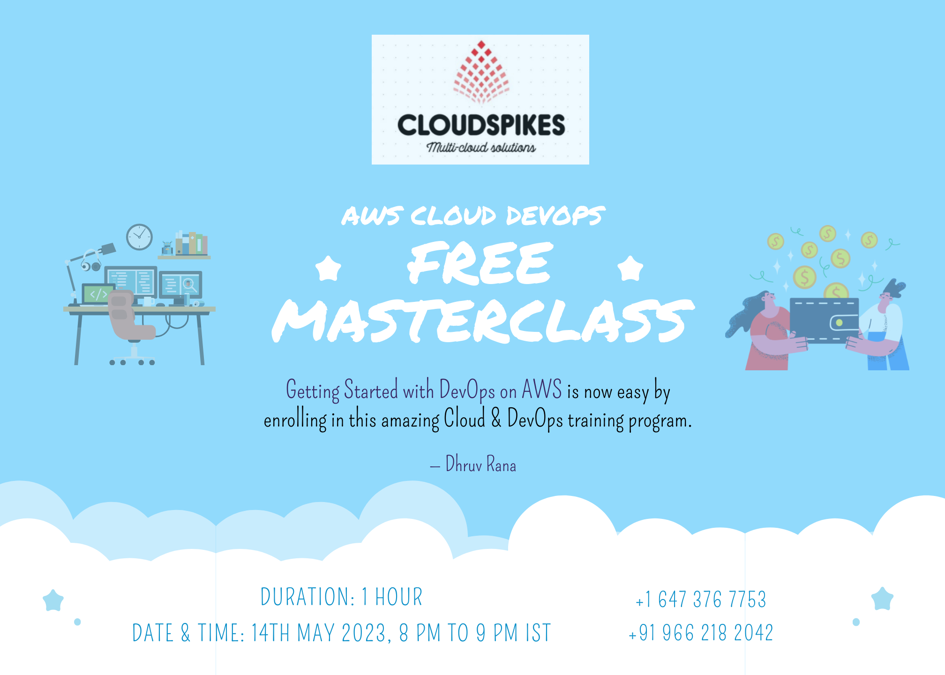

Slide 2




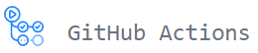

AWS Cloud DevOps Training
Prepared by Dhruv Rana - CloudSpikes

Slide 3
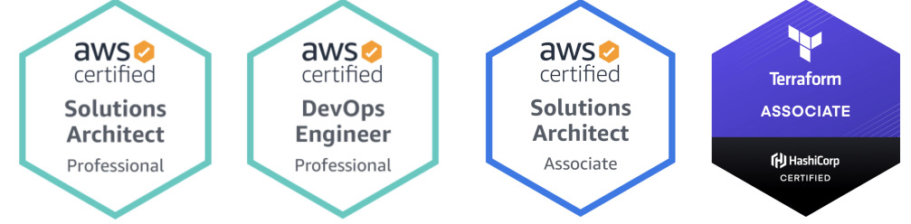
Your mentor – Dhruv Rana
Hello to all Cloud DevOps geeks, this is Dhruv, your trainer to deliver this amazing virtual training on the most desired five tools & frameworks that would help you ace your professional career.
My portfolio: I am a 3x AWS Certified Solutions Architect – Pro. and Hashicorp Certified Terraform Associate Engineer with 8+ years of IT industry experience. Currently, I am associated with BMO and The Home Depot as a Cloud Consultant working on AWS & GCP Cloud Platform along with DevOps tech stack.
Prepared by Dhruv Rana - CloudSpikes

Slide 4
Opportunities post-course completion
Sr. No. | Designation | Salary package in CAD
1. | Cloud Engineer (CloudOps) | $127,512 per year
2. | AWS Engineer | $95,383 per year
3. | DevOps Engineer | $154,280 per year
4. | Site Reliability Engineer (SRE) | $154,385 per year
5. | DevSecOps | $132,085 per year
6. | Infrastructure Engineer | $126,328 per year
7. | Platform Engineer | $140,522 per year
8. | Systems Engineer (SysOps) | $86,630 per year
Prepared by Dhruv Rana - CloudSpikes

Slide 5

Any questions or queries?
Reach out to me on Insta, LinkedIn, Email or WhatsApp:
  Insta: @dhruv_rana_29_10
  LinkedIn: @dhruv-r-b033949b
  Email: support@cloudspikes.ca
  WhatsApp: +1-647-376-7753

