Slide 1
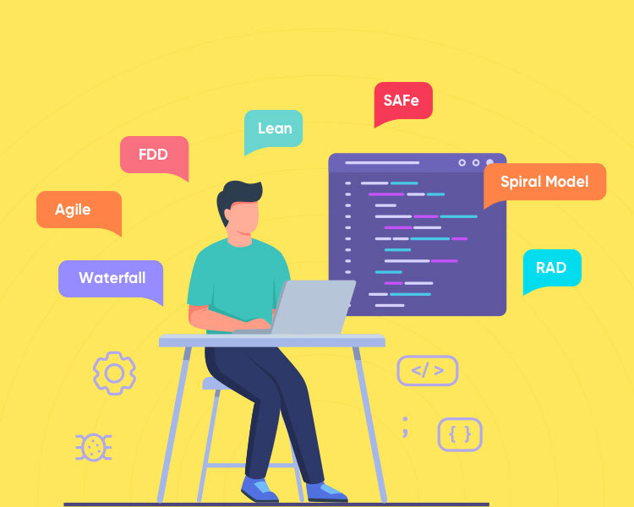
An Overview of Software Apps and Best Practices
Prepared by Dhruv Rana - CloudSpikes

Slide 2
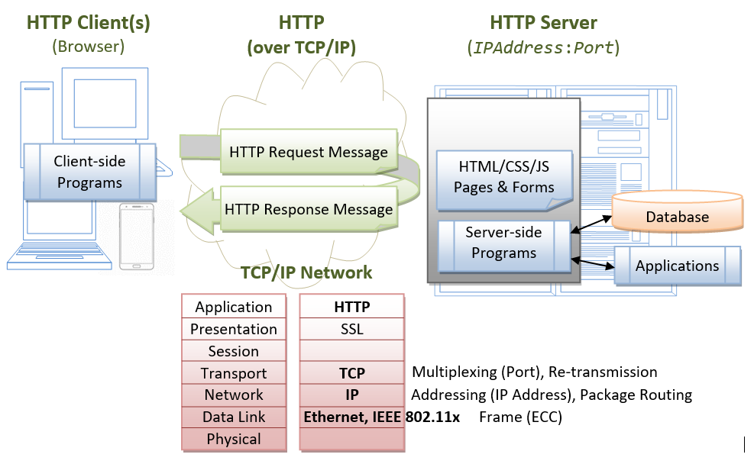
Req/Res Web Application Model
Prepared by Dhruv Rana - CloudSpikes

Slide 3
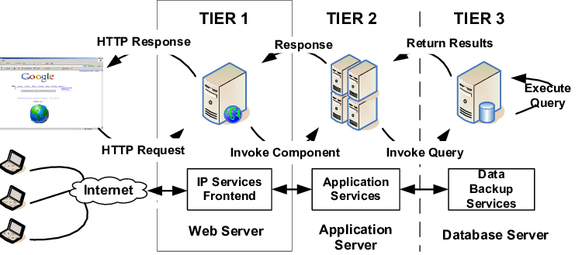
3 Tier Application Architecture
Prepared by Dhruv Rana - CloudSpikes

Slide 4
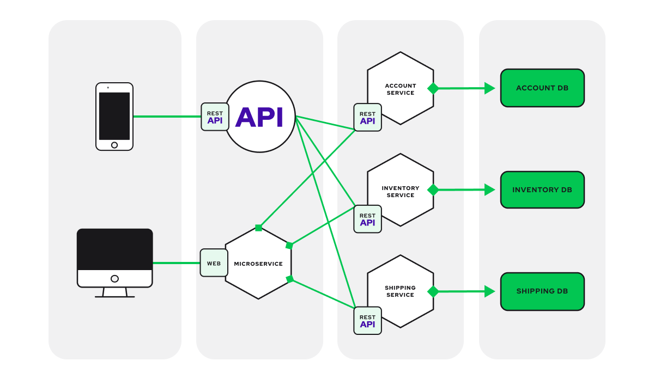
Microservice Architecture
Prepared by Dhruv Rana - CloudSpikes

Slide 5
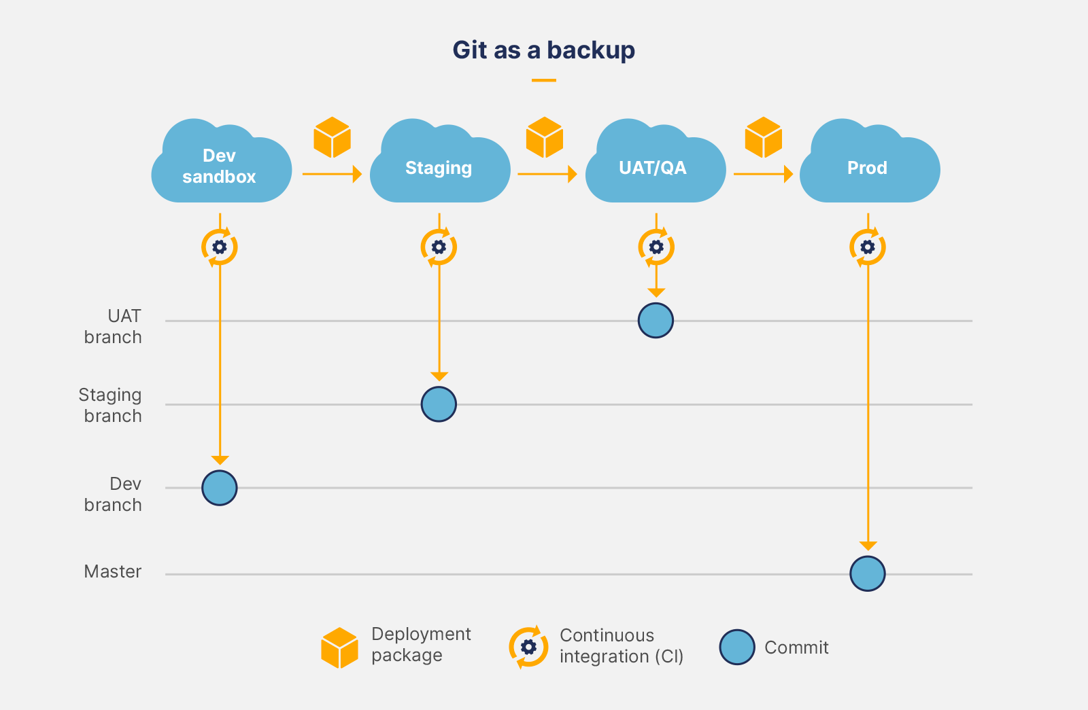
GIT Branching Strategy
Prepared by Dhruv Rana - CloudSpikes

Slide 6
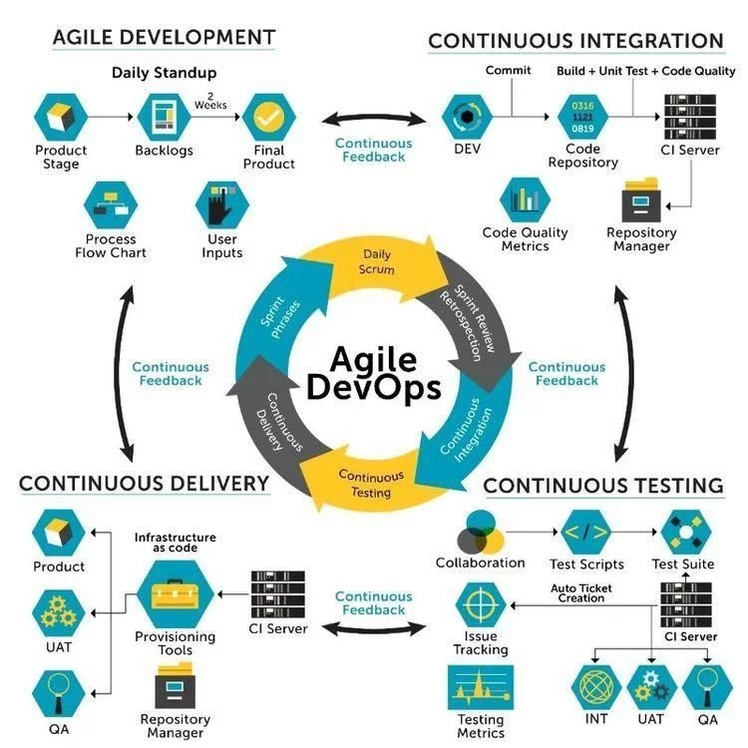
Agile Methodology - DevOps
Prepared by Dhruv Rana - CloudSpikes

Slide 7
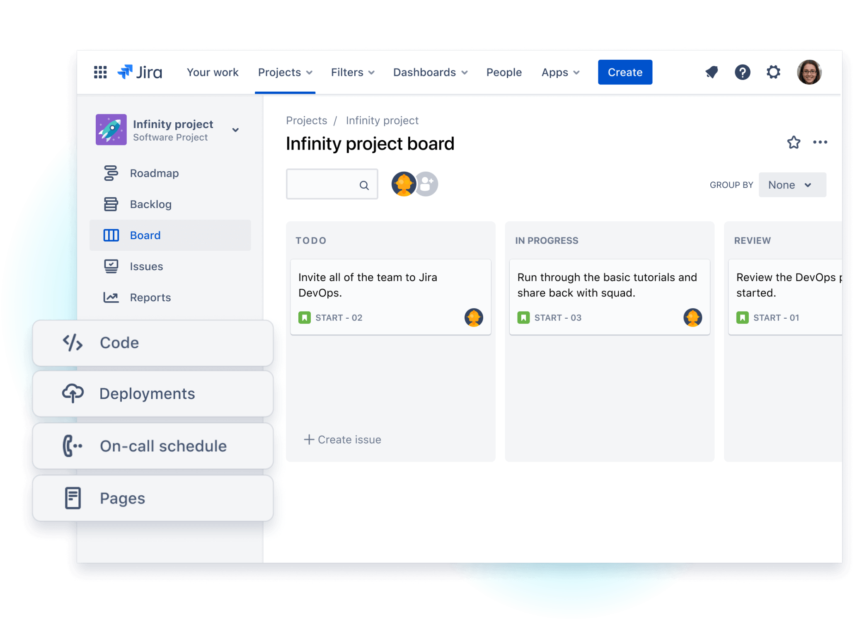
Ticket management - DevOps
Prepared by Dhruv Rana - CloudSpikes

Slide 8
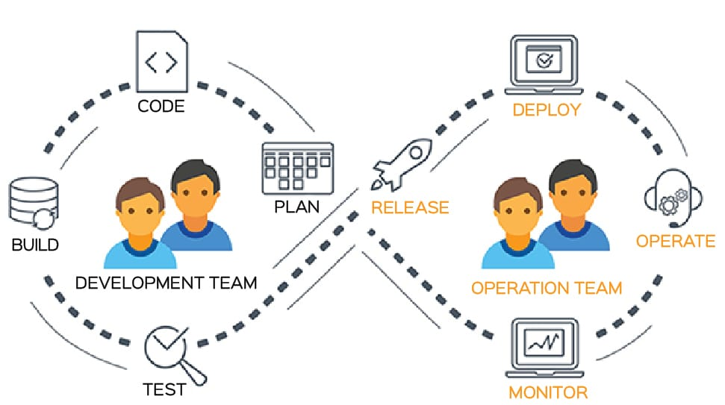
Dev team + Ops team = DevOps
Prepared by Dhruv Rana - CloudSpikes

Slide 9

Any questions or queries?
Reach out to me on Insta, LinkedIn, Email or WhatsApp:
  Insta: @dhruv_rana_29_10
  LinkedIn: @dhruv-r-b033949b
  Email: support@cloudspikes.ca
  WhatsApp: +1-647-376-7753

