Slide 1
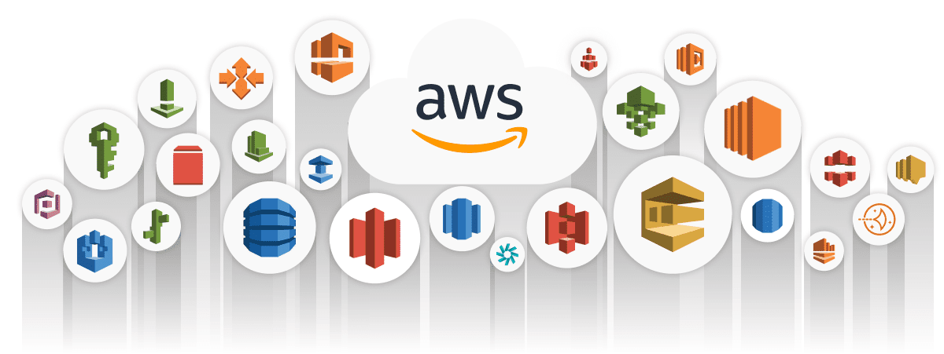
AWS Cloud DevOps Training
Prepared by Dhruv Rana - CloudSpikes

Slide 2
Cost Explorer
AWS Cost Explorer has an easy-to-use interface that lets you visualize, understand, and manage your AWS costs and usage over time.
Using this procedure on the Billing and Cost Management console, you can enable Cost Explorer for your account.
You can't enable Cost Explorer using the API. After enabling Cost Explorer, AWS prepares the data about your current month and the last 12 months’ costs, then calculate the forecast for the next 12 months.
Prepared by Dhruv Rana - CloudSpikes

Slide 3
Identity & Access Management
With AWS Identity and Access Management (IAM), you can specify who or what can access services and resources in AWS, centrally manage fine-grained permissions, and analyze access to refine permissions across AWS.
Create granular permissions based on user attributes—such as department, job role, and team name—by using attribute-based access control.
Use IAM to manage and scale workload and workforce access securely supporting your agility and innovation in AWS.
Prepared by Dhruv Rana - CloudSpikes

Slide 4
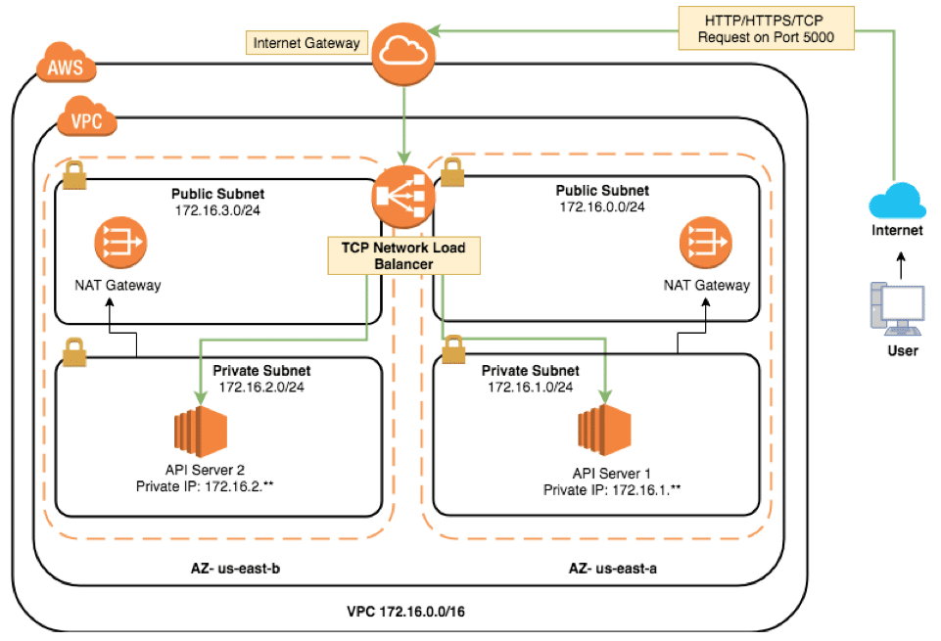
Public & Private Subnets with EC2
Prepared by Dhruv Rana - CloudSpikes

Slide 5
Virtual Private Cloud
Amazon Virtual Private Cloud (Amazon VPC) enables you to launch AWS resources into a virtual network that you've defined.
This virtual network closely resembles a traditional network that you'd operate in your own data center, with the benefits of using the scalable infrastructure of AWS.
A VPC is a virtual network that resembles a traditional network you'd operate in your own data center.
Prepared by Dhruv Rana - CloudSpikes

Slide 6
Elastic Compute Cloud
Amazon Elastic Compute Cloud (Amazon EC2) is a web service that provides secure, resizable compute capacity in the cloud.
Access reliable, scalable infrastructure on demand. Scale capacity within minutes with SLA commitment of 99.99% availability.
Optimize performance and cost with flexible options like AWS Graviton-based instances, Amazon EC2 Spot instances, and AWS Savings Plans.
Prepared by Dhruv Rana - CloudSpikes

Slide 7
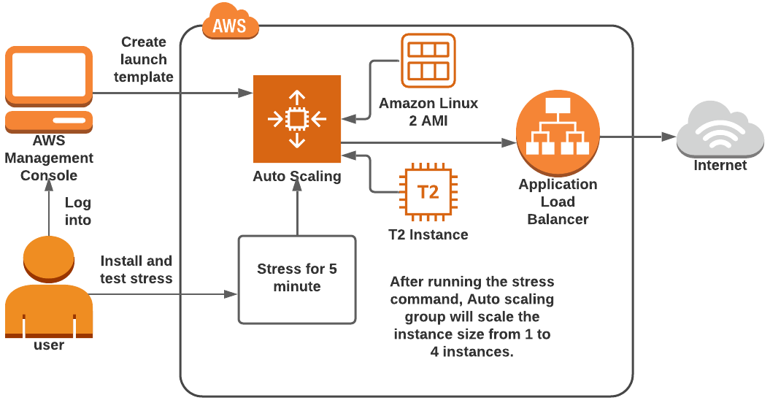
EC2 with ASG & ALB
Prepared by Dhruv Rana - CloudSpikes

Slide 8
Load Balancer
Elastic Load Balancing (ELB) automatically distributes incoming application traffic across multiple targets and virtual appliances in one or more Availability Zones (AZs).
Types of Load Balancers (ELB):
  Application Load Balancer
  Network Load Balancer
  Gateway Load Balancer
Load balance across AWS and on-premises resources using a single load balancer.
Prepared by Dhruv Rana - CloudSpikes

Slide 9
EC2 - Auto Scaling
Add or remove compute capacity to meet changing demand.
Improve fault tolerance through automatic detection and replacement of unhealthy instances.
Increase availability with predictive or dynamic scaling policies with the right amount of compute capacity.
Optimize workload performance and cost by combining purchase options and instance types.
Reduce the complexity of configuration changes and application deployments with instance refresh.
Prepared by Dhruv Rana - CloudSpikes

Slide 10
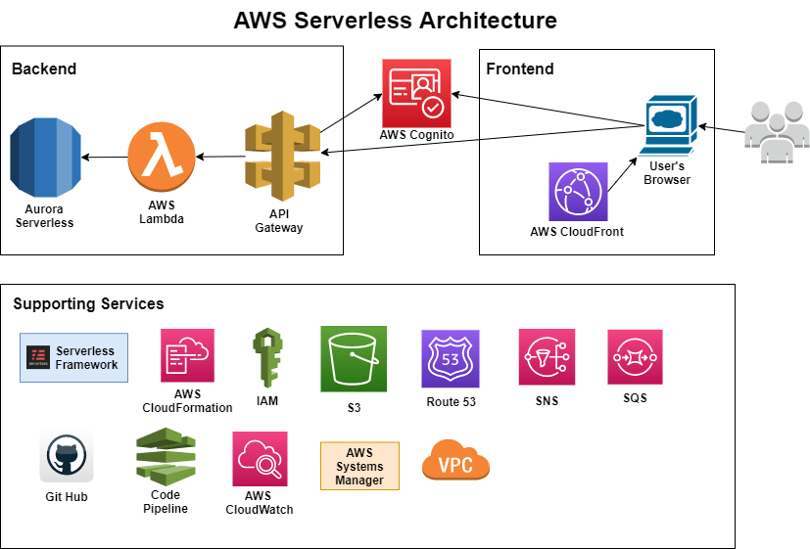
Serverless Architecture Reference
Prepared by Dhruv Rana - CloudSpikes

Slide 11
Simple Storage Service
Amazon S3 is an object storage service that offers industry-leading scalability, data availability, security, and performance.
Store and protect any amount of data for a range of use cases, such as data lakes, websites, cloud-native applications, backups, archive, machine learning, and analytics.
Amazon S3 is designed for 99.999999999% (11 9's) of durability, and stores data for millions of customers all around the world.
Prepared by Dhruv Rana - CloudSpikes

Slide 12
Lambda Function
Run code without provisioning or managing infrastructure. Simply write and upload the code as a .zip file or container image.
Automatically respond to code execution requests at any scale, from a dozen events per day to hundreds of thousands per second.
Optimize code execution time and performance with the right function memory size. Respond to high demand in double-digit milliseconds with Provisioned Concurrency.
Prepared by Dhruv Rana - CloudSpikes

Slide 13
CloudWatch
Observe and monitor resources and applications on AWS, on premises, and on other clouds.
Collect, access, and analyze your resource and application data using powerful visualization tools.
Seamlessly integrate with more than 70 AWS services for simplified monitoring and scalability.
Troubleshoot operational problems with actionable insights derived from logs and metrics in your CloudWatch dashboards.
Prepared by Dhruv Rana - CloudSpikes

Slide 14
API Gateway
Amazon API Gateway is a fully managed service that makes it easy for developers to create, publish, maintain, monitor, and secure APIs at any scale.
APIs act as the "front door" for applications to access data, business logic, or functionality from your backend services.
Using API Gateway, you can create RESTful APIs and WebSocket APIs that enable real-time two-way communication applications. API Gateway supports containerized and serverless workloads, as well as web applications.
Prepared by Dhruv Rana - CloudSpikes

Slide 15
Simple Notification Service
Amazon Simple Notification Service (SNS) sends notifications two ways, A2A and A2P. A2A provides high-throughput, push-based, many-to-many messaging between distributed systems, microservices, and event-driven serverless applications.
These applications include Amazon Simple Queue Service (SQS), Amazon Kinesis Data Firehose, AWS Lambda, and other HTTPS endpoints. A2P functionality lets you send messages to your customers with SMS texts, push notifications, and email.
Prepared by Dhruv Rana - CloudSpikes

Slide 16
Simple Queue Service
Amazon Simple Queue Service (SQS) lets you send, store, and receive messages between software components at any volume, without losing messages or requiring other services to be available.
Eliminate overhead with no upfront costs and without needing to manage software or maintain infrastructure.
Reliably deliver large volumes of data, at any level of throughput, without losing messages or needing other services to be available for Asynchronous data processing logic.
Prepared by Dhruv Rana - CloudSpikes

Slide 17
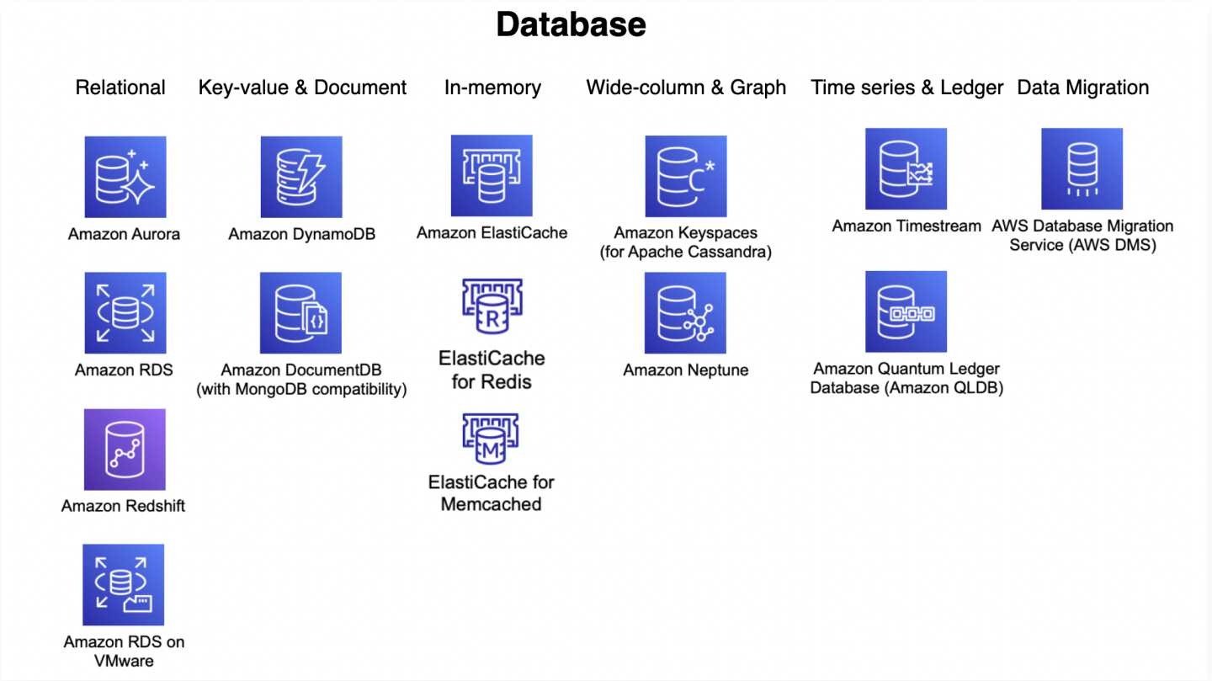
AWS DB Services
Prepared by Dhruv Rana - CloudSpikes

Slide 18
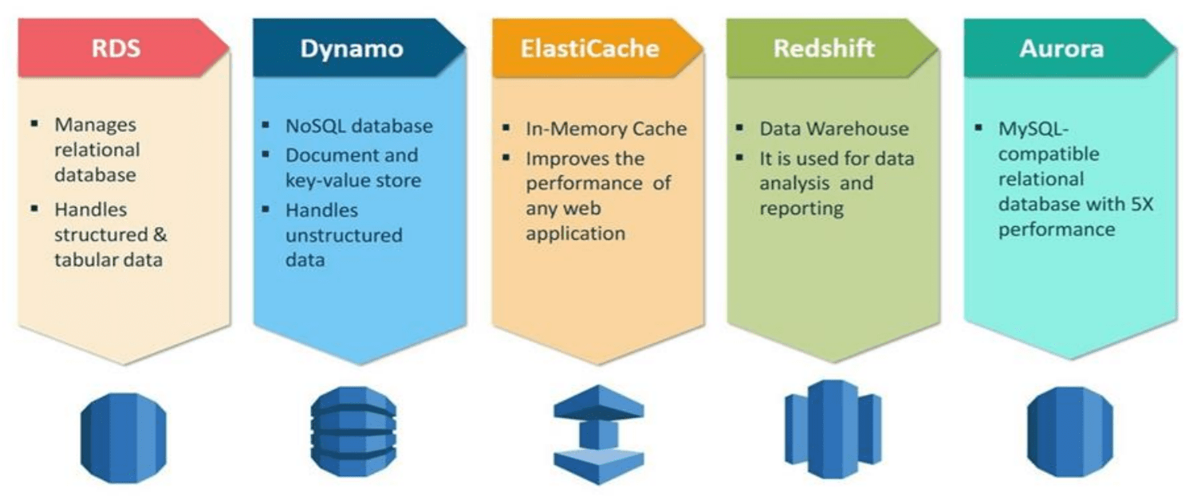
AWS DB Services Overview
Prepared by Dhruv Rana - CloudSpikes

Slide 19
Relational Database Service
Amazon RDS is a managed relational database service for MySQL, PostgreSQL, MariaDB, Oracle BYOL, or SQL Server.
Support growing apps with high availability, throughput, and storage scalability.
Take advantage of flexible pay-per-use pricing to suit various application usage patterns.
Innovate and build new apps with Amazon RDS instead of worrying about self-managing your databases, which can be time consuming, complex, and expensive.
Prepared by Dhruv Rana - CloudSpikes

Slide 20
DynamoDB
A serverless database for applications that need high performance at any scale for NoSQL data structure.
Amazon DynamoDB is a fully managed, serverless, key-value NoSQL database designed to run high-performance applications at any scale.
DynamoDB offers built-in security, continuous backups, automated multi-Region replication, in-memory caching, and data import and export tools.
Prepared by Dhruv Rana - CloudSpikes

Slide 21
RedShift
Amazon Redshift uses SQL to analyze structured and semi-structured data across data warehouses, operational databases, and data lakes, using AWS-designed hardware and machine learning to deliver the best price performance at any scale.
Tens of thousands of customers today rely on Amazon Redshift to analyze exabytes of data and run complex analytical queries, making it a widely used cloud data warehouse.
Run and scale analytics in seconds on all your data without having to manage your data warehouse infrastructure.
Prepared by Dhruv Rana - CloudSpikes

Slide 22
Aurora (As a part of RDS)
Designed for unparalleled high performance and availability at global scale with full MySQL and PostgreSQL compatibility.
Amazon Aurora provides built-in security, continuous backups, serverless compute, up to 15 read replicas, automated multi-Region replication, and integrations with other AWS services.
Amazon Aurora is a relational database management system (RDBMS) built for the cloud with full MySQL and PostgreSQL compatibility. Aurora gives you the performance and availability of commercial-grade databases at one-tenth the cost.
Prepared by Dhruv Rana - CloudSpikes

Slide 23
Neptune
Amazon Neptune is a fully managed database service built for the cloud that makes it easier to build and run graph applications.
Neptune provides built-in security, continuous backups, serverless compute, and integrations with other AWS services.
Build graph queries for near real-time fraud pattern detection by modeling relationships between people, places, and transactions to discover relationships that might not be obvious.
Prepared by Dhruv Rana - CloudSpikes

Slide 24
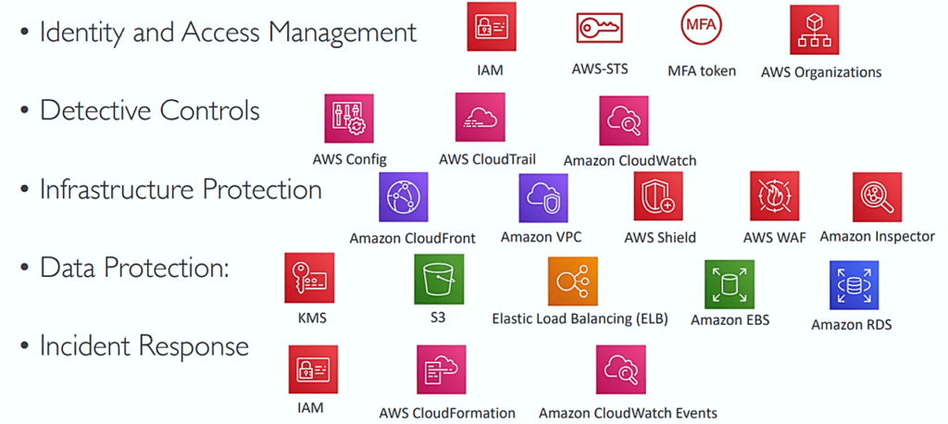
AWS Security Services
Prepared by Dhruv Rana - CloudSpikes

Slide 25
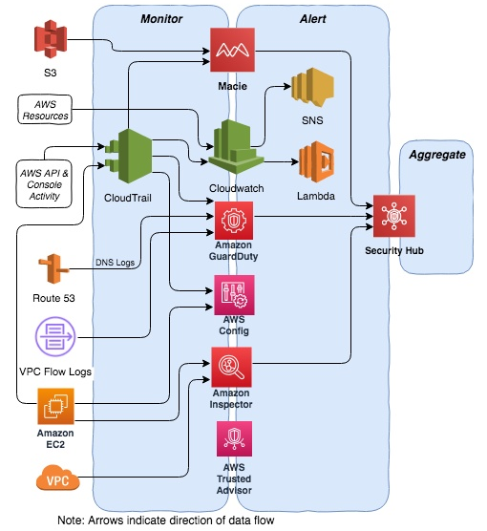
AWS Security Setup Reference
Prepared by Dhruv Rana - CloudSpikes

Slide 26
Secrets Manager
AWS Secrets Manager helps you manage, retrieve, and rotate database credentials, API keys, and other secrets throughout their lifecycles.
AWS Secrets Manager helps you manage access to your applications, services, and IT resources.
Centrally store and manage credentials, API keys, and other secrets.
Use AWS Identity and Access Management (IAM) permissions policies to manage access to your secrets.
Prepared by Dhruv Rana - CloudSpikes

Slide 27
Key Management Service
AWS Key Management Service (AWS KMS) lets you create, manage, and control cryptographic keys across your applications and AWS services.
Use AWS KMS to encrypt data across your AWS workloads, digitally sign data, encrypt within your applications using AWS Encryption SDK, and generate and verify message authentication codes (MACs).
Activate server-side encryption with AWS KMS using KMS keys that you control and manage.
Prepared by Dhruv Rana - CloudSpikes

Slide 28
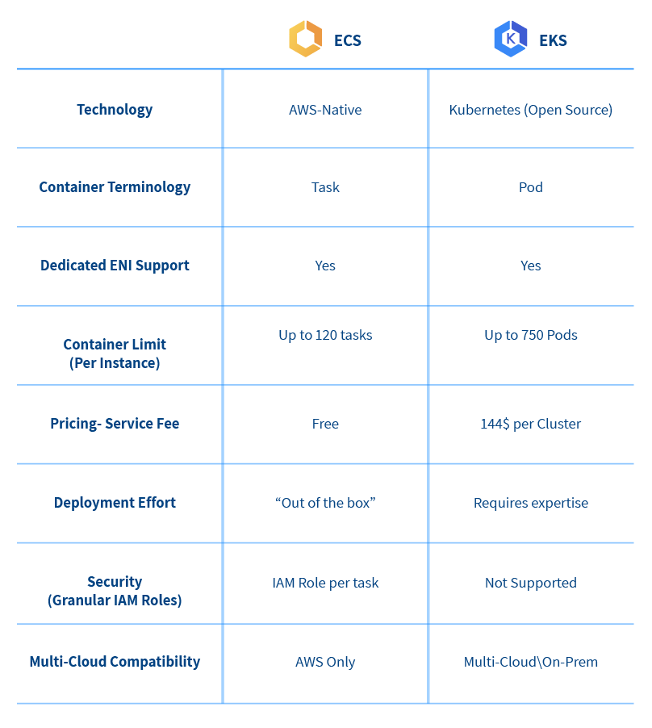
AWS Container Services
Prepared by Dhruv Rana - CloudSpikes

Slide 29
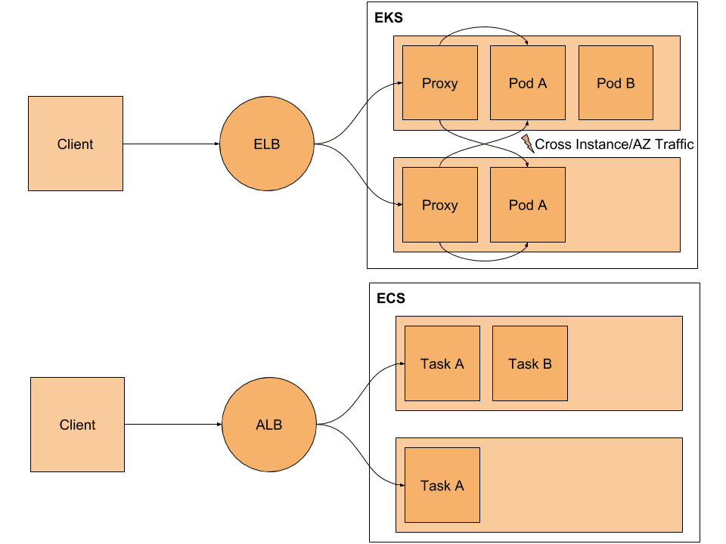
AWS Container Services
Prepared by Dhruv Rana - CloudSpikes

Slide 30
Elastic Container Registry
Amazon ECR is a fully managed container registry offering high-performance hosting, so you can reliably deploy application images and artifacts anywhere.
Meet your image compliance security requirements using the tightly integrated Amazon Inspector vulnerability management service to automate vulnerability assessment scanning and remediation ticket routing.
Publish containerized applications with a single command and easily integrate your self-managed environments.
Prepared by Dhruv Rana - CloudSpikes

Slide 31
Elastic Container Service
Amazon Elastic Container Service (ECS) is a fully managed container orchestration service that simplifies your deployment, management, and scaling of containerized applications.
Amazon ECS is a fully managed container orchestration service that helps you to more efficiently deploy, manage, and scale containerized applications.
It deeply integrates with the AWS environment to provide an easy-to-use solution for running container workloads in the cloud and on premises.
Prepared by Dhruv Rana - CloudSpikes

Slide 32
Elastic Kubernetes Service
Amazon EKS is a managed Kubernetes service to run Kubernetes in the AWS cloud and on-premises data centers.
In the cloud, Amazon EKS automatically manages the availability and scalability of the Kubernetes control plane nodes responsible for scheduling containers, managing application availability, storing cluster data, and other key tasks.
With Amazon EKS, you can take advantage of all the performance, scale, reliability, and availability of AWS infrastructure.
Prepared by Dhruv Rana - CloudSpikes

Slide 33
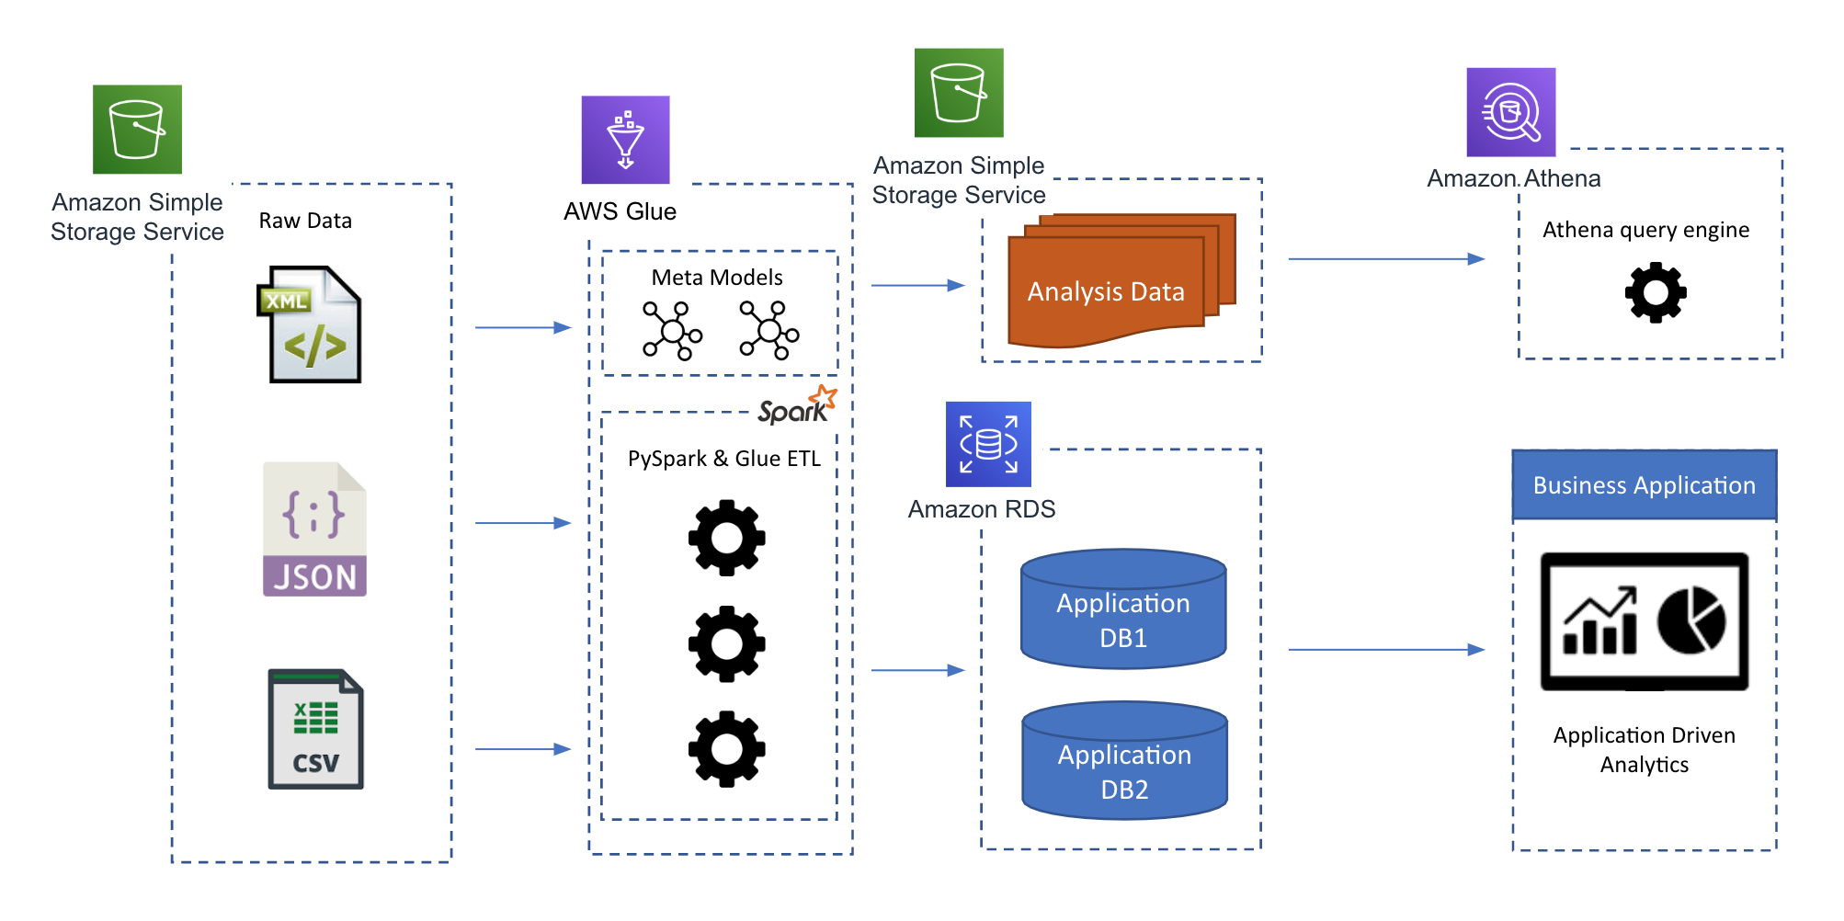
AWS Data Engineering Services
Prepared by Dhruv Rana - CloudSpikes

Slide 34
Glue (ETL Jobs)
AWS Glue is a serverless data integration service that makes it easier to discover, prepare, move, and integrate data from multiple sources for analytics, machine learning (ML), and application development.
Preparing your data to obtain quality results is the first step in an analytics or ML project. AWS Glue is a serverless data integration service that makes data preparation simpler, faster, and cheaper.
You can discover and connect to over 70 diverse data sources, manage your data in a centralized data catalog, and visually create, run, and monitor ETL pipelines to load data into your data lakes.
Prepared by Dhruv Rana - CloudSpikes

Slide 35
CloudFormation (IaC)
AWS CloudFormation lets you model, provision, and manage AWS and third-party resources by treating infrastructure as code.
Automate, test, and deploy infrastructure templates with continuous integration and delivery (CI/CD) automations.
Run anything from a single Amazon Elastic Compute Cloud (EC2) instance to a complex multi-region application.
Prepared by Dhruv Rana - CloudSpikes

Slide 36
CloudTrail
AWS CloudTrail monitors and records account activity across your AWS infrastructure, giving you control over storage, analysis, and remediation actions.
Monitor, store, and validate activity events for authenticity. Easily generate audit reports required by internal policies and external regulations.
Detect unauthorized access using the Who, What, and When information in CloudTrail Events. Respond with rules-based EventBridge alerts and automated workflows.
Prepared by Dhruv Rana - CloudSpikes

Slide 37
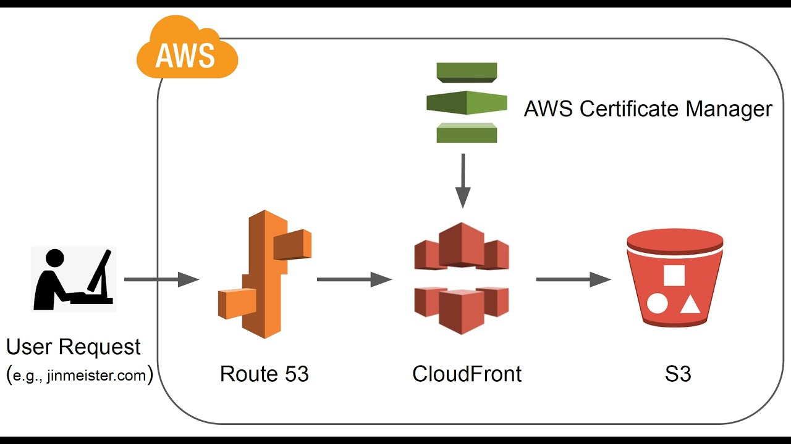
AWS DNS + CDN Management
Prepared by Dhruv Rana - CloudSpikes

Slide 38
CloudFront
Amazon CloudFront is a content delivery network (CDN) service built for high performance, security, and developer convenience.
Reach viewers across the globe in milliseconds with built-in data compression, edge compute capabilities, and field-level encryption.
Optimize dynamic web content delivery with the purpose-built and feature-rich AWS global network infrastructure supporting edge termination and WebSockets.
Prepared by Dhruv Rana - CloudSpikes

Slide 39
Route53
Amazon Route 53 is a highly available and scalable Domain Name System (DNS) web service. Route 53 connects user requests to internet applications running on AWS or on-premises.
Create, visualize, and scale complex routing relationships between records and policies with easy-to-use global DNS features.
Set routing policies to pre-determine and automate responses in case of failure, like redirecting traffic to alternative Availability Zones or Regions.
Prepared by Dhruv Rana - CloudSpikes

Slide 40

Any questions or queries?
Reach out to me on Insta, LinkedIn, Email or WhatsApp:
  Insta: @dhruv_rana_29_10
  LinkedIn: @dhruv-r-b033949b
  Email: support@cloudspikes.ca
  WhatsApp: +1-647-376-7753

