Slide 1
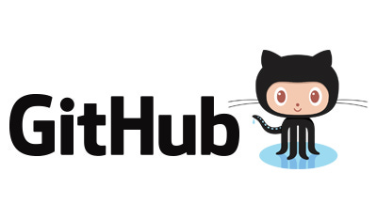



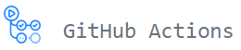
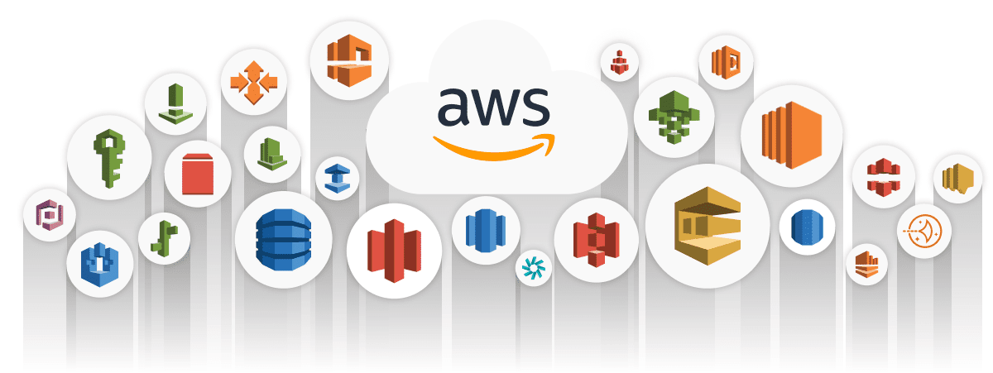
AWS Cloud DevOps Training
Prepared by Dhruv Rana - CloudSpikes

Slide 2
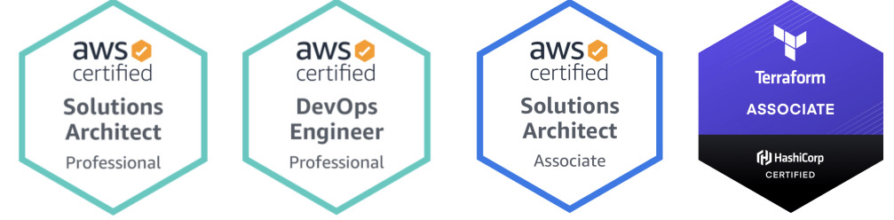
Your mentor – Dhruv Rana
Hello to all Cloud DevOps geeks, this is Dhruv, your trainer to deliver this amazing virtual training on the most desired five tools & frameworks that would help you ace your professional career.
My portfolio: I am a 3x AWS Certified Solutions Architect – Pro. and Hashicorp Certified Terraform Associate Engineer with 8+ years of IT industry experience. Currently, I am associated with BMO and The Home Depot as a Cloud Consultant working on AWS & GCP Cloud Platform along with DevOps tech stack.
Prepared by Dhruv Rana - CloudSpikes

Slide 3
Opportunities post-course completion
Sr. No. | Designation | Salary package in CAD
1. | Cloud Engineer (CloudOps) | $127,512 per year
2. | AWS Engineer | $95,383 per year
3. | DevOps Engineer | $154,280 per year
4. | Site Reliability Engineer (SRE) | $154,385 per year
5. | DevSecOps | $132,085 per year
6. | Infrastructure Engineer | $126,328 per year
7. | Platform Engineer | $140,522 per year
8. | Systems Engineer (SysOps) | $86,630 per year
Prepared by Dhruv Rana - CloudSpikes

Slide 4
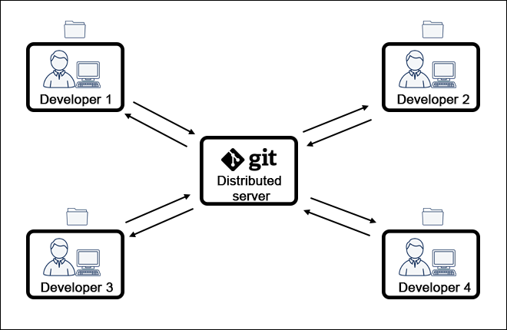
Overview – Git & GitHub
What is Git?
  Git is a mature, actively maintained open-source project originally developed in 2005 by Linus Torvalds, the famous creator of the Linux operating system kernel.
  Git is a distributed version control system that tracks changes in any set of computer files, usually used for coordinating work among programmers collaboratively developing source code during software development.
Why use Git?
  Git is used to track changes in the source code, enabling multiple developers to work together on non-linear development.
How to use Git?
  You can use the Git tool by simply installing it on your local machine.
Prepared by Dhruv Rana - CloudSpikes

Slide 5

Overview – Git & GitHub
What is GitHub?
  GitHub, Inc. is an Internet hosting service for software development and version control using Git. It provides the distributed version control of Git plus access control, bug tracking, software feature requests, task management, continuous integration, and wikis for every project.
  It is basically an online portal for Git operation management and many other advanced features.
Why use GitHub?
  GitHub allows collaboration with developers from all over the world. Open-source solutions like GitHub enable potential developers to contribute and share their knowledge to benefit the global community.
How to use GitHub?
  You can simply start using GitHub by registering online using this link and creating a new Git repository in it.
Prepared by Dhruv Rana - CloudSpikes

Slide 6
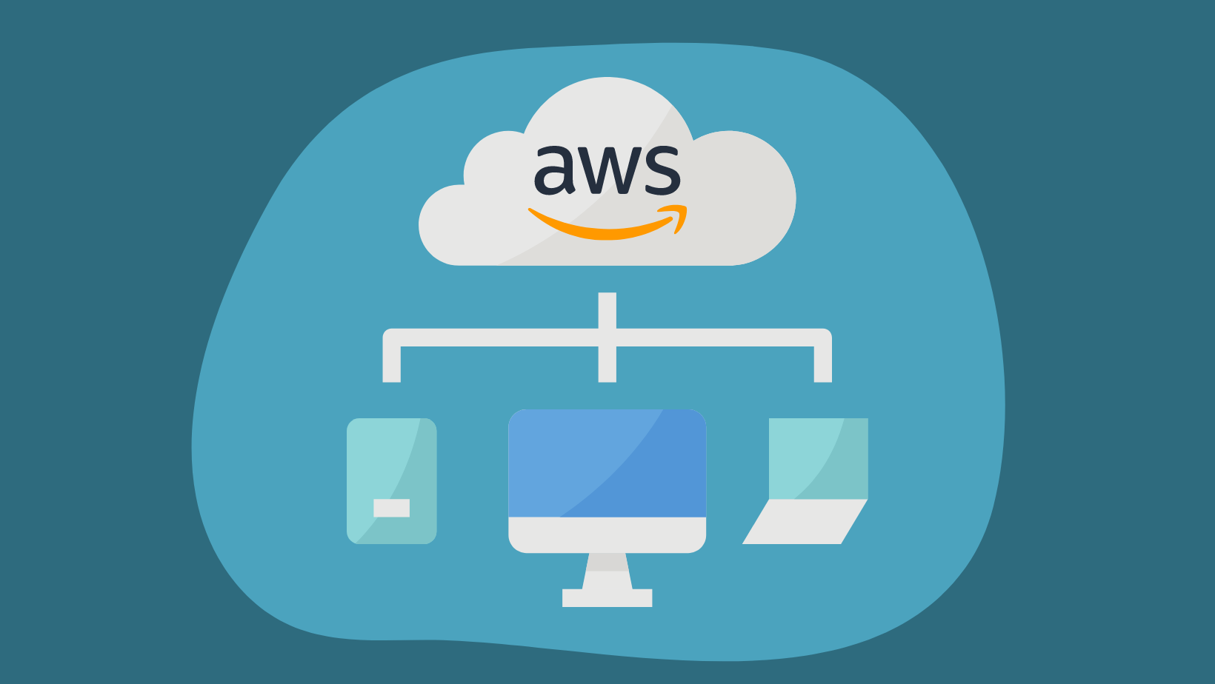
Overview – AWS Cloud Platform
What is AWS?
  Amazon Web Services, Inc. is a subsidiary of Amazon that provides on-demand cloud computing platforms and APIs to individuals, companies, and governments, on a metered, pay-as-you-go basis.
Why use AWS?
  It offers On the Go Pricing, Free tier, Performance, Deployment speed, Security, Flexibility, Scalability, etc.
How to use AWS?
  You can simply sign up for AWS Console from this link and start using various AWS Services for the dynamic needs for your application/software requirements.
Prepared by Dhruv Rana - CloudSpikes

Slide 7
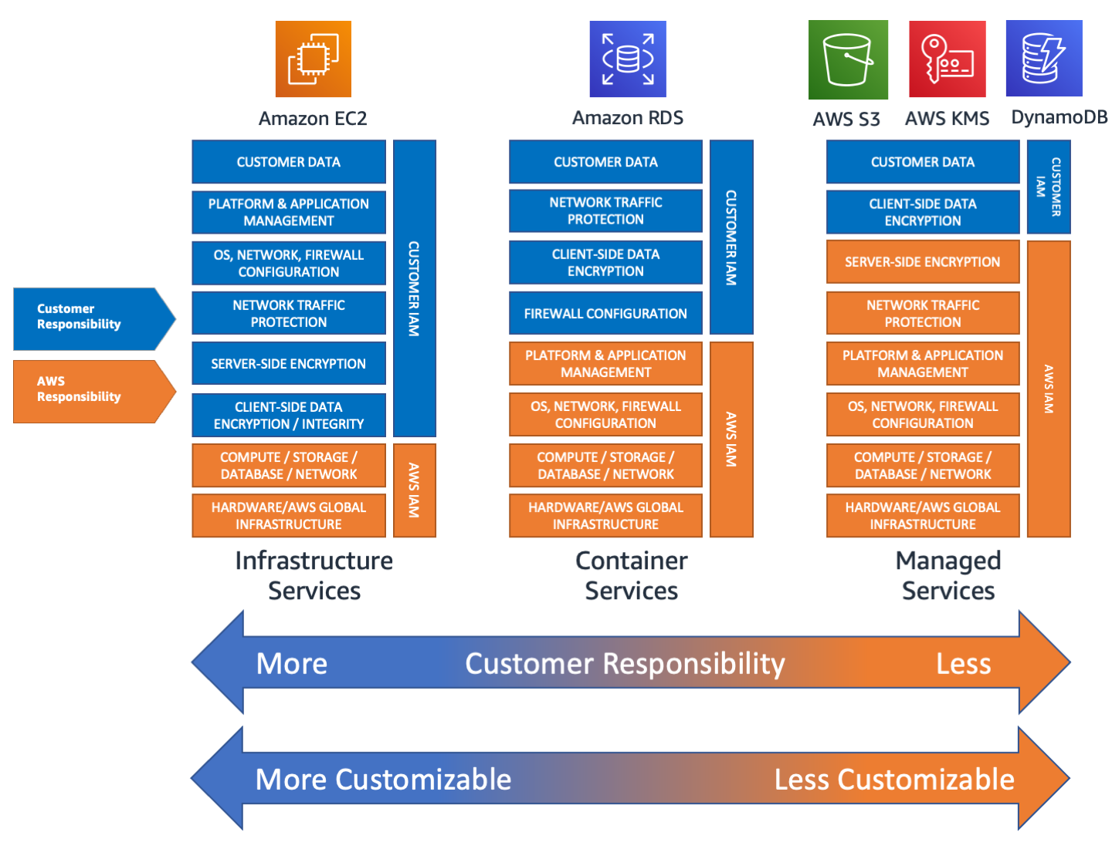
Overview – AWS Shared Responsibility Model
Prepared by Dhruv Rana - CloudSpikes

Slide 8
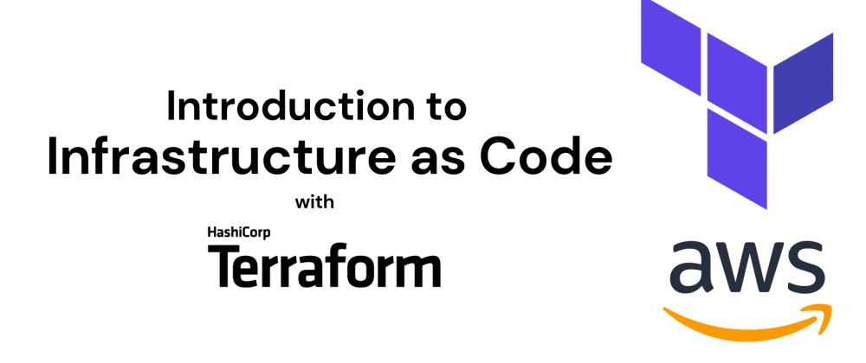
Overview – Terraform IaC Framework
What is Terraform IaC?
  Terraform is an open-source infrastructure-as-code (IaC) software tool created by HashiCorp. Users define and provide data center infrastructure using a declarative configuration language known as HashiCorp Configuration Language (HCL), or optionally JSON.
Why use Terraform?
  Terraform lets you use the same workflow to manage multiple providers and handle cross-cloud dependencies. This simplifies management and orchestration for large-scale, multi-cloud infrastructures.
How to use Terraform?
  You can install terraform tool on your local machine and start scripting tf files to provision infra resources with just a few configurations.
Prepared by Dhruv Rana - CloudSpikes

Slide 9
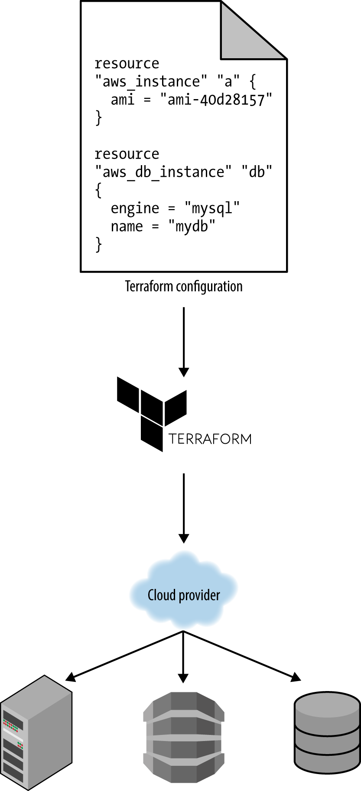
Overview – Terraform Workflow
Prepared by Dhruv Rana - CloudSpikes

Slide 10
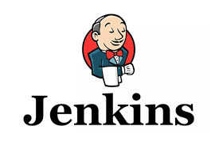
Overview – Jenkins Tool
What is Jenkins?
  Jenkins is an open-source automation server. It helps automate the parts of software development related to building, testing, and deploying, facilitating continuous integration and continuous delivery.
Why use Jenkins?
  It enables and automates various processes (such as testing, building, and development). As a platform, it creates CI pipelines that define a series of actions a server will take for requisite tasks.
How to use Jenkins?
  You need to install the Jenkins tool and expose it on a public IP from a web server or on localhost. Once Jenkins is installed, you can install default plugins and start creating custom pipelines for your application needs.
Prepared by Dhruv Rana - CloudSpikes

Slide 11
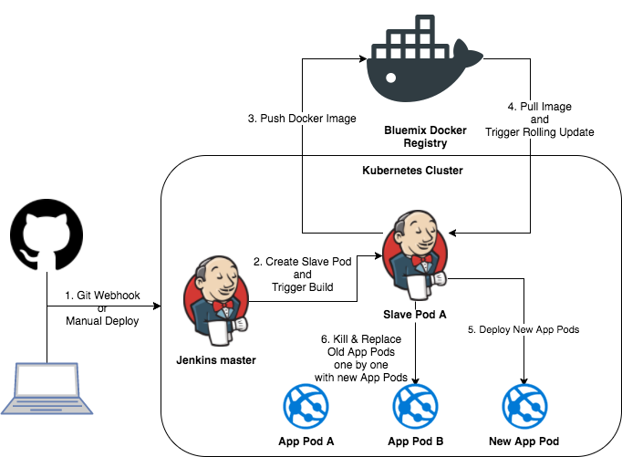
Overview – Jenkins Architecture
Prepared by Dhruv Rana - CloudSpikes

Slide 12
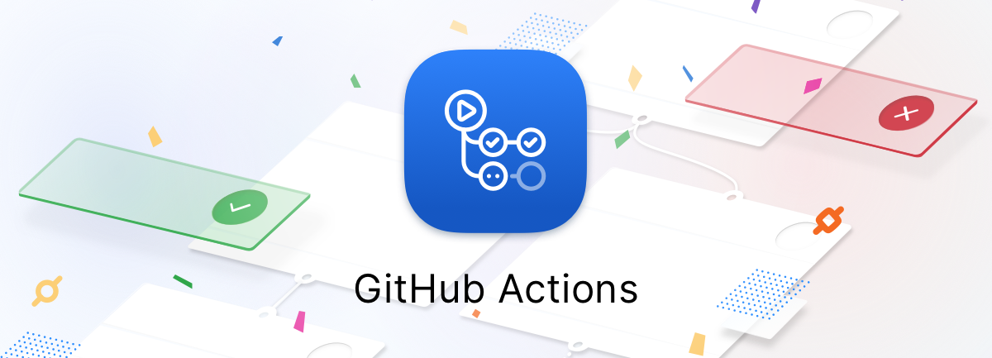
Overview – GitHub Actions Tool
What is GitHub Actions?
  GitHub Actions is a continuous integration and continuous delivery (CI/CD) platform that allows you to automate your build, test, and deployment pipeline.
Why use GitHub Actions?
  Use action to help reduce the amount of repetitive code that you write in your workflow files. An action can pull your git repository from GitHub, set up the correct toolchain for your build environment, or set up the authentication to your cloud provider.
How to use GitHub Actions?
  You just need to create an additional YAML script under the .github/workflows directory at the root location of your repo. This script has all the steps defined in it for CI and CD process as per your application needs.
Prepared by Dhruv Rana - CloudSpikes

Slide 13
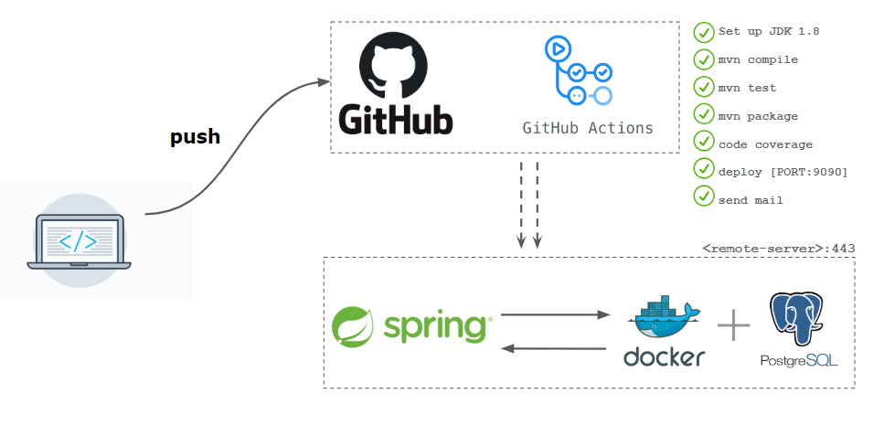
Overview – GitHub Actions CI/CD
CI/CD Pipeline overview for a Dockerized Spring Boot Java application with
PostgreSQL DB.
Prepared by Dhruv Rana - CloudSpikes

Slide 14

Any questions or queries?
Reach out to me on Insta, LinkedIn, Email or WhatsApp:
  Insta: @dhruv_rana_29_10
  LinkedIn: @dhruv-r-b033949b
  Email: support@cloudspikes.ca
  WhatsApp: +1-647-376-7753

