Slide 1


Git-GitHub
Prepared by Dhruv Rana - CloudSpikes

Slide 2
Overview
Git
  Version control system.
  Source code management.
  Alternate tools: SVN, StarTeam, etc.
Github
  Repository site.
  Team collaboration.
  CI/CD support.
  Integration with Jira.
Prepared by Dhruv Rana - CloudSpikes

Slide 3
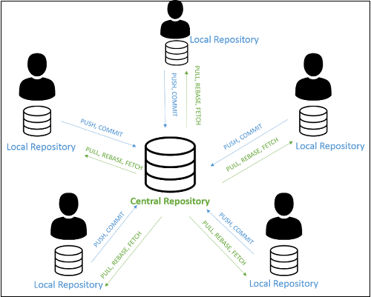
Overview
Prepared by Dhruv Rana - CloudSpikes

Slide 4
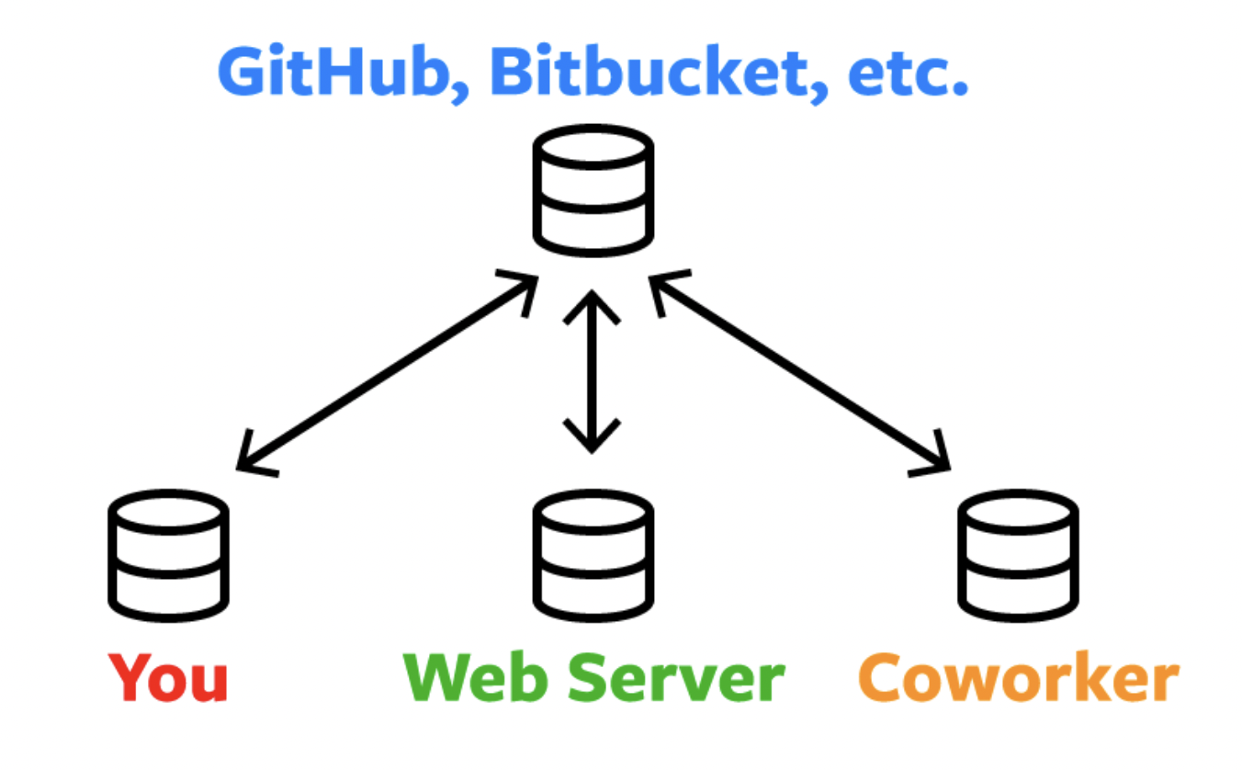
Overview
What is Git?
  Git is a free and open-source distributed version control system designed to handle everything from small to very large projects with speed and efficiency.
Prepared by Dhruv Rana - CloudSpikes

Slide 5
GIT Installation & Setup
All OS: https://git-scm.com/book/en/v2/Getting-Started-Installing-Git
Windows OS: https://git-scm.com/download/win
Let’s define ourselves first.
git config --global user.email "you@example.com"
  git config --global user.name "Your Name"
Prepared by Dhruv Rana - CloudSpikes

Slide 6
Local first
First, let’s make a git folder on our computer.
  git clone https/ssh-url
After cloning check the current branch.
  git branch (list only local branch)
  git branch –r (list only remote branch)
  git branch -a (list only local as well as remote branch)
Prepared by Dhruv Rana - CloudSpikes

Slide 7
Check the status & add
Check the current status on local.
  git status
  This will display track & untrack files/folders
  New files/folders are called untracked files.
  Existing modified files/folders are known as tracked files.
Add the files/folders you need.
  git add . (Add all files/folders)
  git add files/folders (Add only specific files/folders)
Prepared by Dhruv Rana - CloudSpikes

Slide 8
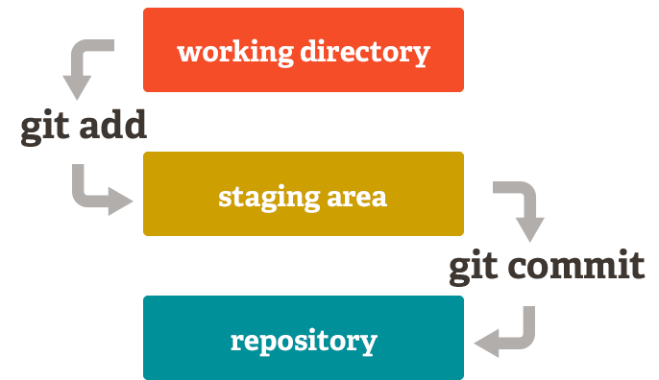
Git commit process
Prepared by Dhruv Rana - CloudSpikes

Slide 9
Check the status & commit the changes
Check the current status on local after adding.
  git status
Now, commit the changes (added files/folders)
  git commit –m ”commit message”
  -m parameter is used to pass the mandatory commit message to the committed changes.
Prepared by Dhruv Rana - CloudSpikes

Slide 10

Check the commit history & push the commit/s
Check the recent commits.
  git log (Displays all the commits)
  git log -n 5 (Check recent 5 commit history)
Now, push the commits to the remote repo
  git push
  git push --set-upstream-to origin <branch>
  Need to set upstream branch when a new branch is forked from an existing branch.
Prepared by Dhruv Rana - CloudSpikes

Slide 11
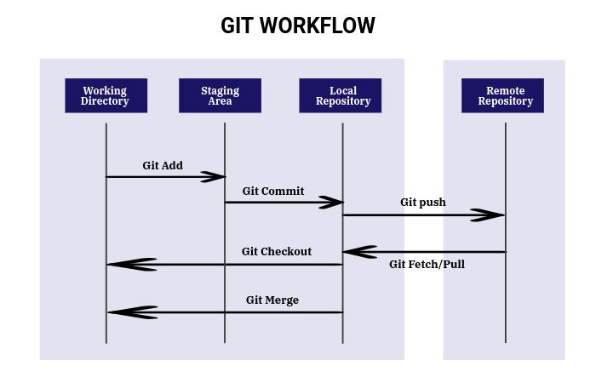
Prepared by Dhruv Rana - CloudSpikes

Slide 12
Practical hands-on sessions.
Prepared by Dhruv Rana - CloudSpikes

Slide 13
Pulling a repository/editing
let’s pull a repository from github
  git pull https://github.com/cosai/test
Edit the file a.txt
Add the file by: git add a.txt
Commit the added changes: git commit -m ‘something added’
Finally, push the commit to the remote repo: git push
Prepared by Dhruv Rana - CloudSpikes

Slide 14

Remove a file
Removing a file: git rm somefile.txt
Commit the change: git commit –m ‘removed’
Finally, push the new commit: git push
Prepared by Dhruv Rana - CloudSpikes

Slide 15
Temporary backup your changes
First check your changes by: git status
Then back up the tracked changes: git stash
You can now check out to any other branch now: git checkout new-branch-name
Come back to the previous branch: git checkout previous-branch-name
You can list the stashed changes by: git stash list
Prepared by Dhruv Rana - CloudSpikes

Slide 16
Temporary backup your changes
If you want to delete the listed stash changes, you can execute: git stash drop
And if you want to bring back the backed-up changes: git stash pop
Prepared by Dhruv Rana - CloudSpikes

Slide 17

One step back!
An easy way to revert last commit (1)
  git reset HEAD^
  git log (to check if the previous commit is gone)
  git push origin +HEAD
Prepared by Dhruv Rana - CloudSpikes

Slide 18
Playing around GIT Branches
Fork/Create a new branch from current branch:
  git branch (check current branch)
  git checkout -b “new-branch-name”
  git branch (check the current branch as the new branch)
Switch between branches:
  git branch (check current branch)
  git checkout “destination-branch-name”
  git branch (check the current branch as the destination branch)
Prepared by Dhruv Rana - CloudSpikes

Slide 19
GIT Merge. Fetch vs Pull
Merge branch:
  git branch (check current branch)
  git checkout “main-branch-name”
  git merge (previous feature branch)
Fetch vs Pull:
  Git fetch gives the information of a new change from a remote repository without merging into the current branch.
  Git pull Brings a copy of all the changes from a remote repository and merges them into the current branch
Prepared by Dhruv Rana - CloudSpikes

Slide 20
GIT Squash Merge
Say your bug fix branch is called bugfix and you want to merge it into the master:
  git checkout master (Switches to your master branch)
  git merge --squash bugfix (Takes all commits from the bugfix branch and groups it for a 1 commit with your current branch)
  git commit (Creates a single commit from the merged changes)
  Omitting the -m parameter in the above commit command lets you modify a draft commit message containing every message from your squashed commits before finalizing your commit.
Prepared by Dhruv Rana - CloudSpikes

Slide 21
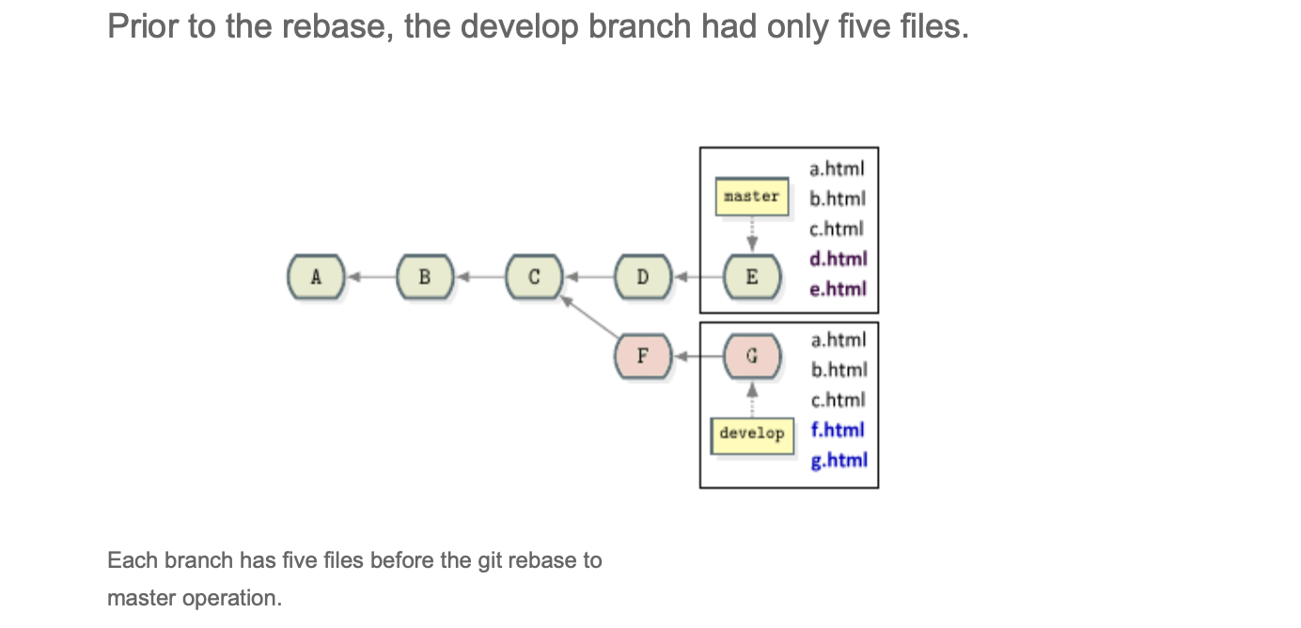
GIT Rebase
Prepared by Dhruv Rana - CloudSpikes

Slide 22
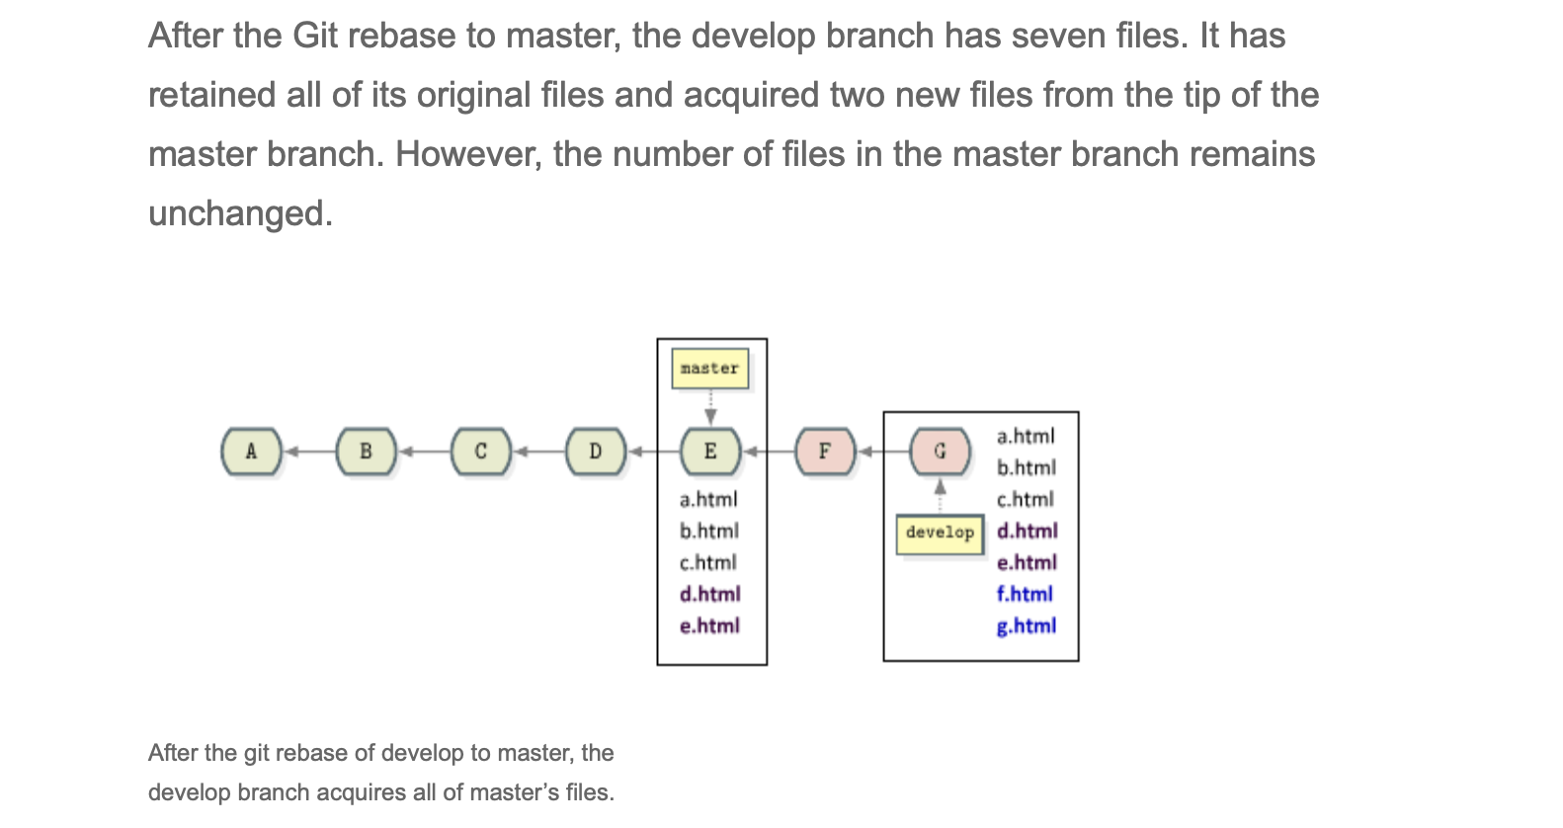
GIT Rebase
Prepared by Dhruv Rana - CloudSpikes

Slide 23
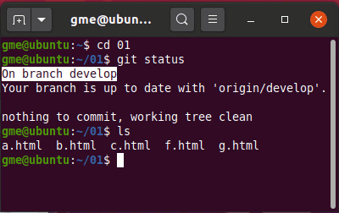
GIT Rebase
Prepared by Dhruv Rana - CloudSpikes

Slide 24
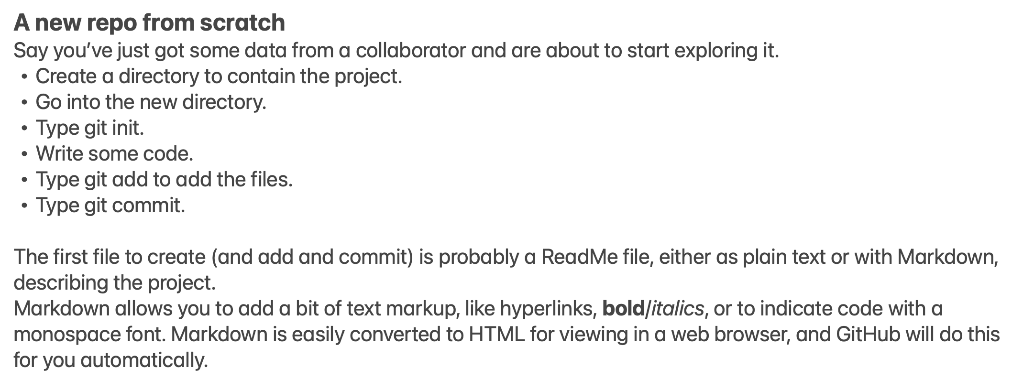
GIT Init
Prepared by Dhruv Rana - CloudSpikes

Slide 25
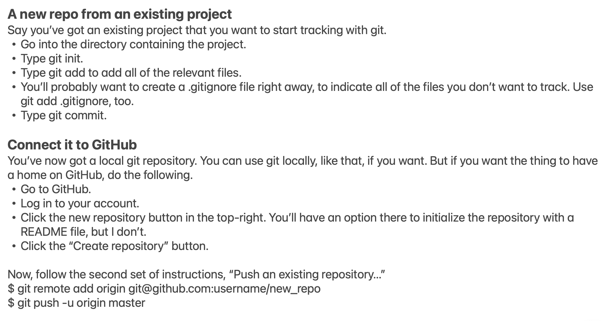
GIT Init
Prepared by Dhruv Rana - CloudSpikes

Slide 26
GIT Remove tracked & untracked changes
Remove tracked files/folders:
  git status (check tracked files/folders)
  git checkout . (removing tracked files/folders)
  git status (check tracked files/folders after removing them to confirm the removal)
Remove untracked files/folders:
  git status (check untracked files/folders)
  git clean -df (removing untracked files/folders)
  git status (check untracked files/folders after removing them to confirm the removal)
Prepared by Dhruv Rana - CloudSpikes

Slide 27
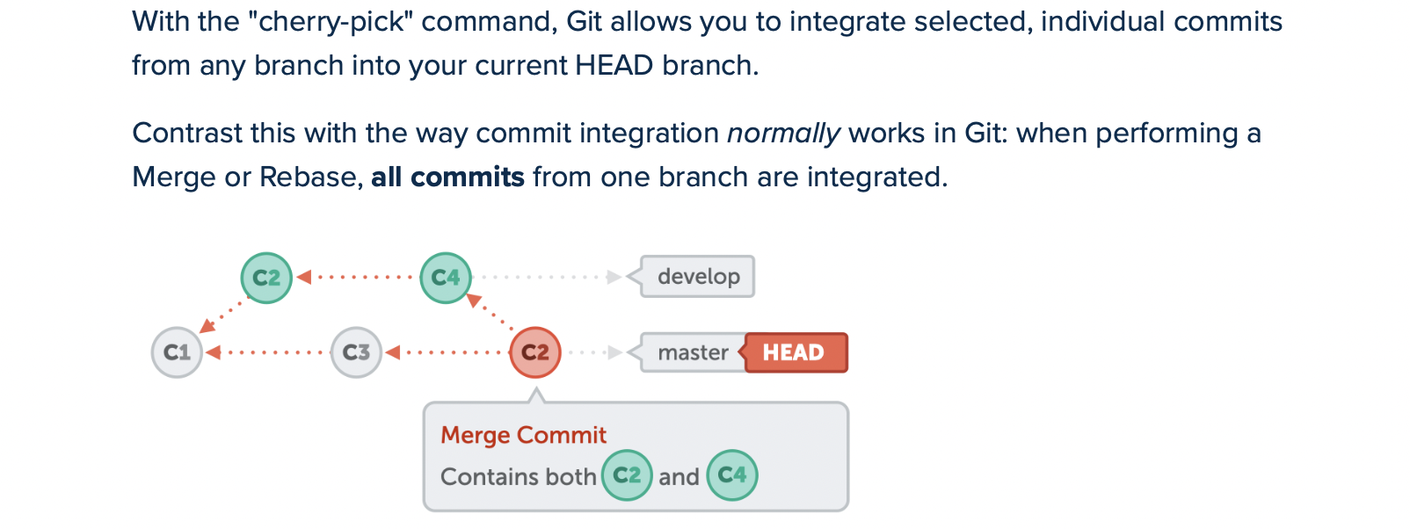
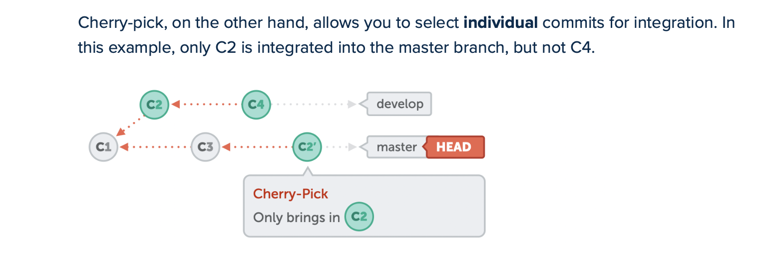
GIT Cherry pick
Prepared by Dhruv Rana - CloudSpikes

Slide 28
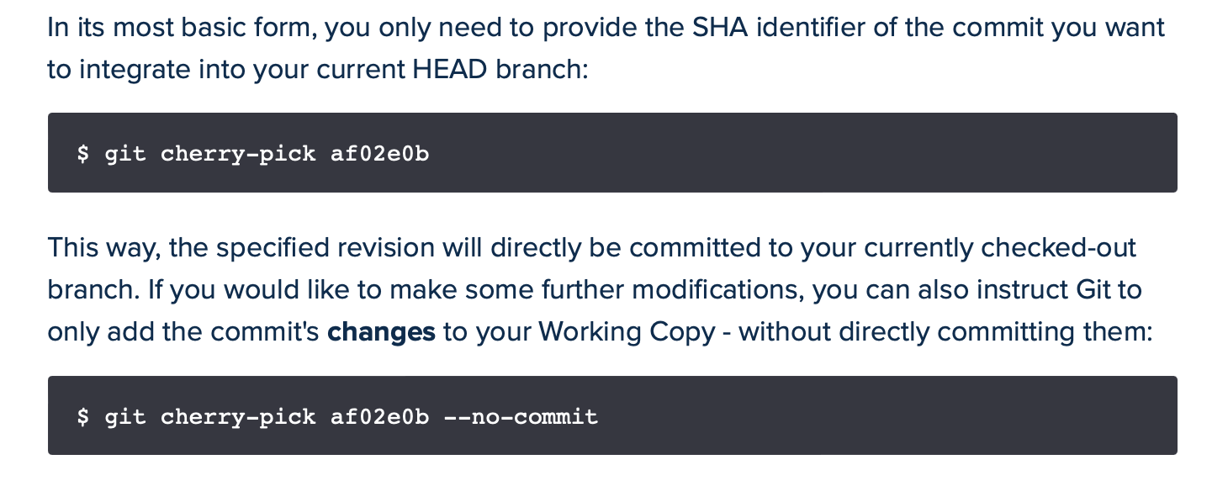
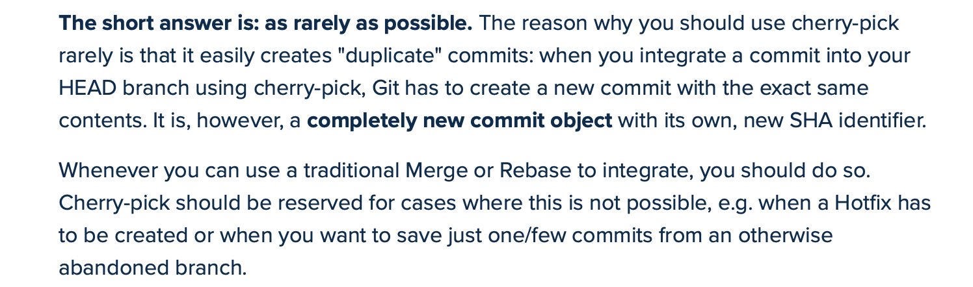
How to use GIT Cherry pick?
Prepared by Dhruv Rana - CloudSpikes

Slide 29
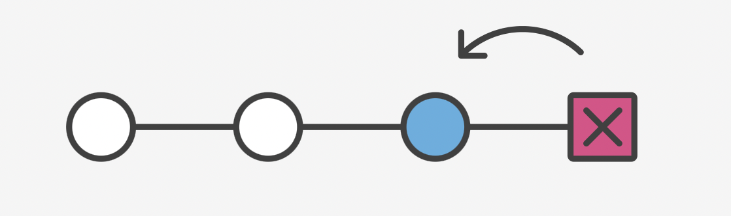
GIT revert & reset
Revert commit:
  git log (check commit history)
  git revert HEAD (go back to the last commit)
  git log (check commit history after reverting)
Reset changes:
  Use the git reset command to remove the added files/folders by checking the git status.
  For e.g., git reset file-name
Prepared by Dhruv Rana - CloudSpikes

Slide 30
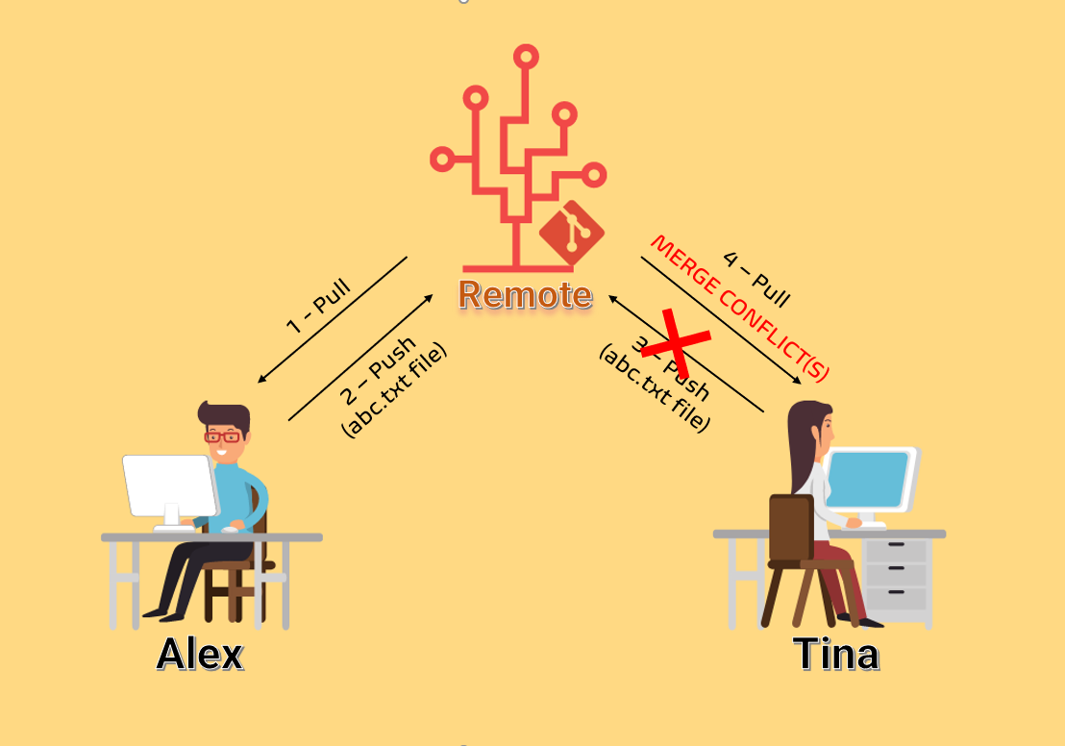
GIT Conflict Scenario
Prepared by Dhruv Rana - CloudSpikes

Slide 31
Steps to Resolve GIT Merge Conflicts
First of all, get all the new commits by: git pull
Then check for any files in status for tracked changes: git status
Once you find the tracked changes, accept incoming, remove, or keep both changes using VS Code IDE with ease.
Finally, commit & push the changes that will push a new commit with the resolved conflict as all the missing commit changes will be now incorporated as needed.
Prepared by Dhruv Rana - CloudSpikes

Slide 32

Any questions or queries?
Reach out to me on Insta, LinkedIn, Email or WhatsApp:
  Insta: @dhruv_rana_29_10
  LinkedIn: @dhruv-r-b033949b
  Email: support@cloudspikes.ca
  WhatsApp: +1-647-376-7753

