Slide 1
Explaining Explanations: An Overview of Interpretability of Machine Learning
Gilpin L H, Bau D, Yuan B Z, et al. Explaining Explanations: An Overview of Interpretability of Machine Learning[J]. ieee international conference on data science and advanced analytics, 2018.

Slide 2
Abstract
This research area tackles the important problem that complex machines and algorithms often cannot provide insights into their behavior and thought processes.

Slide 3
Introduction
Interpretability → Explainability
We take the stance that interpretability alone is insufficient. In order for humans to trust black-box methods, we need explainability - models that are able to summarize the reasons for neural network behavior, gain the trust of users, or produce insights about the causes of their decisions.
While interpetability is a substantial first step, these mechanisms need to also be complete, with the capacity to defend their actions, provide relevant responses to questions, and be audited.
Explainable models are interpretable by default, but the reverse is not always true.

Slide 4
Introduction
In this survey, we present a set of definitions, construct a taxonomy, and present best practices to start to standardize interpretability and explanatory work in AI.

Slide 5
Background and Foundational Concepts
What is an Explanation?
Interpretability vs. Completeness
Explainability of Deep Networks

Slide 6
What is an Explanation?
why-shouldn’t and why-should

Slide 7
Interpretability vs. Completeness
An explanation can be evaluated in two ways: according to its interpretability, and according to its completeness.
The goal of interpretability is to describe the internals of a system in a way that is understandable to humans.
The goal of completeness is to describe the operation of a system in an accurate way.

Slide 8
Interpretability vs. Completeness
When explaining a self-contained computer program such as a deep neural network, a perfectly complete explanation can always be given by revealing all the mathematical operations and parameters in the system.
It is difficult to achieve interpretability and completeness simultaneously.

Slide 9
Explainability of Deep Networks
Explanations of the operation of deep networks have focused on either explaining the processing of the data by a network, or explaining the representation of data inside a network.
Why does this particular input lead to that particular output?
What information does the network contain?
A third approach to interpretability is to create explanation-producing systems.

Slide 10
Review
Explanations of Deep Network Processing
Explanations of Deep Network Representations
Explanation-Producing Systems

Slide 11
Explanations of Deep Network Processing
ResNet
5×107 learned parameters
executes about 10¹⁰ floating point operations
Reduce the complexity of operations
Proxy Model: similarly to the original model but easier to explain.
Salience Map: highlight a small portion of the computation which is the most relevant.

Slide 12
Explanations of Deep Network Processing
Proxy Model
Linear Proxy Models
Decision Trees
Automatic-Rule Extraction
Salience Mapping

Slide 13
Linear Proxy Models
LIME (Local Interpretable Model-Agnostic Explanations)
With LIME, a black-box system is explained by probing behavior on perturbations of an input, and then that data is used to construct a local linear model that serves as a simplified proxy for the full model in the neighborhood of the input.
can be used to identify regions of the input that are most influential for a decision

Slide 14
Decision Trees
DeepRED
RxREN: prune unnecessary input
C4.5: a statistical method for creating a parsimonious decision tree.
But the generated tree can be quite large.
ANN-DT
Use sampling to expand training using a nearest neighbor method.

Slide 15
Automatic-Rule Extraction
KT
Goes through each neuron, layer-by-layer and applies an if-then rule by finding a threshold.
DeepRED
There is a merging step which creates rules in terms of the inputs rather than the outputs of the preceding layer.
Fuzzy Rules
By transforming each neuron into an approximate rule.
Validity Interval Analysis, Sampling, Reverse Engineer

Slide 16
Automatic-Rule Extraction
MofN
Try to find rules that explain single neurons by clustering and ignoring insignificant neurons.
FERNN
Try to identify the meaningful hidden neurons and inputs to a particular network.

Slide 17
Salience Mapping
where a network is repeatedly tested with portions of the input occluded to create a map showing which parts of the data actually have influence on the network output.
LRP, DeepLIFT, CAM, Grad-CAM, Integrated gradients, SmoothGrad

Slide 18
Explanations of Deep Network Representations
To understand the role and structure of the data flowing through these bottlenecks.
Granularity
Layer
Unit
Vector

Slide 19
Explanation-Producing Systems
Attention Networks
Disentangled Representations
Generated Explanations

Slide 20
Related Work
Interpretability
Explainable AI for HCI
Explanations for Black-Box Models
Explainability in Other Domains

Slide 21
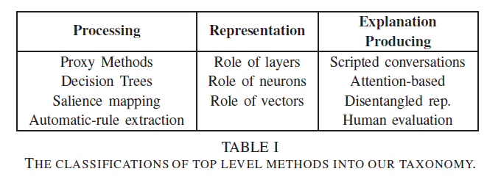
Taxonomy

Slide 22
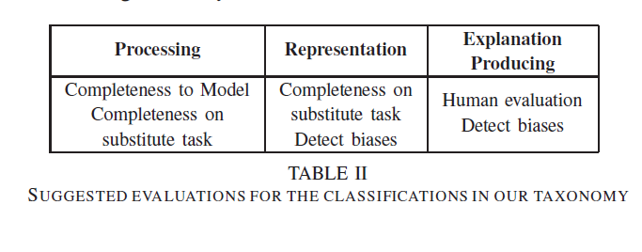
Evaluation

Slide 23
Conclusions

